Slide 1
Research results and directions for positioning in the analog domain
Research Talk | Telecommunication Networks

Slide 2

Use case: Fast tracking of Autonomous Mobile Robots for Smart Factory
Environment:
  Dense and dynamic indoor factory floors.
Requirement:
  Real-time object tracking for collision avoidance.
[1] Franchi et al, "German Perspective on 6G – Use Cases, Technical Building Blocks and Requirements. Insights by the 6G Platform Germany," Friedrich–Alexander University of Erlangen–Nuremberg (FAU), White Paper, December 2024

Slide 3
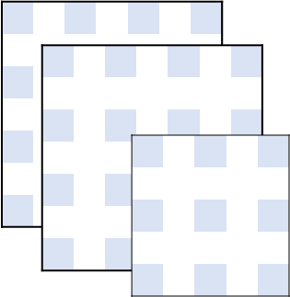
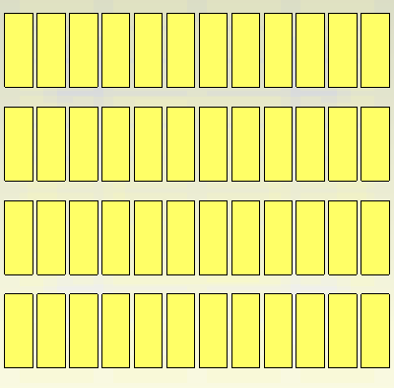
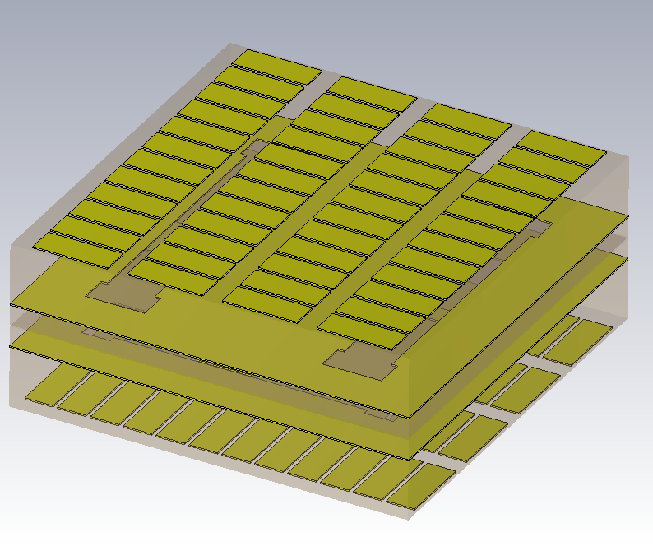
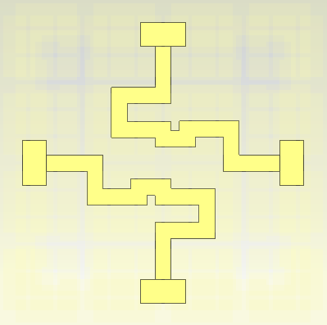
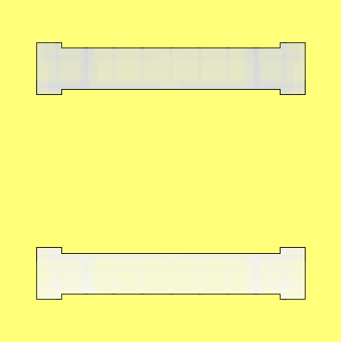



















SIM 2
SIM 1
Neural
Network
$$2D−DFT$$
Rectifier
$$∆_{ψ_{x}}=12$$
$$∆_{ψ_{y}}=12$$
$$∆_{ψ_{x}}=0$$
$$∆_{ψ_{y}}=0$$
$$∆_{ψ_{x}}=9$$
$$∆_{ψ_{y}}=9$$
$$Υ_{i}(ξ_{i,t})$$
Envelope
detector
ADC
Q-Table
DAC
$$ψ_{y}$$
2D-DFT grid
$$ψ_{y}$$
$$ψ_{y}$$
MU
electric
angle
SIM
L9) Transmitting
plane
a
grid_l
$$ψ_{x}$$
$$ψ_{x}$$
$$ψ_{x}$$
grid_w
Optimal selection
L5) TTD lines
snapshot $1$
$$⋯$$
$$⋯$$
$$⋯$$
snapshot $T_{x}×T_{y}$
$$y$$
snapshot $2$
snapshot $125$
$$x$$
time
$$h$$
mic_w
Machine Learning mediated
$$x$$
m_l
$$z$$
$$y$$
m_w
$$x$$
$$y$$
Cell unit
slot_l
2d
L3) Lower ground
slots
$$x$$
db_w
$$y$$
db_l

Slide 4
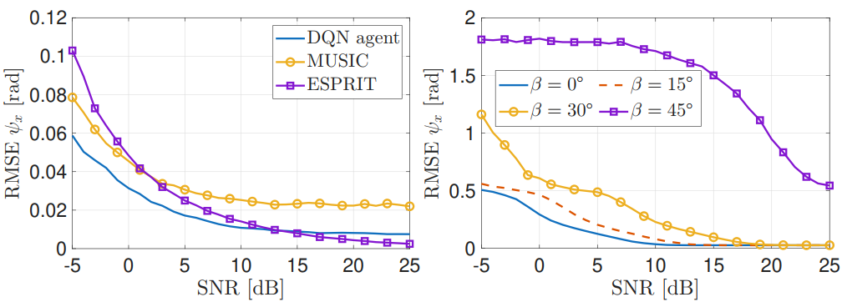
SIM 2
SIM 1
Neural
Network
$$2D−DFT$$
Rectifier
$$Υ_{i}(ξ_{i,t})$$
Envelope
detector
ADC
Q-Table
DAC

Slide 5
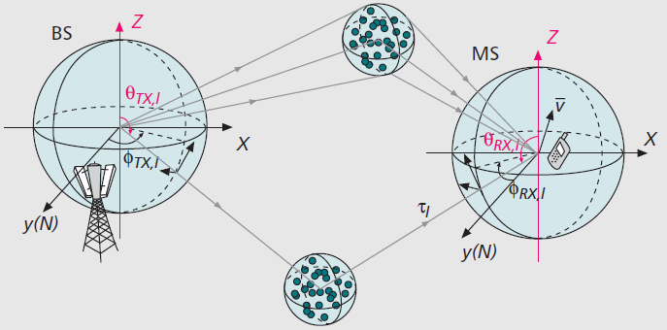
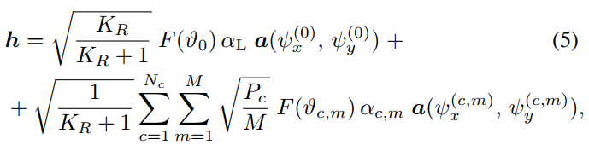
3GPP Ricean Channel
[1] J. Zhang, C. Pan, F. Pei, G. Liu, and X. Cheng, “Three-dimensional fading channel models: A survey of elevation angle research,” IEEE Communications Magazine, vol. 52, no. 6, pp. 218–226, Jun. 2014, doi: 10.1109/MCOM.2014.6829967.

Slide 6

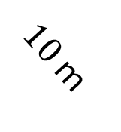
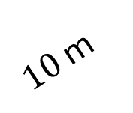
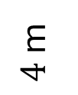
SIMs
$4$ m
$10$ m
$$120°$$
$10$ m

Slide 7
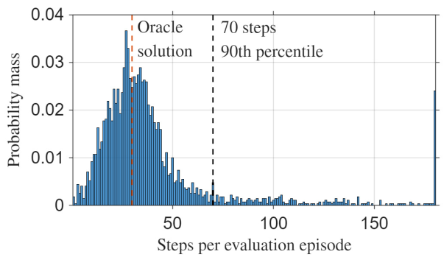





SIM 2
SIM 1
Neural
Network
$$2D−DFT$$
Rectifier
$$Υ_{i}(ξ_{i,t})$$
Envelope
detector
ADC
Q-Table
DAC
$$T_{ADC}=8 ns$$
$$T_{steer}=20 ns$$
$$T_{Q}=40 ns$$
$$T_{DAC}=160 ns$$
Latency per step $=M×(T_{steer}+T_{ADC})+T_{Q}+T_{DAC}≈1 μs$
(1)
Total Latency $≈70 μs$
(2)

Slide 8
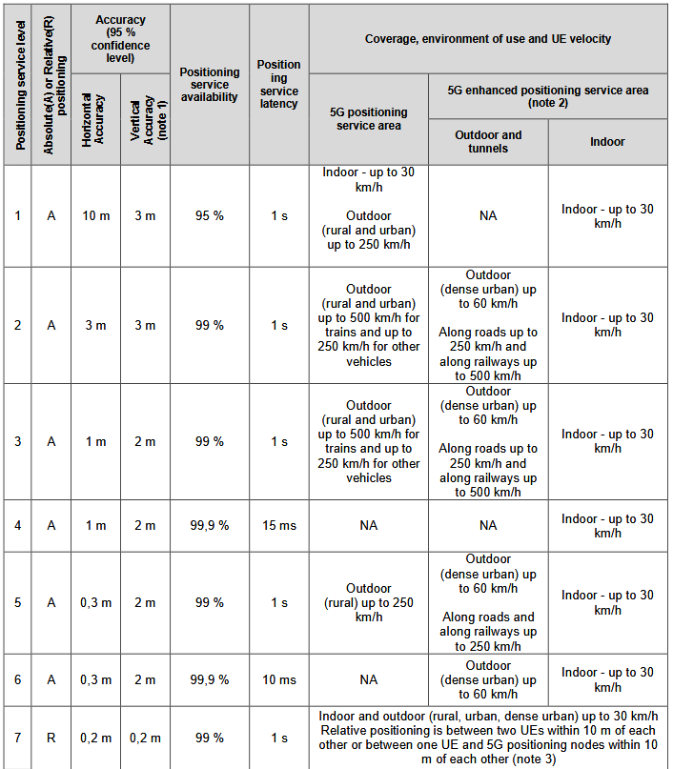
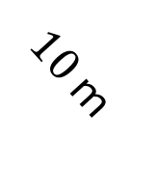
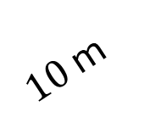

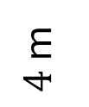


SIMs
$4$ m
$10$ m
$$120°$$
$10$ m
Total Latency $≈70 μs$
(1)
(1)
Precision $≈1.7$m
(2)
A. Li, “Service requirements for the 5G system; Stage 1 (Release 20),” 3rd Generation Partnership Project (3GPP), 3rd Generation Partnership Project, Sophia Antipolis, France, Technical specification (TS) TS 22.261 V20.6.0, Mar. 2026

Slide 9
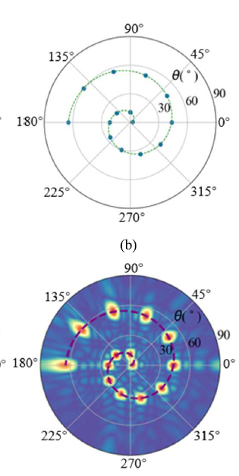
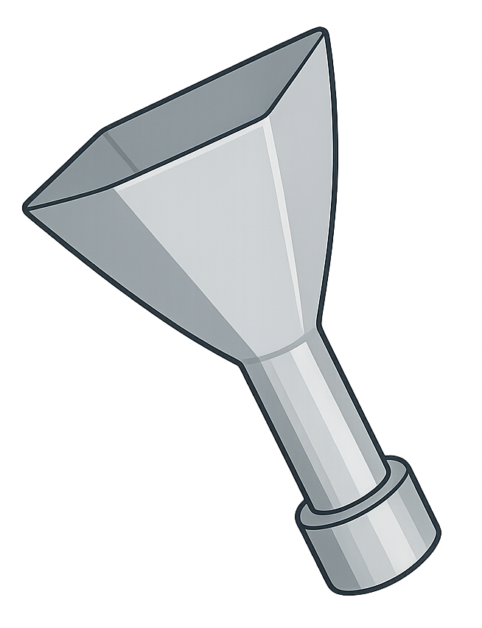
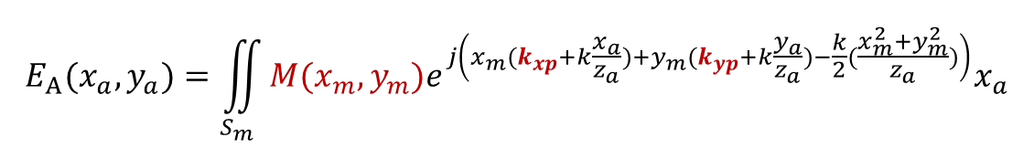






Metasurface
Probe
antenna
$$y_{a}$$
$$x_{a}$$
$$y_{m}$$
$$x_{m}$$
$$E_{A}(x_{a},y_{a})=\iint_{S_{m}}{M(x_{m},y_{m})e^{j\left(x_{m}(k_{xp}+k\frac{x_{a}}{z_{a}})+y_{m}(k_{yp}+k\frac{y_{a}}{z_{a}})−\frac{k}{2}(\frac{x_{m}^{2}+y_{m}^{2}}{z_{a}})\right)}x_{a}}$$
(1)
$$k_{xp}=k sinθ_{p} cosφ_{p}$$
(2)
$$k_{yp}=k sinθ_{p} sinφ_{p}$$
(3)
[1] W. Li, N. Wang, and J. Qi, “Direct Angle of Arrival (AOA) EstimationUsing a Metasurface Antenna With Single Frequency PhaselessMeasurements Obeyed Schwarz Inequality,” IEEE Transactions onMicrowave Theory and Techniques, vol. 72, no. 4, pp. 2677–2685, Apr.2024.

Slide 10
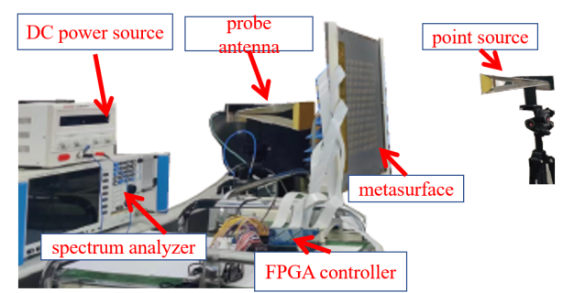

$$20×20$$
[1] W. Li, N. Wang, and J. Qi, “Direct Angle of Arrival (AOA) EstimationUsing a Metasurface Antenna With Single Frequency PhaselessMeasurements Obeyed Schwarz Inequality,” IEEE Transactions onMicrowave Theory and Techniques, vol. 72, no. 4, pp. 2677–2685, Apr.2024.

Slide 11

Inference
Measurements
Rectifier
$$M(x_{m},y_{m})$$
Envelope
detector
ADC
Q-Table
DAC
$$E_{A}(x_{a},y_{a})=\iint_{S_{m}}{M(x_{m},y_{m})e^{j\left(x_{m}(k_{xp}+k\frac{x_{a}}{z_{a}})+y_{m}(k_{yp}+k\frac{y_{a}}{z_{a}})−\frac{k}{2}(\frac{x_{m}^{2}+y_{m}^{2}}{z_{a}})\right)}x_{a}}$$
(1)
$$k_{xp}=k sinθ_{p} cosφ_{p}$$
(2)
$$k_{yp}=k sinθ_{p} sinφ_{p}$$
(3)
[1] W. Li, N. Wang, and J. Qi, “Direct Angle of Arrival (AOA) EstimationUsing a Metasurface Antenna With Single Frequency PhaselessMeasurements Obeyed Schwarz Inequality,” IEEE Transactions onMicrowave Theory and Techniques, vol. 72, no. 4, pp. 2677–2685, Apr.2024.

Slide 12
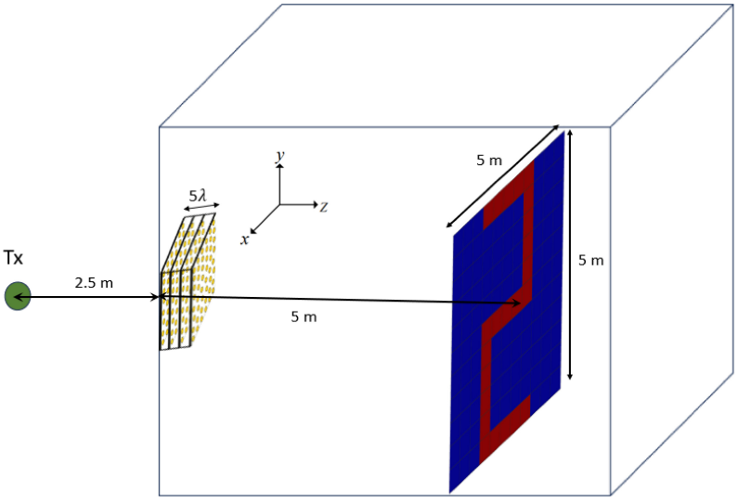
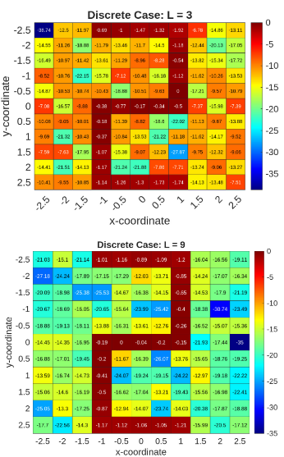

Beamformer
Rectifier
$$M(x_{m},y_{m})$$
Envelope
detector
ADC
Q-Table
DAC
[1] W. Li, N. Wang, and J. Qi, “Direct Angle of Arrival (AOA) EstimationUsing a Metasurface Antenna With Single Frequency PhaselessMeasurements Obeyed Schwarz Inequality,” IEEE Transactions onMicrowave Theory and Techniques, vol. 72, no. 4, pp. 2677–2685, Apr.2024.
[2] N. U. Hassan, J. An, M. Di Renzo, M. Debbah, and C. Yuen, “Efficient Beamforming and Radiation Pattern Control Using Stacked Intelligent Metasurfaces,” IEEE Open Journal of the Communications Society, vol. 5, pp. 599–611, 2024, doi: 10.1109/OJCOMS.2023.3349155.

Slide 13



Coarse estimator and Beamformer
Rectifier
$$M(x_{m},y_{m})$$
$30$ cm
Envelope
detector
ADC
Q-Table
DAC
$1.7$ m
$1.7$ m
[1] W. Li, N. Wang, and J. Qi, “Direct Angle of Arrival (AOA) EstimationUsing a Metasurface Antenna With Single Frequency PhaselessMeasurements Obeyed Schwarz Inequality,” IEEE Transactions onMicrowave Theory and Techniques, vol. 72, no. 4, pp. 2677–2685, Apr.2024.

Slide 14
SIM 2
SIM 1
Neural
Network
$$2D−DFT$$
Rectifier
$$Υ_{i}(ξ_{i,t})$$
Envelope
detector
ADC
Q-Table
DAC
[1] W. Li, N. Wang, and J. Qi, “Direct Angle of Arrival (AOA) EstimationUsing a Metasurface Antenna With Single Frequency PhaselessMeasurements Obeyed Schwarz Inequality,” IEEE Transactions onMicrowave Theory and Techniques, vol. 72, no. 4, pp. 2677–2685, Apr.2024.

