Slide 1
Associating Metabolic reactions and AI machines
Notes:
reactions that are differentiallz expressed

Slide 2












Biological Networking: Physical Components
${10}^{6}$m
Carl Sagan exobiology: Floaters in Jupiter (video in this link)
Mount
Everest
Human Scale
$3μ$m
Bacteria
CMOS
Technology
$100$ nm
Virus
Cellular Scale
Nanofiber
$10$ nm
Protein
Nanorobotics
$100$ nm -- $100 μ$m
Nanotube
$1$ nm
DNA
Nano Scale
$0.1$ nm
Molecule

Slide 3
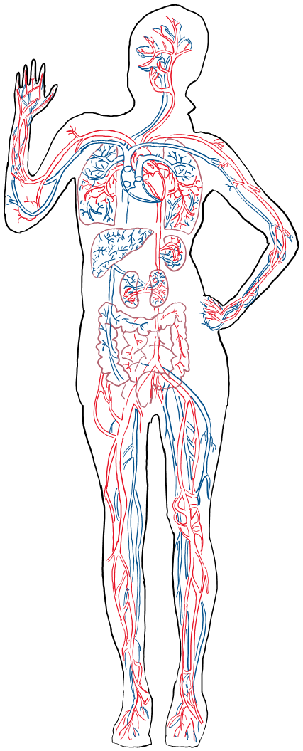

Internet of Bio-Nano-Things
Gateway
Wound

Slide 4
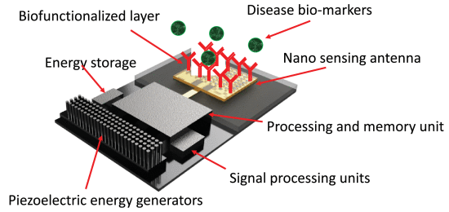
Internet of Bio-Nano-Things
Gateway
Wound
[1] A. Sangwan and J. M. Jornet, "Joint Communication and Bio-Sensing With Plasmonic Nano-Systems to Prevent the Spread of Infectious Diseases in the Internet of Nano-Bio Things," in IEEE Journal on Selected Areas in Communications, vol. 40, no. 11, pp. 3271-3284, Nov. 2022, doi: 10.1109/JSAC.2022.3214288.

Slide 5
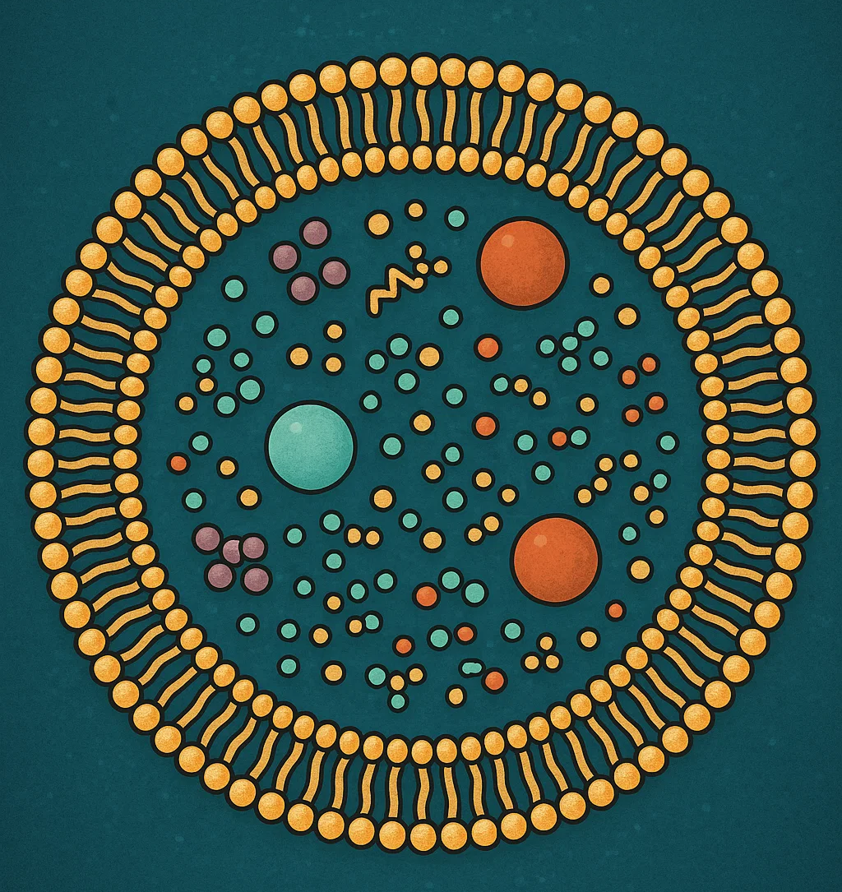


Bio-Building Carriers
Cancer Cell
[1] C. A. Söldner et al., “A Survey of Biological Building Blocks for Synthetic Molecular Communication Systems,” IEEE Communications Surveys Tutorials, vol. 22, no. 4, pp. 2765–2800, Fourthquarter 2020.

Slide 6
Bio-Building Carriers
Cancer Cell
$$C$$
$$d_{0}$$
$$d$$

Slide 7
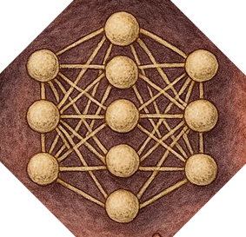
Bio-Building Carriers
Cancer Cell
$$C$$
$$d_{0}$$
$$d$$

Slide 8
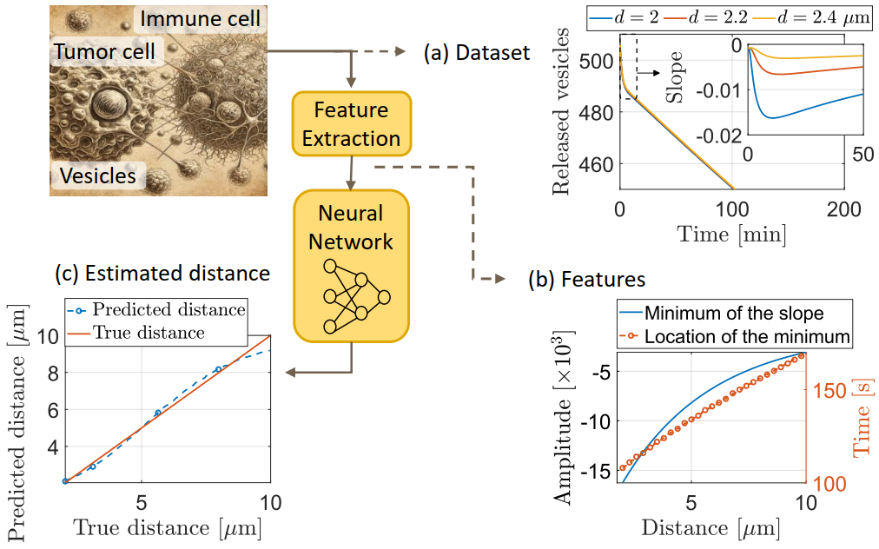

Slide 9
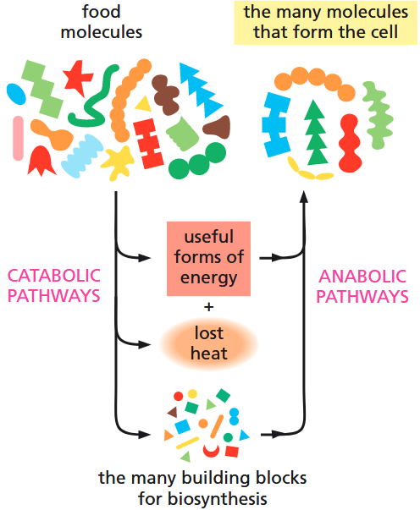
Concept
Metabolic Network
[1] B. Alberts, D. Bray, and K. Hopkin, Essential Cell Biology, 4th rev ed. edition. New York, NY: Norton & Company, 2014.
Notes:
Figure 3–2 Catabolic and anabolic pathways together constitute the cell’s metabolism. Note that a major portion of the energy stored in the chemical bonds of food molecules is dissipated as heat. thus, only some of this energy can be converted to the useful forms of energy needed to drive the synthesis of new molecules.

Slide 10

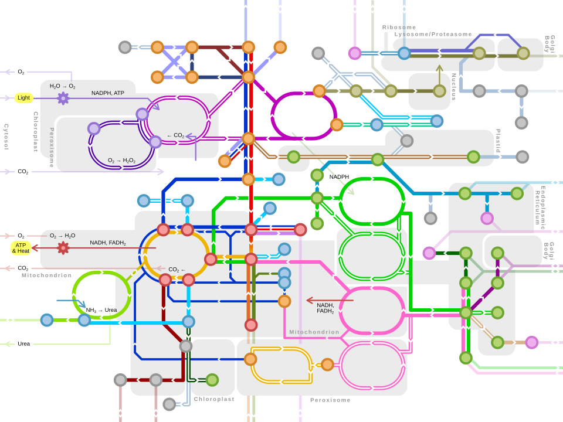
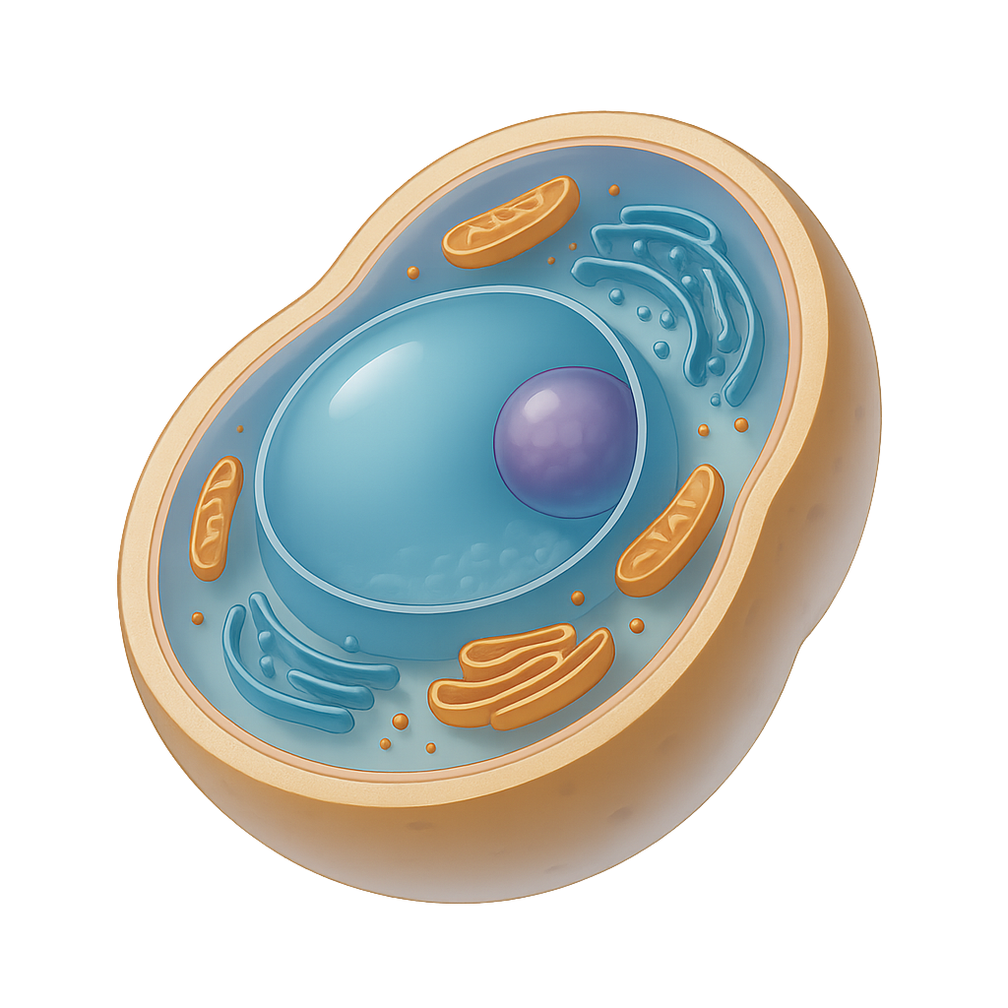
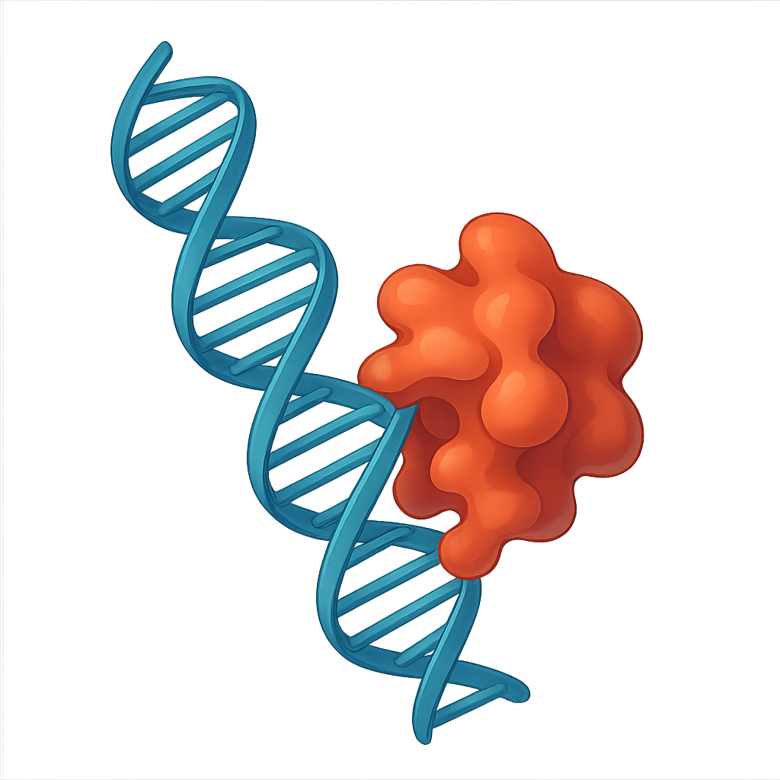
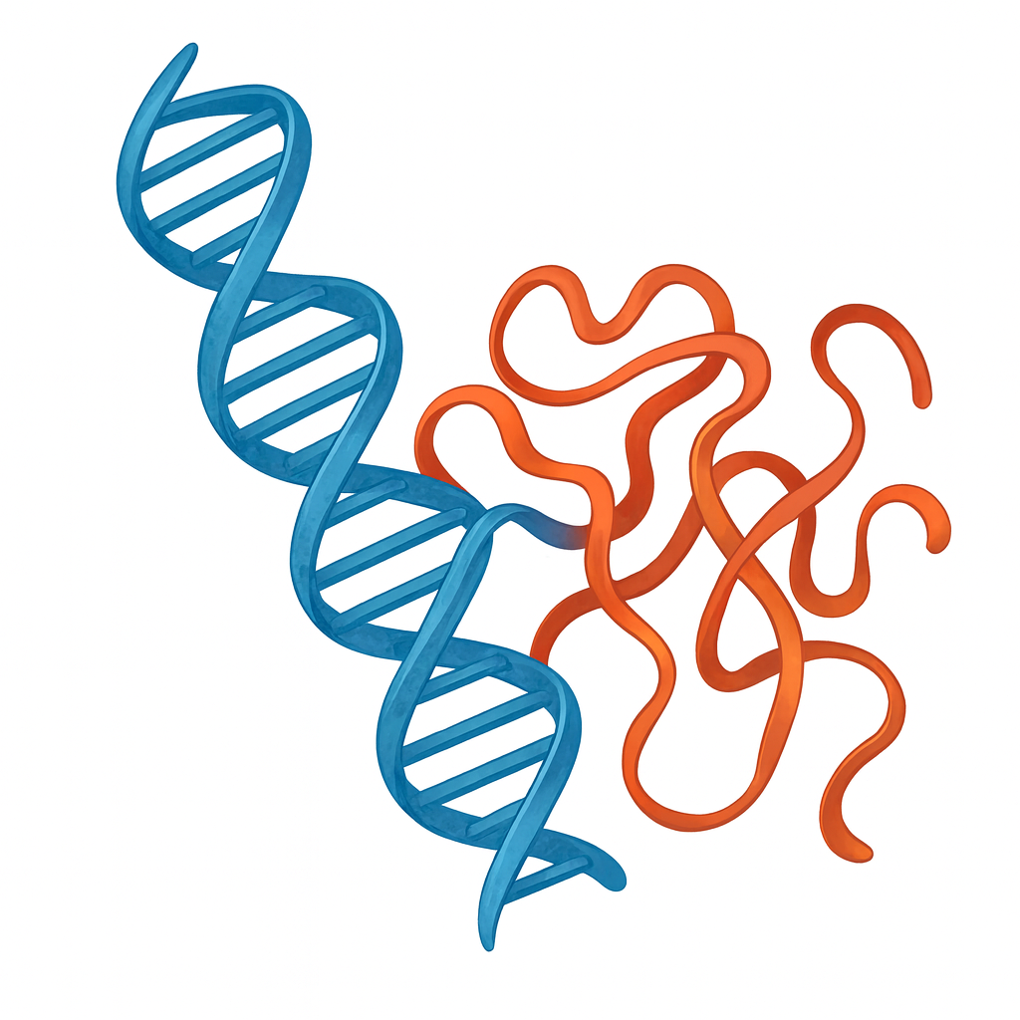




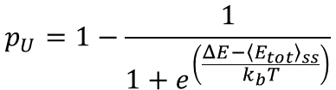
Concept
Antenna Array
Terahertz
Waveforms
Metabolic Network
Folded Enzyme
Yeast Cell
● Enzyme unfolding probability
$$p_{U}=1−\frac{1}{1+e^{\left(\frac{ΔE−{\left\langle E_{tot}\right\rangle }_{ss}}{k_{b}T}\right)}}$$
Unfolded Enzyme
$${\left\langle E_{tot}\right\rangle }_{ss}$$
Total energy of the enzyme
$$ΔE$$
Enzyme-free energy
$$k_{b}$$
Boltzmann constant
$$T$$
Temperature of the Cell
Notes:
Figure 3–2 Catabolic and anabolic pathways together constitute the cell’s metabolism. Note that a major portion of the energy stored in the chemical bonds of food molecules is dissipated as heat. thus, only some of this energy can be converted to the useful forms of energy needed to drive the synthesis of new molecules.

Slide 11
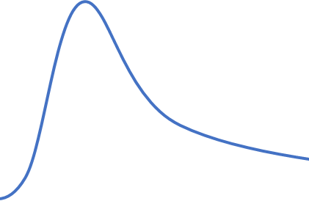






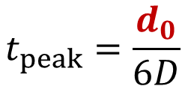








Point Transmitter
Receiver
$$m_{0}(t)$$
$$d_{0}$$
$$t_{peak}=\frac{d_{0}}{6D}$$
time
Feature extraction
NN
$$m_{2}$$
$$r_{2}$$
$$m_{4}$$
Counter
$$m_{5}$$
$$m_{1}$$
$$r_{1}$$
$$r_{4}$$
$$m_{0}$$
$$m_{3}$$
$$m_{4}$$
$$r_{3}$$
$$z^{−1}$$

Slide 12















Algorithm
Point Transmitter
Receiver
$$m_{0}(t)$$
$$d_{0}$$
Chemical Reactions
$$t_{peak}=\frac{d_{0}}{6D}$$
time
Feature extraction
NN
Metabolic Network
$$m_{2}$$
$$r_{2}$$
$$m_{4}$$
Counter
$$m_{1}$$
$$m_{5}$$
$$r_{1}$$
$$r_{4}$$
THz Actuation
$$m_{in}$$
$$m_{3}$$
$$m_{4}$$
$$r_{3}$$
$$z^{−1}$$

Slide 13














Digital
Differentiator
Algorithm
Counter
Chemical Differentiator
$$m_{1}$$
$$m_{F}$$
$$m_{d}$$
$$m_{d}$$
$$r_{F}$$
$$r_{d}$$
$$m_{in}$$
$$m_{in}$$
$$m_{Df}$$
Chemical Reactions
$$m_{d}$$
$$r_{S}$$
$$r_{I}$$
$$z^{−1}$$
$$m_{Sd}$$
Metabolic Network
THz Actuation

Slide 14













Algorithm
Digital counter
Counter
$$m_{0}(t)$$
$$m_{1}$$
$$m_{in}$$
Chemical Reactions
$$m_{d}$$
$$z^{−1}$$
$$t_{peak}=\frac{d_{0}}{6D}$$
time
$$m_{1}$$
Metabolic Network
Chemical counter
$$r_{C}$$
$$m_{1}$$
time
THz Actuation
$$m_{d}$$
$$m_{S}$$
$$r_{I1}$$
$$r_{I2}$$

Slide 15
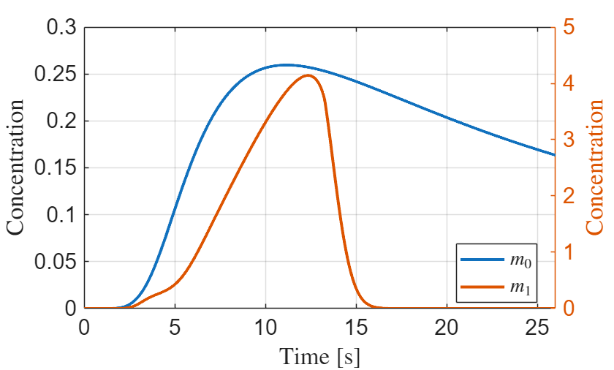
















Chemical counter
Algorithm
Chemical Differentiator
$$m_{1}$$
$$m_{1}$$
$$r_{C}$$
$$m_{F}$$
$$m_{d}$$
$$m_{d}$$
$$r_{F}$$
$$r_{d}$$
$$m_{Sc}$$
$$r_{I1}$$
$$m_{in}$$
Chemical Reactions
$$m_{Df}$$
$$r_{S}$$
$$r_{I}$$
$$r_{I2}$$
$$m_{Sd}$$
Metabolic Network
THz Actuation

Slide 16
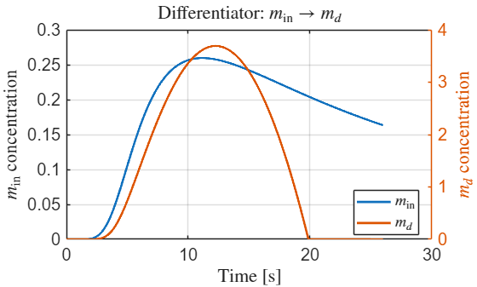
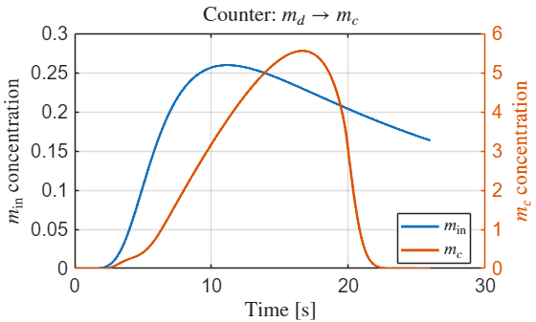
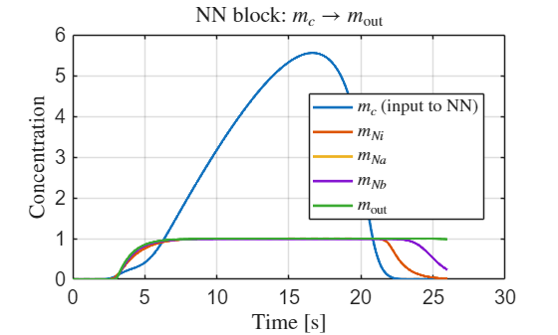























Chemical counter
NN
$$r_{Na}$$
Chemical Differentiator
$$m_{c}$$
$$m_{c}$$
$$m_{Nc}$$
$$r_{Cp}$$
$$m_{Na}$$
$$m_{Df}$$
$$m_{d}$$
$$m_{d}$$
$$m_{c}$$
$$m_{out}$$
$$r_{Df}$$
$$r_{Dp}$$
$$m_{Cs}$$
$$r_{Cg}$$
$$r_{Ni}$$
$$r_{No}$$
$$m_{in}$$
$$m_{Nb}$$
$$m_{Nc}$$
$$r_{Ds}$$
$$r_{Di}$$
$$r_{Cr}$$
$$r_{Nb}$$
$$m_{Ds}$$
Algorithm
Chemical Reactions
Metabolic Network
THz Actuation

Slide 17
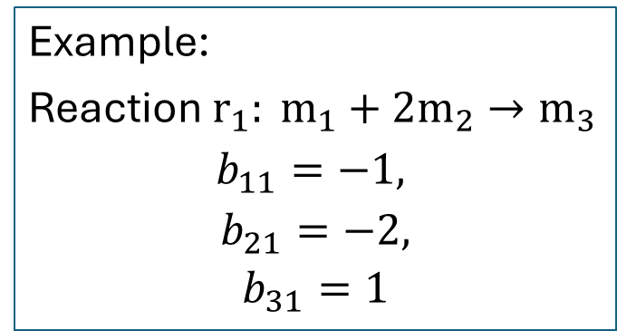
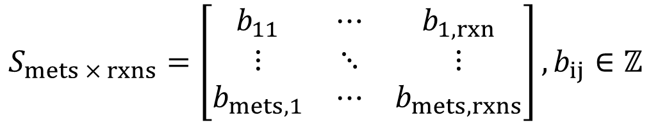
Stoichiometric matrix
Algorithm
$$S_{mets × rxns}=\left[\begin{matrix}b_{11} & ⋯ & b_{1,rxn} \\ ⋮ & ⋱ & ⋮ \\ b_{mets,1} & ⋯ & b_{mets,rxns}\end{matrix}\right],b_{ij}∈ℤ$$
(1)
Chemical Reactions
Metabolic Network
Example:
Reaction $r_{1}: m_{1}+2m_{2}→m_{3}$
$$b_{11}=−1,$$
$$b_{21}=−2,$$
$$b_{31}=1$$
(2)
THz Actuation

Slide 18

























Mapping a 2-neuron NN
Algorithm
Pattern
$$m_{2}$$
$$r_{F}$$
$$m_{F}$$
$$r_{1}$$
$$r_{I}$$
$$r_{F}$$
$$r_{S}$$
$$r_{5}$$
Chemical Reactions
$$m_{1}$$
$$m_{0}$$
$$m_{0}$$
$$r_{1}$$
$$r_{I}$$
$$m_{1}$$
$$+$$
$$m_{2}$$
Metabolic Network
$$m_{3}$$
$$m_{S}$$
$$m_{3}$$
$$r_{S}$$
$$m_{F}$$
$$−$$
$$m_{S}$$
$$−$$
THz Actuation
Notes:
Algorithm
For each metabolite $m$, list producers $P$(reactions with $S_{m,j}>0$)
List consumers $C$(reactions with $S_{m,j}<0$)
If $∣P∣≥2$and $∣C∣≥1$, check candidate outputs $r_{3}∈C$
Prefer cases where $m$has exactly 2 producers and 1 consumer (tightest “adder”)
Intersect producers with your single-gene reaction list (your current code already gives that)

Slide 19







Mapping a 2-neuron NN
Algorithm
Pattern
$$m_{2}$$
$$r_{F}$$
$$m_{F}$$
$$r_{1}$$
$$r_{I}$$
$$r_{F}$$
$$r_{S}$$
$$r_{5}$$
Chemical Reactions
$$m_{1}$$
$$m_{0}$$
$$m_{0}$$
$$r_{1}$$
$$r_{I}$$
$$m_{1}$$
$$+$$
$$m_{2}$$
$$−$$
Metabolic Network
$$m_{3}$$
$$m_{S}$$
$$m_{3}$$
$$−$$
$$r_{S}$$
$$m_{F}$$
$$−$$
$$+$$
$$m_{S}$$
$$−$$
$$+$$
THz Actuation
Notes:
Algorithm
For each metabolite $m$, list producers $P$(reactions with $S_{m,j}>0$)
List consumers $C$(reactions with $S_{m,j}<0$)
If $∣P∣≥2$and $∣C∣≥1$, check candidate outputs $r_{3}∈C$
Prefer cases where $m$has exactly 2 producers and 1 consumer (tightest “adder”)
Intersect producers with your single-gene reaction list (your current code already gives that)

Slide 20







Mapping a 2-neuron NN
Algorithm
Pattern
$$m_{2}$$
$$r_{F}$$
$$m_{F}$$
$$r_{1}$$
$$r_{I}$$
$$r_{F}$$
$$r_{S}$$
$$r_{5}$$
Chemical Reactions
$$m_{1}$$
$$m_{0}$$
$$−$$
$$m_{0}$$
$$r_{1}$$
$$r_{I}$$
$$m_{1}$$
$$+$$
$$m_{2}$$
$$+$$
$$−$$
Metabolic Network
$$m_{3}$$
$$m_{S}$$
$$m_{3}$$
$$+$$
$$−$$
$$r_{S}$$
$$m_{F}$$
$$−$$
$$+$$
$$m_{S}$$
$$−$$
$$+$$
THz Actuation
Notes:
Algorithm
For each metabolite $m$, list producers $P$(reactions with $S_{m,j}>0$)
List consumers $C$(reactions with $S_{m,j}<0$)
If $∣P∣≥2$and $∣C∣≥1$, check candidate outputs $r_{3}∈C$
Prefer cases where $m$has exactly 2 producers and 1 consumer (tightest “adder”)
Intersect producers with your single-gene reaction list (your current code already gives that)

Slide 21















Mapping a 2-neuron NN
Algorithm
Pattern
$$m_{2}$$
$$r_{F}$$
$$m_{F}$$
$$r_{1}$$
$$r_{I}$$
$$r_{F}$$
$$r_{S}$$
$$r_{5}$$
Chemical Reactions
$$m_{1}$$
$$m_{0}$$
$$−$$
$$m_{0}$$
$$r_{1}$$
$$r_{I}$$
$$m_{1}$$
$$+$$
$$m_{2}$$
$$+$$
$$−$$
Metabolic Network
$$m_{3}$$
$$m_{S}$$
$$m_{3}$$
$$+$$
$$−$$
$$r_{S}$$
$$m_{F}$$
$$−$$
$$+$$
$$m_{S}$$
$$−$$
$$+$$
THz Actuation
Notes:
Algorithm
For each metabolite $m$, list producers $P$(reactions with $S_{m,j}>0$)
List consumers $C$(reactions with $S_{m,j}<0$)
If $∣P∣≥2$and $∣C∣≥1$, check candidate outputs $r_{3}∈C$
Prefer cases where $m$has exactly 2 producers and 1 consumer (tightest “adder”)
Intersect producers with your single-gene reaction list (your current code already gives that)

Slide 22










Solutions
Reaction 1: peroxisomal acyl-CoA thioesterase
EC code: 3.1.2.2
PBD ID: 1TUB
Gene: YJR019C
Formula:
C31H50N7O17P3S + H2O -> C21H32N7O16P3S + C10H19O2 + H
Location: Peroxisome
Algorithm
Chemical Reactions
$$m_{2}$$
$$r_{F}$$
$$m_{F}$$
$$m_{1}$$
Reaction F: acetyl-CoA C-acyltransferase (decanoyl-CoA)
EC code: 2.3.1.16
Gene: YIL160C
C33H52N7O18P3S + C21H32N7O16P3S -> C23H34N7O17P3S + C31H50N7O17P3S
Location: Peroxisome
$$m_{0}$$
Metabolic Network
$$r_{1}$$
$$r_{I}$$
$$m_{3}$$
$$m_{S}$$
$$r_{S}$$
THz Actuation
Reaction S: fatty-acid--CoA ligase (decanoate)
EC code: 6.2.1.3
Gene: YER015W
C10H12N5O13P3 + C21H32N7O16P3S + C10H19O2 -> C10H12N5O7P + C31H50N7O17P3S + HO7P2
Location: Peroxisome
Notes:
Algorithm
For each metabolite $m$, list producers $P$(reactions with $S_{m,j}>0$)
List consumers $C$(reactions with $S_{m,j}<0$)
If $∣P∣≥2$and $∣C∣≥1$, check candidate outputs $r_{3}∈C$
Prefer cases where $m$has exactly 2 producers and 1 consumer (tightest “adder”)
Intersect producers with your single-gene reaction list (your current code already gives that)

Slide 23
























Chemical counter
NN
$$r_{Na}$$
Chemical Differentiator
$$m_{c}$$
$$m_{c}$$
$$m_{Nc}$$
$$r_{Cp}$$
$$m_{Na}$$
$$m_{Df}$$
$$m_{d}$$
$$m_{d}$$
$$m_{c}$$
$$m_{out}$$
$$r_{Df}$$
$$r_{Dp}$$
$$m_{Cs}$$
$$r_{Cg}$$
$$r_{Ni}$$
$$r_{No}$$
$$m_{in}$$
$$m_{Nb}$$
$$m_{Nc}$$
$$r_{Ds}$$
$$r_{Di}$$
$$r_{Cr}$$
$$r_{Nb}$$
$$m_{Ds}$$
1
2
3
4
Map Chem.
Diff. in S
Simulate
Kinetics
Map
Counter in S
Map
NN in S
Restrictions:
Metabolites: Black listed currency ones: H+, O2, CO2, H2O, ATP, ADP, AMP, Inorganic phosphate, Inorganic diphosphate, NAD⁺, NADH, NADP⁺, NADPH, NH3, NH4, Coenzyme A, FAD, FADH, FADH2.
Reactions: Chemical reactions must be gene-mediated and have disjoint genes.
Algorithm
Chemical Reactions
Metabolic Network
THz Actuation

Slide 24

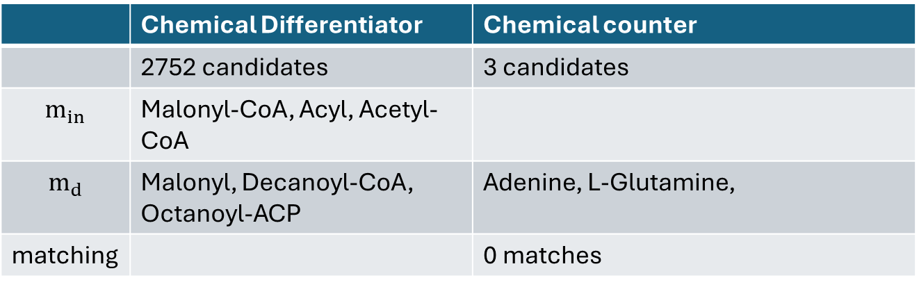
Chemical counter
NN
$$r_{Na}$$
Chemical Differentiator
$$m_{c}$$
$$m_{c}$$
$$m_{Nc}$$
$$r_{Cp}$$
$$m_{Na}$$
$$m_{Df}$$
$$m_{d}$$
$$m_{d}$$
$$m_{c}$$
$$m_{out}$$
$$r_{Df}$$
$$r_{Dp}$$
$$m_{Cs}$$
$$r_{Cg}$$
$$r_{Ni}$$
$$r_{No}$$
$$m_{in}$$
$$m_{Nb}$$
$$m_{Nc}$$
$$r_{Ds}$$
$$r_{Di}$$
$$r_{Cr}$$
$$r_{Nb}$$
$$m_{Ds}$$
 | Chemical Differentiator | Chemical counter
 | 2752 candidates | 3 candidates
$$m_{in}$$ | Malonyl-CoA, Acyl, Acetyl-CoA
$$m_{d}$$ | Malonyl, Decanoyl-CoA, Octanoyl-ACP | Adenine, L-Glutamine,
matching |  | 0 matches
Algorithm
Chemical Reactions
Metabolic Network
THz Actuation

Slide 25
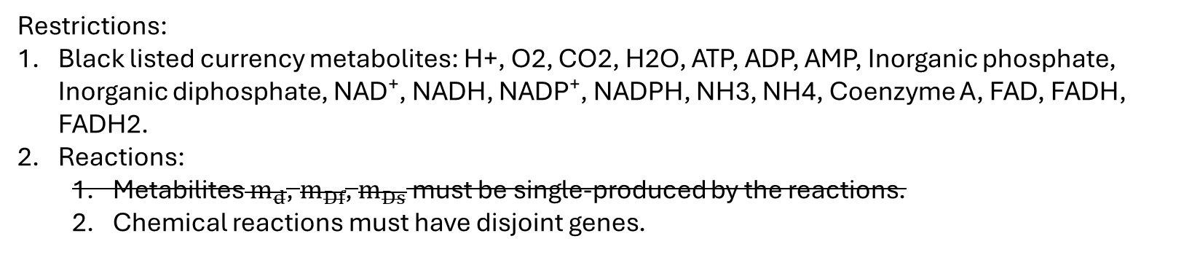
Chemical counter
NN
$$r_{Na}$$
Chemical Differentiator
$$m_{c}$$
$$m_{c}$$
$$m_{Nc}$$
$$r_{Cp}$$
$$m_{Na}$$
$$m_{Df}$$
$$m_{d}$$
$$m_{d}$$
$$m_{c}$$
$$m_{out}$$
$$r_{Df}$$
$$r_{Dp}$$
$$m_{Cs}$$
$$r_{Cg}$$
$$r_{Ni}$$
$$r_{No}$$
$$m_{in}$$
$$m_{Nb}$$
$$m_{Nc}$$
$$r_{Ds}$$
$$r_{Di}$$
$$r_{Cr}$$
$$r_{Nb}$$
$$m_{Ds}$$
1
2
3
4
Map Chem.
Diff. in S
Simulate
Kinetics
Map
Counter in S
Map
NN in S
Restrictions:
Black listed currency metabolites: H+, O2, CO2, H2O, ATP, ADP, AMP, Inorganic phosphate, Inorganic diphosphate, NAD⁺, NADH, NADP⁺, NADPH, NH3, NH4, Coenzyme A, FAD, FADH, FADH2.
Reactions:
Metabilites $m_{d}$, $m_{Df}$, $m_{Ds}$ must be single-produced by the reactions.
Chemical reactions must have disjoint genes.
Algorithm
Chemical Reactions
Metabolic Network
THz Actuation

Slide 26
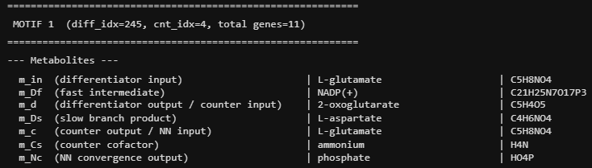
Chemical counter
NN
$$r_{Na}$$
Chemical Differentiator
$$m_{c}$$
$$m_{c}$$
$$m_{Nc}$$
$$r_{Cp}$$
$$m_{Na}$$
$$m_{Df}$$
$$m_{d}$$
$$m_{d}$$
$$m_{c}$$
$$m_{out}$$
$$r_{Df}$$
$$r_{Dp}$$
$$m_{Cs}$$
$$r_{Cg}$$
$$r_{Ni}$$
$$r_{No}$$
$$m_{in}$$
$$m_{Nb}$$
$$m_{Nc}$$
$$r_{Ds}$$
$$r_{Di}$$
$$r_{Cr}$$
$$r_{Nb}$$
$$m_{Ds}$$
Algorithm
Chemical Reactions
Metabolic Network
THz Actuation

Slide 27

























Chemical counter
NN
$$r_{Na}$$
Chemical Differentiator
$$m_{c}$$
$$m_{c}$$
$$m_{Nc}$$
$$r_{Cp}$$
$$m_{d}$$
$$m_{Na}$$
$$m_{Df}$$
$$m_{d}$$
$$m_{c}$$
$$m_{out}$$
$$r_{Df}$$
$$r_{Dp}$$
$$m_{Cs}$$
$$r_{Cg}$$
$$r_{Ni}$$
$$r_{No}$$
$$m_{in}$$
$$m_{Nb}$$
$$r_{Ds}$$
$$r_{Di}$$
$$r_{Cr}$$
$$m_{Nc}$$
$$m_{Ds}$$
$$r_{Nb}$$
Algorithm
Chemical Reactions
Metabolic Network
THz Actuation
Notes:
The gene code YNR050C is searched in Uniport at https://www.uniprot.org/
The result is a protein and we click on Structure on the left menu.
In the table of Structure you select the Identifier which in this case is 2AXQ.
The PDB ID is the one giving the mechanical structure to evaluate the resonant frequency.

Slide 28
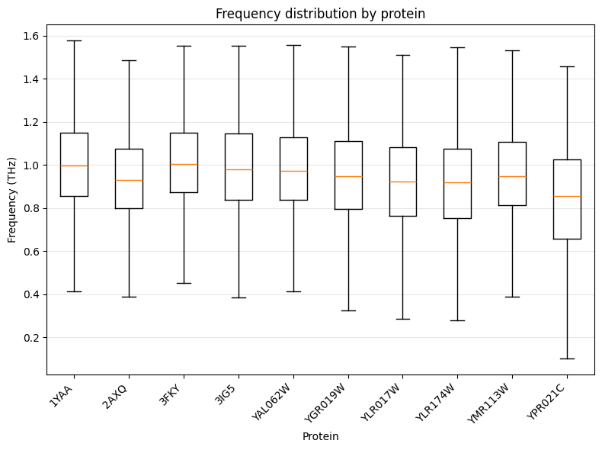
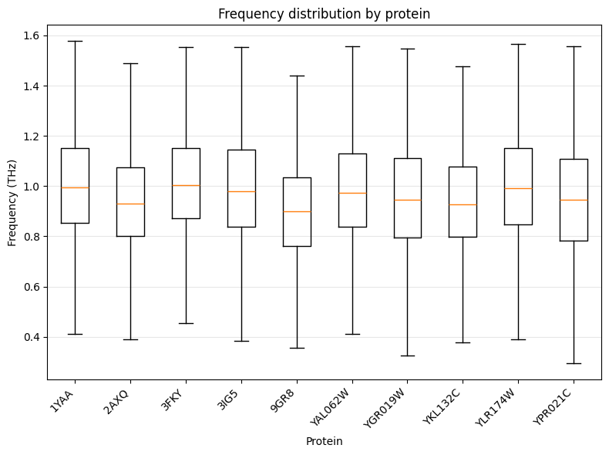
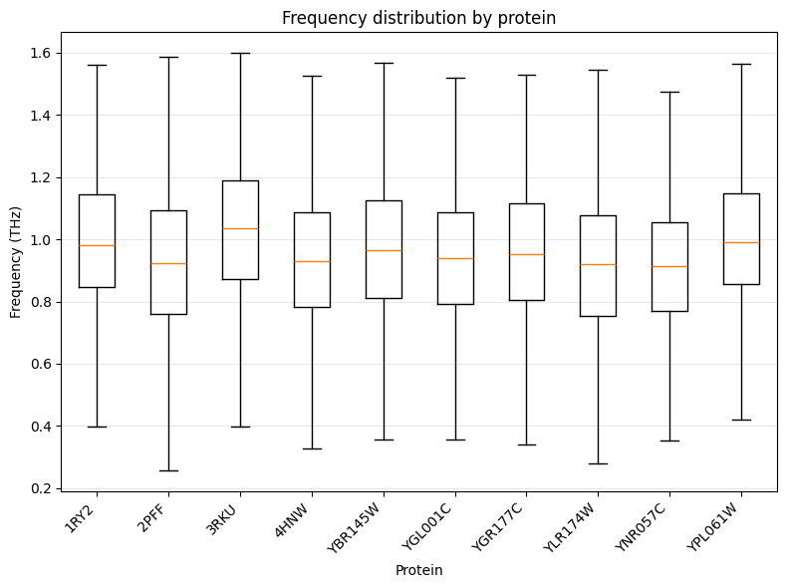








Motif 1
Motif 30
Motif 52
$$r_{Nb}$$
$$r_{Na}$$
$$r_{Na}$$
$$r_{No}$$
$$r_{Nb}$$
$$r_{Na}$$
$$r_{Nb}$$
$$r_{No}$$
Notes:
The gene code YNR050C is searched in Uniport at https://www.uniprot.org/
The result is a protein and we click on Structure on the left menu.
In the table of Structure you select the Identifier which in this case is 2AXQ.
The PDB ID is the one giving the mechanical structure to evaluate the resonant frequency.

Slide 29
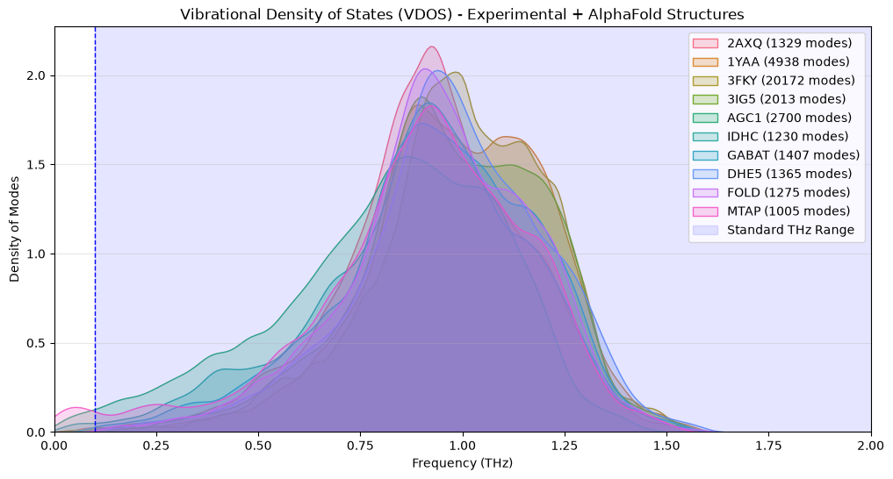
Chemical counter
NN
$$r_{Na}$$
Chemical Differentiator
$$m_{c}$$
$$m_{c}$$
$$m_{Nc}$$
$$r_{Cp}$$
$$m_{d}$$
$$m_{Na}$$
$$m_{Df}$$
$$m_{d}$$
$$m_{c}$$
$$m_{out}$$
$$r_{Df}$$
$$r_{Dp}$$
$$m_{Cs}$$
$$r_{Cg}$$
$$r_{Ni}$$
$$r_{No}$$
$$m_{in}$$
$$m_{Nb}$$
$$r_{Ds}$$
$$r_{Di}$$
$$r_{Cr}$$
$$m_{Nc}$$
$$m_{Ds}$$
$$r_{Nb}$$
Motif 1
Algorithm
Chemical Reactions
Metabolic Network
THz Actuation
Notes:
The gene code YNR050C is searched in Uniport at https://www.uniprot.org/
The result is a protein and we click on Structure on the left menu.
In the table of Structure you select the Identifier which in this case is 2AXQ.
The PDB ID is the one giving the mechanical structure to evaluate the resonant frequency.

Slide 30

























Chemical counter
NN
$$r_{Na}$$
Chemical Differentiator
$$m_{c}$$
$$m_{c}$$
$$m_{Nc}$$
$$r_{Cp}$$
$$m_{Na}$$
$$m_{Df}$$
$$m_{d}$$
$$m_{d}$$
$$m_{c}$$
$$m_{out}$$
$$r_{Df}$$
$$r_{Dp}$$
$$m_{Cs}$$
$$r_{Cg}$$
$$r_{Ni}$$
$$r_{No}$$
$$m_{in}$$
$$m_{Nb}$$
$$m_{Nc}$$
$$r_{Ds}$$
$$r_{Di}$$
$$r_{Cr}$$
$$r_{Nb}$$
$$m_{Ds}$$
Motif 1
Element | Reaction | Genes
r_Df (differentiator: fast) | H + C6H11NO3 + C5H8NO4(m_c) + C21H26N7O17P3 -> H2O + C11H19N2O6 + C21H25N7O17P3(m_Df) | YNR050C
r_Ds (differentiator: slow) | C4H6NO4 + C5H8NO4(m_c) -> C4H6NO4(m_Ds) + C5H8NO4 | YPR021C
r_Dp (differentiator: producer) | YLR027C+ C21H25N7O17P3(m_Df) -> C5H4O5(m_d) + CO2 + C21H26N7O17P3 | YBR166C
r_Di (differentiator: integrator) | C5H4O5(m_d) + C4H6NO4(m_Ds) -> C5H8NO4(m_c) + C4H2O5 | YLR174W
r_Cp (counter: producer) | C5H4O5(m_d) + C4H9NO2 -> C5H8NO4(m_c) + C4H5O3 | YGR019W
r_Cg (counter: gate) | C5H4O5(m_d) + H4N(m_Cs) + H + C21H26N7O17P3 -> H2O + C5H8NO4(m_c) + C21H25N7O17P3(m_Df) | YAL062W or YOR375C
r_Cr (counter: reset) | H4N(m_Cs) + C10H12N5O13P3 + C5H8NO4(m_c) -> C10H12N5O10P2 + H + C5H10N2O3 + HO4P(m_Nc) | YPR035W
r_Na (NN: neuron a) | C14H13N6O3 + C10H12N5O13P3 + C5H8NO4(m_c) -> C10H12N5O10P2 + C19H19N7O6 + H + HO4P(m_Nc) | YMR113W
r_Nb (NN: neuron b) | C10H12N5O13P3 + C3H7NO2S + C5H8NO4(m_c) -> C10H12N5O10P2 + H + C8H13N2O5S + HO4P(m_Nc) | YJL101C
r_No (NN: merge/output) | C11H15N5O3S + HO4P(m_Nc) -> C5H5N5 + C6H11O7PS | YLR017W
Algorithm
Chemical Reactions
Metabolic Network
THz Actuation

Slide 31









Chemical counter
NN
$$r_{Na}$$
Chemical Differentiator
$$m_{c}$$
$$m_{c}$$
$$m_{Nc}$$
$$r_{Cp}$$
$$m_{Na}$$
$$m_{Df}$$
$$m_{d}$$
$$m_{d}$$
$$m_{c}$$
$$m_{out}$$
$$r_{Df}$$
$$r_{Dp}$$
$$m_{Cs}$$
$$r_{Cg}$$
$$r_{Ni}$$
$$r_{No}$$
$$m_{in}$$
$$m_{Nb}$$
$$m_{Nc}$$
$$r_{Ds}$$
$$r_{Di}$$
$$r_{Cr}$$
$$r_{Nb}$$
$$m_{Ds}$$
Motif 1
Reaction | Genes | PDB ID | Frequency
r_Df (differentiator: fast) | YNR050C | 2AXQ
r_Ds (differentiator: slow) | YPR021C | AF-Q12482-F1-model_v6.pdb (AlphaFold)
r_Dp (differentiator: producer) | YLR174W | AF-P41939-F1-model_v6.pdb (AlphaFold)
r_Di (differentiator: integrator) | YLR027C | 1YAA
r_Cp (counter: producer) | YGR019W | AF-P17649-F1-model_v6.pdb (AlphaFold)
r_Cg (counter: gate) | YAL062W or YOR375C | AF-P39708-F1-model_v6.pdb (AlphaFold)
r_Cr (counter: reset) | YPR035W | 3FKY
r_Na (NN: neuron a) | YMR113W | AF-Q12676-F1-model_v6.pdb (AlphaFold)
r_Nb (NN: neuron b) | YJL101C | 3IG5 3IG8 3LVW
r_No (NN: merge/output) | YLR017W | AF-Q07938-F1-model_v6.pdb (AlphaFold)
Algorithm
Chemical Reactions
Metabolic Network
THz Actuation

Slide 32



























Chemical counter
$$m_{c}$$
NN
$$r_{Na}$$
Chemical Differentiator
$$r_{Cp}$$
$$m_{c}$$
$$m_{Nc}$$
$$m_{d}$$
$$m_{Na}$$
$$m_{Df}$$
$$m_{d}$$
$$m_{c}$$
$$m_{out}$$
$$r_{Df}$$
$$r_{Dp}$$
$$m_{Cs}$$
$$r_{Cg}$$
$$r_{Ni}$$
$$r_{No}$$
$$m_{in}$$
Algorithm
$$m_{Nb}$$
$$r_{Ds}$$
$$r_{Di}$$
$$r_{Cr}$$
$$m_{Nc}$$
$$m_{Ds}$$
$$r_{Nb}$$
Motif 1
Chemical Reactions
$$r_{Nb}$$
$$r_{Na}$$
Metabolic Network
THz Actuation
Notes:
The gene code YNR050C is searched in Uniport at https://www.uniprot.org/
The result is a protein and we click on Structure on the left menu.
In the table of Structure you select the Identifier which in this case is 2AXQ.
The PDB ID is the one giving the mechanical structure to evaluate the resonant frequency.

Slide 33
Chemical counter
NN
$$r_{Na}$$
Chemical Differentiator
$$m_{c}$$
$$m_{c}$$
$$m_{Nc}$$
$$r_{Cp}$$
$$m_{d}$$
$$m_{Na}$$
$$m_{Df}$$
$$m_{d}$$
$$m_{c}$$
$$m_{out}$$
$$r_{Df}$$
$$r_{Dp}$$
$$m_{Cs}$$
$$r_{Cg}$$
$$r_{Ni}$$
$$r_{No}$$
$$m_{in}$$
$$m_{Nb}$$
$$r_{Ds}$$
$$r_{Di}$$
$$r_{Cr}$$
$$m_{Nc}$$
$$m_{Ds}$$
$$r_{Nb}$$
Motif 30
Reaction | Genes | PDB ID | EC code | Ka | Km | Frequency
r_Df (differentiator: fast) | YNR050C | 2AXQ | 1.5.1.10
r_Ds (differentiator: slow) | YPR021C | AF-Q12482-F1-model_v6.pdb (AlphaFold) | non
r_Dp (differentiator: producer) | YLR174W | AF-P41939-F1-model_v6.pdb (AlphaFold) | 1.1.1.42
r_Di (differentiator: integrator) | YLR027C | 1YAA | 2.6.1.1
r_Cp (counter: producer) | YGR019W | AF-P17649-F1-model_v6.pdb (AlphaFold) | 2.6.1.19
r_Cg (counter: gate) | YAL062W or YOR375C | AF-P39708-F1-model_v6.pdb (AlphaFold) | 1.4.1.4
r_Cr (counter: reset) | YPR035W | 3FKY | 6.3.1.2
r_Na (NN: neuron a) | YJL101C | 3IG5 3IG8 3LVW | 6.3.2.2
r_Nb (NN: neuron b) | YKL132C or YOR241W | AF-P36001-F1-model_v6.pdb (AlphaFold) | 6.3.2.17
r_No (NN: merge/output) | YLR410W | 9GR8 | 2.7.4.21;2.7.4.24
Algorithm
Chemical Reactions
Metabolic Network
THz Actuation
Notes:
Looking for the enzyme
The gene code YNR050C is searched in Uniport at https://www.uniprot.org/
The result is a protein and we click on Structure on the left menu.
In the table of Structure you select the Identifier which in this case is 2AXQ.
The PDB ID is the one giving the mechanical structure to evaluate the resonant frequency.
Looking for the reaction constants associated to the enzyme
With the EC code visit the website https://www.brenda-enzymes.info/functional_parameter_statistics.php
Molecular parameters
https://web.expasy.org/protparam/
chemspider.com

Slide 34

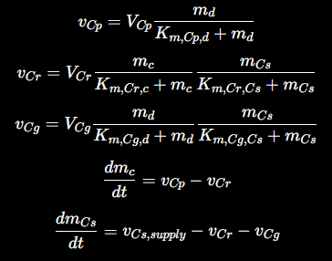

Chemical counter
NN
$$r_{Na}$$
Chemical Differentiator
$$m_{c}$$
$$m_{c}$$
$$m_{Nc}$$
$$r_{Cp}$$
$$m_{d}$$
$$m_{Na}$$
$$m_{Df}$$
$$m_{d}$$
$$m_{c}$$
$$m_{out}$$
$$r_{Df}$$
$$r_{Dp}$$
$$m_{Cs}$$
$$r_{Cg}$$
$$r_{Ni}$$
$$r_{No}$$
$$m_{in}$$
$$m_{Nb}$$
$$r_{Ds}$$
$$r_{Di}$$
$$r_{Cr}$$
$$m_{Nc}$$
$$m_{Ds}$$
$$r_{Nb}$$

Slide 35



Chemical counter
$$m_{c}$$
NN
$$r_{Na}$$
Chemical Differentiator
$$r_{Cp}$$
$$m_{c}$$
$$m_{Nc}$$
$$m_{d}$$
$$m_{Na}$$
$$m_{Df}$$
$$m_{d}$$
$$m_{c}$$
$$m_{out}$$
$$r_{Df}$$
$$r_{Dp}$$
$$m_{Cs}$$
$$r_{Cg}$$
$$r_{Ni}$$
$$r_{No}$$
$$m_{in}$$
Algorithm
$$m_{Nb}$$
$$r_{Ds}$$
$$r_{Di}$$
$$r_{Cr}$$
$$m_{Nc}$$
$$m_{Ds}$$
$$r_{Nb}$$
Motif 30
Chemical Reactions
$$r_{Na}$$
$$r_{No}$$
$$r_{Nb}$$
Metabolic Network
THz Actuation
Notes:
The gene code YNR050C is searched in Uniport at https://www.uniprot.org/
The result is a protein and we click on Structure on the left menu.
In the table of Structure you select the Identifier which in this case is 2AXQ.
The PDB ID is the one giving the mechanical structure to evaluate the resonant frequency.

Slide 36
Chemical counter
NN
$$r_{Na}$$
Chemical Differentiator
$$m_{c}$$
$$m_{c}$$
$$m_{Nc}$$
$$r_{Cp}$$
$$m_{d}$$
$$m_{Na}$$
$$m_{Df}$$
$$m_{d}$$
$$m_{c}$$
$$m_{out}$$
$$r_{Df}$$
$$r_{Dp}$$
$$m_{Cs}$$
$$r_{Cg}$$
$$r_{Ni}$$
$$r_{No}$$
$$m_{in}$$
$$m_{Nb}$$
$$r_{Ds}$$
$$r_{Di}$$
$$r_{Cr}$$
$$m_{Nc}$$
$$m_{Ds}$$
$$r_{Nb}$$
Motif 37
Reaction | Genes | PDB ID | Frequency
r_Df (differentiator: fast) | YNR050C | 2AXQ
r_Ds (differentiator: slow) | YPR021C | AF-Q12482-F1-model_v6.pdb (AlphaFold)
r_Dp (differentiator: producer) | YLR174W | AF-P41939-F1-model_v6.pdb (AlphaFold)
r_Di (differentiator: integrator) | YLR027C | 1YAA
r_Cp (counter: producer) | YGR019W | AF-P17649-F1-model_v6.pdb (AlphaFold)
r_Cg (counter: gate) | YAL062W or YOR375C | AF-P39708-F1-model_v6.pdb (AlphaFold)
r_Cr (counter: reset) | YPR035W | 3FKY
r_Na (NN: neuron a) | YJL101C | 3IG5 3IG8 3LVW
r_Nb (NN: neuron b) | YKL132C or YOR241W | AF-P36001-F1-model_v6.pdb (AlphaFold)
r_No (NN: merge/output) | YNR013C | AF-P27514-F1-model_v6.pdb (AlphaFold)
Algorithm
Chemical Reactions
Metabolic Network
THz Actuation
Notes:
The gene code YNR050C is searched in Uniport at https://www.uniprot.org/
The result is a protein and we click on Structure on the left menu.
In the table of Structure you select the Identifier which in this case is 2AXQ.
The PDB ID is the one giving the mechanical structure to evaluate the resonant frequency.

Slide 37
Chemical counter
$$m_{c}$$
NN
$$r_{Na}$$
Chemical Differentiator
$$r_{Cp}$$
$$m_{c}$$
$$m_{Nc}$$
$$m_{d}$$
$$m_{Na}$$
$$m_{Df}$$
$$m_{d}$$
$$m_{c}$$
$$m_{out}$$
$$r_{Df}$$
$$r_{Dp}$$
$$m_{Cs}$$
$$r_{Cg}$$
$$r_{Ni}$$
$$r_{No}$$
$$m_{in}$$
Algorithm
$$m_{Nb}$$
$$r_{Ds}$$
$$r_{Di}$$
$$r_{Cr}$$
$$m_{Nc}$$
$$m_{Ds}$$
$$r_{Nb}$$
Motif 37
Chemical Reactions
$$r_{Na}$$
$$r_{No}$$
$$r_{Nb}$$
Metabolic Network
THz Actuation
Notes:
The gene code YNR050C is searched in Uniport at https://www.uniprot.org/
The result is a protein and we click on Structure on the left menu.
In the table of Structure you select the Identifier which in this case is 2AXQ.
The PDB ID is the one giving the mechanical structure to evaluate the resonant frequency.

Slide 38
Chemical counter
NN
$$r_{Na}$$
Chemical Differentiator
$$m_{c}$$
$$m_{c}$$
$$m_{Nc}$$
$$r_{Cp}$$
$$m_{d}$$
$$m_{Na}$$
$$m_{Df}$$
$$m_{d}$$
$$m_{c}$$
$$m_{out}$$
$$r_{Df}$$
$$r_{Dp}$$
$$m_{Cs}$$
$$r_{Cg}$$
$$r_{Ni}$$
$$r_{No}$$
$$m_{in}$$
$$m_{Nb}$$
$$r_{Ds}$$
$$r_{Di}$$
$$r_{Cr}$$
$$m_{Nc}$$
$$m_{Ds}$$
$$r_{Nb}$$
Motif 47
Reaction | Genes | PDB ID | Frequency
r_Df (differentiator: fast) | YDL215C | AF-P33327-F1-model_v6 (AlphaFold)
r_Ds (differentiator: slow) | YPR021C | AF-Q12482-F1-model_v6 (AlphaFold)
r_Dp (differentiator: producer) | YPR035W | 3FKY
r_Di (differentiator: integrator) | YGR124W or YPR145W | AF-P49090-F1-model_v6 (AlphaFold)
r_Cp (counter: producer) | YGR061C | AF-P38972-F1-model_v6 (AlphaFold)
r_Cg (counter: gate) | YFL060C or YNL334C | AF-P43544-F1-model_v6 (AlphaFold)
r_Cr (counter: reset) | YGR192C or YJL052W or YJR009C | 3PYM
r_Na (NN: neuron a) | YLR410W | 9GR8
r_Nb (NN: neuron b) | YDR017C | AF-Q12494-F1-model_v6 (AlphaFold)
r_No (NN: merge/output) | YOR163W | 7AUI
Algorithm
Chemical Reactions
Metabolic Network
THz Actuation
Notes:
The gene code YNR050C is searched in Uniport at https://www.uniprot.org/
The result is a protein and we click on Structure on the left menu.
In the table of Structure you select the Identifier which in this case is 2AXQ.
The PDB ID is the one giving the mechanical structure to evaluate the resonant frequency.

Slide 39
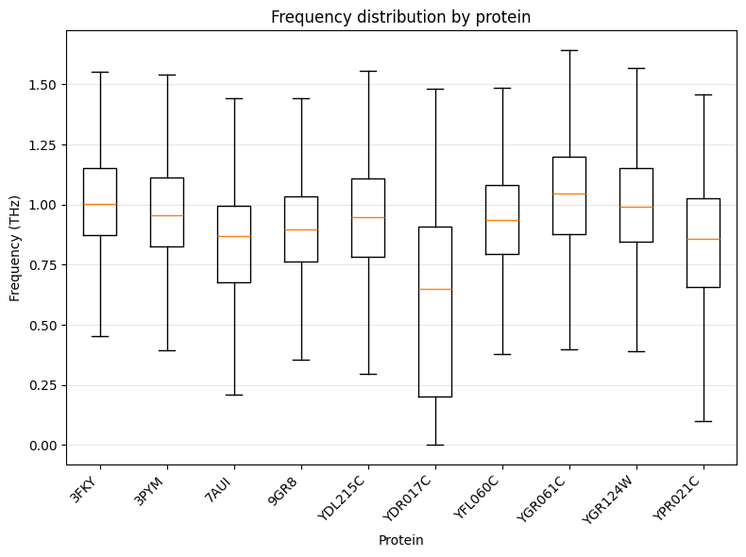



Chemical counter
$$m_{c}$$
NN
$$r_{Na}$$
Chemical Differentiator
$$r_{Cp}$$
$$m_{c}$$
$$m_{Nc}$$
$$m_{d}$$
$$m_{Na}$$
$$m_{Df}$$
$$m_{d}$$
$$m_{c}$$
$$m_{out}$$
$$r_{Df}$$
$$r_{Dp}$$
$$m_{Cs}$$
$$r_{Cg}$$
$$r_{Ni}$$
$$r_{No}$$
$$m_{in}$$
Algorithm
$$m_{Nb}$$
$$r_{Ds}$$
$$r_{Di}$$
$$r_{Cr}$$
$$m_{Nc}$$
$$m_{Ds}$$
$$r_{Nb}$$
Motif 47
Chemical Reactions
$$r_{Na}$$
$$r_{No}$$
$$r_{Nb}$$
Metabolic Network
THz Actuation
Notes:
The gene code YNR050C is searched in Uniport at https://www.uniprot.org/
The result is a protein and we click on Structure on the left menu.
In the table of Structure you select the Identifier which in this case is 2AXQ.
The PDB ID is the one giving the mechanical structure to evaluate the resonant frequency.

Slide 40
Chemical counter
NN
$$r_{Na}$$
Chemical Differentiator
$$m_{c}$$
$$m_{c}$$
$$m_{Nc}$$
$$r_{Cp}$$
$$m_{d}$$
$$m_{Na}$$
$$m_{Df}$$
$$m_{d}$$
$$m_{c}$$
$$m_{out}$$
$$r_{Df}$$
$$r_{Dp}$$
$$m_{Cs}$$
$$r_{Cg}$$
$$r_{Ni}$$
$$r_{No}$$
$$m_{in}$$
$$m_{Nb}$$
$$r_{Ds}$$
$$r_{Di}$$
$$r_{Cr}$$
$$m_{Nc}$$
$$m_{Ds}$$
$$r_{Nb}$$
Motif 50
Reaction | Genes | PDB ID | Frequency
r_Df (differentiator: fast) | YDL215C | AF-P33327-F1-model_v6.pdb (AlphaFold)
r_Ds (differentiator: slow) | YPR021C | AF-Q12482-F1-model_v6.pdb (AlphaFold)
r_Dp (differentiator: producer) | YPR035W | 3FKY
r_Di (differentiator: integrator) | YGR124W or YPR145W | AF-P49090-F1-model_v6.pdb (AlphaFold)
r_Cp (counter: producer) | YGR061C | AF-P38972-F1-model_v6.pdb (AlphaFold)
r_Cg (counter: gate) | YFL060C or YNL334C | AF-P43544-F1-model_v6.pdb (AlphaFold)
r_Cr (counter: reset) | YGR192C or YJL052W or YJR009C | 3PYM
r_Na (NN: neuron a) | YLR017W | AF-Q07938-F1-model_v6.pdb (AlphaFold)
r_Nb (NN: neuron b) | YLR209C | AF-Q05788-F1-model_v6.pdb (AlphaFold)
r_No (NN: merge/output) | YDR441C or YML022W | AF-P36973-F1-model_v6.pdb (AlphaFold)
Algorithm
Chemical Reactions
Metabolic Network
THz Actuation
Notes:
The gene code YNR050C is searched in Uniport at https://www.uniprot.org/
The result is a protein and we click on Structure on the left menu.
In the table of Structure you select the Identifier which in this case is 2AXQ.
The PDB ID is the one giving the mechanical structure to evaluate the resonant frequency.

Slide 41
Chemical counter
$$m_{c}$$
NN
$$r_{Na}$$
Chemical Differentiator
$$r_{Cp}$$
$$m_{c}$$
$$m_{Nc}$$
$$m_{d}$$
$$m_{Na}$$
$$m_{Df}$$
$$m_{d}$$
$$m_{c}$$
$$m_{out}$$
$$r_{Df}$$
$$r_{Dp}$$
$$m_{Cs}$$
$$r_{Cg}$$
$$r_{Ni}$$
$$r_{No}$$
$$m_{in}$$
Algorithm
$$m_{Nb}$$
$$r_{Ds}$$
$$r_{Di}$$
$$r_{Cr}$$
$$m_{Nc}$$
$$m_{Ds}$$
$$r_{Nb}$$
Motif 50
Chemical Reactions
Metabolic Network
THz Actuation
Notes:
The gene code YNR050C is searched in Uniport at https://www.uniprot.org/
The result is a protein and we click on Structure on the left menu.
In the table of Structure you select the Identifier which in this case is 2AXQ.
The PDB ID is the one giving the mechanical structure to evaluate the resonant frequency.

Slide 42
Chemical counter
NN
$$r_{Na}$$
Chemical Differentiator
$$m_{c}$$
$$m_{c}$$
$$m_{Nc}$$
$$r_{Cp}$$
$$m_{d}$$
$$m_{Na}$$
$$m_{Df}$$
$$m_{d}$$
$$m_{c}$$
$$m_{out}$$
$$r_{Df}$$
$$r_{Dp}$$
$$m_{Cs}$$
$$r_{Cg}$$
$$r_{Ni}$$
$$r_{No}$$
$$m_{in}$$
$$m_{Nb}$$
$$r_{Ds}$$
$$r_{Di}$$
$$r_{Cr}$$
$$m_{Nc}$$
$$m_{Ds}$$
$$r_{Nb}$$
Motif 52
Reaction | Genes | PDB ID | Frequency
r_Df (differentiator: fast) | YPL061W | AF-P54115-F1-model_v6.pdb (AlphaFold)
r_Ds (differentiator: slow) | YBR145W or YOL086C | AF-P38113-F1-model_v6.pdb (AlphaFold)
r_Dp (differentiator: producer) | YAL054C or YLR153C | 1RY2
r_Di (differentiator: integrator) | YGR177C or YOR377W | AF-P53296-F1-model_v6.pdb
r_Cp (counter: producer) | YKL182W and YPL231W | 2PFF
r_Cg (counter: gate) | YHR013C and YDL040C and YOR253W | 4HNW
r_Cr (counter: reset) | YMR226C | 3RKU
r_Na (NN: neuron a) | YGL001C | AF-P53199-F1-model_v6.pdb (AlphaFold)
r_Nb (NN: neuron b) | YLR174W | AF-P41939-F1-model_v6.pdb (AlphaFold)
r_No (NN: merge/output) | YNR057C | AF-P53630-F1-model_v6.pdb (AlphaFold)
Algorithm
Chemical Reactions
Metabolic Network
THz Actuation
Notes:
The gene code YNR050C is searched in Uniport at https://www.uniprot.org/
The result is a protein and we click on Structure on the left menu.
In the table of Structure you select the Identifier which in this case is 2AXQ.
The PDB ID is the one giving the mechanical structure to evaluate the resonant frequency.

Slide 43



Chemical counter
$$m_{c}$$
NN
$$r_{Na}$$
Chemical Differentiator
$$r_{Cp}$$
$$m_{c}$$
$$m_{Nc}$$
$$m_{d}$$
$$m_{Na}$$
$$m_{Df}$$
$$m_{d}$$
$$m_{c}$$
$$m_{out}$$
$$r_{Df}$$
$$r_{Dp}$$
$$m_{Cs}$$
$$r_{Cg}$$
$$r_{Ni}$$
$$r_{No}$$
$$m_{in}$$
Algorithm
$$m_{Nb}$$
$$r_{Ds}$$
$$r_{Di}$$
$$r_{Cr}$$
$$m_{Nc}$$
$$m_{Ds}$$
$$r_{Nb}$$
Motif 52
Chemical Reactions
$$r_{Na}$$
$$r_{Nb}$$
$$r_{No}$$
Metabolic Network
THz Actuation
Notes:
The gene code YNR050C is searched in Uniport at https://www.uniprot.org/
The result is a protein and we click on Structure on the left menu.
In the table of Structure you select the Identifier which in this case is 2AXQ.
The PDB ID is the one giving the mechanical structure to evaluate the resonant frequency.

Slide 44
Chemical counter
NN
$$r_{Na}$$
Chemical Differentiator
$$m_{c}$$
$$m_{c}$$
$$m_{Nc}$$
$$r_{Cp}$$
$$m_{Na}$$
$$m_{Df}$$
$$m_{d}$$
$$m_{d}$$
$$m_{c}$$
$$m_{out}$$
$$r_{Df}$$
$$r_{Dp}$$
$$m_{Cs}$$
$$r_{Cg}$$
$$r_{Ni}$$
$$r_{No}$$
$$m_{in}$$
$$m_{Nb}$$
$$m_{Df}$$
$$m_{Nc}$$
$$r_{Ds}$$
$$r_{Di}$$
$$r_{Cr}$$
$$r_{Nb}$$
$$m_{Ds}$$
1
2
3
4
Map Chem.
Diff. in S
Simulate
Kinetics
Map
Counter in S
Map
NN in S
Algorithm
Chemical Reactions
Metabolic Network
THz Actuation

Slide 45
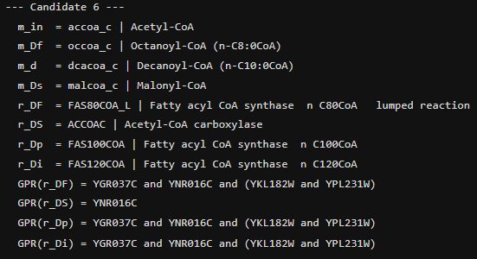
Chemical counter
NN
$$r_{Na}$$
Chemical Differentiator
$$m_{c}$$
$$m_{c}$$
$$m_{Nc}$$
$$r_{Cp}$$
$$m_{Na}$$
$$m_{Df}$$
$$m_{d}$$
$$m_{d}$$
$$m_{c}$$
$$m_{out}$$
$$r_{Df}$$
$$r_{Dp}$$
$$m_{Cs}$$
$$r_{Cg}$$
$$r_{Ni}$$
$$r_{No}$$
$$m_{in}$$
$$m_{Nb}$$
$$m_{Df}$$
$$m_{Nc}$$
$$r_{Ds}$$
$$r_{Di}$$
$$r_{Cr}$$
$$r_{Nb}$$
$$m_{Ds}$$
1
2
3
4
Map Chem.
Diff. in S
Simulate
Kinetics
Map
Counter in S
Map
NN in S
Total candidates (4-reaction topology): 22
Algorithm
Chemical Reactions
Metabolic Network
THz Actuation

Slide 46
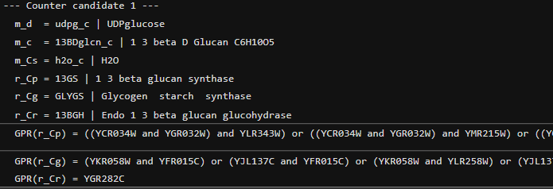
Chemical counter
NN
$$r_{Na}$$
Chemical Differentiator
$$m_{c}$$
$$m_{c}$$
$$m_{Nc}$$
$$r_{Cp}$$
$$m_{Na}$$
$$m_{Df}$$
$$m_{d}$$
$$m_{d}$$
$$m_{c}$$
$$m_{out}$$
$$r_{Df}$$
$$r_{Dp}$$
$$m_{Cs}$$
$$r_{Cg}$$
$$r_{Ni}$$
$$r_{No}$$
$$m_{in}$$
$$m_{Nb}$$
$$m_{Df}$$
$$m_{Nc}$$
$$r_{Ds}$$
$$r_{Di}$$
$$r_{Cr}$$
$$r_{Nb}$$
$$m_{Ds}$$
1
2
3
4
Map Chem.
Diff. in S
Simulate
Kinetics
Map
Counter in S
Map
NN in S
Joint candidates passing 7-reaction gene-disjointness: 31
Algorithm
Chemical Reactions
Metabolic Network
THz Actuation

Slide 47
Chemical counter
NN
$$r_{Na}$$
Chemical Differentiator
$$m_{c}$$
$$m_{c}$$
$$m_{Nc}$$
$$r_{Cp}$$
$$m_{Na}$$
$$m_{Df}$$
$$m_{d}$$
$$m_{d}$$
$$m_{c}$$
$$m_{out}$$
$$r_{Df}$$
$$r_{Dp}$$
$$m_{Cs}$$
$$r_{Cg}$$
$$r_{Ni}$$
$$r_{No}$$
$$m_{in}$$
$$m_{Nb}$$
$$m_{Df}$$
$$m_{Nc}$$
$$r_{Ds}$$
$$r_{Di}$$
$$r_{Cr}$$
$$r_{Nb}$$
$$m_{Ds}$$
1
2
3
4
Map Chem.
Diff. in S
Simulate
Kinetics
Map
Counter in S
Map
NN in S
Algorithm
Chemical Reactions
Metabolic Network
THz Actuation

Slide 48
Chem A
Chem B
Chem C
Algorithm
Chemical Reactions
Metabolic Network
THz Actuation

Slide 49

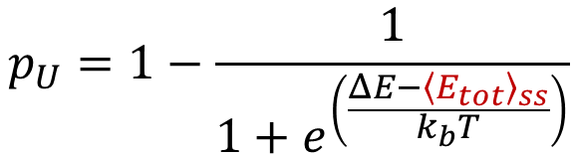



Antenna Array
Algorithm
Enzyme unfolding probability
Terahertz
Waveforms
$$p_{U}=1−\frac{1}{1+e^{\left(\frac{ΔE−{\left\langle E_{tot}\right\rangle }_{ss}}{k_{b}T}\right)}}$$
Chemical Reactions
Folded Enzyme
Yeast Cell
$${\left\langle E_{tot}\right\rangle }_{ss}$$
Total energy of the enzyme
Metabolic Network
$$ΔE$$
Enzyme-free energy
$$k_{b}$$
Boltzmann constant
THz Actuation
Unfolded Enzyme
$$T$$
Temperature of the Cell
[1] Hadeel Elayan, Andrew W. Eckford, and Raviraj S. Adve. 2023. Terahertz In-duced Protein Interactions in a Random Medium. IEEE Transactions on Molecular, Biological and Multi-Scale Communications 9, 4 (Dec. 2023), 435–446. https://doi.org/10.1109/tmbmc.2023.3327302
Notes:
Algorithm
For each metabolite $m$, list producers $P$(reactions with $S_{m,j}>0$)
List consumers $C$(reactions with $S_{m,j}<0$)
If $∣P∣≥2$and $∣C∣≥1$, check candidate outputs $r_{3}∈C$
Prefer cases where $m$has exactly 2 producers and 1 consumer (tightest “adder”)
Intersect producers with your single-gene reaction list (your current code already gives that)

Slide 50
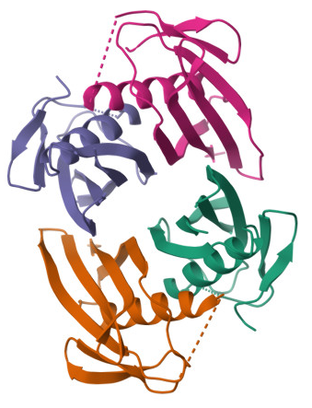
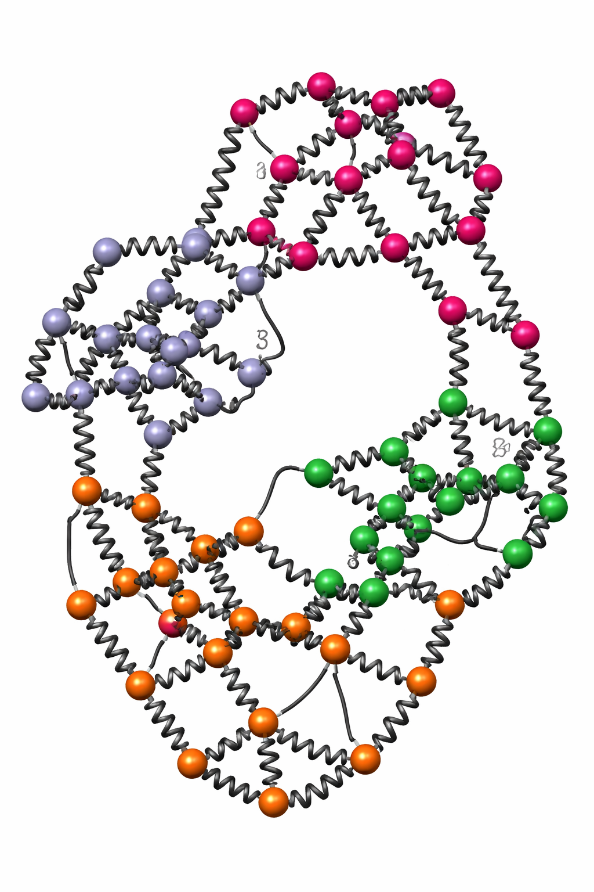

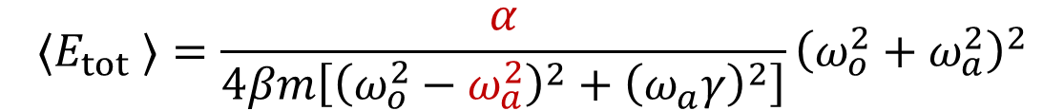

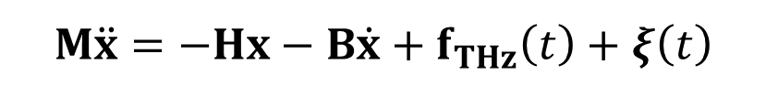

Enzyme
PBD ID: 1TUB
Anisotropic Network
Model
Algorithm
Langevin Equation
$$M\ddot{x}=−Hx−B\dot{x}+f_{THz}\left(t\right)+ξ\left(t\right)$$
(1)
Chemical Reactions
$$f_{THz}\left(t\right)=f_{o}\text{cos}\left(ω_{a}t+Θ\right)$$
(2)
$$f_{o}=2πr^{3}ε_{m}Re\left\{𝒦\right\}∇{\left|E_{rms}\right|}^{2}$$
(3)
Metabolic Network
$$p_{U}=1−\frac{1}{1+e^{\left(\frac{ΔE−{\left\langle E_{tot}\right\rangle }_{ss}}{k_{b}T}\right)}}$$
THz Actuation
(4)
[1] Hadeel Elayan, Andrew W. Eckford, and Raviraj S. Adve. 2023. Terahertz In-duced Protein Interactions in a Random Medium. IEEE Transactions on Molecu-lar, Biological and Multi-Scale Communications 9, 4 (Dec. 2023), 435–446. https://doi.org/10.1109/tmbmc.2023.3327302
$$⟨E_{tot} ⟩=\frac{α}{4βm\left[{\left(ω_{o}^{2}−ω_{a}^{2}\right)}^{2}+{\left(ω_{a}γ\right)}^{2}\right]}{\left(ω_{o}^{2}+ω_{a}^{2}\right)}^{2}$$
(5)
Notes:
Algorithm
For each metabolite $m$, list producers $P$(reactions with $S_{m,j}>0$)
List consumers $C$(reactions with $S_{m,j}<0$)
If $∣P∣≥2$and $∣C∣≥1$, check candidate outputs $r_{3}∈C$
Prefer cases where $m$has exactly 2 producers and 1 consumer (tightest “adder”)
Intersect producers with your single-gene reaction list (your current code already gives that)

Slide 51
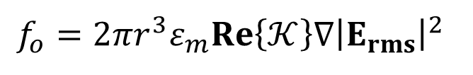

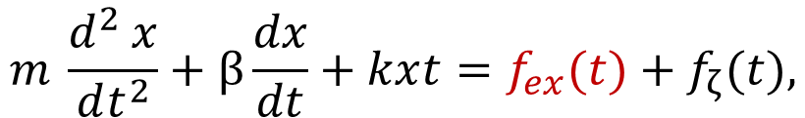

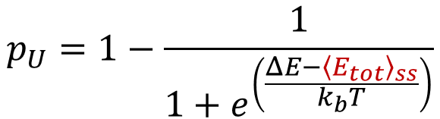
Enzyme
PBD ID: 1TUB
Anisotropic Network
Model
Algorithm
Langevin Equation
$$m \frac{d^{2} x}{dt^{2}}+\ddot{β}\frac{dx}{dt}+kx\left(t\right)=f_{ex}\left((t)\right)+f_{ζ}\left((t)\right)\text{,}$$
(1)
Chemical Reactions
$$f_{ex}\left(t\right)=f_{o}\text{cos}\left(ω_{a}t+Θ\right)$$
(2)
$$f_{o}=2πr^{3}ε_{m}Re\left\{𝒦\right\}∇{\left|E_{rms}\right|}^{2}$$
Metabolic Network
(3)
$$p_{U}=1−\frac{1}{1+e^{\left(\frac{ΔE−{\left\langle E_{tot}\right\rangle }_{ss}}{k_{b}T}\right)}}$$
(4)
THz Actuation
[1] Hadeel Elayan, Andrew W. Eckford, and Raviraj S. Adve. 2023. Terahertz In-duced Protein Interactions in a Random Medium. IEEE Transactions on Molecu-lar, Biological and Multi-Scale Communications 9, 4 (Dec. 2023), 435–446. https://doi.org/10.1109/tmbmc.2023.3327302
$$⟨E_tot ⟩=\frac{α}{4βm\left[{\left(ω_{o}^{2}−ω_{a}^{2}\right)}^{2}+{\left(ω_{a}γ\right)}^{2}\right]}{\left(ω_{o}^{2}+ω_{a}^{2}\right)}^{2}$$
(5)
Notes:
Algorithm
For each metabolite $m$, list producers $P$(reactions with $S_{m,j}>0$)
List consumers $C$(reactions with $S_{m,j}<0$)
If $∣P∣≥2$and $∣C∣≥1$, check candidate outputs $r_{3}∈C$
Prefer cases where $m$has exactly 2 producers and 1 consumer (tightest “adder”)
Intersect producers with your single-gene reaction list (your current code already gives that)

Slide 52


Algorithm
Enzyme PBD ID: 1TUB
Anisotropic Network Model (ANM)
Chemical Reactions
Metabolic Network
THz Actuation
Notes:
Algorithm
For each metabolite $m$, list producers $P$(reactions with $S_{m,j}>0$)
List consumers $C$(reactions with $S_{m,j}<0$)
If $∣P∣≥2$and $∣C∣≥1$, check candidate outputs $r_{3}∈C$
Prefer cases where $m$has exactly 2 producers and 1 consumer (tightest “adder”)
Intersect producers with your single-gene reaction list (your current code already gives that)

Slide 53

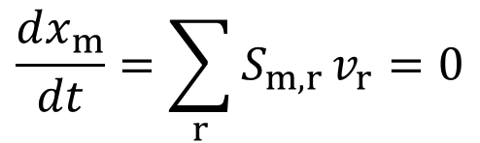

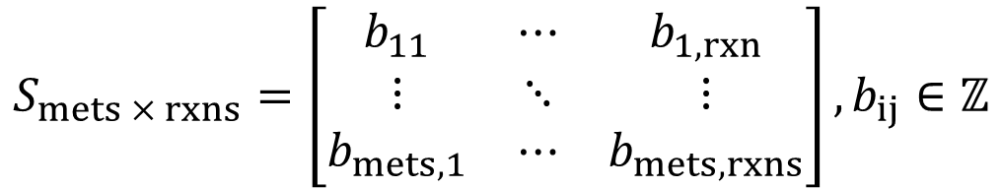
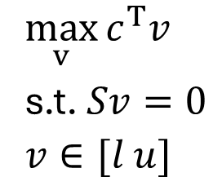
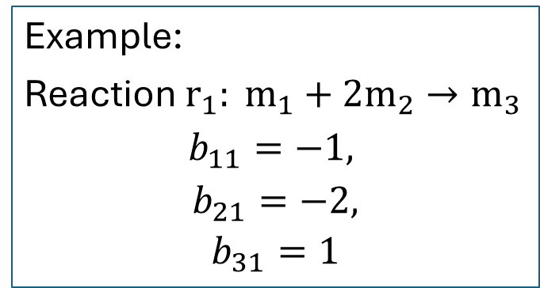

Fundamentals of Flux Balance Analysis (FBA)
$$\frac{dx_{m}}{dt}=\sum_{r}{S_{m,r}}v_{r}=0$$
(1)
Stoichiometric matrix:
$$⟹$$
$$S_{mets × rxns}=\left[\begin{matrix}b_{11} & ⋯ & b_{1,rxn} \\ ⋮ & ⋱ & ⋮ \\ b_{mets,1} & ⋯ & b_{mets,rxns}\end{matrix}\right],b_{ij}∈ℤ$$
$$\max_{v}{c^{T}v}$$
s.t. $Sv=0$
$$v∈[l u]$$
(3)
(2)
Reaction flux:
$$v∈ℝ^{|rxns|}$$
(4)
Example:
Reaction $r_{1}: m_{1}+2m_{2}→m_{3}$
$$b_{11}=−1,$$
$$b_{21}=−2,$$
$$b_{31}=1$$

Slide 54





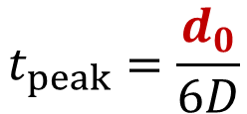








System
Feature extraction
NN
$$m_{2}$$
$$r_{2}$$
$$m_{4}$$
Counter
$$m_{5}$$
$$m_{1}$$
$$r_{1}$$
$$r_{4}$$
$$m_{0}$$
$$m_{3}$$
$$m_{4}$$
$$r_{3}$$
$$m_{0}(t)$$
$$z^{−1}$$
$$t_{peak}=\frac{d_{0}}{6D}$$
time

Slide 55

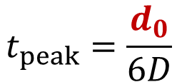



System
Feature extraction
Counter
$$m_{1}$$
(2)
$$m_{0}$$
$$z^{−1}$$
$$m_{0}(t)$$
(1)
$$t_{peak}=\frac{d_{0}}{6D}$$
time

Slide 56
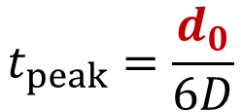









Differentiator
Differentiator
Counter
$$m_{1}$$
$$r_{F}$$
$$m_{F}$$
$$m_{d}$$
$$m_{0}$$
$$m_{0}$$
$$r_{I}$$
$$m_{d}$$
$$r_{S}$$
$$m_{S}$$
$$z^{−1}$$
Point Transmitter
Receiver
$$m_{0}(t)$$
$$t_{peak}=\frac{d_{0}}{6D}$$
time

Slide 57



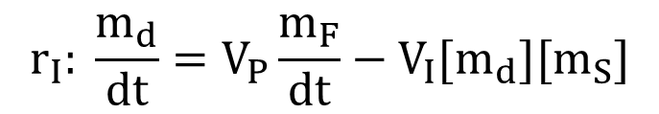

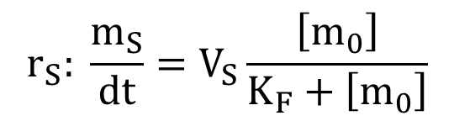

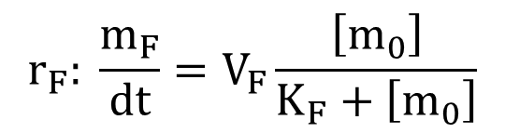


Michaeles-Menten Eq.
$$r_{F}: \frac{m_{F}}{dt}=V_{F}\frac{\left[m_{0}\right]}{K_{F}+\left[m_{0}\right]}$$
(1)
Differentiator
$$r_{F}$$
$$m_{F}$$
$$m_{d}$$
$$m_{0}$$
$$r_{I}$$
$$r_{S}: \frac{m_{S}}{dt}=V_{S}\frac{\left[m_{0}\right]}{K_{F}+\left[m_{0}\right]}$$
(2)
$$r_{S}$$
$$m_{S}$$
$$r_{I}: \frac{m_{d}}{dt}=V_{P}\frac{m_{F}}{dt}−V_{I}[m_{d}][m_{S}]$$
(3)
Notes:
[1] B. Alberts, D. Bray, and K. Hopkin, Essential Cell Biology, 4th rev ed. edition. New York, NY: Norton & Company, 2014.

Slide 58
























Mapping a 2-neuron NN
Pattern within the Stoichiometry Matrix
$$m_{2}$$
$$r_{2}$$
$$m_{4}$$
$$r_{1}$$
$$r_{2}$$
$$r_{3}$$
$$r_{4}$$
$$r_{5}$$
$$m_{5}$$
$$m_{1}$$
$$m_{1}$$
$$\left[\begin{matrix}− & & \begin{matrix} & & \end{matrix} \\ + & − & \begin{matrix} & & \end{matrix} \\ \begin{matrix}+ \\ \\ \end{matrix} & \begin{matrix} \\ + \\ \end{matrix} & \begin{matrix}\begin{matrix}− \\ + \\ \end{matrix} & \begin{matrix} \\ − \\ +\end{matrix} & \begin{matrix} \\ \\ \end{matrix}\end{matrix}\end{matrix}\right]$$
$$r_{1}$$
$$r_{4}$$
$$m_{2}$$
$$m_{3}$$
$$m_{4}$$
$$m_{3}$$
$$r_{3}$$
$$m_{4}$$
$$m_{5}$$
$$r_{i}$$
$$r_{j}$$
$$r_{k}$$
$$[0, ⋯,b_{mi}>0,⋯,b_{mj}>0,⋯,b_{mk}<0,⋯,0]$$
Notes:
Algorithm
For each metabolite $m$, list producers $P$(reactions with $S_{m,j}>0$)
List consumers $C$(reactions with $S_{m,j}<0$)
If $∣P∣≥2$and $∣C∣≥1$, check candidate outputs $r_{3}∈C$
Prefer cases where $m$has exactly 2 producers and 1 consumer (tightest “adder”)
Intersect producers with your single-gene reaction list (your current code already gives that)

Slide 59




Step 1: Find the m4-like metabolites and the reactions $r_{2}$’s and $r_{3}$’s
Pattern within the Stoichiometry Matrix
$$m_{2}$$
$$r_{2}$$
$$m_{4}$$
$$r_{1}$$
$$r_{2}$$
$$r_{3}$$
$$r_{4}$$
$$r_{5}$$
$$m_{5}$$
$$m_{1}$$
$$m_{1}$$
$$\left[\begin{matrix}− & & \begin{matrix} & & \end{matrix} \\ + & − & \begin{matrix} & & \end{matrix} \\ \begin{matrix}+ \\ \\ \end{matrix} & \begin{matrix} \\ + \\ \end{matrix} & \begin{matrix}\begin{matrix}− \\ + \\ \end{matrix} & \begin{matrix} \\ − \\ +\end{matrix} & \begin{matrix} \\ \\ \end{matrix}\end{matrix}\end{matrix}\right]$$
$$r_{1}$$
$$r_{4}$$
$$m_{2}$$
$$m_{3}$$
$$m_{4}$$
$$m_{3}$$
$$r_{3}$$
$$m_{4}$$
$$m_{5}$$
$$r_{3}$$
$$r_{4}$$
$$r_{2}$$
$$[b_{mi}, ⋯,b_{42}>0,⋯,b_{43}>0,⋯,b_{44}<0,⋯,b_{mR}]$$
Notes:
Algorithm
For each metabolite $m$, list producers $P$(reactions with $S_{m,j}>0$)
List consumers $C$(reactions with $S_{m,j}<0$)
If $∣P∣≥2$and $∣C∣≥1$, check candidate outputs $r_{3}∈C$
Prefer cases where $m$has exactly 2 producers and 1 consumer (tightest “adder”)
Intersect producers with your single-gene reaction list (your current code already gives that)

Slide 60











Step 1: Find the m4-like metabolites and the reactions $r_{2}$’s and $r_{3}$’s
$$m_{2}$$
$$r_{2}$$
$$m_{4}$$
$$m_{5}$$
$$m_{1}$$
$$r_{1}$$
$$r_{4}$$
$$m_{3}$$
$$m_{4}$$
$$r_{3}$$
Notes:
Algorithm
For each metabolite $m$, list producers $P$(reactions with $S_{m,j}>0$)
List consumers $C$(reactions with $S_{m,j}<0$)
If $∣P∣≥2$and $∣C∣≥1$, check candidate outputs $r_{3}∈C$
Prefer cases where $m$has exactly 2 producers and 1 consumer (tightest “adder”)
Intersect producers with your single-gene reaction list (your current code already gives that)

Slide 61












Step 2: Find reaction $r_{1}$- like
$$r_{1}$$
$$r_{2}$$
$$r_{3}$$
$$r_{4}$$
$$r_{5}$$
$$m_{2}$$
$$r_{2}$$
$$m_{1}$$
$$m_{4}$$
$$\left[\begin{matrix}− & & \begin{matrix} & & \end{matrix} \\ + & − & \begin{matrix} & & \end{matrix} \\ \begin{matrix}+ \\ \\ \end{matrix} & \begin{matrix} \\ + \\ \end{matrix} & \begin{matrix}\begin{matrix}− \\ + \\ \end{matrix} & \begin{matrix} \\ − \\ +\end{matrix} & \begin{matrix} \\ \\ \end{matrix}\end{matrix}\end{matrix}\right]$$
$$m_{2}$$
$$m_{5}$$
$$m_{1}$$
$$m_{3}$$
$$r_{1}$$
$$r_{4}$$
$$m_{4}$$
$$m_{5}$$
$$m_{3}$$
$$m_{4}$$
$$r_{3}$$
Notes:
Algorithm
For each metabolite $m$, list producers $P$(reactions with $S_{m,j}>0$)
List consumers $C$(reactions with $S_{m,j}<0$)
If $∣P∣≥2$and $∣C∣≥1$, check candidate outputs $r_{3}∈C$
Prefer cases where $m$has exactly 2 producers and 1 consumer (tightest “adder”)
Intersect producers with your single-gene reaction list (your current code already gives that)

Slide 62










Solutions
Reaction 1: peroxisomal acyl-CoA thioesterase
EC code: 3.1.2.2
Gene: YJR019C
Formula:
C31H50N7O17P3S + H2O -> C21H32N7O16P3S + C10H19O2 + H
Location: Peroxisome
$$m_{2}$$
$$r_{2}$$
$$m_{4}$$
$$m_{5}$$
$$m_{1}$$
$$r_{1}$$
$$r_{4}$$
Reaction 2: acetyl-CoA C-acyltransferase (decanoyl-CoA)
EC code: 2.3.1.16
Gene: YIL160C
C33H52N7O18P3S + C21H32N7O16P3S -> C23H34N7O17P3S + C31H50N7O17P3S
Location: Peroxisome
$$m_{3}$$
$$m_{4}$$
$$r_{3}$$
Metabolite m2: C21H32N7O16P3S | Name: coenzyme A| 405 | ID: s_0534
Reaction 3: fatty-acid--CoA ligase (decanoate)
EC code: 6.2.1.3
Gene: YER015W
C10H12N5O13P3 + C21H32N7O16P3S + C10H19O2 -> C10H12N5O7P + C31H50N7O17P3S + HO7P2
Location: Peroxisome
Metabolite m3: C10H19O2 | Name: decanoate| 460 | ID: s_0600
Metabolite m4: C31H50N7O17P3S
Notes:
Algorithm
For each metabolite $m$, list producers $P$(reactions with $S_{m,j}>0$)
List consumers $C$(reactions with $S_{m,j}<0$)
If $∣P∣≥2$and $∣C∣≥1$, check candidate outputs $r_{3}∈C$
Prefer cases where $m$has exactly 2 producers and 1 consumer (tightest “adder”)
Intersect producers with your single-gene reaction list (your current code already gives that)

Slide 63











Mapping with restrictions
Restrictions:
The metabolite $m_{4}$ is a rich extracellular metabolite.
The metabolic network associated with $m_{4}$ is the least impactful.
$$m_{2}$$
$$r_{2}$$
$$m_{4}$$
$$m_{5}$$
$$m_{1}$$
$$r_{1}$$
$$r_{4}$$
$$m_{3}$$
$$m_{4}$$
$$r_{3}$$

Slide 64











Mapping with restrictions
Restrictions:
The metabolite $m_{4}$ is a rich extracellular metabolite.
The metabolic network associated with $m_{4}$ is the least impactful.
r_4155
Q5
E3
$$m_{2}$$
$$r_{2}$$
$$m_{4}$$
$$m_{1}$$
$$m_{5}$$
$$r_{1}$$
$$r_{4}$$
$$m_{3}$$
$$r_{3}$$
$$m_{4}$$
V3
E3
r_1088
Kate Campbell, Jakob Vowinckel, Michael Mülleder, Silke Malmsheimer, Nicola Lawrence, Enrica Calvani, Leonor Miller-Fleming, Mohammad T Alam, Stefan Christen, Markus A Keller, Markus Ralser (2015) Self-establishing communities enable cooperative metabolite exchange in a eukaryote eLife 4:e09943
Notes:
We choose this combination for E3, as it relates with the metabolites of the highest concentration

Slide 65










THz-Induced Enzyme Unfolding Model
$$p_{F}=\frac{1}{1+e^{\left(\frac{ΔE−{\left\langle E_{tot}\right\rangle }_{ss}}{k_{b}T}\right)}}$$
(1)
(2)
$ΔE=E_{f}−E_{u}$ : free energy
THI2
$${\left\langle E_{tot}\right\rangle }_{ss}=\frac{α}{4βm\left[{\left(ω_{o}^{2}−ω_{a}^{2}\right)}^{2}+{\left(ω_{a}\overline{γ}\right)}^{2}\right]}\left(ω_{a}^{2}+ω_{o}^{2}\right)+k_{b}T$$
(3)
$ω_{o}^{2}=\frac{k}{m}$ , $ω_{0}$ is the natural frequency of the protein
(4)
$$\overline{γ}=\frac{\ddot{β}}{m}$$
(5)
$\ddot{β}$: Damping coefficient of the protein
(6)
(7)
$m$: Protein mass
$k$: Protein spring constant
(8)
$ω_{a}$: Antenna radiation angular frequency
(9)
[1] Hadeel Elayan, Andrew W. Eckford, and Raviraj S. Adve. 2023. Terahertz Induced Protein Interactions in a Random Medium. IEEE Transactions on Molecular, Biological and Multi-Scale Communications 9, 4 (Dec. 2023), 435–446. https: //doi.org/10.1109/tmbmc.2023.3327302

Slide 66














Enzymes
Reaction 1
Reaction 2
Gene
YPL214C (THI6)
Gene
YGR144W (THI4)
Enzymes
THI2
Enzymes
HST1
THI3
PDC2
Sir2
$$m_{z}$$
$$m_{1}$$
$$r_{1}$$
$$r_{3}$$
$$m_{4}$$
$$m_{2}$$
$$r_{2}$$
$$m_{z}$$

Slide 67


















Step 1: Looking for 2-neuron NNs
$$b_{ai}$$
$$S_{mets × rxns}=\left[\begin{matrix}b_{11} & \begin{matrix}b_{12} & ⋯\end{matrix} & b_{1,R} \\ \begin{matrix}⋮ \\ b_{m1} \\ ⋮\end{matrix} & \begin{matrix}\begin{matrix} & ⋱\end{matrix} \\ \begin{matrix}b_{m2} & ⋯\end{matrix} \\ \begin{matrix} & ⋱\end{matrix}\end{matrix} & \begin{matrix}⋮ \\ b_{m,R} \\ ⋮\end{matrix} \\ b_{M,1} & \begin{matrix} & ⋯\end{matrix} & b_{M,R}\end{matrix}\right]$$
$${met}_{a}$$
$$r_{i}$$
$${met}_{m}$$
$$b_{mi}$$
$${met}_{c}$$
$$r_{k}$$
$${met}_{m}$$
$$b_{mk}$$
$${met}_{b}$$
$$b_{bj}$$
$$r_{j}$$
$$r_{i}$$
$$r_{j}$$
$$r_{k}$$
$$b_{mj}$$
$$[b_{m1}, ⋯,b_{mi}>0,⋯,b_{mj}>0,⋯,b_{mk}<0,⋯,b_{mR}]$$
Notes:
Algorithm
For each metabolite $m$, list producers $P$(reactions with $S_{m,j}>0$)
List consumers $C$(reactions with $S_{m,j}<0$)
If $∣P∣≥2$and $∣C∣≥1$, check candidate outputs $r_{3}∈C$
Prefer cases where $m$has exactly 2 producers and 1 consumer (tightest “adder”)
Intersect producers with your single-gene reaction list (your current code already gives that)

Slide 68









Looking for 2-neuron NNs
[1] B. Alberts, D. Bray, and K. Hopkin, Essential Cell Biology, 4th rev ed. edition. New York, NY: Norton & Company, 2014.
$$m_{z}$$
$$m_{1}$$
$$r_{3}$$
$$r_{1}$$
$$m_{4}$$
$$r_{2}$$
$$m_{2}$$
$$m_{z}$$
Notes:
Algorithm
For each metabolite $m$, list producers $P$(reactions with $S_{m,j}>0$)
List consumers $C$(reactions with $S_{m,j}<0$)
If $∣P∣≥2$and $∣C∣≥1$, check candidate outputs $r_{3}∈C$
Prefer cases where $m$has exactly 2 producers and 1 consumer (tightest “adder”)
Intersect producers with your single-gene reaction list (your current code already gives that)

