Slide 1

CS 5200 Database Management System
Professor: Nate Derbinsky
Bingqi Liu, Mitresh Pandya, Syed Aman Alam, Yue Cheng
Notes:
Hi professor, let we show our group project. Here are the names of our team members.

Slide 2
Content
Introduction & Motivation
System Description
System Architecture
Database Design

Slide 3
Project Motivation
We as hired as Lead Database Engineer by startup named ''trainly.io'' .
The company want to become a APP store of training.
students can register, enroll in different courses, complete course materials, ask questions and make playlists. When students complete our courses, they can get certification to prove their ability.
It’s same as a real university and everyone here can find his/her role.
It’s a big challenge for traditional education.
Notes:
Different people can play different role in our platform. Student will learn different courses and get certification. Faculties can create courses, upload course materials and answer students’ questions. Administrator can validate faculty and grant other administrator.
So, in order to realize this platform. A huge database management system is indispensable, that’s why we haired.

Slide 4
Character
Students: registration, enrollment.
Faculties: validation.
Administrators: validation.
Courses: created by faculties and completed by students.
Course Materials: which have file, link, post and quiz 4 different types; created by faculties and completed by students.
Course Questions: asked by students and answered by faculties.
Playlists: created by students.

Slide 5
Description & Database Design
Student sub-view:
Notes:
A user is by default a student and may fall in administrator and faculty.
A Student have a unique Student ID。 For the safety, we should not directly save user’s password in the database: we associate a salting number with the password and add it as key, we save both random number and key in the database and not the actual password.
a faculty will validated by an administrator.
Administrator who is grantee must be granted by another administrator who is grantor for any enhanced position they take。

Slide 6
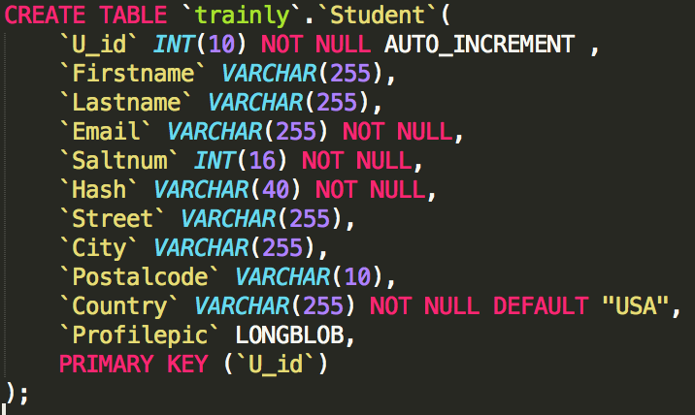
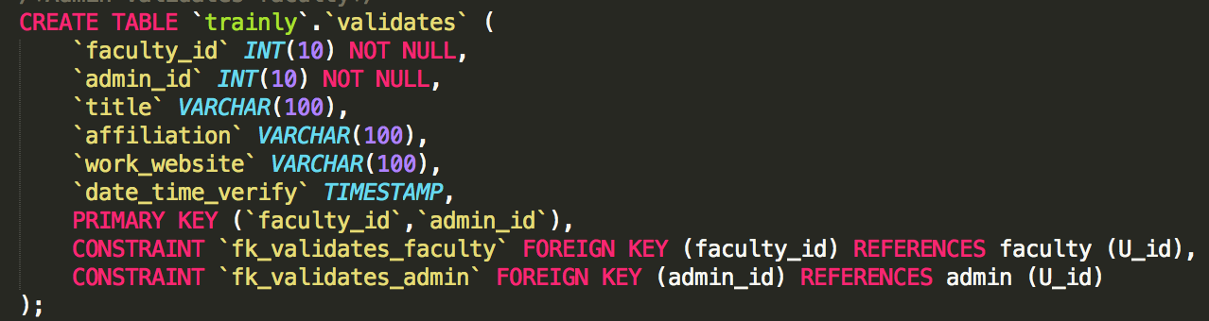
Description & Database Design
Student sub-view:
Notes:
Let’s see the relational mode and physical design. In the ERD, we have 3 entity, respectively are STUDENT, FACULTY and ADMIN. The relationship between FACULTY and ADMIN is M-to-N, So, we create a junction tables to connect FACULTY and ADMIN table.
Our DDL is on the right side, I pick two important table to show up. First is STUDENT table, you can see that we create every attribute in the table then give each attribute a data type and enough space to save data. Primary key is student ID, also the index, because INT is almost purely arbitrary—or rather, almost arbitrary, because it is actually faster to search on numeric fields in many database engines; hence, numeric fields make good primary keys.
Second table is VALIDATES, it’s the relationship between FACULTY and ADMIN. So, in this table, we set faculty ID and Admin ID as primary key in VALIDATES table, and also as foreign key to connect faculty table and admin table.

Slide 7
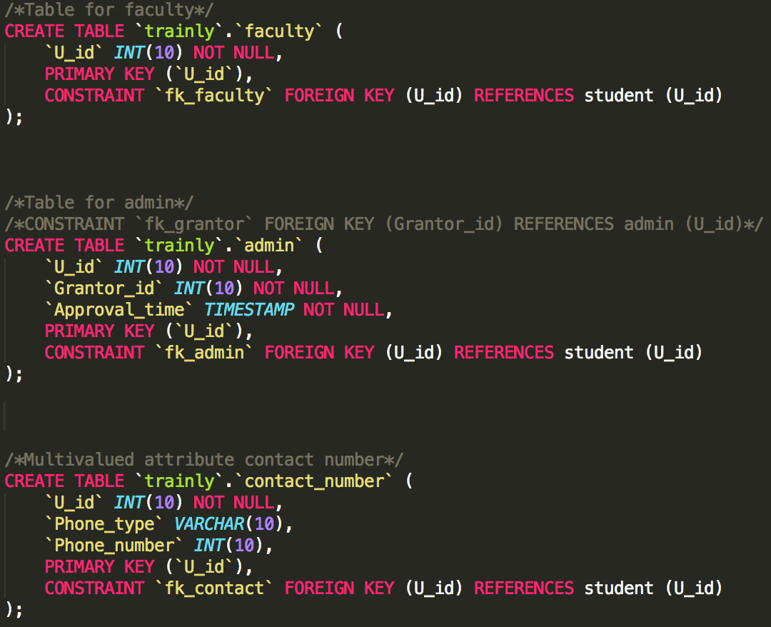
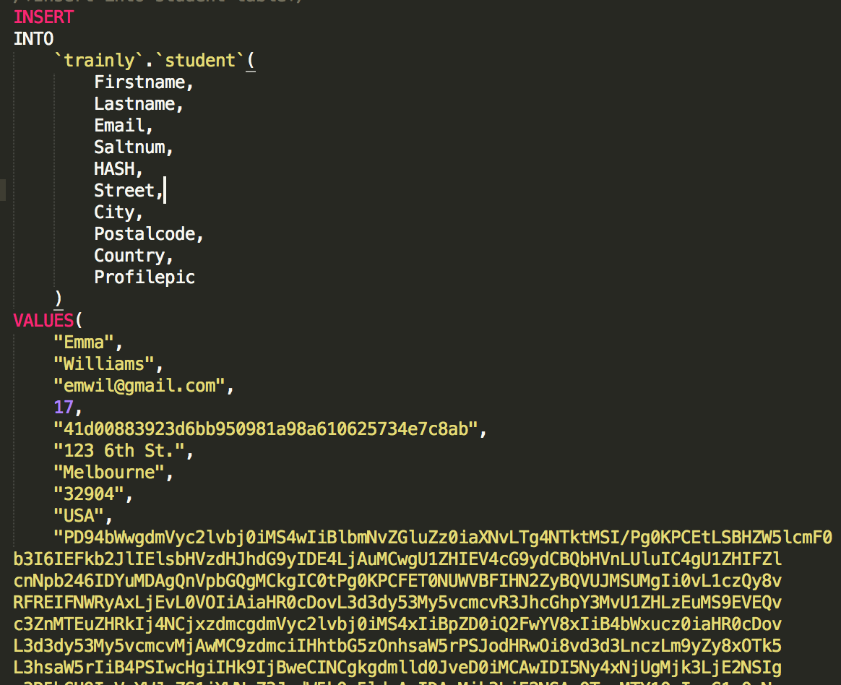
Description & Database Design
Student sub-view:
Notes:
There is the rest of table in Student sub-view. The right side is how we insert value in each attribute, you can see the salting number and hash. It makes our password become very safe.

Slide 8
Description & Database Design
Course sub-view:
Notes:
Faculty are the creators of courses, and must be validated by one or more administrator.
Students can enroll in different courses. Each course has a primary topic, as well as any number of secondary topics. Every topic has a unique Topic ID and name.
Each course have at least one course material.

Slide 9
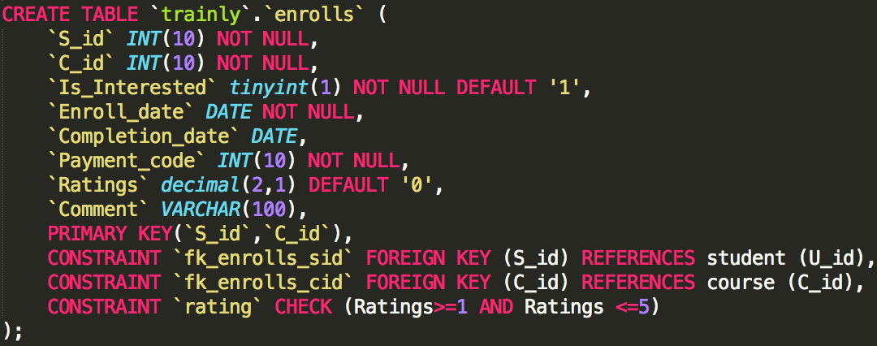
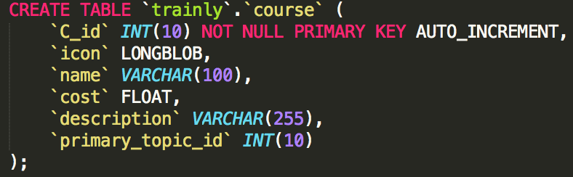
Description & Database Design
Course sub-view:
Notes:
The relational model and how we create database.
The ENROLLS is a junction table, means students enroll different courses. So, we use student ID and course ID to connect student table and course table.
We want to use 1 to 5 as evaluation criterion. So, we set a constrain on Rating attribute.

Slide 10
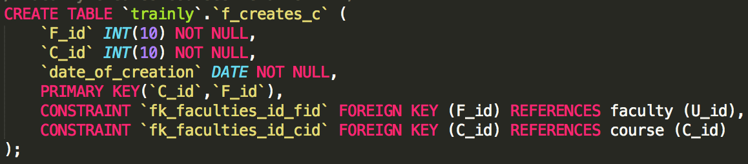
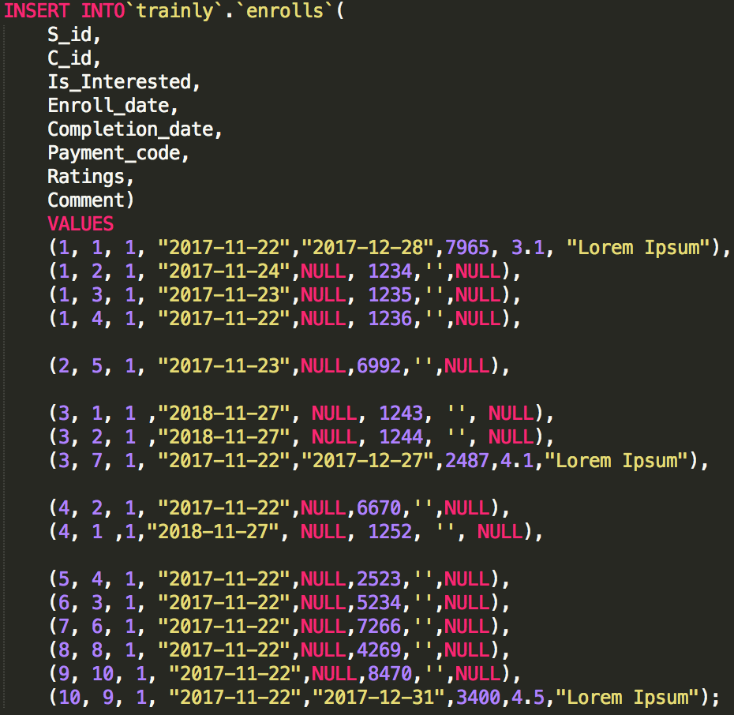
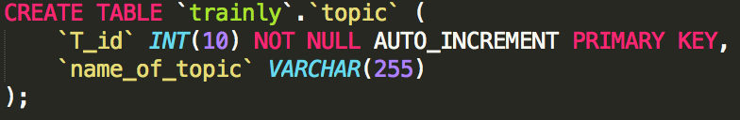
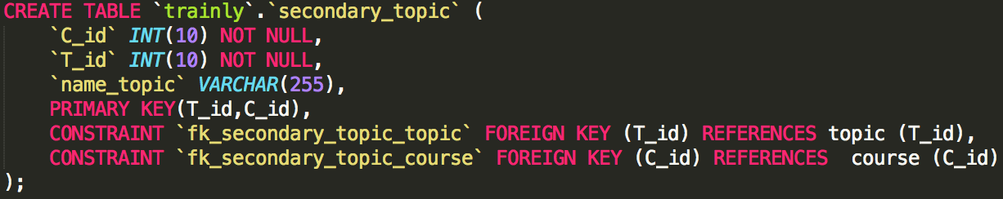
Description & Database Design
Course sub-view:
Notes:
The rest of table and how we insert data in it.

Slide 11
Description & Database Design
Playlist sub-view:
Notes:
Course Material is the biggest part in our database. From the ERD, we can see that course material table almost connect every table. So, course material play a very important role in our database and the content is the most.
Every course contains its own materials, Course material can fall in one of four types (different have type have different type ID): a downloadable file, a link, a post, or a quiz. Each question in quiz has a unique number (not necessarily shown to user), a text, and a set of answers (each with a text, and indication of correct or not). All questions are taken from a single question bank and thus each question can be identified alone with the quiz as well. After we provide the answer, we will receive the feedback from students, we should also save these feedbacks. Student also have chance to answer the quiz question, maybe there have many student’s answers for one quiz question.
Students will have many questions when they read different course materials, every question have a unique question ID. If any of the creators believes the question will be of use to other students, s/he makes the question visible and supplies an answer. If the question shows up, other students can “like” questions they find useful, we can calculate the rating to make a rank on different question.
Each student has at least one playlists. Every playlist has a unique name. Each playlist has lots of course material which student interested in, also each course material included in different playlist which created by different students.

Slide 12
Coursematerial sub-view:
Notes:
Course Material is the biggest part in our database. From the ERD, we can see that course material table almost connect every table. So, course material play a very important role in our database and the content is the most.
Every course contains its own materials, Course material can fall in one of four types (different have type have different type ID): a downloadable file, a link, a post, or a quiz. Each question in quiz has a unique number (not necessarily shown to user), a text, and a set of answers (each with a text, and indication of correct or not). All questions are taken from a single question bank and thus each question can be identified alone with the quiz as well. After we provide the answer, we will receive the feedback from students, we should also save these feedbacks. Student also have chance to answer the quiz question, maybe there have many student’s answers for one quiz question.
Students will have many questions when they read different course materials, every question have a unique question ID. If any of the creators believes the question will be of use to other students, s/he makes the question visible and supplies an answer. If the question shows up, other students can “like” questions they find useful, we can calculate the rating to make a rank on different question.
Each student has at least one playlists. Every playlist has a unique name. Each playlist has lots of course material which student interested in, also each course material included in different playlist which created by different students.

Slide 13
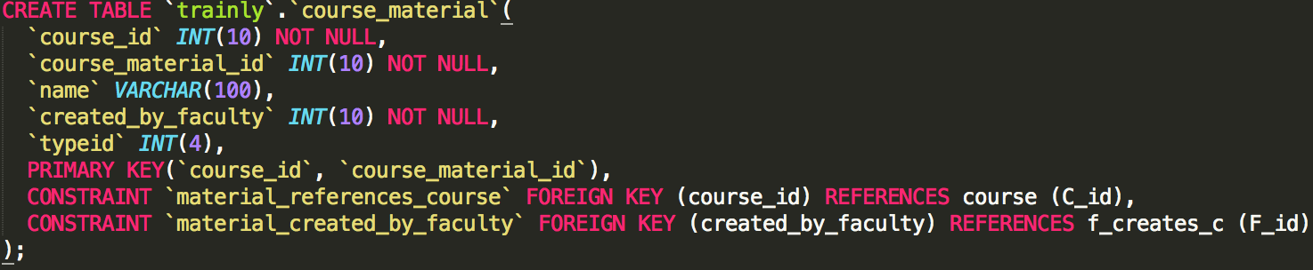
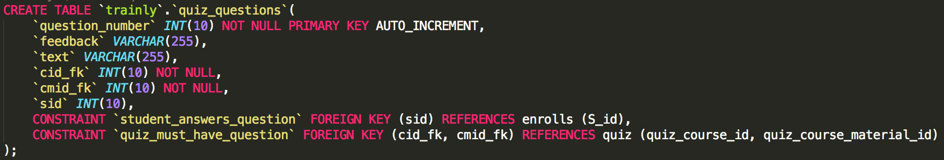
Description & Database Design
Course Material sub-view:
Notes:
This is the most complicated part in the data base. See the relation model, we can see lots of arrows point to COURSE_MATERIAL. So, we need to set Course Material ID in all correlated table. That operation will bring constrain when we add data in each table. The existence of foreign key constrain, When we add data in one table, we need to make sure other correlated table also have that data type. Otherwise, it will fail to add data in the table.

Slide 14
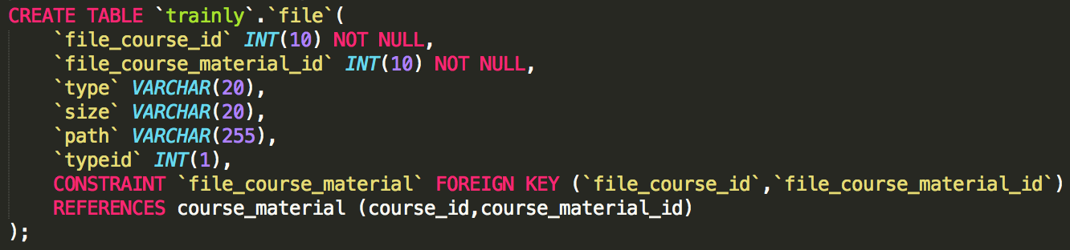
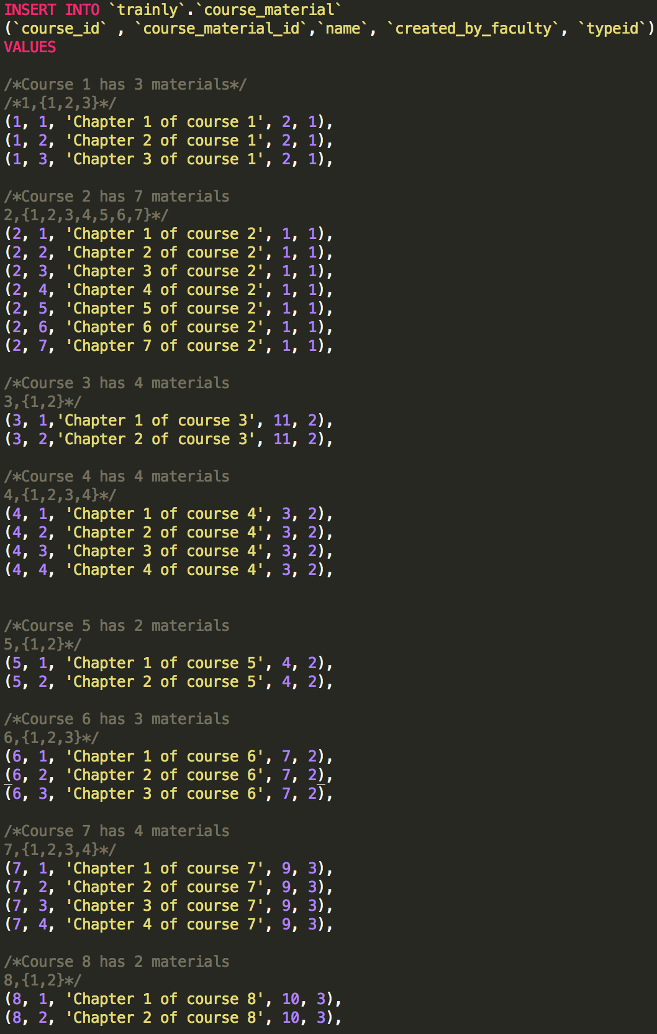
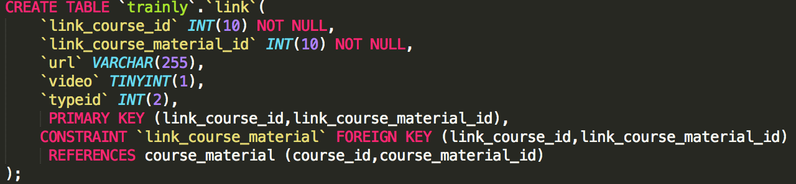
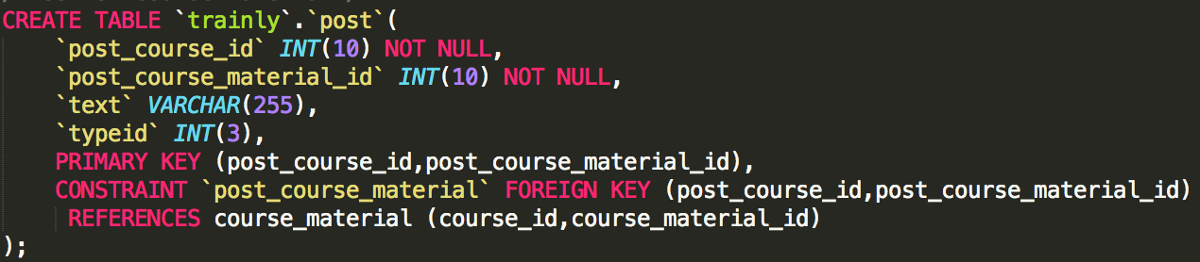
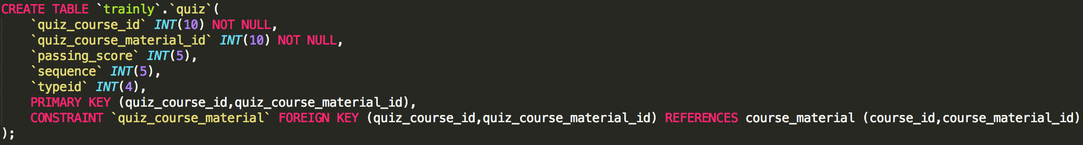
Description & Database Design
Course Material sub-view:

Slide 15
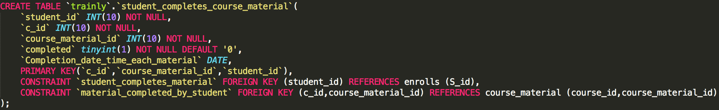
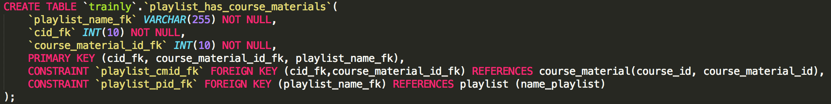
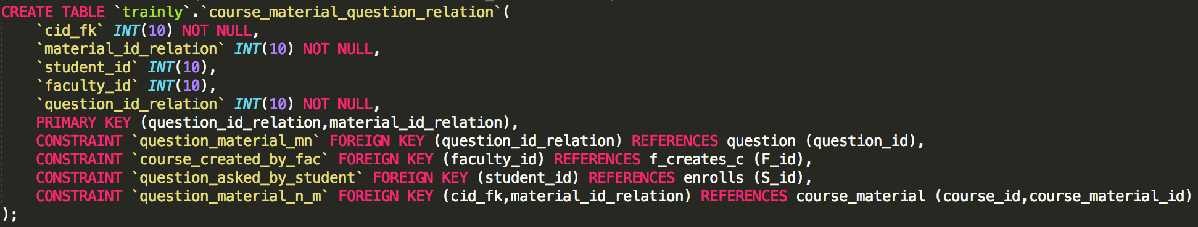
Description & Database Design
Course Material sub-view:
Notes:
There have so many foreign key in each table. So, we need to make sure the value of every foreign key need to same with the value of primary key in other table.

Slide 16
Conclusion
Final words
Assimilation of all ideas
What we learnt
Challenges
What else could have been done

