Slide 1
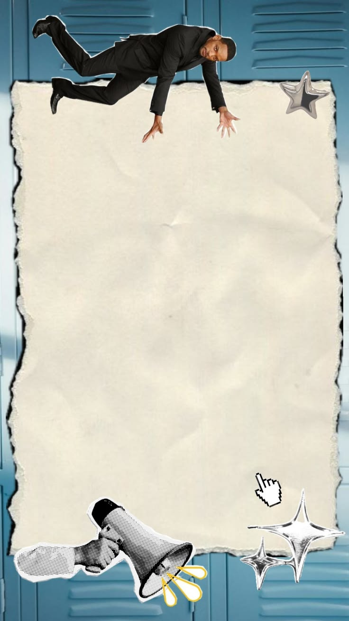
Seminar
Mutation Testing
and
Test Effectiveness
23120255 - Lê Tấn Hiệp
23120262 - Tống Dương Thái Hòa
23120264 - Nguyễn Phúc Hoàng

Slide 2

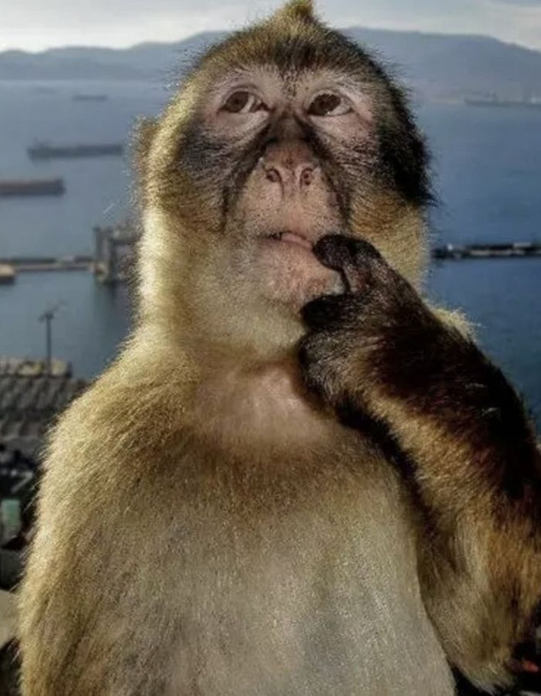
T10 / THE QUESTION
All tests passed. So... no bugs?
ALL TESTS
PASS
Does PASS mean
the code is correct?
Question: Can tests catch wrong results?
MUTATION TESTING - ESHOP CASE STUDY - GROUP 12
01 / 12
Notes:
[object Object]
1

Slide 3


T10 / THE PROBLEM
Running code ≠ checking the result.
CODE COVERAGE
MUTATION TESTING
Did we visit
Did we notice
this code?
a wrong result?
✓
YES
?
NOT ALWAYS
A test can run the right code and still miss the wrong answer.
MUTATION TESTING - ESHOP CASE STUDY - GROUP 12
02 / 12
Notes:
[object Object]
2

Slide 4
T10 / ONE SIMPLE EXAMPLE
One character can change the answer.
ORIGINAL RULE
CHANGED RULE
amount ≥ 100
amount > 100
Test the exact boundary:
100
✓
YES
×
NO
The mutant is visible only when the input exposes its difference.
MUTATION TESTING - ESHOP CASE STUDY - GROUP 12
03 / 12
Notes:
[object Object]
3

Slide 5
T10 / THE METHOD
Stryker makes mistakes. Tests hunt them.
01
02
03
04
START
MUTATE
RETEST
DECIDE
Good code
Change one thing
Run same tests
Read result
KILLED
SURVIVED
✓
×
A test fails on the changed code
The tests still pass
A SURVIVOR is a clue to investigate, not proof of a bug.
MUTATION TESTING - ESHOP CASE STUDY - GROUP 12
04 / 12
Notes:
[object Object]
4

Slide 6
T10 / OUR REAL CASE STUDY
We tested an online shop backend.
88
36
26
26
Cart & Orders
Coupons
Accounts
PASSING TESTS
Add items and place orders
Discount and usage limits
Login and access
Our starting point
First we wrote passing tests. Then Stryker tested those tests.
MUTATION TESTING - ESHOP CASE STUDY - GROUP 12
05 / 12
Notes:
[object Object]
5

Slide 7
T10 / WHY THESE TOOLS
Two helpers. Different jobs. Humans decide.
STRYKERJS
AI ASSISTANT
HUMAN REVIEW
Find weak tests
Suggest improvements
Check what is right
Create mutants
Propose assertions
Read requirements
Run tests
Explain candidates
Accept or reject
Show survivors
May be wrong
Verify by running
Why StrykerJS? Our EShop uses JavaScript. PIT targets Java; mutmut targets Python.
MUTATION TESTING - ESHOP CASE STUDY - GROUP 12
06 / 12
Notes:
[object Object]
6

Slide 8
T10 / ESHOP FINDING 01
The new cart was not really empty.
WHAT THE MUTANT DID
WHAT THE TEST CHECKED
Before
“Request succeeded”
NEW CART
1 unexpected item
After
“Cart has 0 items”
It should contain ZERO items.
SURVIVED → KILLED
Key idea: “Success” does not mean the DATA is correct.
MUTATION TESTING - ESHOP CASE STUDY - GROUP 12
07 / 12
Notes:
[object Object]
7

Slide 9
T10 / ESHOP FINDING 02
Better input reveals the hidden difference.
SET USAGE LIMIT = 1
SET USAGE LIMIT = 3
Expected saved value
Expected saved value
1
1
3
vs
1
vs
NO DIFFERENCE
MUTANT DETECTED
Changing the input helped our tests detect 2 related mutants.
MUTATION TESTING - ESHOP CASE STUDY - GROUP 12
08 / 12
Notes:
[object Object]
8

Slide 10
T10 / OUR EXPERIMENT
Same starting point. Different test improvements.
SAME ORIGINAL CODE + BASELINE TESTS
MANUAL
AI-ASSISTED
People add better checks
AI suggests ⟶ human verify
RUN TESTS AGAIN → COMPARE WHICH MUTANTS WERE KILLED
MUTATION TESTING - ESHOP CASE STUDY - GROUP 12
09 / 12
Notes:
[object Object]
9

Slide 11
T10 / RESULTS ON ESHOP
More useful checks caught more changes.
CART & ORDERS
COUPONS
Starting tests
82
Start
39
Manual
41
Manual
105
AI-assisted
41
AI-assisted
95
Auth: comparison pending
Number of mutants detected
MUTATION TESTING - ESHOP CASE STUDY - GROUP 12
10 / 12
Notes:
[object Object]
10

Slide 12
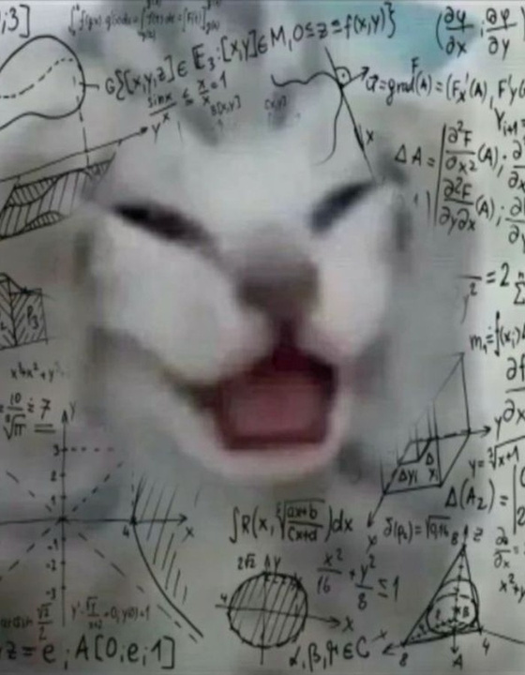
T10 / IMPORTANT LIMITS
A bigger score is not the whole truth.
01 TIMEOUT
A slow test is not a proven bug catch.
02 WRONG RULE
Tests can enforce bad expectations.
03 SURVIVOR
It might be a missing test or equivalent.
AI gives ideas. A passing test on the original + a verified mutant kill gives evidence.
MUTATION TESTING - ESHOP CASE STUDY - GROUP 12
11 / 12
Notes:
[object Object]
11

Slide 13

T10 / NEXT: LIVE DEMO
Now watch us hunt a mutant.
SEE IT CHANGE.
WATCH THE TEST
CATCH IT.
NEXT 10 MIN: REAL TERMINAL + ESHOP
Afterward: your turn with 5 mutants.
MUTATION TESTING - ESHOP CASE STUDY - GROUP 12
12 / 12
Notes:
[object Object]
12

Slide 14

THE END OF MY PRESENTATION
ANY QUESTION BRUH?

