Slide 1
Drools Trouble-Shooting
Agenda
  Unexpected rule firing
  Property Reactivity
  Debugging Spreadsheet
  Control the flow of rule execution
  Performance issues
Demo projects can be found in https://github.com/tkobayas/kie-live
They run with Drools 7.52.0.Final : Please use the latest version as possible!

Slide 2
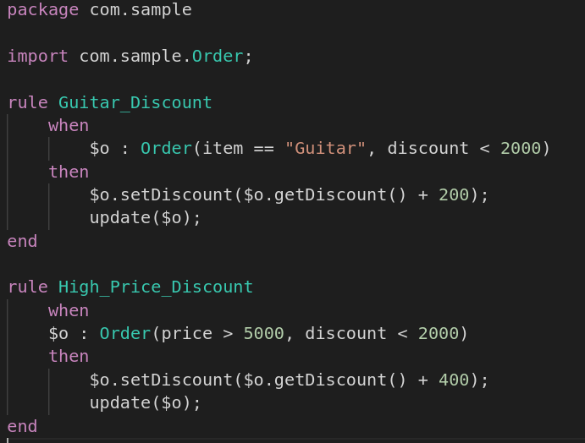
What's wrong with this rule?
<DEMO>

Slide 3
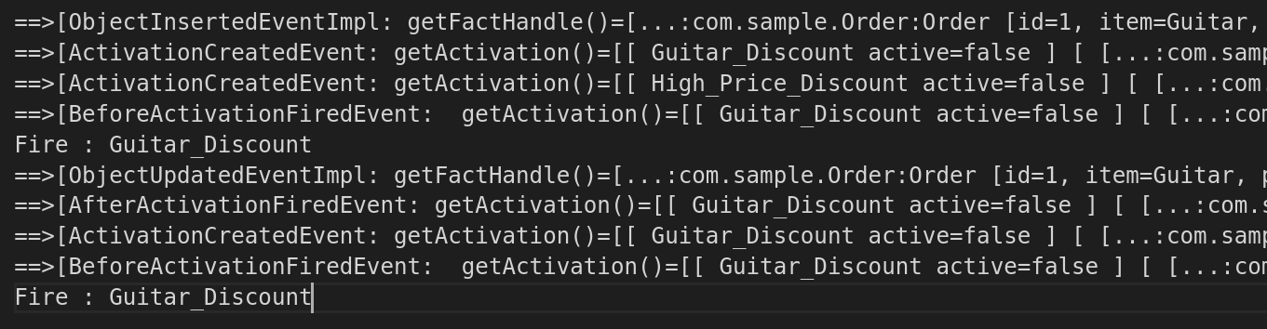
My rule is looping! (recap)
Use EventListener to understand what's happening
  DebugRuleRuntimeEventListener
  DebugAgendaEventListener
This Rule is
activated
Firing this Rule
This Object is
updated
This Rule is
activated again!

Slide 4
My rule is looping! (recap)
no-loop
  Only prevent a loop which is triggered by the rule itself
lock-on-active
  Once the rule is fired, no longer fired regardless of the origin of re-evaluation

Slide 5
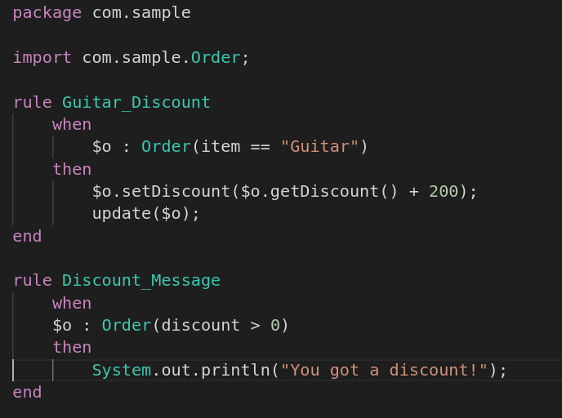
Property reactivity
<DEMO>

Slide 6
Property reactivity (recap)
Why this doesn't loop?

Slide 7
Property reactivity (recap)
Why this doesn't loop?
Because Drools Engine
knows:
1) This rule only tests item
2) item is not changed

Slide 8
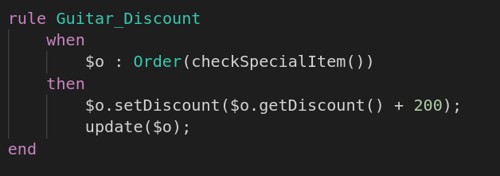
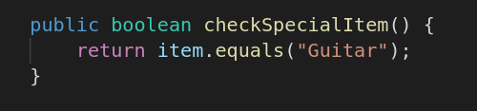
Property reactivity (recap)
blackbox method
LOOP!
Drools Engine doesn't know
which property is tested

Slide 9
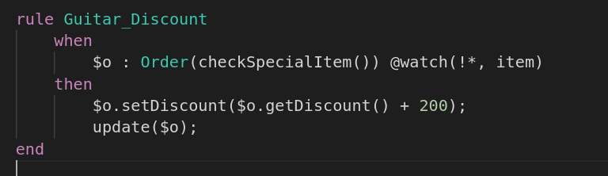
Property reactivity (recap)
Don't loop!
This @watch tells :
Re-evaluate this Pattern
only when item is changed

Slide 10

Property reactivity
Since Drools 7, property reactivity is enabled by default
  Be careful when you migrate from Drools 6
  Property reactivity is good for performance. But if you don't want this behavior, you can disable it.
kmodule.xml

Slide 11
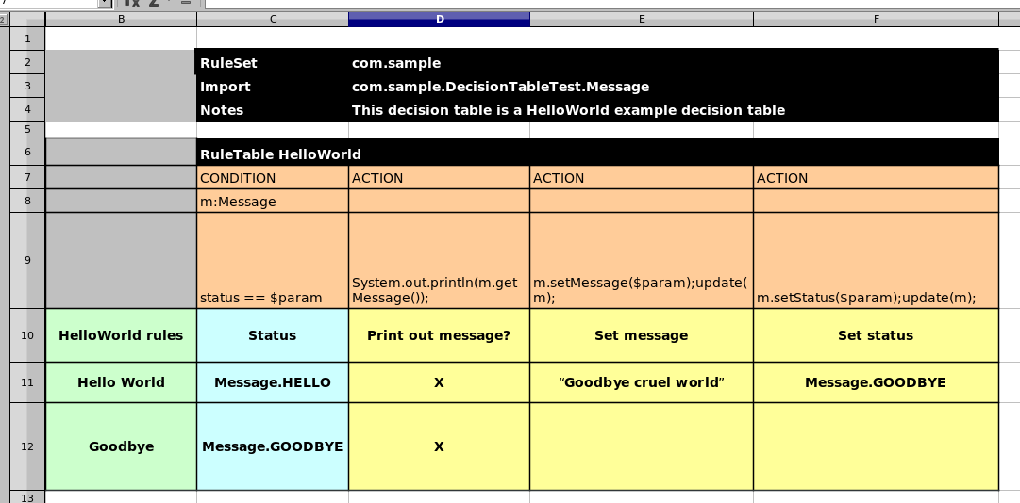
Debug Spreadsheet
<DEMO>

Slide 12
Debug Spreadsheet (recap)
[main] ERROR Unable to build KieBaseModel:defaultKieBase
[10,15]: [ERR 101] Line 10:15 no viable alternative at input ''
[10,35]: [ERR 101] Line 10:35 no viable alternative at input ''
[0,0]: Parser returned a null Package
This message means,
"A wrong word/character here!"
Line# and Column#
in the generated DRL
(Note: \t is 1 char)

Slide 13
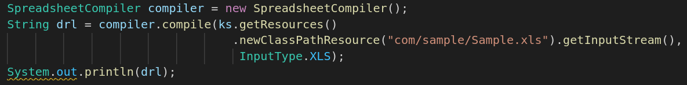
Debug Spreadsheet (recap)
drools.dump.dir
SpreadsheetCompiler

Slide 14
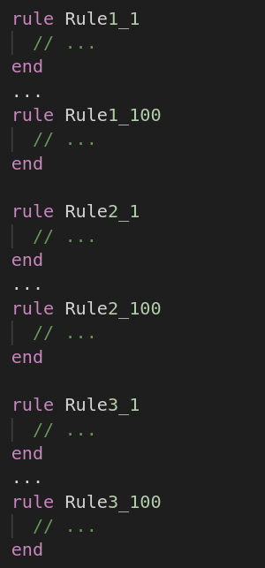
How to control the flow of rules?
First evaluation group
Second evaluation group
Second evaluation group
Final evaluation group

Slide 15
How to control the flow of rules?
Split into multiple KieBases
  Good for maintenance/debug if your kbase is large
Salience
  Most convenient but too much use could be messy
Agenda Group
  Standard approach
Ruleflow Group
  Good combination with BPMN
Control Fact
  Flexible
<DEMO>

Slide 16
Performance issues:
Set up your benchmark for repeatable testing
  JMH (https://github.com/openjdk/jmh) is recommended for fine tuning
Enable GC logging
Narrow down the bottle-neck
  Rule execution itself?
  kie-server payload marshalling?
  Application logic?
  External system access in RHS? (e.g. DB, Web Service)

Slide 17
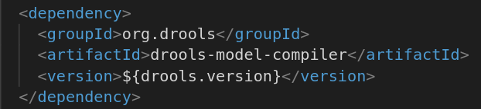
The first response is slow
KieBase loading is slow
  Try executable model
  just add dependency "drools-model-compiler", Then build a kjar (mvn clean install)

Slide 18
The first response is slow
First "fireAllRules" is slow... gradually getting faster
  Various internal caching
  Mvel interpreter
  MvelConstraint Jitting is triggered after 20 times evaluations
  JVM Jitting
  Try executable model
  Warm up KieBase
    Create a dummy KieSession. Insert dummy facts into a ksession and fire

Slide 19
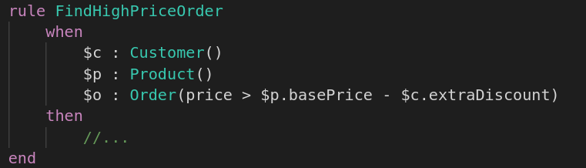
Rule execution is slow
Watch out for Cross Product
If you insert 1000 Customer facts
and 1000 Product facts,
1000*1000 combination will be evaluated!

Slide 20



Rule execution is slow
List the most restrictive rule conditions first
Use simple field constraints as possible (No eval)

Slide 21
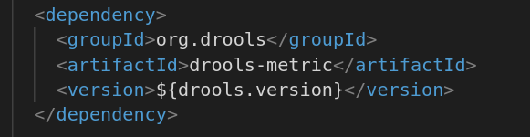
Rule execution is slow
But reviewing lots of rules is hard...
drools-metric helps your analysis
<DEMO>

Slide 22
Rule execution is slow (recap)
Find bottle-neck Node from drools-metric logs
With ReteDumper.dumpAssociatedRulesRete(), you can find a rule which is associated with the problematic Node
Fix rules following the best practice
For detailed explanation, please read:
  https://github.com/tkobayas/MetricLogUtils/wiki/How-to-use-MetricLogUtils

Slide 23
Community
Zulip chat
  https://kie.zulipchat.com/
    #drools
Google group
  https://groups.google.com/g/drools-usage
  https://groups.google.com/g/drools-setup

