Slide 1



Anycast in Context: A Tale of Two Systems
Thomas Koch, Ke Li, Calvin Ardi, Ethan Katz-Bassett, Matt Calder, John Heidemann

Slide 2
Overview
Mixed Reviews
(Li et. al., SIGCOMM 2018) “While it is not surprising that IP anycast is suboptimal … we find [anycast’s] inefficiencies to be surprisingly excessive.”
(Calder et. al., IMC 2015) “For most clients, anycast performs well despite the lack of centralized control.”
What is going on?
To understand these differences, we study two different uses of anycast: DNS and CDN
By placing anycast in context, we find that anycast performance can be good when it matters.
Notes:
(CLICK)
In the literature, we see some mixed reviews of anycast.
Quoted here are two papers from major conferences within a few years of each other that arrive at two very different conclusions. One study says anycast’s inefficiencies are surprisingly excessive while the other says anycast performs well despite the lack of centralized control.
So naturally, we were confused. We went ahead and cleared up the confusion, by analyzing two systems that use anycast using both the same methodology and coverage so we could compare results. When we placed anycast performance in the context of the system, we realized that anycast performance can be quite good when it MATTERS to users.

Slide 3
Motivation
Background and Definitions
Root DNS and Microsoft’s CDN
Inflation in Anycast Deployments
Performance in Context
Investment and Incentive Shapes Deployments and Paths

Slide 4
Anycast in Practice
Many systems use anycast 1. DNS (roots, Akamai, Cloudflare, some public DNS) 2. CDNs (Microsoft, Verizon, Cloudflare) 3. Google
# of Sites
 | 2015 | Today
Microsoft’s CDN | 30 | 110
Root DNS | 500 | 1400
Deployments are growing
Deployments host latency-sensitive services Google Cloud VMs can host game engines!
Notes:
(CLICK)
Anycast is used by many systems on the Internet, each of which have different goals and system designs.
Deployments are also growing. Both Microsoft and the root DNS have more than doubled in size in the past 5 years.
These deployments also host some of the most latency-sensitive services there are: Google Cloud VM’s can host game engines which have strict latency requirements

Slide 5
Anycast in Literature
Mixed Reviews
(Li et. al., SIGCOMM 2018) “While it is not surprising that IP anycast is suboptimal … we find [anycast’s] inefficiencies to be surprisingly excessive.”
(Calder et. al., IMC 2015) “For most clients, anycast performs well despite the lack of centralized control.”
Deployment investigated: the root DNS.
Deployment investigated: Microsoft’s anycast CDN.
Why such different conclusions? Is it due to the deployments?
Notes:
(CLICK)
Recall that some papers had mixed reviews about anycast.
We noticed that they evaluated different types of deployments so its difficult to compare results.
So, why are there different takeaways about anycast performance? In particular, do the deployments have anything to do with the different results?

Slide 6
Contributions
Analyzing root DNS and Microsoft’s CDN we show
Anycast performs poorly in root DNS, but well in Microsoft.
Latency hardly matters for root DNS since caching is effective.
Latency matters for Microsoft since users frequently traverse paths.
Microsoft optimizes performance by peering strategically.
Notes:
(CLICK)
To answer these questions, we make the following contributions. First, we find that the root DNS specifically has poor anycast performance, but anycast performs well for Microsoft. Second, we show that root DNS performance hardly matters to users, since caching of root DNS records is so effective.
On the other hand, performance is quite important in Microsoft’s CDN, since users frequently traverse paths to Microsoft.
Finally, we provide evidence that Microsoft keeps performance good by peering closely with end user networks, which shortens paths between users and content.

Slide 7
Motivation
Background and Definitions
Root DNS and Microsoft’s CDN
Inflation in Anycast Deployments
Performance in Context
Investment and Incentive Shapes Deployments and Paths
Notes:
We’ve been a little high level -- let’s dive into the details.

Slide 8
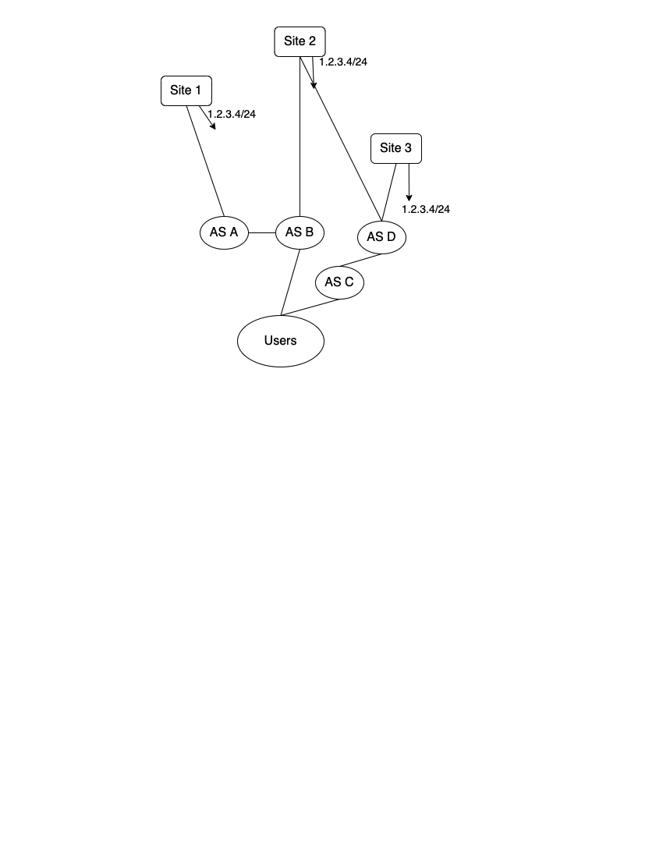
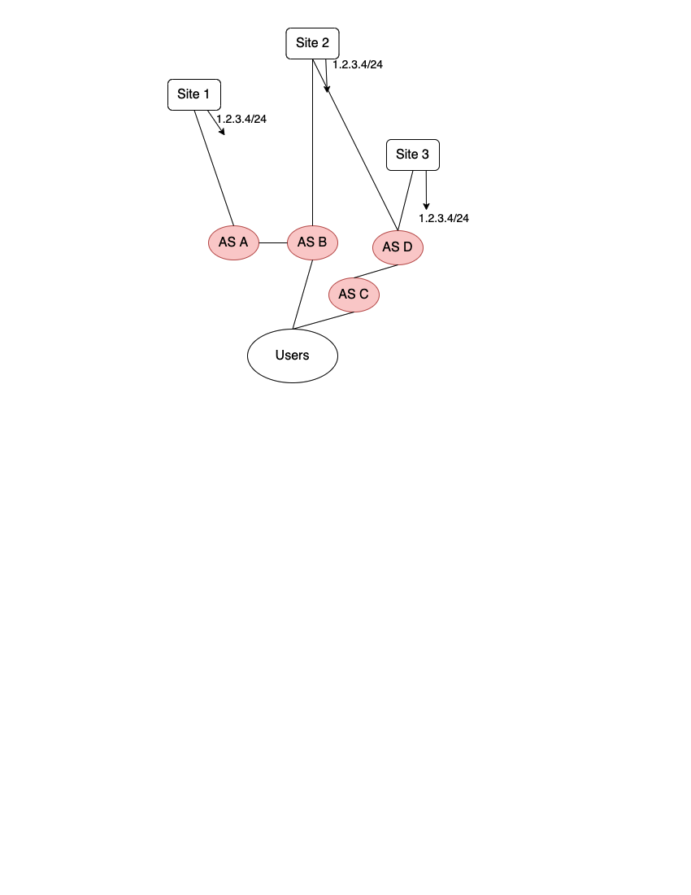
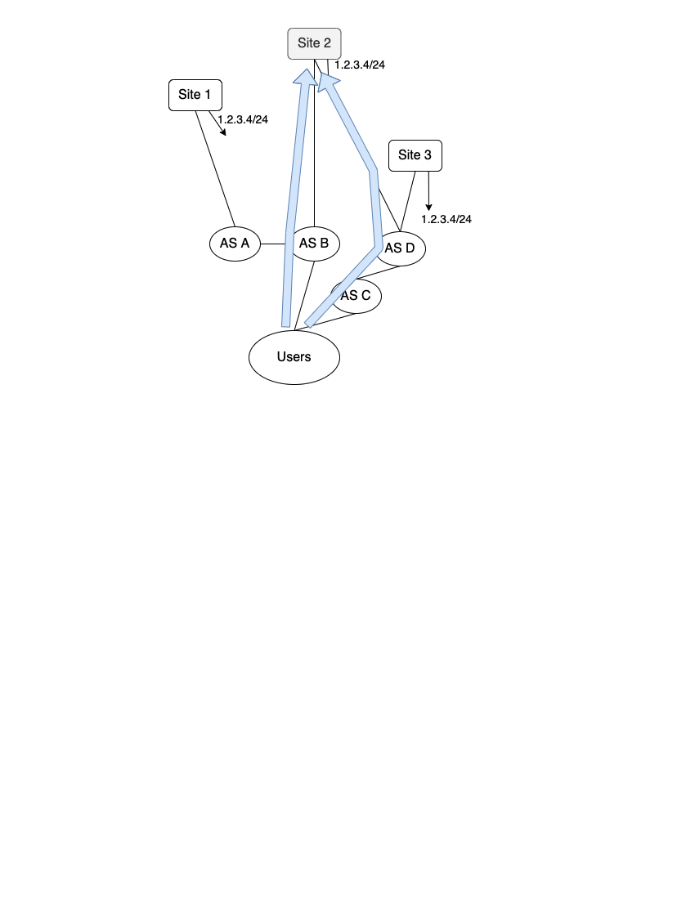
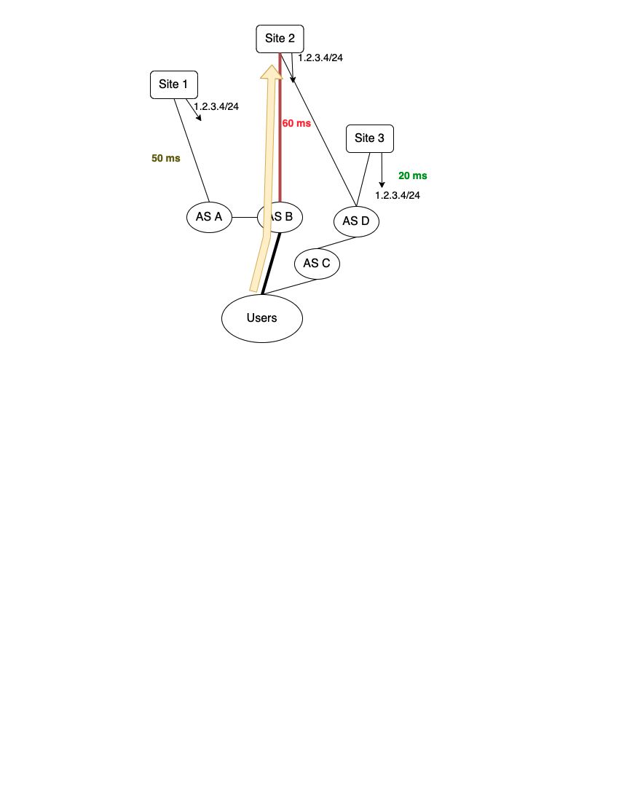
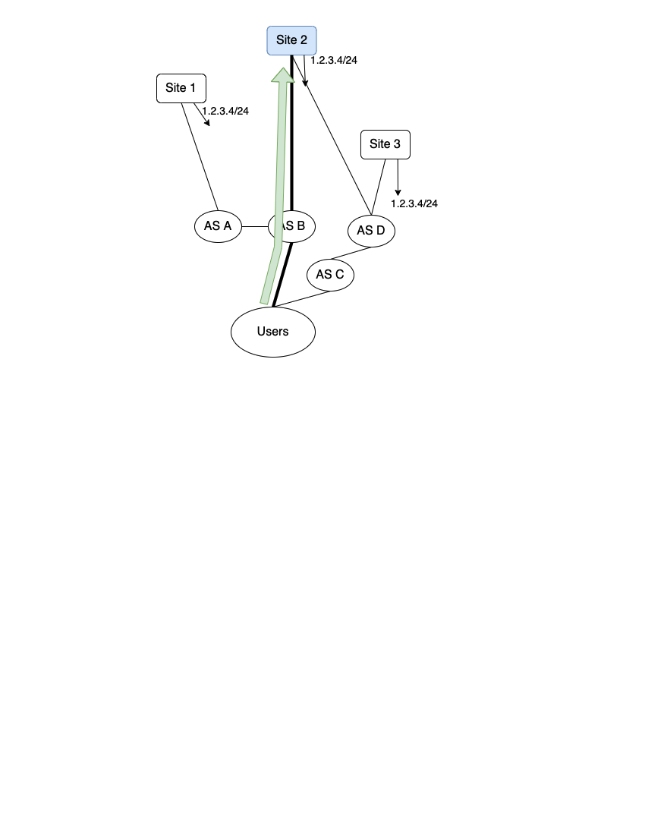
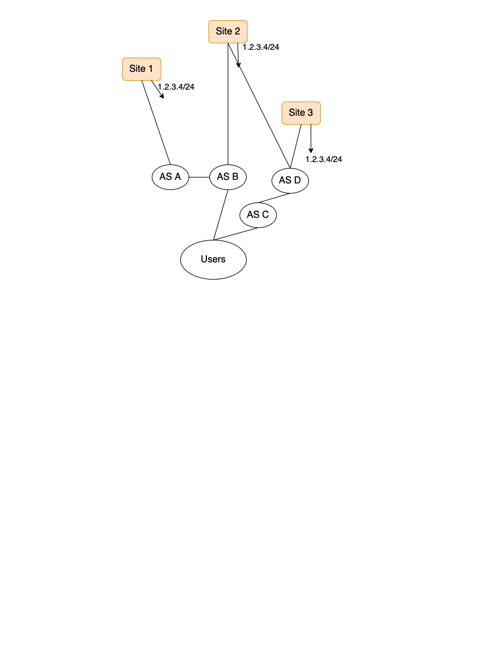
What is IP Anycast?
An approach to routing, where distinct servers (sites) all use the same IP address and serve the same content.
The set of sites is the deployment.
Inflation: BGP does not incorporate performance into its decision-making process, so users may take unnecessarily high latency paths.
Routes to sites are selected via BGP.
Potential Benefits of Anycast 1. Simple, scalable content distribution. 2. Seamless handling of certain types of site failure / route withdrawals. 3. DDoS protection.
Users incur 60 ms reaching site 2, even though site 3 offers lower latency.
The route from a network of users to 1.2.3.4/24 is selected (via BGP) to be the route through AS B to Site 2.
Notes:
(DOUBLE CLICK)
IP anycast is an approach to routing, where servers (which we call sites) all use the same IP address and serve the same content. The set of sites is called a deployment.
In this figure,
you can see a deployment with three sites in three distinct locations all advertising the same prefix,
and they’re connected to a network of users by way of ASes A through D. Not only can the network of users reach three different sites to get the same content,
but the network also has many paths to each of these three sites given its connectivity to other ASes.
The route from the network of users to a site is selected via BGP, which takes into account properties such as local preference and AS path length.
In this example, users reach site 2 through AS B.
Anycast provides many benefits including scalability, simple handling of certain types of failure, and DDoS protection. So, is anycast all good? Not quite. Since BGP doesn’t take performance into account when making decisions about which routes to select, users may take unnecessarily high latency paths. This phenomenon is called inflation. Users here reach site 2 in 60 ms, but the path to site 3 is 20 ms, so these users would benefit from instead reaching site 3.

Slide 9
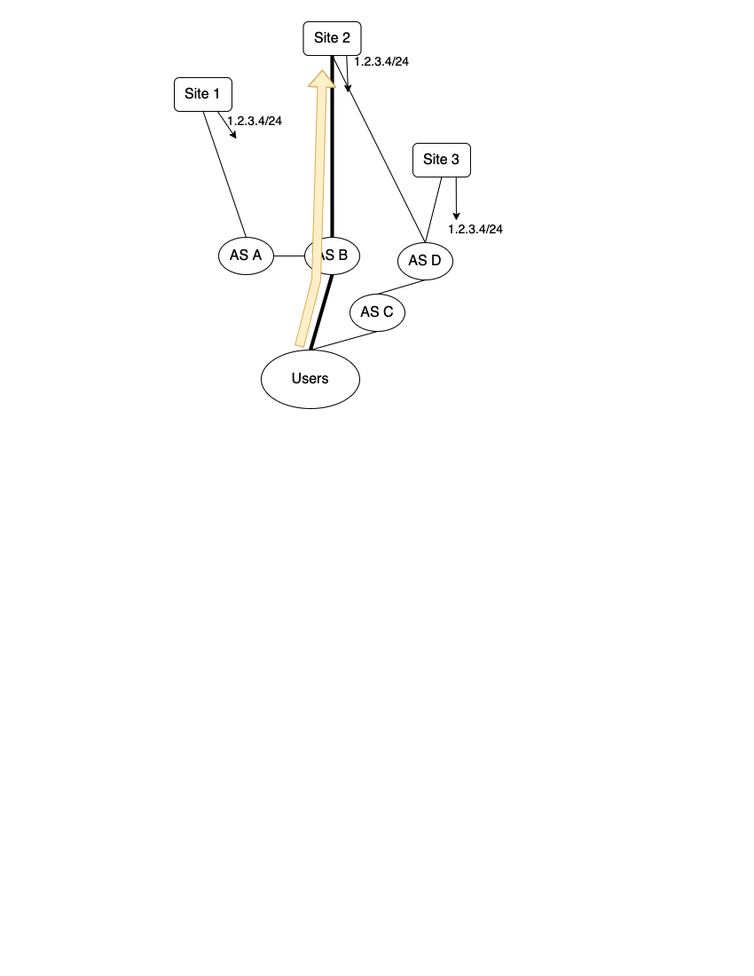
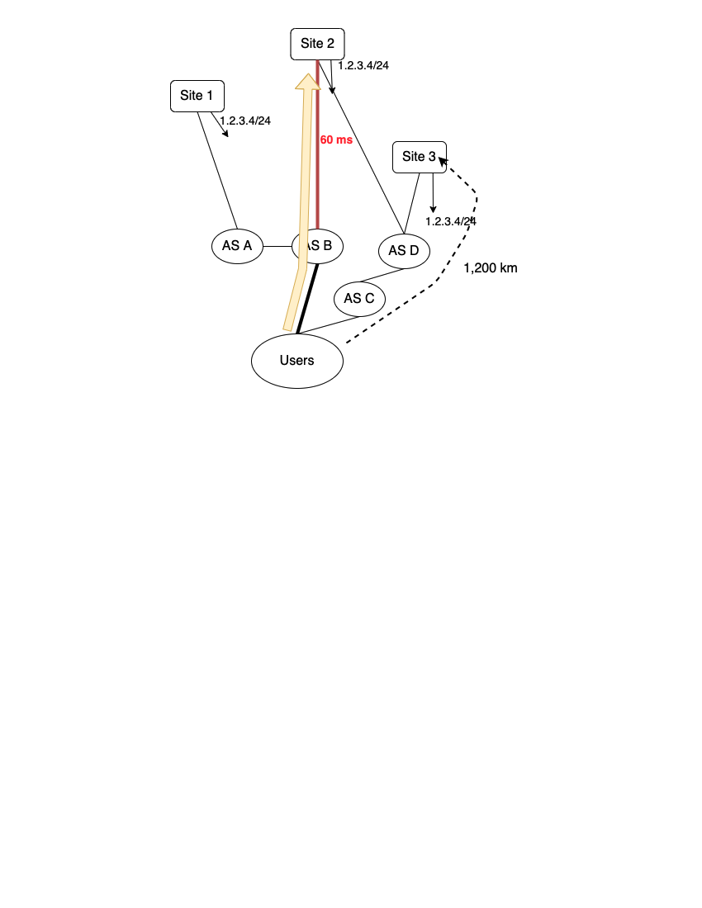
How We Calculate Inflation
Latency Inflation: Extra Latency over Reasonable Lowest Latency
( 60 ms - 1,200 km * 1.5 * 1 ms / 200 km = 51 ms)
Notes:
So how do we measure this inflation? In this talk, we’re going to talk about latency inflation. We also measure geographic inflation, which you can read more about in the paper.
To calculate latency inflation we compute the achieved latency minus a reasonable lowest alternative latency. We say the reasonable lowest latency is 1 and a half times the great circle distance, converted to the speed of light in fiber. We selected this lower bound for technical reasons, which you can read more about in the paper.
Let’s look at an example. Recall that the set of users goes through AS B to reach site 2.
Users reach site 2 in 60 ms and the closest site is 1,200km. The reasonable lowest alternative latency 9 ms, and so the latency inflation is 51 ms.

Slide 10
Motivation
Background and Definitions
Root DNS and Microsoft’s CDN
Inflation in Anycast Deployments
Performance in Context
Investment and Incentive Shapes Deployments and Paths
Notes:
Let’s discuss the two systems -- the root DNS and Microsoft’s CDN.

Slide 11

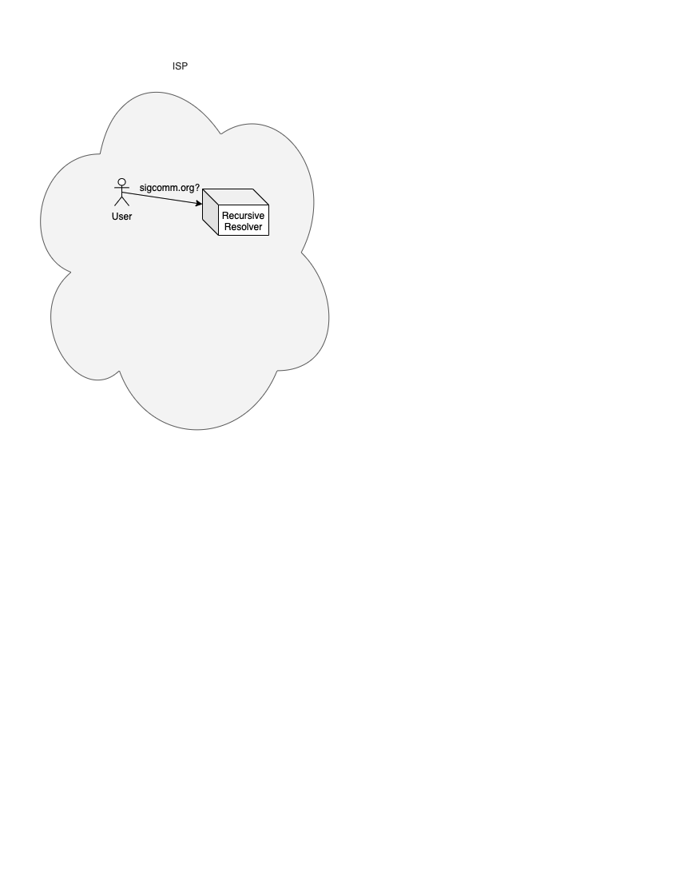
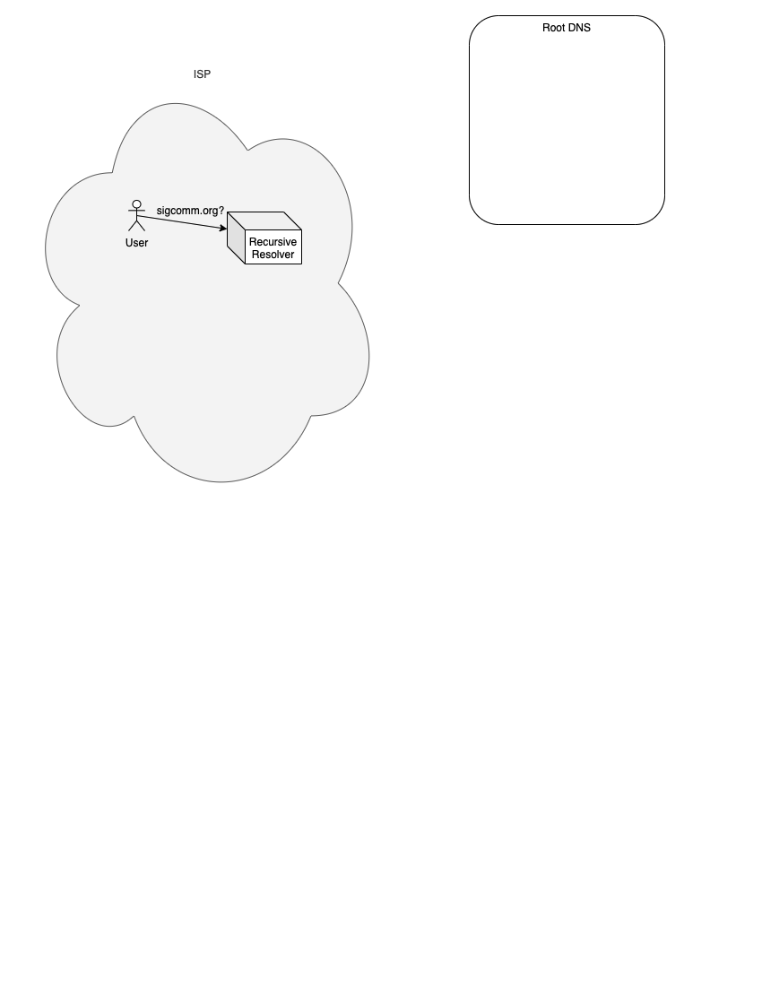
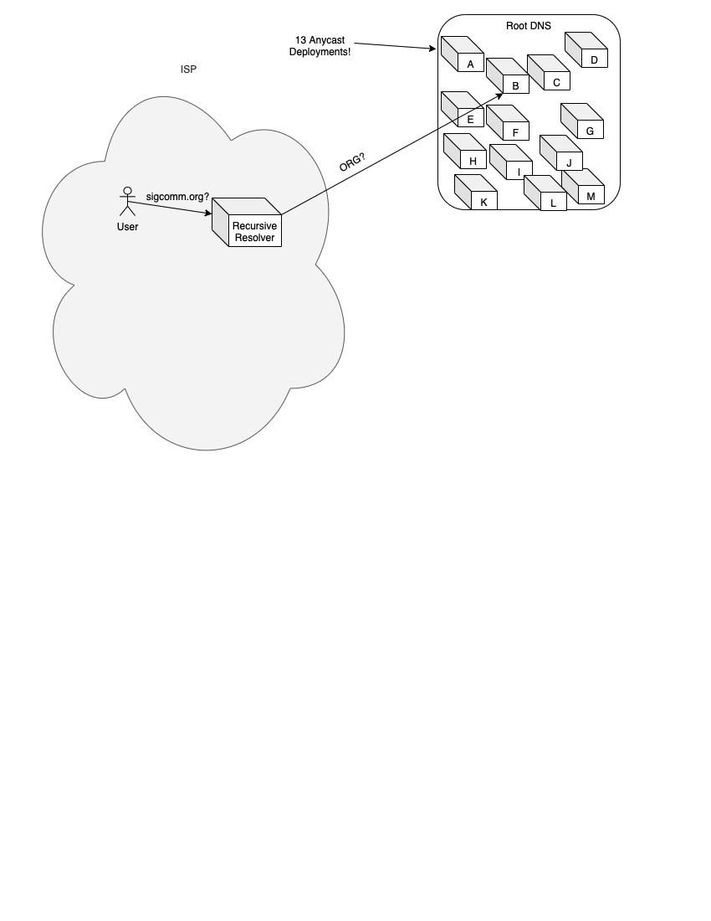

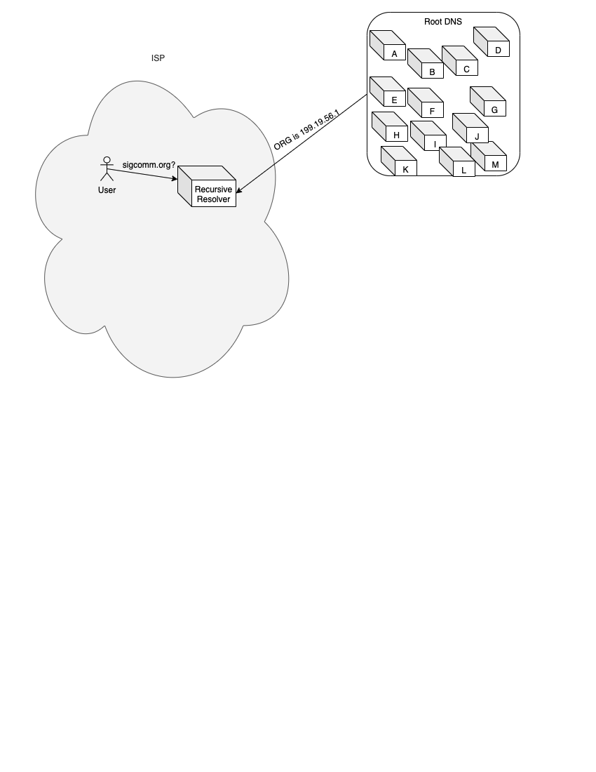
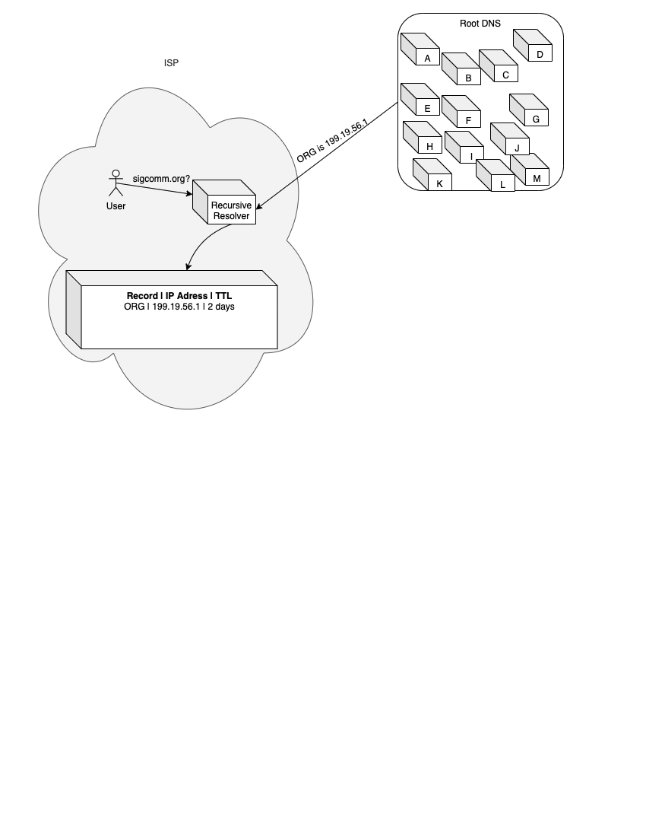
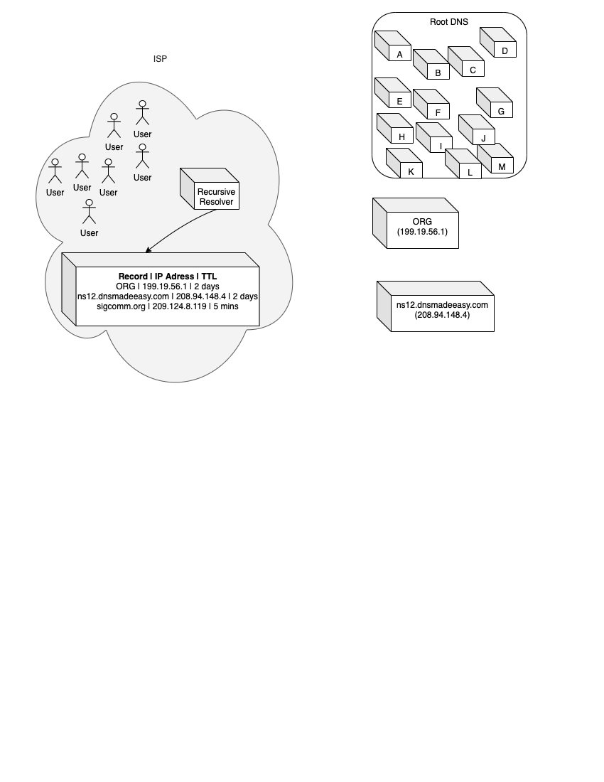
What is the Root DNS?
Notes:
First, what’s the root DNS?
It all starts with a user. The user wants to resolve a human-readable name, like sigcomm.org, to the IP address where sigcomm.org can be found.
(DOUBLE CLICK) The user asks the recursive resolver about sigcomm.org. The recursive resolver will query the root DNS, asking about the Top Level Domain (or TLD, for short). The root DNS is a group of 13 anycast deployments (referred to by letters of the alphabet), run by different organizations. The deployments are anywhere from 6 to 250 sites.
The recursive resolver can choose whichever root letter it wants to query, since each letter deployment provides an identical service. In this case, the recursive resolver asks B root where it can find ORG, since the user is asking about sigcomm DOT ORG.
(DOUBLE CLICK) The recursive resolver stores the answer from B root in its cache. Nearly all records from the root servers have a TTL (which is a time to liv) of 2 days, which means the recursive resolver can store that record for up to 2 days before it needs to refresh it. The recursive then completes the resolution process and forwards the result to the user. Usually, these recursive resolvers (and therefore their caches) are shared among users in an ISP. So, the chance that a user has to wait for a root DNS query is very small, since there is (ideally) one query per TLD every 2 days among the entire set of users.

Slide 12
Data from the Root DNS
Concurrent captures from nearly all sites for nearly all root letters.
Global picture of who is querying the root DNS, how often they do it, which sites they’re hitting.
From TCP DNS queries, we extract RTTs to measure latency.
Queries are from more than 50,000 ASes.
Notes:
(CLICK)
We used concurrent packet captures for 2 days from nearly all root letters.
Which tell us who is querying the root DNS, how often they query, and which sites they’re hitting. From TCP DNS queries, we can extract latency from recursive resolvers to sites, which we use to calculate latency inflation.
Measurements come from queriers in more than 50,000 ASes.

Slide 13
Microsoft’s Anycast CDN and Data
Microsoft’s CDN has 110 sites -- called R110.
Microsoft user counts (number of IP addresses)
Latency measurements from users to all rings.
Measurements are from more than 50,000 ASes.
Notes:
(CLICK)
Microsoft operates an anycast CDN with 110 sites, which we call R110. Microsoft also has smaller (sub-)deployments that we discuss in the paper, but we focus on the largest one here.
We obtain user counts from Microsoft, who approximates user counts by counting distinct IP addresses.
Server side logs and client-side measurements give us latency measurements from users to sites.
Microsoft measurements are also from more than 50,000 ASes.

Slide 14
Motivation
Background and Definitions
Root DNS and Microsoft’s CDN
Inflation in Anycast Deployments
Performance in Context
Investment and Incentive Shapes Deployments and Paths
Notes:
Now that we have sufficient background, let’s jump into some results

Slide 15
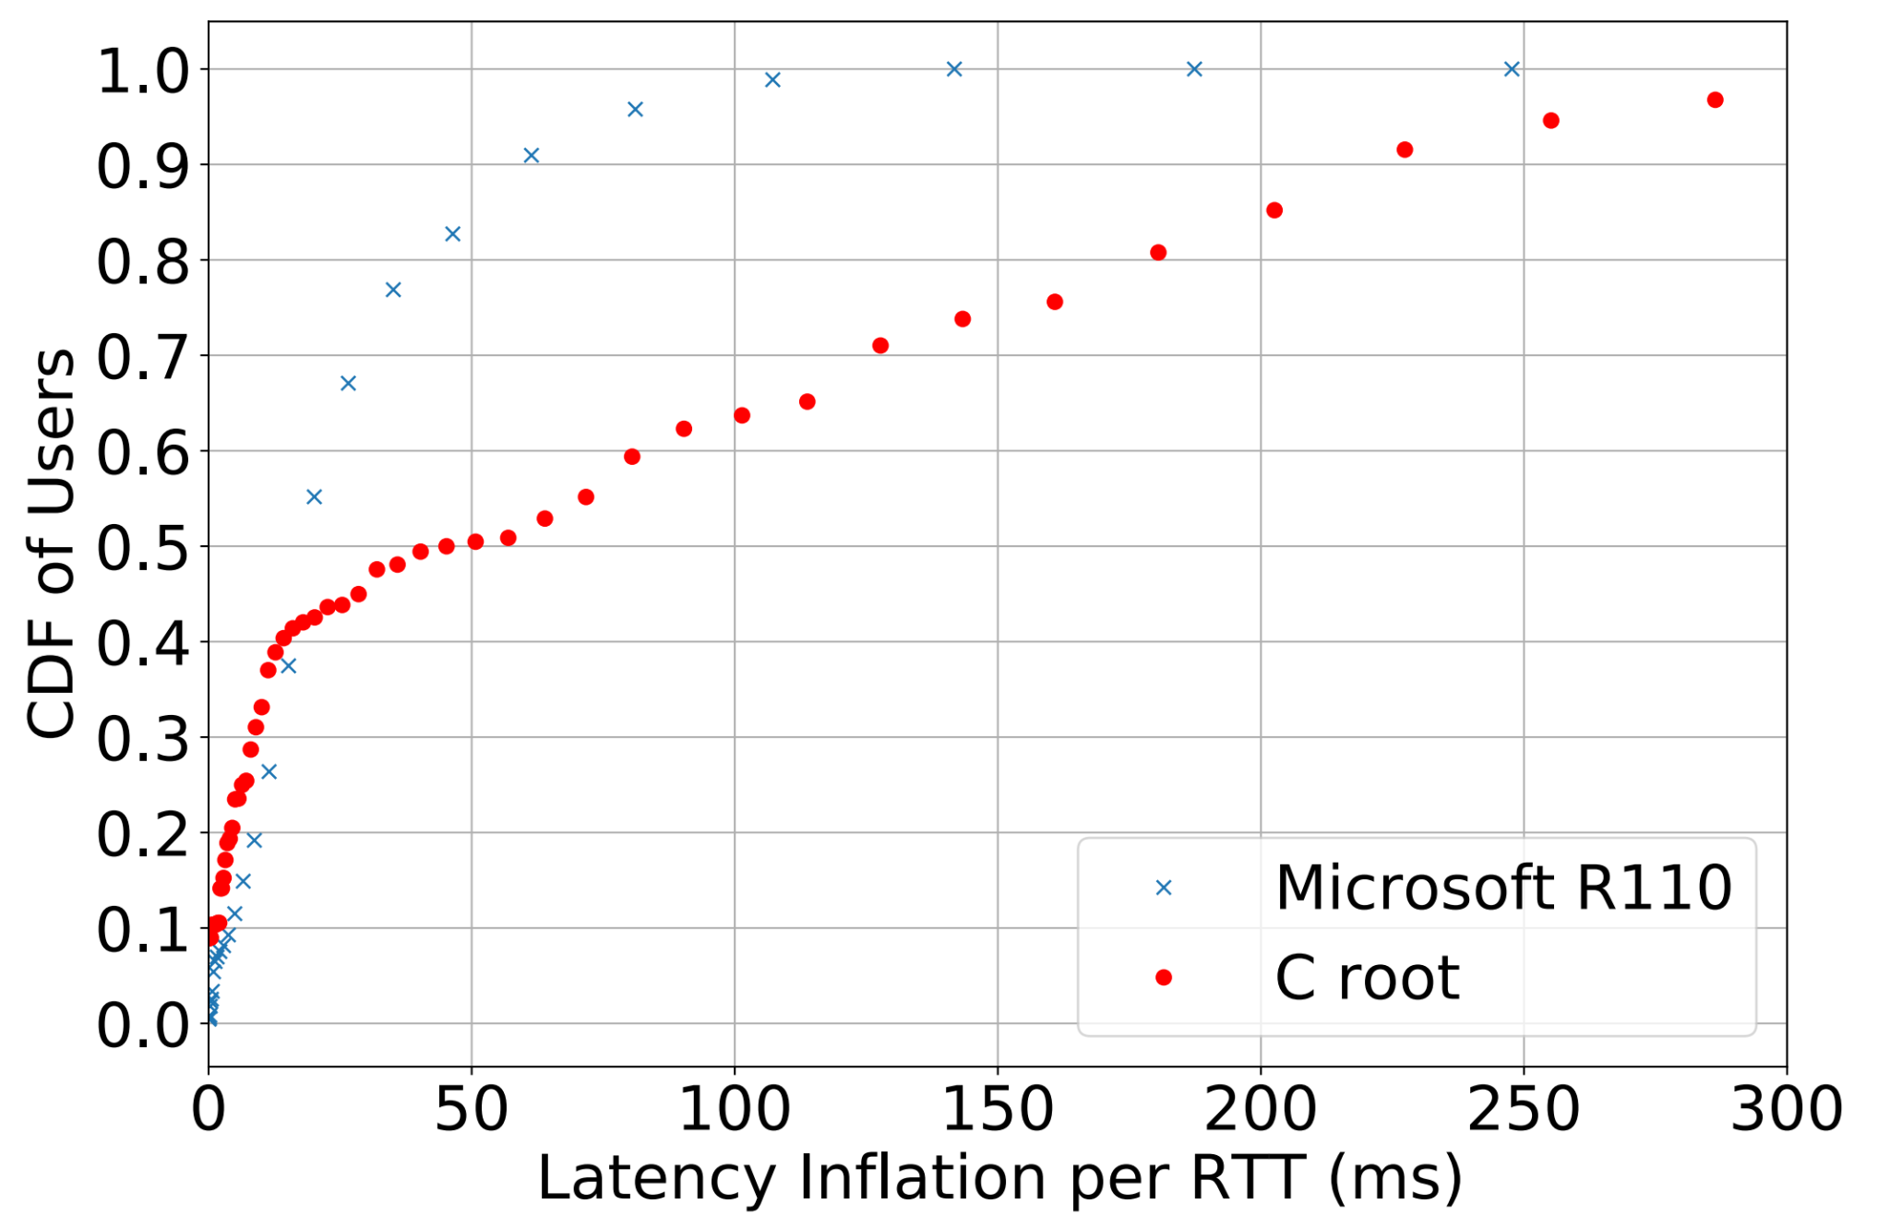
Inflation in the Root DNS and Microsoft’s CDN
Microsoft
Latency Inflation
1. Individual root letters have lots of inflation (e.g., C root), Microsoft’s is much lower.
C root
2. Microsoft’s inflation is quite low, despite massive growth in its deployment.
Notes:
First, our results on inflation.
The x axis shows latency inflation and the y axis shows the cumulative fraction of users.
For example the point at (50, .5) means that 50% of users experience at most 50 ms of latency inflation.
The blue x’s show latency inflation for Microsoft’s deployment,
and the red markers show C root’s inflation as an example of an individual root’s inflation (which is similar to other root letters).
For root letters inflation is quite large -- much larger than in Microsoft’s CDN. For example, the red circles show that 65% of users experience less than 100 ms of latency inflation to C root, but 98% of users experience less than 100 ms to Microsoft.

Slide 16


Measuring Inflation in Context
Latency Inflation
How does inflation impact users?
For root DNS, one thinks “not a lot” due to caching.
But there is a lot of attention placed on root DNS latency, and deployments are growing.
Notes:
So,
is large inflation in the root DNS a problem? That is, “does the inflation impact users”? For the root DNS one might think “no, it doesn’t really” due to the caching of DNS records we mentioned.
That being said, there’s lots of attention being placed on root DNS latency.
In addition to the 2018 SIGCOMM paper we mentioned earlier, here are newsposts, some of which are from reputable sources such as ThousandEyes. Given all this attention on root DNS latency, we felt it was necessary to measure inflations impact on users, despite our ability to reason intuitively about root DNS interactions.

Slide 17
Motivation
Background and Definitions
Root DNS and Microsoft’s CDN
Inflation in Anycast Deployments
Performance in Context
Investment and Incentive Shapes Deployments and Paths

Slide 18
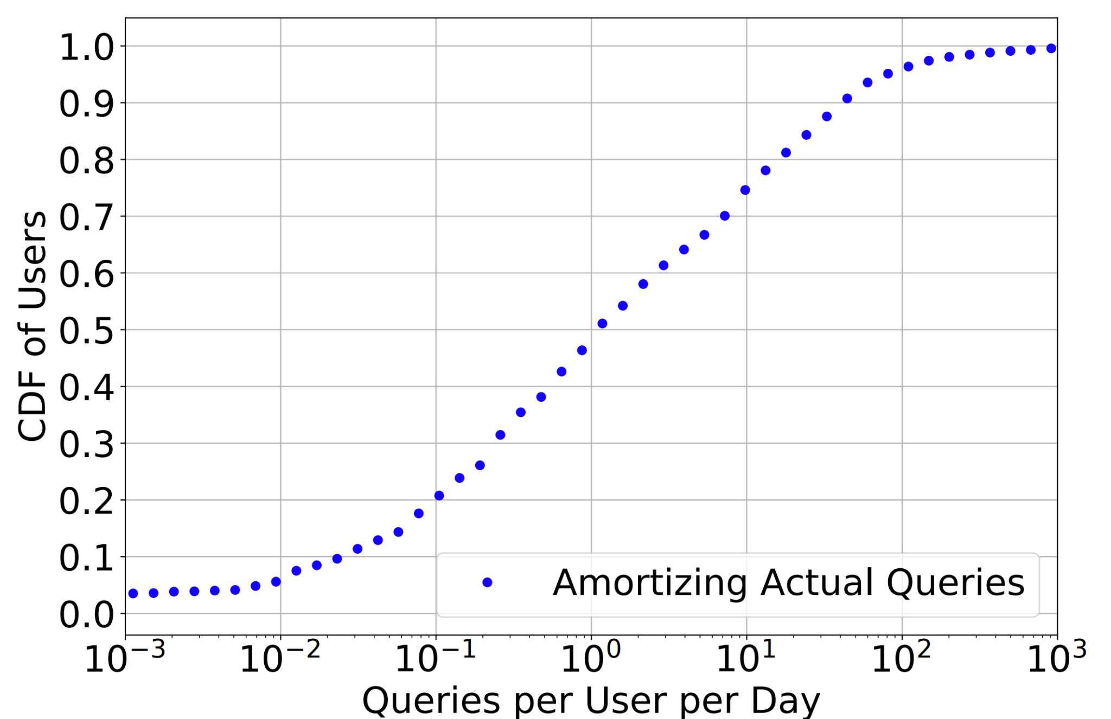

Root DNS Latency and Inflation Hardly Matter
We amortize root DNS queries over users to get queries per day.
# of queries per RR in the root traces
Med ≈ 1
# of Microsoft users using recursive
Takeaway: Most users rarely interact with the root DNS.
1 query per day 1 round trip per query
Notes:
So, to measure this impact, we looked at how users interact with the root DNS.
We calculate the number of queries each user makes each day by counting the number of queries seen in our root DNS traces by recursives,
and divide daily query counts by the number of users seen using that recursive. The numerator in the equation is the number of queries made by a recursive, while the denominator is the number of users using that recursive.
The figure shows queries per user per day on the x axis, and the cumulative fraction of users on the y axis. For example, the point at (.1, .2) circled in red means that 20% of users experience at most .1 queries per day to the root DNS, on average.
At the median, users execute about a query a day to the root DNS, and that’s out of all the other things you are doing on the Internet. If we’re only querying it once per day, anycast could route our queries to the root DNS around the globe, and we wouldn’t notice the difference. It would hardly affect our Internet experience. Hence root DNS latency hardly matters to users.

Slide 19
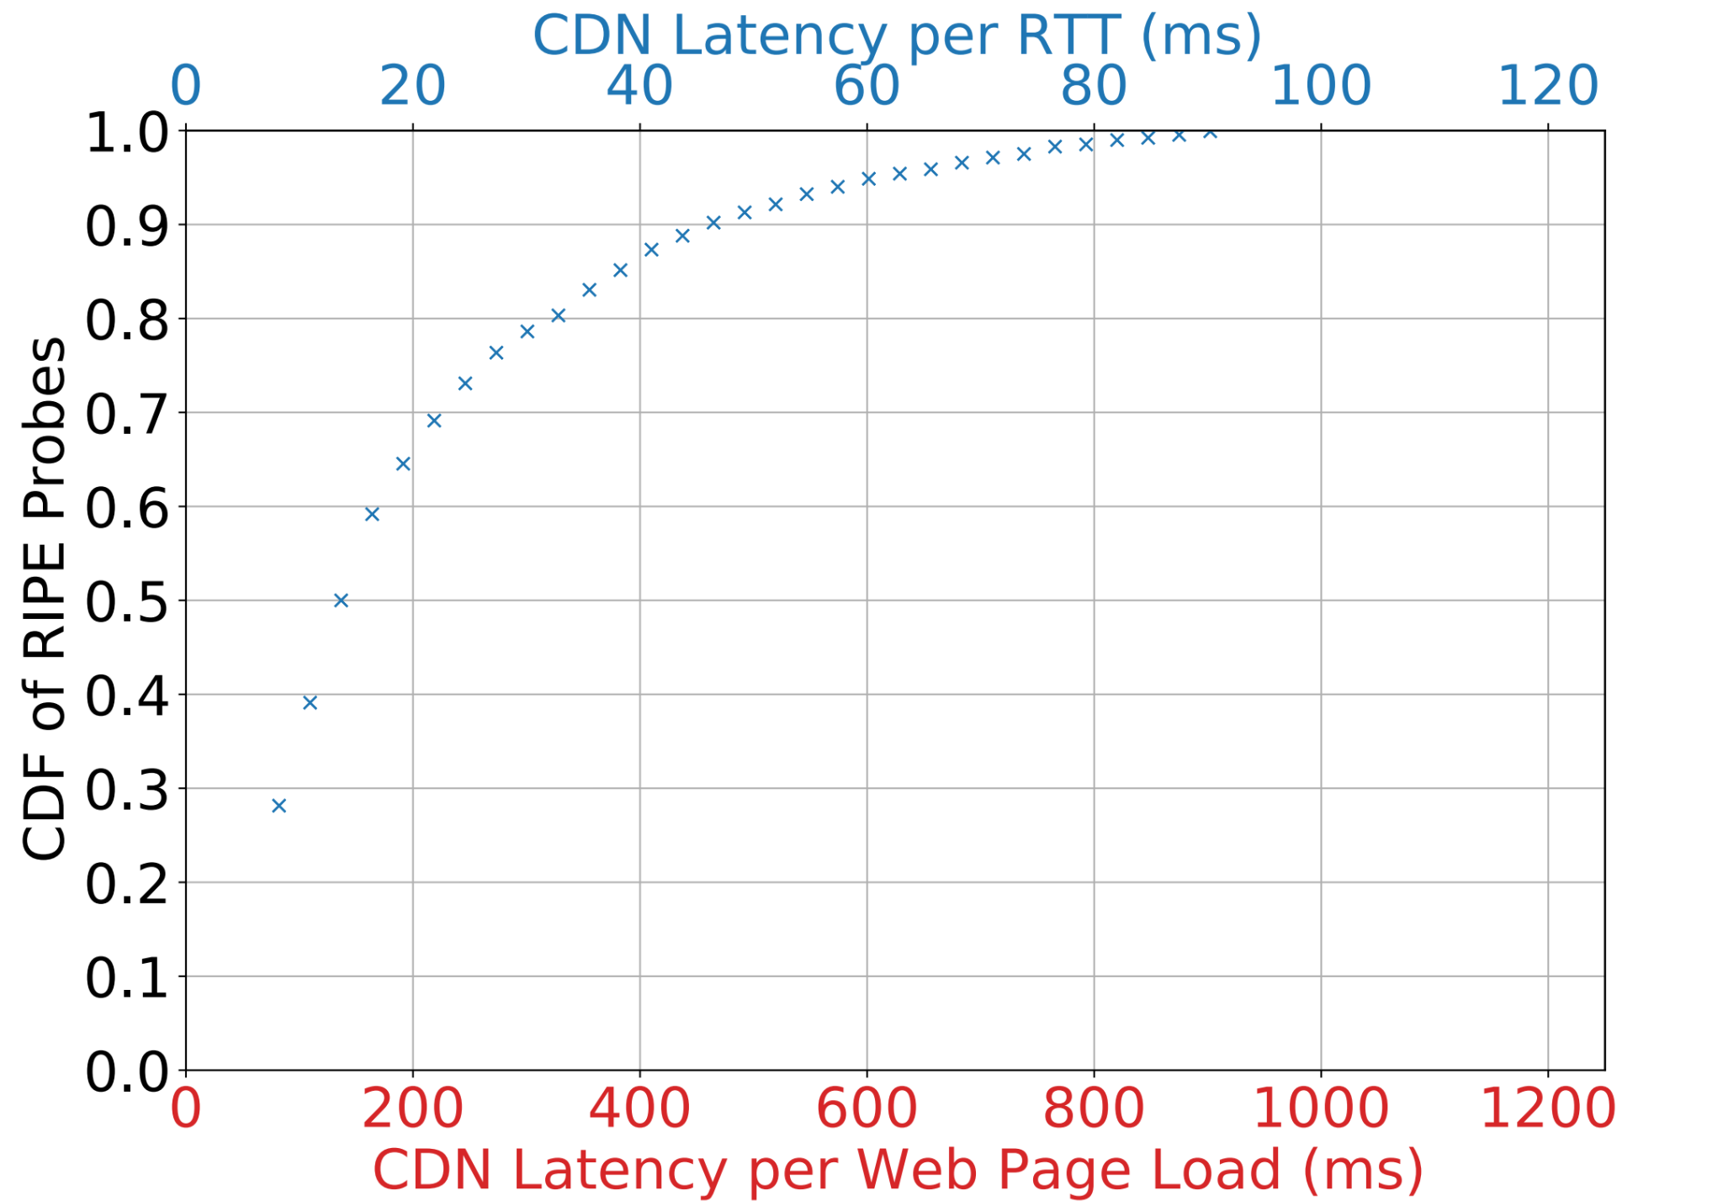


Microsoft CDN Latency and Inflation Really Matter
Number of RTTs per page load:
Latency per page load:
C Root’s Inflation
Latency Per Page Load
Latency Per RTT
Latency to Microsoft is low, but inflated paths could really hurt users!
Notes:
Conversely, in Microsoft’s CDN, we show that latency really does matter. Unlike in the root DNS, where a round trip (or RTT) is rarely incurred, we measured that users incur at least 10 RTTs when fetching Microsoft web pages. To obtain a lower bound on how much latency matters in a web page load, for example, we multiply latency per round trip by the lower bound on the number of round trips (which is 10).
The figure shows a CDF of latency per RTT for users on the top axis , and latency per web page on the bottom axis.
For example, the red circle indicates that 65% of users experience at most 20 ms per round trip or, equivalently, roughly 200 ms per page load
Latency for users is low, but inflation could hurt users significantly, since the inflation is compounded with each round trip. Recall that median latency inflation in C root, for example, was 50 ms.
Adding C roots inflation at the median would drastically increase page load times (by at least 500 ms!). Therefore, Microsoft has a much larger incentive than root DNS operators to limit inflation for users.

Slide 20
Motivation
Background and Definitions
Root DNS and Microsoft’s CDN
Inflation in Anycast Deployments
Performance in Context
Investment and Incentive Shapes Deployments and Paths
Notes:
So, why is inflation so different?

Slide 21
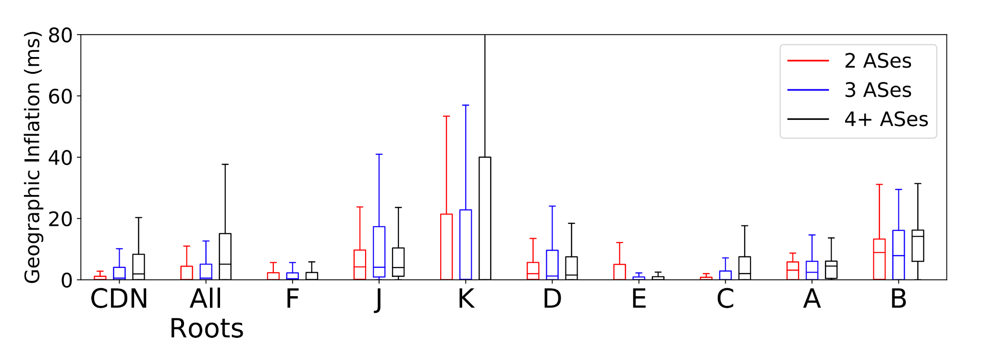
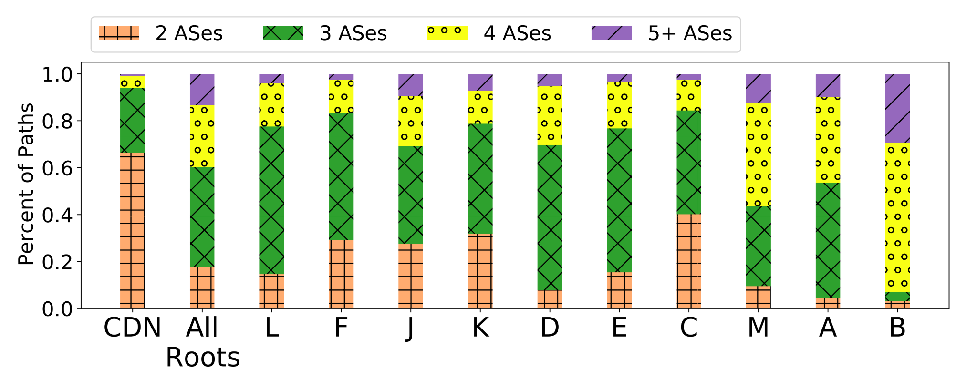
AS Paths to Microsoft are Short & Short Paths Have Less Inflation
Direct paths sidestep the challenges of BGP: paths through peers and shorter AS paths are preferred.
Microsoft invests in expensive peering relationships, and optimizes routing.
AS Path Lengths
AS Path Length vs. Inflation
AS path lengths and correlation between AS path length and inflation, as measured from RIPE Atlas. Root letters are listed in size order.
Notes:
To answer this, we looked at paths to Microsoft and the roots, and found that
AS paths to Microsoft are shorter. The left plot shows a bar graph of AS path lengths to each destination from RIPE Atlas probes.
For example, 63% of paths to Microsoft are direct connections, but only 15% of paths to the root DNS are direct connections as highlighted by the red circles.
The right plot shows that shorter AS paths have less inflation so it seems that the short paths on the left plot are helping Microsoft control inflation. To obtain the right plot, we plot the inflation RIPE Atlas probes experience in a box and whisker, sorted by the AS path length to each destination.
For example, the ‘CDN’ and ‘All Roots’ whiskers show that paths of length 2 have less inflation than paths of length 3 and 4. The trend is not absolute across all root letters, likely since deployment and routing strategies play roles as well.
So, why are paths to Microsoft paths shorter? And why do shorter paths have less inflation? Microsoft directly connects to networks, sidestepping the challenges of BGP -- that is, BGP does not take performance into account. Direct paths through peers and shorter AS paths are preferred in the BGP decision process, and so Microsoft can more directly optimize for performance. Optimizing BGP advertisements to reduce inflation, and peering with end user networks to shorten AS paths, takes a lot of time and money. This expense doesn’t really make sense for roots since latency hardly matters.

Slide 22
Anycast Deployment Comparison
 | Property
 | Total Sites | Sites per Deployment | Prefix to Site Assignments | Connectivity per Site | RTTs per Content Fetch | Optimization Strategy
Microsoft | 110 | 30-110 (regulatory restrictions) | By application | Multiple Transit, 100s of Peers | At least 10 | Peering widely, Global WAN
Akamai DNS | Hundreds | 25 (spread load, redundancy) | For performance | 1 Transit 1- 15 Peers | Probably Less than One | Intricate, automated optimization
Root DNS | 1400 | 6-250 (different orgs, same service) | By root letter | Various | Hardly Any | Caching with long TTLs
 | Property
 | Total Sites | Sites per Deployment | Prefix to Site Assignments | Connectivity per Site | RTTs per Content Fetch | Optimization Strategy
Microsoft | 110 | 30-110 (regulatory restrictions) | By application | Multiple Transit, 100s of Peers | At least 10 | Peering widely, Global WAN
Akamai DNS | Hundreds | 25 (spread load, redundancy) | For performance | 1 Transit 1- 15 Peers | Probably Less than One | Intricate, automated optimization
Root DNS | 1400 | 6-250 (different orgs, same service) | By root letter | Various | Hardly Any | Caching with long TTLs
 | Property
 | Total Sites | Sites per Deployment | Prefix to Site Assignments | Connectivity per Site | RTTs per Content Fetch | Optimization Strategy
Microsoft | 110 | 30-110 (regulatory restrictions) | By application | Multiple Transit, 100s of Peers | At least 10 | Peering widely, Global WAN
Akamai DNS | Hundreds | 25 (spread load, redundancy) | For performance | 1 Transit 1- 15 Peers | Probably Less than One | Intricate, automated optimization
Root DNS | 1400 | 6-250 (different orgs, same service) | By root letter | Various | Hardly Any | Caching with long TTLs
 | Property
 | Total Sites | Sites per Deployment | Prefix to Site Assignments | Connectivity per Site | RTTs per Content Fetch | Optimization Strategy
Microsoft | 110 | 30-110 (regulatory restrictions) | By application | Multiple Transit, 100s of Peers | At least 10 | Peering widely, Global WAN
Akamai DNS | Hundreds | 25 (spread load, redundancy) | For performance | 1 Transit 1- 15 Peers | Probably Less than One | Intricate, automated optimization
Root DNS | 1400 | 6-250 (different orgs, same service) | By root letter | Various | Hardly Any | Caching with long TTLs
 | Property
 | Total Sites | Sites per Deployment | Prefix to Site Assignments | Connectivity per Site | RTTs per Content Fetch | Optimization Strategy
Microsoft | 110 | 30-110 (regulatory restrictions) | By application | Multiple Transit, 100s of Peers | At least 10 | Peering widely, Global WAN
Akamai DNS | Hundreds | 25 (spread load, redundancy) | For performance | 1 Transit 1- 15 Peers | Probably Less than One | Intricate, automated optimization
Root DNS | 1400 | 6-250 (different orgs, same service) | By root letter | Various | Hardly Any | Caching with long TTLs
Deployment
Notes:
Let’s compare three anycast deployments: Microsoft, Akamai DNS, and the root DNS. Although we don’t discuss Akamai DNS in our paper, we feel it's important to compare since there is a talk about it soon, and there are key differences. Let’s look at the first 3 columns. Akamai assigns IP addresses to sites to optimize performance and promote resilience, with only 25 / hundreds of sites given one IP address. The distinguishing factor between Microsoft’s anycast deployments (which we talk more about in the paper) is regulatory, and so the prefix to site assignments are related to the applications each site hosts. The root DNS assigns prefixes to sites by root letter, and all sites in a root letter advertise the same prefix.
These services have different connectivity -- Microsoft has multiple transit providers per site and peers with hundreds of end user networks. Akamai has one transit provider per site and between 1 and 15 peers. Root DNS connectivity varies among root letters.
The talk about Akamai DNS coming up soon presents AnyOpt, an anycast optimization framework. Unfortunately, since Microsoft has lots of peers and so many sites, its unlikely AnyOpt can be applied to CDNs such as Microsoft’s. However, we’re excited that anycast deployment optimization is an active area of research, and are looking forward to their talk.
The three services serve content with different latency requirements which we approximate with ‘round trips per content fetch’. Users fetching Microsoft content incur at least 10 RTTs, so inflation really hurts. Queries to Akamai DNS occur more often than in the root DNS since they host more DNS records and have shorter TTLs, but caching and small content size still implies users probably will incur (on average) less than an RTT when fetching content. Queries to the root DNS rarely occur due to caching.
Because of all these differences, the three deployments optimize performance in different ways which we summarize in final column ‘Optimization Strategy’. Microsoft invests in peering, optimizes route announcements, and leverages its global WAN; Akamai uses intricate optimization algorithms that assign certain prefixes to certain sites; recursive resolvers rely on caching to deliver performance benefits to users in the root DNS.

Slide 23
Conclusions
One should assess anycast in context of the system.
Generalizing root DNS to other applications can be misleading.
Comparing root DNS latency and anycast inflation is unproductive.
Root DNS operators should not deploy new sites to lower latency.
Inflation is a misleading metric -- absolute latency is more important.
Anycast deployments can be engineered to keep latency low.
Notes:
Recall that we began this investigation because of prior work that assessed anycast out of the context of its deployment (the root DNS). Hence, our major conclusion is that anycast must be assessed IN CONTEXT,
and we must understand how that context can shape performance.
In particular, root DNS latency hardly matters to users, so we should stop focusing on it
and deploying to reduce it.
Moreover, inflation can be a misleading metric, since absolute latency is more important,
and anycast deployments can be engineered to keep latency low, despite the presence of some inflation.

Slide 24
Can CDNs like Microsoft’s Benefit From AnyOpt [1]?
Scaling issues prevent application.
Lots of sites and multiple transit providers per site.
The paper admits that the methodology does not yet scale.
Lots of peers, which are the preferred connection.
But the insights from AnyOpt are still valuable.
Many principles in AnyOpt are general and, if further developed, may be useful for anycast CDNs similar to Microsoft’s.
[1] AnyOpt: Predicting and Optimizing IP Anycast Performance. Zhang, Xiao and Sen, Tanmoy and Zhang, Zheyuan and April, Tim and Chandrasekaran, Balakrishnan and Choffnes, David and Maggs, Bruce M. and Shen, Haiying and Sitaraman, Ramesh K. and Yang, Xiawei. In Proceedings of the 2021 SIGCOMM Conference. Online.
Notes:
A question we might ask about AnyOpt (which is the paper coming up soon), is whether the methodology it presents can be used to improve anycast CDNs such as Microsoft’s.
(DOUBLE CLICK)
Unfortunately, the answer is likely ‘no’.
AnyOpt likely doesn’t scale to deployments of Microsoft’s size,
including the number of sites and the number of providers.
Microsoft also has many more peers, and AnyOpt’s support for optimizing over peering connections is limited.
But we still find the insights in their paper very valuable.
Anycast CDNs will always be trying to optimize their deployments. AnyOpt has opened many avenues for research, which may lead to practical anycast optimization frameworks for other anycast networks. We’re looking forward to their talk.

Slide 25
Rough Outline
Overview to give folks the gist
Prior work has painted anycast in both good and bad lights. The bad especially doesn’t make sense since anycast is used more and more (growing deployments), in latency-sensitive applications.
We resolve the discrepancy by investigating anycast in the context of the system in which its used -- how does latency translate to users?
We show anycast performance is good when it matters to users, and is generally better than previously thought.
Motivation -- anycast has been perceived in good and bad lights, using different methodology. So we don’t know what to think.
Give numbers of growing deployments -- why are they growing if performance is poor?
Give example of conflicting takeaways from prior work -- lots of inflation in C root (UMD paper), not so much in Microsoft’s CDN.
Discuss how they use different methodology / coverage, so it’s difficult to see what is going on.
Not too much detail
Contributions
Definitions of anycast, inflation, comparison to prior work, why we chose these measures of inflation in particular.
Descriptions of the two systems we study, the data we use.
Inflation (gist for 12 minute, longer for 25 minute)
Geographic and latency inflation in root DNS.
Geographic and latency inflation in CDN.
How users experience latency
Why and how we analyze how often users interact with root DNS (versus just relying on intuition).
Interaction with root DNS at ISI and for the two author computers.
Queries per day for root DNS, latency per page load for CDN -> need to reduce inflation leads to low inflation
Why is inflation different
Routing comparison
Interplay between deployment size, latency, efficiency
Are root DNS operators concerned about latency? (survey results)
Notes:
For the hook, quotes from the two different papers would be cool
Insert a 1.5 -- define anycast, BGP (ekb: I think it can be 2.5, maybe -- I was thinking of it as part of 4, but swapping the order of 3 and 4)
Show definitions using figures to make them less dry and more informative
Insert a 4.5 -- our contributions are …
(--or-- a 2.5 if you make it flow well)
For the 12 minute talk, a nice thing to do is have a slide that says what you’re not talking about in the presentation
Root interactions per day and routing comparison are some of the more interesting points, include other points for longer version
For author computers and ISI, confirm with a bullet you don’t say
*****Differentiate the Microsoft deployment from Akamai’s deployment, since it comes a few presentations later
Page numbers

Slide 26
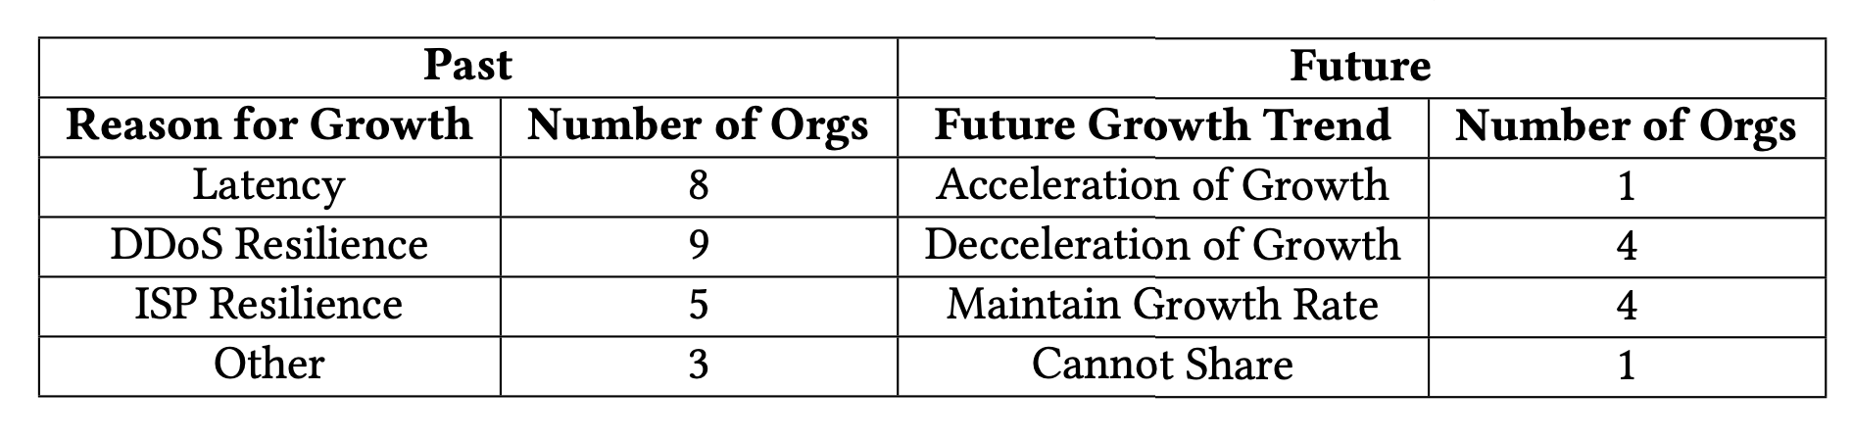
What Caused All the Growth?
We asked root DNS operators why they expanded, and whether the expansion will continue.
Surprisingly, many listed decreasing latency as a reason for expanding.
Expansion will likely slow.

Slide 27
Comparison to Akamai DNS Anycast Deployment
Number of PoPs & Available Sites - Akamai has hundreds of sites. Queries for Akamai DNS-hosted domains are served by subsets of sites. There are 24 anycast deployments, each consisting of about 25 sites. - Microsoft has 110 sites. Queries to Microsoft can reach any site, given legal regulations.
PoP Prefix Assignments - For Akamai DNS, prefixes are assigned to sites to spread load, enhance resiliency, and optimize performance, with no more than 2 prefixes per site. - For Microsoft, different services have different regulatory requirements. Each level of regulatory requirement has its own anycast prefix, and all sites that meet the requirement advertise that prefix. The smallest set (most stringent requirements) is 28 sites, roughly the same size as an Akamai anycast deployment.
Connectivity of Sites - Akamai has only one transit provider per site, and peers at each site number in the teens. - Microsoft has multiple transit providers per site for resilience, and peers at each site number in the hundreds.
Notes:
Before our concluding thoughts, lets discuss Akamai DNS’ anycast deployment (even though its not in our paper). We feel that it’s necessary to explicitly highlight the differences between Akamai’s anycasted DNS service and Microsoft’s anycast CDN, since there is a talk about it soon, there are key differences, and their talk is about optimizing an anycast deployment which is very relevant.
We’ve identified some differences that we think are the most important. First, Akamai’s deployment has hundreds of sites. It’s deployment is actually 24 individual anycast deployments, each consisting of about 25 sites. Microsoft only has 110 sites, but queries to Microsoft can reach any of these sites, aside from regulatory restrictions.
Second, Akamai assigns prefixes to sites to spread load, enhance resiliency and optimize performance with no more than 2 prefixes per site. But Microsoft only considers regulatory requirements when assigning prefixes to sites. All sites that meet sufficient regulatory requirements advertise the corresponding prefix. The smallest set (which has the strictest requirements) is 28 sites, roughly the same size as an Akamai anycast deployment.
Finally, Akamai DNS and Microsoft have very different connectivity. Akamai has only one transit provider per site, and only has tens of peers. Microsoft has multiple transit providers and peers at each site number in the hundreds.

Slide 28
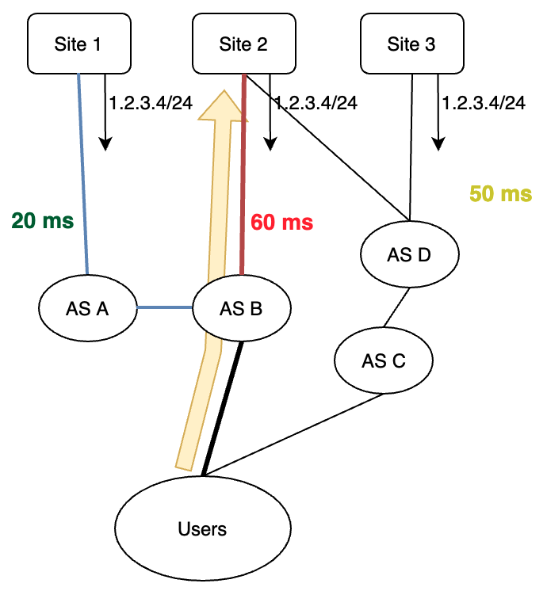
How Prior Work Calculates Inflation
Prior Work [1-4]: Inflation = Achieved - best alternative = 60 ms - 20 ms = 40 ms
Limitations of this approach:
1. Measuring the “20 ms” path would sacrifice coverage.
2. The “20 ms” path may still be inflated!
[1] Hitesh Ballani and Paul Francis. 2005. Towards a Global IP Anycast Service. In Proceedings of the 2005 ACM SIGCOMM Conference (Philadelphia, PA, USA). [2] Matt Calder, Ashley Flavel, Ethan Katz-Bassett, Ratul Mahajan, and Jitendra Padhye. 2015. Analyzing the Performance of an Anycast CDN. In Proceedings of the 2015 Internet Measurement Conference (IMC) (Tokyo, Japan).
[3] Ricardo de Oliveira Schmidt, John Heidemann, and Jan Harm Kuipers. 2017. Anycast Latency: How Many Sites Are Enough? In International Conference on Passive and Active Network Measurement (PAM) (Sydney, Australia).
[4] Zhihao Li, Dave Levin, Neil Spring, and Bobby Bhattacharjee. 2018. Internet Anycast: Performance, Problems, & Potential. In Proceedings of the 2018 ACM SIGCOMM Conference (Budapest, Hungary).
Users incur 40 ms extra compared to the best alternative.
Notes:
We measure inflation in our paper, but do it a bit differently than prior work. Prior work calls inflation the difference between achieved and best unicast alternative latency.
Let’s look at the figure for an example calculation of how prior work calculates inflation. The latency to site 2 is 60 ms, and the lowest alternative is the latency to site 1 -- 20 ms. So the inflation calculation would be the difference between 60 and 20 which is 40 ms.
However,
you need a lot of vantage points to measure these “alternate latencies” (the 20 ms path), so we’d sacrifice coverage if we calculated inflation this way. For example, one could use RIPE Atlas, but RIPE Atlas only has vantage points in about 3000 networks. This compares to the 50,000 networks we cover in this study.
Moreover, the “20 ms” path might still be inflated, and so we even with full coverage we might not capture all the inflation. For example, the path to site 1 may be unnecessarily circuitous.

Slide 29
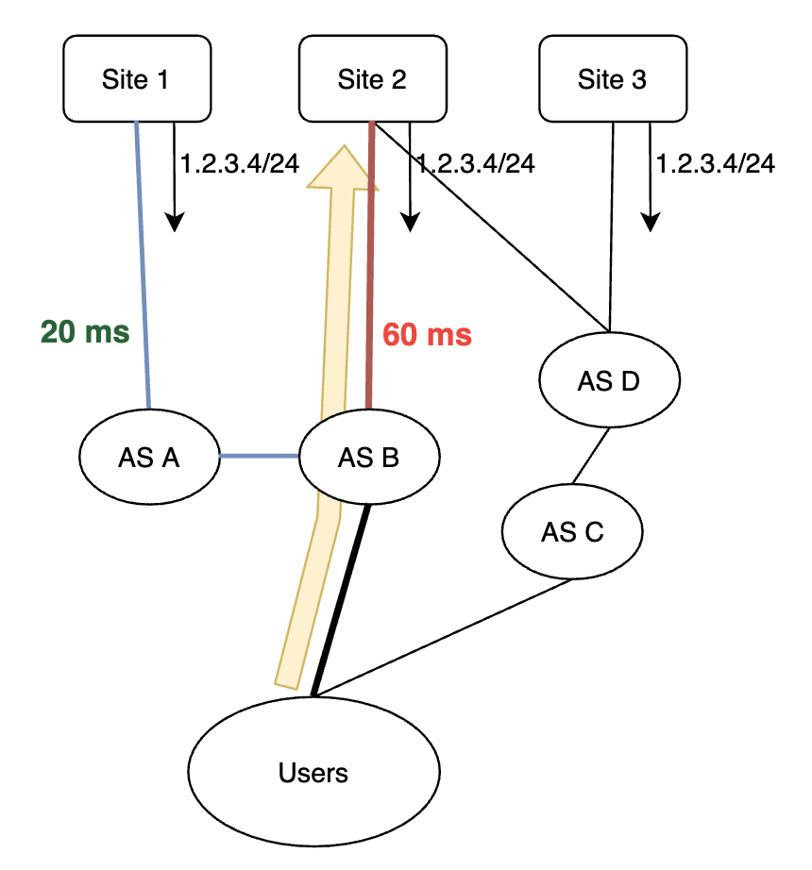
What Can Go Wrong?
Inflation: BGP does not incorporate performance into its decision-making process, and so can make decisions that lead to higher latency than the best alternative.
Inflation is a type of inefficiency, where low latency options for users exist, but are not used.
Users incur 60 ms reaching site 2, even though site 1 offers lower latency.
Notes:
So, is anycast all good? Not quite. Since BGP doesn’t take performance into account when making decisions about which routes to select, users may take paths to sites that are a higher latency than the best alternative.
Users here reach site 2 in 60 ms, but the path to site 1 is 20 ms, so these users would benefit from instead reaching site 1. We can interpret inflation as a type of inefficiency, since we are not taking full advantage of the deployment.

