Slide 1
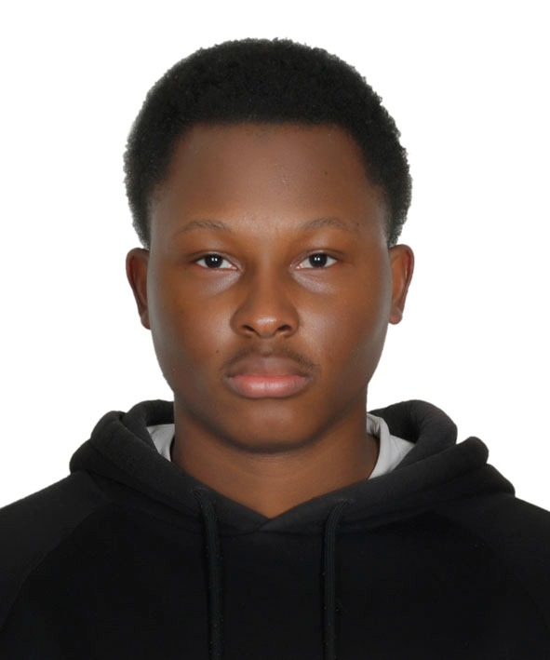
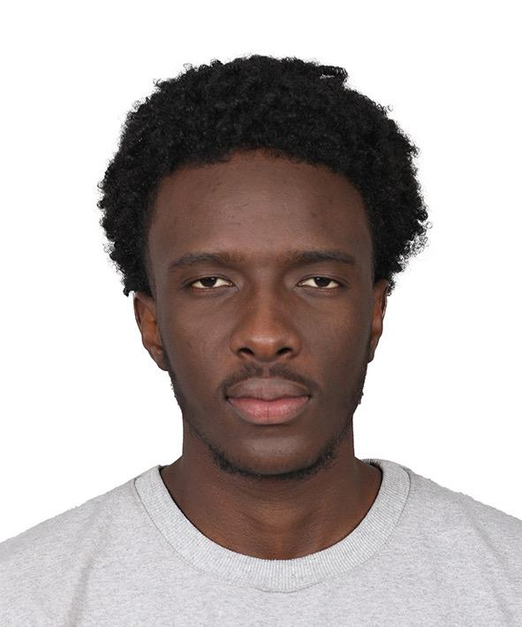
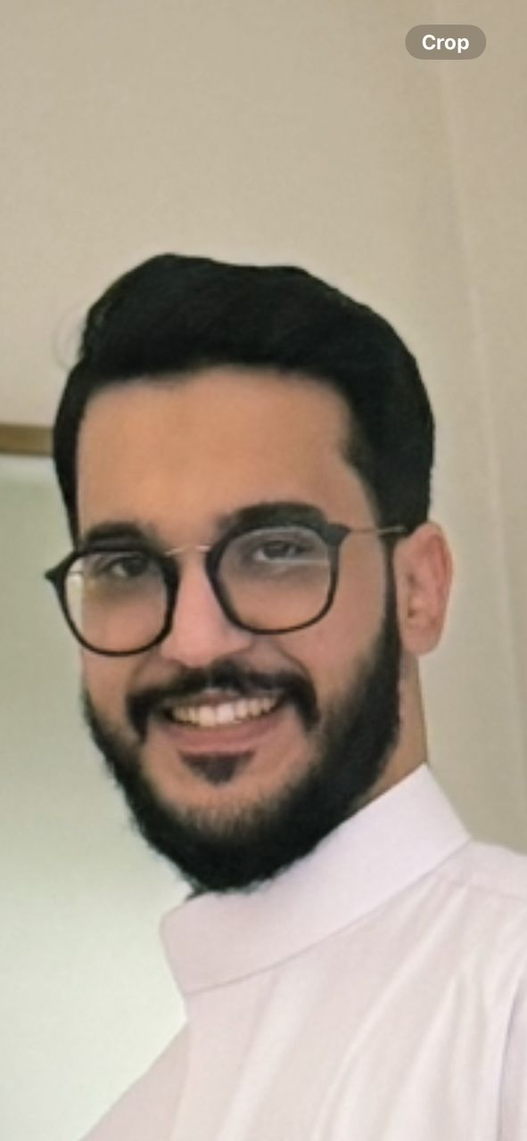
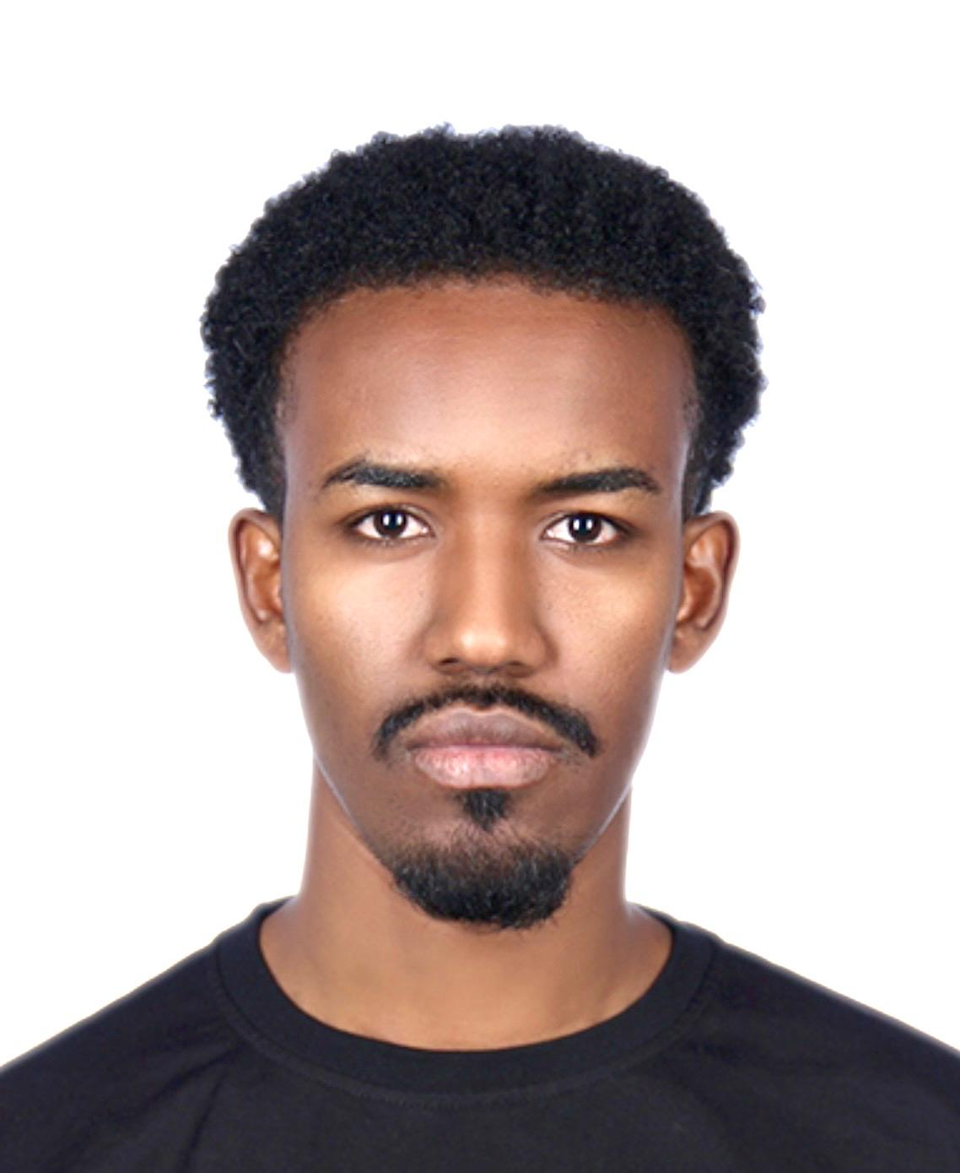
GRADUATION PROJECT · 2026
AstroBot
An Intelligent Conversational AI Assistant
with Multimodal Capabilities, RAG and Workflow Integration
MFBP 402 — Graduation Project II
Computer Engineering · Faculty of Engineering
OSTIM Technical University
Tidiane Konaté
Architecture · Backend · Deployment
Sidi Mohamed Sall
Vision · Product · UX
Ahmed Essalem
AI Engineer · LLM & Multimodal
Saad Ibrahim Houssein
QA · Frontend · Testing
May 18 – 21, 2026 · Advisor: Assist. Prof. Dr. Yücel TEKİN

Slide 2
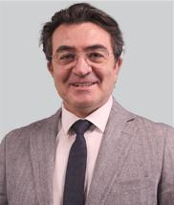
Meet the Team
Four engineers, one goal: make AI feel useful again.
Tidiane Konaté
Sidi Mohamed Sall
Ahmed Essalem
Saad Ibrahim Houssein
Architecture · Backend · Deployment
Vision · Product · UX
AI Engineer · LLM & Multimodal
QA · Frontend · Testing
Advisor · Assist. Prof. Dr. Yücel TEKİN — Computer Engineering · Faculty of Engineering
AstroBot · Graduation Project 2026
Introduction

Slide 3
Agenda
Four parts. About fifteen minutes. One demo.
01
Introduction & Vision
Why AstroBot — the problem, the goals, the users
PRESENTER
Sidi Mohamed Sall
02
Architecture & Design
System model, tech stack, data and security flow
PRESENTER
Tidiane Konaté
03
Implementation
Chat, image gen, RAG, OCR, voice, productivity
PRESENTER
Ahmed Essalem
04
Admin · Testing · Deployment
Dashboard, 66 tests, Docker stack, live MVP
PRESENTER
Saad Ibrahim Houssein
AstroBot · Graduation Project 2026
Introduction

Slide 4
01
Introduction & Vision
Presented by Sidi Mohamed Sall
Why AstroBot — the problem, the goals, the users.

Slide 5
The Problem
The AI assistant landscape is rich — and broken.
Fragmented tools
Chat, image gen, OCR, voice and document Q&A live in different apps. Users waste time switching contexts.
Paywalls everywhere
Most useful features are gated behind subscriptions or per-call fees, which puts students and small teams off-side.
Disposable conversations
Sessions are flat lists. No tags, no folders, no notebook context, no exportable record of what was discussed.
Black-box workflows
Multi-step prompt pipelines are either rebuilt from scratch every time, or invisible inside closed agents.
AstroBot · Graduation Project 2026
Sidi Mohamed Sall · Part 1 of 4

Slide 6
Project Objectives
Build one place where AI feels integrated, not glued together.
01
Unify modalities
Text, image, audio, OCR, document Q&A and code highlighting in a single chat surface.
02
Stay free for users
Combine free-tier APIs (HuggingFace, Mistral, Groq) and self-hosted models behind one wrapper.
03
Make sessions persistent
Folders, tags, notebooks, exports — give every conversation a memory and a paper trail.
04
Show our work
Workflows are saved, replayable and visible — including the n8n graph that drives the agent.
05
Ship a real MVP
Live, dockerised, on a real server, with admin tooling and a 66-test suite — not a prototype.
06
Ground on academic rigor
Defend every choice with measurements, diagrams and reproducible deployment scripts.
AstroBot · Graduation Project 2026
Sidi Mohamed Sall · Part 1 of 4

Slide 7
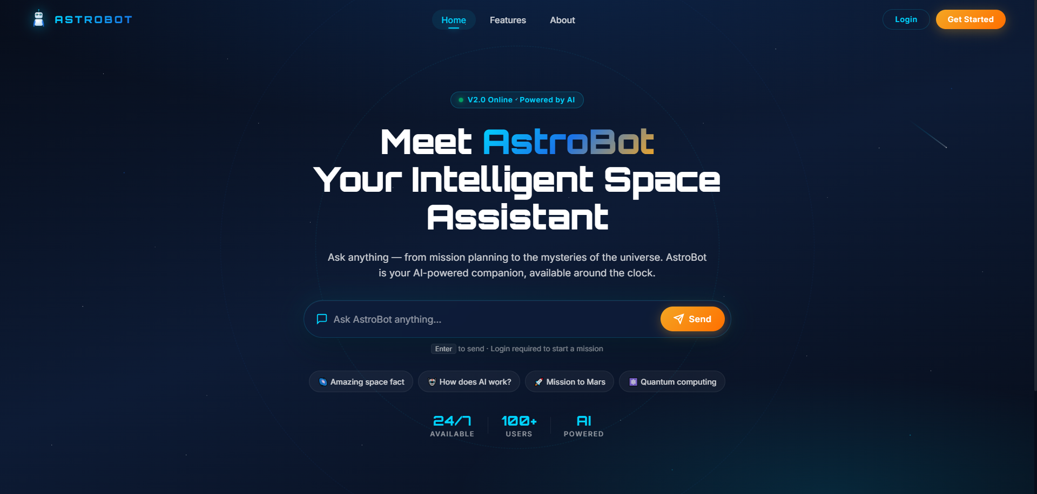
Users & First Impression
Who we built this for — and what they see.
Target users
• Students prepping reports & code
• Developers exploring multimodal AI
• Knowledge workers doing doc Q&A
• Anyone who wants one tab, not ten
Scope of the MVP
• Public + authenticated chat surface
• Admin dashboard with real metrics
• 12+ AI-powered features (see Part 3)
• Production deployment on a real VM
Public landing page — central chat bar, animated robot mascot.
AstroBot · Graduation Project 2026
Sidi Mohamed Sall · Part 1 of 4

Slide 8
02
Architecture & Design
Presented by Tidiane Konaté
How the pieces fit together — services, data, security.

Slide 9
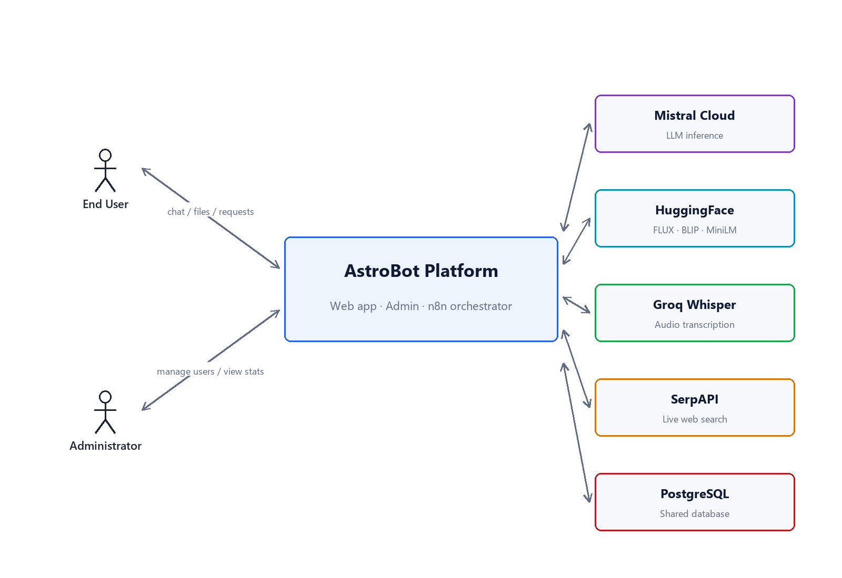
Context Diagram
The system in its environment — who talks to AstroBot and what flows in and out.
What this shows
AstroBot sits in the middle. Around it are the people and external services it talks to.
Actors
• End user — chats, uploads, listens to replies.
• Administrator — runs the dashboard, manages accounts and audits activity.
External services
• Mistral Cloud — the language model behind every reply.
• HuggingFace — image generation, captioning, embeddings.
• Groq Whisper — voice-to-text.
• SerpAPI — web search tool for the AI agent.
Boundary
Everything outside the central box is out of our control and reached over HTTPS only.
AstroBot · Graduation Project 2026
Tidiane Konaté · Part 2 of 4

Slide 10
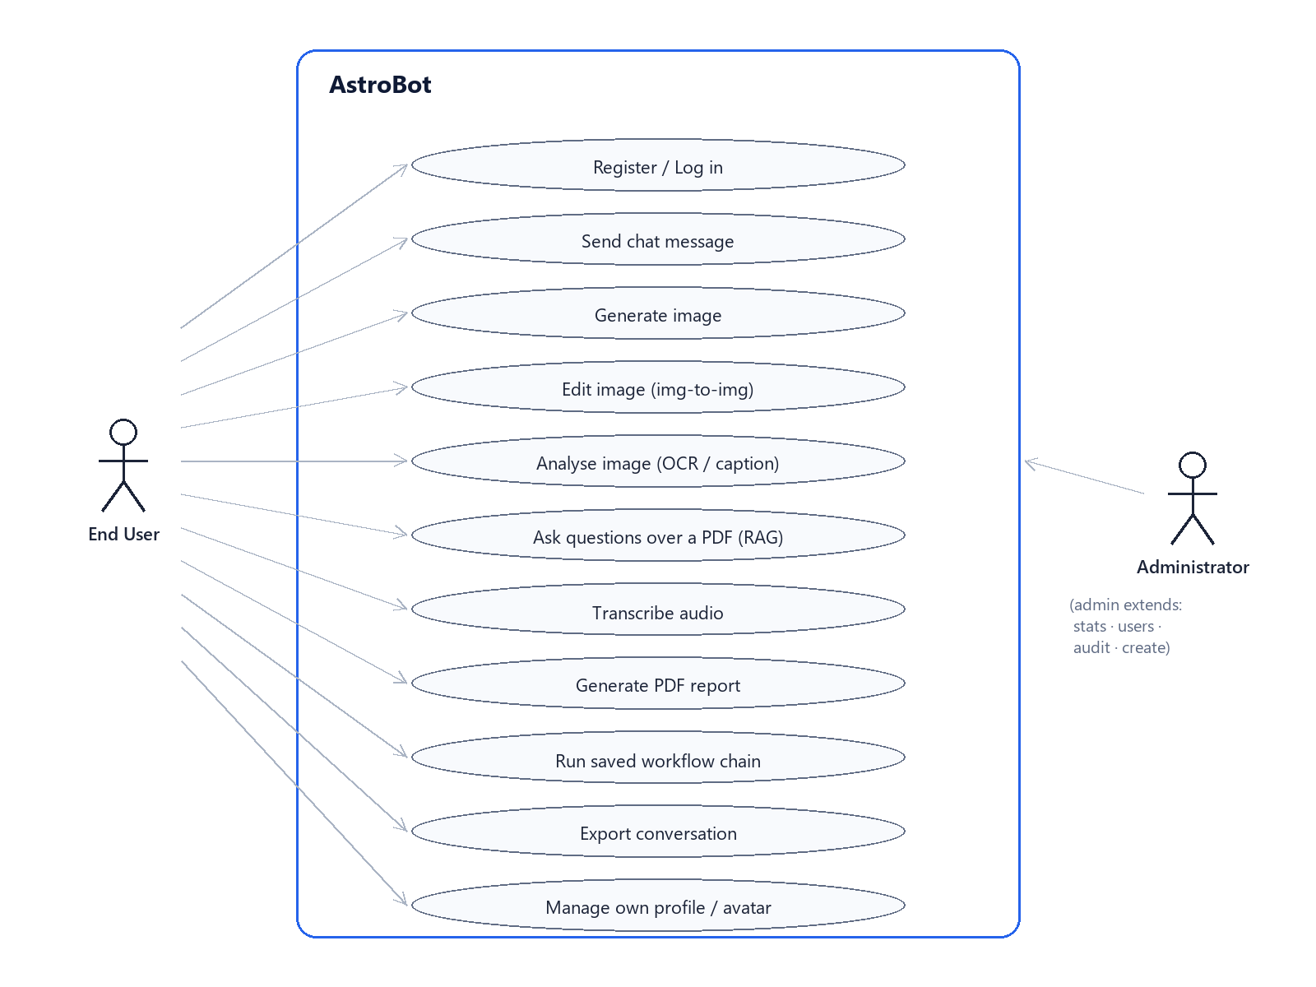
Use-Case Diagram
What end users and administrators can actually do with the system.
End user
• Register & log in (JWT)
• Chat in seven personas
• Generate or edit images
• Ask questions over a PDF (RAG or notebook)
• Speak a message (Whisper transcription)
• Read an image (OCR + BLIP captioning)
• Generate a PDF report on demand
• Save, tag, search and export sessions
• Compose multi-step workflow chains
Administrator
• Log in to the admin dashboard
• View KPIs and activity charts
• Search, suspend, reactivate, delete or create users
• Reset a user's password
• Inspect any user's conversation history
Every use case here also goes through the JWT auth + role gate.
AstroBot · Graduation Project 2026
Tidiane Konaté · Part 2 of 4

Slide 11
System Architecture
Three Docker services on a shared n8n private network.
User Browser
Main App :3000
Public chat surface
Express · JWT · Helmet
Admin Dashboard :7040
Stats · users · audit
Role-gated by JWT
n8n Orchestrator :5678
Mistral agent · SerpAPI
Whisper · Think tool
PostgreSQL (shared)
users · convs · documents · embeddings · workflows
HuggingFace Router
FLUX.1-schnell · BLIP · MiniLM · fal-ai
External APIs
Mistral Cloud · Groq Whisper · SerpAPI
Why this shape:
• Reuses an existing PostgreSQL container — no extra DB to operate.
• All AI traffic exits through n8n, so prompts and tools can be tuned without redeploying.
• Admin lives in its own service so a public-facing exploit can never reach the dashboard process.
AstroBot · Graduation Project 2026
Tidiane Konaté · Part 2 of 4

Slide 12
Technology Stack
Boring, well-supported building blocks at every layer.
Frontend
Backend
AI / LLM
Infrastructure
• Vanilla HTML / CSS / JavaScript
• KaTeX · highlight.js · Mermaid
• Cropper.js · Chart.js (admin)
• No framework — fast & maintainable
• Node.js 18 · Express 4
• JWT · bcrypt 12 rounds
• Helmet · express-rate-limit
• pg, pdfkit, tesseract.js, pdf-parse
• Mistral medium-latest (via n8n agent)
• HuggingFace FLUX.1-schnell · BLIP
• MiniLM-L6-v2 embeddings
• Groq Whisper-large-v3-turbo
• Docker · Docker Compose
• Shared PostgreSQL container
• n8n network (existing)
• Python deploy.py (paramiko)
AstroBot · Graduation Project 2026
Tidiane Konaté · Part 2 of 4

Slide 13
Database Schema
Idempotent migrations on every boot — no manual DBA work.
users
conversations
documents
id · email · password_hash
is_admin · status · avatar · last_login
id · user_id · message · response
session_id · session_tag · image_url
pdf_url · pdf_filename · attachment
id · user_id · name · mime
size · text_content · created_at
document_chunks
notebook_bindings
workflows
document_id · chunk_index
chunk_text · embedding (TEXT)
user_id · session_id · document_id
mode (notebook | rag)
id · user_id · name
steps (JSON)
AstroBot · Graduation Project 2026
Tidiane Konaté · Part 2 of 4

Slide 14
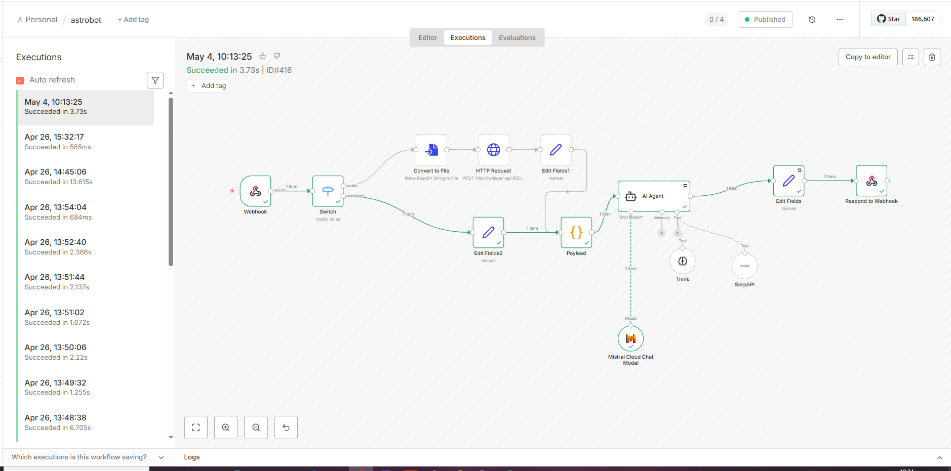
n8n LLM Orchestration
A visual workflow we can tune without redeploying the backend.
Pipeline
Webhook — POST receiver
Switch — audio vs text branch
Whisper — audio transcription
Payload — history + persona enrichment
AI Agent — Mistral medium · 20-iter cap
SerpAPI — live web search (max 2 calls)
Think — scratchpad reasoning
Edit Fields — extracts JSON `response`
Respond — back to backend
AstroBot · Graduation Project 2026
Tidiane Konaté · Part 2 of 4

Slide 15
Security & Resilience
Defence in depth — secrets never live in the repo.
01
Authentication
• JWT (7-day expiry) signed with rotating secret
• bcrypt password hashing (12 rounds)
• Admin gate via `is_admin` JWT claim
02
Network surface
• Helmet HTTP security headers
• CORS allow-list per origin
• No cache on static assets
03
Rate limits
• Auth · 20 / 15 min
• Chat · 30 / min
• Global · 200 / 15 min · Admin · 500 / 15 min
04
Operational hygiene
• Secrets in .env files (gitignored)
• File uploads capped 10 MB · 5 attachments
• Idempotent migrations + admin re-seed at boot
AstroBot · Graduation Project 2026
Tidiane Konaté · Part 2 of 4

Slide 16
03
Implementation
Presented by Ahmed Essalem
The features — chat, multimedia, RAG, productivity.

Slide 17
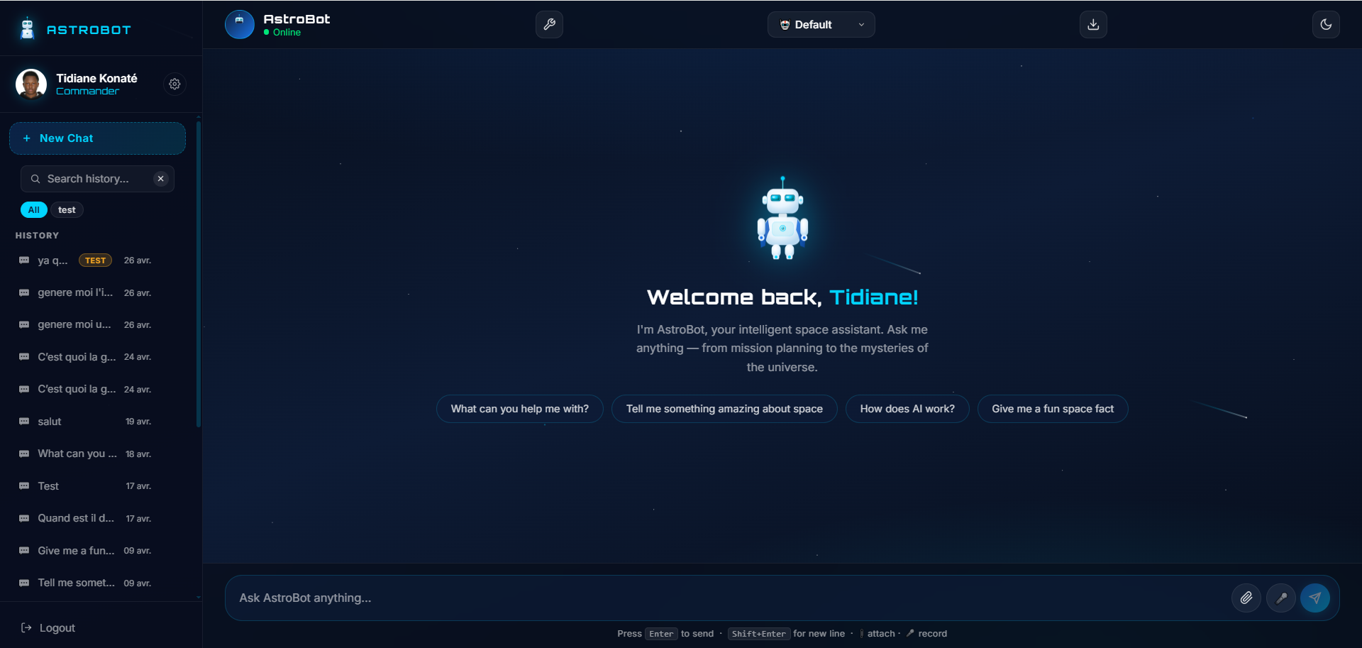
Chat Experience
Streaming-style replies, multilingual, persona-aware.
Mistral medium via n8n
15-message context window per session, persona directives prepended.
Word-by-word reveal
Animated streaming UX without server-side streaming complexity.
Markdown · Math · Code · Diagrams
GitHub-flavored Markdown, KaTeX, highlight.js, Mermaid all live in the same bubble.
Multi-language
Auto-detect FR / EN / ES / DE / AR / ZH / JA / KO / RU / EL.
7 personas
Default · Formal · Casual · Teacher · Developer · Poet · Scientist.
Authenticated chat — welcome screen with quick-start prompts.
AstroBot · Graduation Project 2026
Ahmed Essalem · Part 3 of 4

Slide 18
Rich Content Rendering
A bot bubble is a tiny IDE — it renders what the prompt deserves.
Markdown
Lists, headings, emphasis, blockquotes, links — sanitised on output.
LaTeX math
$E=mc^2$ inline, $$\int_0^\infty$$ block, KaTeX renders client-side.
Code highlighting
highlight.js detects 180+ languages; one-click copy buttons.
Mermaid diagrams
Flow charts, sequence diagrams, ER models, Gantt — straight from text.
Markdown rendering with structured lists, emphasis and code.
AstroBot · Graduation Project 2026
Ahmed Essalem · Part 3 of 4

Slide 19
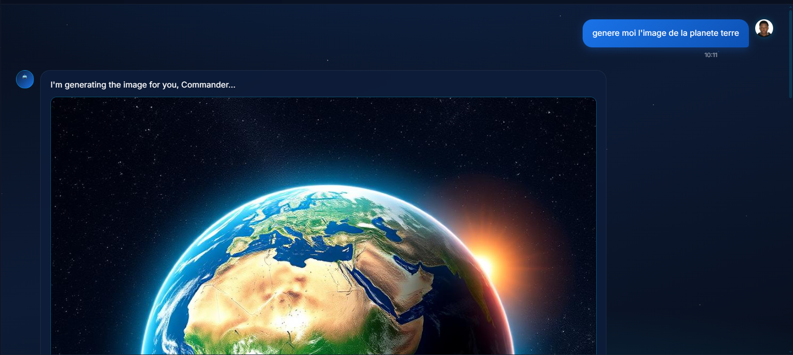
AI Image Generation
Prompt → image, inline, in the same chat thread.
FLUX.1-schnell
HuggingFace router endpoint — 4-step diffusion model, free tier.
fal-ai fallback
Automatic retry path when HF rate-limits or times out.
Image-to-image
Style transfer (anime, oil painting, etc.) via FLUX dev img2img.
Inline rendering
Image is stored as data URL on the conversation row — survives reloads.
Image generation example — prompt-to-render in a single bubble.
AstroBot · Graduation Project 2026
Ahmed Essalem · Part 3 of 4

Slide 20
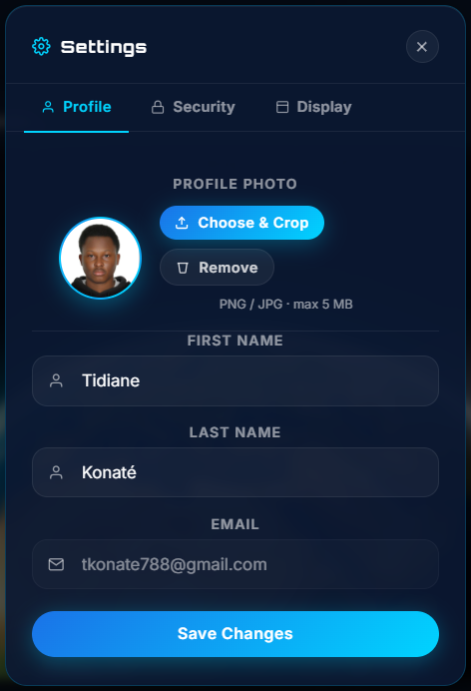
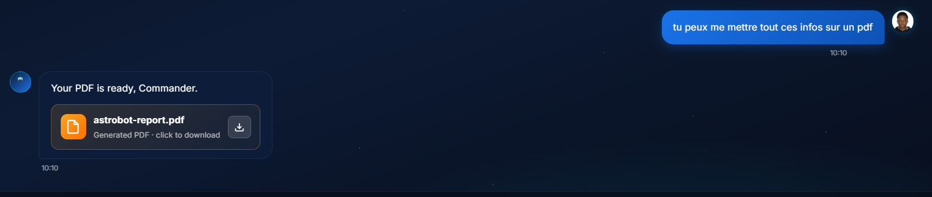
On-Demand PDF Reports
Heuristic detection: when the bot promises a PDF, we ship one.
PDFKit
Server-side composition with title, body, sections and styled emphasis.
Heuristic action triggers
Backend re-parses the agent reply — if it acknowledges the report, we force `generate_pdf`.
Inline preview card
Filename, size badge, one-click download from inside the bubble.
Persisted
Stored as data URL in the conversation row for re-download anytime.
A generated PDF surfaced as a download card inside the chat.
AstroBot · Graduation Project 2026
Ahmed Essalem · Part 3 of 4

Slide 21
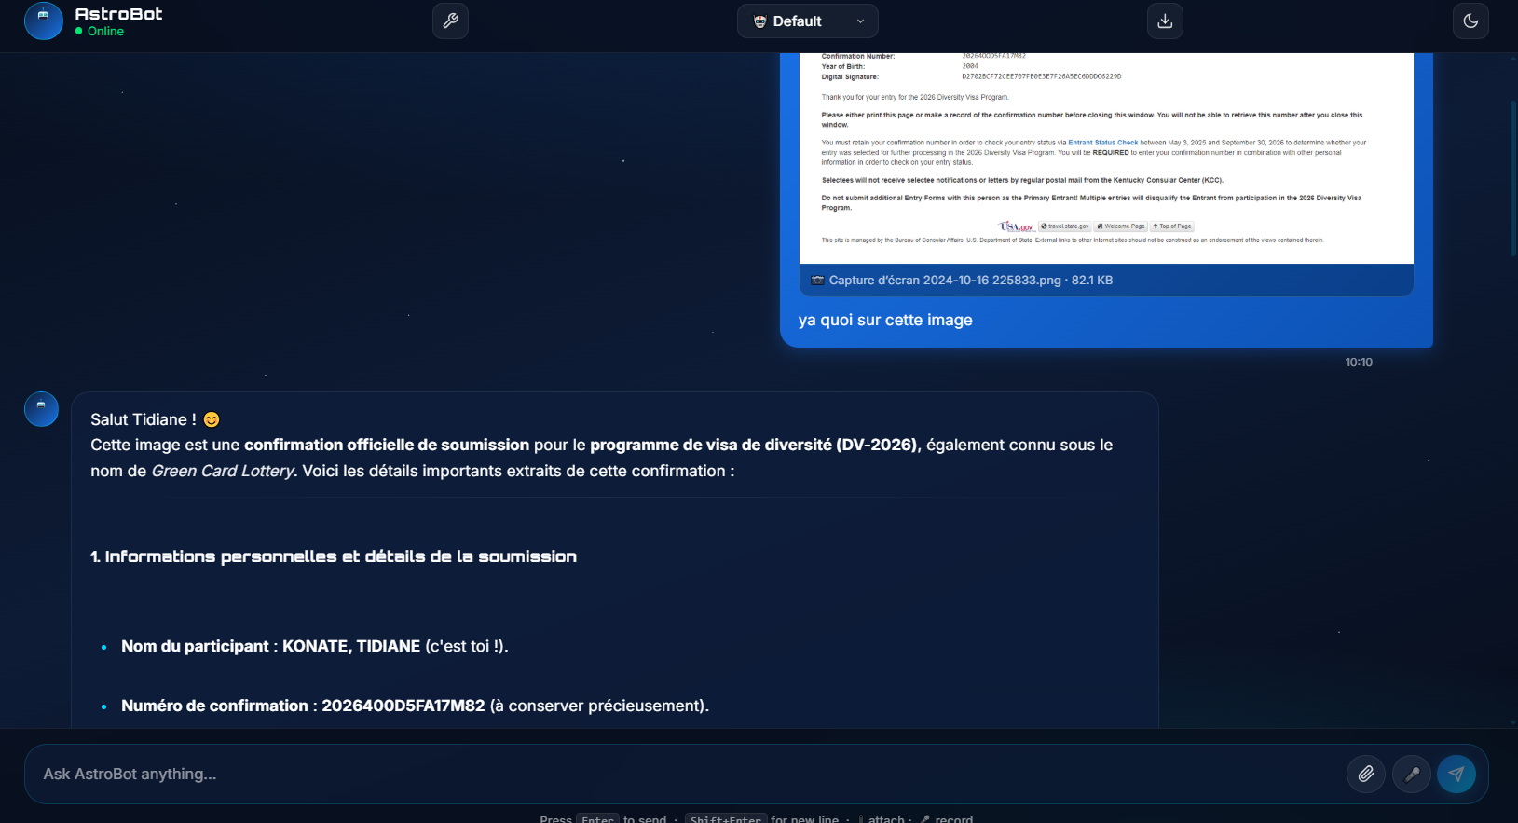
OCR & Visual Understanding
Drop in any image — we'll read it AND describe it.
Tesseract.js
On-server OCR · English + French · embedded as message context.
BLIP captioning
HuggingFace BLIP visualizes the image when there's no text.
Combined into context
Both signals are concatenated to the prompt before reaching Mistral.
Use cases
Forms, screenshots, error messages, scanned documents, ID cards.
OCR + reasoning — the AI explains a Green Card lottery confirmation.
AstroBot · Graduation Project 2026
Ahmed Essalem · Part 3 of 4

Slide 22
Document Q&A — RAG & Notebook
Two retrieval modes, one chat surface.
Upload PDF
pdf-parse
Chunk
800 chars · 100 overlap
Embed
MiniLM-L6-v2
Retrieve
top-4 cosine
Inject + Ask
Mistral via n8n
Notebook mode
First 6,000 characters of the bound document are *always* in context. Best for short PDFs or when you want the AI to discuss the whole document.
RAG mode
On every question we embed the prompt with MiniLM and pull the top-4 most similar chunks (cosine similarity) into context. Scales to long documents.
Why we kept both:
• Notebook is dependable for thesis-sized PDFs (<10 pages).
• RAG is the only thing that makes 200-page books answerable in real time.
AstroBot · Graduation Project 2026
Ahmed Essalem · Part 3 of 4

Slide 23
Productivity Tools
The pieces we missed in every other AI app.
01
Workflow chains
Save multi-step prompt sequences and replay them on a single click.
02
Folders & tags
Color-coded session tags · search across full conversation history.
03
Exports
Conversation as PDF · Markdown · JSON — three clicks each.
04
YouTube summarizer
Paste a URL, get a transcript-grounded summary inside the chat.
05
Audio transcription
Browser recording → Groq Whisper-large-v3-turbo → typed reply.
06
Profile + cropper
Built-in image cropper (rotate · zoom · flip) for avatars.
AstroBot · Graduation Project 2026
Ahmed Essalem · Part 3 of 4

Slide 24
04
Admin · Testing · Deployment
Presented by Saad Ibrahim Houssein
How we operate, audit and ship the product.

Slide 25
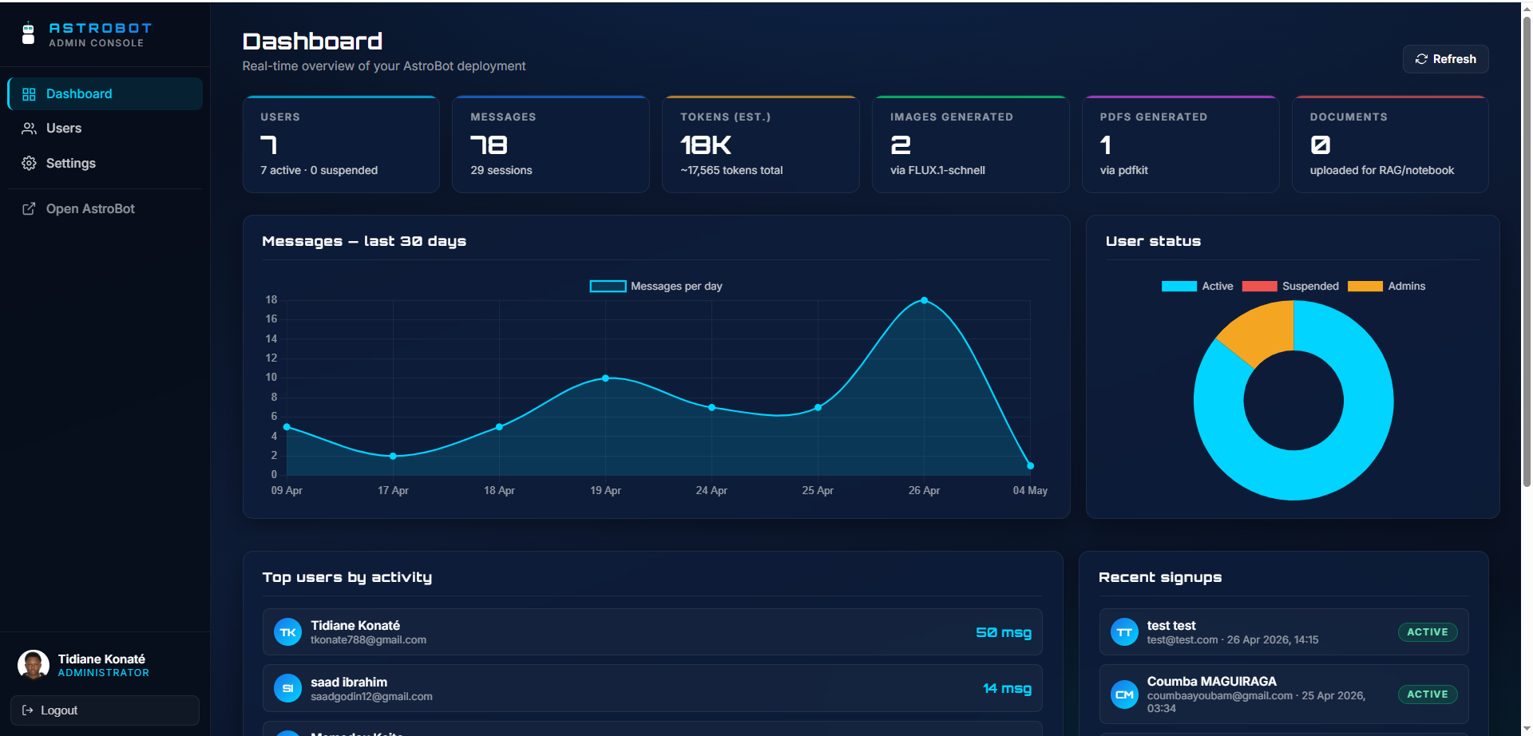
Admin Dashboard
A second Express service — fully isolated from the public app.
Real-time KPIs
Users · messages · sessions · tokens · images · PDFs · documents.
Charts
Daily activity (30 days) and user-status doughnut, both Chart.js.
Recent signups & top users
Quick triage panels visible above the fold.
Hard role gate
Login refuses any account that is not `is_admin = TRUE`.
Admin dashboard — KPIs, daily message chart, status doughnut.
AstroBot · Graduation Project 2026
Saad Ibrahim Houssein · Part 4 of 4

Slide 26
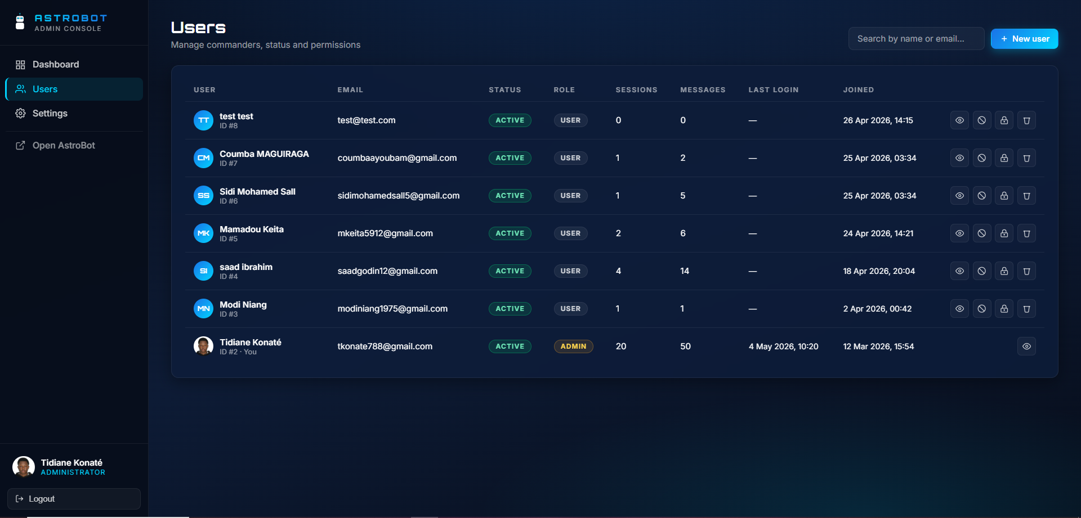
User Management
Search, audit, suspend, reset, delete — without touching the database.
Searchable table
Status · role · sessions · messages · last login · joined date.
Lifecycle actions
Suspend / activate · reset password · delete user (self-delete blocked).
Account creation
Admins create regular or admin accounts directly from the UI.
Soft 403 responses
Non-admin tokens are rejected before any state is read.
User management table with status, role and recent activity columns.
AstroBot · Graduation Project 2026
Saad Ibrahim Houssein · Part 4 of 4

Slide 27
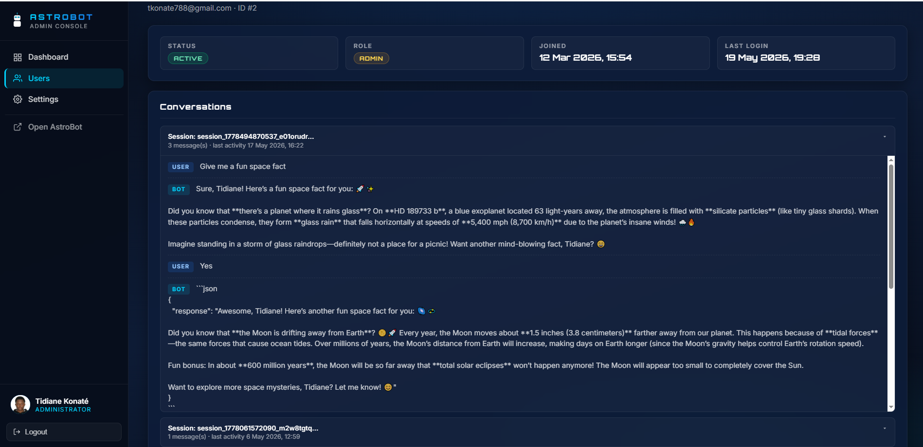
Conversation Audit
Every conversation, grouped by session, on demand.
Profile metadata
Email · joined · status · role · counts at a glance.
Sessions list
Each session previewed with its first message and tag.
Drill-down
Open any session to see the full message + response history.
Compliance-ready
Built so we can answer a 'what did this user ask?' request in seconds.
User detail — full conversation history grouped by session.
AstroBot · Graduation Project 2026
Saad Ibrahim Houssein · Part 4 of 4

Slide 28
Testing — 66 Integration Tests
`python test_all.py` — single command, full suite, real server.
Health Main + admin /health endpoints reachable
Static assets HTML/CSS/JS served with no-cache headers
Auth Login · wrong password · missing token · role check
Admin CRUD Stats · users list · create · update · suspend · reset · delete
Main app Profile · avatar set + clear · password change
Chat flow Round-trip via n8n → Mistral → response
Sessions Tags · history · session detail · session delete
Exports PDF · Markdown · JSON exports validate
Features Documents · RAG bind/unbind · workflows CRUD
Validation Bad inputs return clean 400/422 — never 500
AstroBot · Graduation Project 2026
Saad Ibrahim Houssein · Part 4 of 4

Slide 29
Production Deployment
One command. Real VM. Real users.
deploy.py — five remote commands
Live containers
1. tar -cz frontend backend admin docker
2. SFTP upload to /tmp on the VM
3. ssh: tar -xz into ~/astrobot
4. docker compose up -d --build
5. healthcheck verifies both services
astrobot:2.0.0 :3000 main app
astrobot-admin:1.0.0 :7040 admin dashboard
postgre_container :5432 shared (read/write own DB only)
n8n :5678 external · do not modify
Try it right now
Web app · http://76.13.62.195:3000
Admin · http://76.13.62.195:7040
Source · github.com/tkonate788/astrobot
AstroBot · Graduation Project 2026
Saad Ibrahim Houssein · Part 4 of 4

Slide 30
Lessons Learned & What's Next
What we'd build differently — and where we're heading.
Lessons learned
What's next
Cache-Control: no-store on iOS
Mobile Safari held onto stale CSS for hours; killed it at the express layer.
Heuristic action triggers
LLMs occasionally agree to a PDF without flagging it — backend re-parses replies.
Idempotent migrations
ALTER TABLE ... ADD COLUMN IF NOT EXISTS lets the app self-heal on every boot.
Single deploy script
Beats `git pull` over SSH — no half-deployed state on partial failures.
Mobile-first PWA
Service worker · push notifications · standalone app feel.
Voice mode
Two-way audio loop — Whisper in, Web Speech out.
More languages
Tesseract Arabic + Cyrillic; persona auto-tuning per language.
Self-hosted Whisper
Already in n8n graph — extend it to all audio paths.
Plug-in marketplace
Workflows shared and rated across users.
AstroBot · Graduation Project 2026
Saad Ibrahim Houssein · Part 4 of 4

Slide 31
Key Takeaways
What AstroBot proves we can deliver.
12+
66
3
4
AI-powered features, all in one place — chat, image, OCR, RAG, voice, PDF, workflows.
Integration tests covering auth, chat, admin and features; runnable in one command.
Dockerised services on a single shared network — reproducible from a fresh VM.
Engineers, four roles, four months — no feature got dropped along the way.
AstroBot is not a demo — it is a working product.
Every feature shown today runs against the live VM at http://76.13.62.195:3000 — feel free to log in during Q&A.
AstroBot · Graduation Project 2026
Conclusion

Slide 32
Thank you for your attention!
QUESTIONS WELCOME
Try AstroBot live
Web app · http://76.13.62.195:3000
Admin · http://76.13.62.195:7040
GitHub · github.com/tkonate788/astrobot
Tidiane Konaté · Sidi Mohamed Sall · Ahmed Essalem · Saad Ibrahim Houssein
Advisor — Assist. Prof. Dr. Yücel TEKİN
OSTIM Technical University · May 18 – 21, 2026

