Slide 1
Result
 | Block Matching |  | Our Method |  | Classic++
Name | Time (s) | AAE (deg) | Time (s) | AAE (deg) | Time (s) | AAE (deg)
Rubber Whale | 21 | 10.4 | 86 | 5.6 | 210 | 3.8
Grove2 | 29 | 7.4 | 142 | 5.6 | 316 | 2.2
Dimetrodon | 23 | 11.1 | 89 | 8.0 | 215 | 1.9
Hydrangea | 20 | 10.0 | 89 | 8.8 | 217 | 6.8
Grove3 | 30 | 12.9 | 141 | 11.6 | 312 | 6.3
Venus | 15 | 13.8 | 55 | 15.4 | 139 | 4.4
Average | 23 | 10.9 | 100 | 9.2 | 235 | 4.2
We achieve reasonable AAE using our approach while reducing the computation time by at least 2x.

Slide 2
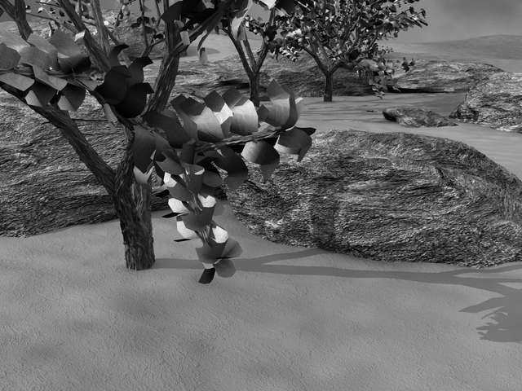
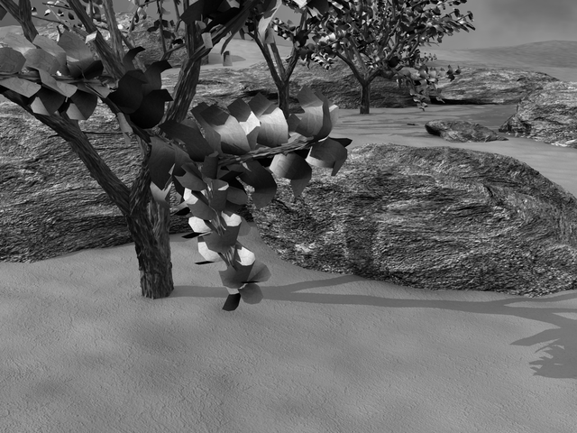
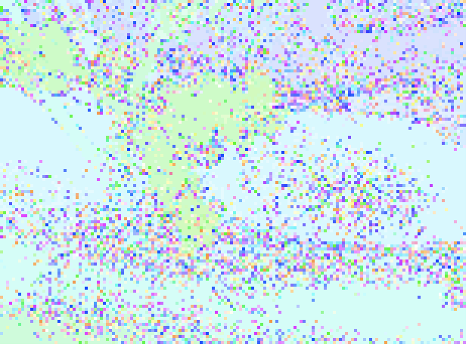
Block Matching (con’t)
Frame 1
Frame 2
Block Matching
Optical flow from block matching requires additional processing to remove artifacts.

Slide 3
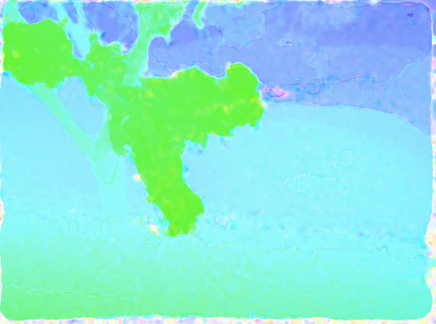
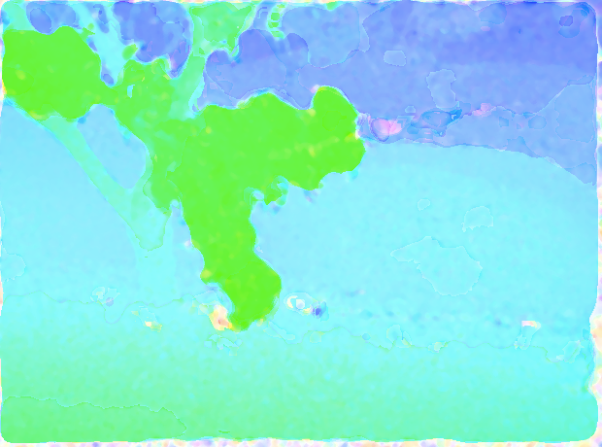
Median Filter (con’t)
Raw Block Matching
Median Filter Applied
Weighted Median Filter
Applied
The output of the regular and weighted median filter are indistinguishable.

