Slide 1
Optical Flow Estimation Using Block Matching with Weighted Median Filtering
Twan Koolen and James Noraky
December 8, 2014

Slide 2
Motivation
Modern optical flow algorithms (e.g. Classic++) are accurate but computationally slow
Optimization techniques like coarse-fine optimization, GNC optimization, etc. are slow
Block matching algorithms are fast but inaccurate compared to optical flow algorithms
Compromise: Can we use block matching algorithms to speed up optical flow estimation?
Notes:
Stress 2 angles video compression

Slide 3
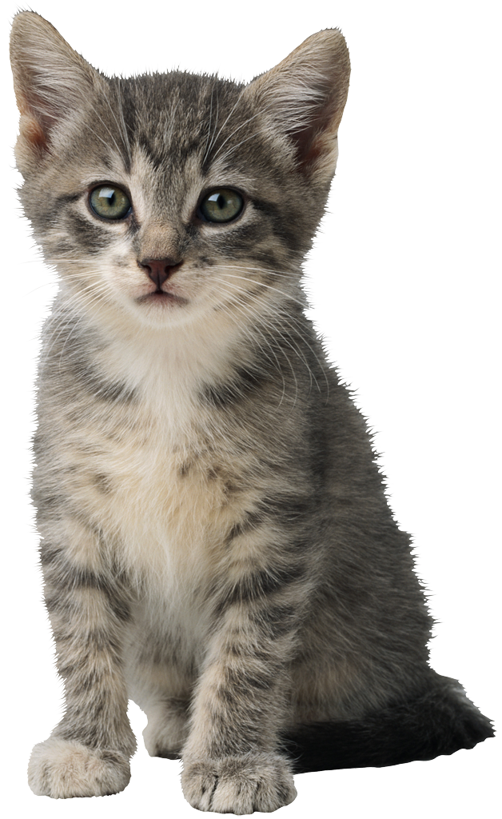
Block Matching
Block matching is used to find the motion of blocks of pixels across consecutive video frames
Matching criteria include: Sum squared difference, Sum absolute difference, normalized correlation
Frame 1
??
✪
Frame 2
Compute normalized
correlation
Find point that corresponds to maximum
Notes:
Block matching is not very good

Slide 4
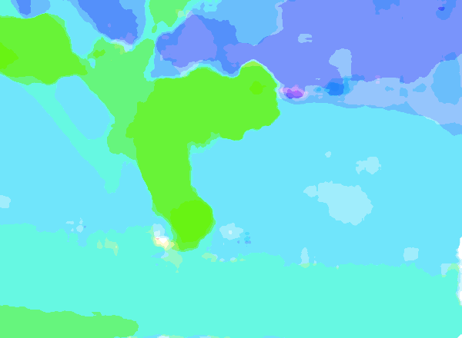
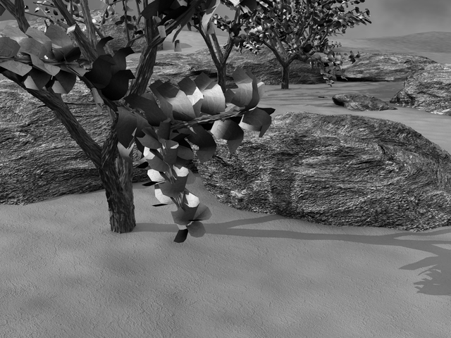
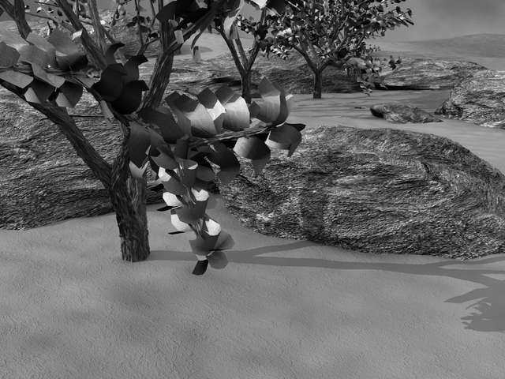
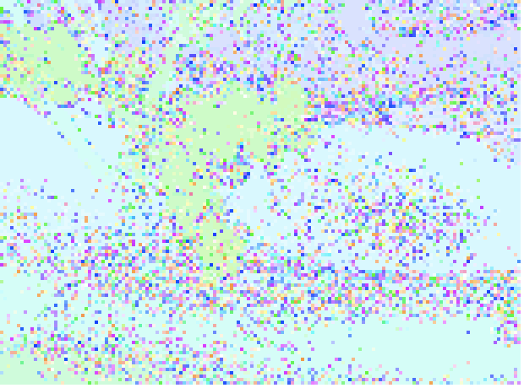
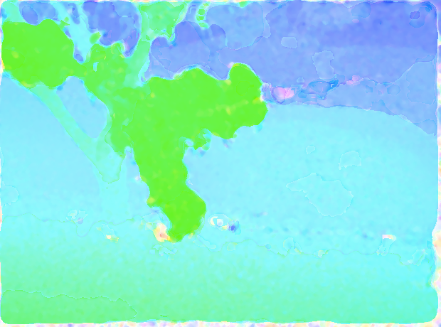
Our Proposed Method
Warp
Frame 2
Block Matching
Median Filtering
Differential method
Frame 1
Notes:
Slow but nuggets (weighted median filter) we can take from it

Slide 5
Weighted Median Filter (Twan)
Optical flow obtained through block matching is then
Notes:
Show example of

Slide 6
Setup
Used Middlebury Optical Flow Training Set (n=8)
Evaluated our proposed methods (with regular and weighted median filtering) and Classic++ against ground truth flow
Evaluation Metrics
Time (seconds)
Average Angular Error (AAE):
Average Endpoint Error (EPE)

Slide 7
Results
 | Our Method Without Weighted Median |  |  | Classic++
Name | Time | AAE | EPE | Time | AAE | EPE
Dimetrodon | 92 | 8.0 |  | 215 | 1.9
Grove2 | 150 | 5.6 | 0.4 | 316 | 2.2 | 0.149
Grove3 | 152 | 11.6 | 1.1 | 312 | 6.3 | 0.662
Hydrangea | 93 | 8.8 |  | 217 | 6.8
RubberWhale | 92 | 5.6 |  | 210 | 3.8
Venus | 59 | 15.4 |  | 139 | 4.4
Urban2 | 127 | 27.2 | 6.4 | 306 | 3.0 | 0.414
Urban3 | 117 | 51.0 | 6.2 | 304 | 8.1 | 1.003
We achieve reasonable AAE and AEP using our approach while reducing the computation time by at least 2x.

Slide 8
Results (con’t)
 | Our Method With Weighted Median |  |  | Classic++
Name | Time | AAE | EPE | Time | AAE | EPE
Dimetrodon | 184 | 8.4 |  | 215 | 1.9
Grove2 | 210 | 5.3 | 0.4 | 316 | 2.2 | 0.149
Grove3 | 311 | 11.1 | 1.1 | 312 | 6.3 | 0.662
Hydrangea | 160 | 8.7 |  | 217 | 6.8
RubberWhale | 131 | 5.6 |  | 210 | 3.8
Venus | 84 | 15.4 |  | 139 | 4.4
Urban2 | 342 | 27.2 | 6.4 | 306 | 3.0 | 0.414
Urban3 | 370 | 51.0 | 6.2 | 304 | 8.1 | 1.003
Weighted median filter slows down optical flow estimation without significant gain.

Slide 9
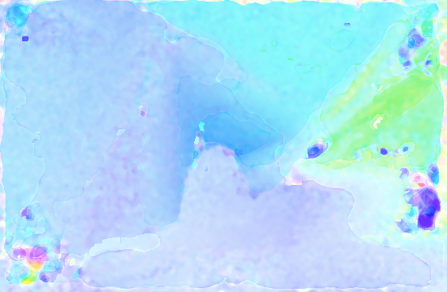
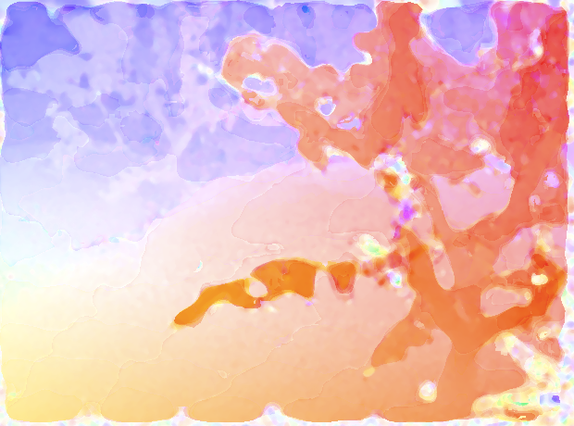
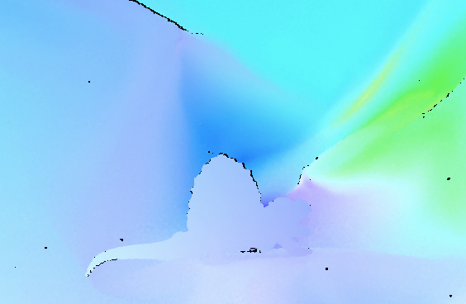
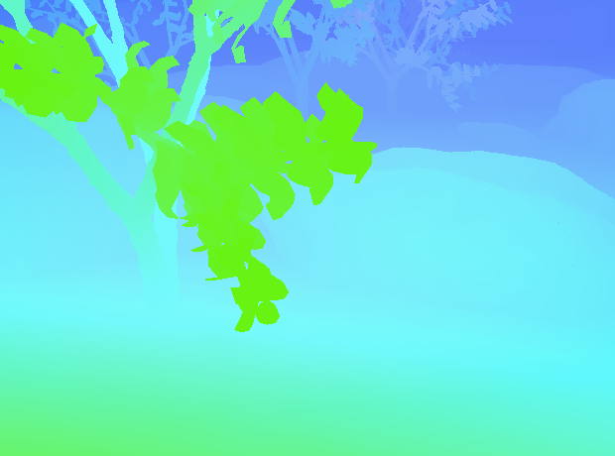
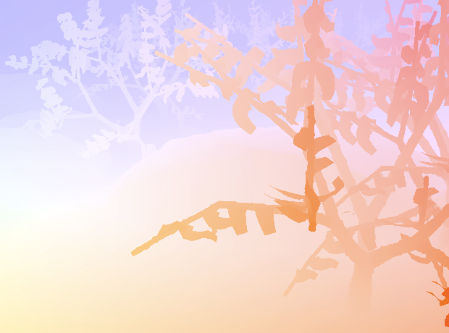
Results (con’t)
Dimetrodon
Grove 2
Grove 3
TOP: Flow estimates obtained by our approach
BOTTOM: Ground truth flow estimates

Slide 10
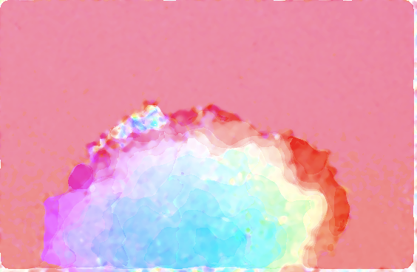
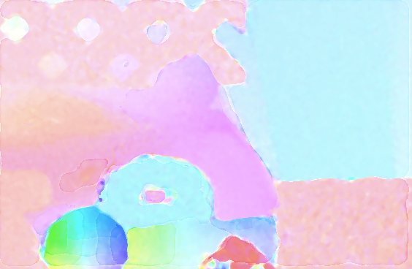
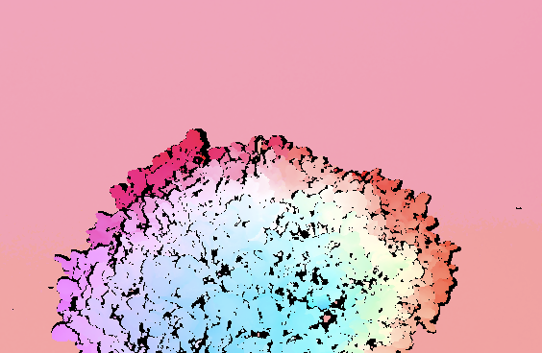
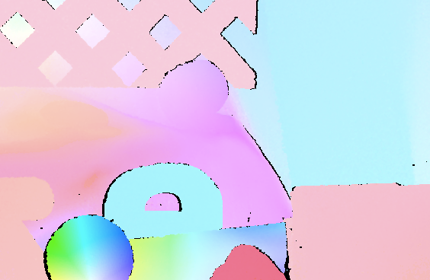
Results (con’t)
Hydrangea
Rubber Whale
TOP: Flow estimates obtained by our approach
BOTTOM: Ground truth flow estimates

Slide 11
Contributions (??)

