Slide 1

AI for the Industry 4.0 - Sensor Validation Plan
Tomasz Korulczyk

Slide 2
Goal
To predict the value of spectroscopic signals of sensor for isopropanol and for water based on measured characteristics in air using Machine Learning algorithm.

Slide 3
Importing data
First, the data from the files were loaded using a loop and the variability due to the affiliation of the measurement to a particular sensor was taken into account.
Upload of data was based on 10 independent sensor measurements for all the required properties being tested (air, water, isopropanol

Slide 4
Cleaning data phase
Then, the cleaning data procedure was verified, i.e., it was checked (1) whether there are any erroneous entries, (2) whether there are missing data and what is the scale of the phenomenon, (3) whether there are outlier cases. None of the above was shown.

Slide 5
Learning phase
The collection was divided into a test and training section in a ratio of 80% (test) to 20% (training).

Slide 6
Training phase
Linear regression was used to explain the value of the explained variance by the independent variable (air) relative to the dependent variables (water, isopropanol). R2 and MSE model fit indices were calculated.
The model showed a good fit, with 87.99% of the explained variance for the training set and 87.70% of the explained variance for the test set.
This means that air is a good predictor of the other properties (water and isopropanol).

Slide 7
Training phase
MSE of training set (5.679) and test set (5.505) is relatively small and test results are slightly higher than train one - which means a relatively good fit of the model.

Slide 8
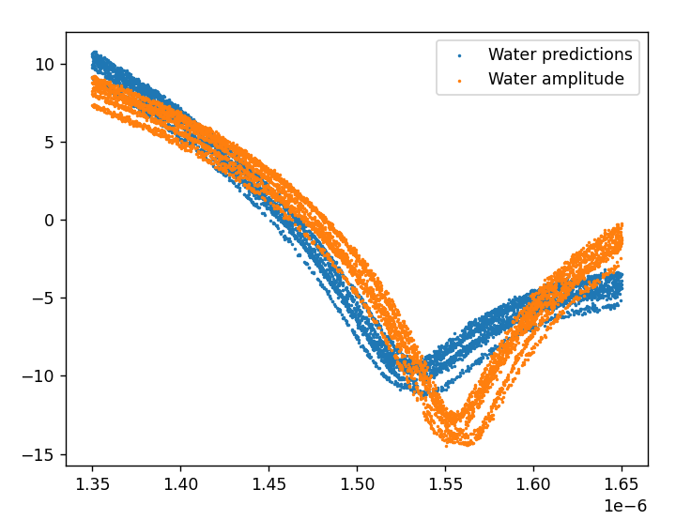
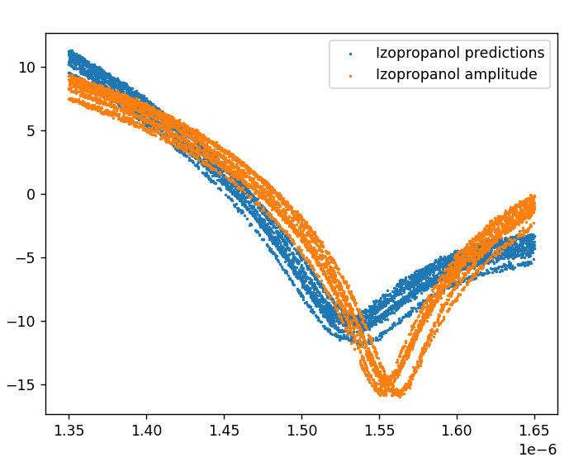
Visual evaluation phase
Visual evaluation of predicted and true results of water and isopropanol shows that the values are relatively well matched, however there are fragments of poorer matching, particularly at wavelengths below -10.

Slide 9
Conclusions and recommendations
It can be said that linear regression can be used as an input proposal. however, it is worth checking whether a non-linear regression, such as quadratic regression, would prove to be a better fit.

