Slide 1
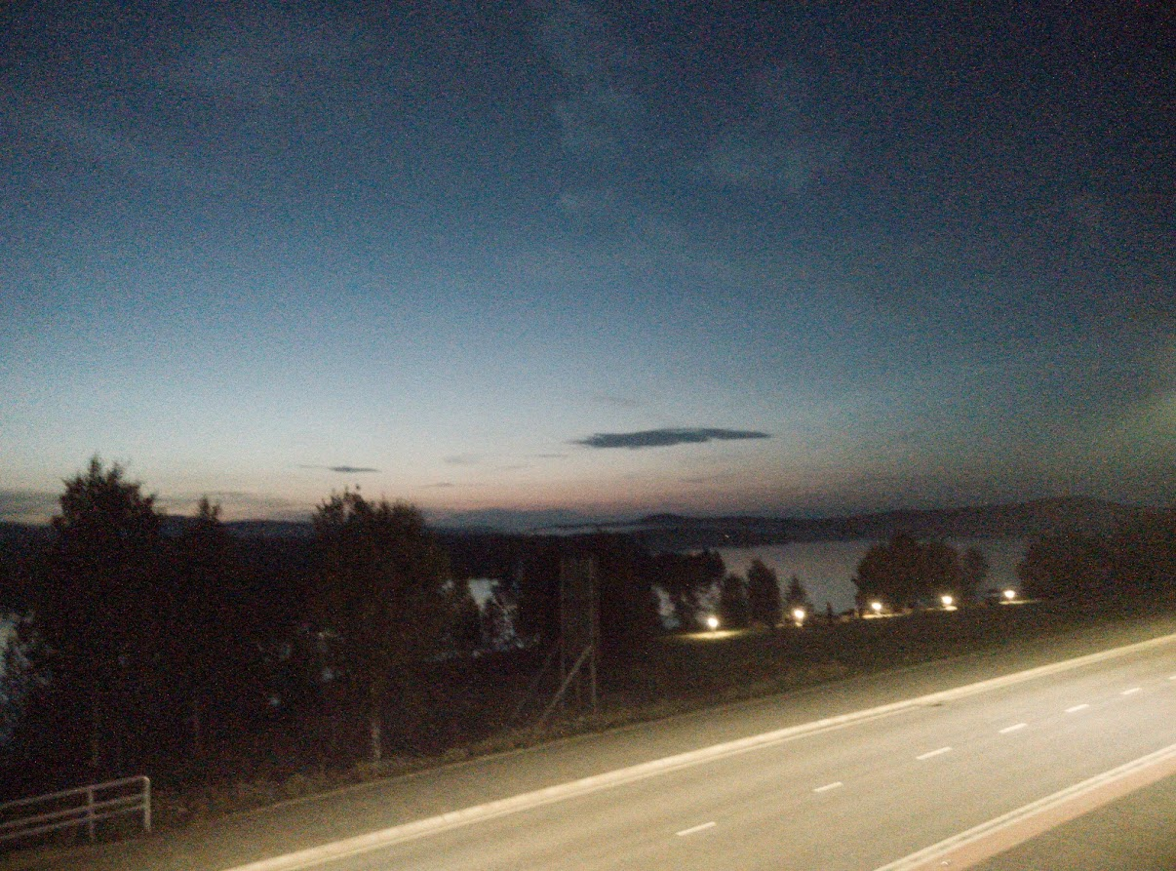
Vowel Harmony and Related Phenomena in Inari Saami
Tuomas Koukkari
Giellagas Institute, University of Oulu
Congressus XIII Internationalis Fenno-Ugristarum
Vienna, 24.08.2022

Slide 2
Earlier Works
Äimä 1918: IS phonetics and phonology
Itkonen 1939, 1971, etc.: Historical and recent development, metaphony
Korhonen 1981 (etc.): Historical development
Sammallahti 1984, 1998 etc.: Historical and recent development, metaphony
Morottaja 2016: Harmony, vowel families and types (vookaalperruuh já -tiijpah; vokaaliperheet ja -tyypit)
Ibid.; Morottaja & Olthuis (2022): vowel families and types, morpho-phonological classification of words based on first-syllable vowel

Slide 3
Note on Transcription
IPA | FUT | Itkonen (e.g. 1971, 1992) | Valtonen et al. (2022) | Morottaja & Olthuis (2022) | Current standard | Koukkari
ə, ɤ, ɘ, ɜ, ɐ | e̮, ɛ͔, ɛ̮, ɒ, ă | æ¹, a² | ə | ɘ, â (ə) | e¹, â² | ə
e | e | e | e | e | e | e
ɑ | a | a | ɑ | a | a | ɑ
a, æ | ȧ, ä | ȧ, ä | æ | á, ä | á, ä | a > æ
1) First syllable
2) Non-initial syllables
In this presentation:
  Example words in (standard) orthography.
  Phonemic transcriptions in the same IPA-based system as used by Valtonen, Aikio & Ylikoski in the Oxford Guide to the Uralic Languages.
  Historical reconstructions in the established FUT.

Slide 4
Vowel Phonemes
Monophthongs
Rounded front vowels only occur as independent phonemes in loanwords.
Status of ə is complicated.
Vowel length:
  Usually considered phonemic; 2-3 degrees for monophthongs, 2 for diphthongs.
  Standard orthography indicates long monophthongs with double letter (<aa> = /ɑː/); length otherwise not shown.
  Length in 1st syllable varies independently of quality, and can thus be ignored in this presentation (mainly short vowels used, but same rules for long ones).
i | (y) |  | u
e, (ø) |  | ə | o
æ |  |  | ɑ
Diphthongs
ie | ye | uo
iæ | uæ

Slide 5
Historical Development: PS Situation
Proto-Saamic vowels
Mainly bisyllabic word roots
All non-contracted vowels may occur as 1st-syllable vowel (V1).
Contracted vowels only occur as V2.
The only non-contracted vowels occurring freely as V2 are *e̮, *ē, *ɔ̄.
  *o̭, *u, *ɛ̄, *ō not found in this position.
  *i, *ā as V2 (almost) exclusively in suffixed forms.
Short
*i |  | *u
 | *e̮ | *o̭
Long
*ē | *ō
*ɛ̄ | *ɔ̄
*ā
Contracted
*î | *û
*ê | *ɔ̂
*â

Slide 6
Historical Development: Main Rules
V1 | V2 | *e̮ | *i | *î | *û | *ā | *â | *ɔ̄ | *ɔ̂ | *ē |  | *ê
*e̮ |  | o–ə | o–i |  | o–u | ɑ–ɑ |  | a–o |  | ɑ–e
*o̭ |  | u–ə | u–i |  | u–u | o–æ |  | o–o |  | o–e
*u |  |  |  |  |  | u–æ |  | u–o |  | u–e
*i |  | i–ə | i–i |  | i–u | i–æ |  | i–o |  | i–e
*ā |  | ɑ–ə | ɑ–i |  | ɑ–u | ɑ–ɑ |  | æ–u | æ–o | æ–i |  | æ–e
*ɔ̄ |  | o–ə | o–i |  | o–u | uæ–æ |  | uæ–u | uæ–o | uæ–i |  | uæ–e
*ō |  | uo–ə | uo–i |  | uo–u |  |  |  |  | ye–i | ye–e
*ɛ̄ |  | ə–ə | e–i |  | ə–u | iæ–æ |  | iæ–u | iæ–o | e–i | e–e
*ē |  | ie–ə | ie–i |  | ie–u |  |  |  |  | ie–i | ie–e
V2 quality
largely
retained.
  Non-contr.
  *ɔ̄,*ē > u, i
  usually after
  long V1.
IS V1
depends
on V2; some combinations rare or impossible.

Slide 7
Historical Development: Exceptions in V2
*e̮ > /ɑ/ before final /h/: kielâ ’tongue, language’, NOM.PL kielah.
Changes before /j/:
  *e̮ > /æ/ (in originally trisyllabic forms): kielâ, SG.COM kieláin
  *ɔ̄ > /o/ (as above): ákku ’grandmother’ SG.COM áhhoin
  *î > /e/ (in uncontracted forms of contr. verbs): finniđ ’get’, PST.1SG finnejim
Split of *ē after historically long V1:
  *ē > /e/ when preceded by a short consonant and V1 of the group /e ie ye/:
  eelliđ ’live’, IMP.2SG ele
  *ē > /i/ otherwise.
  Dialectal variation: *ē > /e/ may occur more broadly than specified above, and there may be a similar split of *ɔ̄ into /o/ and /u/.

Slide 8
Current Situation: V1–V2
 | ɑ | o | u | i | æ | e | ə
ɑ | ɑ–ɑ | ɑ–o | ɑ–u | ɑ–i | ɑ–æ | ɑ–e | ɑ–ə
o | o–ɑ | o–o | o–u | o–i | o–æ | o–e | o–ə
u | u–ɑ | u–o | u–u | u–i | u–æ | u–e | u–ə
i | i–ɑ | i–o | i–u | i–i | i–æ | i–e | i–ə
æ | - | æ–o | æ–u | æ–i | æ–æ | æ–e | -
e | e–ɑ | e–o | e–u | e–i | e–æ | e–e | -
ə | ə–ɑ | - | ə–u | - | ə–æ | ə–e | ə–ə
iæ | - | iæ–o | iæ–u | - | iæ–æ | - | -
uæ | - | uæ–o | uæ–u | uæ–i | uæ–æ | uæ–e | -
uo | uo–ɑ | uo–o | uo–u | uo–i | uo–æ | ? | uo–ə
ie | ie–ɑ | ? | ie–u | ie–i | ie–æ | ie–e | ie–ə
ye | - | - | - | ye–i | - | ye–e | -
◼ Typical
◼ Limited
◼ Very
limited
(individual
forms,
recent
loans)
◼ Marginal
or non-
existent

Slide 9
Current Situation: V1–V2
 | ɑ | o | u | i | æ | e | ə
ɑ | asta | asto | rahtuđ | rahtim | palláim | alme | hattâ
o | joolah | osko | oskum | ostim | kován | kove | jollâ
u | tuulah | puško | muttuđ | muttiđ | sukká | mušteđ | tullâ
i | čiiŋah | kirkko | pivdum | finniđ | pirrá | ihe | čiŋŋâ
æ | - | áhhoid | ákku | rähtiđ | lášká | käskee | -
e | teltta | leijoon | hersku | enni | kehá | pele | -
ə | eeđah | - | ennuv | - | hææjȧid | tælle | ettâ
iæ | - | siäloid | siälu | - | hiärrá | - | -
uæ | - | vuároid | vuáru | kuáti | puátá | puáttee | -
uo | čuolmah | kuoro | puohtuđ | puohtim | čuolmáid | ? | čuolmâ
ie | kieđah | ? | tiettuđ | tiettiđ | kieđáid | tieđe | kietâ
ye | - | - | - | kyeli | - | kyele | -
◼ Typical
◼ Limited
◼ Very
limited
(individual
forms,
recent
loans)
◼ Marginal
or non-
existent

Slide 10
/ɑ/ vs. /æ/: Harmony
 | ɑ | æ
ɑ | ɑ–ɑ | ɑ–æ
o | o–ɑ | o–æ
u | u–ɑ | u–æ
i | i–ɑ | i–æ
æ | - | æ–æ
e | e–ɑ | e–æ
ə | ə–ɑ | ə–æ
iæ | - | iæ–æ
uæ | - | uæ–æ
uo | uo–ɑ | uo–æ
ie | ie–ɑ | ie–æ
ye | - | -
 | ɑ | o | u | i | æ | e | ə
ɑ | ɑ–ɑ | ɑ–o | ɑ–u | ɑ–i | ɑ–æ | ɑ–e | ɑ–ə
æ | - | æ–o | æ–u | æ–i | æ–æ | æ–e | -
Cannot normally co-occur in a (non-compound) word.
  With other vowels partially complementary.
V1 /ɑ/ causes V2 /ɑ/ instead of /æ/:
  ihe ’year’, SG.ILL ihán; kove ’picture’, SG.ILL kován;
  ahe ’age’ SG.ILL ahan
Some forms feature regressive metaphony instead of progressive harmony:
  aassâđ /ɑːssəð/ ’live, dwell’, PRS.3SG áásá /æːsæ/

Slide 11
/ɑ/ vs. /æ/: Disharmony
Disharmonic sequences may occur when the first-syllable vowel is /ɑ/:
  Before /j/: aassâđ, PST.3DU aasáin /ɑːsæjn/
  In polysyllabic forms: VABE asâhánnáá /ɑsəhænnæː/
  With long /æː/: taat /tɑːt/ ’this’, SG.ABE taanttáá /tɑːnttæː/
No disharmonic words with first-syllable /æ/ (?).
  No suitable development from Proto-Saamic
  Finnish also has vowel harmony, while /æ/ is rare in Scandinavian languages > no loanwords with the combination /æ–ɑ/

Slide 12
The Status of /ə/
 | ɑ | e | ə
ɑ | ɑ–ɑ | ɑ–e | ɑ–ə
o | o–ɑ | o–e | o–ə
u | u–ɑ | u–e | u–ə
i | i–ɑ | i–e | i–ə
æ | - | æ–e | -
e | e–ɑ | e–e | -
ə | ə–ɑ | ə-e | ə–ə
iæ | - | - | -
uæ | - | uæ–e | -
uo | uo–ɑ | ? | uo–ə
ie | ie–ɑ | ie–e | ie–ə
ye | - | ye–e | -
 | ɑ | o | u | i | æ | e | ə
ɑ | ɑ–ɑ | ɑ–o | ɑ–u | ɑ–i | ɑ–æ | ɑ–e | ɑ–ə
e | e–ɑ | e–o | e–u | e–i | e–æ | e–e | -
ə | ə–ɑ | - | ə–u | - | ə–æ | ə-e | ə–ə
Almost compl. dist. with /e/ as V1; some variation before /u/ and in monosyllables.
Contrast with /ɑ/: same contexts as above,
plus pairs /ɑ–ɑ ɑ–ə ə–ə/.
  As V2 after other V1’s: /ɑ/ before /h/, /ə/ otherwise.
Considered phonemic in this presentation.
  Minimal triad: vardâm vardem vardam
  ’figure.PX1SG’ ’bleeding’ ’bleed.PTCP.PST’

Slide 13
/ə/ vs. /e/: Distribution
 | e | ə
ɑ | ɑ–e | ɑ–ə
o | o–e | o–ə
u | u–e | u–ə
i | i–e | i–ə
æ | æ–e | -
e | e–e | -
ə | ə–e | ə–ə
iæ | - | -
uæ | uæ–e | -
uo | ? | uo–ə
ie | ie–e | ie–ə
ye | ye–e | -
 | ɑ | o | u | i | æ | e | ə
e | e–ɑ | e–o | e–u | e–i | e–æ | e–e | -
ə | ə–ɑ | - | ə–u | - | ə–æ | ə–e | ə–ə
Cannot normally co-occur in a (non-
compound) word.
As V1: /e/ before /i/ and (less commonly) /e/, otherwise /ə/.
enni /enni/ ’mother’, ele /ele/ ’live.IMP.2SG’
ettâ /əttə/ ’thing’, ennuv /ənnuv/ ’much’
  No minimal pairs.
As V2: contrast after /ɑ o u i/, otherwise
mostly complementary.

Slide 14
/ə/ vs. /e/: Metaphony
Regressive metaphony only; no systematic alternation
in non-initial syllables (cf. /ɑ/ vs. /æ/).
Typical case: V2 alternation /ə/ ~ /i/ ~ /æ/ causes, respectively, V1 /ə/ ~ /e/ ~ /iæ/:
    ettâđ /əttəð/ ’say’
    PST.1SG ettim /ettim/
    PRS.3SG iätá /iætæ/
V1 /e/ also before /e/: PRS.3SG eteh /eteh/

Slide 15
/ə/ vs. /e/: Exceptions
Lexical & idiolectal variation before /u/ and in monosyllables:
    meendu /məːndu/ ~ /meːndu/ ’excessively, too’; lâš ~ leš ’be.POT.3SG’
  Some dialects (and idiolects?) always use /e/.
V2 /ə/ > /æ/ before /j/ does not appear to cause V1 /ə/ > /iæ/:
    ettâđ, PST.3DU eeđáin /əːðæjn/ (Itkonen 1986: ɛ͔̄δȧ̀in)
Polysyllabic forms:
The disharmonic V1–V2 sequence /ə–e/ occasionally found in
colloquial speech (Itkonen 1992):
  Recorded in 1952.
  Apparently only in certain high-frequency words; prosodically unstressed?
aassâđ, PRS.2PL asâvetteđ
árvuštâllâđ ’evaluate’, PST.1SG árvuštâllim ~ árvuštellim
tælle /təlle/ ’then’ (standard talle) mæhte /məhte/ ’how’ (maht, mahte)

Slide 16
Rounded Vowels: Front vs. Back
/ø y/ as independent phonemes only in recent loanwords.
  [ʉ] (~ [y]) historically an allophone of /u/ after certain consonants
  and in the diphthong ye [ʉə ~ ye] (could be analyzed as /ue/ or /uə/).
/y/ imported in some loans as demanded by Finnish harmony,
but remains marginal:
/ø/ extremely rare.
  Olthuis (2017) finds six words, the most common being ministeriö.
    /ø/ is V1 in the other five; /ø/ in a non-initial syllable in only one word.
kännyk ’cellphone’ (< Fi coll. kännykkä)
pövkkyr ’coarse fur coat’ (< Fi dial. pöykkyri)
pygálys ~ pygálus ’reindeer roundup’ (< Fi dial. pykälys)

Slide 17
V1 Groups
 | ɑ | o | u | i | æ | e | ə
ɑ | ɑ–ɑ | ɑ–o | ɑ–u | ɑ–i | ɑ–æ | ɑ–e | ɑ–ə
o | o–ɑ | o–o | o–u | o–i | o–æ | o–e | o–ə
u | u–ɑ | u–o | u–u | u–i | u–æ | u–e | u–ə
i | i–ɑ | i–o | i–u | i–i | i–æ | i–e | i–ə
æ | - | æ–o | æ–u | æ–i | æ–æ | æ–e | -
e | e–ɑ | e–o | e–u | e–i | e–æ | e–e | -
ə | ə–ɑ | - | ə–u | - | ə–æ | ə–e | ə–ə
iæ | - | iæ–o | iæ–u | - | iæ–æ | - | -
uæ | - | uæ–o | uæ–u | uæ–i | uæ–æ | uæ–e | -
uo | uo–ɑ | uo–o | uo–u | uo–i | uo–æ | ? | uo–ə
ie | ie–ɑ | ? | ie–u | ie–i | ie–æ | ie–e | ie–ə
ye | - | - | - | ye–i | - | ye–e | -
◼ Typical
◼ Limited
◼ Very
limited
(individual
forms,
recent
loans)
◼ Marginal
or non-
existent

Slide 18
V1 Groups
 | ɑ | o | u | i | æ | e | ə
ɑ | ɑ–ɑ | ɑ–o | ɑ–u | ɑ–i | ɑ–æ | ɑ–e | ɑ–ə
o | o–ɑ | o–o | o–u | o–i | o–æ | o–e | o–ə
u | u–ɑ | u–o | u–u | u–i | u–æ | u–e | u–ə
i | i–ɑ | i–o | i–u | i–i | i–æ | i–e | i–ə
æ | - | æ–o | æ–u | æ–i | æ–æ | æ–e | -
e | e–ɑ | e–o | e–u | e–i | e–æ | e–e | -
ə | ə–ɑ | - | ə–u | - | ə–æ | ə–e | ə–ə
iæ | - | iæ–o | iæ–u | - | iæ–æ | - | -
uæ | - | uæ–o | uæ–u | uæ–i | uæ–æ | uæ–e | -
uo | uo–ɑ | uo–o | uo–u | uo–i | uo–æ | ? | uo–ə
ie | ie–ɑ | ? | ie–u | ie–i | ie–æ | ie–e | ie–ə
ye | - | - | - | ye–i | - | ye–e | -
/ɑ o u i/ as
V1 combine
(relatively) freely with
any V2.
  Limited where other V1’s occur freely (V2 /u i/).
/æ e ə/ and diphthongs solely from historically long vowels.

Slide 19
V1 Groups
V2 /e o/ rarely occur if V1 is /æ e ə/ or a diphthong; usually changed to /i u/.
  V2 alternation /e/~/i/ or /o/~/u/ (dependent on V1) in some forms.
  Certain extra complications for V1 /e ie ye/ before V2 /e i/ (cf. split of historic *ē).
V1 /ɑ o u i/ before V2 /u i/ indicates contraction or loan, and thus a different inflectional pattern.
  Same restriction for /uo/ and (before /u/ only) /ə ie/.

Slide 20
V1 Groups
Possible grouping:
  Two main groups, /ɑ o u i/ vs. /æ e iæ uæ ie/.
    The latter has two subgroups: /æ iæ uæ/ (æ group) vs. /e ie/ (e group).
  /ə uo ye/ rarely occur in the relevant environments; /ə uo/ roughly pattern with /ɑ o u i/, while /ye/ patterns with /æ e iæ uæ ie/.
Terminology:
  Provisionally ”back” vs. ”front”, but this requires /i/ to be ”back”.
  Dark vs. bright (cf. Fischer-Jørgensen 1967)?
    Sometimes used to describe the low back vs. front vowel in IS & NS.
    Roughly analogous to back vs. front; may also have the same problem, in that /i/ should be dark, but is often considered the ”brightest” vowel (ibid.).

Slide 21
V1 Groups
 | Dark | Bright | /e ie/
PRS.3PL of â-stem verbs | -eh nuurrâđ : noreh | -ih aassâđ : ääsih | either (?) ettâđ : eteh keččâđ : keččih
1st and 3rd person imperative | -o- nuurrâđ : noros | -u- aassâđ : áásus
Metaphonic alternation in i-stem nouns | no pilli : piilin : piilij | yes kyessi : kuásán : kuosij
Latus alternation in u-stem nouns | no tavlu : tavluin | yes ákku : áhhoin
Verbs ending in -iđ, -uđ | contracted čurgiđ : čorgee | non-contracted puáttiđ : puátá | either hettiđ : hettee pettiđ : piättá
V1 before grade II in á-stem nouns and â-stem verbs | short pirrá : pirá nuurrâđ : norá | long lášká : láášká aassâđ : áásá
nuurrâđ ’collect’ tavlu ’framed picture’ hettiđ ’obstruct’
keččâđ ’look’ čurgiđ ’clean’ pettiđ ’deceive’
pilli ’drinking straw’ puáttiđ ’come’ pirrá’spinning top’
kyessi ’guest lášká ’slacker, slob’

Slide 22
Current Developments: Instability?
/ɑ/ vs. /æ/: Both can be reduced to /ə/.
väldiđ ’take’, PTCP.PST váldám ~ váldâm
vardeđ ’bleed’, vardam ~ vardâm
  Mainly as V2 (although cf. previous note on /ə–e/)
  Conversely, some speakers use /ɑ/ instead of /ə/ (Itkonen 1971).
V1 /ə/ merging with /e/?
  Itkonen 1971:
      ”nykyisin alkaa yleistyä […] tietyissä sanatyypeissä […] esim. pes'tuꞏm voi
      murteittain ääntyä myös pes̄t̀um”
  Mettovaara (forthc.)

Slide 23
Current Developments: Instability?
New vowel combinations increasingly appearing in loans.
  Widespread bilingualism, Finnish often being dominant > IS increasingly affected by the phonological structure of Finnish, while loans from the latter face decreasing pressure to conform to IS?
Increased literacy in IS, written form plays important role in how many new speakers learn the language.
  Olthuis 2009:
    ”Lâi máttátmist väädis finniđ párnáid luuhâđ škovlâ togobeht, kost
    čallui puáris čäällimvyevi mield škovla.”
  Modern orthography distinguishes /ə/ from /ɑ/ in non-initial
  syllables, but not from /e/ as V1; effects?

Slide 24
Conclusions
/ɑ/ vs. /æ/: Both progressive and regressive metaphony.
  Progressive harmony quite limited.
/ə/ vs. /e/: No true progressive harmony; three-way
regressive metaphony between /ə/ ~ /e/ ~ /iæ/.
/u/ vs. /y/: Marginal, only as imported from Finnish.
First-syllable vowels may be divided into two broader groups (”dark” and ”bright”) based on certain morphophonological features of the word that can be inferred from them.
  Wide range of effects, only partially related to vowel quality.
System based on historical distinctions; might be lost if
certain trends obscuring these distinctions continue.

Slide 25
Takkâ!
https://github.com/tkoukkar/anaraskiela/

