Slide 1
A new synchronic view on gradation and quantitative alternation in Aanaar Saami
Tuomas Koukkari
Giellagas Institute, University of Oulu
Saami Linguistics Symposium 5
Tartu, 23.09.2022

Slide 2
Background
Castrén 1839, 1845: Earliest systematic descriptions of Aanaar Saami
and Saami consonant gradation, comparison with Finnish & Estonian
Lagercrantz 1927; Collinder 1929: Separation of quantitative and qualitative alternation
Itkonen 1946, 1971 (etc.): Current understanding and terminology concerning quantitative and qualitative alternation and its history in AS (and other Saami languages)
Korhonen 1967, 1969, 1981 etc.; Sammallahti 1984, 1998, 2009 etc.: Morphophonology, historical & current developments
Morottaja & Olthuis 2022: Thorough description of AS morphophonology
Koukkari 2020: Synchronic view to be elaborated upon in this presentation

Slide 3
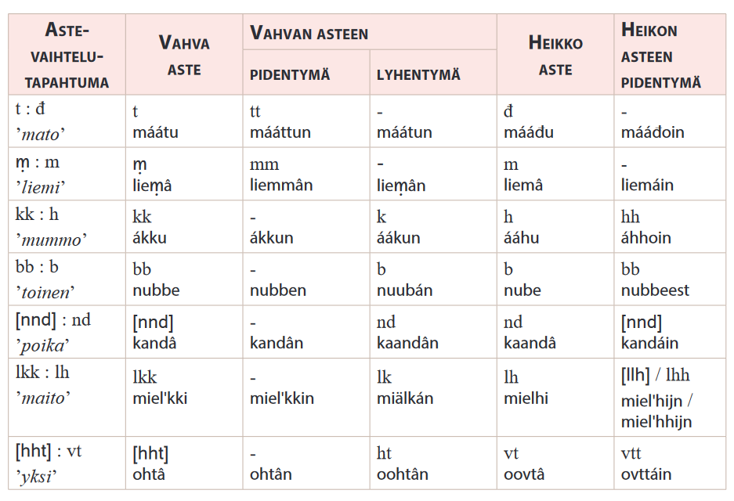
Background
Description of AS gradation in established terminology
(from Morottaja
& Olthuis 2022):
5 grades: strong,
lengthened &
shortened strong, weak, lengthened weak
Plus: lengthening
& shortening stem types

Slide 4
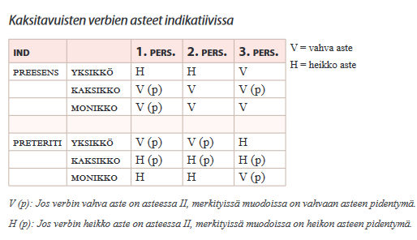
Background
Example: grades in bisyllabic verbs in the indicative
(from Morottaja
& Olthuis 2022):

Slide 5
Background
Established terminology relatively unchanged since Itkonen 1946.
Itkonen’s description places a lot of emphasis on why
the system works as it does; i.e. on its diachronic background.
  Intended for an audience of Finno-Ugricisists, not lay language learners.
    ”This is easy if you know Proto-Saamic!”
For many consonants, the end results of different historical developments are synchronically identical!

Slide 6
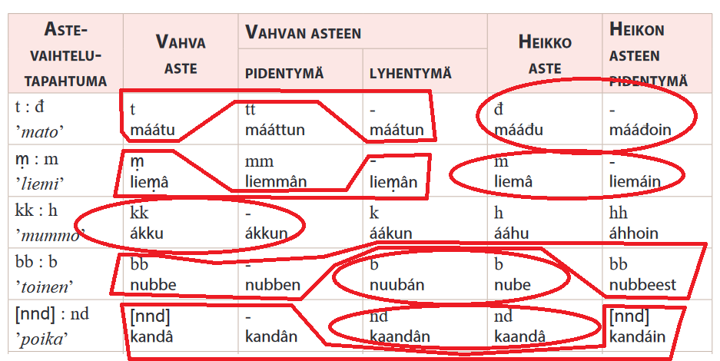
Background

Slide 7
Vowel Phonemes
Monophthongs
Standard orthography used in tables
  y = ü
  e = ə in the first syllable of a word, unless the
  following syllable contains e or i: ennuv /ənnuv/ ’much’
    e = e otherwise: enni /enni/ ’mother’, alme /alme/ ’sky’
  â = ə
  á = ȧ historically, but does not contrast with ä
Stressed vowels may be divided into 2
classes (Koukkari 2022):
  ”Dark”: a, o, u, i, (uo, ə)
  ”Bright”: ä/á, e, iä, uá, ie, (ye)
i | (y) |  | u
e, (ö) |  | e, â | o
ä, á |  |  | a
Diphthongs
ie | ye | uo
iä | uá

Slide 8
Consonant Phonemes
 | Labial |  | Dental | Alveolar | Postalv. | Palatal | Velar | Glottal
Nasals | m |  | n |  |  | nj | ŋ
Stops | p b |  | t d |  |  |  | k g
Affricates |  |  |  | c z | č ž | č |  | h
Fricatives | f | v | đ | s | š | j (i) | j | h
Approximants |  |  |  | l r
Standard orthography used in table
  nj = ń, đ = δ, z = ʒ, ž = ǯ
  i = j post-vocalically
Stops and affricates contrast fortis/lenis; lenis semi-voiced, fortis aspirated in non-initial position (initially no contrast, except in loans).

Slide 9
Quantity
Three degrees of quantity can be distinguished for voiced continuant consonants and (most) monophthongal vowels: short, mid-long, and long.
  Mid-long quantity not phonemic for vowels; may be considered
  an allophone of either long or short (but ambiguous which).
  Contrast between mid-long and long consonants being lost in spoken language in certain positions (Türk et al 2015).
    Not (yet?) standard; ignored in this presentation.
All other consonants contrast a short vs. long degree.
Diphthongs and consonant clusters: short vs. long.

Slide 10
Quantity
Standard orthography mostly distinguishes two degrees.
  Single letter = short phoneme: na /na/ ’well’ (interjection)
  Doubled letter = long phoneme: naa /nā/ ’yes, yeah; indeed’
  Mid-long phonemes written the same as short ones: kove /kov̀è/ ~ /kovè/
  Diphthong and consonant cluster length not indicated.
Precision diacritics used in this presentation¹:
  Dot below = mid-long consonant: sääṇi ’word’
  Grave = mid-long latus vowel: koṿè ’picture’
    Not used before coda /j/ (sources disagree; length neutralized?)
  Preceding apostrophe = short consonant cluster: a̕lmè ’sky.GEN.SG’
    Not used after long vowels; clusters always short in this position (?)
  Breve on first element = short diphthong: vy̆elgiđ ’leave’
¹) Modified from Sammallahti & Morottaja 1993

Slide 11
Terminology and Notation
jävri
’lake’
First-syllable vowel = Vowel Center (VC)
Consonant(s) in coda of 1st & onset of 2nd syllable = Consonant Center (CC)
Second-syllable vowel = Latus
The quantitative degree of the consonant center is denoted with a Roman numeral: from shortest to longest, QI, QII, QIII.
QI only exists for sonorants; short obstruents represent QII!
Long clusters represent QIII, short ones QII.

Slide 12
Key Observations
Grades distinguished mainly by quantity.
Only 2 distinct quantities for obstruents & clusters; 3 for sonorants.
Shortened and lengthened grades distinct only where qualitative differences appear between strong and weak.
– But: shortening type (ST) - short vowel center regardless of grade, occurs by default when an ending adds one or more syllables to
word.
Qualitative differences between grades only appear for a relatively small number of consonants.

Slide 13
Stem Types
Disyllabic stems
  Reflect basic Proto-Saamic stem type; most common vocabulary
  Divided into subtypes based on stem vowel (typically latus in
  citation form)
  Most morphophonological alternation; topic of this presentation
Other stem types:
  Trisyllabic: Less complex alternation; typically two stem allomorphs
  Tetrasyllabic: Resemble bisyllabic words; somewhat less complex
  Contracted: Either no consonant alternation at all, or roughly similar
  to trisyllabic words

Slide 14
Disyllabic Nouns
  NOM.SG ends in a vowel (usually the stem vowel)
    May be any monophthongal vowel; a and á rare, but do exist.¹
  Three main types of quantity alternation:
    Binary gradation with vowel length alternation in VC (â-, u-, i- & á-stems)
    Binary gradation with vowel length alternation in latus (o-, a-, á-)
    Ternary gradation (â-, u-, i-, o-)
  Other, rarer types also exist, but are mostly outside the
  scope of this presentation.
  Qualitative gradation to be dealt with separately.
  Disyllabic adjectives outside the scope of this presentation, but largely follow same rules.
¹) Omitted by mistake from abstract of this presentation
- as noted by keen-eyed anonymous reviewer -
but mentioned previously in Koukkari 2020.

Slide 15
Disyllabic Nouns: Type 1
Stem vowel â, i, u or, in bright-vocalic words, á.
NOM.SG has QIII.
cŭoppâ ’fish meat’
áldu ’reindeer cow’
ky̆ermi ’load’
hĭärrá ’lord’
Alternation QIII : QII
  Short vowel center before
  QIII and in ST, long otherwise.

Slide 16
Disyllabic Nouns: Type 2
Stem vowel o, a¹ or, in dark-
vocalic words, á.
NOM.SG has QIII.
mušto ’memory’
pirrá ’spinning top’
teltta ’tent’
Alternation QIII : QII
  Short latus in NOM.SG, ESS & PART; long in LOC.SG; mid-long following QII.
    Ambiguous where followed by /j/.
  Exception: ILL.SG has long VC and short latus.
¹) Often in loans, not all of which conform regularly to this type.

Slide 17
Disyllabic Nouns: Type 3
Stem vowel â, u, i or o.
NOM.SG has QII.
kieḷâ ’tongue, language’
tááḷu ’house, building’
sääṇi ’word’
piṇò ’pile, heap’
Alternation QIII : QII : QI
  o-stems: latus long after QIII, both vowels in LOC.SG.
  Otherwise no vowel length
  alternation, apart from ST.

Slide 18
Disyllabic Nouns: e-stems
Stem-final e alternates with i,
with effects on gradation.
      alme ’sky’
      koṿè ’picture’
Mixed gradation:
  SG forms & NOM.PL: same quantity structure as o-stems
    QIII in NOM.SG > type 2
    QII in NOM.SG > type 3
  Oblique PL:
    QIII in NOM.SG > as type 1
    QII in NOM.SG > VC lengthened,
    except in ST.

Slide 19
Disyllabic Nouns: Possessive Forms
Nouns may be declined to indicate the person (but not number!) of a possessor: hĭärrám ’my/our lord’, hĭärrád ’your lord’, hĭärrás ’their lord’
Much less commonly used than the absolute declension; this account based on rules given by Itkonen (1991) and Morottaja & Olthuis (2022).
Same gradation types as in abs. declension may be distinguished.
More extensive syncretism: in addition to GEN.SG & ACC.SG, GEN.PL, ACC.PL & ILL.PL as well as COM.SG & LOC.PL merge in all types.
  NOM.PL not in use (Itkonen 1991).
ABE & COM.PL formed by attaching -ttáá or
-gijn, respectively, to corresponding GEN.
hiäṛád ’of your lord’
hiäṛádttáá ’without your lord’
hĭäṛáidis ’of their lords’
hĭäṛáidisgijn ’with their lords’
hĭäṛáidisttáá ’without their lords

Slide 20
Disyllabic Nouns: Type 1, Poss.
Gradation QIII : QII
  Vowel lengthening only in GEN/ACC.SG 2nd & 3rd person.
  Note lack of ST in ILL.SG
  & ESS.
2nd person forms, where
not otherwise indicated, may be formed by
replacing the -n of the corresponding 1st person form with -d.
hĭäṛástân ’from my/our lord’
hĭäṛástâd ’from your lord’

Slide 21
Disyllabic Nouns: Type 2, Poss.
Gradation QIII : QII
  Latus long in GEN/ACC.SG 2nd
  & 3rd person, mid-long in LOC.SG.
  Note lack of ST in ILL.SG & ESS.
2nd person forms, where not otherwise indicated, may be formed by replacing the -n of the corresponding 1st person form
with -d.
te̕ltàstân ’in my/our tent’
te̕ltàstâd ’in your tent’

Slide 22
Disyllabic Nouns: Type 3, Poss.
Gradation QIII : QII : QI
  o-stems: Latus long after
  QIII and GEN/ACC.SG 2nd & 3rd person, mid-long in LOC.SG.
  Otherwise no vowel length alternation, apart from ST.
  Note presence of ST in
  ILL.SG & ESS.
2nd person forms, where not otherwise indicated, may be formed by replacing the -n
of the corresponding 1st person form with -d.

Slide 23
Disyllabic Verbs
  INF ends in stem vowel + đ
    a- and á-stem disyllabic verbs do not exist.
  Two main types of quantitative alternation: binary & ternary.
    The grade of the CC in a form does not depend on the stem vowel.
    Qualitative gradation to be dealt with separately.
  INF always has QIII.
    Binary gradation if both vowels are short
    Ternary gradation if either VC or latus is long.
  Possible subgrouping based on form of PRS.3SG:
    Ends in -á, bright VC
    Ends in -a or -á, dark VC
    Bare stem of verb (ends in o or u)

Slide 24
Disyllabic Verbs: Binary, Subtype 1
i-stems, â-stems with bright VC in PRS.3SG.
  vy̆elgiđ ’leave’
  pallâđ ’be warm enough’
Gradation QIII : QII
  Long VC before QII.

Slide 25
Disyllabic Verbs: Binary, Subtype 2
e-stems, â-stems with dark VC in PRS.3SG.
  čulgâđ ’spit’
  koddeđ ’kill’
Gradation QIII : QII
  Long VC in PST forms with QII.
  â-stems: long VC in PRS.1SG, 2SG & CNG.
  Otherwise short VC, mid-long latus with QII.

Slide 26
Disyllabic Verbs: Binary, Subtype 3
u-stems, o-stems
  áiguđ ’intend’
  oskođ ’believe’
Gradation QIII : QII
  VC long in u-stems before QII.
  o-stems do not
  feature VC lengthening; latus
  mid-long after QII.

Slide 27
Disyllabic Verbs: Ternary, Subtype 1
e-stems, â-stems with
bright VC in PRS.3SG.
  faallâđ ’offer’
  čäälliđ ’write’
Gradation QIII : QII : QI
  INF stem in PRS.3DU,
  PRS.1PL & PTCP.PST.
  Short VC in PST.3PL.
  i-stems: short VC, mid-
  long latus in PRS.1SG & 2SG.
  Long VC in all other
  forms, except in ST.

Slide 28
Disyllabic Verbs: Ternary, Subtype 2
e-stems, â-stems with
dark VC in PRS.3SG.
  moonnâđ ’go’
  kođđeeđ ’knit, weave’
Gradation QIII : QII : QI
  INF stem in PRS.3DU,
  PRS.1PL & PTCP.PST.
  Long VC in all PST forms except 3PL.
  â-stems: long VC in PRS.1SG, 2SG & CNG.
  Short VC and short (â) or mid-long latus elsewhere.

Slide 29
Disyllabic Verbs: Ternary, Subtype 3
u-stems, o-stems
  kuárruđ ’sew’
  orroođ ’be, stay, dwell’
Gradation QIII : QII : QI
  INF stem in PRS.3DU, PRS.1PL & PTCP.PST.
  Short VC in PST.3PL.
  Long VC in PST.1SG & 2SG.
  Long VC in u-stems before QII
  & QII.
  o-stems do not feature VC lengthening; latus mid-long
  after QII.

Slide 30
Qualitative Gradation
Qualitative differences between grades only appear in historically
short unvoiced stops & affricates.
  Exception: the sound change */k/ > /h/
  also affects the weak grade of the
  historical geminate /kk/:
  ákku (< *ākkɔ̄) ’grandmother’ : ááhu
  Also used to occur in sibilants (cf. Itkonen 1971), but this has been lost.
The strong grade retains the original stop or affricate, while the weak is a fricative or an approximant.
The pairs p ~ v & t ~ đ feature ternary gradation, with the weak grade in QI.
In the pairs h ~ ṿ, c ~ s, č ~ j̣ & kk ~ h, neither consonant represents QI; these feature complex gradation.
lyepi (< *lōpē ) ’lamina’ GEN.SG ly̆eve
kietâ (< *kēte̮) ’hand’ : kieđâ
juuhâ (< *joke̮) ’river’ : juuṿâ
čääci (< *čācē) ’water’ : čääsi
eeči (< *e̮čē) ’father’ : eej̣i

Slide 31
Qualitative Gradation: p & t, Nouns
Disyllabic nouns with single
p or t in CC in NOM.SG
belong to type 3.
  Weak grade in QI.
Disyllabic nouns with single
p or t in CC in NOM.SG
belong to type 3.
  Weak grade in QI.
      kietâ ’hand; arm’
      liäpu ’rest’
      tääpi ’manner’
      ito ’sprout’

Slide 32
Qualitative Gradation: p & t, Nouns
Cf. type-3 nouns without qualitative gradation.

Slide 33
Qualitative Gradation: p & t, Verbs
Disyllabic verbs with ternary gradation and
p or t in CC in INF are inflected like other verbs with ternary gradation.
  Weak grade in QI.
    sooppâđ ’agree; fit’
    puáttiđ ’come’

Slide 34
Qualitative Gradation: p & t, Verbs
Cf. subtype-1 verbs with ternary alternation without qualitative gradation.

Slide 35
Complex Gradation
Concerns the alternating pairs h ~ ṿ, c ~ s & č ~ j̣, as well as k(k) ~ h.
Exhibit a form of binary gradation; quantity is either QIII or QII.
  Prototypically QII (except for kk, which is QIII), but both members of each pair may be lengthened to QIII, i.e. geminated.
Disyllabic nouns with complex gradation and stem vowel â, i, or u
(or á) appear to follow the quantity structures of type 1.
  o-stems either type 2 or mixed 2/3 (?).
Disyllabic verbs with complex gradation are grouped with ternary gradation (or rather, II : I) by Morottaja & Olthuis (2022), but quantities do not always appear to match.
Further research required.

Slide 36
Complex Gradation: Nouns
CC c, č, h, or kk in NOM.SG.
Stem vowel â, i, u or, in
bright-vocalic words, á;
      muocâ ’moth’
      ákku ’grandmother’
      eeči ’father’
      čiähá ’hiding place, cache’
Weak grade in all forms except NOM.SG, ILL.SG, ESS & PART.
Quantities as in type 1, apart
from NOM.SG.
  Note retention of vowel length in ESS & PART.

Slide 37
Complex Gradation: Nouns
Cf. type-1 nouns without qualitative gradation.

Slide 38
Concluding Remarks
Consonant gradation in AS can be mostly described in terms of quantitative alternation only.
Disyllabic words can be divided into a number of inflection classes based on the paradigmatic quantitative alternation they exhibit.
Qualitative alternation only concerns a limited number of consonants.
  Words exhibiting these can at least fairly often be classified into the same quantitative alternation classes as other words.
Each inflection class can be described in relatively simple terms on
its own, but the number of classes can get quite large (esp. including word types not covered in this presentation).
  Simpler description overall? Probably a matter of taste, but perhaps the elephant is easier to eat in smaller parts.

Slide 39
Takkâ!
https://github.com/tkoukkar/anaraskiela/

Slide 40
Bibliography
FISCHER-JØRGENSEN, ELI 1967: Perceptual dimensions of vowels. In To honor Roman
Jakobson : essays on the occasion of his seventieth birthday 11 october 1966, Vol. 1:
667-671. Janua linguarum, Series maior 31. The Hague: Mouton.
ITKONEN, ERKKI 1939: Der ostlappische Vokalismus vom qualitativen Standpunkt
aus mit besonderer Berücksichtigung des Inari- und Skoltlappischen.
Lautgeshichtliche Untersuchung. SUST 79. Helsinki: Suomalais-Ugrilainen Seura.
––– 1971: Ehdotus inarinlapin fonemaattiseksi transkriptioksi. In Erkki Itkonen, Terho
Itkonen, Mikko Korhonen & Pekka Sammallahti (eds.), Lapin murteiden fonologiaa:
43-67. Castrenianumin toimitteita 1. Helsinki: Suomalais-Ugrilainen Seura.
––– 1973: Phonetische und phonologische Betrachtung der ostlappischen Dialekte.
SUSA 72 – Juhlakirja Aulis J. Joen kuusikymmenvuotispäiväksi 2.6.1973: 129-149.
Helsinki: Suomalais-Ugrilainen Seura.
––– 1986-1991: Inarilappisches Wörterbuch I-IV. Lexica Societatis Fenno-Ugricae XX,
1-4. Helsinki: Suomalais-Ugrilainen Seura.

Slide 41
Bibliography (cont.)
––– 1992: Inarinsaamelaisia kielennäytteitä = Aanaarkiela cȧjttuzeh. SUST 213.
Helsinki: Suomalais-Ugrilainen Seura.
KORHONEN, MIKKO: Lapin kielen vartalonsisäisten äännevaihtelujen morfologisesta
funktiosta. Virittäjä 71: 353–358.
––– 1981: Johdatus lapin kielen historiaan. Suomalaisen Kirjallisuuden Seuran
toimituksia 370. Helsinki: Suomalaisen Kirjallisuuden Seura.
Koukkari, Tuomas 2020: Kvantiteettivaihtelu inarinsaamen nominintaivutuksessa.
Master’s thesis, University of Helsinki.
METTOVAARA, JUKKA forthc.¹: Thoughts on Inari Saami metaphony and mid-central
vowels. Presentation at CIFU XIII at the University of Vienna, 24.08.2022.
MOROTTAJA, MATTI 2007: Anarâškielâ ravvuuh. Helsig: Paikkieennâm kielâi
tutkámkuávdáš.
¹) As in immediately after this presentation.

Slide 42
Bibliography (cont.)
MOROTTAJA, PETTER 2016: Anarâškielâ vokalij kvalitetnubástusâi myensteristem
kielâtekno morfologisii analysaattorist. Master’s thesis, University of Oulu.
MOROTTAJA, PETTER – OLTHUIS, MARJA-LIISA 2022: Inarinsaamen taivutusoppi.
Aanaar: Sämitigge.
OLTHUIS, MARJA-LIISA 2009: Mii kirjekielâ lii já maht tot šadda?. In Klaas Ruppel (ed.) Omin sanoin - Kirjoituksia vähemmistökielten kirjallistumisesta. Kotimaisten kielten tutkimuskeskuksen verkkojulkaisuja 6. Helsinki: Kotimaisten kielten tutkimuskeskus.
https://kaino.kotus.fi/www/verkkojulkaisut/julk6/Omin_sanoin.pdf.
––– 2017: ”Tego ö-puustav puállupeevdi roobdâst”. Anarâš 5/2017: 36-37.
SAMMALLAHTI, PEKKA 1984: New developments in Inari Lappish Phonology. In
Péter Hajdú & László Honti (eds.), Studien zur phonologischen Beschreibung
uralischer Sprachen. Bibliotheca Uralica 7. Budapest: Akadémiai kiadó.

Slide 43
Bibliography (cont.)
––– 1998: The Saami Languages: An Introduction. Kárášjohka: Davvi Girji.
VALTONEN, TAARNA – YLIKOSKI, JUSSI – AIKIO = LUOBBAL SÁMMOL SÁMMOL ÁNTE 2022: Aanaar (Inari) Saami. In Marianne Bakró-Nagy, Johanna Laakso & Elena
Skribnik (eds.) The Oxford Guide to the Uralic Languages: 178-195. Oxford
University Press.
ÄIMÄ, FRANS 1918a: Phonetik und Lautlehre des Inarilappischen : I :
Beobachtungsphonetik und deskriptive lautlehre : Erste lieferung. SUST XLII, 1.
Helsinki: Société Finno-ougrienne.
––– 1918b: Phonetik und Lautlehre des Inarilappischen : II : Instrumentale versuche und
messungen : mit 96 Abbildungen in 2 Serie (Tafeln). SUST XLIII. Helsinki: Société
Finno-ougrienne.

Slide 44
Earlier Works
Äimä 1918: IS phonetics and phonology
Itkonen 1939, 1971, etc.: Historical and recent development, metaphony
Korhonen 1981 (etc.): Historical development, morphophonology
Sammallahti 1984, 1998 etc.: Historical and recent development, metaphony
Morottaja 2016: Harmony, vowel families and types (vookaalperruuh já -tiijpah; vokaaliperheet ja -tyypit)
Ibid.; Morottaja & Olthuis (2022): vowel families and types, morpho-phonological classification of words based on first-syllable vowel

