Slide 1
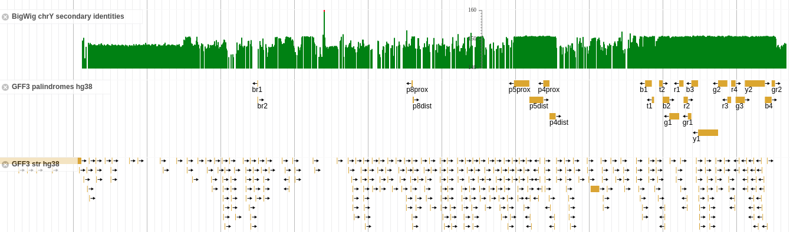
Improving the Y chromosome analysis methods for maximizing the usable phylogenetic content
Thomas Krahn, YSEQ

Slide 2
Y chromosome analysis
Every male individual has a different Y chromosome
Finding the differences is like needle in haystack
Not all differences help us to explain inheritance
Not all differences are accessible with current technologies

Slide 3
Technical limitations
Limited number of control samples to compare
Limited sample volume
Analysis cost for getting the whole Y-DNA information
Repetitive elements (homopolymer, STR, large repeats, palindrome)
Identity to other chromosomes and the chrY itself
The laboratory has only influence to optimize the last two points

Slide 4
All burns down to repeat structures
Repeats of any kind are problematic for studying inheritance because they’re prone to recombination mechanisms
Most frequent reason for back- and parallel mutations
They’re difficult to sequence with any sequencing technology
Goal is to use the maximum chrY DNA but still avoid repeats
Identification of repeat structures is key for optimizing the usable range

Slide 5
What has been done before?
Checking each individual marker with BLAT
Rough static regions in a BED file
Visual inspection of sequencing traces

Slide 6
BLAT usage to identify identities
Select a Region +/- 500 bases around SNP
Submit sequence to BLAT
Check the first non-identical hit
Rule of thumb: >95% identity: problems start
Reliable results (+)
Time consuming (-)

Slide 7
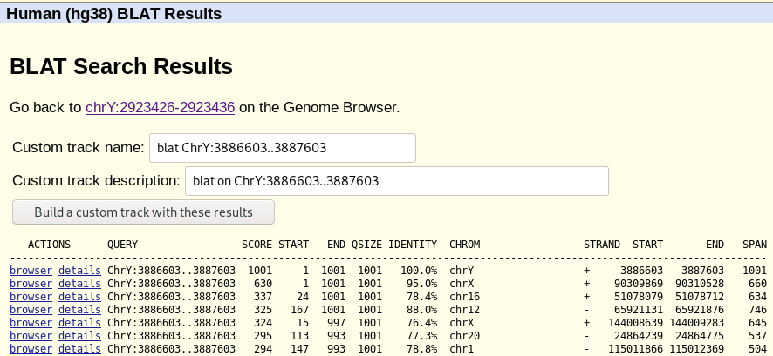
BLAT pitfalls

Slide 8
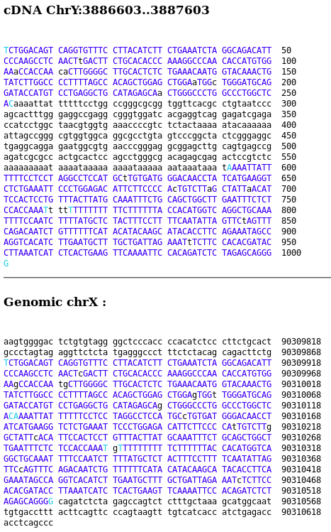
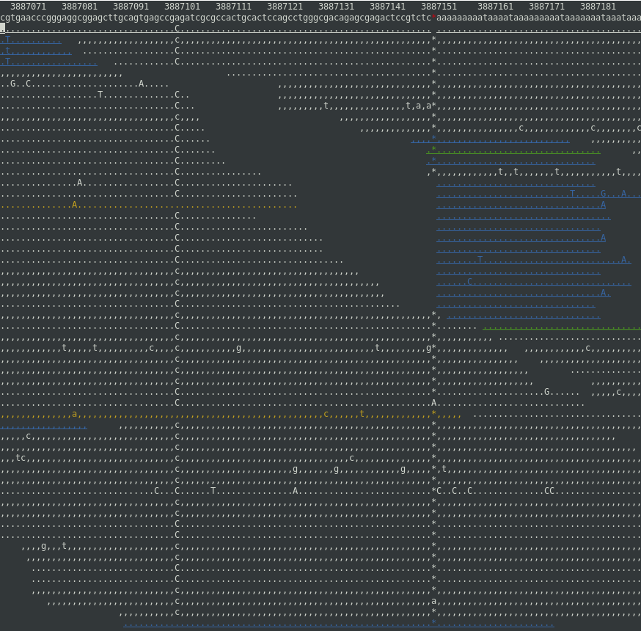
BLAT pitfalls
Perfectly nice “island”
just where our SNP is

Slide 9
Wouldn’t it be good to get identity scores for every base on the Y?
There are 23,891,735 bases total (excluding PAR and Yq12)
A script to pull a sequence around each possible SNP position and BLAT through a web service takes at least 5 seconds per SNP
23,891,735 * 5 sec = 119,458,675 sec = 3.8 years!!
Ups! That’s not enough time to prepare this talk...

Slide 10
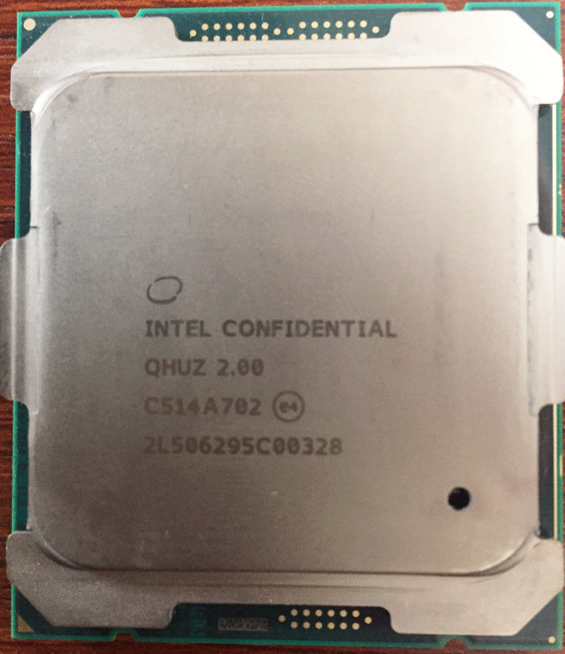
How about command line BLAT on the own computer?
BLAT one sequence around a SNP vs. whole genome takes 45 seconds => even worse. Why?
UCSC BLAT server: Four machines with dual 12-core AMD Opteron processors (each). Complete database is kept in 256 Gbyte RAM
Solution: Split by querying each chromosome
in parallel (multi-threading)
Buy more RAM and bigger processors on Ebay…

Slide 11
Using BWA-MEM instead of BLAT
Modern aligners use clever sorting and indexing algorithms
Much faster than Smith-Waterman code
Normally used to map NGS reads (millions of them)
BWA MEM returns an “alignment score” AS which is good enough for almost identical sequences
Not quite as exact as BLAT
Let’s try to use it...

Slide 12
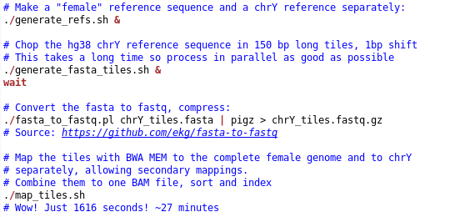
This is what we did:

Slide 13
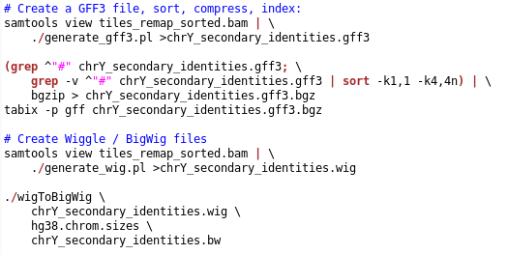
Bring it in indexed formats

Slide 14
How can we use this data?
No need to do all steps by yourself
Free download of data files available at Ybrowse
http://ybrowse.org/gbrowse2/gff/
If you want to make changes, sources are available on github:
https://github.com/tkrahn/y_identity
Fast access from stored file (e.g. P25):
tabix chrY_secondary_identities.gff3.bgz ChrY:22840918-22840918
ChrY bwa identity 22840918 22840918 1 . . name=identity;bwa_hit=ChrY:24474591..24474742;AS=151
Or access it remotely:
tabix http://ybrowse.org/gbrowse2/gff/chrY_secondary_identities.gff3.bgz ChrY:22840918-22840918
ChrY bwa identity 22840918 22840918 1 . . name=identity;bwa_hit=ChrY:24474591..24474742;AS=151

Slide 15
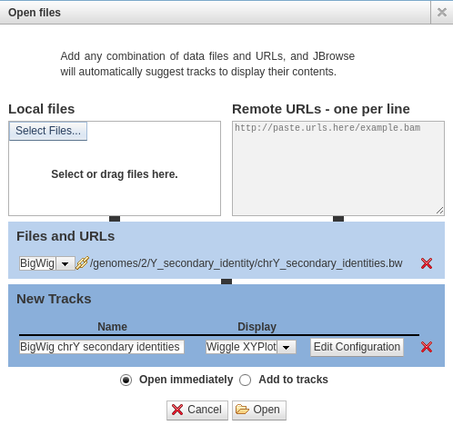
Open the BigWig file in jbrowse

Slide 16
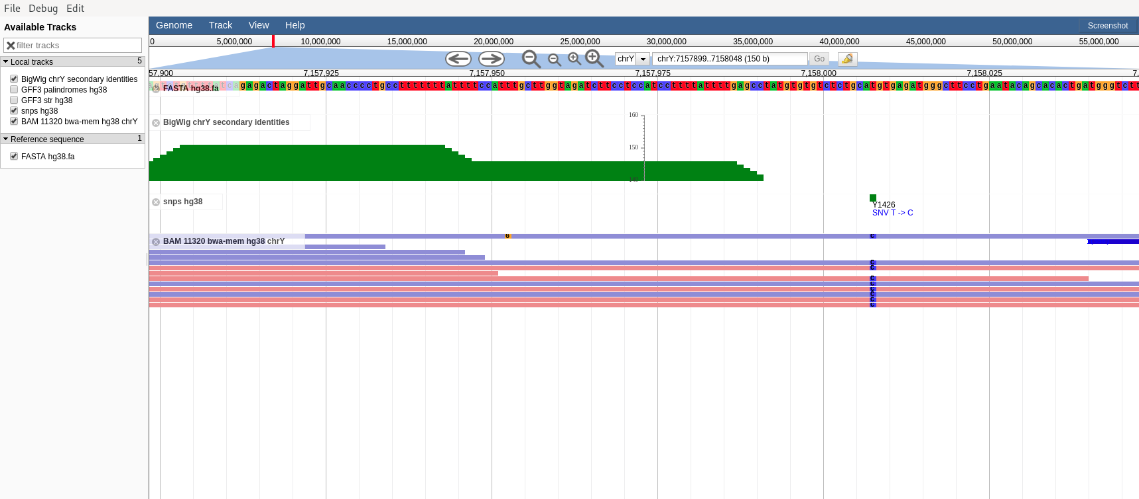
Enjoy identity data next to your own

Slide 17
Still unresolved:
BWA MEM is not as accurate as BLAT
Need to tweak parameters
Try to use minimap2 or other aligners
Short tandem repeats and homopolymers ignored
How can we improve STR analysis from NGS?

Slide 18
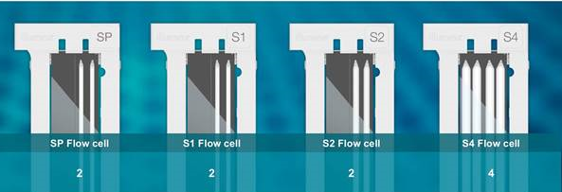
Longer reads for short repeats
Illumina Novaseq 6000 flow cells
2x 250 pe
2x 150 pe
2x 150 pe
2x 150 pe
325-400 Gb
400-500 Gb
1000-1250 Gb
2400-3000 Gb
Real: 488 Gb

Slide 19
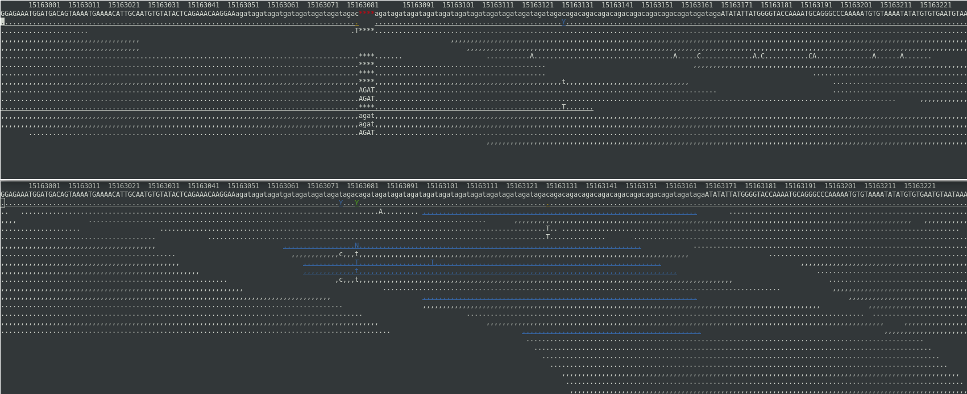
DYS390 is a long Y-STR
2 x 250bp PE (15x WGS YSEQ)
25 repeats
2 x 100bp PE (30x WGS Dante)
25 repeats

Slide 20
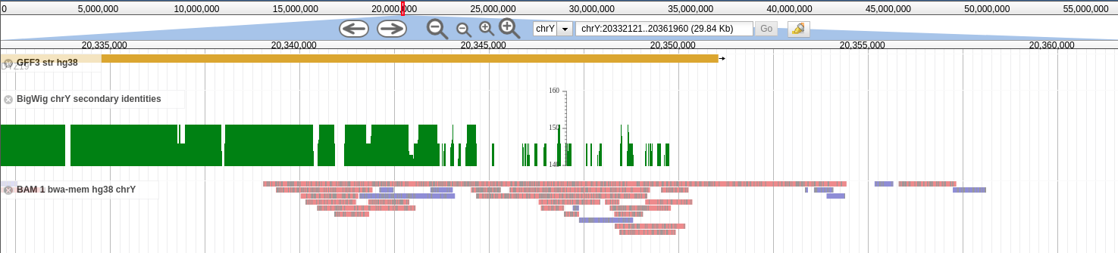
Even longer reads with Nanopore
Nanopore reads spanning a large section at the end of the DYZ19 region
15,392 bp

Slide 21
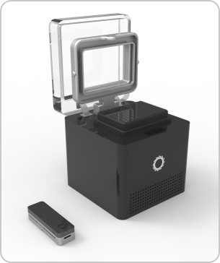
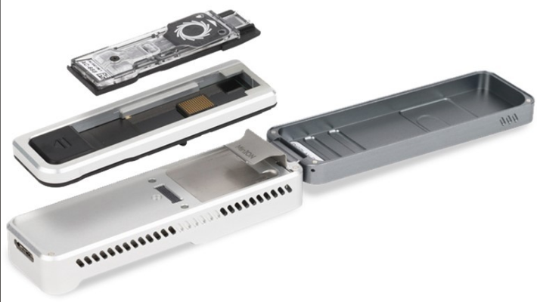
New Nanopore developments
Flongle flow cells (sufficient for our use) for ~$100
Improvements of read accuracy through software and R10
“Plongle” (96 well plate of flow cells)

Slide 22
Thank You!
https://www.yseq.net
thomas@yseq.net

