Slide 1

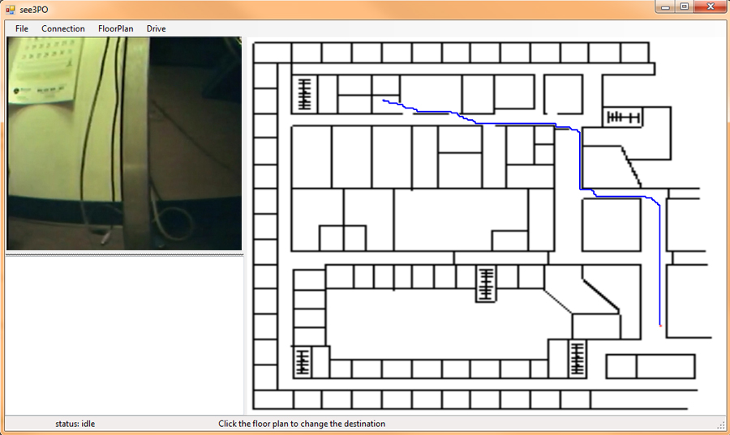
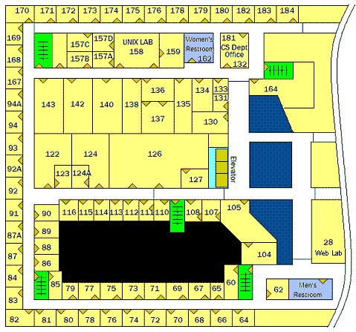
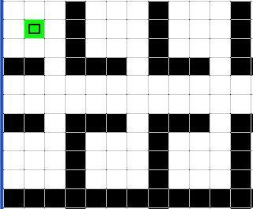
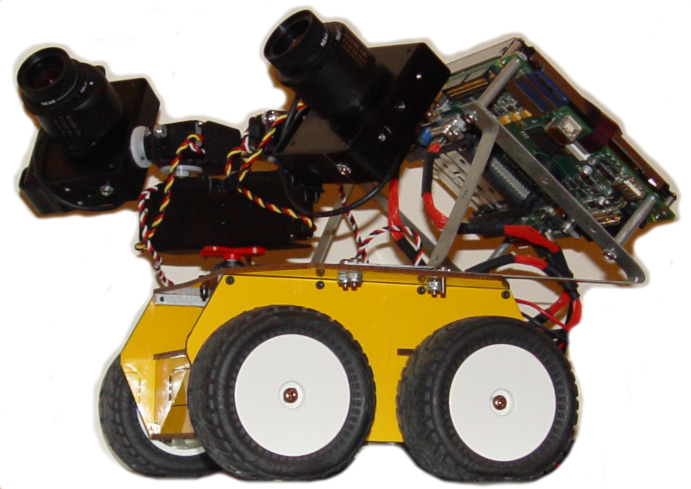

See3PO
Frank, Jacky, Nick, Hao, and Debarati
Introduction
Floor Plan Processing
Host GUI
walkable
Science Building – 3F (image)
wall
Features
s
Robot
t
Path Finding
s
Demonstration Time!
t
CS682 Software Engineering, Department of Computer Science, University of Massachusetts at Boston

