Slide 1

See3PO
Frank Marino, Nick Wang, Jacky Yu, Hao Wu and Debarati Basu
Department of Computer Science
University of Massachusetts at Boston
Tyler Garaas and Srikumar Ramalingam
Mitsubishi Electric Research Laboratories (MERL)

Slide 2
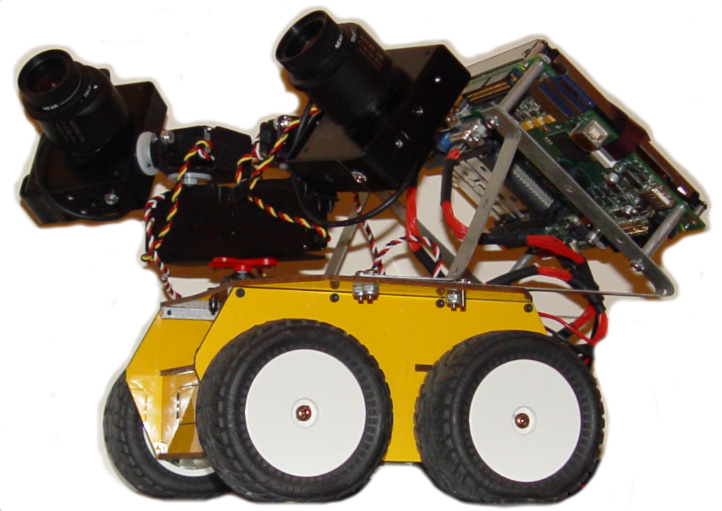
The Anatomy of a See3PO
Cameras
Used by the Locator to get position
Local Brain
(currently being replaced)
Runs the local version of our program.
Communicates with the Host PC and with the Atom.
Atom Computer
Controls the Servos and the Wheels

Slide 3
Host
Floor Plan Processing
PathFinder
Path
Floor Plan
Position
Destination
FP Image
Floor Plan
Local Brain
Robot Images
Host
GUI
Commands
FP Image
Destination
Floor Plan
Robot Images
Position
Locator
Robot
Host PC

Slide 4
Host – An overview
The Host class manages all other Host-Side processes
The User selects a Floor Plan Image from the GUI
Host sends this image to FloorPlanProcessing, which returns a FloorPlan.
This FloorPlan is sent to PathFinder to be converted into a graph. It is also sent back to GUI for display.

Slide 5
Host – An overview
Either the User (GUI) or the Locator sets the robot’s current Position, then the User (GUI) selects a Destination.
  If using the Locator, the Host requests images from LocalBrain, and sends these to the Locator.
These points are sent to the PathFinder, which returns a Path of (X,Y) coordinates.
Host converts this Path to distinct Left/Right/Duration MoveComand objects, and sends them to the LocalBrain, one at a time.

Slide 6
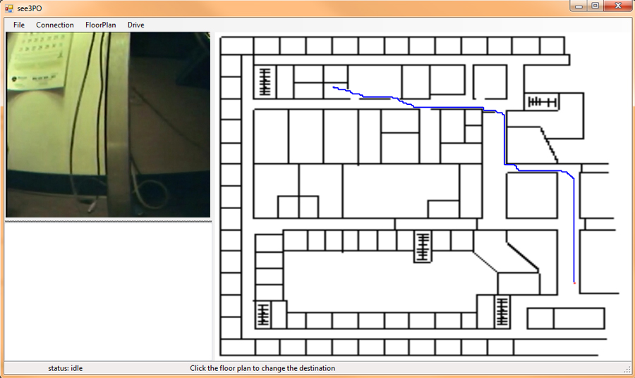
GUI

Slide 7
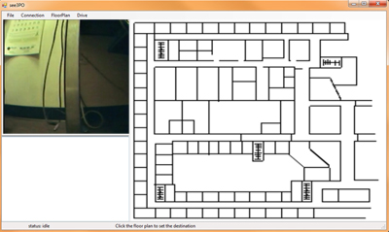
GUI
Status Screen
Displays detailed messages from the Host
Live Panel
Displays a live view from the Robot
Floor Panel
The Main Interface:
Displays The Floor Plan
Allows the user to set:
  Scale
  Current Position
  Destination
Displays the best Path
During execution, updates the Path and Position.
Connection Status
Instructions

Slide 8
Locator
Returns the current Position of the robot: Location(X,Y)
Facing (0 -359)
This position is used by PathFinder to create a Path, and to monitor and correct the robot’s progress while moving.
The only external inputs required are:
  A Floor Plan Image
  Robot Images from the robot’s two cameras
contd..
Notes:
Tyler and Shi will be providing us with a location program, which we have been calling “WHERE AM I”
WhereAmIwill be used to continuously update See3PO on its current position, including both Location and Orientation
The only external data required by WhereAmI will be a stream of images transmitted from the Robot

Slide 9
Locator
Advantages:
  Precise
  Works Indoors
  Self-correcting
  Recognizes changes
    open/closed door
    obstacles
Notes:
Because of this, See3PO will be capable of working in situations where a GPS-based system would not, Indoors, for example
Additionally, this system will be more precise than GPS, which is accurate only to about 20 meters.
Because of the way that WhereAmI will work, it will be simple to compare expected views to Observed views
This will allow recognition of changes such as opened or closed doors or obstacles

Slide 10
Testing
Unit tests – are already in place
System tests – test plans are being developed
Notes:
Because of this, See3PO will be capable of working in situations where a GPS-based system would not, Indoors, for example
Additionally, this system will be more precise than GPS, which is accurate only to about 20 meters.
Because of the way that WhereAmI will work, it will be simple to compare expected views to Observed views
This will allow recognition of changes such as opened or closed doors or obstacles

Slide 11
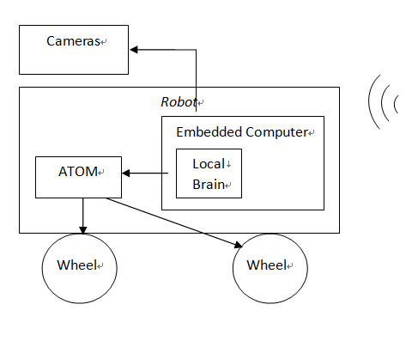
Robot
Main parts of the robot
Local Brain
  Receive commands from Host
  Control ATOM and cameras
  Send image back to Host
ATOM
  Control wheels
Cameras
Wheels

Slide 12
Communication Protocol
Command sent from Host to local brain (TCP)
Command sent from local brain to ATOM (RS-232)
Byte 0 | 1 | 2 | 3 | 4 | 5 | 6 | 7 | 8 | 9
0x01 | 0x10 | 0x11 | LWS_H | LWS_L | RWS_H | RWS_L | TM_H | TM_L | 0xEF
Byte 0 | 1 | 2 | 3 | 4 | 5 | 6
0x01 | 0x10 | 0x11 | LWS_H | LWS_L | RWS_H | RWS_L

Slide 13
High Packet Loss Rate-ATOM
Original Code
main:
“send speed to wheel every 20ms
for i = 1 to 5
pulsout p12, rightSpeed
pulsout p13, leftSpeed
pause 20
next
“read packet through COM port
SERIN S_IN,i9600,…
…
goto main
If the packet come in during the loop…
Why????

Slide 14
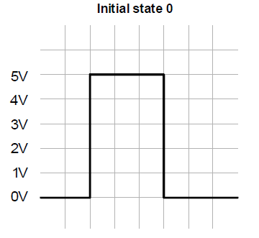
How to solve that problem?
Wheels need to get the pulse at least every 20ms to keep running.
The longer the pulse, the faster the speed.
Receiving speed data through COM port
time
Syntax
pulsout pin, time
pin: the I/O pin to use.
time: the duration of the pulse in 0.5 microseconds increments.

Slide 15
Our Solution
New Code
ONINTERRUPT TIMERAINT,drive
ENABLE TIMERAINT
main:
“read packet in from COM port
SERIN S_IN,i9600,…
…
goto main
drive:
pulsout p12, rightSpeed
pulsout p13, leftSpeed
resume
What did we implement?
Interrupted by a timer every 20ms

Slide 16
Robot cannot move straight
Original Code
leftSpeed = 3000
rightSpeed = 3000
main:
gosub drive
gosub receive_command
goto main
drive:
if initialized = 1 then
for i = 1 to 5
pulsout p12, rightSpeed
pulsout p13, leftSpeed
pause 20
next
endif
return
Notes:
Pulsout means output a pulse

Slide 17

How do we solve that
Send different speed to the wheels
  Take the move forwards for example
  leftspeed=3179
  rightspeed=3150
  Note: the data comes from experiment test
Notes:
approximately the same in 10 feet

Slide 18
Local Brain UI
Debug mode
  show commands
Movement control
  forward
  left
  stop
  ..
Setting left and right speed as well as driving time
Notes:
approximately the same in 10 feet

Slide 19
What will the robot have for version 1.0?
Servo system can work
Leave the robot anywhere in the science building, it can send pictures back to the host.
After comparing the data in the host, the host can tell the robot where it is.
The robot can receive the destination where the host tells.

Slide 20
What can we do if we still have time?
Let the robot get something itself
  Example: get coffee from a coffee machine and send it to one of our professors
Use new wireless system (we use the wireless card, so it can just cover about 10 square meters)
  Use local internet (like the UMass wireless) to make the robot move in the whole campus
  Use new wireless like the iphone, make the robot to move further.

Slide 21
Questions?
http://code.google.com/p/see3po/
Please feel free to ask questions.
Notes:
Our team will try our best to explain.

