Slide 1
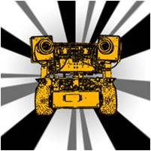

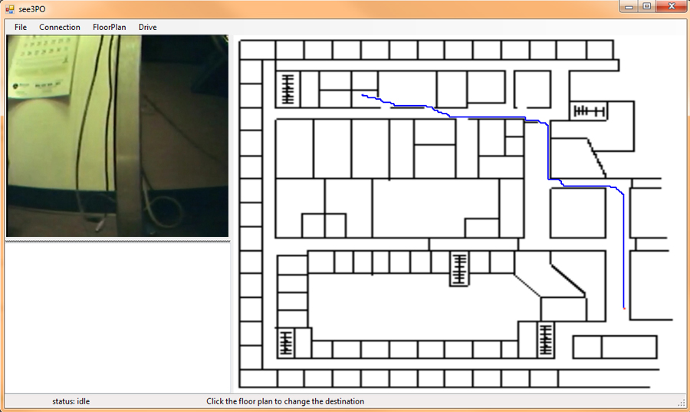
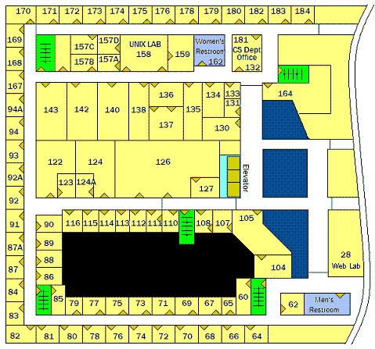
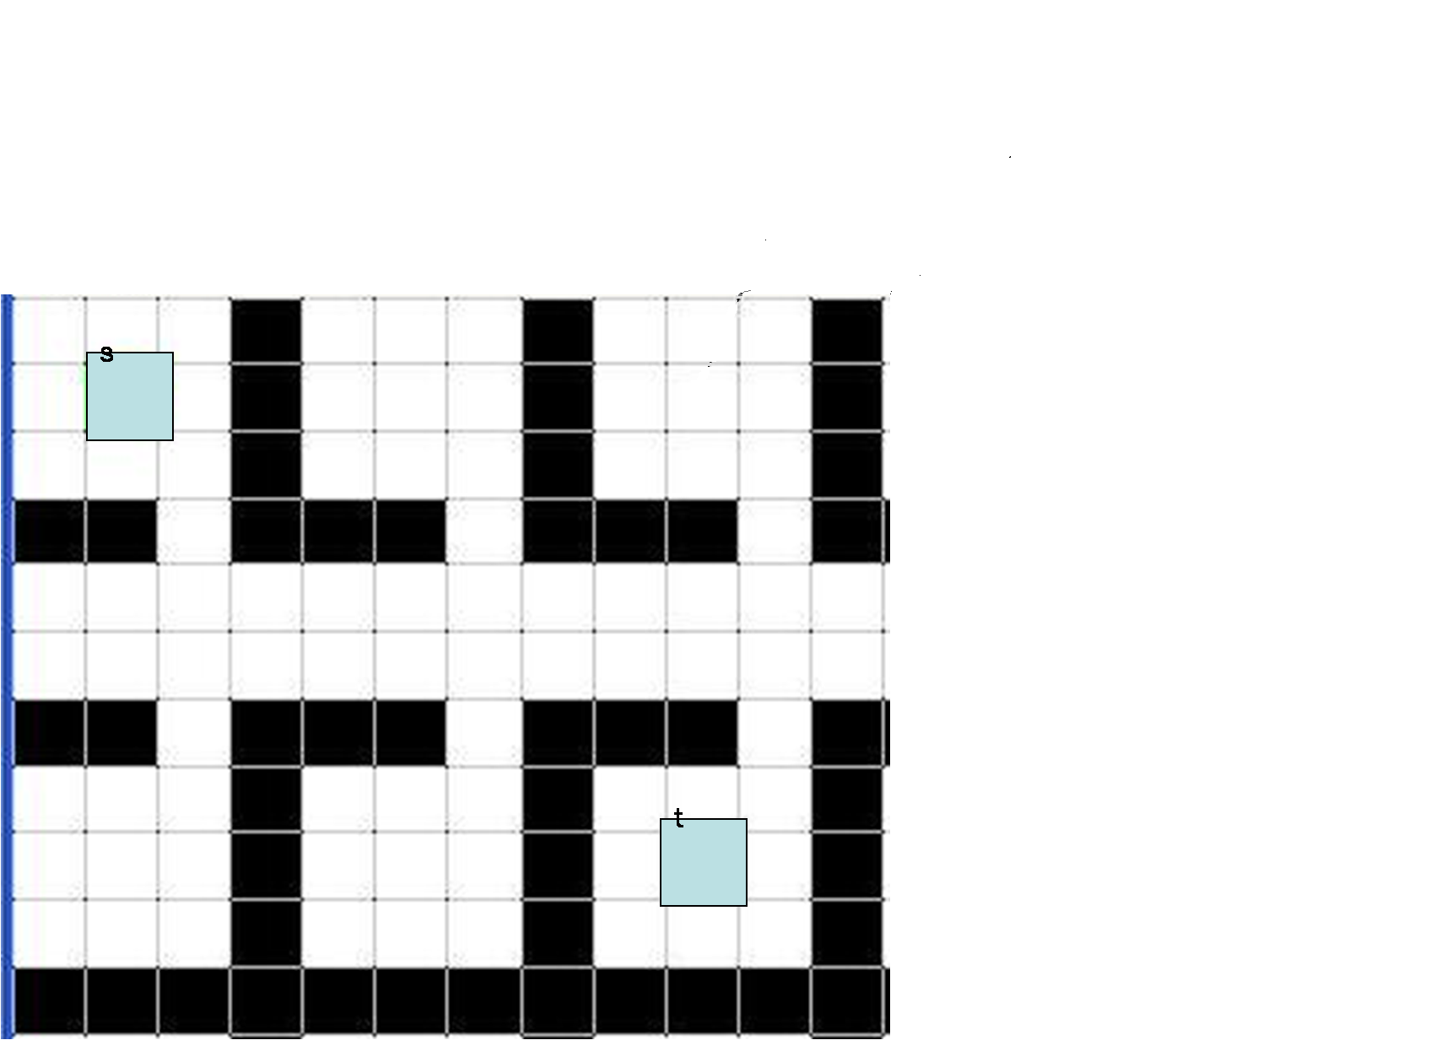
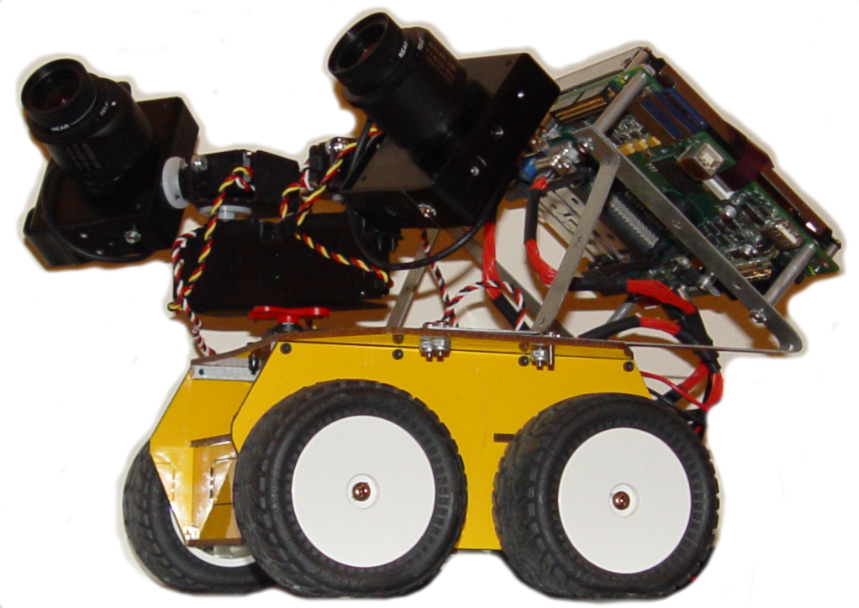

See3PO
See3PO - A Visually Capable Path Finding Robot
Frank, Jacky, Nick, Hao and Debarati
Host GUI
Introduction
Floor Plan Processing
Science Building – 3F (image)
Robot
Features
s
Path Finding
t
Demonstration Time!
Client: Tyler Garaas and Srikumar Ramalingam, Mitsubishi Electric Research Laboratories (MERL)

