Slide 1


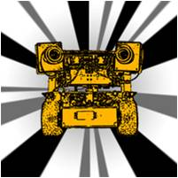
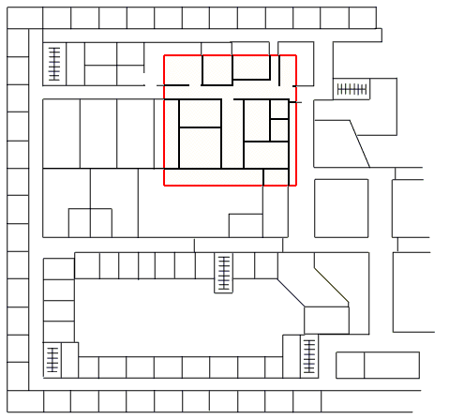
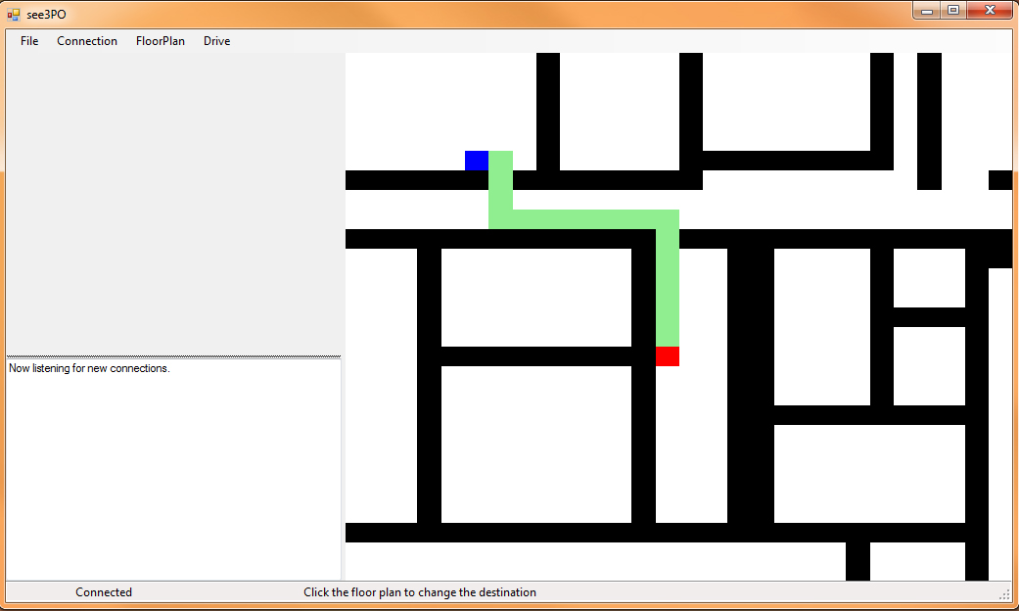
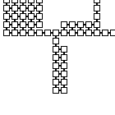
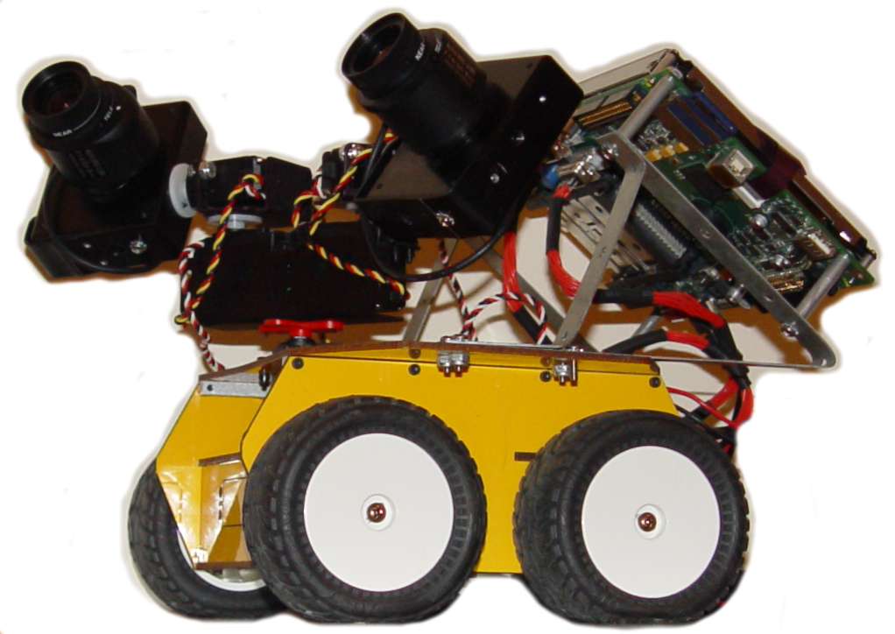
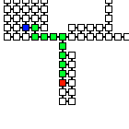

See3PO
See3PO - A Visually Capable Path Finding Robot
Frank, Jacky, Nick, Hao and Debarati http://code.google.com/p/see3po/
Department of Computer Science University of Massachusetts at Boston
Missions - Our mission is to develop software to drive robot with existing map and given starting and target.
- The robot is able to send images as feedback for further analysis such as identifying the current location.
Floor Plan Processing - Graph - Walkable Tiles - Walls
Image Transferring - Feedback for Host
Sending Move Command - Forward N Tiles - Turns (Left and Right)
Path Finding - Dijkstra's Algorithm
Client: Tyler Garaas and Srikumar Ramalingam
Mitsubishi Electric Research Laboratories (MERL)

