Slide 1
See3PO
A Visually Capable Path Finding Robot
Frank, Nick, Jacky, Hao, and Debarati
Department of Computer Science
University of Massachusetts at Boston
Tyler Garass and Shi Kumar
Mitsubishi Electric Research Laboratories (MERL)
CS682 Software Engineering
Instructor: Ethan Bolker

Slide 2
Why See3PO?

Slide 3
Delivering

Slide 4
Picking Up Tennis Balls

Slide 5
And More…
Chasing Animals
Sweeping Leaves
Security / Surveillance

Slide 6
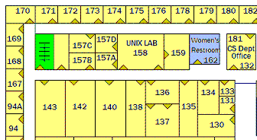
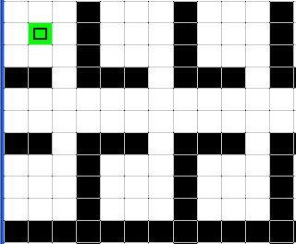
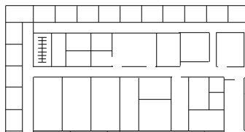

How?
walkable
wall
s
Floor Plan
Processing
t
Science Building – 3F (image)
Graph /
Path Finder
Confirm Position
Position Finder
s
s
t
Generate
Move Command
t

Slide 7
Why We Can Do It?
Excellent Team Members
Robust Software Development
Established Hardware

Slide 8
People
Effective Communication
UML
Google Code, Google Group
Easy-to-work-with Clients
Experienced Instructor

Slide 9
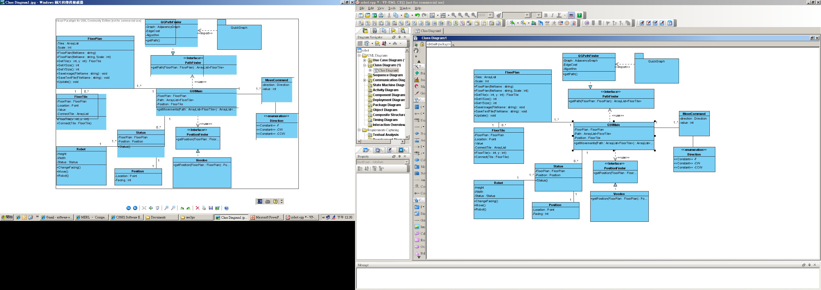
Software – OOP / Design Patterns
Strategy Pattern
XXPathFinder
…
+ getPath()
XXPositionFinder
…
+ getPosition()

Slide 10
Software – Unit Tests
Class should contain its own test.
Tests
Fully automatic
Check their own results (Assert)
Powerful bug detector
Decrease the time to find bugs
FloorPlan
…
…
+ GetXSize()
+ GetYSize()
…
FloorPlanTest
…
…
+ GetXSizeTest()
+ GetYSizeTest()
…

Slide 11
Software - Documentation
Requirements
Architecture/Design
Technical Docs
Code
Algorithms
Interfaces
APIs
User Manual

Slide 12
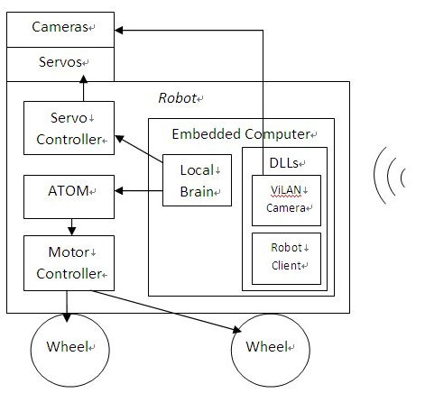
Established Hardware
Ability to develop WinCE network program with OOSD.
Robot can be easily deployed.
Ability to customize communication protocols
Easy to extend.
Proven robot’s driving functions in embedded computer with manual control without host.
Ready to self-tests
Ability to develop PLC-like (microchip) programs on driving control unit.
Full control of robot movements.

