Slide 1
See3PO
Frank, Nick, Jacky, Hao, and Debarati
Department of Computer Science
University of Massachusetts at Boston
Tyler Garaas and Srikumar Ramalingam
Mitsubishi Electric Research Laboratories (MERL)
CS682 Software Engineering
Instructor: Ethan Bolker

Slide 2
What is See3PO?
A Path Finding Robot
Vision Based
Location and Facing through Visual Cues
Notes:
1. See3PO will use software from MERL to ascertain its current position and facing.
2. Using this information as well as user input, it travel autonomously to its destination.

Slide 3

Video Time

Slide 4
Why have See3PO?
Research
Can a robot autonomously navigate using only Vision?
Surveillance
Discovery
Delivery/Retrieval
Notes:
1. See3PO is primarily a proof-of-concept – Can a robot autonomously navigate, using nothing but vision?
2. See3PO will be capable of detecting changes between the images expected and those being viewed by the robot.
3. See3PO can record images and video. If given a path, See3PO can photograph the route automatically.
4. Because it can navigate automatically, it can be used to get to places that are dangerous, impossible or simply inconvenient for humans.

Slide 5
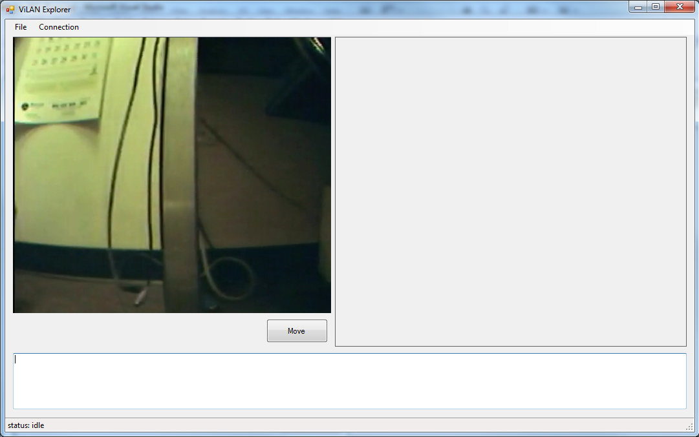
Graphic User Interface
Notes:
The Live View will show the most up-do-date images or video from the robot’s camera
The user can import any image file, and the program will attempt to convert this to a usable format. To begin with, simplified floor plans, including only walls and floor will be required.
The GUI will handle connections to the robot.

Slide 6
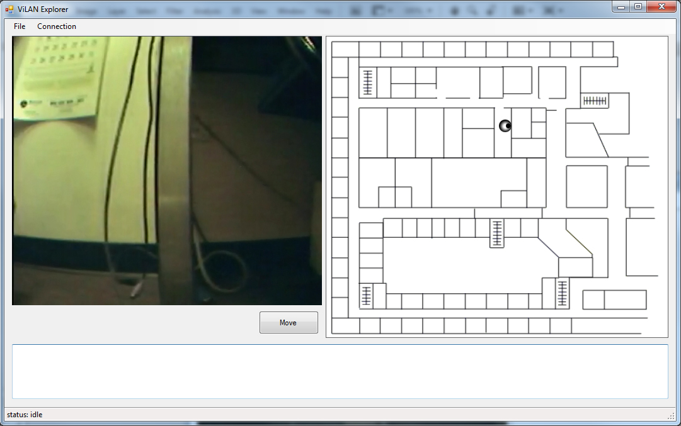
Graphic User Interface
Notes:
When the user loads a FLOOR PLAN, the image will be displayed in the right Panel
At this time. The floor plan will also be processed behind the scenes into a graph, so that the PATH FINDER can work its magic
The ROBOT will be displayed at its current position
To select a DESTINATION, the user will simply double-click a location on the map
Possible PATHS will be displayed over the floor plan.
The BEST PATH will be selected and highlighted.
Future updates will allow the user to select specific paths.

Slide 7
MERL : Position Finder
Providing Location and Orientation of the Robot
This Data is used by Path Finder to monitor progress and plan paths
Uses only Image data from the Robot and Data about the environment.
Notes:
Tyler and Shi will be providing us with a location program, which we have been calling “WHERE AM I”
WhereAmIwill be used to continuously update See3PO on its current position, including both Location and Orientation
The only external data required by WhereAmI will be a stream of images transmitted from the Robot

Slide 8
MERL : Position Finder
Advantages:
Works Indoors
Precise
Constantly Updates
Self-correcting
Recognizes changes in the environment
Open/Closed Doors
Obstacles
Notes:
Because of this, See3PO will be capable of working in situations where a GPS-based system would not, Indoors, for example
Additionally, this system will be more precise than GPS, which is accurate only to about 20 meters.
Because of the way that WhereAmI will work, it will be simple to compare expected views to Observed views
This will allow recognition of changes such as opened or closed doors or obstacles

Slide 9
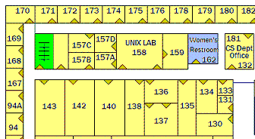
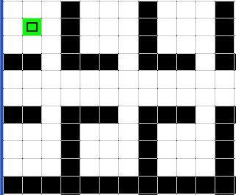
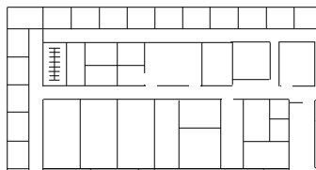

How?
walkable
wall
s
Floor Plan
Processing
t
Science Building – 3F (image)
Graph /
Path Finder
Confirm Position
Position Finder
s
s
t
Generate
Move Command
t

Slide 10
Why We Can Do It?
Excellent Team Members
Robust Software Development
Established Hardware

Slide 11
People
Effective Communication
UML
Google Code, Google Group
Easy-to-work-with Clients
Experienced Instructor

Slide 12
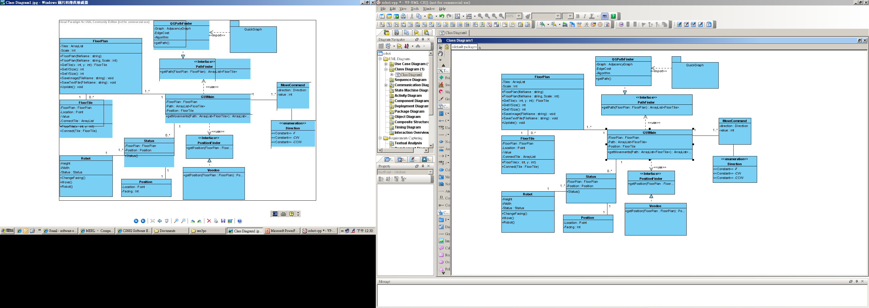
Software – OOP / Design Patterns
Strategy Pattern
XXPathFinder
…
+ getPath()
XXPositionFinder
…
+ getPosition()

Slide 13
Software – Unit Tests
Class should contain its own test.
Tests
Fully automatic
Check their own results (Assert)
Powerful bug detector
Decrease the time to find bugs
FloorPlan
…
…
+ GetXSize()
+ GetYSize()
…
FloorPlanTest
…
…
+ GetXSizeTest()
+ GetYSizeTest()
…

Slide 14
Software - Documentation
Requirements
Architecture/Design
Technical Docs
Code
Algorithms
Interfaces
APIs
User Manual
Graph Search Algorithm
+ Depth-first Search
+ Breadth-first Search
+ Dijskra
+ AStar
+ …

Slide 15
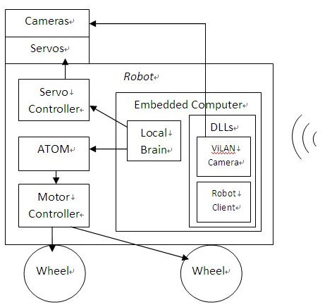
Established Hardware
Ability to develop WinCE network program with OOSD.
Robot can be easily deployed.
Ability to customize communication protocols
Easy to extend.
Proven robot’s driving functions in embedded computer with manual control without host.
Ready to self-tests
Ability to develop PLC-like (microchip) programs on driving control unit.
Full control of robot movements.

Slide 16
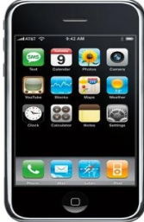
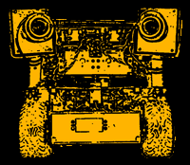
Future
iPhone & See3PO
Low-cost / High-accuracy Navigation System
Multi-functional Assistant
Picking up tennis balls
Delivering
…

