Slide 1
See3PO
A Visually Capable Path Finding Robot
Frank, Nick, Jacky, Hao, and Debarati
Department of Computer Science
University of Massachusetts at Boston
Tyler Garass and Shi Kumar
Mitsubishi Electric Research Laboratories (MERL)
CS682 Software Engineering
Instructor: Ethan Bolker

Slide 2
Why See3PO?

Slide 3
Delivering

Slide 4
Picking Up Tennis Balls

Slide 5
And More…
Chasing Animals
Sweeping Leaves
Security / Surveillance

Slide 6
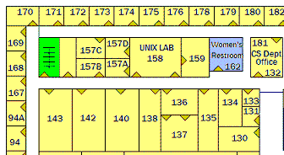
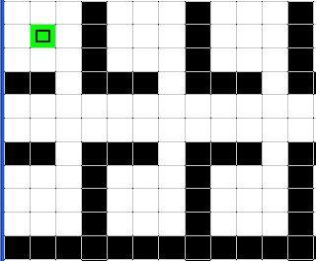
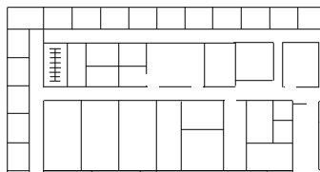
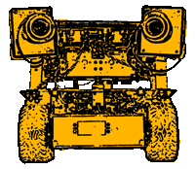
How?
walkable
wall
s
Floor Plan
Processing
t
Science Building – 3F (image)
Graph /
Path Finder
Confirm Position
Position Finder
s
s
t
Generate
Move Command
t

Slide 7
Why We Can Do It?
Excellent Team Members
Robust Software Development
Established Hardware

Slide 8
People
Effective Communication
UML
Google Code, Google Group

Slide 9
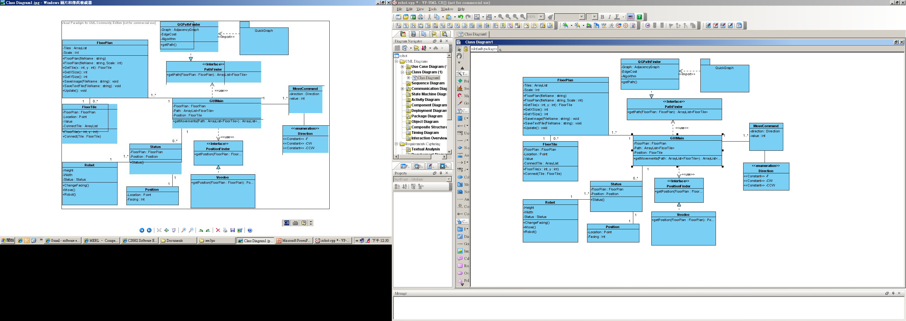
Software – OOP / Design Patterns
Strategy Pattern

Slide 10
Software – Unit Tests
Class should contain its own test.
Tests
Fully automatic
Check their own results (Assert)
Powerful bug detector
Decrease the time to find bugs
FloorPlan
…
…
+ GetXSize()
+ GetYSize()
…
FloorPlanTest
…
…
+ GetXSizeTest()
+ GetYSizeTest()
…

Slide 11
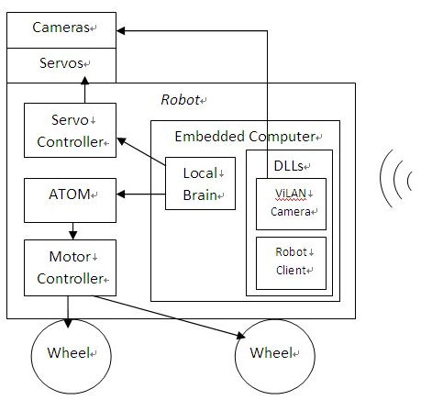
Software - Documentation
Requirements
Architecture/Design
Technical Docs
Code
Algorithms
Interfaces
APIs.
User Manual

Slide 12
Established Hardware
Wireless over TCP/IP
Adopt wireless on WinCE embedded system for remote control. Therefore, the robot can be easily deployed.
Ability to develop WinCE network program with OOSD.
Customized communication protocols
Protocols between control host and robot. (TCP)
Protocols between embedded system and driving control unit. (RS-232)
Ability to develop PLC-like (microchip) programs on driving control unit.
Proven robot’s driving functions with manual control without host.

Slide 13
Future

