Slide 1
Handwritten digit classification using higher order singular value decomposition
Course: Introduction to data mining
Faculty of Science – Department of Mathematics
22.2.2021.
Tin Kranželić

Slide 2
Contents
Briefly about tensors
Introduction to the problem
Algorithm 1
Algorithm 2
Results and discussion
List of functions
References

Slide 3
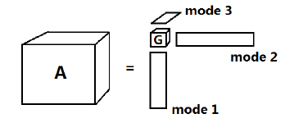
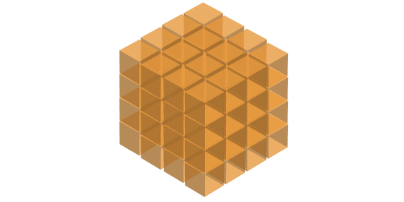
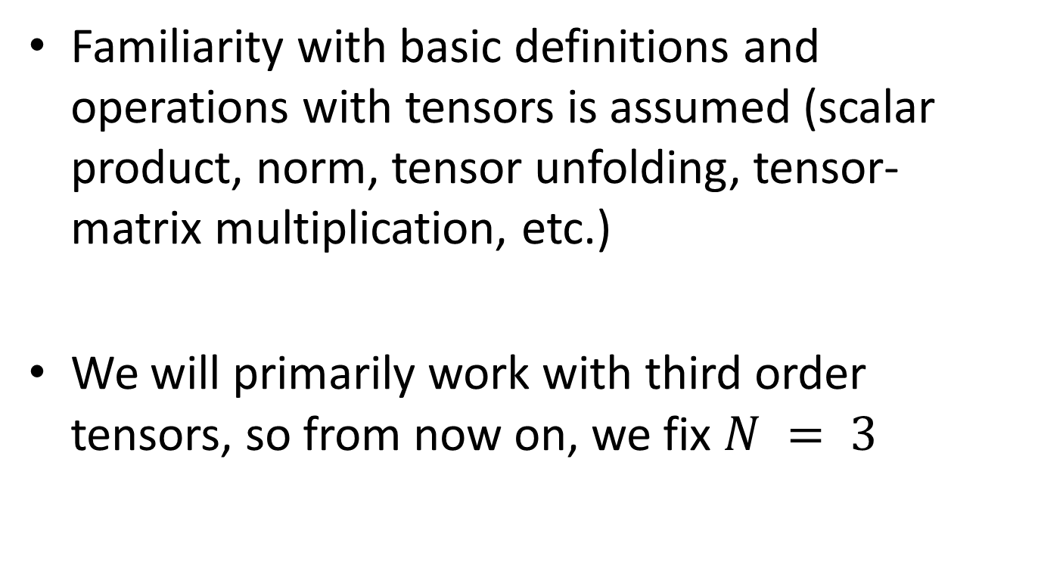
Tensors
Familiarity with basic definitions and operations with tensors is assumed (scalar product, norm, tensor unfolding, tensor-matrix multiplication, etc.)
We will primarily work with third order tensors, so from now on, we fix $N = 3$

Slide 4
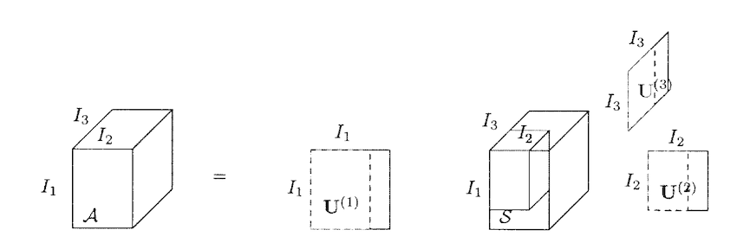
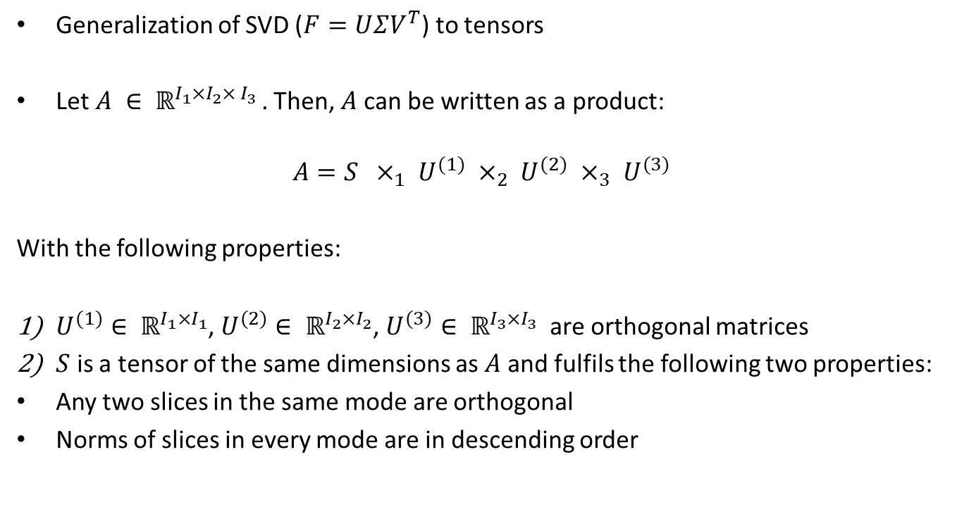
HOSVD
Generalization of SVD ($F=UΣV^{T}$) to tensors
Let $A ∈ ℝ^{I_{1}×I_{2}×{ I}_{3} }$. Then, $A$ can be written as a product:
$$A=S ×_{1} U^{(1)} ×_{2} U^{(2)} ×_{3} U^{(3)}$$
With the following properties:
$U^{(1)}∈ ℝ^{I_{1}×I_{1}}$, $U^{(2)}∈ ℝ^{I_{2}×I_{2}}$, $U^{(3)}∈ ℝ^{I_{3}×I_{3}}$ are orthogonal matrices
$S$ is a tensor of the same dimensions as $A$ and fulfils the following two properties:
Any two slices in the same mode are orthogonal
Norms of slices in every mode are in descending order

Slide 5
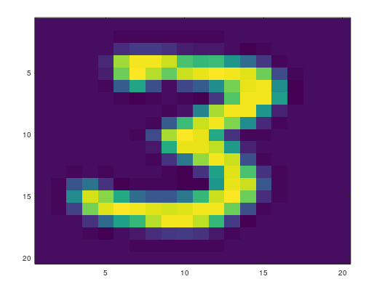
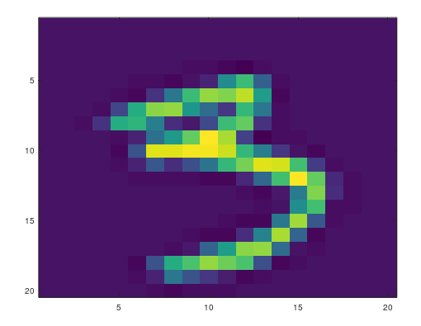

Our task
Dataset of handwritten digits ($20x20$ images)
Example:
Construct two algorithms based on HOSVD
Classify unknown digit as one of the classes $\left\{0, 1, 2, 3, 4, 5, 6, 7, 8, 9\right\}$

Slide 6
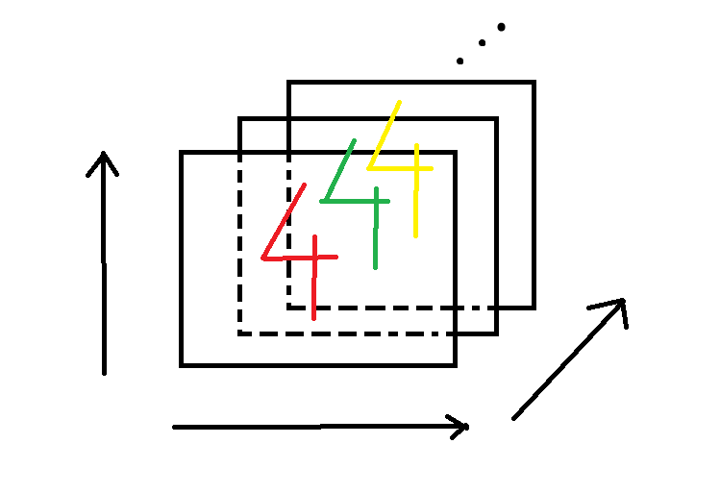
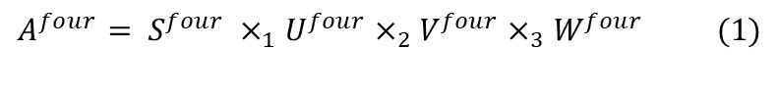
Algorithm 1
Idea: for each of the classes calculate a set of basis matrices and determine which one describes a given unknown digit in the best way
Key steps in training phase:
We sort digits from the training dataset into tensors with digits from the same class
Calculate HOSVD of all 10 tensors
Calculate normalized basis matrices
$$A^{four}= S^{four} ×_{1}U^{four}×_{2}V^{four}×_{3}W^{four} (1)$$
1.
2.

Slide 7
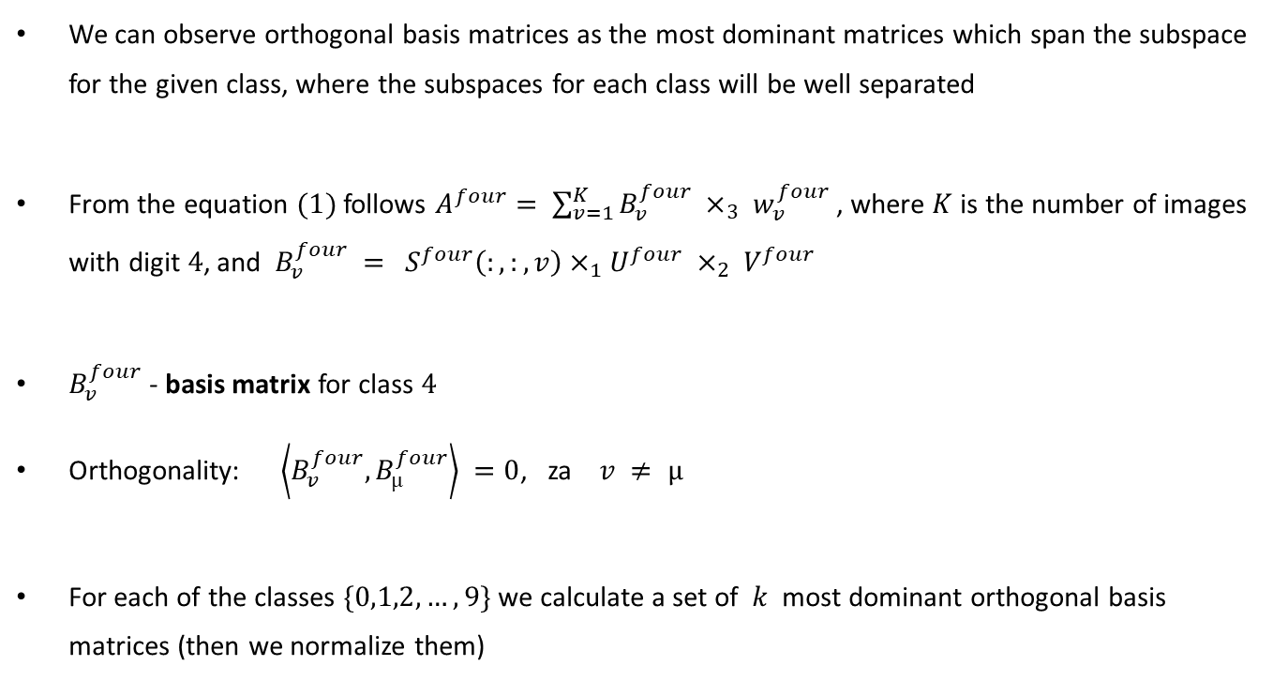
Normalized basis matrices
We can observe orthogonal basis matrices as the most dominant matrices which span the subspace for the given class, where the subspaces for each class will be well separated
From the equation $(1)$ follows $A^{four}= \sum_{v=1}^{K}{B_{v}^{four} ×_{3} w_{v}^{four}}$ , where $K$ is the number of images with digit $4$, and $B_{v}^{four} = S^{four}\left(:,:,v\right)×_{1}U^{four} ×_{2} V^{four}$
$B_{v}^{four}$ - basis matrix for class $4$
Orthogonality: $\left\langle B_{v}^{four},B_{µ}^{four}\right\rangle =0$, za $v ≠ µ$
For each of the classes $\{0,1,2,…,9\}$ we calculate a set of $k$ most dominant orthogonal basis matrices (then we normalize them)

Slide 8

Classification
Now, how do we classify a normalized unknown digit $D$?
($∀ µ ∈\left\{0,1,2,…,9\right\}) \min_{α_{v}^{μ}}\left\|D − \sum_{v=1}^{k}{α_{v}^{μ}}B_{v}^{µ}\right\|$
Least squares problem: ${\hat{α}}_{v}^{μ}= \left\langle D, B_{v}^{μ}\right\rangle$, $v=1,…, k$
Final solution: $\arg{\min_{μ}{R(μ)}}$ , where: $R\left(μ\right)=1 − \sum_{v=1}^{k}{{\left\langle D, B_{v}^{μ}\right\rangle }^{2}}$

Slide 9
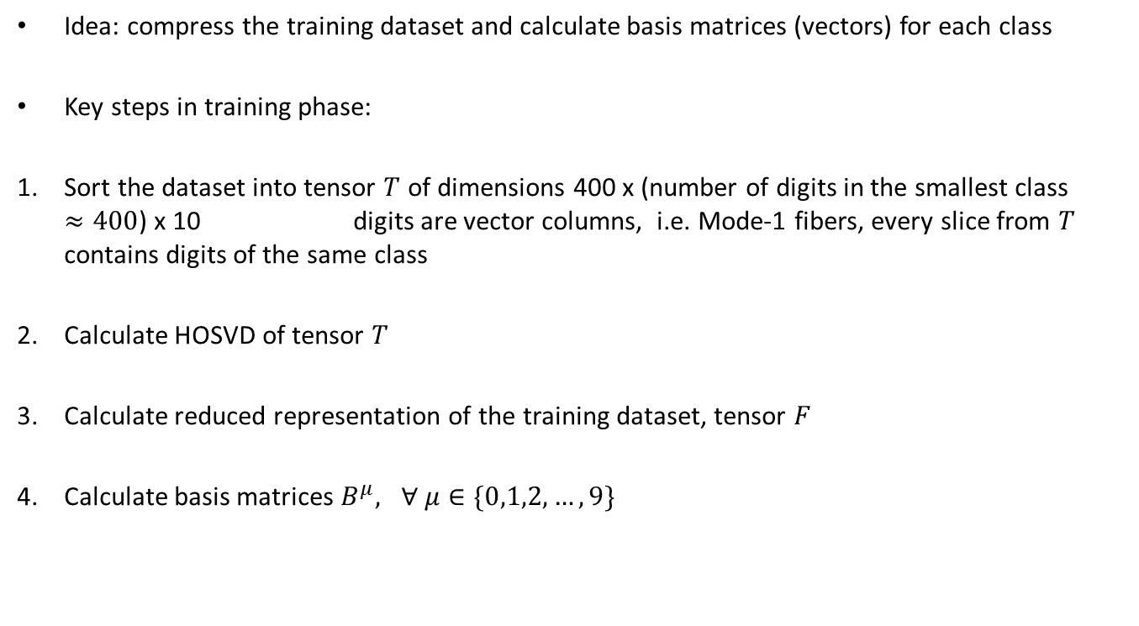
Algorithm 2
Idea: compress the training dataset and calculate basis matrices (vectors) for each class
Key steps in training phase:
Sort the dataset into tensor $T$ of dimensions 400 x (number of digits in the smallest class $≈400$) x 10 digits are vector columns, i.e. Mode-1 fibers, every slice from $T$ contains digits of the same class
Calculate HOSVD of tensor $T$
Calculate reduced representation of the training dataset, tensor $F$
Calculate basis matrices $B^{μ}, ∀ μ∈\{0,1,2,…,9\}$

Slide 10



Tensor $F$
$HOSVD → T=S ×_{1}U ×_{2}V×_{3}W ≈ F×_{1}U_{p} ×_{2}V_{q}$, where${ U}_{p}=U\left(:, 1:p\right), V_{q}=V\left(:, 1:q\right), F=S\left(1:p, 1:q,:\right)×_{3}W$
By doing this, we reduced the representation of the individual digits from $ℝ^{400}$ to $ℝ^{p}$ and the number of digits in each class to q
$p, q ≪400$, but how do we choose them?
$T$T

Slide 11
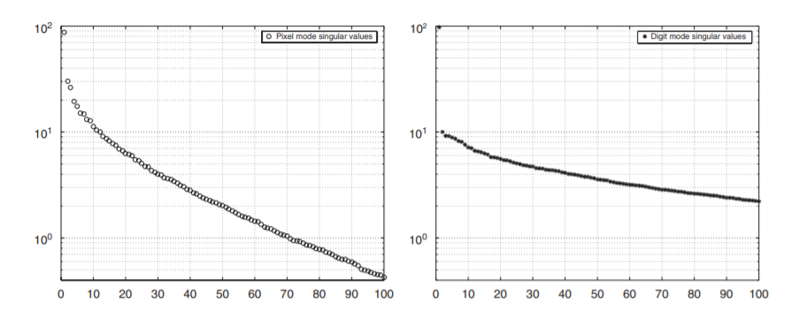
Mode-1 singular values
Mode-2 singular values

Slide 12


Basis matrices $B^{μ}$
$F^{μ} ≔F(:,:,µ)$
SVD of $F^{μ}$ $F^{μ} = \left[B^{μ}{\left(B^{μ}\right)}^{\text{⊥}}\right]{ Σ}^{μ } {(Q^{μ})}^{T}, μ=0,1,…,9$
We take $k$ most significant left singular vectors
$B^{μ} ∈ ℝ^{p×k}$, columns ortonormal

Slide 13
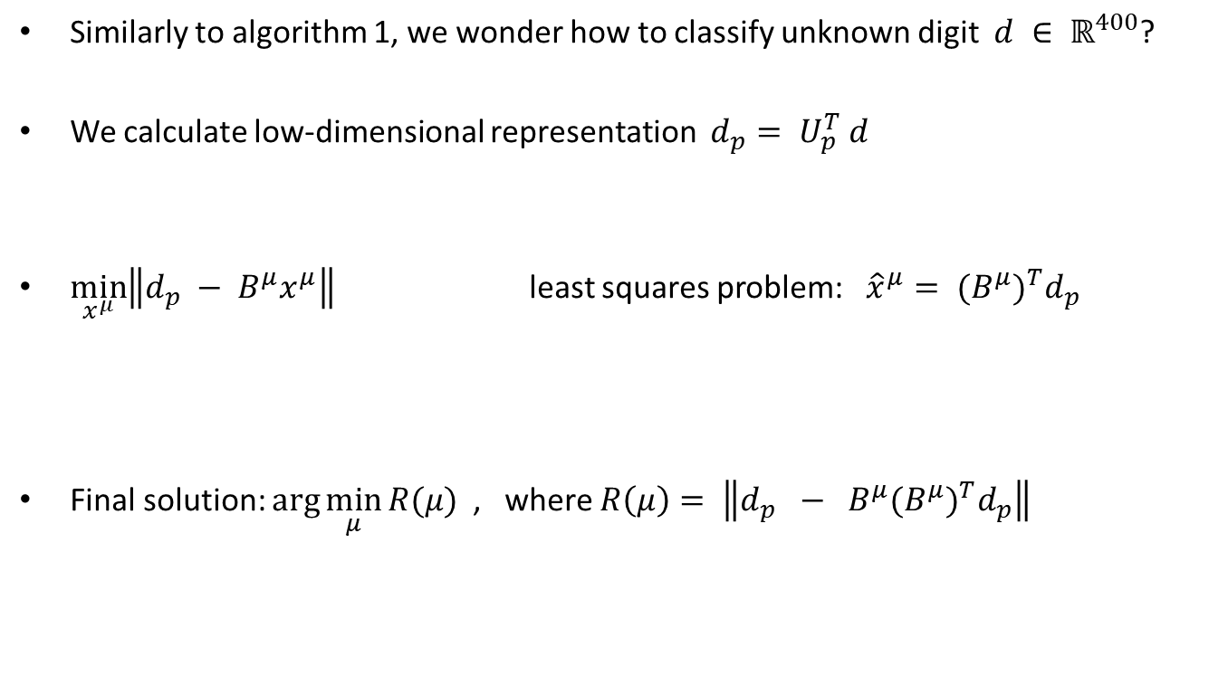
Classification
Similarly to algorithm 1, we wonder how to classify unknown digit $d ∈ ℝ^{400}$?
We calculate low-dimensional representation $d_{p}= U_{p}^{T} d$
$\min_{x^{μ}}\left\|d_{p} − B^{μ}x^{μ}\right\|$ least squares problem: ${\hat{x}}^{μ}= {(B^{μ})}^{T}d_{p}$
Final solution: $\arg{\min_{μ}{R(μ)}}$ , where $R\left(μ\right)= \left\|d_{p} − B^{μ}{(B^{μ})}^{T}d_{p}\right\|$

Slide 14

Results and discussion
Description of the dataset we used: $500$ digits in each class
We have randomly shuffled them and split into train and test datasets
We got the following distribution of digits:
 | 0 | 1 | 2 | 3 | 4 | 5 | 6 | 7 | 8 | 9 | Total
train | 386 | 399 | 399 | 400 | 384 | 421 | 394 | 418 | 395 | 404 | 4000
test | 114 | 101 | 101 | 100 | 116 | 79 | 106 | 82 | 105 | 96 | 1000

Slide 15
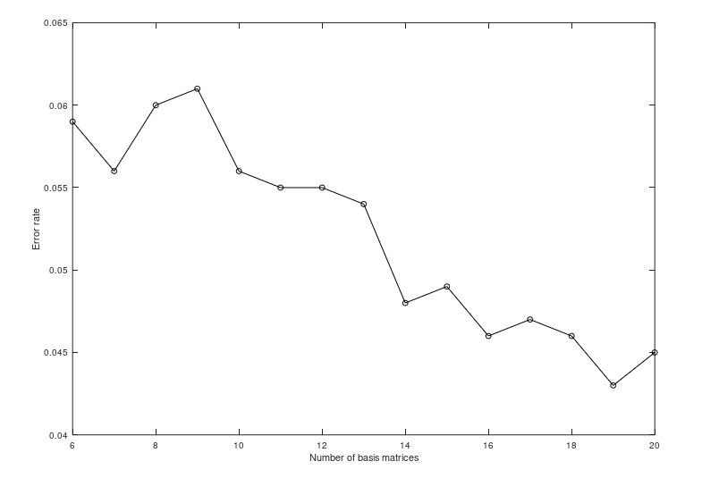


Performance of algorithm 1 for different choices of $k$
We can see that the highest precision was achieved for $k=19$ and it was almost $96\%$

Slide 16
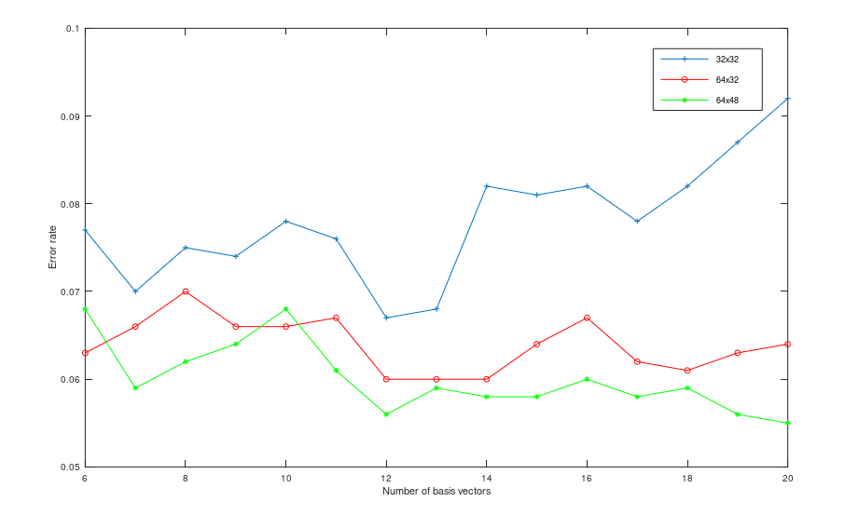
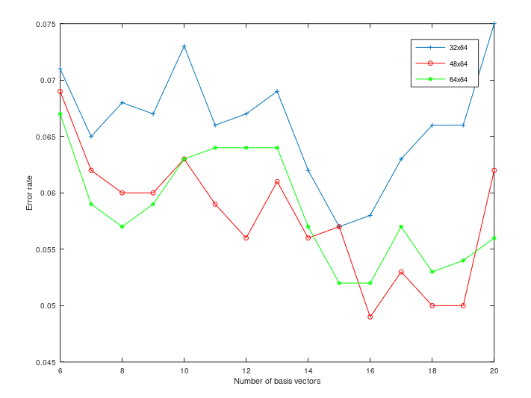

Performance of algorithm 2 for different choices of $p,q$and $k$
We can see that the highest precision achieved for algorithm 2 was around $95\%$

Slide 17
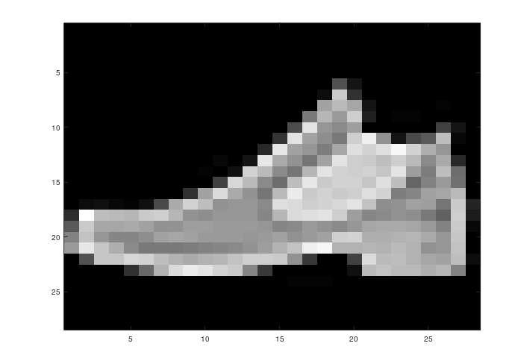
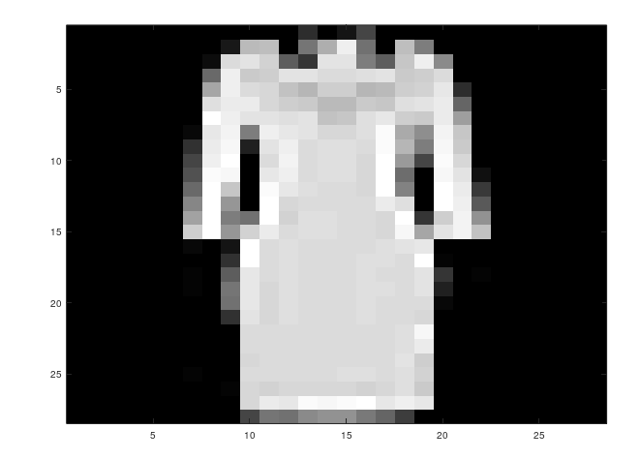
Another classification example
Fashion items
10 classes - {"T-shirt/top"; "Trouser"; "Pullover"; "Dress"; "Coat"; "Sandal"; "Shirt"; "Sneaker"; "Bag"; "Ankle boot"}
Ankle boot
Dress
Algorithm 2 achieved precision of about 75%

Slide 18
Conclusion
We saw how to efficiently solve the digit classification problem using HOSVD
Algorithm 2, even after great compression of the dataset, achieves high precision in comparison with algorithm 1, while faster and more efficient

Slide 19
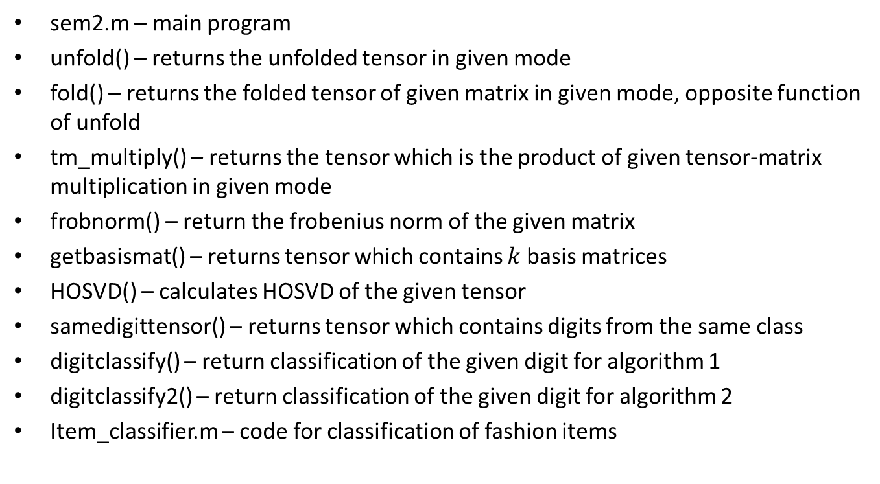
List of functions
sem2.m – main program
unfold() – returns the unfolded tensor in given mode
fold() – returns the folded tensor of given matrix in given mode, opposite function of unfold
tm_multiply() – returns the tensor which is the product of given tensor-matrix multiplication in given mode
frobnorm() – return the frobenius norm of the given matrix
getbasismat() – returns tensor which contains $k$basis matrices
HOSVD() – calculates HOSVD of the given tensor
samedigittensor() – returns tensor which contains digits from the same class
digitclassify() – return classification of the given digit for algorithm 1
digitclassify2() – return classification of the given digit for algorithm 2
Item_classifier.m – code for classification of fashion items

Slide 20
References
[1] Handwritten digit classification using higher order singular value decomposition Berkant Savas, Lars Eldén Department of Mathematics, Linköping University
[2] Zlatko Drmač: Lectures from the Course: Introduction to data mining, Zagreb 2021.
[3] Data for classification of fashion items was downloaded from: https://www.kaggle.com/zalando-research/fashionmnist

