Slide 1
SAROPS
Search and Rescue Optimal Planning System
  Person is missing at sea. Find him.
  First Problem: Where is he?
    Simulator
      Monte Carlo
        Environmental Data
        Motion Model: Pre-Distress and Post-Distress
  Second Problem: Where do we send the Helos?
    Planner
      Helicopters, Fixed Wing, Surface Ships
      Called SRUs (Search and Rescue Units)

Slide 2
Simulator
Monte Carlo Input:
  Scenarios
    1. (P = 0.7) We think he went fishing in fishing area 1 and then on to fishing area 2. In this case, he went 12 kts, …
    2. (P = 0.3) But we also heard a mayday and it might have been him. In this case, he has been adrift from a roughly circular area, for the last 12 hours, …
  Environmental Data and Model Interplay (Post Distress)
    Rafts follow wind, “persons-in-water” follow current.
    Jibing effect
    Uncertainties in environmental data
      Uncertainties are correlated within a particle

Slide 3
Hourglassing
Consider a scenario with a sequence of fishing areas.
Make a random draw from one 2-d area and a random draw from the next 2-d area.
  Half of the time, you will cross the line connecting their centers.
  That’s too often; if a particle starts to the right, it should stay “towards the right.”
Independent draw and you get an hourglass. Hence, we want a correlated draw.

Slide 4
Simulator: Technical Issues
An Area has the following functions:
  Cdf(x)→p, Cdf(y|x)→q
  Cdf⁻¹(p)→x, Cdf⁻¹(q|x)→y
  Rotate the distribution about its Center of Mass (COM): θ→new distribution.

Slide 5
“Avoid Hourglassing” Algorithm
Given (x,y) in Area 1, make a draw in Area 2.
  Shift and rotate the distributions so that Area 1’s COM is at (0,0) and Area 2’s COM is at (0,y).
  Convert (x,y) to rotated coordinates and then get its Cdf values.
  Perturb them a bit using ρ.
    For perfect stovepiping, leave them alone.
    For perfect hourglassing, subtract them from 1.0.
    In general, mix in new independent random draws.
  Use this pair of Cdfs to get a draw in Area 2.
  Un-rotate Area 2’s draw.

Slide 6
Parameter in code: ρ
Controls the Hourglass shape
  Stovepiping (ρ=1)
  Hourglassing (ρ=-1)
  Independent (ρ=0)
We use ρ=0.75

Slide 7
Hourglassing Algorithm
The draws from each Area are an IID sample from that distribution.
Can chain together any Areas
  We have only uniform polygon and bivariate normal.
  Uniform polygon is far harder to deal with since the Cdfs and inverses are harder to compute.

Slide 8
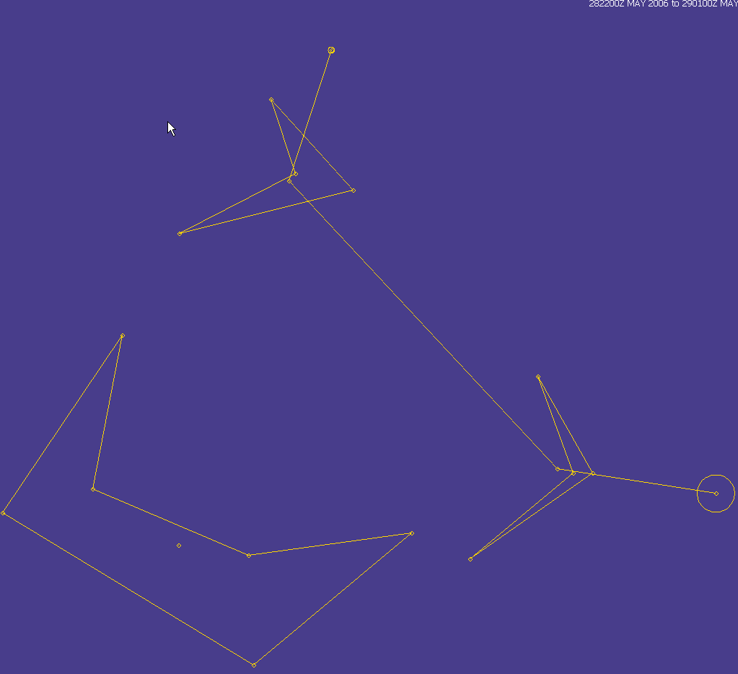

Slide 9
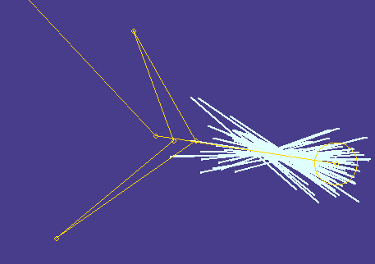
Perfect Hourglassing: ρ = -1

Slide 10
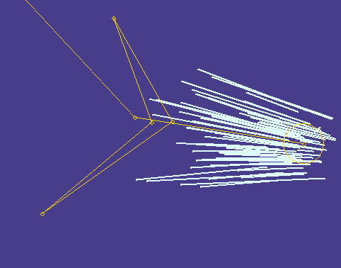
Perfect Stovepiping: ρ = 1

Slide 11
Land Recognition: Based on Gshhs
Pick a Resolution, Read the File.
Discard Irrelevant Polygons
Truncate Large Polygons
  Based on a Circular Area of Interest
  Given a “Lat/Lng Box”, find a small circle that contains the box.

Slide 12
Land Recognition
In-4
In-2
Out-4
Out-1
In-3
Out-2
Out-3
Start and End
AOI
In-1

Slide 13
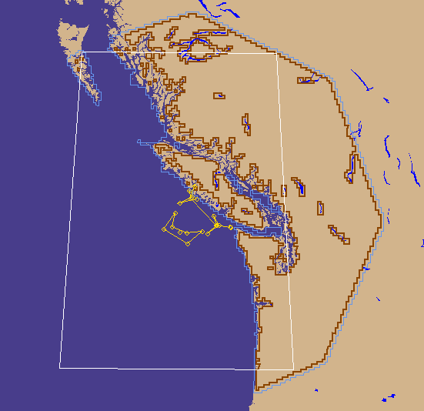
“Shrink” North and South America

Slide 14
Interpretation
White is given, “Unseen Circle” is my creation
Outside of Jagged edge on the east is water
I read and store a tiny fraction of North and South America

Slide 15
Land Recognition
Use only the edges that are kept from the previous algorithm.
Break the AOI into a grid of cells.
Each cell knows which edges intersect it.
Particles move through the cells.
  When a particle enters a cell, check if it crosses any of the edges that intersect that cell.
    Note that most particles don’t move through cells that have any edges.
  Result is that particles stick to land-edges, and not cell boundaries
Computation is fast

Slide 16
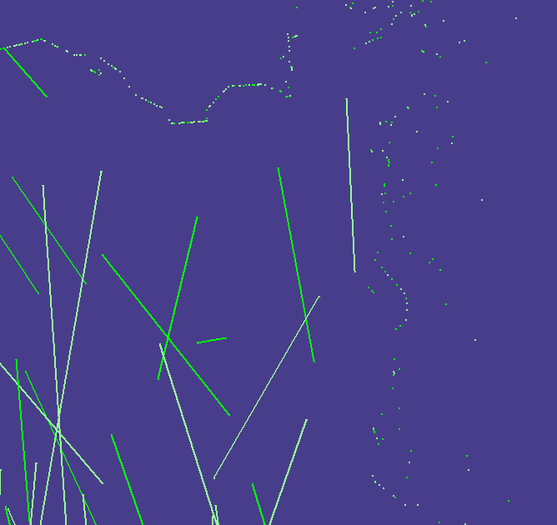
Without Land Drawn In

Slide 17
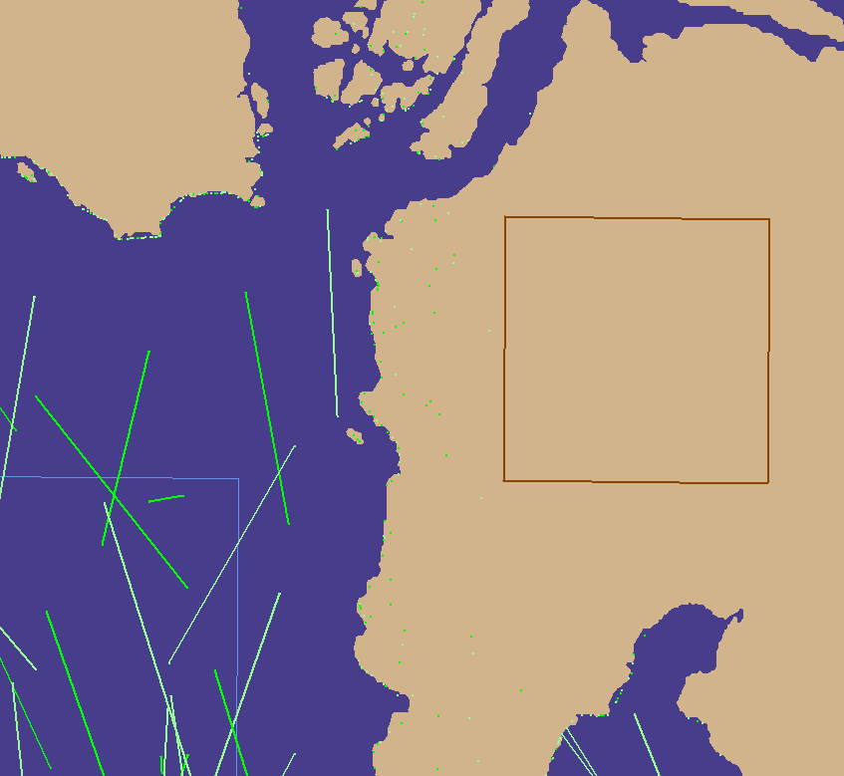
With Land Drawn In

Slide 18
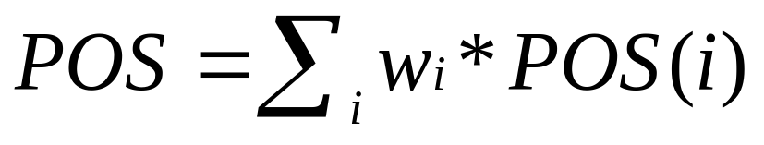
Planner
One Rectangle for each SRU
Arbitrary Orientation for each SRU
Maximize POS = Probability of Success. Maximize POS.
POS(i):
  1 – probability that all SRUs failed to find particle i.
    Expensive computation
For optimization purposes, avoid doing the entire sum.
  For each proposed solution, sample the particles until the estimate for POS has a small confidence interval

Slide 19
Planner
Basic Optimization Algorithm: P-Moves and Q-Moves
  Get Initial Solution
  Refine until an apparent Local Max (P-Moves)
  Start at a new Initial Solution (Q-move)
Demo 1
  Compute overlap
  Move the rectangles
  They don’t stretch smoothly

Slide 20
More Planner
Overlap Avoidance
  Avoid mid-air collisions
  POS and Ovl are at odds with each other.
Interactive GUI
Miscellaneous:
  Cache parts of POS Computations
  Admissibility of Solutions
  Use parallel processing
    Uses my new desktop and Java
  Warm Start; re-run, start where you left off.
Demo 2

Slide 21
Demo

Slide 22
Planner: Remaining Work
Better Initial Solutions
Better Choice of P-Moves
  Not based on moving one SRU
Re-define “POS”
  Find Object AND Object is Alive
    Lets Planner do the “triage;” USCG does not look for bodies.
Re-define “Overlap”
  Is “complete non-overlap” necessary?
  When can the rules be bent?
  How can the software bend them?
Use Optimization Libraries

