Slide 1
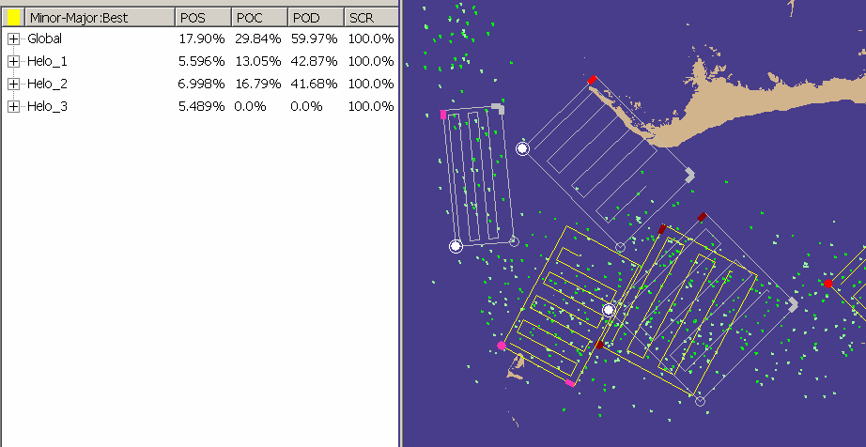
Search and Rescue Optimal Planner System (SAROPS)
Coast Guard Operational System for Deployment of Search/Rescue Units (SRUs)
SAROPS Simulator Creates Probability Distribution for Object Location
  Particle filter produces a time-dependent probability distribution for the object in distress
  Fuses information about the object in distress and environmental data
SAROPS Planner Suggests Where to Send the SRUs
  Displays Gradient Search solution (yellow), and User-Entered solution (gray)
  Displays Measures of Effectiveness for both solutions
  Allows for interaction between the two “Solvers”
Thomas M. Kratzke, PI, tkratzke@metsci.com
Notes:
On the following slide, a snapshot is taken of the two solutions (yellow and gray).
The table on the left is showing the measures for the yellow.
Clicking the yellow smudge in that table will flip it over to gray.

Slide 2
Goals
Better Decisions
  Find people alive faster
Better use of resources
  Don’t send out SRUs unless they might help

Slide 3
Summary
Domain
Mathematical Approach
GUI as part of Mathematical Approach
Next Generation Technology

Slide 4
Domain: Search and Rescue
Deploy Search and Rescue Units (SRUs) to find something
  Typically helicopters
  Visual search (sweep width or log odds model for finding)

Slide 5
Mathematical Approach (1 of 3)
Non-Linear Optimization
Difficult Objective Function
Difficult Feasible Region
  Discontinuous
  No closed form
Had to be Creative

Slide 6
Mathematical Approach (2 of 3)
Optimization Problem Requires a Tactical Picture
  Monte Carlo simulation produces it
  Tactical Picture becomes constants in the objective function
  Represents a probability distribution for the search object

Slide 7
Mathematical Approach (3 of 3)
Using “Cooperative Solvers”
  Also known as “Collaborative Solvers”
Could use many more solvers for cooperating
  Example: Simulated Annealing for choosing a new staring point
Using the GUI for optimization
  One of the solvers
  Side effect: GUI provides mathematical motivation for other ideas

Slide 8
GUI Optimizer
Input from user is useful because of imperfections in:
  Environmental data and drift model
  Optimization model (objective function and modeling of SRUs’ detection function)
Input from user is useful because:
  There are “un-modeled” considerations
Final decision making is left to operator
Metron Vision: User is a Required Resource in Robust Optimization

Slide 9
Next Generation SAR Technology
Current Focus of SAROPS project is first-generation deployment
  Simulator and Planner are working sufficiently well.
  Other deployment concerns draw attention from future technology.
  Need alternative program to develop technology.

Slide 10
Next Generation Technology
GUI
  Roll back to previous solutions.
  Undo, …
  Other ideas?
  “The GUI as a Cooperative Solver” is the only important idea

Slide 11
Next Generation Technology
Optimization
  More sophisticated techniques for generating starting solutions
    Find solutions for problematic scenarios
    Examples:
      Simulated Annealing
      Opt++
  Overlap analysis
      Something better than “No overlap at all.”
      Need input from USCG

Slide 12
Next Generation Technology
Survivability Analysis
  “Success,” as in “Probability of Success” would have to be re-defined as “found him and found him alive.”
    Need this to encourage optimizer to go after PIWs.
  USCG R&D Center has survivability models

Slide 13
Next Generation Technology
Sensitivity Analysis (Examples)
  Evaluate environmental data
    Would better data significantly alter the decisions?
  Evaluate effect of SRU effort on objective function and on deployments
    For example, how much does the presence of SRU 2 affect the solution for SRU 1?
  Evaluate Sweep Widths
    Are the rectangles sensitive to our estimates of sweep widths?

