Slide 1
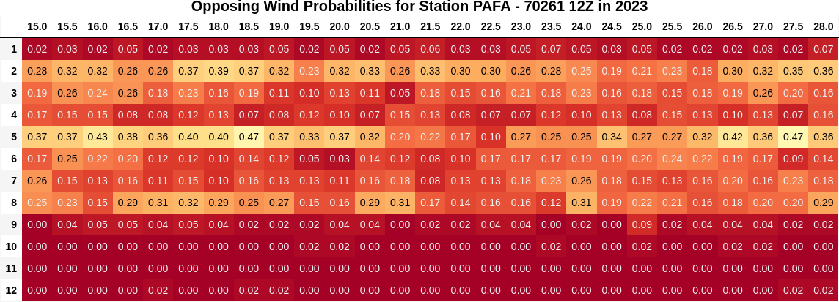
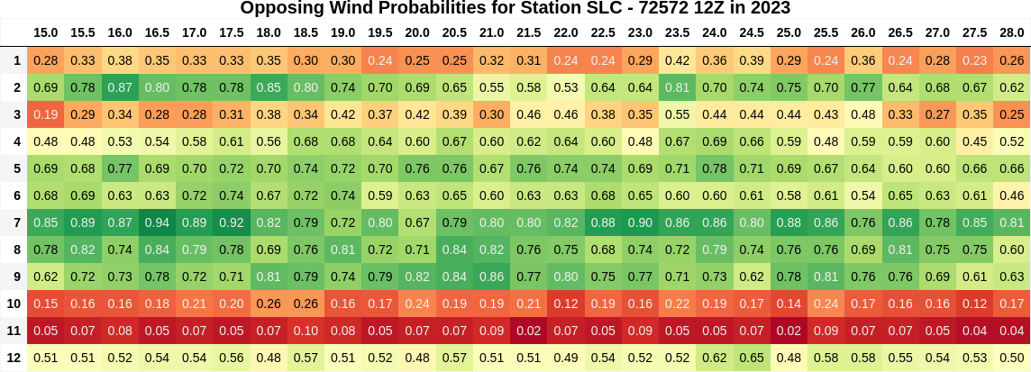
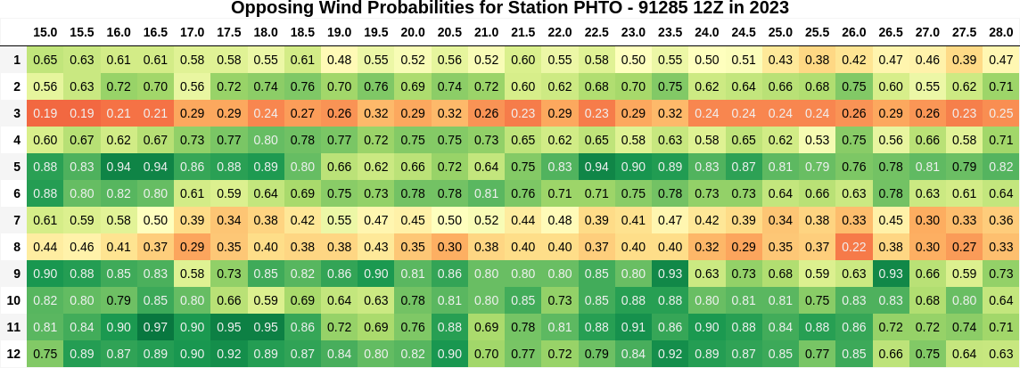
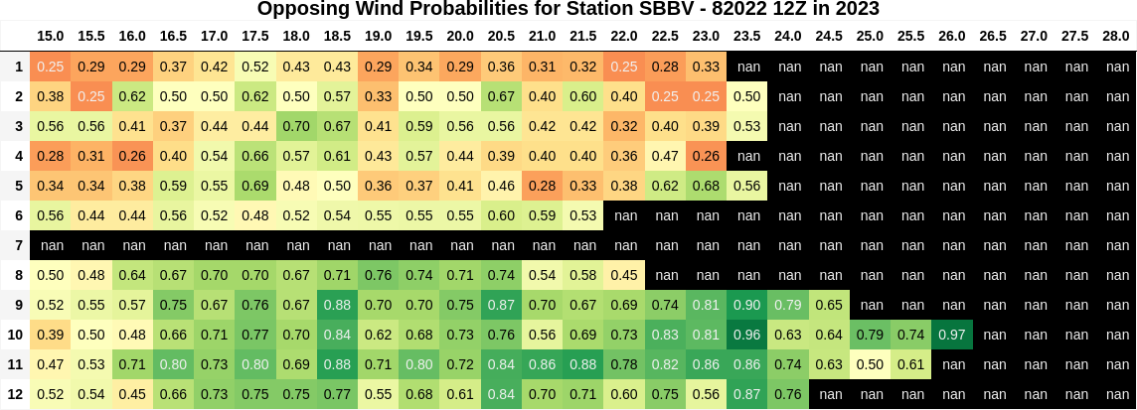
Fairbanks, Alaska USA - 65°N (Station # 70261)
Salt Lake City, Utah USA - 40°N (Station # 72572)
Hilo, Hawaii USA - 20°N (Station # 91285)
Boa Vista, Brazil - 3°N (Station # 70261)

