Slide 1
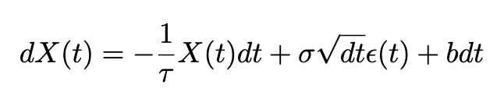
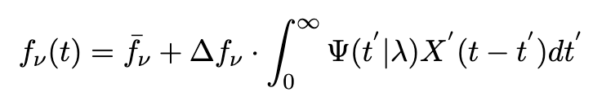
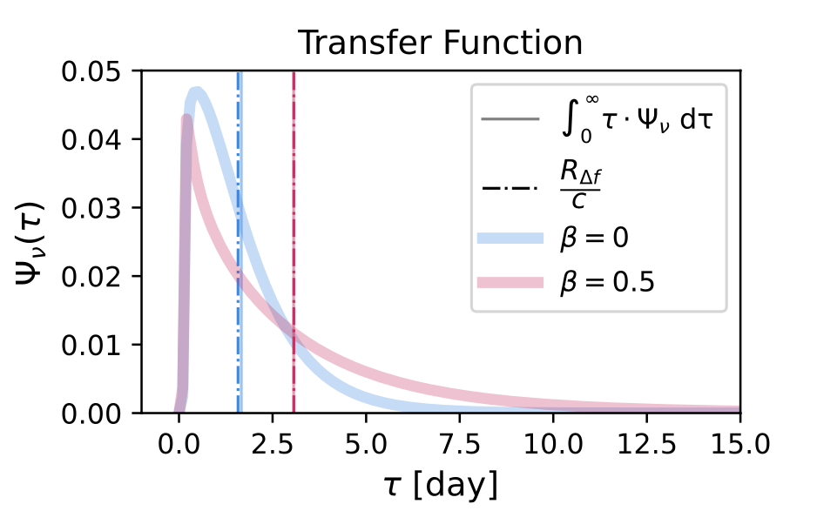
Active galaxy nuclei(AGN) ligh curves modeling
The modeling of the AGN light curve:
1. Generate the light variability based on Damped random Walk:
2. Simulate the photon reprocessing: Applied transfer function on the varaibility signal:
Spectrum time series
Transfer function
3. Apply filters, simulate the observation noises and seasonal gaps

Slide 2
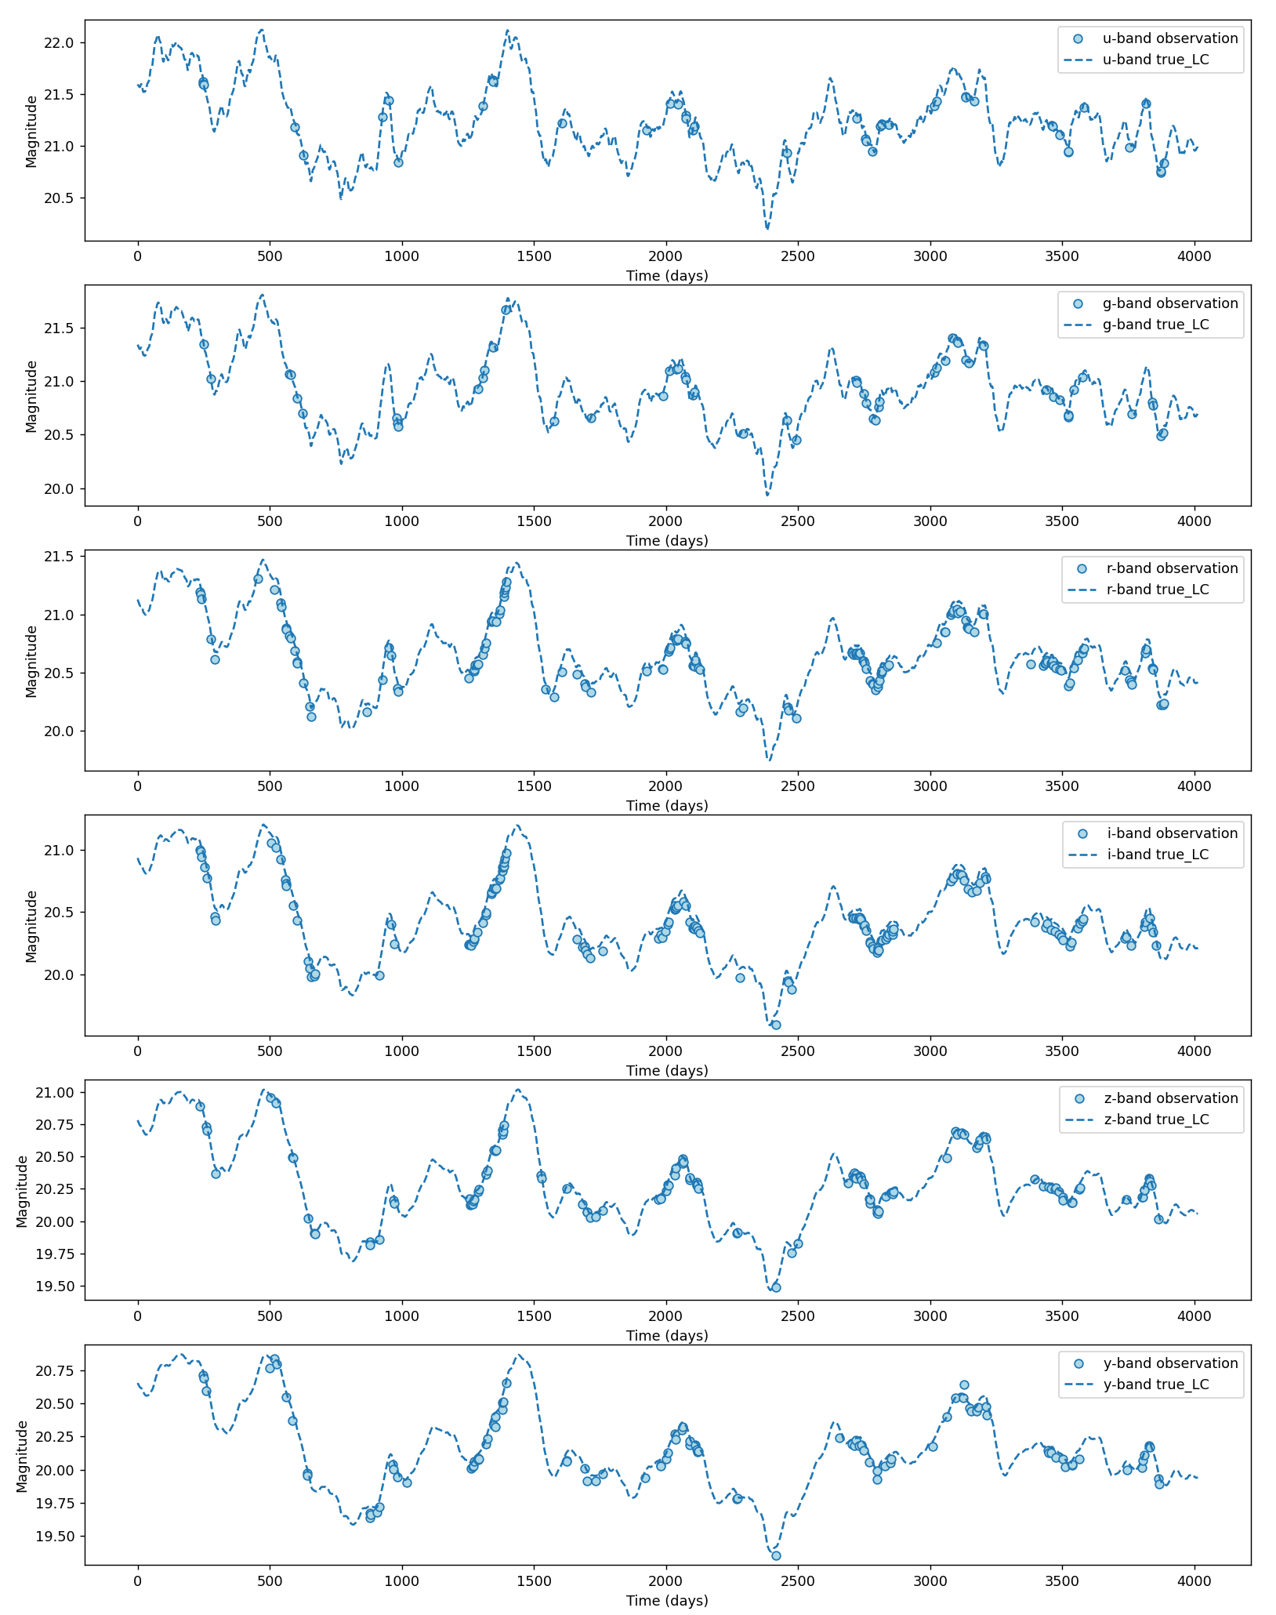
Example light curve data
Q1: How to deal with irregularly sampled data? Instead of forecasting the future, is it possible to reconstruct the time series?
Q2: Is it possible to correlate 6 different bands of time series to some hidden space and fit the time series model on the hidden space? E.g. fit ARMA on the underlying damped random walk process, given that all six bands are just some transfer functions convolve with the damped random walk signal.

Slide 3
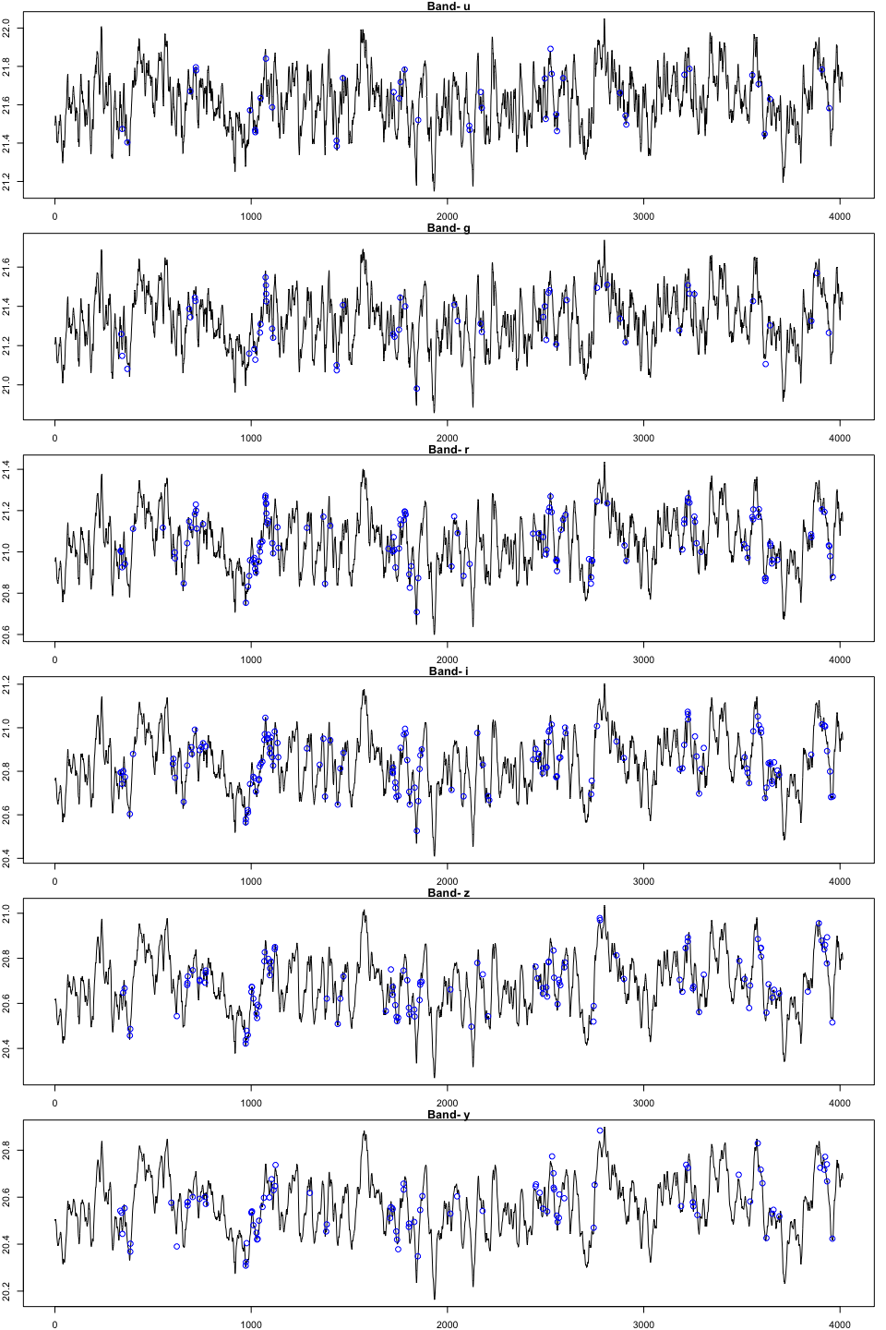
Sample light curve

Slide 4
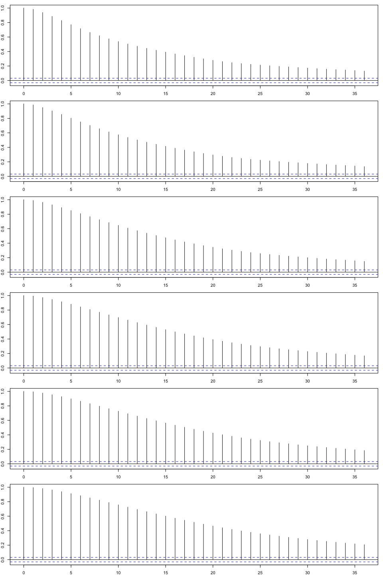
ACFs

Slide 5
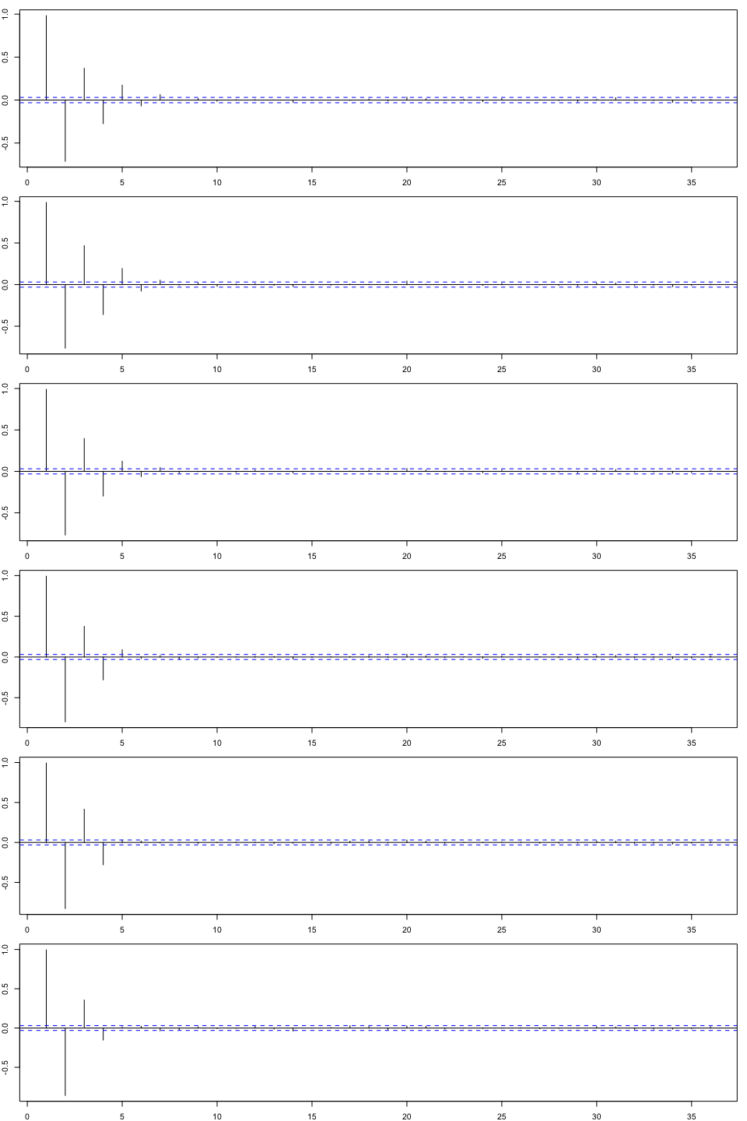
PACFs

Slide 6
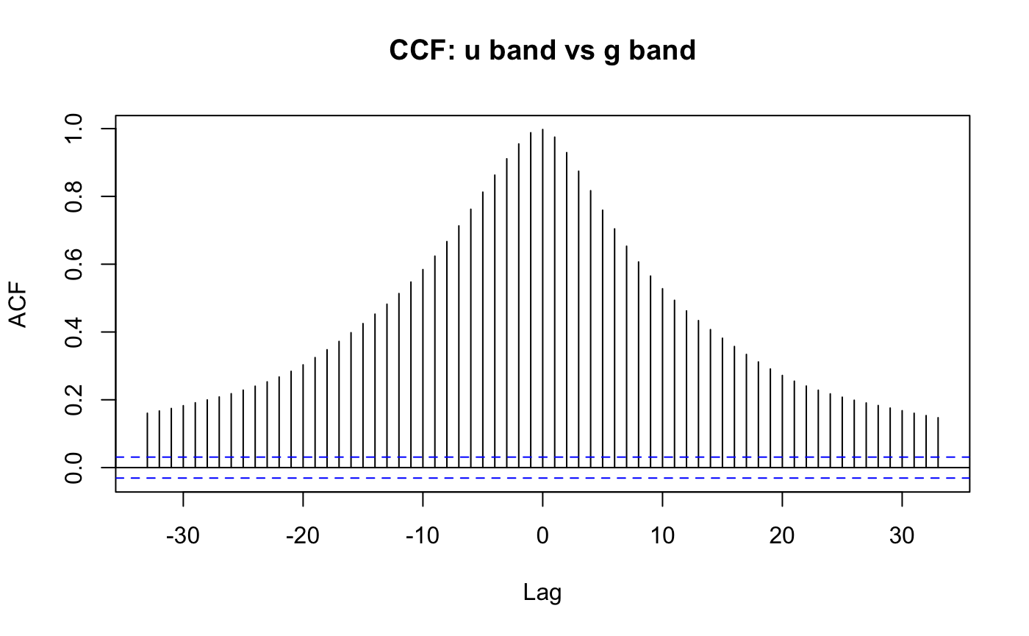
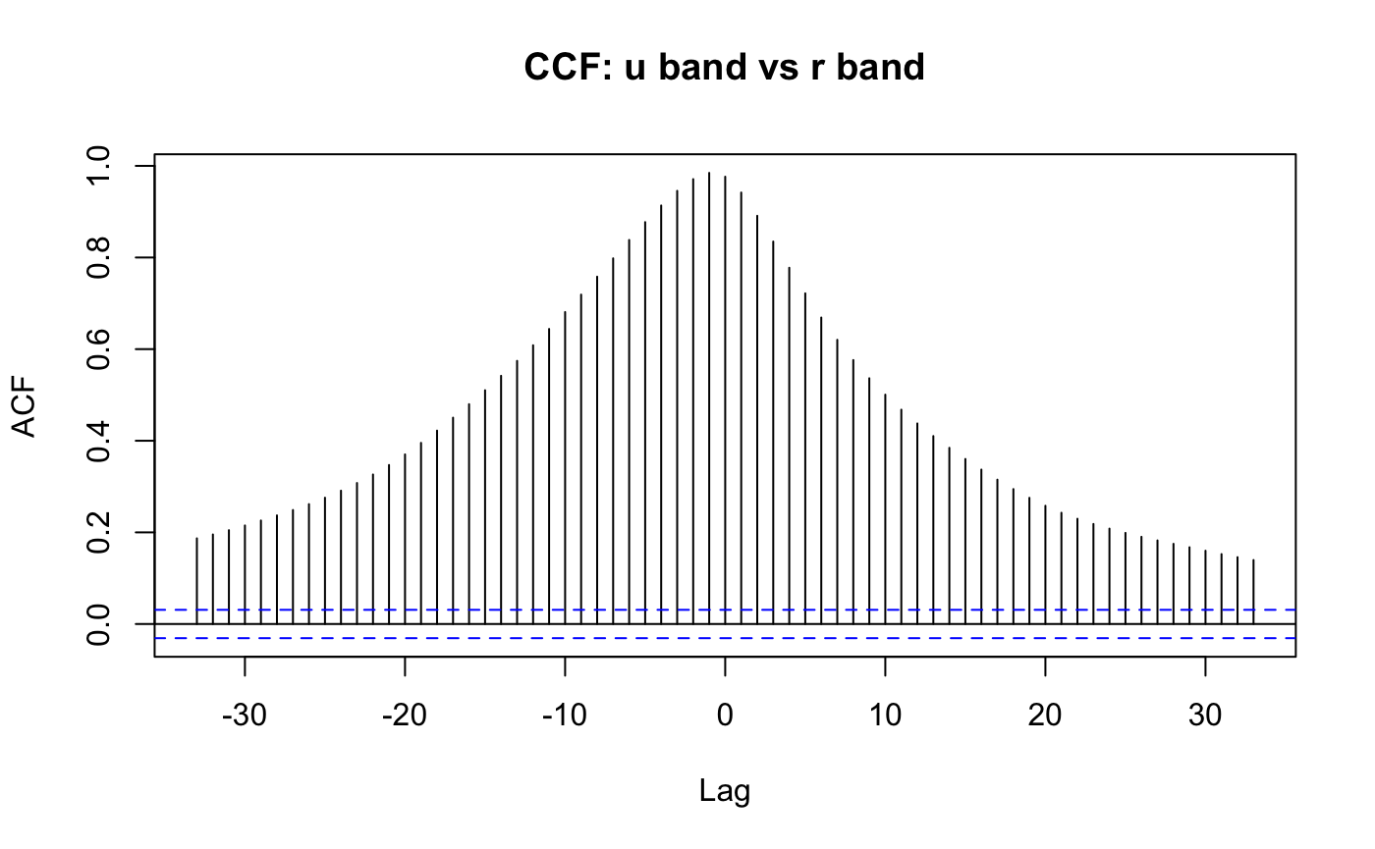
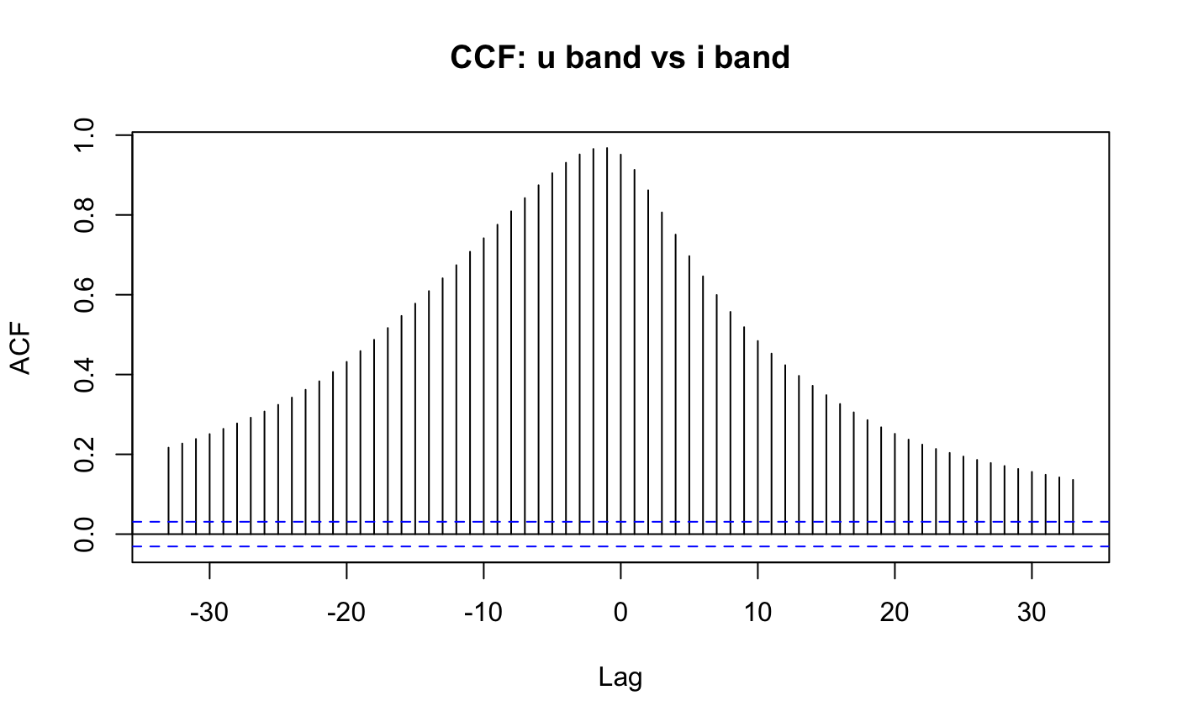
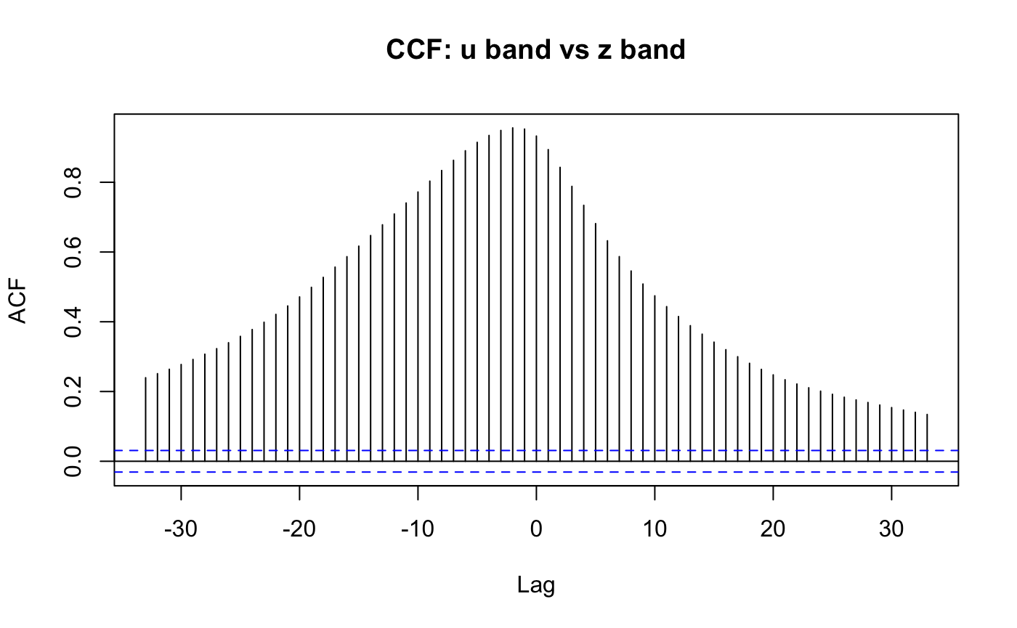
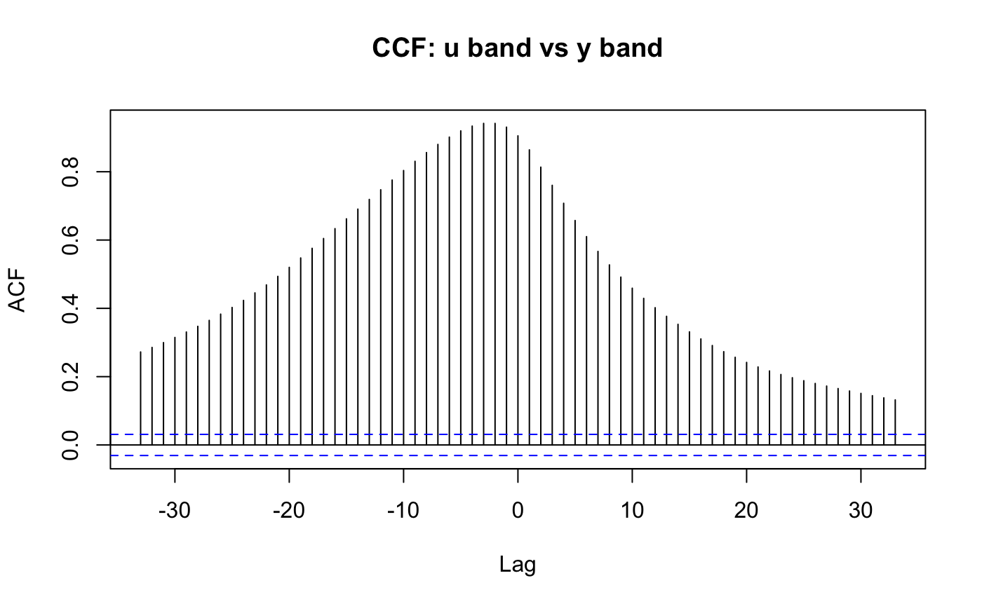
CCFs

