Slide 1
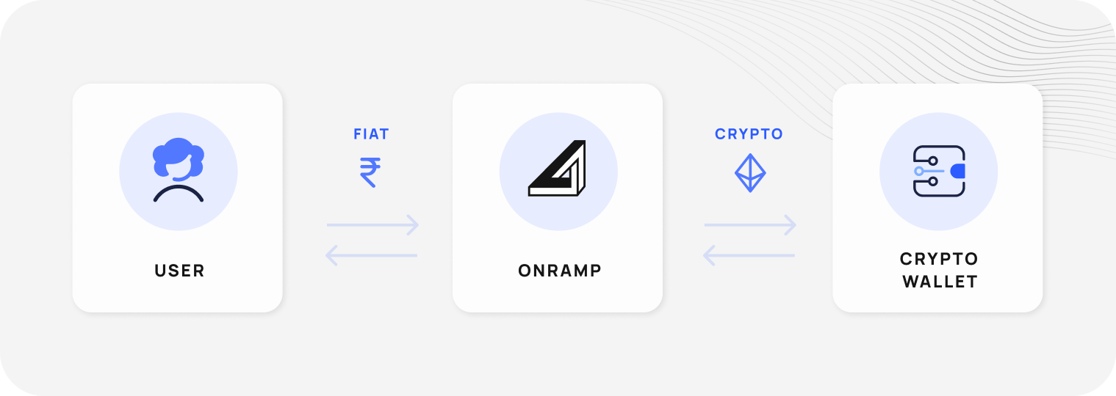
Buy and Sell Crypto with less Fee
Onramp.money helps regular banks and finance companies offer cryptocurrency services.
They provide tools for storing, trading, and following the rules for cryptocurrencies.
Onramp.money makes it easy for traditional finance to join the world of cryptocurrencies while staying legal and safe.
How it works:

Slide 2
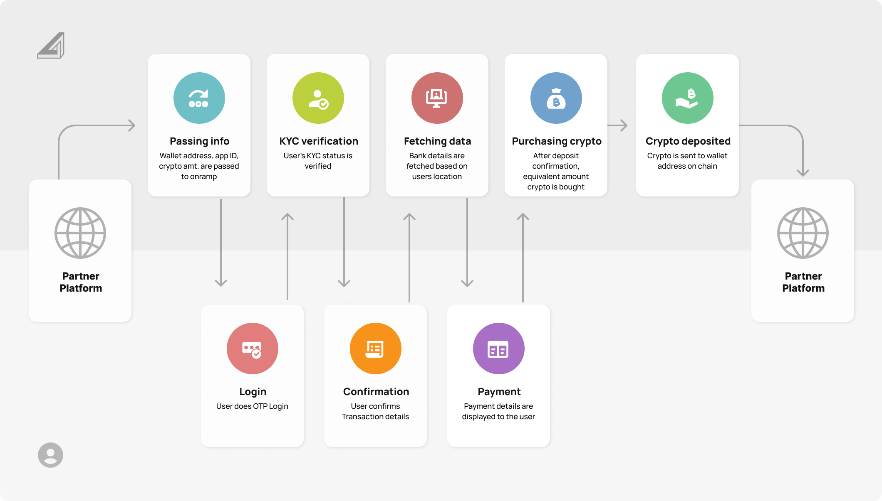
USER FLOW :

Slide 3
User actions can be covered in 3 simple steps (all complexities are handled by onramp)
User logs in via OTP
User confirms transaction details
User makes the payment
Overview of the flow
User is asked to login in via phone based OTP, where the KYC level of the user is checked, incase the user has exceeded the threshold, the user is prompted to complete the next tier of KYC to proceed further
Once the user is logged in, transaction details are shown to the user to confirm and proceed to the next step.
Bank account details would be fetched based on the user’s geographical location.
The account details are displayed and the user is prompted to make the payment using a payment method of his choice.
After successfully completing the payment, deposit is confirmed once the payment has been received, an equivalent amount of cryptocurrency is bought at market price.
The crypto withdrawal onchain is then initiated to the user's address, and the user is redirected back to the platform.

Slide 4
FEES :
Parameter | Example Value | Explanation
clientName | Super Dapp | Name of the client
onRampFee | 0.25 | fee charged by Onramp (in percentage)
isOnRampFeeFlat | 0 | fee charged by Onramp (as flat fee)
clientFee | 0.5 | fee charged by client(in percentage) (Optional)
isClientFeeFlat | 0 | fee charged by client(as flat fee)
supportedCoins | USDT - BEP20 | MATIC20 | ERC20 | TRC20 USDC - ERC20 | MATIC20 BUSD - BEP20 MATIC - MATIC20 ETH - ERC20 | MATIC20 | coins that are supported by the integration partner

Slide 5
KYC Tiers for Users : (INDIA)
Requirements | PhoneNumber Aadhar Card Pan Card Video KYC | EDD bank statement source of income written Income Tax Return (ITR)
Per Transaction | 1,00,000 INR | 5,00,000 INR
Per Month | 1,00,000 INR | 20,00,000 INR
Basic KYC
Full KYC

Slide 6
Path Parameters :
Name | Type | Description
coinAmount | 10 | amount denoted in the native coin/token. either coinAmount or fiatAmount, can be passed. When passed both coinAmount takes precedence
fiatAmount | 1000 | amount denoted in fiat amount. (only ₹ INR is currently supported)
coinCode | usdt | Name of the coin (also denoted as key in data.allCoinConfig in the response returned in the allConfig endpoint) current supported coins: usdt| usdc | busd | eth | bnb | matic | sol
walletAddress | 0x7c8D..596 | Onchain wallet address to which the crypto will be withdrawn to.
paymentMethod | 1 | Type of method the user would choose to pay in. 1 -> Instant transfer (e.g. UPI) 2 -> Bank transfer (e.g. IMPS/FAST)
addressTag | 334552 | memo/tag associated with the transaction can be useful for certain cryptocurrencies that require this information to identify the recipient of a transaction or deposit. E.g. XRP, XLM etc

Slide 7
Path Parameters Continue…..
The parameters that can be pre-filled are:
appId: The application ID that is unique to the client's application.
walletAddress: The user's wallet address where they will receive the cryptocurrency.
coinCode :The code of the cryptocurrency to be purchased (in this case, USDT).
Network : The blockchain network on which the transaction will occur (in this case, MATIC20).
fiatAmount : The amount of fiat currency (in this case, INR) that the user is spending.
fiatType : The type of fiat currency being used. (in this case 1 -> INR).
paymentMethod : The payment method chosen by the user. (in this case 1 -> UPI).

Slide 8
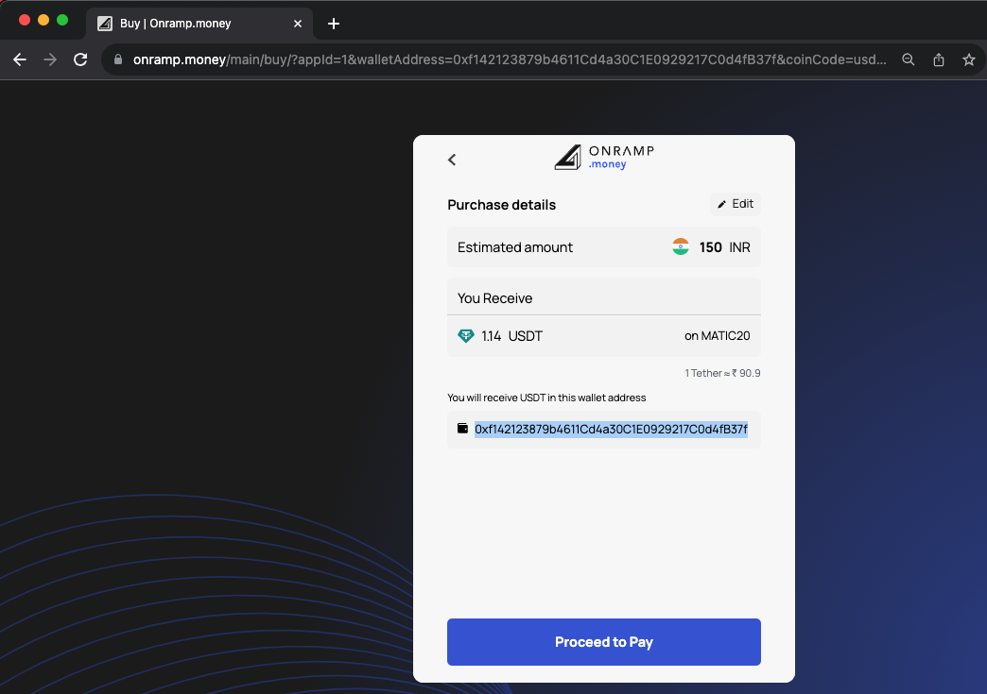
Path Parameters Continue…..

Slide 9
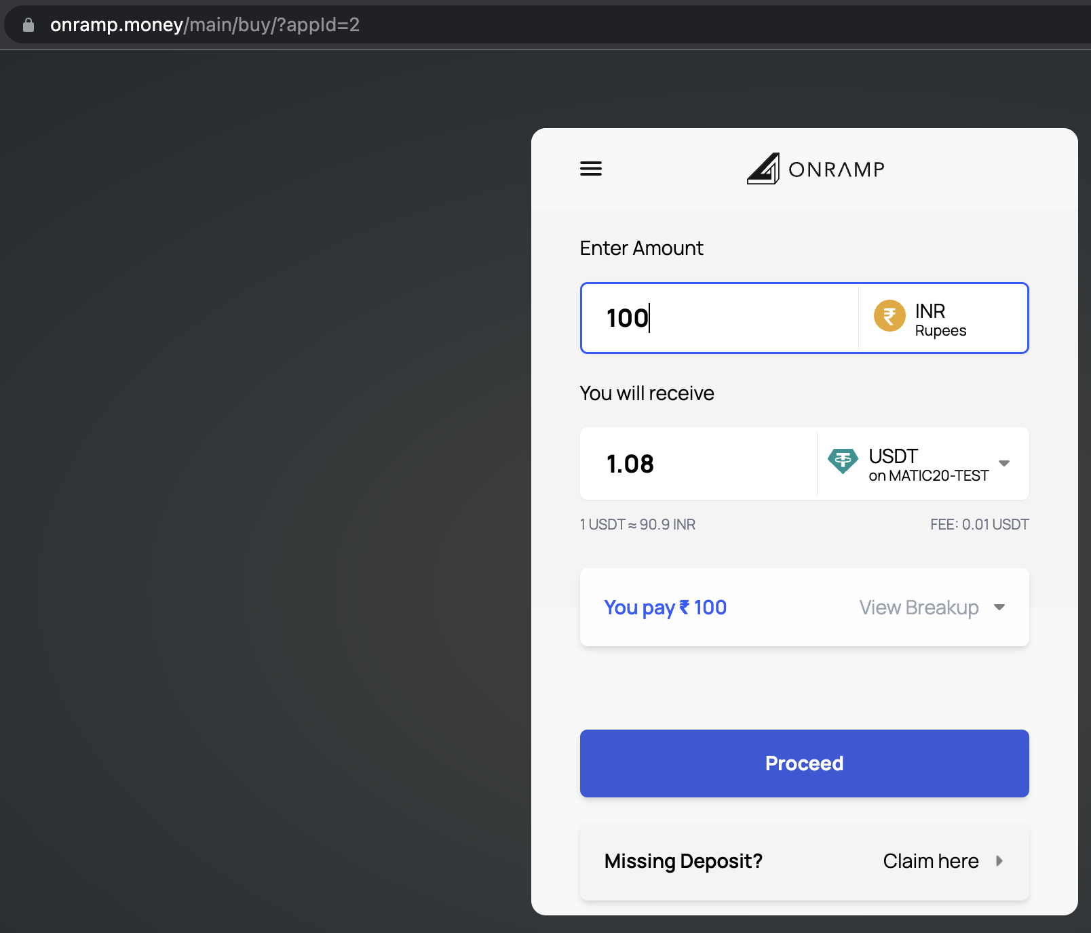
Complete Buy Crypto :
After opening the sandbox link, enter the required amount.

Slide 10
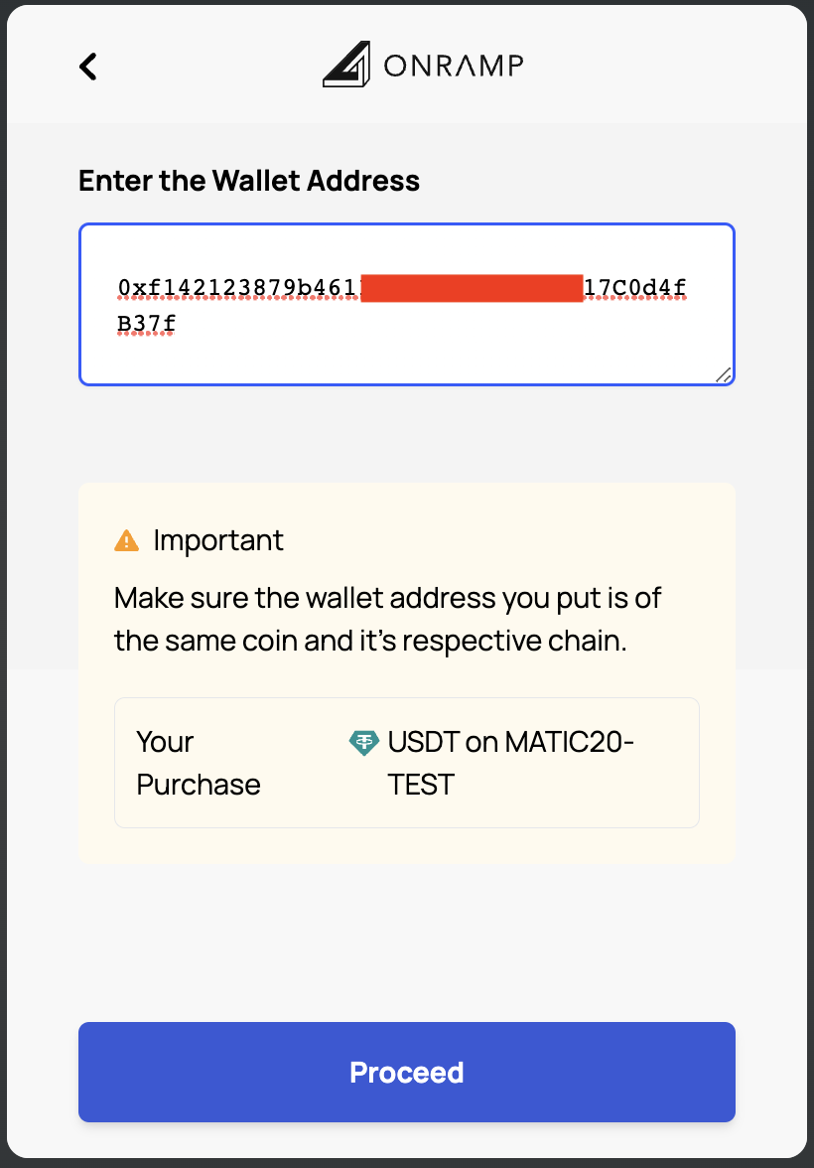
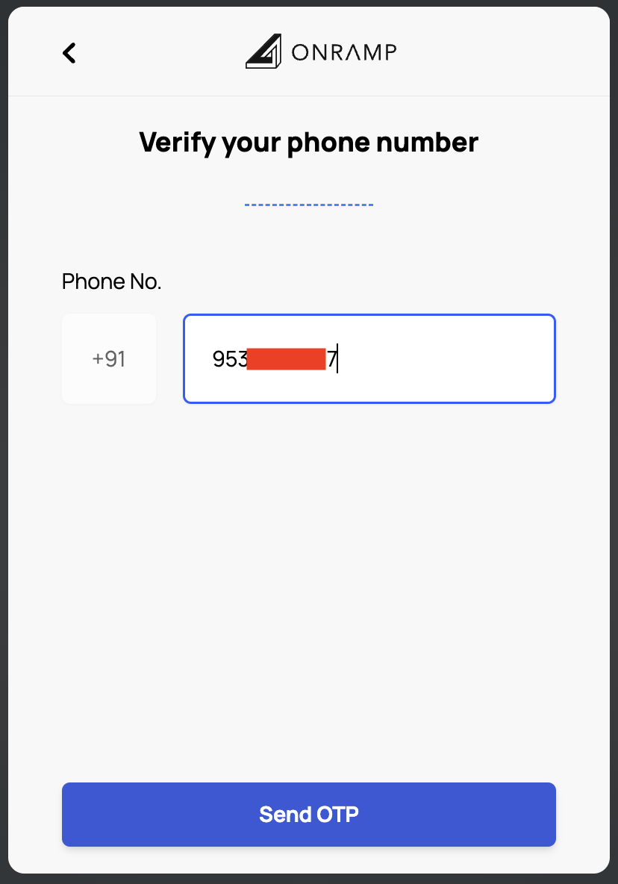
2) Paste Wallet Address
3) Enter your phone number to receive OTP.

Slide 11
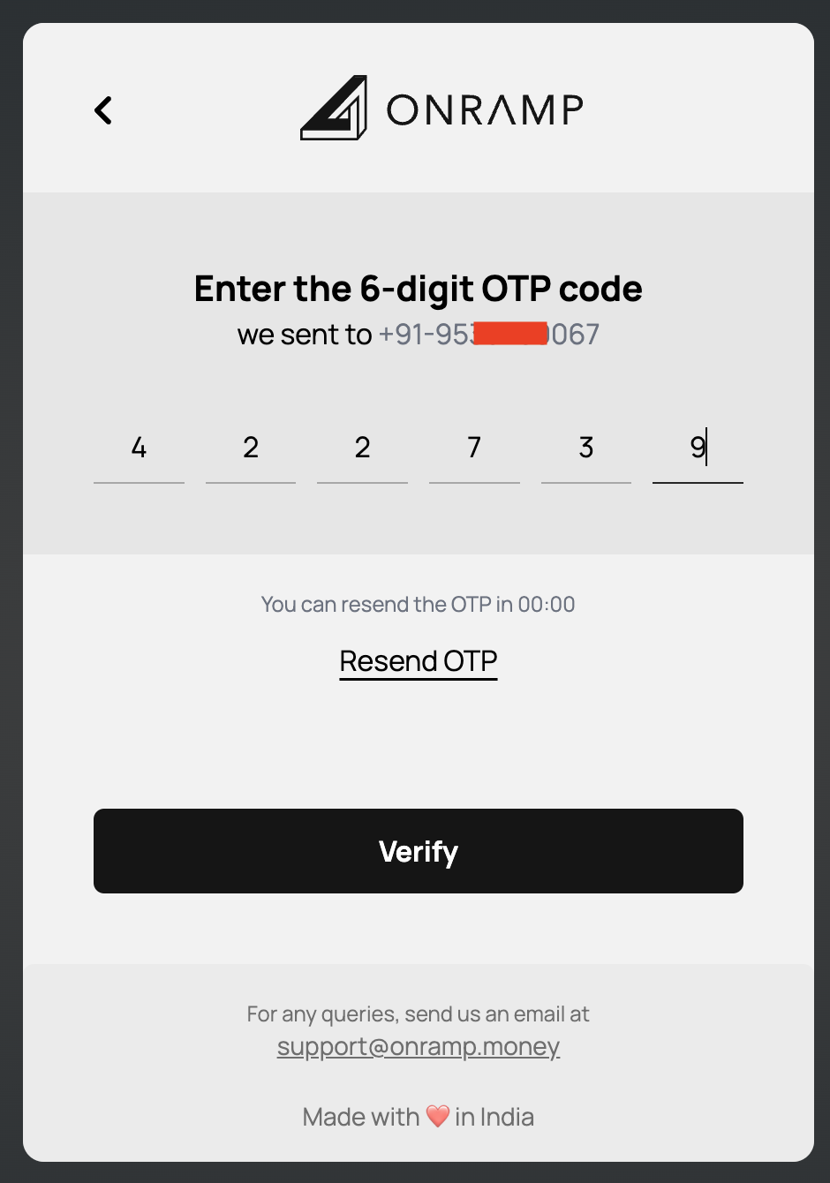
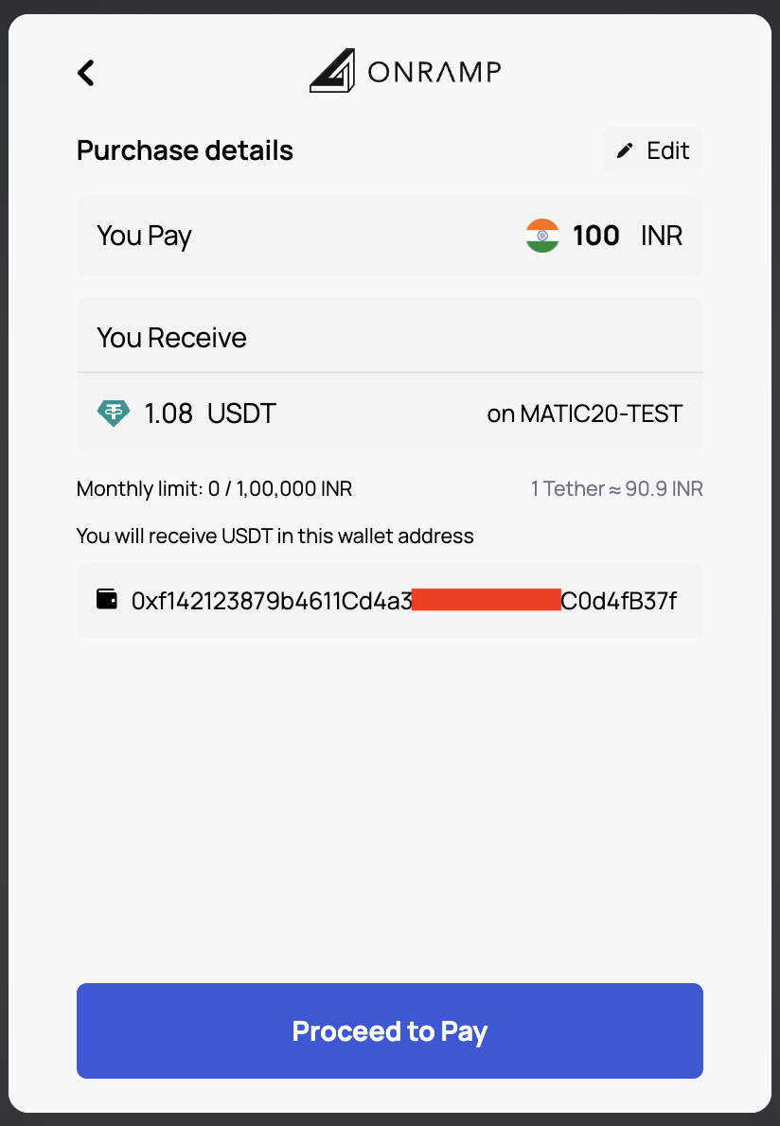
4) Enter the received OTP and click verify.
5) review the transaction details, and choose "Proceed to
Pay" .

Slide 12
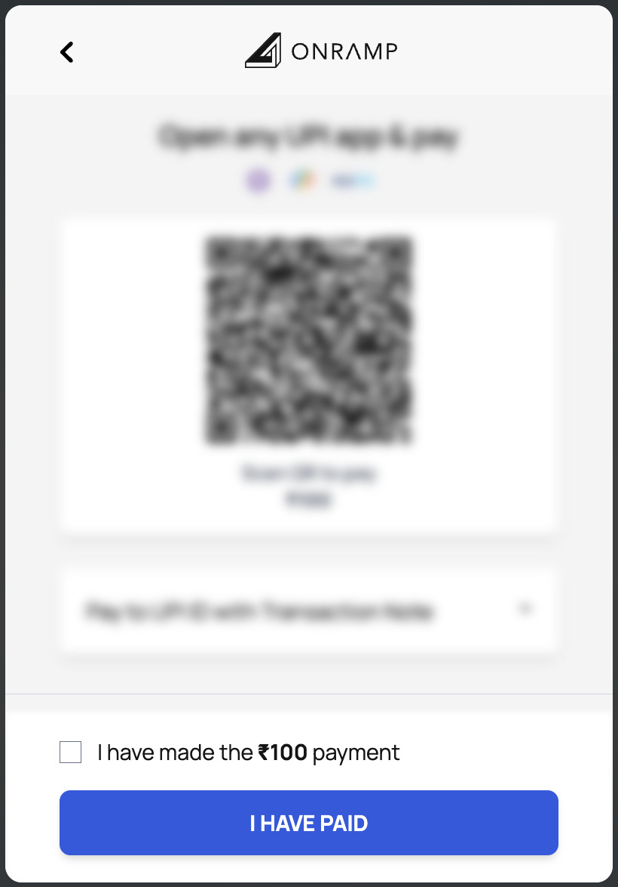
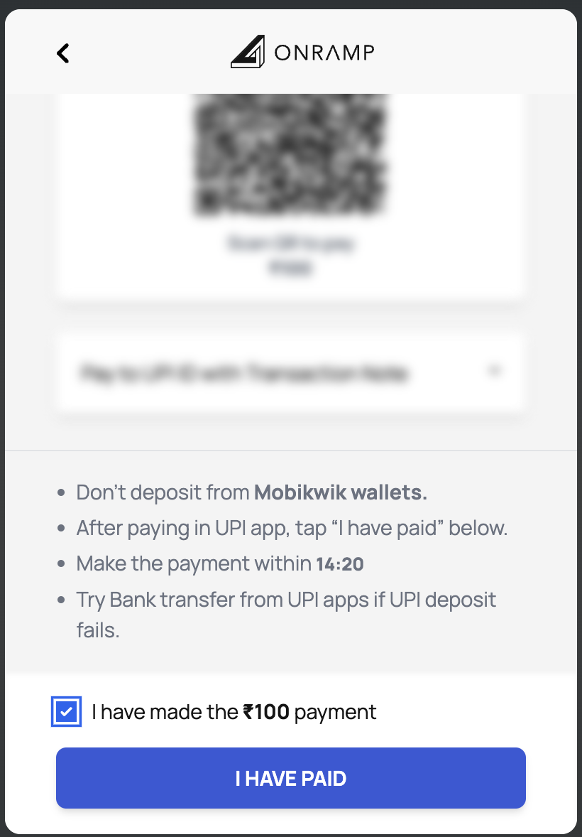
6) Payment details displayed
7) Click on "I HAVE PAID" and proceed.

Slide 13
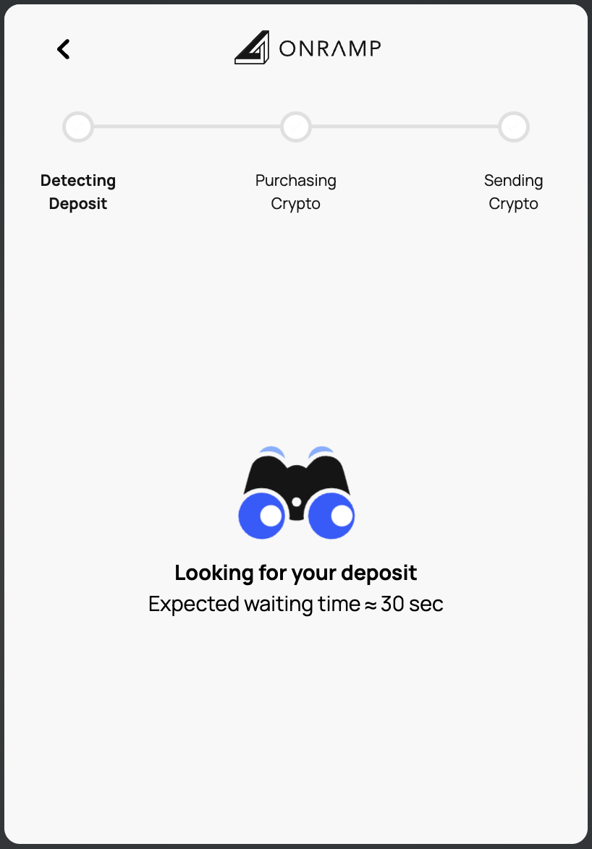
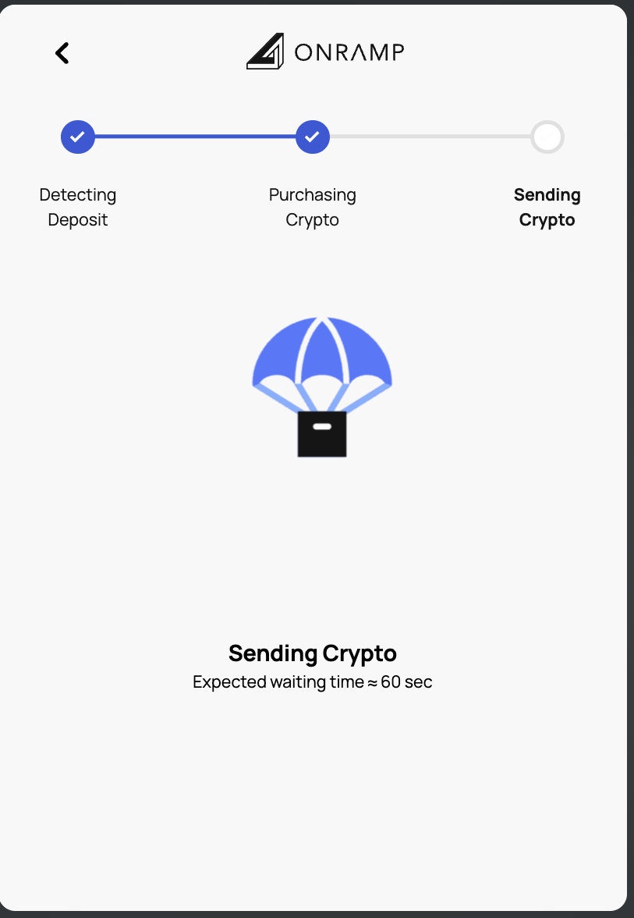
8) This step emulates the average time taken usually to reconcile the transaction.
9) Once the deposit is found, the swap of the desired crypto takes place, and the crypto is then sent to the onchain wallet address.

Slide 14
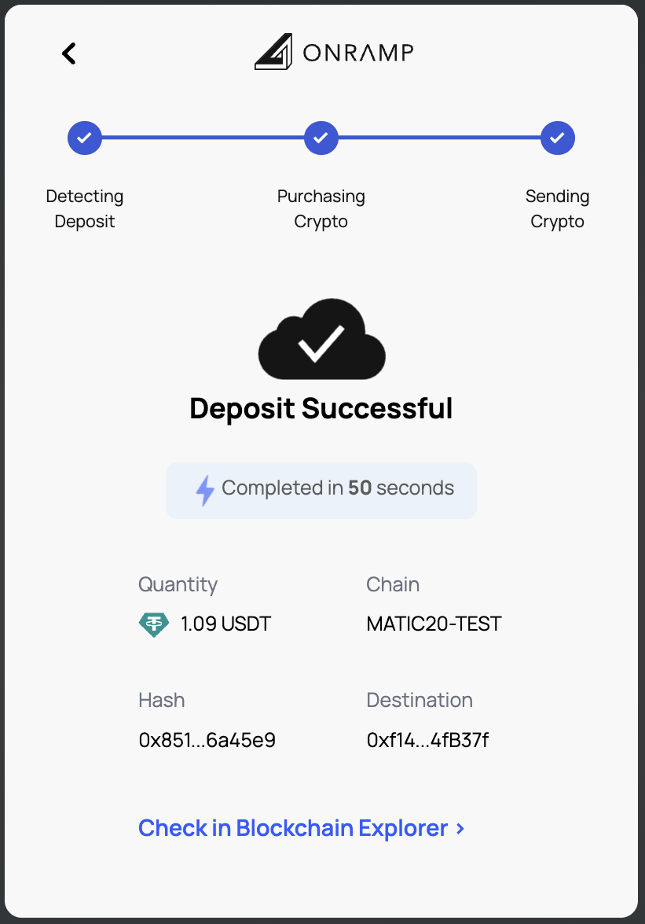
10) After successful screen is displayed once the has is generated, the user can now view the transaction using explore transaction section.

Slide 15
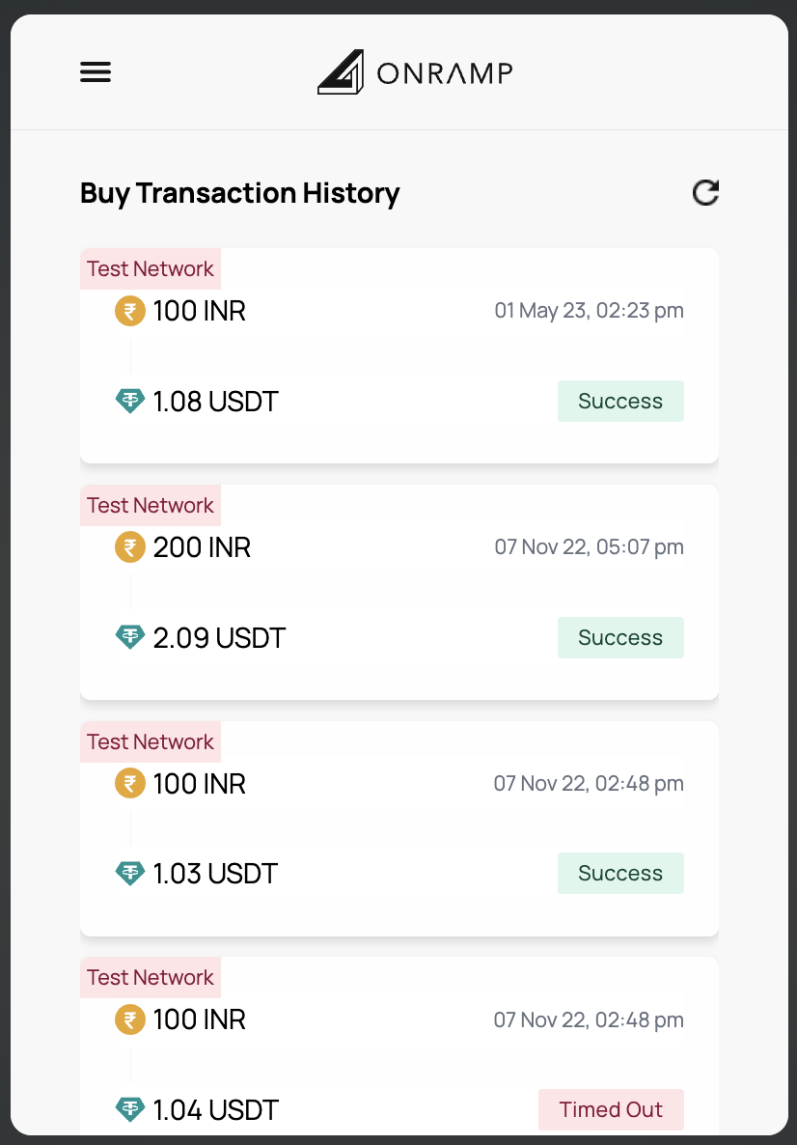
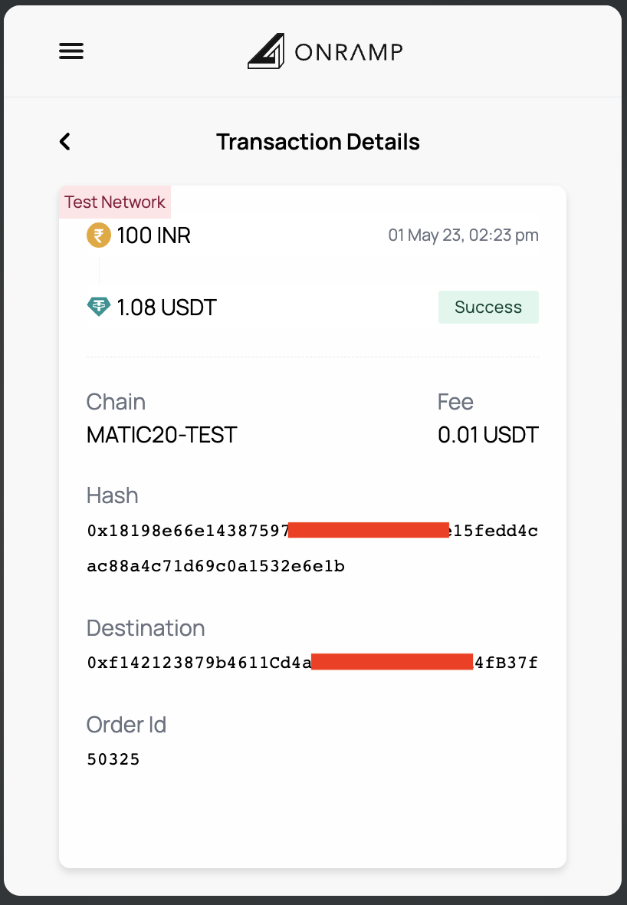
11) The user can find all transactions placed by the user
12) The user can review details for a specific transaction, the Partner/Merchant is able to perform similar function and detailed explanation can be found using:
Webhook ->Response
REST API -> Response

Slide 16
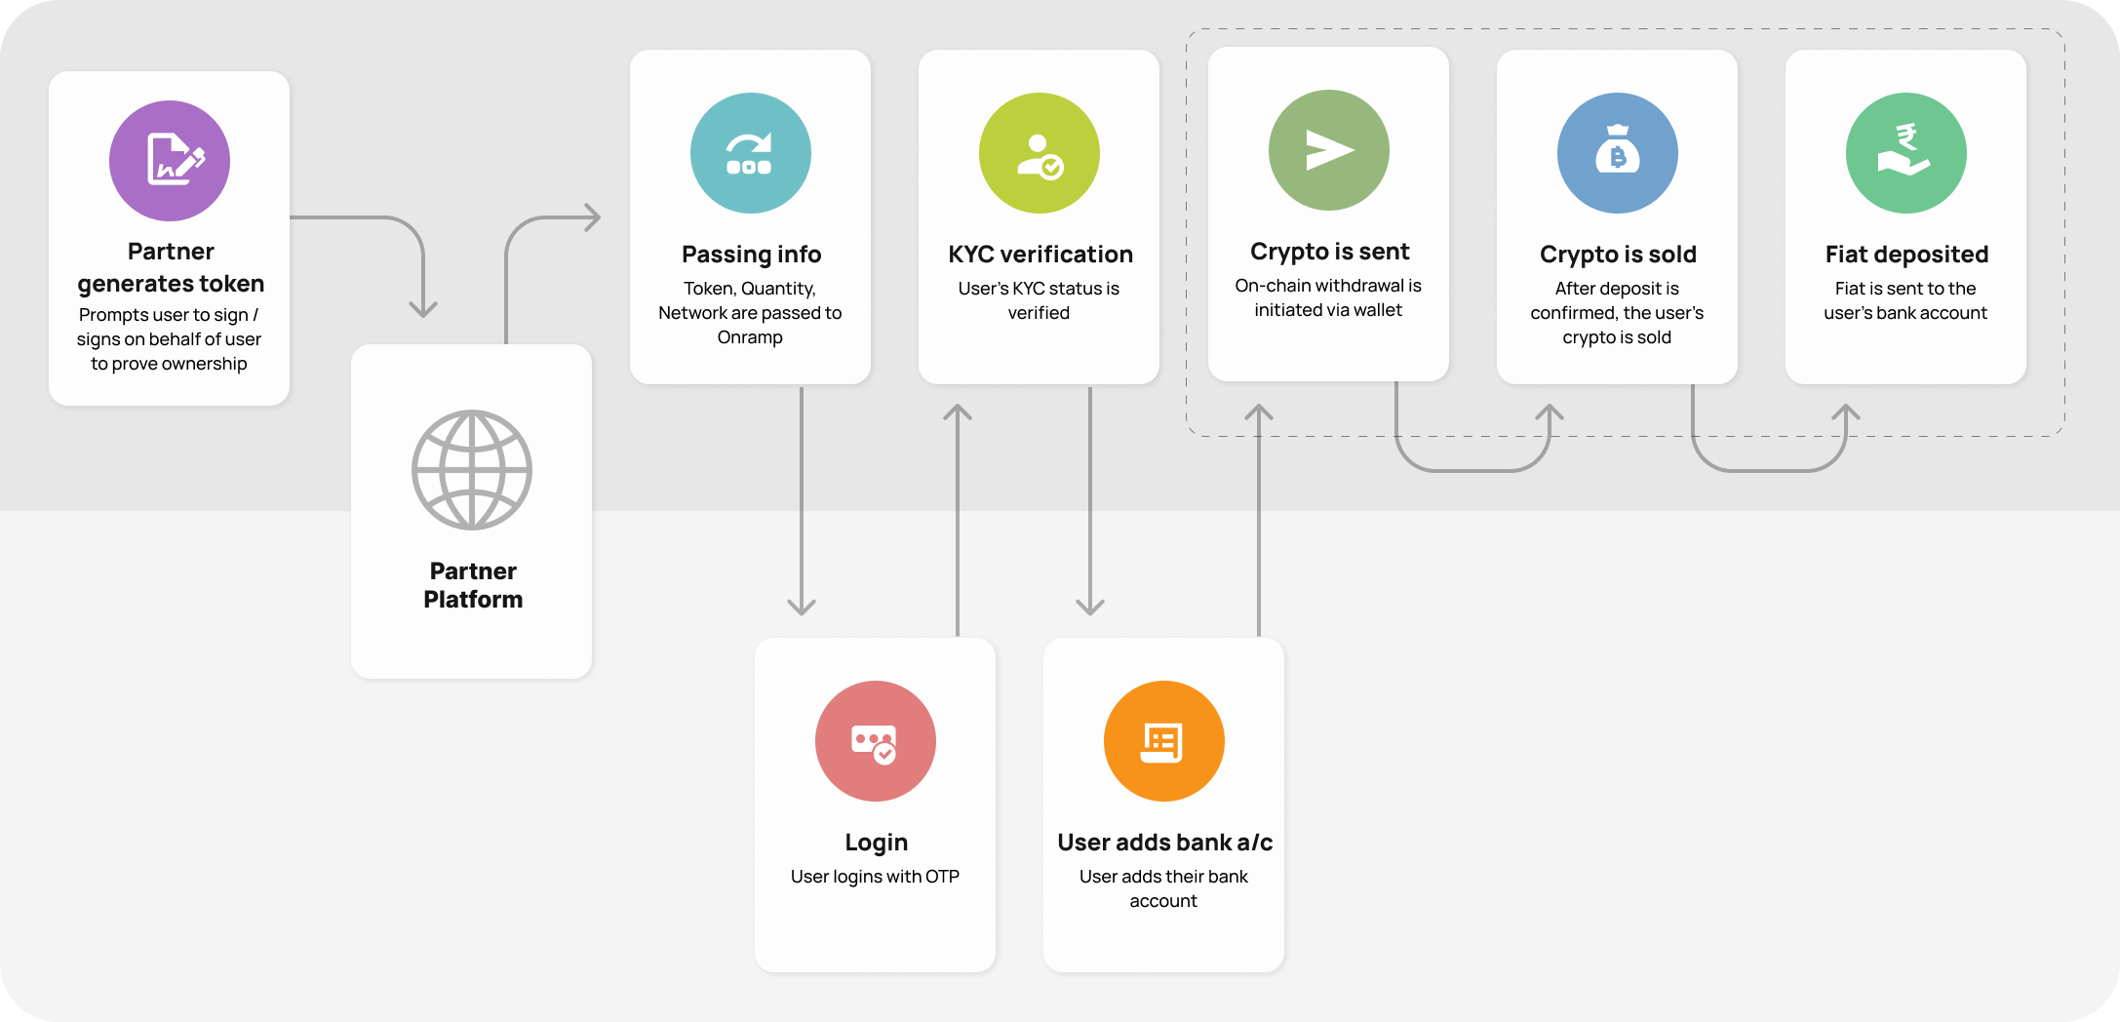
Partner Flow

Slide 17
User actions can be covered in 2 simple steps (all complexities are handled by Onramp.money):
User logs in via mobile OTP (One Time Password).
User confirms bank account details (adds bank account details if not already added).
Overview of the flow:
Token generation: the partner would have to generate a token which is derived from the wallet address and the current timestamp. In case of:
Non-custodial platform: the platform would have to prompt the user to sign the message containing the user's wallet address and the current timestamp.
Custodial platform: the partner platform would have to sign the message on behalf of the user.
Partner then redirects user to Onramp.money, while passing:
token
Quantity
Network
CoinID (etc.)

Slide 18
User is asked to log in via phone-based OTP, where the user's KYC level is checked. In case the user has not completed the KYC, the user is prompted to complete the next tier of KYC to proceed further.
Once the user is logged in, bank account details are displayed to the user. If the user has not added their bank account, they are prompted to add their bank account details.
The user then confirms the order details.
Onramp then initiates a webhook call to the partner, confirming the withdrawal to onramp's wallet address on the user's behalf.
The user is then redirected to the partner platform, with the rest of the steps happening in the background.
On-chain transaction is then initiated to Onramp.money's deposit wallet address, by the partner.
Once the deposit has been confirmed, the user's equivalent amount of crypto is sold at market price for fiat.
A bank-to-bank instant withdrawal is initiated, which enables the user to receive the funds in their bank account in less than 2 minutes. The user is then redirected back to the partner platform.

Slide 19
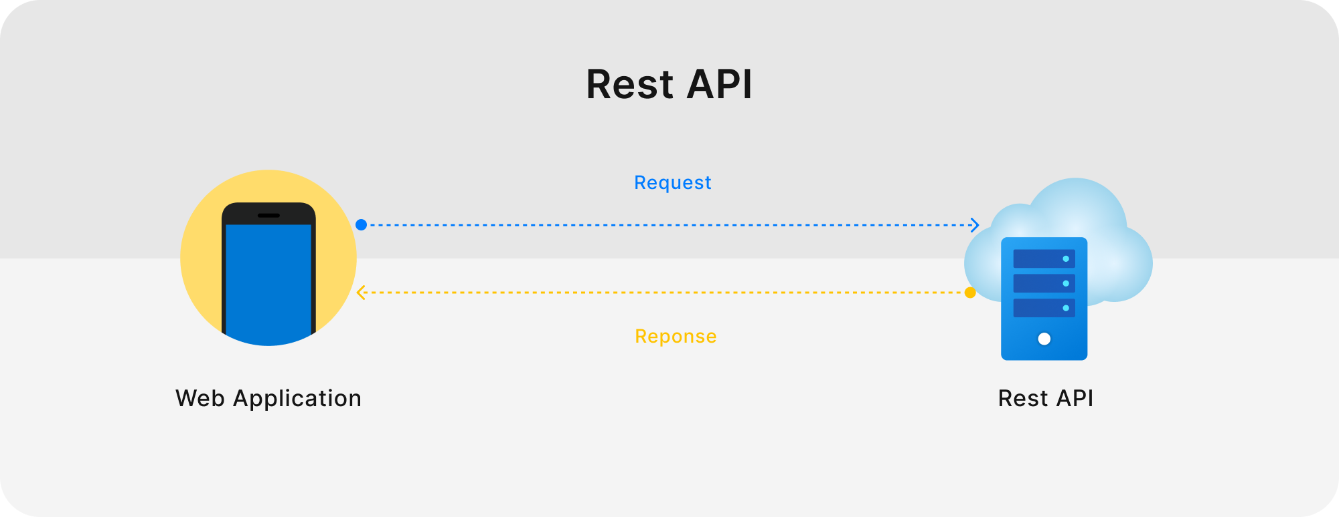
REST API ENDPOINTS
INTRO
A REST service endpoint is a set of REST resources that provides services to endpoints. We provide various endpoints for
Fetching info of all available coins/tokens.
swapping the tokens
Fetching user history and more.

Slide 20
REST API ENDPOINTS
AllGasfees (external withdrawal fees)
Bank details
Quotes API - onramp
Quotes API - offramp
Sample Request for Endpoints
Merchant Transaction History
Order status
All Config Mapping
All Chain Mapping
All Gas Fee Mapping
Limits Mapping
Coin limits mapping
Price Ticker
Set/Update Webhook URL
Resend Webhook
Send Dummy Webhook
Current Timestamp

Slide 21
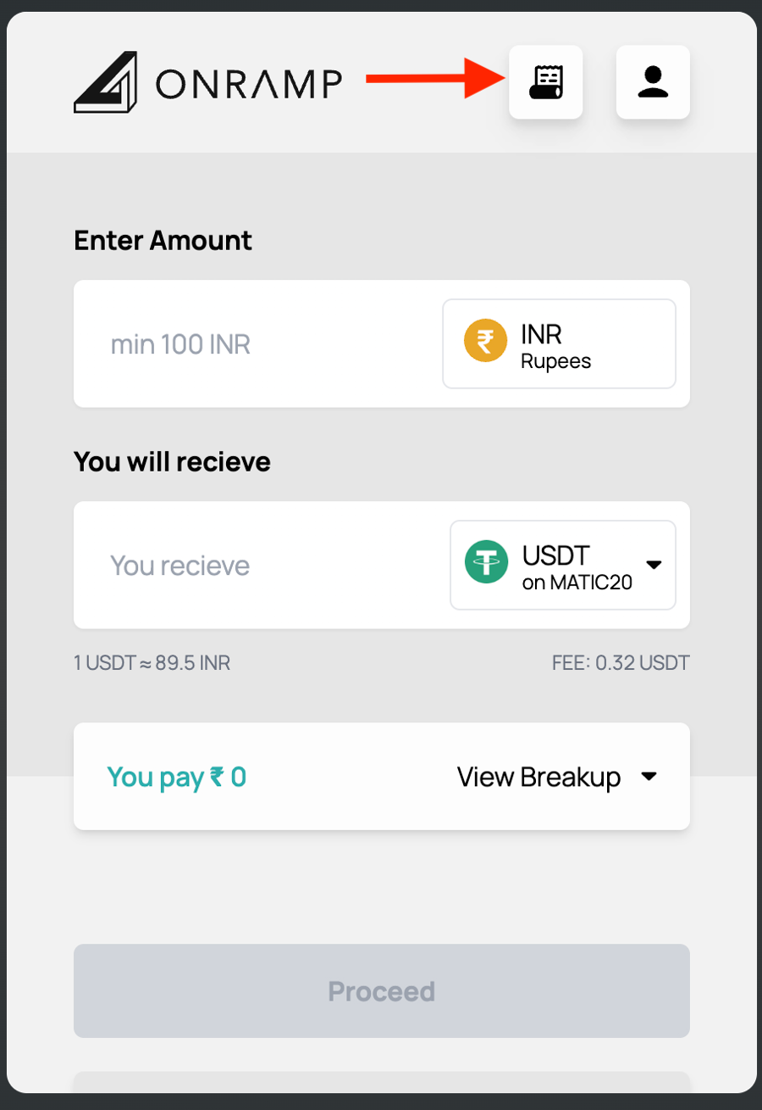
Resume Transaction – onramp
Incase the transaction wasn't completed or failed for any reason, the transaction can still be taken up at a later point of time.
A transaction can usually fail due to:
Timed out ->
incase the user is unable to complete the payment within the allocated time.
incase the user accidentally enters incorrect amount.

Slide 22
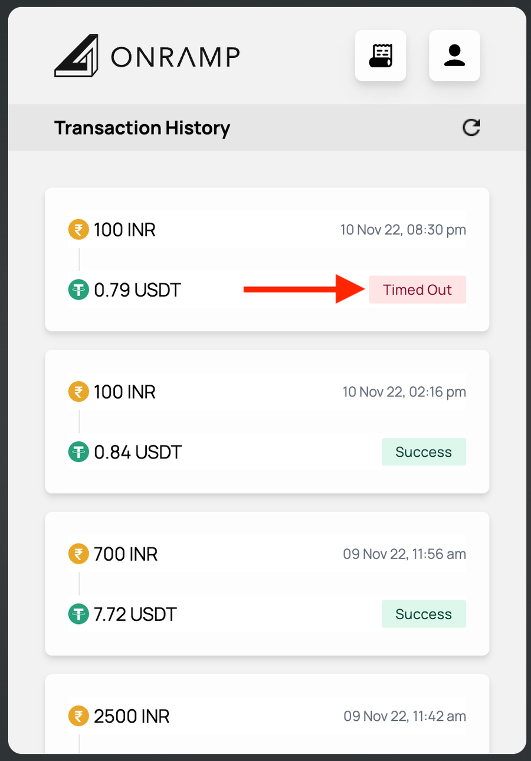
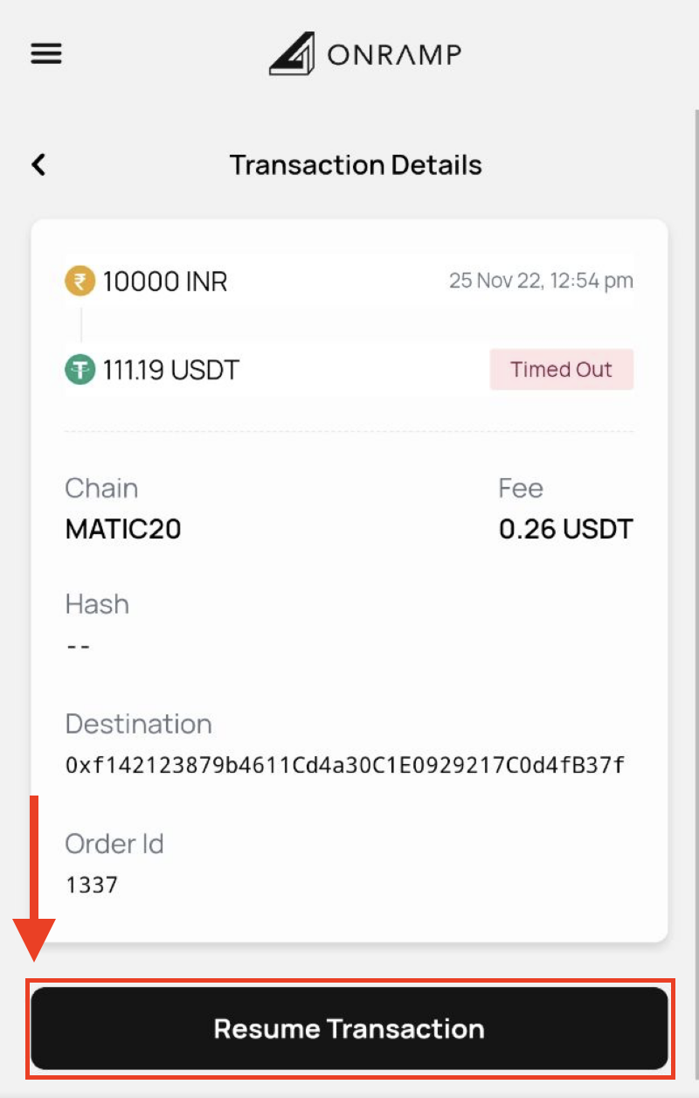
2) You can find the transaction that failed, which would be colour coded in red. Click on the transaction to proceed
3) click on the Resume Transaction, to continue the process.

Slide 23
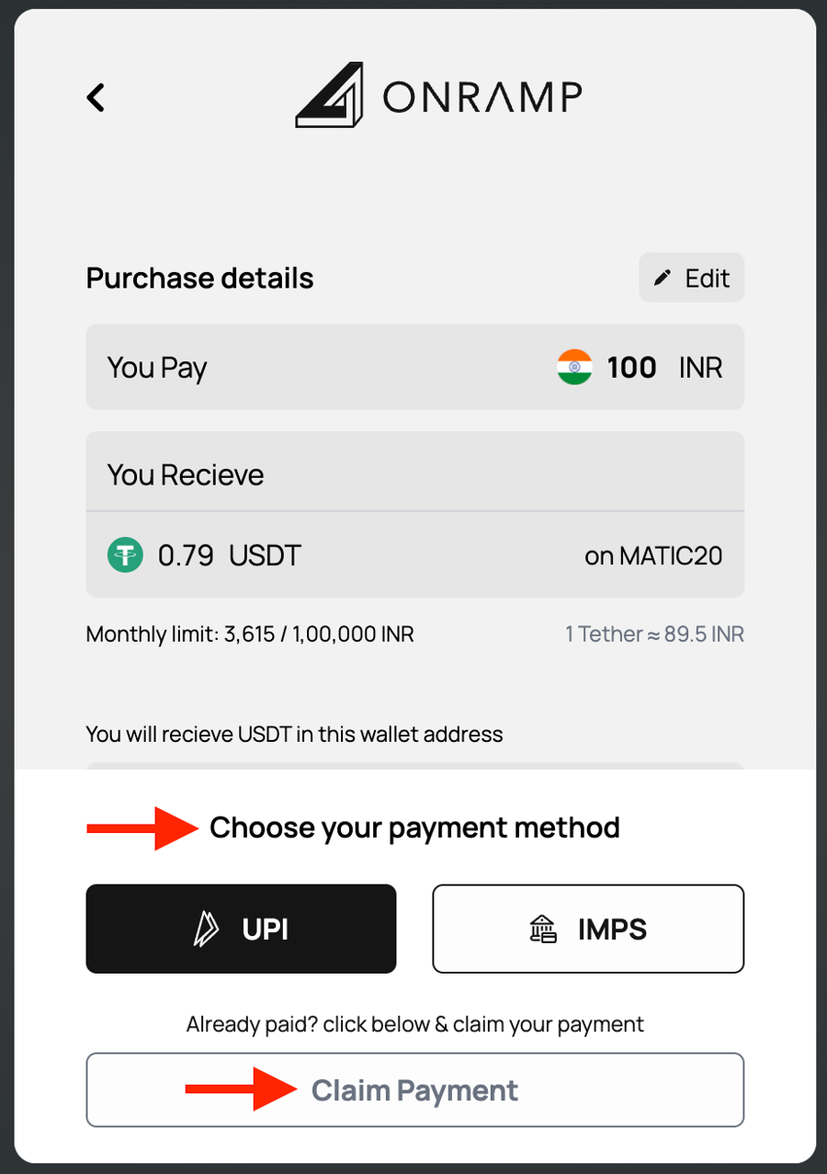
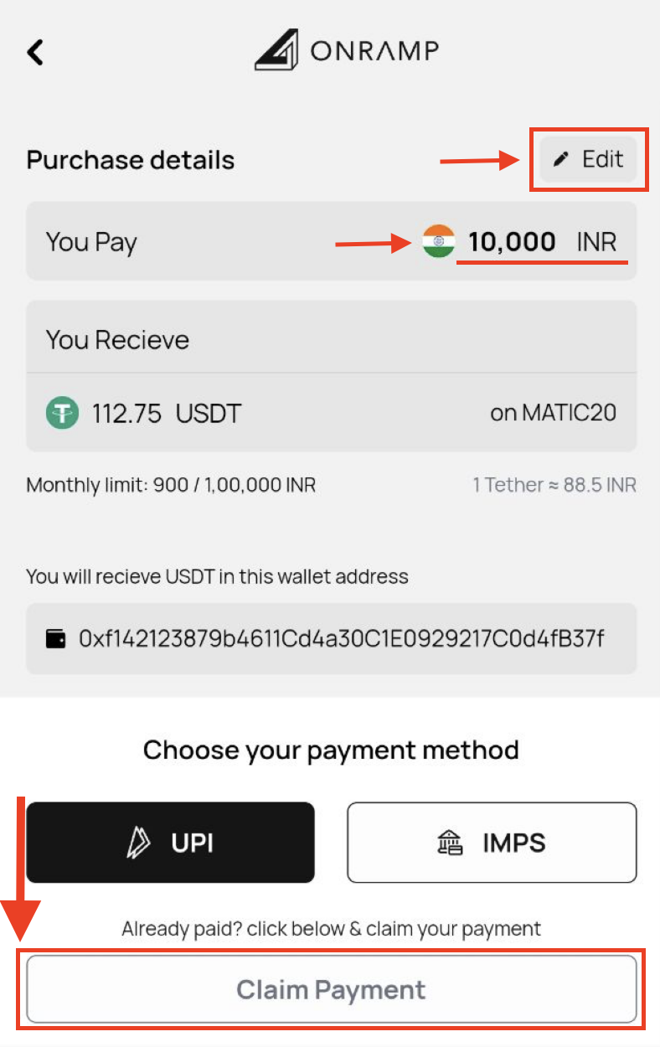
4) Incase the payment was not done due to - Time out click on the desired payment option UPI or IMPS to continue further.
5) Incorrect amount entered, click on Edit and enter the correct amount and proceed to clicking on Claim Payment.

Slide 24
Privacy:
Pdf attached below.
https://onramp.money/assets/privacyPolicy.pdf

