Slide 1

A queue is not extra capacity.
An engineering decision
Buffer the burst. Budget the
recovery.

Slide 2

Capacity and waiting

Slide 3

Fast acceptance.
Unchanged capacity.
The illusion
Accepted in milliseconds.
Finished at the same rate.
Notes:
Fast at the counter, unchanged at the door
Every parcel is stamped the moment it arrives. Behind the counter, the same two couriers still carry one parcel at a time.
A fictional report service moves generation behind a queue. Requests return quickly, but the workers do the same work at the same rate. The waiting has moved out of the request; it has not disappeared.
Assumptions
Reports can finish asynchronously, but not indefinitely late. Jobs have comparable cost, workers share a constrained database, and the initial queue is empty. Numerical inputs below are invented for a simplified model.
Separating submission from execution lets a brief burst wait instead of holding client connections open. Durable storage can preserve accepted work while workers restart, provided the service acknowledges only after that storage confirms the write.
These are useful changes to timing and reliability. They do not, by themselves, raise the completion rate of the database or the workers.

Slide 4
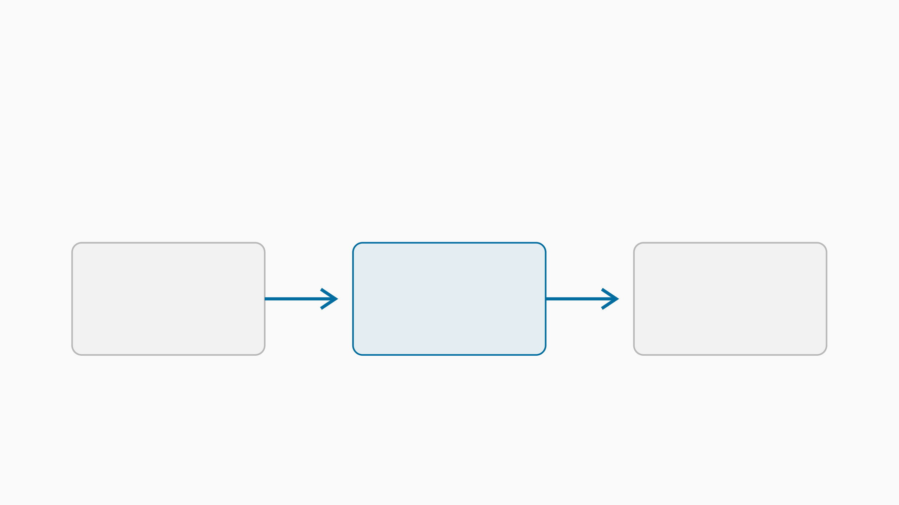
A waiting room.
Not a wider exit.
Admit
Buffer
Complete
Burst
Bounded
Bottleneck
Notes:
Workers can take jobs off the queue faster than the database can finish them. Include in-flight work when counting outstanding promises.

Slide 5

Only spare capacity drains the backlog.
Recovery
Completions must outrun new
arrivals.
Full utilization leaves nothing for
recovery.
Notes:
The heap shrinks only with room to spare
The conveyor already runs at its usual pace. New parcels keep arriving, so only the capacity left over can reach the pile.
While arrivals exceed completions, unfinished work grows. After the burst, only the completion rate left over after new arrivals can drain that work. If the two rates are equal, the backlog stays.
Assume a constant completion capacity of 80 jobs/second. For 30 seconds, 120 jobs/second arrive; afterward arrivals fall to 40 jobs/second. Assume no retries, expiry, or failures, and enough queue space to admit every job.
Phase Calculation Result
Burst (120 − 80) × 30 1,200 extra unfinished jobs
Recovery headroom 80 − 40 40 jobs/second
Drain time 1,200 ÷ 40 30 seconds after the burst ends
This fluid approximation ignores individual job timing and service-time variation. It estimates aggregate drain time, not a latency percentile or a completion guarantee for each request.

Slide 6

The hidden cost of acceptance

Slide 7

Watch the oldest unfinished promise.
Queue depth counts work.
Job age exposes delay.
Include in-flight jobs.
Notes:
Look for the forgotten parcel
A short shelf can still hide one very old promise. Its age, not the number of parcels around it, shows how long someone has been waiting.
The same queue length can represent cheap jobs or slow ones. A nearly empty queue can even hide a stuck job already claimed by a worker. Track age from acceptance through completion, including in-flight work.
Waiting depth describes stored work; in-flight count describes claimed work.
Oldest unfinished age reveals starvation, blocked workers, and long delays.
Completion rate and end-to-end latency show what users actually receive.
Rejection and expiry counts show demand that the service did not satisfy.
Use the report's usefulness deadline to choose an alert budget. An alert should leave time to intervene, not first fire when the oldest accepted report is already useless.

Slide 8

Retries are more arrivals.
One identity per logical job.
One finite retry budget.
Notes:
The same parcel, again and again
Each copy looks like new work. Without one identity per logical job, the depot cannot tell a retry from a fresh request.
A caller that cannot see progress may submit the same report again. If both attempts run, duplicate work competes with the original backlog. Backoff spreads that demand over time; it does not make the work free.
Rule
Count attempts against a retry budget, and identify the logical job before admitting another copy.
Bind a stable submission key to the intended request and retain its state for the supported retry window. Repeating the same key returns that job's status; reusing it for different input is a conflict, not a new job.
A key at admission does not make later side effects exactly-once. Workers must also make result writes idempotent or commit the result and completion state atomically. Retry only transient failures, with backoff, jitter, and a finite attempt or time budget.

Slide 9

A bounded promise

Slide 10

Bound the promise, not just the queue.
Admission
Useful deadline.
Hard storage limit.
Honest rejection.
Notes:
Say no at the door
An early, honest rejection costs less than a promise that expires inside.
The service should accept only the work it expects to finish while it is useful. Combine a hard queue/storage cap with an admission estimate that includes waiting, execution, and a safety margin. Reject clearly when either budget is exhausted.
For comparable first-in-first-out jobs, dividing the outstanding work ahead by a conservative completion rate gives a rough waiting estimate. Add the new job's execution budget and compare the total with its remaining deadline.
That estimate fails when large jobs dominate, priorities reorder the queue, or the database slows down. Use measured cost classes and age signals to tighten admission, and keep a storage cap even when the estimate looks healthy. A queue limit is a policy backed by tests, not a universal constant.

Slide 11

Every job needs a visible ending.
Completed. Failed, with an owner. Explicitly expired.
Never just waiting.
Notes:
SubmissionReturn a stable job identity only after durable acceptance.
ResolutionExpose completion, terminal failure, or explicit expiry through status.
Left to right: completed, failed and under investigation, explicitly expired. None of them is still waiting.
Before starting stale work, check whether its deadline still allows a useful result. Mark expired jobs explicitly rather than silently discarding them. A permanently failing job needs a terminal state and an owner, not an unlimited return trip through the queue.
A failed-job holding area is an investigation tool, not extra processing capacity. Give retained failures a storage limit and retention policy. Replay only after the cause is understood, through the same admission and retry budgets as new work.

Slide 12

Prove recovery under continuing load.
The decision test
Burst. Slow dependency. Worker
restart.
Account for every accepted job.
Notes:
Time the drain, not the intake
The stopwatch runs until every accepted parcel has an ending, while new parcels keep arriving and a worker restarts.
Rehearse a burst, a slow dependency, and a worker restart. Keep normal arrivals running during recovery. Check that accepted work reaches a visible ending and that new demand cannot consume the recovery budget unnoticed.
Decision
Use a bounded queue with explicit admission and job status. Add workers only when the downstream bottleneck has room; increase buffering only when the waiting budget allows it.
Choose the report deadline, storage cap, retry budget, and recovery target before the test.
Record offered, admitted, completed, expired, and failed work. Include in-flight jobs in reconciliation.
Verify the backlog drains within the chosen target while ordinary traffic continues.
Repeat with duplicate submissions and a slower database. Check for duplicate effects and terminal jobs stranded as pending.
Do not call an empty queue a success if jobs were merely moved into worker memory, expired without notice, or lost. The evidence is accounted-for outcomes within the chosen contract.

Slide 13

Buffer the burst.
Budget the recovery.
The key message
A queue buys time, not capacity.
Notes:
A queue buys time only when you have the capacity to repay it.

