Slide 1
Association Rule Learning with ELT(Extract-Load-Transformation)
Talha Nebi Kumru

Slide 2









Model Architecture
TRANSFORMAT
ION
PART
EXTRACT
I
ON
PART
LOADING PART
VISUALIZATION PART

Slide 3
Extraction Part
CSV is streamed with Apache Kafka. Producer is created by python file. Consumer is created by Apache Nifi. Apache Kafka streams CSV file to Apache Nifi. Apache Nifi processes streamed data to sql. Finally Apache Nifi PutSQL to PostgreSQL. So this part is following these steps;
Streaming CSV file by Kafka Stream
Processing / Saving data by Apache Nifi

Slide 4


Streaming CSV file by Kafka Stream
kafka consumer
kafka producer

Slide 5
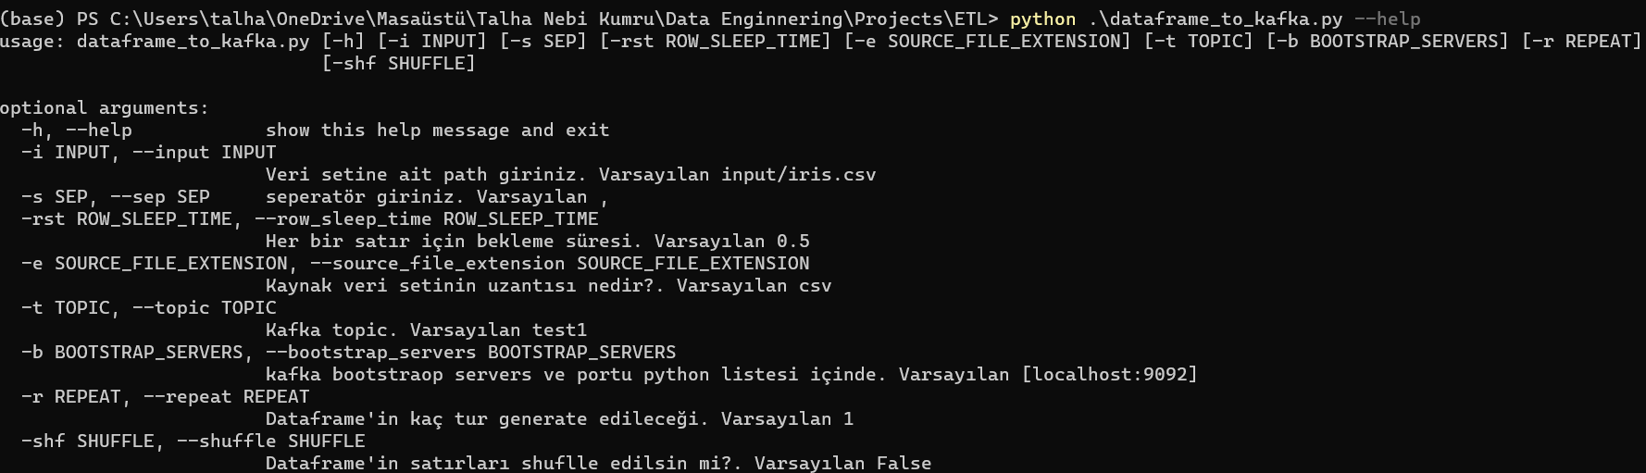
Streaming CSV file by Kafka Stream(1/2)

Slide 6
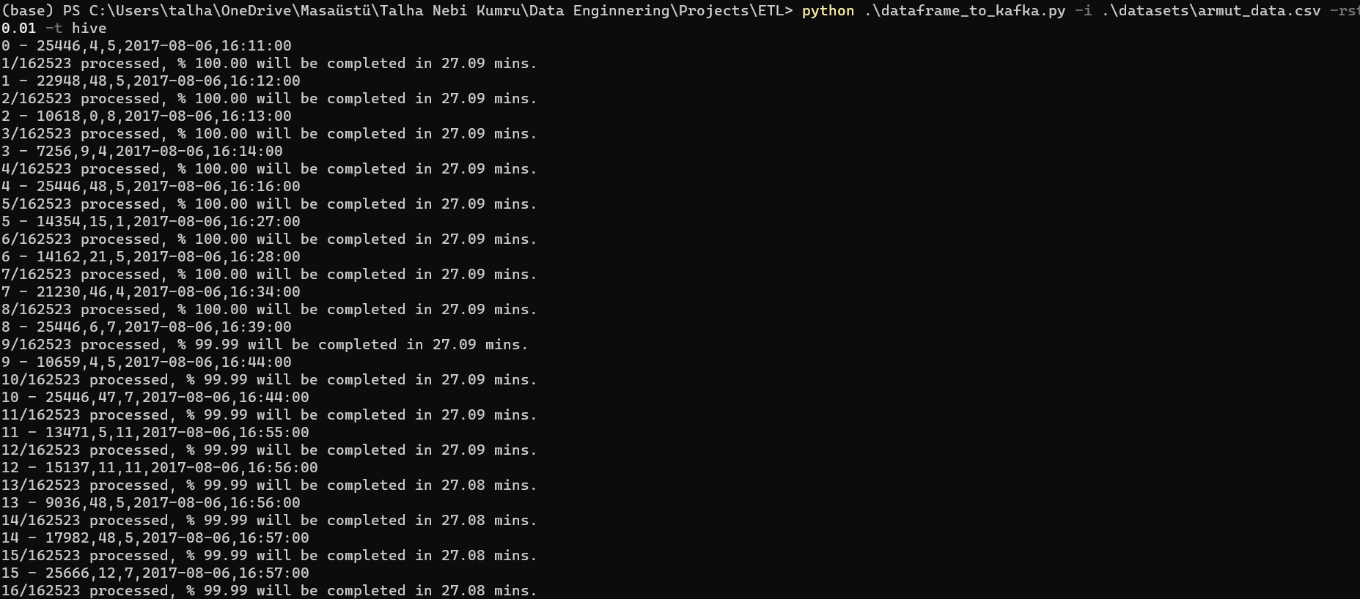
Streaming CSV file by Kafka Stream(2/2)

Slide 7
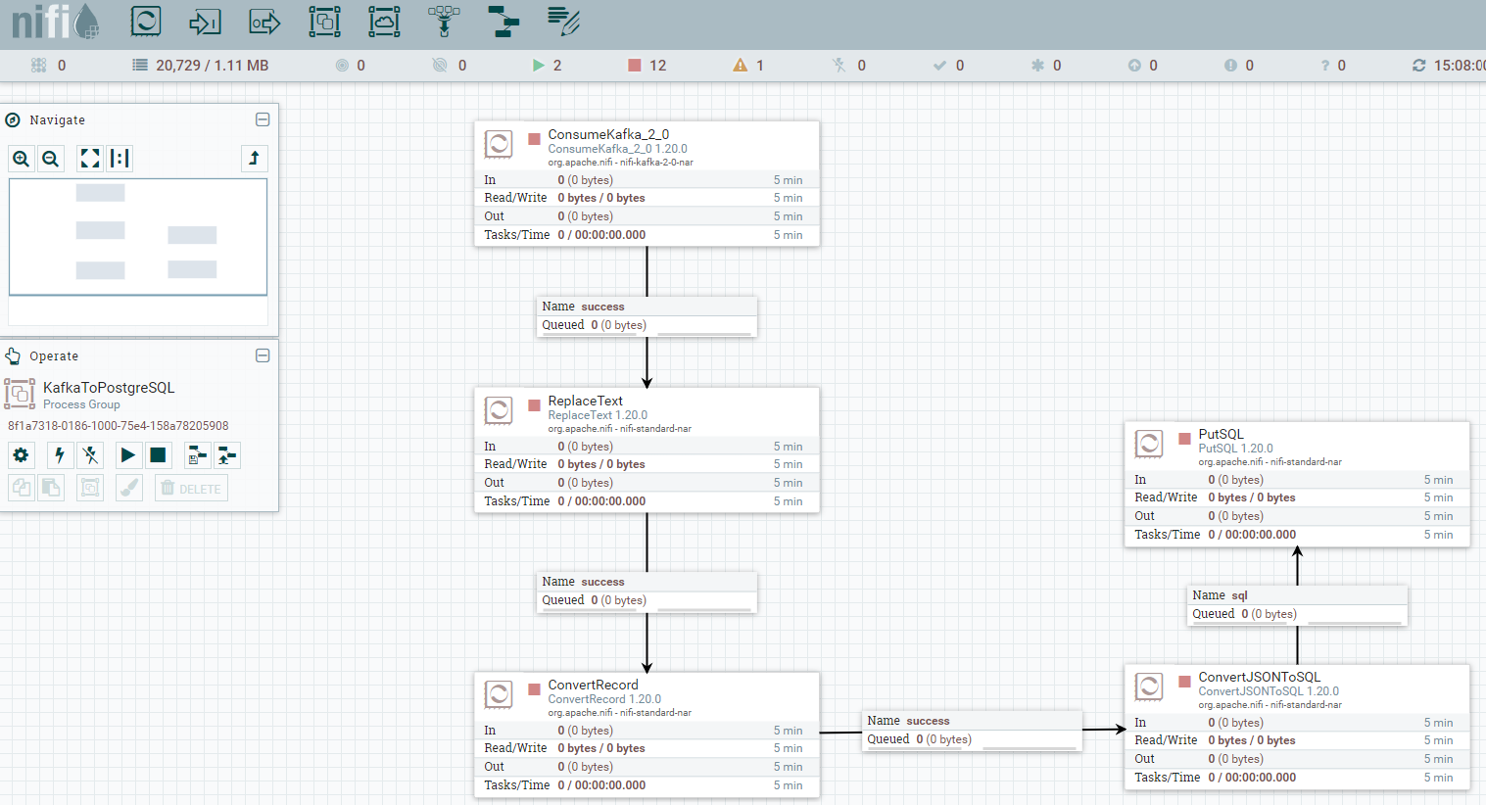
Processing / Saving data by Apache Nifi(1/2)

Slide 8
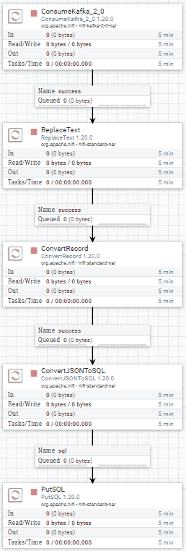
Processing / Saving data by Apache Nifi(2/2)
ConsumeKafka
Reads data from Apache Kafka Producer.
Output:
Row1,row2…
ReplaceText
Processing data from Apache Kafka Consumer.
Output:
Col1,col2…
Row1,row2…
ConvertRecord
Convert data from ReplaceText to JSON.
Output:
[
{
Col1:Row1,
Col2:Row2,
…
}
]
ConverJSONToSQL
Convert json data from ConvertRecord to SQL query.
Output:
INSERT INTO <table> (Col1, Col2,…) VALUES (Row1, Row2,…)
PutSQL
Execute SQL Query in database. Saved data in selected database.

Slide 9
Loading Part
PostgreSQL table in which database is sent to Apache hive table in which database used by Apache Sqoop. So this part is following this step;
Import PostgreSQL to Apache Hive

Slide 10

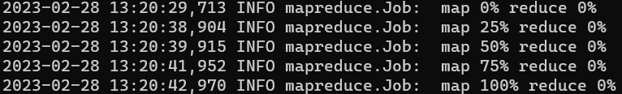
Import PostgreSQL to Apache Hive
Input:
Output:

