Slide 1
Team Seattle
PHP team project

Slide 2
Paricipants
Anton Velikov (antata_iv)
https://softuni.bg/users/profile/show/antata_iv
Tsvetelin Kutsarov (tkutsarov)
https://softuni.bg/users/profile/show/tkutsarov
Iliyan Grekov (iliangrekov)
https://softuni.bg/users/profile/show/iliangrekov
Borislav Yordanov (jumparo)
https://softuni.bg/users/profile/show/jumparo

Slide 3
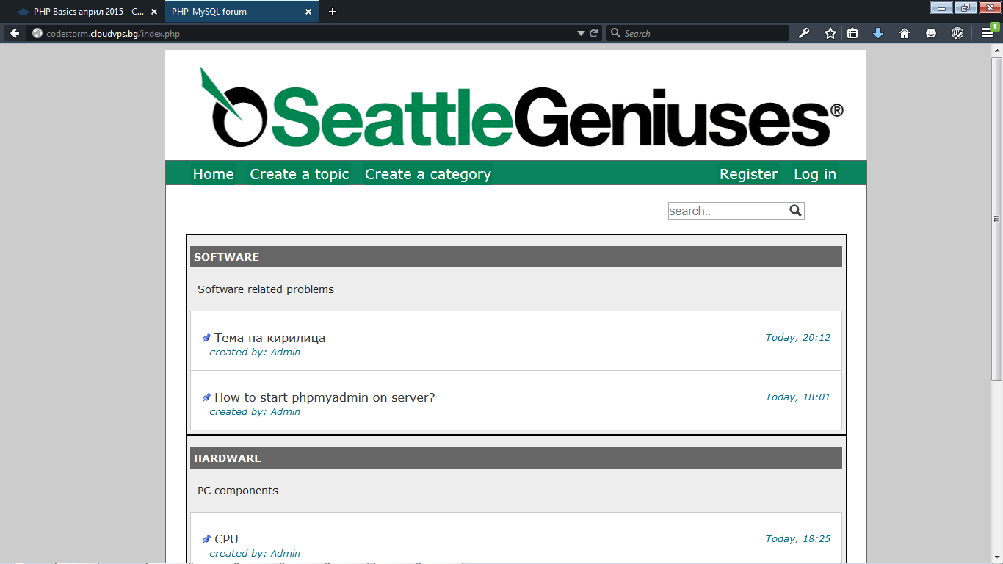
Seattle team Forum

Slide 4
Links
Forum -> http://codestorm.cloudvps.bg/index.php
GitHub -> https://github.com/tkutsarov/PHP_Team_Seattle

