Slide 1
The dataset:
For the homework:
library(car)
library(MASS)
library(xtable)
library(epitools)
library(nnet)
library(foreign)
library(ggplot2)
library(reshape2)
student<-read.dta("http://www.ats.ucla.edu/stat/data/hsbdemo.dta")
load("C:/Users/maria/Downloads/hsbdemo.dta")
student <- read.dta("C:/Users/maria/Downloads/hsbdemo.dta", convert.dates=TRUE, convert.factors=TRUE, missing.type=TRUE, convert.underscore=TRUE,
warn.missing.labels=TRUE)

Slide 2
Cross-tabulation
Cross-tabulating 2 variables:
stud.t1<-xtabs(~female + schtyp, data=student)
stud.t1
rowPercents(stud.t1)
colPercents(stud.t1)
mosaicplot(stud.t1, main="school type by gender")
Redesigning a variable:
student$seslow <- NA
levels(student$seslow)<- c("lower","higher")
student$seslow[student$ses == "low"] <- "lower"
student$seslow[student$ses == "middle"] <- "higher"
student$seslow[student$ses == "high"] <- "higher"
student$seslow <- ordered(student$seslow, levels= c("lower","higher"))
stud.t2<-xtabs(~prog + seslow, data=student)
stud.t2.or<-oddsratio(stud.t2)
stud.t2.or

Slide 3
Assessing the statistical significance of the relationship
Chi-squared test:
chisq.test(stud.t1)$statistic
chisq.test(stud.t1)$expected
stud.t1-chisq.test(stud.t1)$expected
Low vs high ses status analysis:
stud.t1.f <- xtabs(~ female + schtyp, data = student, subset = ses == "low")
stud.t1.f
chisq.test(stud.t1.f)
chisq.test(stud.t1.f)$expected
stud.t1.f- chisq.test(stud.t1.f)$expected
stud.t1.m <- xtabs(~ female + schtyp, data = student, subset = ses == "high")
stud.t1.m
chisq.test(stud.t1.m)
chisq.test(stud.t1.m)$expected
stud.t1.m - chisq.test(stud.t1.m)$expected
Is this reliable? What is the sample size?

Slide 4
MLR model
Visualizing the result:
par(mfrow=c(1,2))
mosaicplot(stud.t1.f)
mosaicplot(stud.t1.m)
Multinomial linear regression model:
prog.mlr <- multinom(schtyp ~ ses + science + math + female, data=student, trace=FALSE)
summary(prog.mlr, cor=FALSE, Wald=TRUE)
z <- summary(prog.mlr, cor=FALSE, Wald=TRUE)$Wald.ratios
p <- (1 - pnorm(abs(z), 0, 1))*2
p
p<0.05

Slide 5
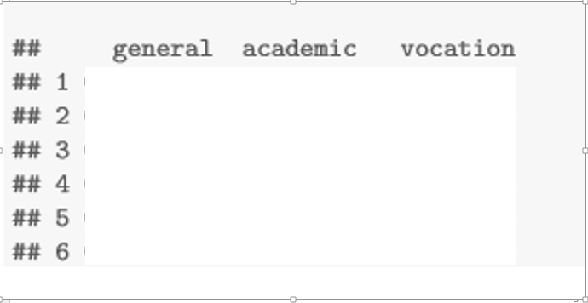
Loglikelihood and probabilities for all combinations of variables
Perfecting our model:
prog.mlr.best <- stepwise(prog.mlr, "backward", criterion="AIC")
Loglikelihood:
logLik(prog.mlr.best)
Probabilities for all combinations:
prog.mlr.best.nd <- data.frame(ses = rep(c("low", "middle", "high"),each=2), schtyp=rep(c("public","private"), 3))
predict(prog.mlr.best, newdata = prog.mlr.best.nd, "probs")
Your result:
-predicted probabilities for the six combinations of socio-economic status and schooltype at the average scores of the other predictors
-row 1 and 2 correspond to low ses and public and private school type, respectively, and so on

Slide 6
Dependency on a certain score
prog.mlr.best.nd <- data.frame(ses = rep(c("low", "middle", "high"),each=2), schtyp=rep(c("public","private"), 3))
predict(prog.mlr.best, newdata = prog.mlr.best.nd, "probs")
prog.mlr.best.nd2 <- data.frame(ses = rep(c("low", "middle", "high"),each=102), science = rep(mean(student$science),306), math = rep(c(30:80),6), read = rep(mean(student$read),306), schtyp=rep(c("public","private"), 153))
prob.math <- cbind(prog.mlr.best.nd2, predict(prog.mlr.best, newdata = prog.mlr.best.nd2, "probs", se = TRUE))
head(prob.math)
by(prob.math[, 6:8], prob.math$ses, colMeans)

