Slide 1
Paris Vs. London
Clustering Neighborhoods of London and Paris using Machine Learning

Slide 2
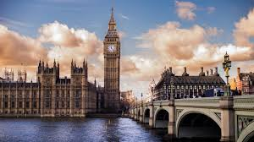
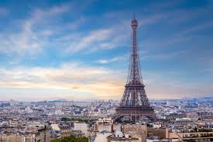
Introduction
London and Paris are both popular tourist destinations. Both are diverse and multicultural. We will group neighborhoods from each city to draw insights towards what each has to offer

Slide 3

Business Problem
We want to help tourists choose their destination based on the experiences neighborhood have to offer
This model will help people who are thinking of migrating to London or Paris
Categories explored include:
Cuisines
Stores
Leisure activities

Slide 4

Data Description
We need geographical data from both London and Paris, we will use Postal codes as a starting point
We will find neighborhoods, boroughs, venues, and most popular venue categories

Slide 5
Data Description: London
We used this link to get data: https://en.wikipedia.org/wiki/List_of_areas_of_London
This gives us information on:
1. borough: Name of Neighborhood
2. town: Name of the borough
3. post_code: Postal codes for London
ArcGIS API
Enables connection to people, locations and data using maps
Use to get the geographical locations of the neighborhoods of London
1. latitude: Latitude for Neighborhood
2. longitude: Longitude for Neighborhood

Slide 6
Data Description: Paris
We used this link to get data: https://www.data.gouv.fr/fr/datasets/r/e88c6fda-1d09-42a0-a069-606d3259114e
This gives us information on:
1. postal_code: Postal codes for France
2. nom_comm: Name of Neighborhoods in France
3. nom_dept: Name of the boroughs, equivalent to towns in France
4. geo_point_2d: Tuple containing the latitude and longitude of the Neighborhoods

Slide 7
Foursquare Api data
Foursquare is a location data provider with information about venues within a certain area
We have chosen each neighborhood to have a 500 meter radius
Foursquare will retrieve data on the venues inside each neighborhood
Data collected will be as followed
Neighbourhood: Name of the Neighborhood
Neighbourhood Latitude: Latitude of the Neighborhood
Neighbourhood Longitude: Longitude of the Neighborhood
Venue: Name of the Venue
Venue Latitude: Latitude of Venue
Venue Longitude: Longitude of Venue
Venue Category: Category of Venue

Slide 8
Methodology
We will be importing the following packages
Pandas: To collect and manipulate data in JSON and HTML and then data analysis
requests: Handle HTTP requests
matplotlib: Detailing the generated maps
folium: Generating maps of London and Paris
sklearn: To import K Means machine learning model.
Approach:
Explore each city
Plot map to show considered neighborhoods
Build model by clustering similar neighborhoods

Slide 9
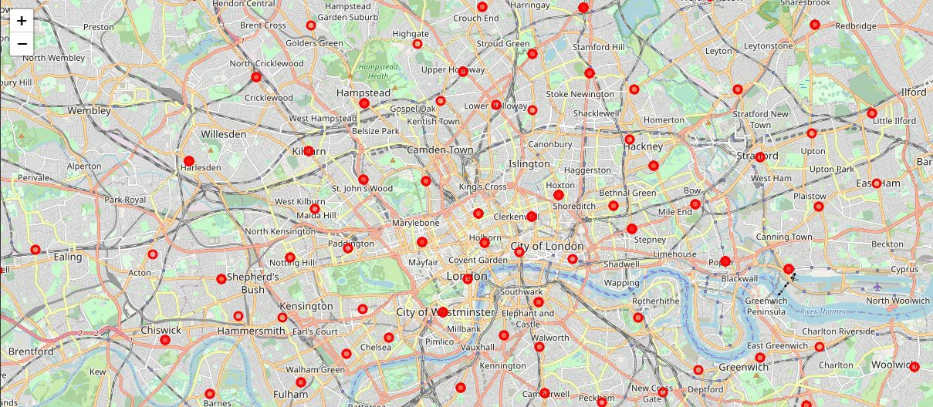
Visualizing London

Slide 10
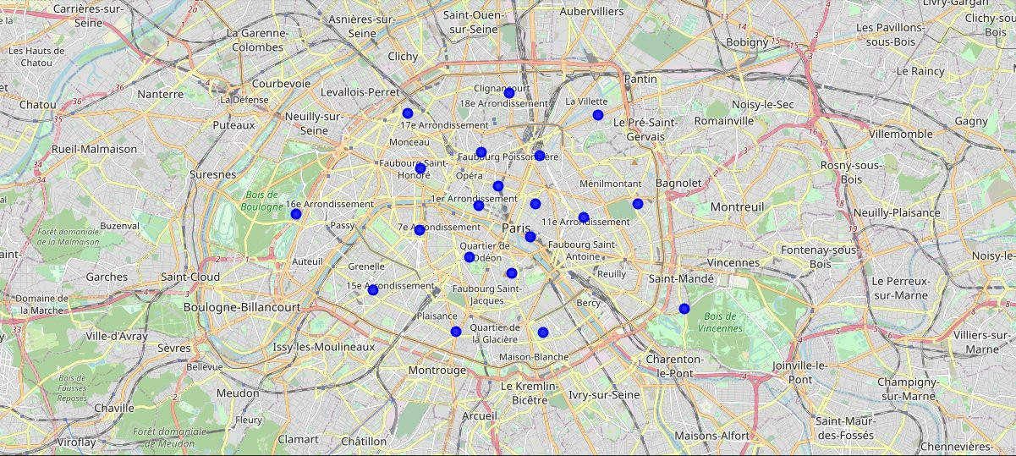
Visualizing Paris

Slide 11
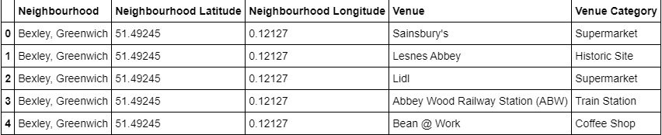
Venues
After visualizing the neighborhoods, we want to find out the common venues in each neighborhood
We use Foursquare to collect information on venues

Slide 12
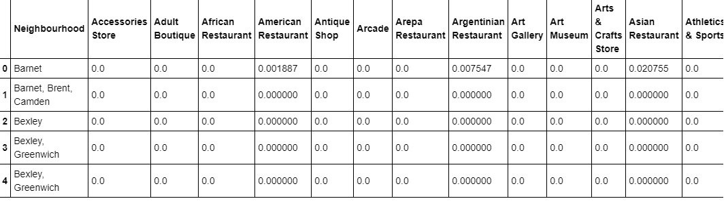
One hot encoding
We calculate the top 10 common venues to base similarity
One Hot Encoding is used to convert categorical data in numerical data

Slide 13
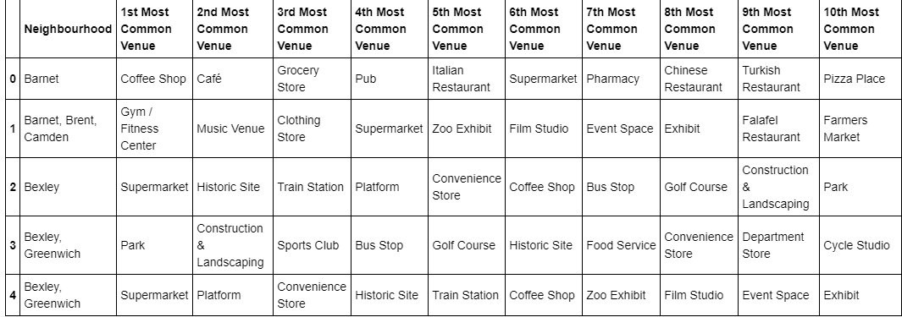
Top venues in the Neighborhoods
We sorted, ranked and labeled the top venue categories in our neighborhood

Slide 14
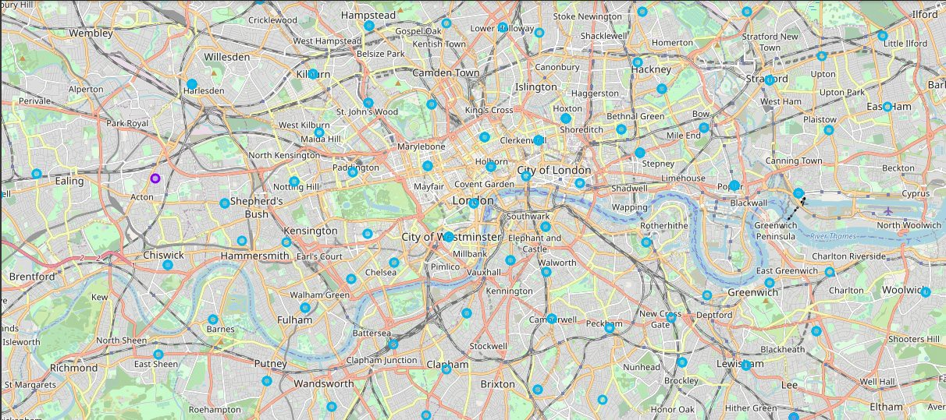
Visualize clustered neighborhood: london

Slide 15
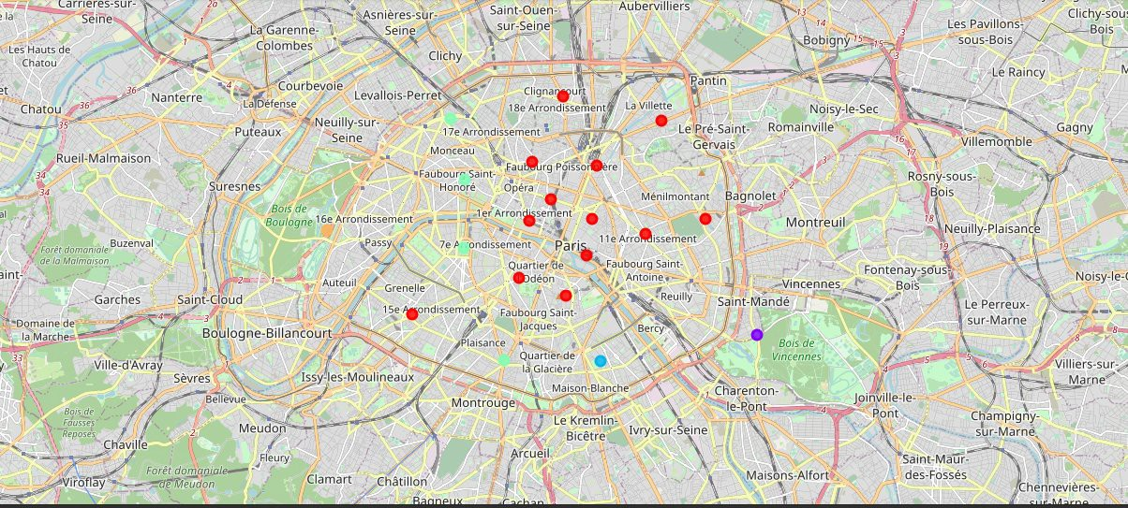
Visualize clustered neighborhood: paris

Slide 16
Results
London has very multicultural neighborhoods. The cuisines range from Italian, Turkish to Chinese. There is also a variety of different types of eating places such as restaurants, bars, coffee shops and juice bars. Further, there are numerous shopping options including fish markets, clothing stores, flea markets, glower shops etc. for leisure, neighborhoods have parks, gold courses, gyms, zoos, etc. Main methods of transportation are buses and trains. London would provide an entertaining experience.
Paris is much smaller geographically, but has a wide variety of activities and eateries. The cuisines offered are French, Thai, Cambodian, Asian, etc. There are many restaurants and bars, and a numerous amount of bistros. There are more modes of public transport in Paris, namely buses, bikes boats and ferries In regards to leisure and sight seeing, there are plazas, parks, historic sites, clothing shops, art galleries and museums. Paris seems like a very diverse interesting vacation spot.

Slide 17
Conclusion
This project was meant to showcase what the cities of Paris and London had to offer to potential migrants and tourists. We explored venues present in each location. Each of the cities neighborhoods have a wide variety of experiences. Yet, they offer different experiences. Both offer a great getaway with many places to explore and numerous cuisines to try. Culture is evident in both cities. Our findings will help people narrow down what specific experiences they would like and which city matcher their preferences more.

