Slide 1
Machine Learning for Trading
T.K. Huynh

Slide 2
Agenda
1. Stock market review
2. Strats
3. Indicators review
4. Manual strat
5. Benchmark portfolios
6. ML Framing
7. ML Trading
8. Success?

Slide 3
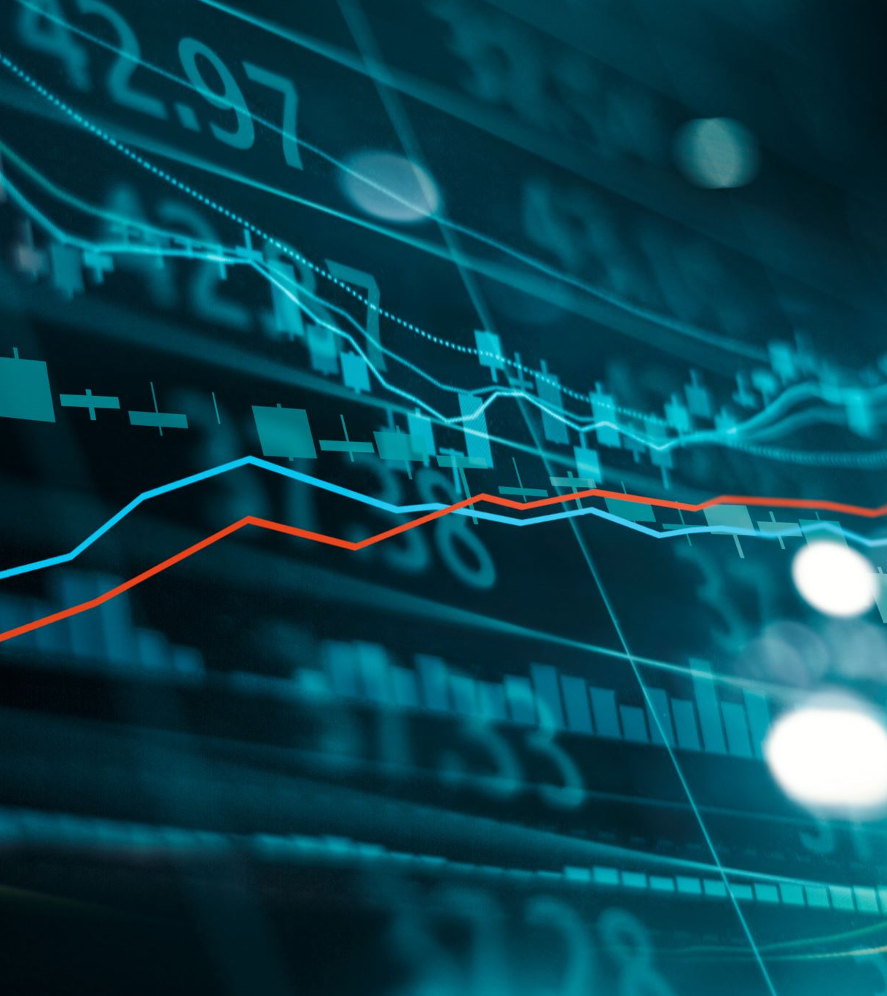
The Stock Market
The stock market is an exchange mechanism that helps investors buy and sell shares in publicly traded companies.
Trades are conducted mostly through electronic means between participants who are remote from each other.
The mechanism is an excellent means for businesses to raise capital from investors.
Companies listed on stock exchanges must be public, meaning their shares are open not just to a select few but traded on stock exchanges and elsewhere. Public companies are subject to many reporting and transparency regulations.
Stocks are sold to institutional investors and high-net-worth individuals, but also those with far more modest means looking for income from a share of the profits, to sell the stock later at a higher price, or simply to have a say in how a company is run.

Slide 4
Stocks
The price of a stock changes based on the demand for shares from new investors who want to buy, or the supply of shares from existing investors who want to sell.
Investors decide to buy or sell based on the company’s performance, economic conditions, the current price of the shares, and other factors.
Not every investor makes decisions based on the same criteria, and what might not seem rational to one investor, will seem perfectly acceptable to another.

Slide 5
Time based Strategies
1. Day Trading
Opens and closes positions within a single trading day
Aims to profit from short-term price movement
Requires quick decision-making and active monitoring
2. Swing Trading
Captures price movements over days to several weeks
Balances between day trading and position trading
Uses support and resistance levels for entry/exit points3
3. Position Trading
Holds positions for months to years
Focuses on long-term market direction
Relies on fundamental analysis with technical analysis support

Slide 6
Technical based Strategies
Trend Following
Capitalizes on asset momentum in specific directions
Uses moving averages and technical indicators
Follows the principle "the trend is your friend"
2. Breakout Trading
Trades when price breaks through support or resistance levels
Uses chart patterns like triangles, flags, and head-and-shoulder
Popular among day and swing traders
3. Scalping
Profits from very small price movements
Holds positions for seconds to minutes
Requires high-frequency trading and quick execution

Slide 7
Advanced Strategies
1. Momentum Trading
Buys rising assets and sells declining ones
Relies on continued price movement direction
Uses moving averages and volume indicators
2. Mean Reversion
Assumes prices will return to average
Identifies overbought and oversold conditions
Works well in ranging markets

Slide 8
Each strategy requires different time commitments, risk tolerance levels, and analytical skills. Success depends on choosing a strategy that matches your trading style and resources.

Slide 9
Indicators
Technical indicators are mathematical calculations derived from historical market data that help predict future price movements and make trading decisions.
For my trading strategy, I used Price/SMA, Bollinger Band percentage, and Momentum.

Slide 10
Price/SMA Ratio
A mathematical comparison between current price and Simple Moving Average that measures whether an asset is trading above or below its average trend.
The ratio helps identify:
Values > 1: Price above average
Values < 1: Price below average

Slide 11
Bollinger Band Percentage
A technical indicator that measures the relative position of price compared to upper and lower Bollinger Bands
It helps identify:
Readings > 80%: Overbought conditions
Readings < 20%: Oversold conditions
50%: Price at middle band

Slide 12
Momentum
A technical tool that measures the velocity and rate of price changes rather than actual price levels.
It helps determine:
Trend strength
Direction of price movements
Market development potential
Values above zero indicate upward movement
Values below zero indicate downward movement

Slide 13
Manual Strategy
Calculate price/sma ratio, Bollinger band percent, and momentum, use that as a signal to buy/sell.
Long entry: Buy 1000 shares when you think price will go up
Happens when:
Market is oversold (BB% < 20) and momentum is positive
OR price is below average and showing upward movement
Short Entry: Borrow and sell 1000 shares when you think price will go down
Happens when market is overbought (BB% > 85), momentum is negative, and price is well above average
Long Exit: Sell your 1000 shares to take profit or prevent losses
Happens when:
Market becomes overbought (BB% > 75)
OR price starts dropping while being above average
Short Exit: Buy back 2000 shares to return borrowed shares and close position
Happens when:
Market becomes oversold (BB% < 25)
OR price starts rising while being below average

Slide 14
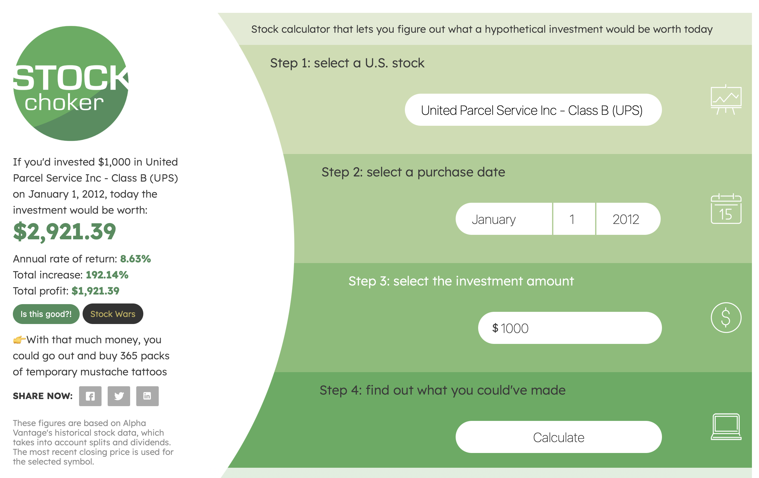
Benchmark Portfolio (2012)

Slide 15
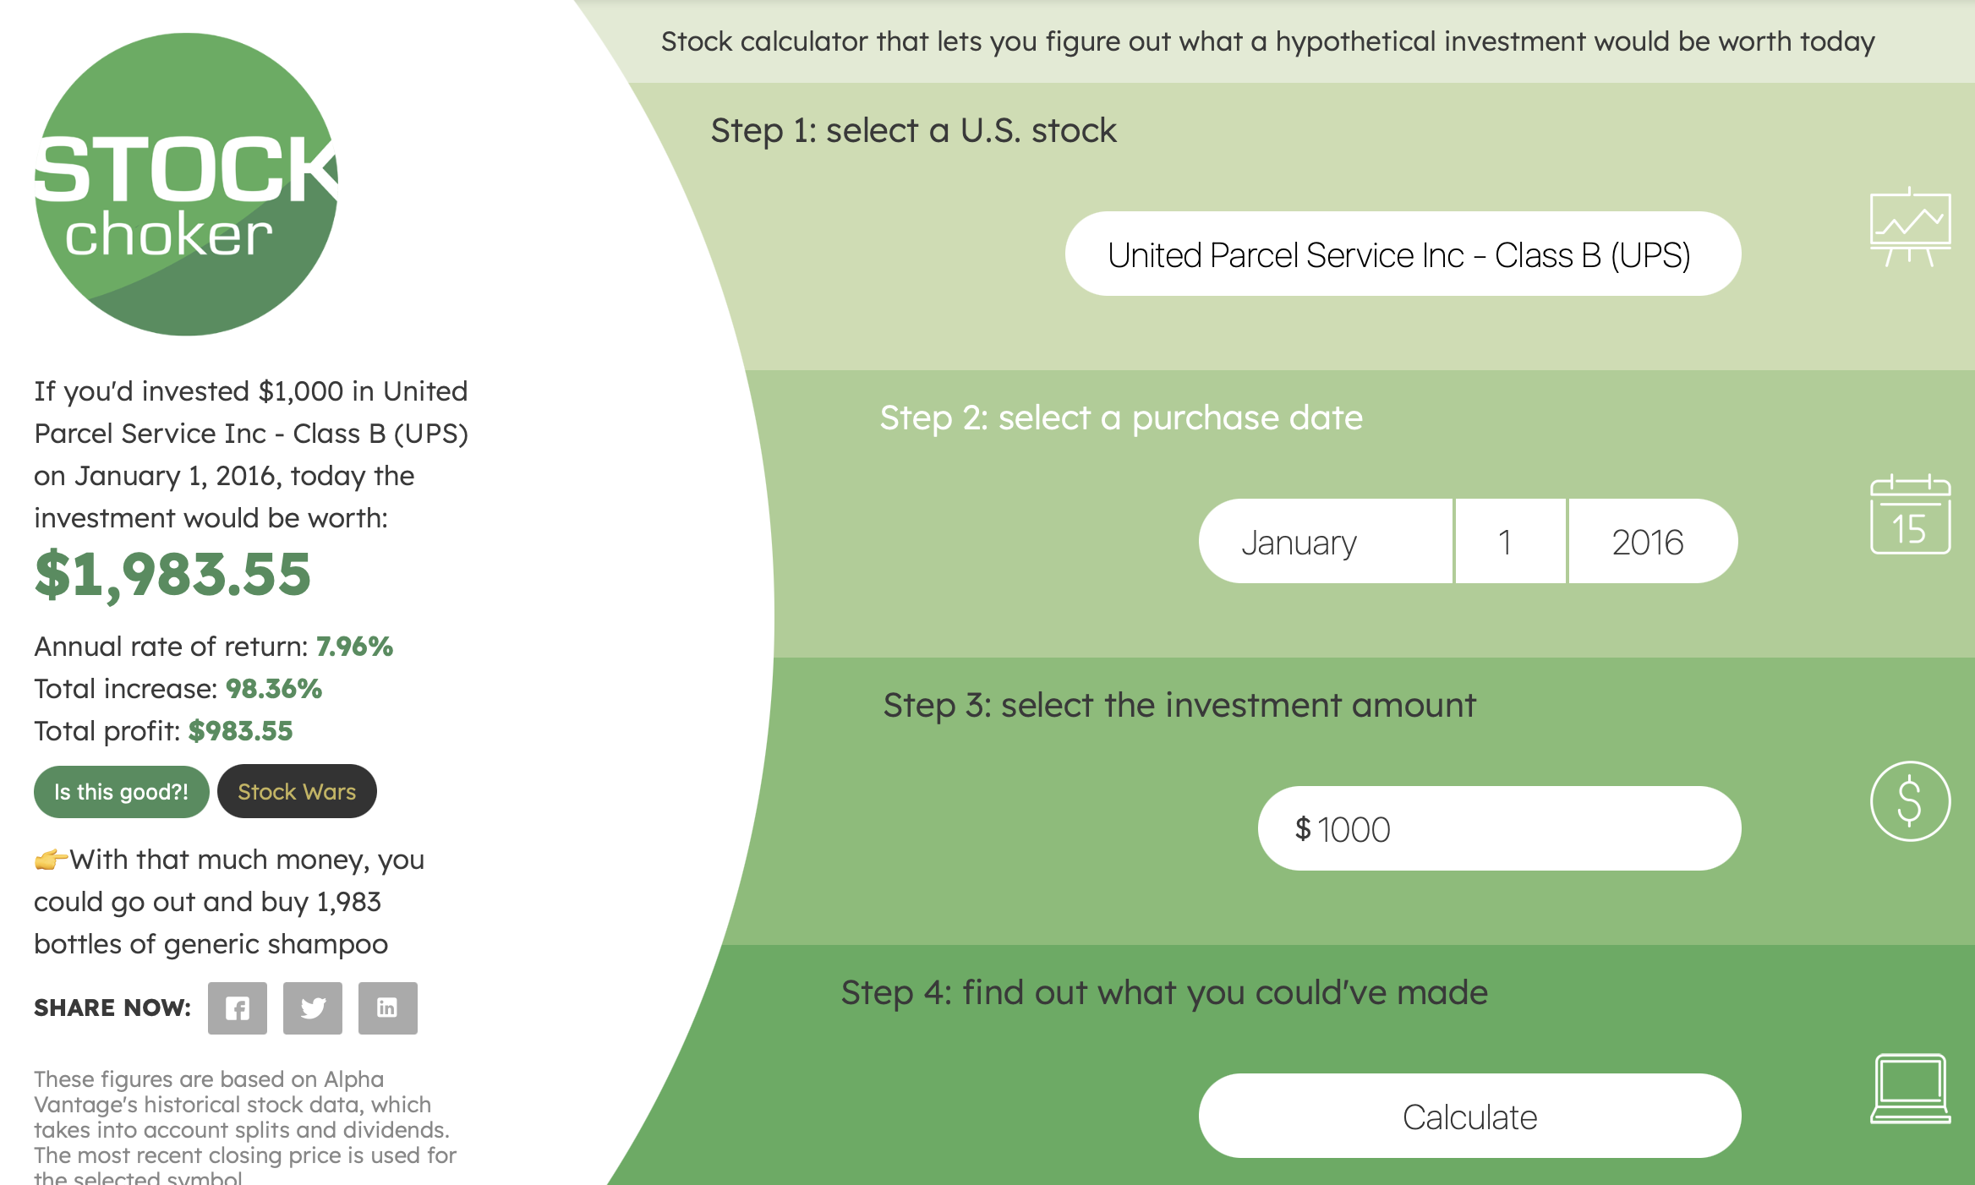
Benchmark Portfolio (2016)

Slide 16
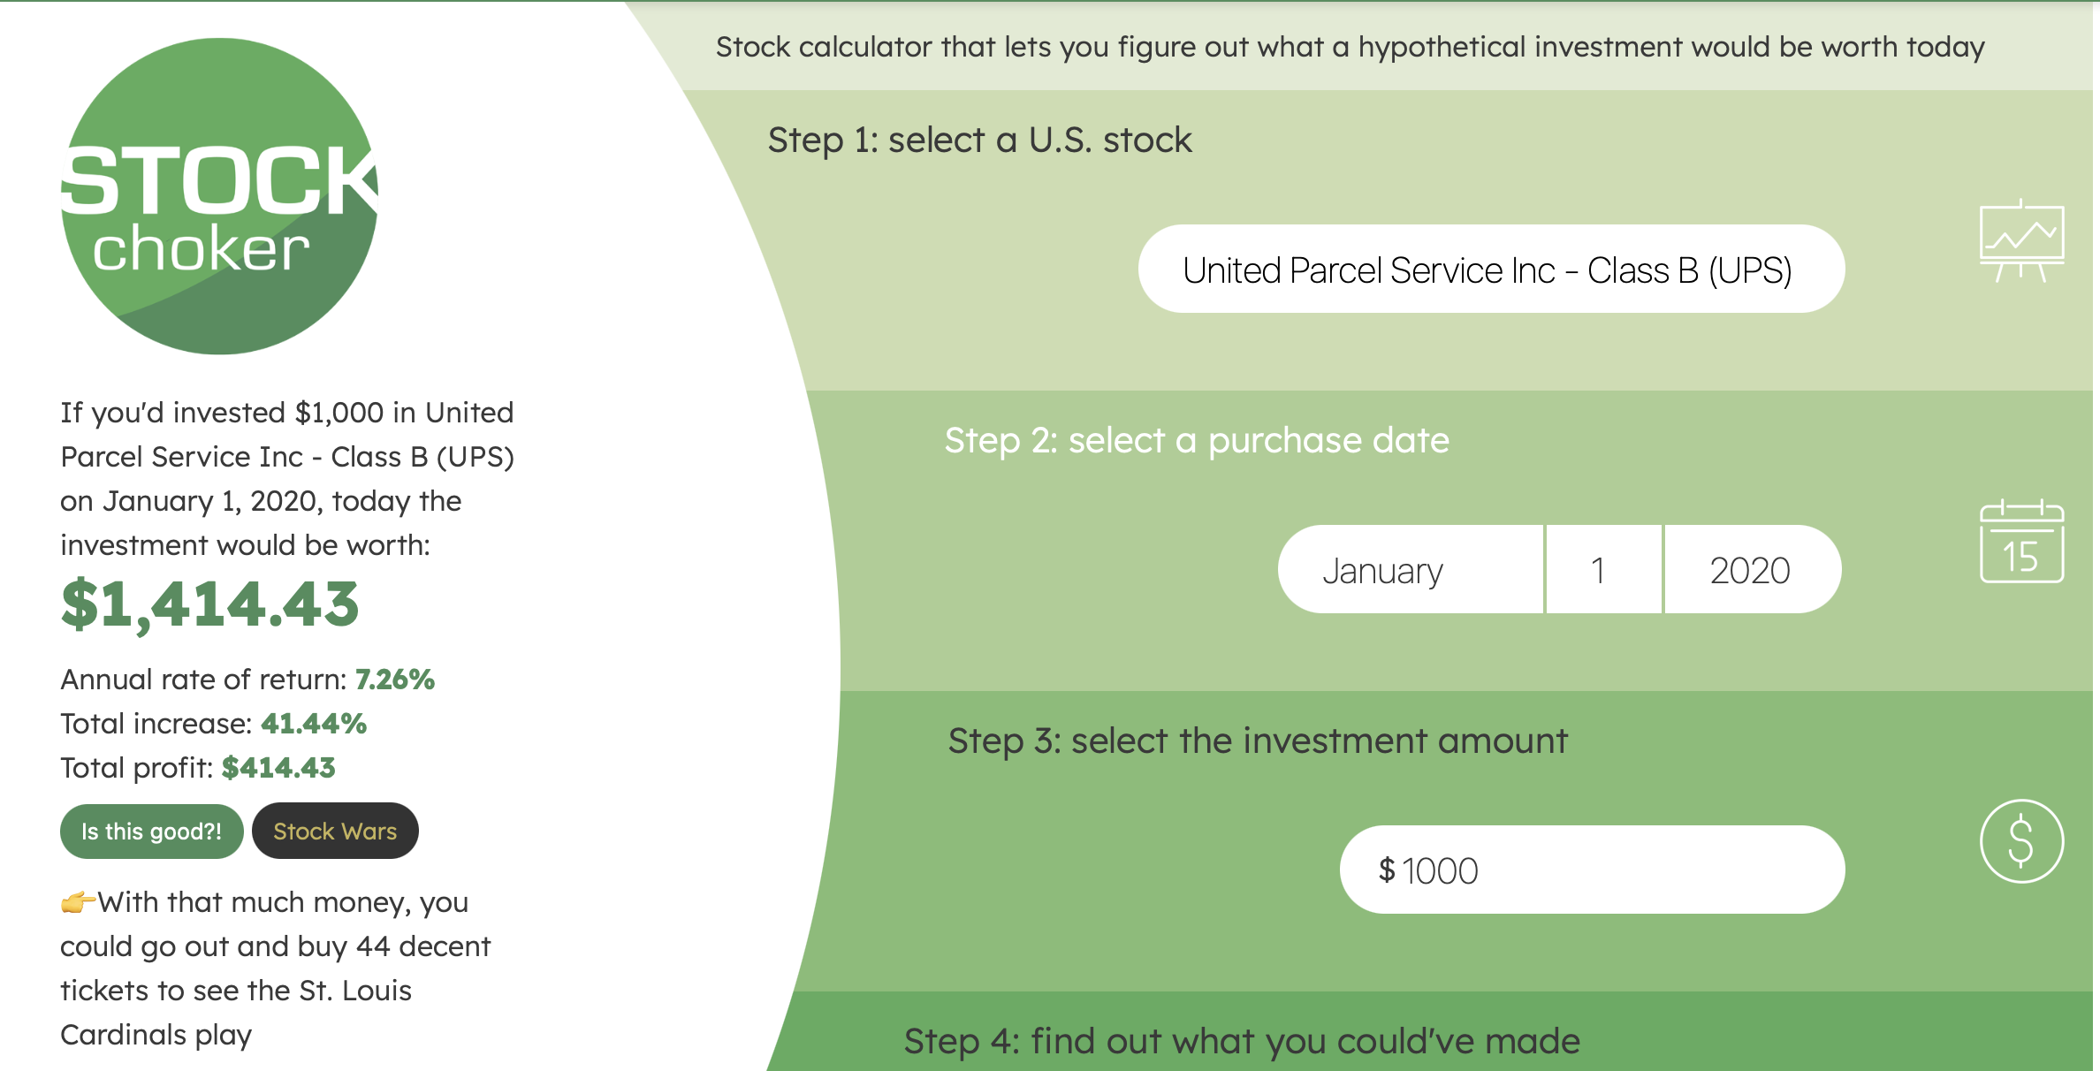
Benchmark Portfolio (2020)

Slide 17
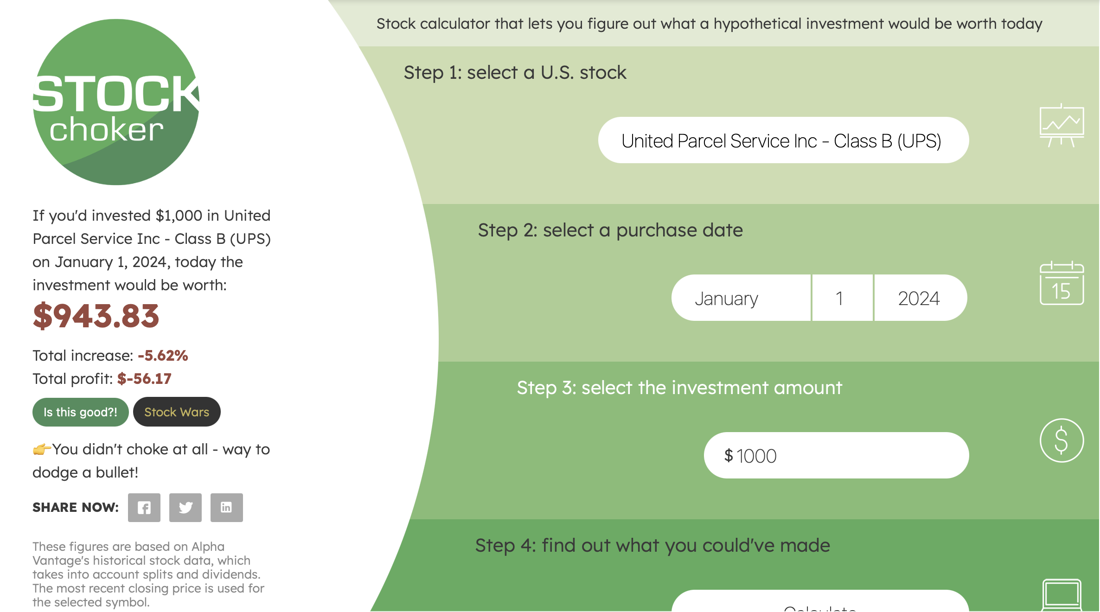
Benchmark Portfolio (2024)

Slide 18
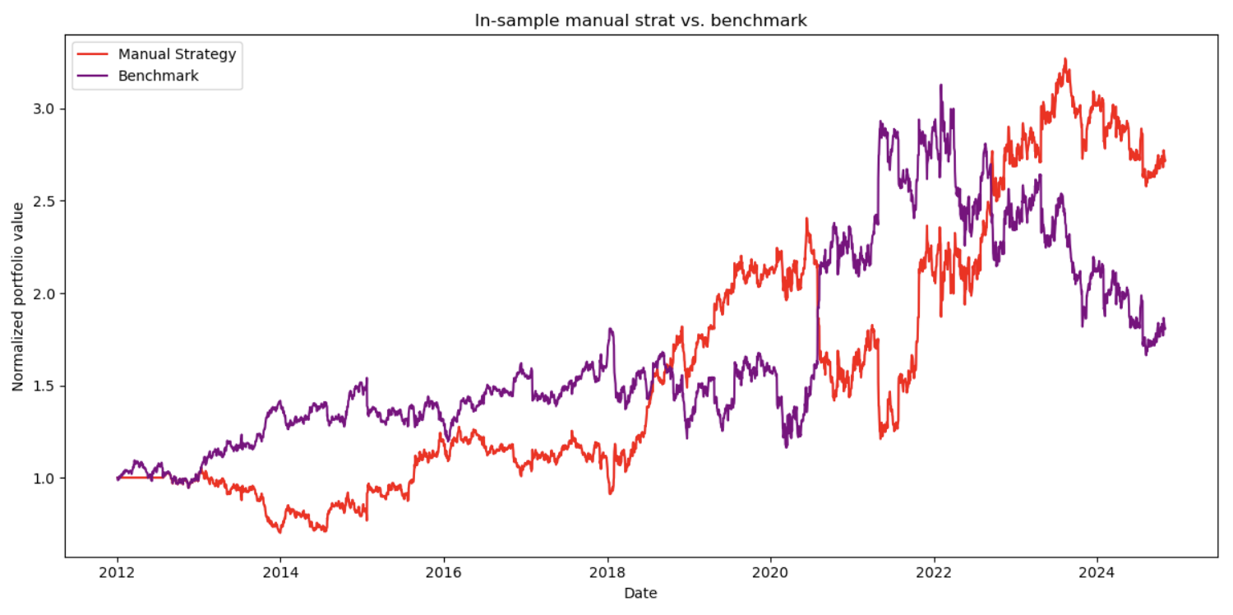
Manual Strategy
Benchmark Final Portfolio Value: $2921 (~192%)
Manual Strategy Portfolio Value: $4112 (~ 311%)

Slide 19
Framing the ML problem
The ML implementation here works like a price movement prediction system in three simple steps:
Data Input
Takes 3 technical indicators as features: Price/SMA ratio, BB%, momentum
Learning Process
Labels Creation: Looks 10 days into the future
Creates three labels based on future returns:
Buy (1): If price goes up more than 3%
Sell (-1): If price goes down more than 3%
Hold (0): If price stays in between
Training
Uses 50 Random Decision Trees working together (Random Forest)
Each tree learns patterns between indicators and future price movements
Combines predictions from all trees for better accuracy

Slide 20
Example
Looking into the Future
Takes current price
Looks 10 days ahead in the future
Calculates the return ratio: (Future Price / Current Price) - 1
Creating Labels
Buy Signal (Y = 1) If 10-day future return > 3% + impact
Example: If impact = 0.02, need return > 5% to trigger buy
Sell Signal (Y = -1) If 10-day future return < -3% - impact
Example: If impact = 0.02, need return < -5% to trigger sell
Hold Signal (Y = 0) If return falls between buy and sell thresholds
Example: Return between -5% and 5% with impact = 0.02
If current price is $100:
Buy (1): If future price > $103
Sell (-1): If future price < $97
Hold (0): If future price between $97-$103

Slide 21
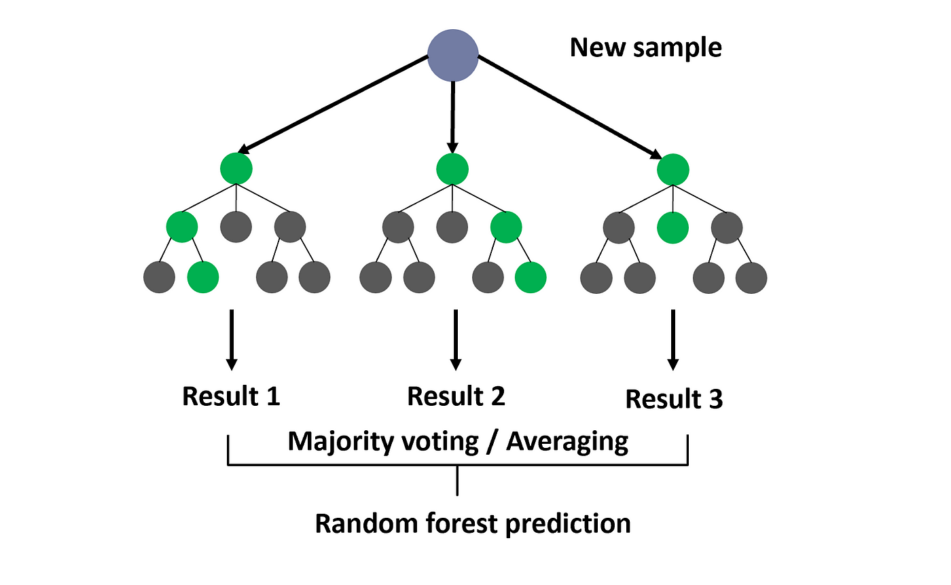
Random Tree Learner
1. Reduces variance in trading decisions
2. Improves prediction stability
3. Minimizes impact of market noise
4. Prevents overfitting to specific market patterns

Slide 22
Applying real world schtuff
Commission and impact are two important trading costs that affect trading performance:
Commissions (we used $9, ~0.9% of trade value)
Fixed commissions: Constant fee regardless of trade size
Variable commissions: Fee based on trade volume
Impact (0.095% or about 9.5 basis points)
The effect that trading activity has on an asset's price
This occurs because buying pushes prices higher, selling pushes prices lower. Larger trades typically have bigger impact
Trading Days= Days in Year−Weekends−Holidays 365−104−9=252 days[5]365−104−9= 252 days
Used SPY, if SPY traded, the market is open

Slide 23
A reminder (2016)

Slide 24
A reminder (2016)

Slide 25
A reminder (2020)

Slide 26
A reminder (2024)

Slide 27
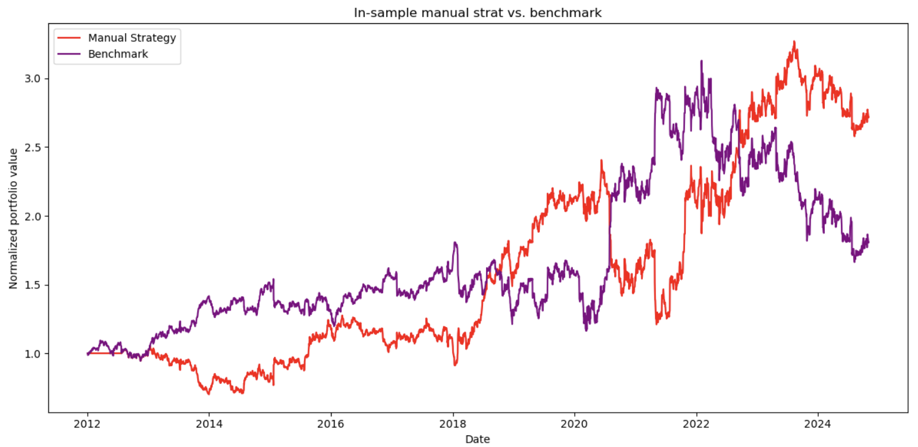
A reminder

Slide 28
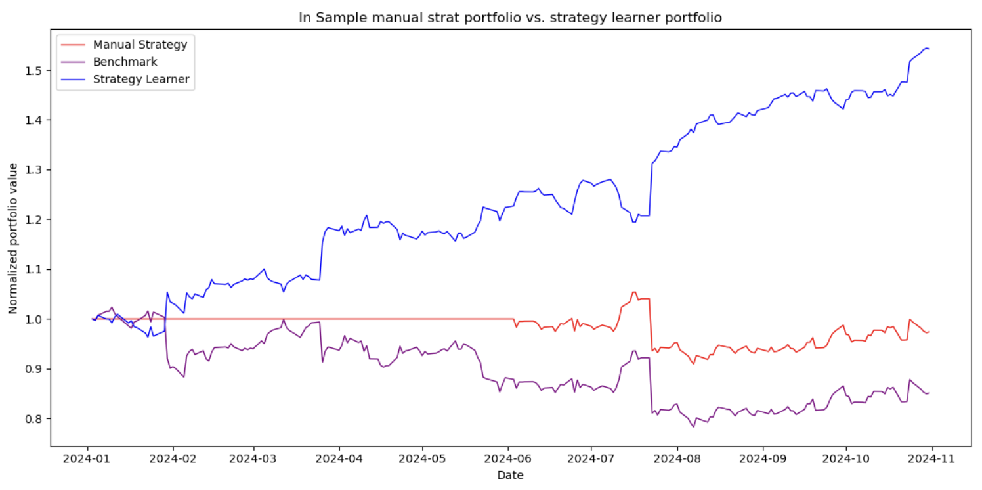
Benchmark Final Portfolio Value: $943 (-5.62%)
Manual Strategy Portfolio Value: $1542 (~ 54%)

Slide 29
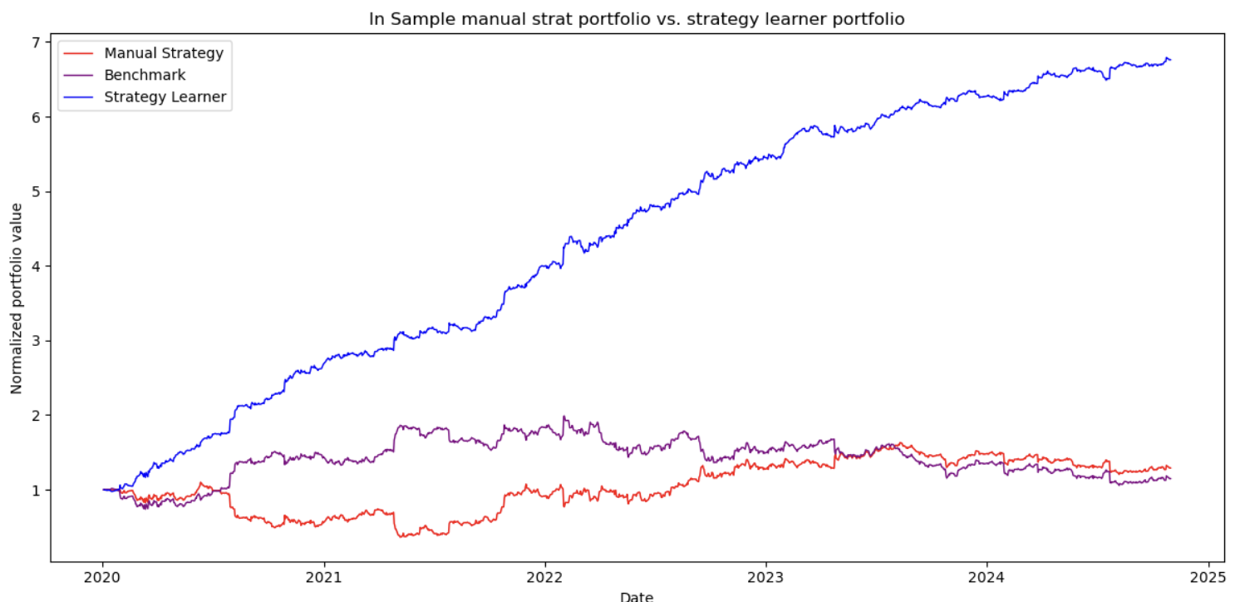
Benchmark Final Portfolio Value: $1414 (~41%)
Manual Strategy Portfolio Value: $6761 (~ 576%)

Slide 30
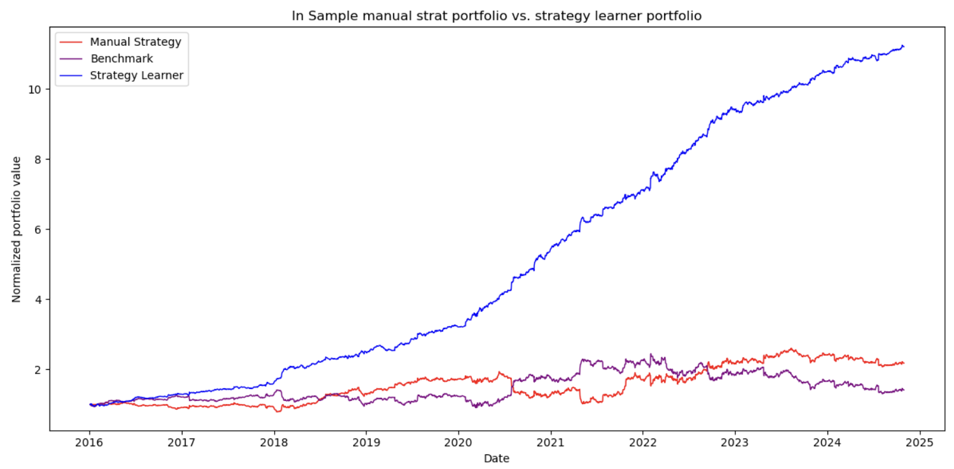
Benchmark Final Portfolio Value: $1983 (~98%)
Manual Strategy Portfolio Value: $11200 (~ 1,020%)

Slide 31
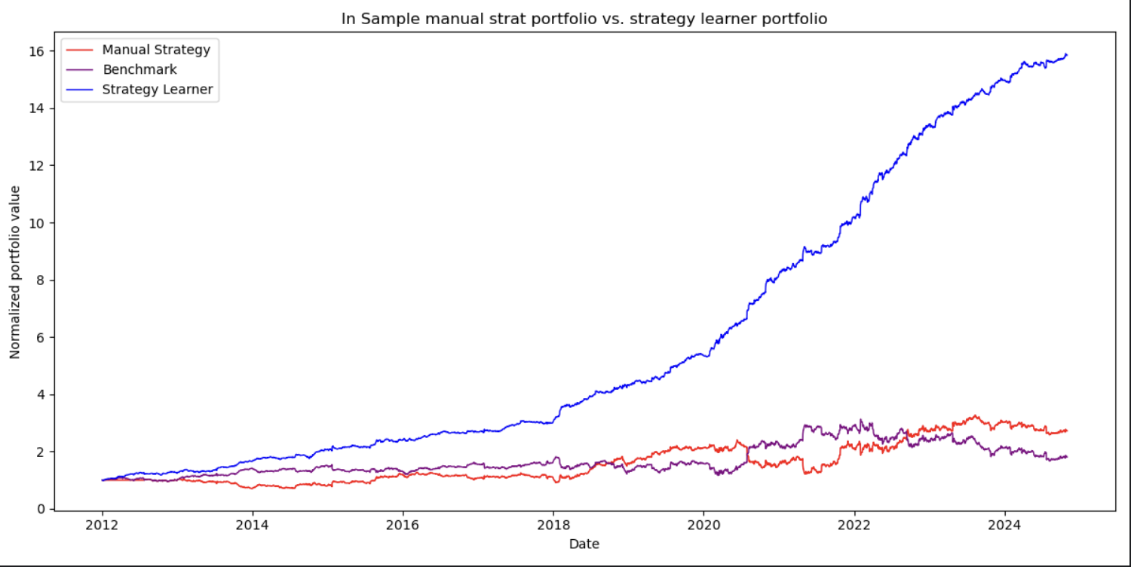
Benchmark Final Portfolio Value: $2921 (~192%)
Manual Strategy Portfolio Value: $15844 (~ 1484%)

Slide 32
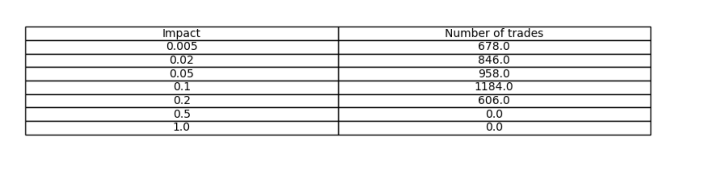
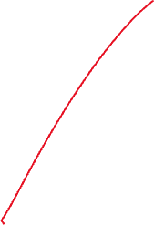
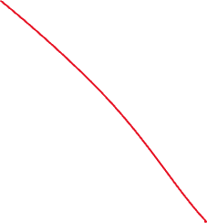
More trades =/= More profit NOOO!!!

Slide 33
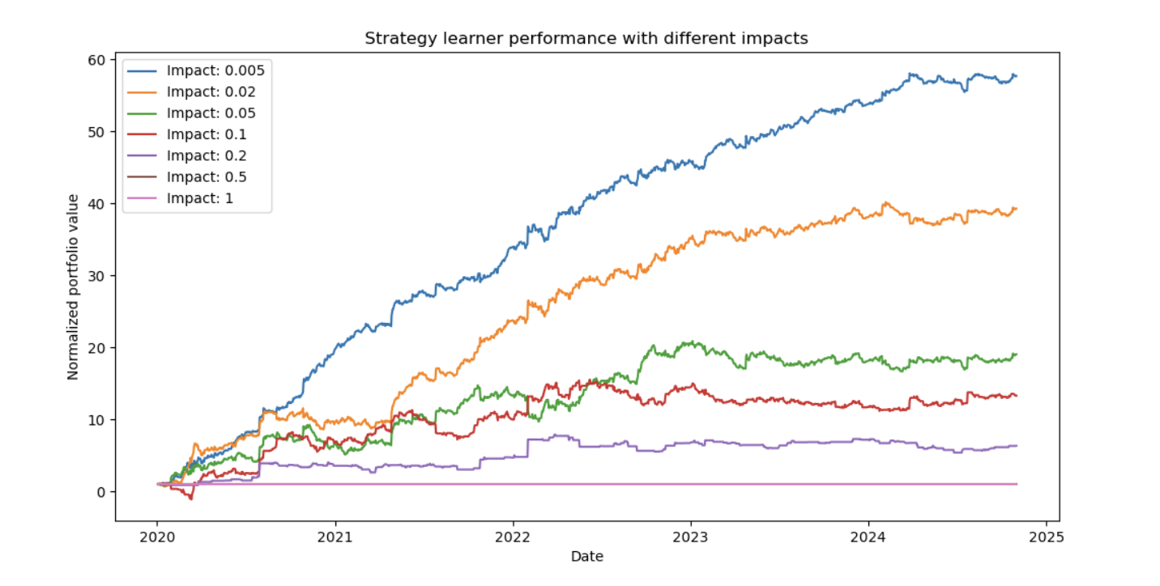
Role of impact

Slide 34
Reminder, trading is patience, luck, and GRIT.

Slide 35
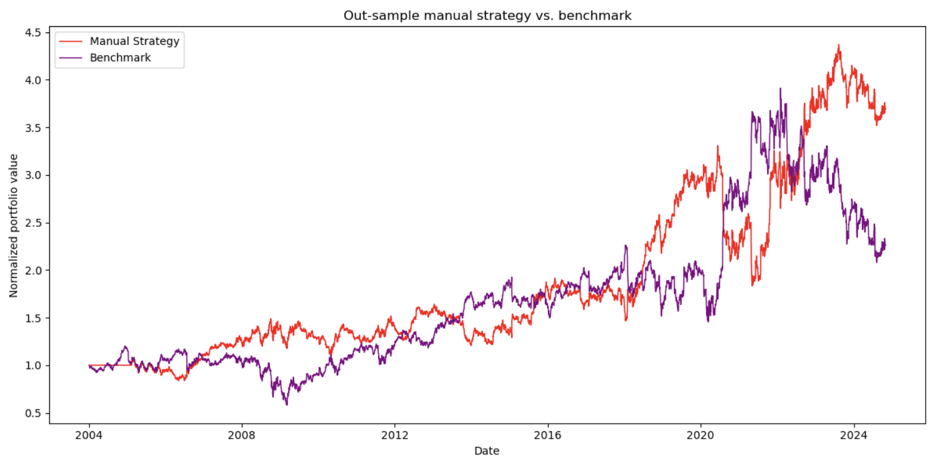
2008…

Slide 36
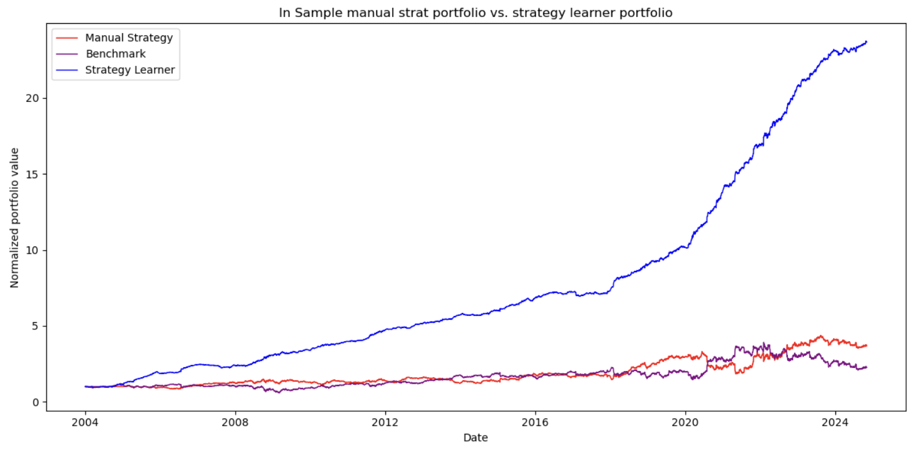
2008…
$23680 final value

Slide 37
Thank you!!!
NOT FINANICAL ADVICE….
ALGORITHM IS COULD BE IMPROVED IMMENSELY!!
Please don’t use my algo for trading
Taught me a lot about trading
There is always someone better…..
Required infrastructure to be better than others.

