Slide 1
Networking

Slide 2
The Network is the Computer
Client-Server computing
Peer-to-Peer
The Web
Today’s networking is wonderful, but
  How is it done?

Slide 3

Ethernet Frame Format
Addresses:
Unique, 48-bit unicast address assigned to each adaptor
Example: 8:0:2b:e4:b1:2
Broadcast: all 1
Multicast: first bit is 1

Slide 4
Layering
Use abstractions to hide complexity
Abstraction naturally leads to layering
Application Programs
Process-to-process
Host-to-Host Connectivity
Hardware
Protocol Stack

Slide 5
Protocols
Building blocks of a network architecture
Each protocol object has two different interfaces
  service interface: defines operations on this protocol
  peer-to-peer interface: defines messages exchanged with peer
Host1
High Level
Object
Protocol
Host2
High Level
Object
Protocol
Service Interface
Peer to peer

Slide 6
Protocol Graph
collection of protocols and their dependencies
most peer-to-peer communication is indirect
peer-to-peer is direct only at hardware level
FTP
Telnet
Video
FTP
Telnet
Video
RRP
MSP
RRP
MSP
HHP
HHP

Slide 7
Communication
Encapsulation (header/body)
Application
Application
data
data
RRP
RRP
RRP data
RRP data
HHP
HHP
HHP RRP data

Slide 8
Standard Architectures
Open Systems Interconnect (OSI) Architecture
  International Standards Organization (ISO)
  International Telecommunications Union (ITU); formerly CCITT
  “X dot” series: X.25, X.400, X.500
  Reference Model

Slide 9
Seven Layer Model
Application
Presentation
Session
Transport
Email, FTP, www
cinteger size, big endian
synchronization, name space
reliability, congestion control
Application
Presentation
Session
Transport
Routing
address
framing
errors
electrical
signals
Network
Data Link
Physical
Network
Data Link
Physical
Network
Data Link
Physical
Network
Data Link
Physical

Slide 10
Internetworking

Slide 11
A Simple Internetwork
Hn = Host
Network 1 (Ethernet)
Rn = Router
H7
R3
H8
H1
H2
H3
Network 4
Network 2 (Ethernet)
(point-to-point)
R1
R2
H4
Network 3 (Token Ring)
H5
H6

Slide 12
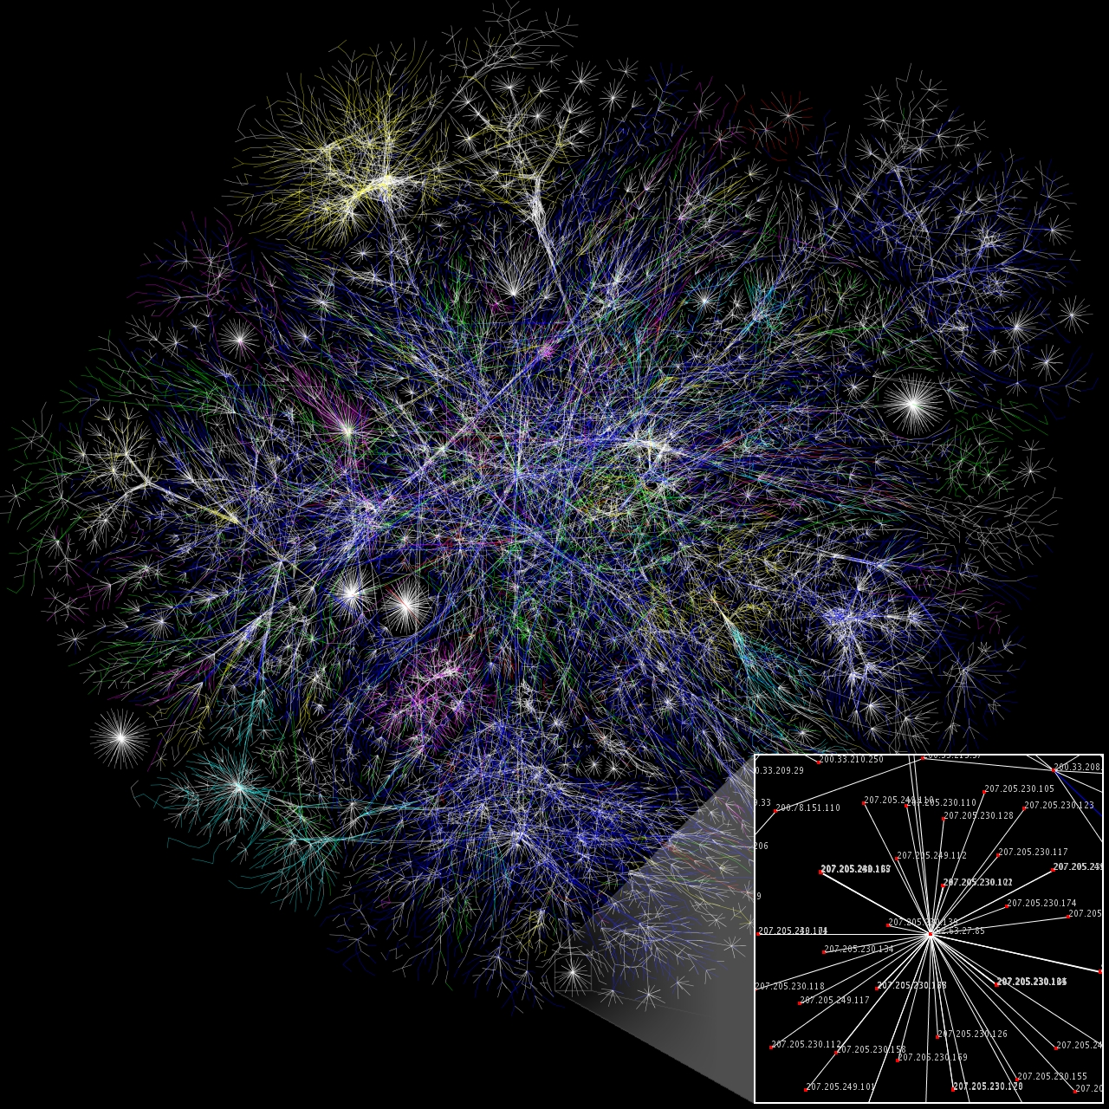
The Internet

Slide 13
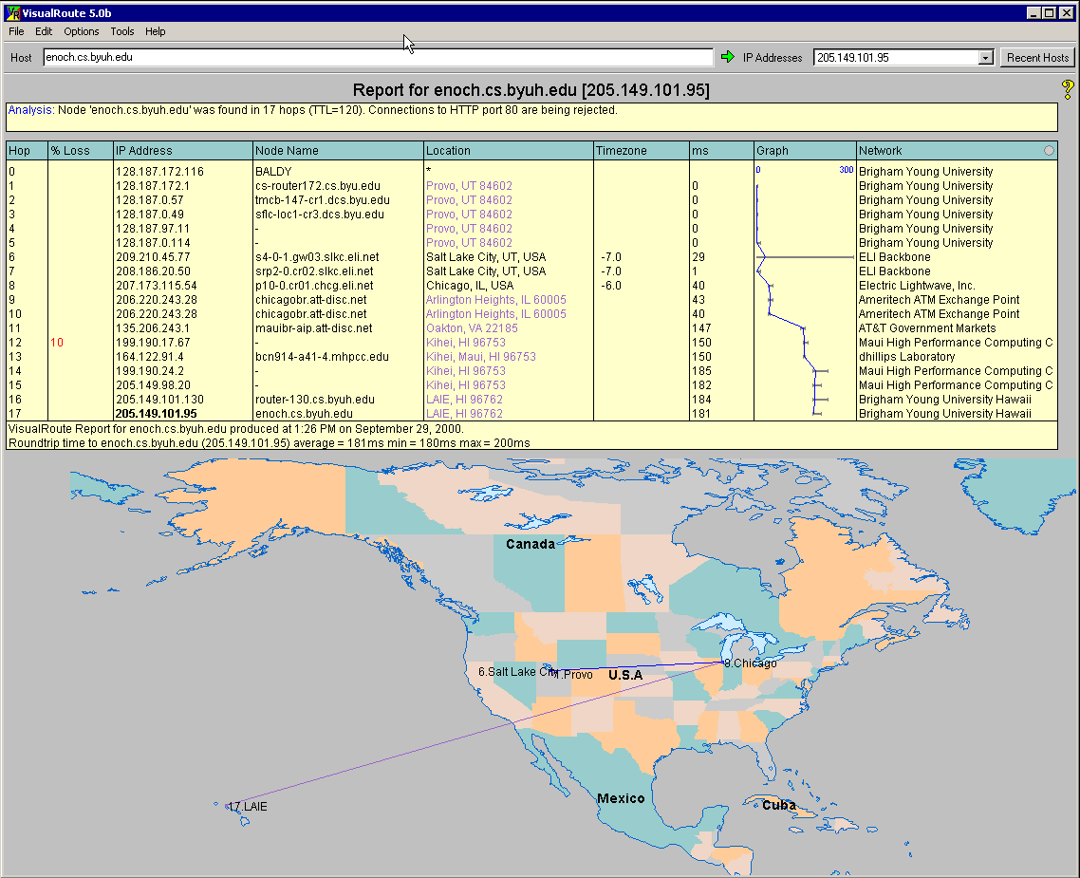

Slide 14
Internet Architecture
Internet Engineering Task Force (IETF)
Application Protocol (FTP, HTTP) – Not applications
TCP – Transmission Control Protocol - Reliable Transport
IP – Internet Protocol – Connect Local Area Networks
FTP
HTTP
NV
TFTP
Application
TCP
UDP
TCP
UDP
IP
IP
Network
NET
1
NET
2
. . . .
NET
n

Slide 15
Internet Protocol (IP)

Slide 16
IP Service Model
Global Addressing Scheme
  IP Addresses
Packet Delivery Model
  Connectionless (datagram-based)
  Best-effort delivery (unreliable service)
    packets are often lost
    packets are often delivered out of order
    duplicate copies of a packet are often delivered
    packets can be delayed for a long time

Slide 17
Datagram format
  Version (4): currently 4
  Hlen (4): number of 32-bit words in header
  TOS (8): type of service (not widely used QoS)
  Length (16): number of bytes in this datagram
  Ident (16): different for each datagram
  Flags/Offset (16): used by fragmentation
  TTL (8): Time to live
    # hops this datagram has traveled
  Protocol (8):
    demux key (TCP=6, UDP=17)
  Checksum (16): of the header only
  DestAddr & SrcAddr (32)

Slide 18
Datagram Forwarding
Strategy
  every datagram contains destination's address
  if directly connected to destination network, then
  forward to host
  if not directly connected to destination network, then forward to some router
  each host has a default router
  each router maintains a forwarding table
  forwarding table maps network number into next hop

Slide 19
My machine
C:\>netstat -r
Network destination Netmask Gateway Interface Metric
0.0.0.0 0.0.0.0 128.187.172.1 128.187.172.116 1
127.0.0.0 255.0.0.0 127.0.0.1 127.0.0.1 1
128.187.172.0 255.255.255.0 128.187.172.116 128.187.172.116 1
128.187.172.116 255.255.255.255 127.0.0.1 127.0.0.1 1
128.187.255.255 255.255.255.255 128.187.172.116 128.187.172.116 1
255.255.255.255 255.255.255.255 128.187.172.116 128.187.172.116 1
Default Gateway: 128.187.172.1

Slide 20
Reliable
Byte-Stream
(TCP)

Slide 21
Overview
Byte-stream
  sending process writes some number of bytes
  TCP breaks into segments and sends via IP
  receiving process reads some number of bytes
  Full duplex
Connection-oriented (Reliable)
  Every segment is numbered & acknowledged
Flow control:
  keep sender from overrunning receiver
Congestion control:
  keep sender from overrunning network

Slide 22
TCP Stream
Appl Process
Appl Process
Write
Read
. . .
Bytes
. . .
Bytes
TCP
TCP
send buffer
receive buffer
segment
. . .
segment
segment
Transmit Segments

Slide 23
Issues
Potentially long delay in network
  need to be prepared for arrival of very old packets
  (limit 60 seconds)
Potentially different capacity at destination
  need to accommodate different amounts of buffering
  (end hosts may have hundreds of applications)
Potentially different network capacity
  need to be prepared for network congestion

Slide 24
Segment Format
Each connection identified with 4-tuple:
  <SrcPort, SrcIPAddr, DstPort, DstIPAddr>
Sliding window + flow control
  Acknowledgment, SequenceNum, AdvertisedWindow
Flags:
  SYN, FIN, RESET, PUSH, URG, ACK
Checksum: pseudo header + tcp header + data
Src Port
Dest Port
SequenceNum
Acknowledgement
HdrLen
0
Flags
Advertised
(4)
(6)
(6)
Window
CheckSum
UrgPtr
options
(variable)
data

Slide 25
TCP Flow
Data (SequenceNum)
Sender
Receiver
Acknowledgement +
AdvertisedWindow

Slide 26
DNS
(Domain Name Service)

Slide 27
DNS
People don’t remember 32-bit numbers very well
Instead of using IP addresses, map the IP address to a name
  People remember names better
Translation of names to IP addresses is done by name servers
  Originally done by files on each host

Slide 28
DNS
Basically, it is a distributed database
  Distributed administration
  Distributed load
  Distributed security problems
Robustness and performance through
  Replication
  Caching

Slide 29
DNS
Root
Name Server
Hierarchical
You can give away control of part of the tree beneath you
Process
  Issue request
  If found, return
  If not
    Ask higher
edu Education level
Name Server
UofU BYU Region Name
Server
ACS CS Local Name
Server
etc

Slide 30
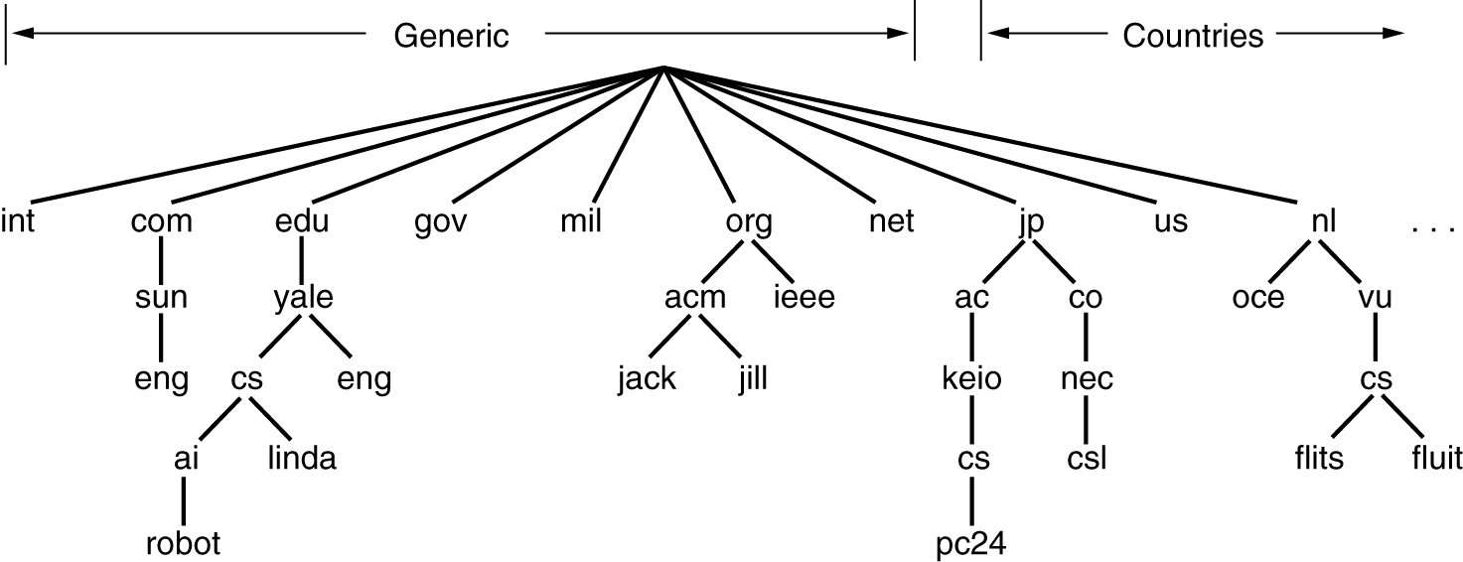
DNS Name Space

Slide 31
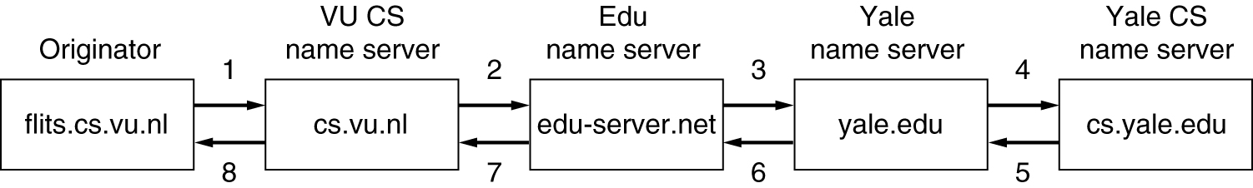
DNS Lookup
flits.cs.vu.nl → linda.cs.yale.edu

Slide 32
DNS
Client-Server application
Normally uses UDP (port 53)
Three Roles
  Resolver – takes request from application, formats it into UDP packet, sends to cache
  Caching Nameserver
    Returns answer if it is known, otherwise searches for authoritative server
    Caches results for further queries
  Authoritative Nameserver
    Contains the actual Resource Record put into the DNS by the domain owner

Slide 33
Testing DNS with "dig"
"dig" is a program which just makes DNS queries and displays the result
Trailing dot (for name lookups only)
  Prevents lookups using the default domain
dig tiscali.co.uk.
-- defaults to query type "A"
dig tiscali.co.uk. mx
-- specified query type
dig @212.74.112.66 tiscali.co.uk. mx
-- send to particular cache (overrides /etc/resolv.conf)

Slide 34
# dig www.gouv.bj. a
; <<>> DiG 9.3.0 <<>> www.gouv.bj a
;; global options: printcmd
;; Got answer:
;; ->>HEADER<<- opcode: QUERY, status: NOERROR, id: 2462
;; flags: qr aa rd ra; QUERY: 1, ANSWER: 2, AUTHORITY: 4, ADD'L: 4
;; QUESTION SECTION:
;www.gouv.bj IN A
;; ANSWER SECTION:
www.gouv.bj. 86400 IN CNAME waib.gouv.bj.
waib.gouv.bj. 86400 IN A 81.91.232.2
;; AUTHORITY SECTION:
gouv.bj. 86400 IN NS rip.psg.com.
gouv.bj. 86400 IN NS ben02.gouv.bj.
gouv.bj. 86400 IN NS nakayo.leland.bj.
gouv.bj. 86400 IN NS ns1.intnet.bj.
;; ADDITIONAL SECTION:
ben02.gouv.bj. 86400 IN A 81.91.232.1
nakayo.leland.bj. 18205 IN A 81.91.225.1
ns1.intnet.bj. 18205 IN A 81.91.225.18
rip.psg.com. 160785 IN A 147.28.0.39
;; Query time: 200 msec
;; SERVER: 212.74.112.67#53(212.74.112.67)
;; WHEN: Tue Dec 28 19:50:01 2004
;; MSG SIZE rcvd: 237

Slide 35
Interpreting the results
STATUS
  NOERROR: 0 or more resource records (RRs) returned
  NXDOMAIN: non-existent domain
  SERVFAIL: cache could not locate answer
FLAGS
  AA: Authoritative answer (not from cache)
  You can ignore the others
    QR: Query/Response (1 = Response)
    RD: Recursion Desired
    RA: Recursion Available

Slide 36
Interpreting the results
Answer section (RRs requested)
  Each record has a Time To Live (TTL)
  Says how long the cache will keep it
Authority section
  Which nameservers are authoritative for this domain
Additional section
  More RRs (typically IP addresses for the authoritative nameservers)
Total query time
Check which server gave the response!
  If you make a typing error, the query may go to a default server
Note: RR = Resource Record

Slide 37
Socket
Berkeley Software Distribution
Handle-like data structure for communicating
A socket is an endpoint
  Send and receive
  Attach a protocol
    UDP user datagram (best effort)
    TCP transmission control (reliable stream)

Slide 38
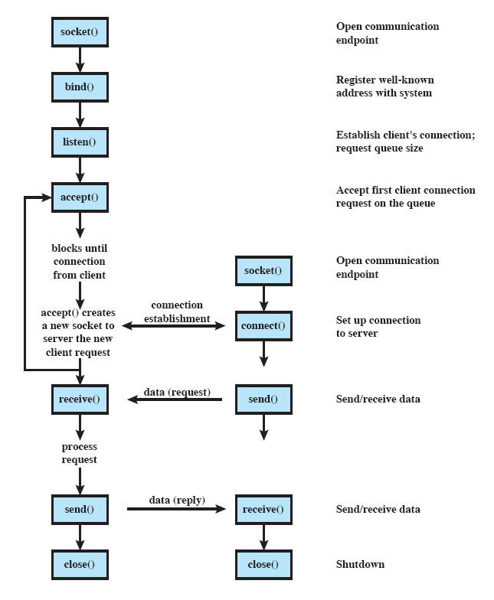
Sockets Programming

Slide 39
Sockets
Sockaddr
  struct sockaddr { u_short sa_family; char sa_data[14]; };
  designed to work with all protocols
    sockaddr_in is used with TCP/IP
Sockaddr_in
  struct sockaddr_in { short sin_family; u_short sin_port; struct inaddr sin_addr; char sin_zero[8]; };

Slide 40
A situation
Client can determine IP address of server
  But how can it know the socket id?
    Socket is a handle – different number on each machine
    Name server can’t deal with all the handles
BSD provides a way to map a socket to a port that exists in the network name space.
  Bind
  A Port is an address
    Many are well known

Slide 41
Client-Server
Client
  Create the socket
  Get the address of the server
  Fill in the sockaddr_in structure
  Connect to server
Server
  Create the socket
  Fill in the sockaddr_in structure
  Bind to a port
  Listen
  Accept connections

Slide 42
Sockets
Created by OS.
  int socket(int af, int type, int protocol)
    af AF_INET
    type SOCK_STREAM or SOCK_DGRAM
    protocol IPPROTO_TCP (determined by type)

Slide 43
Client filling in sockaddr_in
char *serverHostName = “orion-16”;
struct sockaddr_in addr;
memset(&addr, 0, sizeof(sockaddr_in));
addr.sin_family = AF_INET
addr.sin_port = htons((u_short) port)
struct hostent *host;
host = gethostbyname(serverHostName);
memcpy(&addr.sin_addr, host->h_addr_list[0], host->h_length);

Slide 44
Server filling in sockaddr_in
struct sockaddr_in addr;
memset(&addr, 0, sizeof(SOCKADDR_IN));
addr.sin_family = AF_INET
addr.sin_port = htons((u_short) port)
addr.sin_addr.s_addr = INADDR_ANY

Slide 45
Server
Map to the network port
  int bind(int sock, const struct sockaddr *name, int namelen)
    name is pointer to sockaddr_in structure from previous
    namelen is size of sockaddr_in
Set socket to listen mode
  int listen(int sock, int backlog)
    backlog max number of pending connections

Slide 46
Connections
Client initiate a connection
  int connect(int sock, const struct sockaddr *name, int namelen);
Server accepting a connection
  SOCKET accept(int sock, struct sockaddr *addr, int *addrlen);
    creates a new socket for the communication
    Server is free to accept another connection on that socket
    best to fire off a thread to handle the connection.
      send the new socket as an argument to the thread.

Slide 47
Socket Communication
Sending data
  send(int sock, char *buffer, int bufflen, int flags)
    If you are sending strings, remember the ‘\0’
    flags is generally 0
Receiving data
  recv(int sock, char *buffer, int bufflen, int flags)
    Make sure you have enough room
    flags is generally 0

Slide 48
Socket Overview
Client
Server
sc=socket(..)
ss=socket(..)
bind(ss,..)
listen(ss,..)
foo=accept(ss,..)
connect(sc,..)
write(sc,buf,len)
read(foo,buf,len)

Slide 49
#include <sys/types.h>
#include <sys/socket.h>
client()
{
int skt;
struct sockaddr_in name;
skt = socket(AF_INET, SOCK_STREAM, IPPROTO_TCP);
// Fill in the name data structure sockaddr_in
connect(skt, &name, sizeof(name));
// Communicate using send and recv
close(skt);
}

Slide 50
#include <sys/types.h>
#include <sys/socket.h>
server()
{
SOCKET listenSkt, newSkt;
struct sockaddr_in serverName, clientName;
listenSkt = socket(AF_INET, SOCK_STREAM, IPPROTO_TCP);
//Fill in serverName
bind(listenSkt, &serverName, sizeof(serverName));
listen(listenSkt, 5);
newSkt = accept(listenSkt, &clientName, sizeof(clientName));
// Fire off a thread to do communication using send and recv on newSkt
// Loop back and accept another connection
close(skt);
}

Slide 51
Recv
char * GetLine(int fds)
{
char tline[MAX_MSG_SZ];
char *line;
int messagesize = 0;
int amtread = 0;
//Read one byte at a time looking for a \n
while((amtread = read(fds, tline + messagesize, 1)) < MAX_MSG_SZ)
{
if (amtread > 0)
messagesize += amtread;
else
{
perror("Socket Error is:");
fprintf(stderr, "Read Failed on file descriptor %d messagesize = %d\n", fds, messagesize);
exit(2);
}
//fprintf(stderr,"%d[%c]", messagesize,message[messagesize-1]);
if (tline[messagesize - 1] == '\n')
break;
}
tline[messagesize] = '\0';
chomp(tline);
line = (char *)malloc((strlen(tline) + 1) * sizeof(char));
strcpy(line, tline);
//fprintf(stderr, "GetLine: [%s]\n", line);
return line;
}
bool isWhitespace(char c)
{
switch (c)
{
case '\r':
case '\n':
case ' ':
case '\0':
return true;
default:
return false;
}
}
void chomp(char *line)
{
int len = strlen(line);
while (isWhitespace(line[len]))
{
line[len--] = '\0';
}
}

