Slide 1




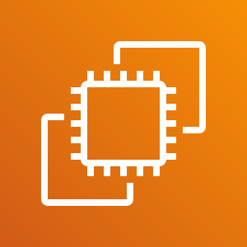
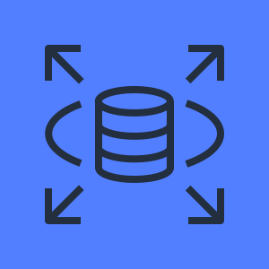
AWS Cloud
VPC
Public subnet
Internet
Amazon EC2
Amazon RDS

