Slide 1
Email
Etiquette
and
Professional
Reputation W241 – Section 2 Summer 2019
Jimmy Dunn, Thanh Le, Sarah Reed
Notes:
No more than 15 minutes presentation + 8 minutes of questions from audience

Slide 2
Our Research Question
Does workplace email composition, tone, and formality cause changes in the recipient’s perception of the sender?
Notes:
In 30 seconds: What is your research question? Why is an experiment necessary?

Slide 3
Experimental Design
Qualtrics survey
Treatment - email with emoticons and with less formal tone
Single-blind experiment
Covariates
Gender identity
Sexual orientation
Race
Age
Highest education
Current employment status
Current location
Survey Questions
15 questions where the participant indicates how strongly they agree or disagree with a statement about the sender or the email itself
Notes:
© In 60 seconds: What is your treatment? Be specific. Show pictures of it, show the language that you used, etc.
Covariates used in regression analysis reduces variability in outcomes by eliminating difference between treatment and control groups resulting in improved precision of the treatment effect estimation

Slide 4
Measurement Units
Power calculation on variety of effect sizes and baselines
Effect sizes = [1, 0.5, 0.25]
Baseline = [1, 2, 3, 4, 5, 6, 7]
Conservative estimate based on power calculation was N>200 samples
Collected N>500 usable samples
Participants
Personal Networks (N = 48)
AWS Mechanical Turk (N = 717)
Attention Check
Notes:
(d) In 30 seconds: explain who/what your measurement units are. People? From where? Robots? What type?

Slide 5
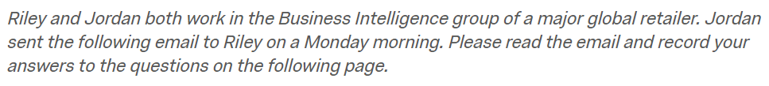
Scenario
Provided to both Control & Treatment groups
Notes:
© In 60 seconds: What is your treatment? Be specific. Show pictures of it, show the language that you used, etc.

Slide 6
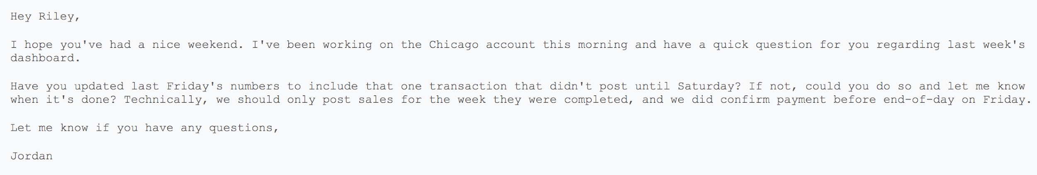
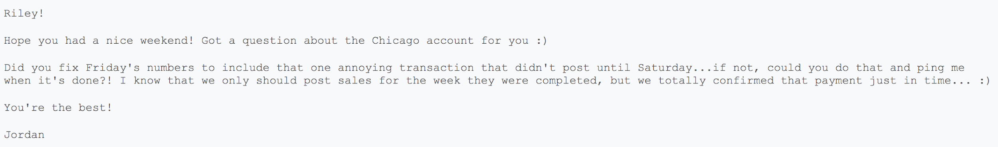
Email versions
Control Email
Treatment Email
Notes:
© In 60 seconds: What is your treatment? Be specific. Show pictures of it, show the language that you used, etc.

Slide 7
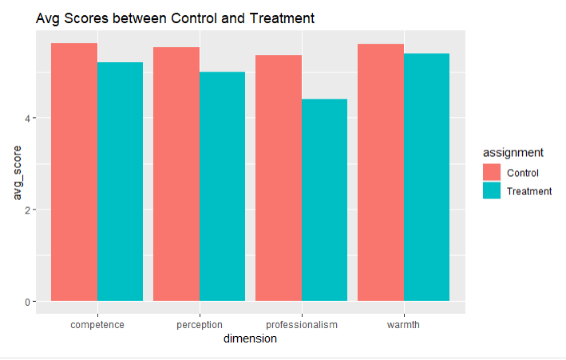
Outcome Measures
Warmth, Professionalism, Competence
Survey consists 5 questions for each area
Notes:
(h) In 60 seconds: Describe your outcome measures. What are they? How are they related to the concept that motivated this experiment? What are they distributed like?

Slide 8
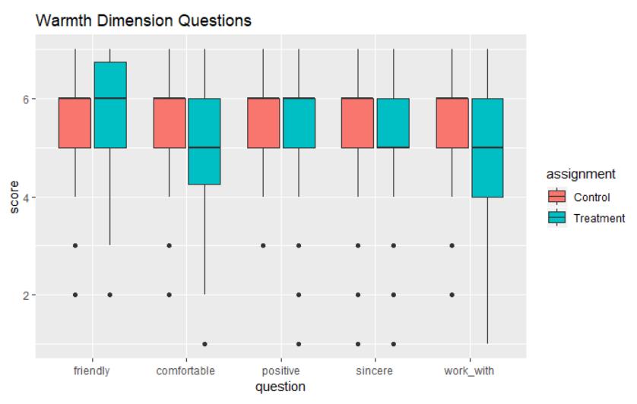
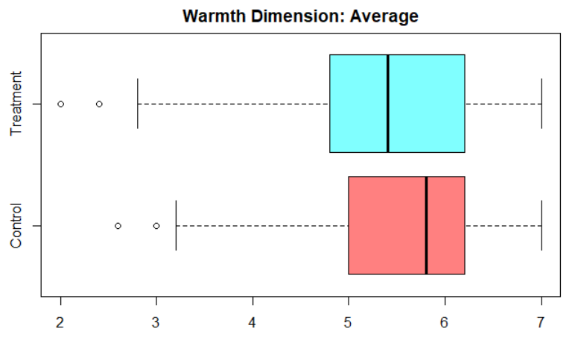
Warmth Dimension
Warmth
Jordan is friendly.
Jordan has a positive attitude
Jordan is sincere.
I would feel comfortable approaching Jordan with problems or challenges.
I would like to work with Jordan.

Slide 9
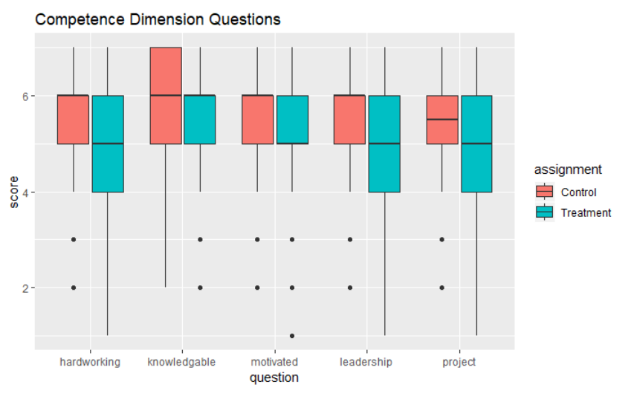
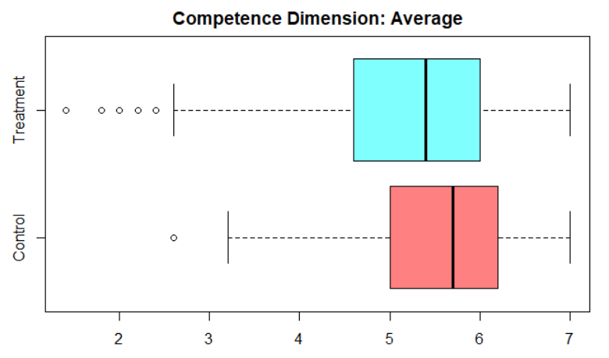
Competence Dimension
Competence
Jordan is hardworking.
Jordan is knowledgeable about his work.
Jordan is highly motivated and committed to his work.
Jordan has leadership qualities.
I would like to work on a project led by Jordan.

Slide 10
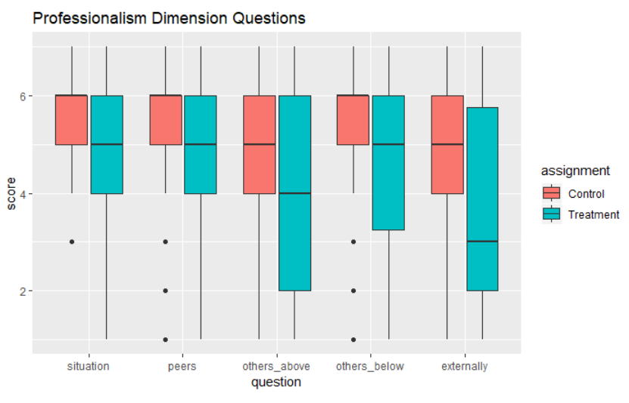
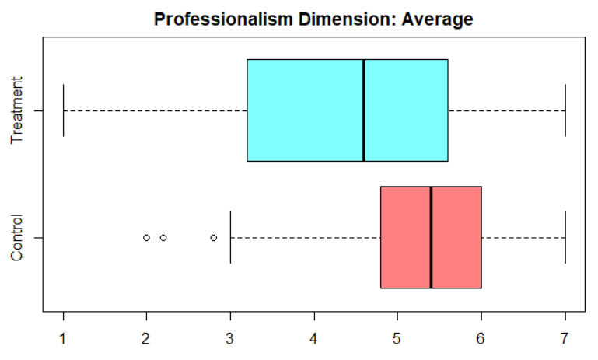
Professionalism Dimension
Professionalism
This email is appropriate for the situation.
This email is acceptable to send to Jordan’s peers at the same organizational level.
This email is acceptable to send to individuals higher in the organizational hierarchy than Jordan.
This email is acceptable to send externally (to a client)

Slide 11
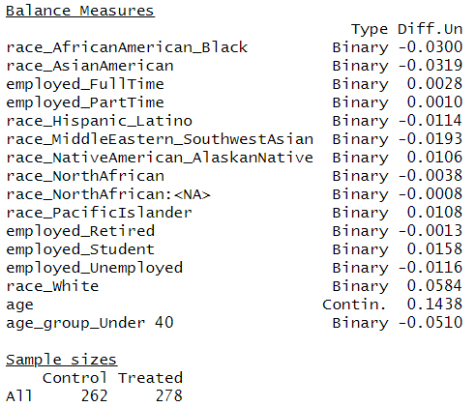
Covariates Balance Check
Qualtric’s randomization feature
Notes:
(e) In 30 seconds: How did you randomize and did it work?
R package “cobalt” for covariate balance check

Slide 12
Flow Document
mTurk Survey Participants
Surveys = N = 717
No Treatment Assignment = 117
Personal Network Survey Participants
Surveys = N = 48
No Treatment Assignment = 1
mTurk Treatment Assignment
N = 600
Control = 299
Treatment = 301
Personal Network Treatment Assignment
N = 47
Control = 24
Treatment = 23
Data Validation
Incomplete Surveys = 3
Failed Attention Check = 98
Data Validation
Incomplete Surveys = 3
Failed Attention Check = 3
Combined Dataset
N = 540
Control
N = 262
Treatment
N = 278
Notes:
from AWS survey ...
717 original
83 BL_b7ALVqd7xfUPSC1
34 blank randomization assignment
257 Treatment (301 originally, 43 failed attn chk, 1 unfinished)
242 Control (299 originally, 55 failed attn chk, 2 unfinished)
499 total usable
48 original
1 blank randomization assignment
21 Treatment (23 originally, 2 unfinished)
20 Control (24 originally, 3 failed attn chk, 1 unfinished)

Slide 13
Treatment Design
R
X
O
Control Group
_
(Normal Email)
Qualtrics Randomize Assignment
(Email)
Observations
(Questions on perception of email sender)
Survey Participants
Treatment Group
X
(Informal Email)
Randomize assignment of email
Expose the treatment subjects to informal email
Take observations of perceptions of sender (evaluation questions)
Between subjects comparison
Notes:
(g) In 60 seconds: Draw out using the ROXO grammar your experiment design, describe the comparisons that you’re going to make that tell you something casual. Call this a RDD, or a D-n-D or a within subjects or a between subjects comparison.

Slide 14
Evaluating the Sharp Null
Sharp Null Hypothesis: the treatment effect at the individual level will be zero.
Between control and treatment group evaluations of an email sender.
Predictions
In general, the treatment will score higher in the “warmth” dimension at the cost of lower scoring in the “professionalism” and “competency” dimensions
Younger age groups will have smaller treatment effects in the “professionalism” and “competency” dimensions
Notes:
(b) In 30 seconds: What is the specific hypothesis that you’re testing that is implied by theory or your question? What direction do you expect your outcomes to move as a consequence of treatment?

Slide 15
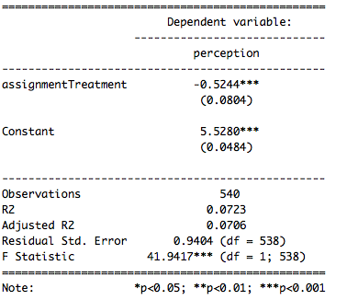
Analysis & Results
Simplest Model Results
Notes:
(i) In 180 seconds: Describe your analysis, results

Slide 16
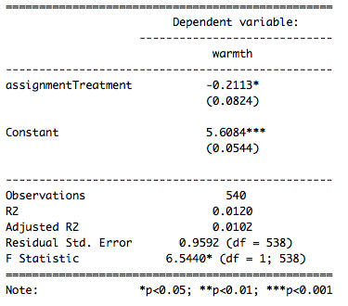
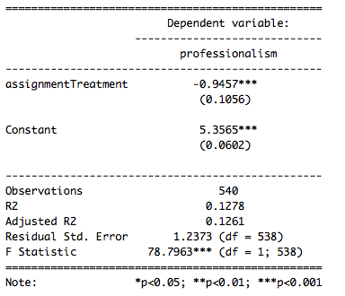
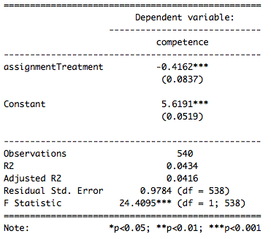
Analysis & Results
Notes:
(i) In 180 seconds: Describe your analysis, results

Slide 17
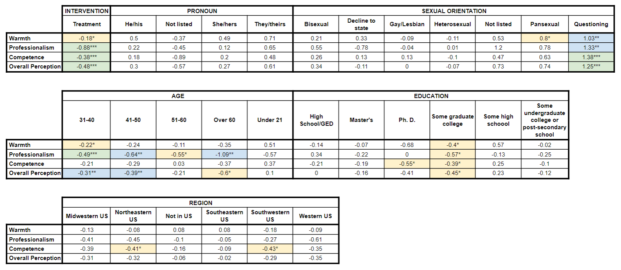
Analysis & Results
Full Model Results
Notes:
(i) In 180 seconds: Describe your analysis, results

Slide 18
Conclusions
Informal work email negative perception of warmth, professionalism, and competence
The treatment email was scored more harshly than the control email in all dimensions, including the “warmth” dimension
The “professionalism” dimension was impacted most negatively with the treatment email scoring -0.88 compared to the control
The “warmth” dimension was impacted least negatively with the treatment email scoring -0.18 compared to the control
The participants over 60 most heavily penalized the treatment email, confirming our intuition that older office workers may be less accustomed to digital expression
Notes:
(i) In 180 seconds: Describe your analysis, results

Slide 19
Questions/Concerns
Validity of survey responses that have the same choice selected for all questions?
How can we test how “good” our questions fit in our selected dimensions?
Future work would involve using randomization inference in addition to the t-tests for testing the sharp null hypothesis
Combining low volume categories
Notes:
(j) In 30 seconds: List the questions and concerns that you want your peers to help you puzzle through.

Slide 20
APPENDIX

Slide 21
EDA
General clean-up
No treatment assignment
incomplete surveys
built-in attention-check
540 observations
started with 765 responses

Slide 22
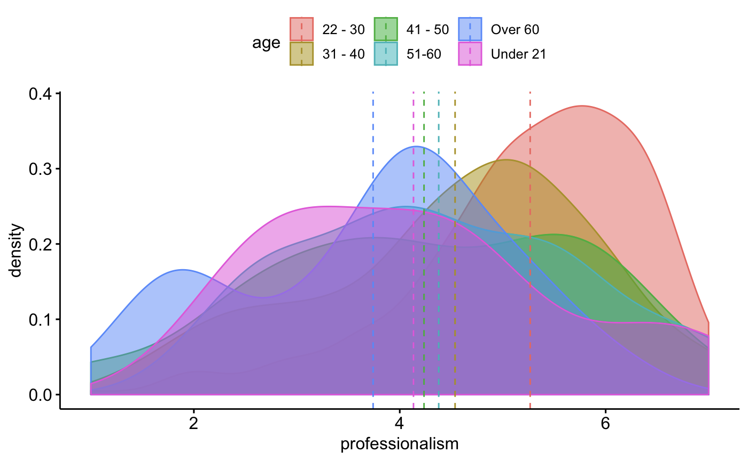
Age on “professionalism”
Notes:
Find interesting … age have similar perception regarding “warmth” and “competence” but varies a bit more regarding “professionalism”

Slide 23
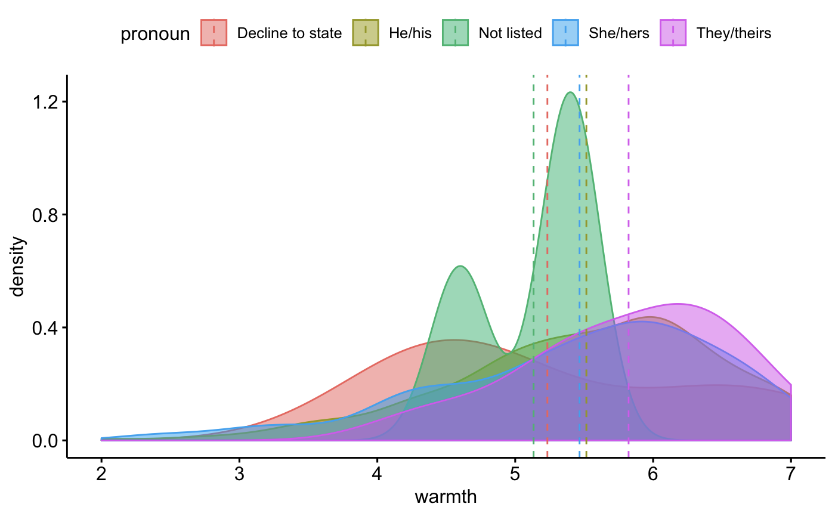
Gender on “warmth”
Notes:
Him and hers have very similar perception regarding “warmth”

Slide 24
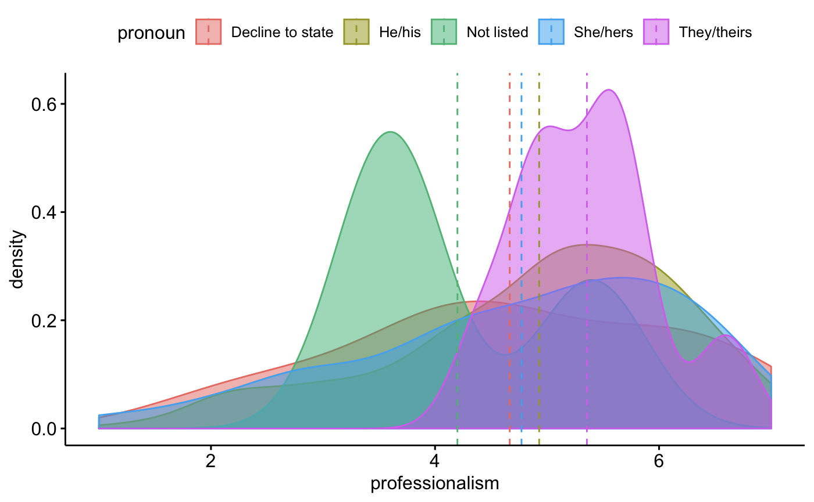
Gender on “professionalism”

Slide 25
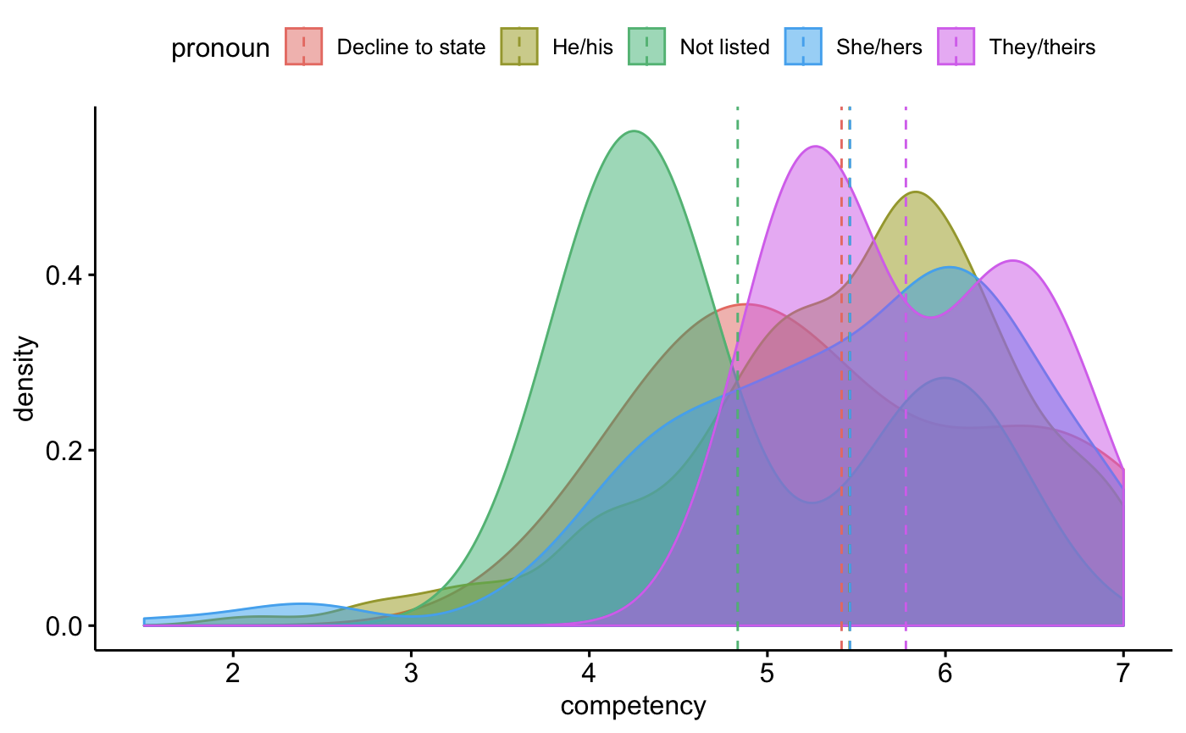
Gender on “competency”

Slide 26
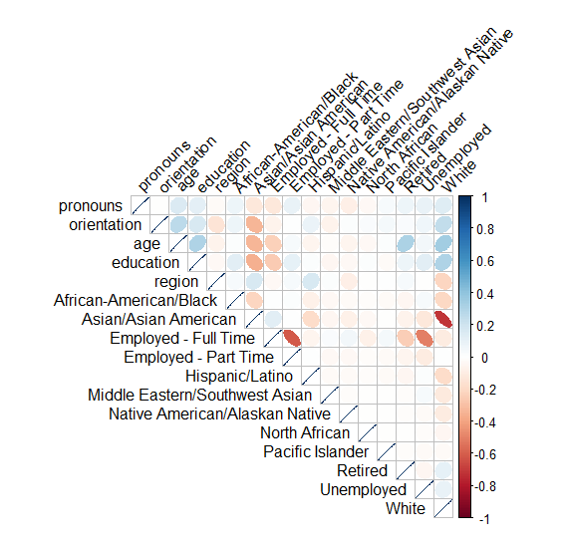
EDA continue ...

Slide 27
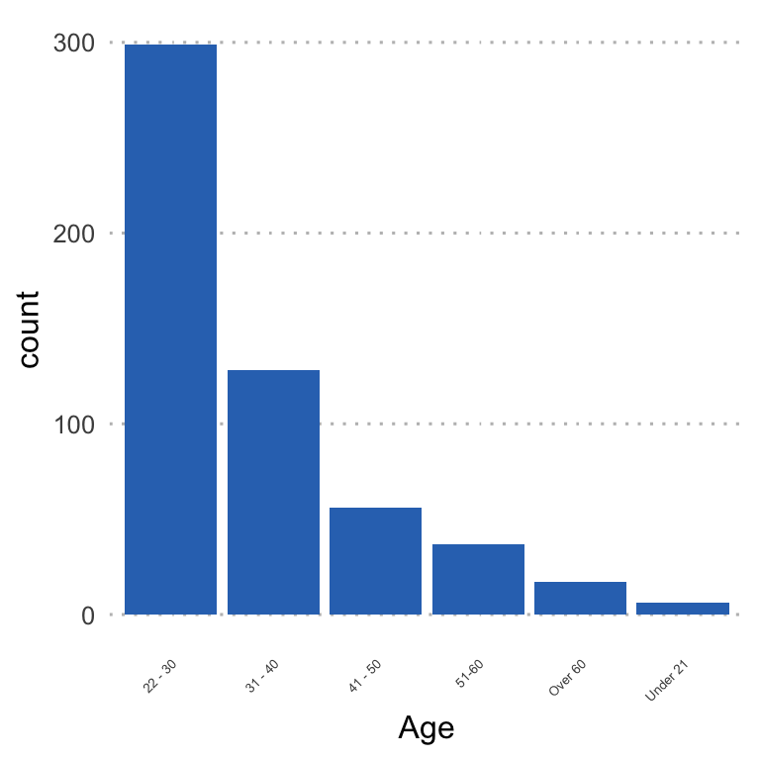
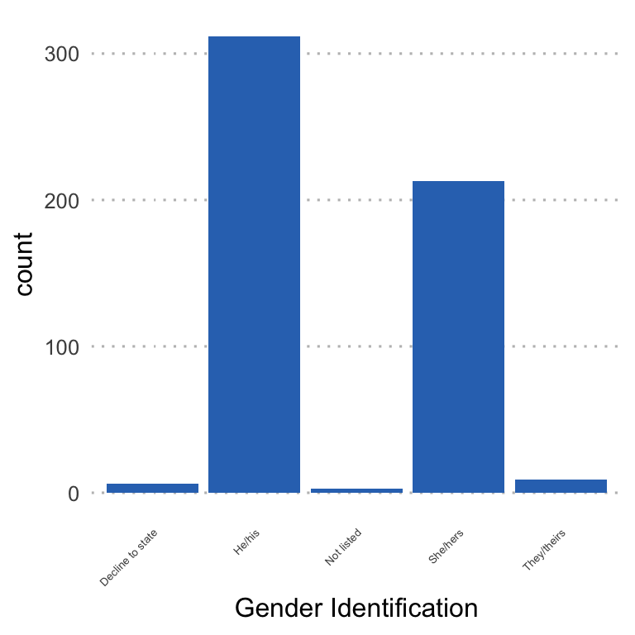
EDA
Notes:
Gender: ≅300 Males, ≅200 Females
Age: Majority of our subjects are btwn 22 - 30

Slide 28
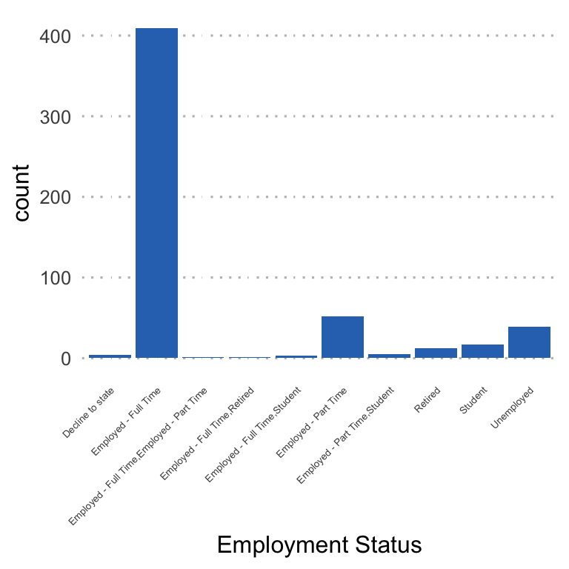
EDA
Notes:
Majority are full time

