Slide 1
Seattle Housing Prices and Public goods
By: Ahmed Almotaileq, Abigail Edelmen, Christopher Lacrampe

Slide 2
Research Goals
To assess the effects of accessibility to public goods on housing prices for Seattle
As research progressed, a narrower focus on the Urban Rail Feature was introduced

Slide 3
Project Data
Variables
Dependent Variable: log(Price)
Independent Variables:
No. Bedrooms and bathrooms
Square feet and lot size
Age and Style of home
Distance to nearest public park, hospital, school, and light rail station
Housing data: Redfin on February 20th, 2018
Public goods’ locations filtered from Seattle.gov’s “My Neighborhood Map” collection.
Light rail data: Seattle.gov on February 20th, 2018
Public parks data: Seattle.gov on February 23, 2018.
Public schools data: Seattle.gov on February 23, 2018.
Public hospital data: Seattle.gov on February 23, 2018.

Slide 4
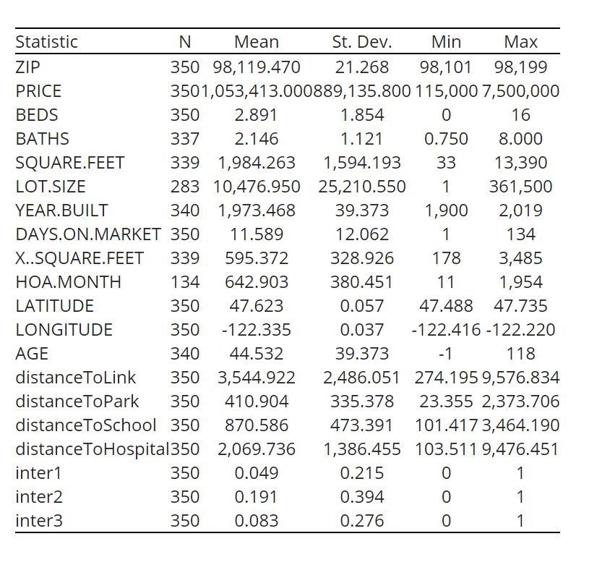
Descriptive stats
350 observations for 12 variables used
St.Dev X_{i} != 0
inter3: 8.3% total listings = True
$1.053 Million mean listing price

Slide 5
Correlation Table
 | Price | Beds | Baths | Square Feet | Lot Size | Age | distanceToLink | distanceToPark | distanceToSchool | distanceToHospital
Price | 1 | 0.448208 | 0.665763 | 0.826682 | -0.02159 | 0.074675 | -0.1701 | -0.14787 | -0.00831 | -0.1112
Beds | 0.448208 | 1 | 0.788607 | 0.645457 | -0.12494 | 0.232263 | 0.068627 | 0.044997 | -0.09881 | 0.072617
Baths | 0.665763 | 0.788607 | 1 | 0.749748 | -0.06161 | 0.007986 | -0.02281 | -0.04485 | -0.07628 | 0.033717
Square Feet | 0.826682 | 0.645457 | 0.749748 | 1 | -0.06232 | 0.264201 | 0.038312 | -0.00809 | -0.08449 | 0.045742
Lot Size | -0.02159 | -0.12494 | -0.06161 | -0.06232 | 1 | 0.008106 | -0.01394 | 0.064294 | 0.084413 | 0.00451
Age | 0.074675 | 0.232263 | 0.007986 | 0.264201 | 0.008106 | 1 | 0.123076 | 0.031736 | -0.17549 | 0.059095
distanceToLink | -0.1701 | 0.068627 | -0.02281 | 0.038312 | -0.01394 | 0.123076 | 1 | 0.234455 | 0.061771 | 0.295369
distanceToPark | -0.14787 | 0.044997 | -0.04485 | -0.00809 | 0.064294 | 0.031736 | 0.234455 | 1 | 0.443297 | 0.19713
distanceToSchool | -0.00831 | -0.09881 | -0.07628 | -0.08449 | 0.084413 | -0.17549 | 0.061771 | 0.443297 | 1 | 0.036274
distanceToHospital | -0.1112 | 0.072617 | 0.033717 | 0.045742 | 0.00451 | 0.059095 | 0.295369 | 0.19713 | 0.036274 | 1
Correlation between X_{i}’s != 1
High correlation:
Price and Square feet
Beds and Baths

Slide 6
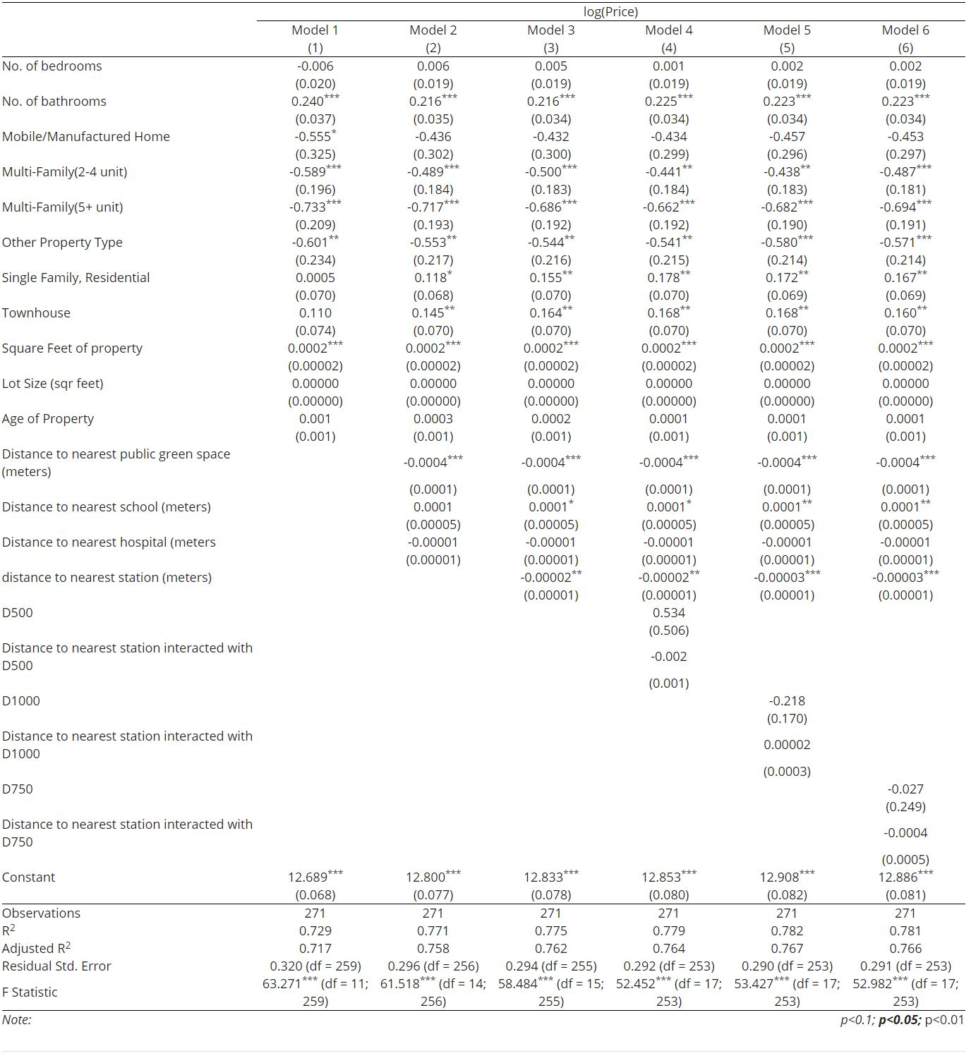
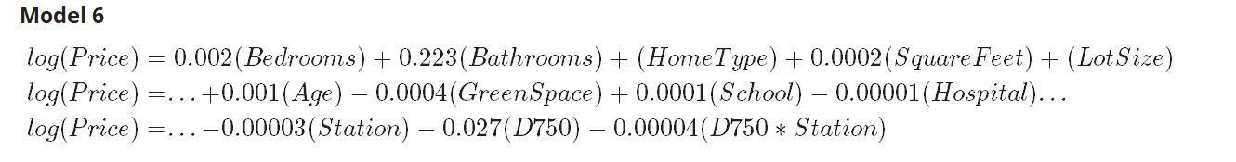
Model Outputs
Final model (mod6 far right)
Adjusted R² = 76.6%
Key Coefficients:
Distance to station: -0.00003
Interaction with D750
Establishes boundary
-0.0004
Total effects of station
-0.43% per meter

Slide 7
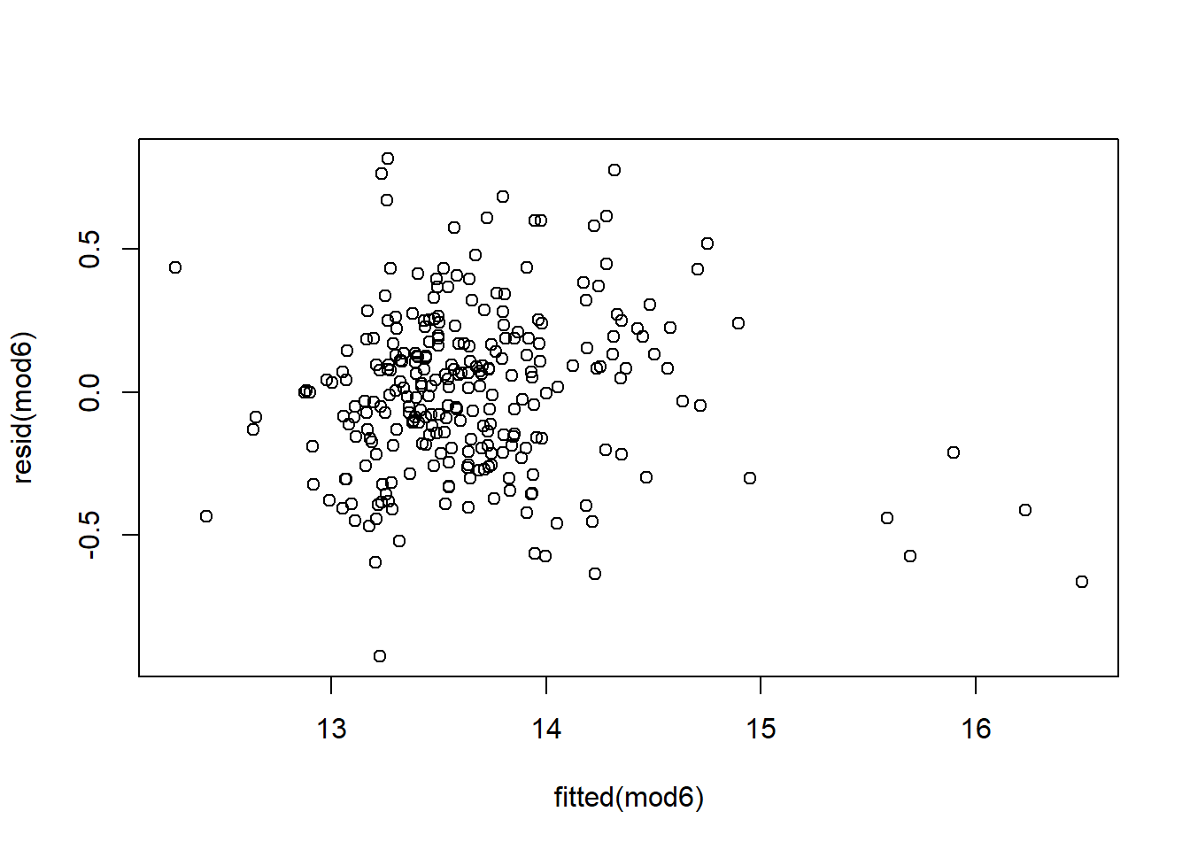
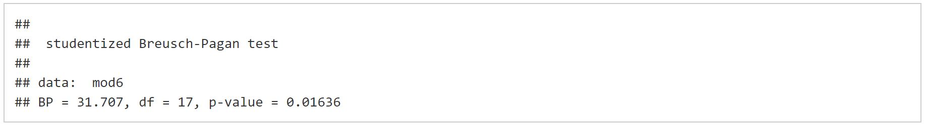
Homoskedastic

Slide 8
Future Exploration
Model strong in some areas, not others
Impact on apartments
Impact on commercial property
Altering proxy for accessibility by indexing public good (max)
Assess impact for future stations

Slide 9
Works Cited
Agostini, C. A., & Palmucci, G. A. (2008). The Anticipated Capitalisation Effect of a New Metro Line on Housing Prices. Fiscal Studies, 29(2), 233- 256. http://web.a.ebscohost.com.proxy.seattleu.edu/ehost/pdfviewer/pdfviewer?vid=1&sid=07433 d5b-2221-4c97-92eb-8e5561d4e7bd%40sessionmgr4009
Debrezion, G., Pels, E. A., & Rietveld, P. (2007). The Impact of Railway Stations on Residential and Commercial Property Value: A Meta Analysis. SSRN Electronic Journal, 35(2),161- 180. https://link.springer.com/article/10.1007/s11146-007-9032-z
Hewitt, C., & Hewitt, W. (2012). The Effect of Proximity to Urban Rail on Housing Prices inOttawa. Journal of Public Transportation, 15(4), 43- 65. http://scholarcommons.usf.edu/cgi/viewcontent.cgi?article=1080&context=jpt
Li, S., Chen, L., & Zhao, P. (2016). The impact of metro services on housing prices: a casestudy from Beijing. Sustainability, 8, 380. https://smartech.gatech.edu/bitstream/handle/1853/43479/BinYan_Land+Values+Impacts+of +Subway+Stations.pdf;jsessionid=71FC1FF5925271D11E484D61188E7A3F.smartech?sequence=1

