Slide 1

Learning Snake with Deep Reinforcement Learning
Tyrone Lagore
V00995698

Slide 2
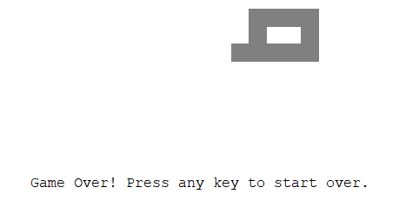
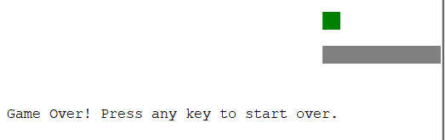

Defining the Goal
Avoid biting own tail
Episodic game where the goal is to maximize score for the round
Each time the snake obtains food, it grows in size and gains score
Hitting a wall or biting its own tail ends the game
Avoid hitting walls
Maximize score by obtaining food

Slide 3
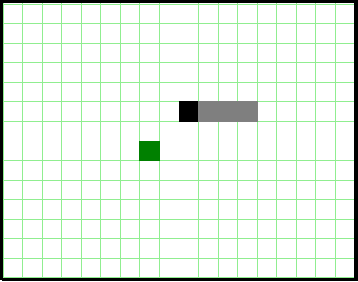
Defining the States
States can be seen as the grid cells
Direction the snake entered the cell.
Since a snake cannot go back on itself, the actions will be different at this cell
Position of head
Position of body
Position of food piece
Terminal is wall or body

Slide 4
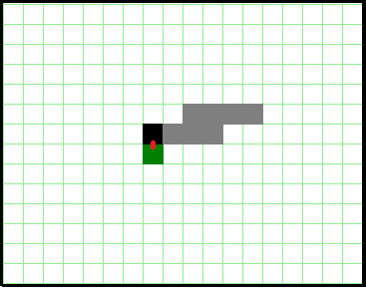
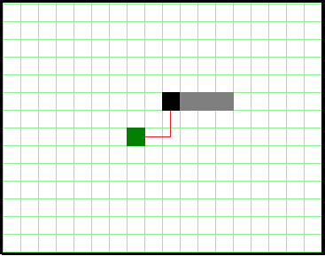

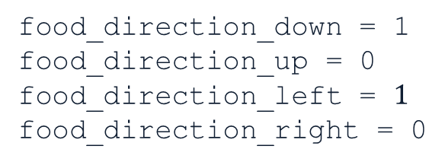
Defining State Attributes
Food
Food is immediately obtainable
food_up = 0
food_left = 0
food_down = 1
food_right = 0
Food Obtainability: Food is obtainable if it is in a cell immediately next to the snake head. Instead of maintaining this as one attribute, it can be maintained as 4, with the direction of the piece marked as 0 or 1 to avoid categorization bias
$x∈\{0, 1\}$
Direction of Food: Food direction in relation to the head, marked as 0 or 1
$x∈\{0, 1\}$
Distance
Direction of food
food_direction_down = 1
food_direction_up = 0 food_direction_left = $1$
food_direction_right = 0

Slide 5
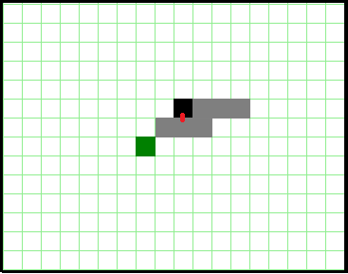
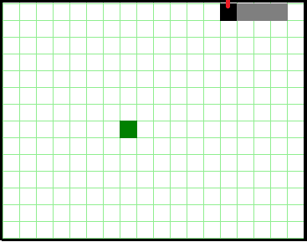

Defining State Attributes
Next to body
Head is next to body
obstacle_up = 0
obstacle_left = 0
obstacle_down = 1
obstacle_right = 0
OR
Head position relative to obstacles: The head can collide with 2 things to lose the game, the body and a wall. They can either be defined separately, or as a single obstacle.
Both methods will be used to see what produces the best results
$x∈\{0, 1\}$
A similar method as was used to describe food location will be used to avoid categorization bias
$x∈\{0, 1\}$
body_up = 0
body_left = 0
body_down = 1
body_right = 0
Next to wall
Head is next to wall
obstacle_up = 1
obstacle_left = 0
obstacle_down = 0
obstacle_right = 0
OR
wall_up = 1
wall_left = 0
wall_down = 1
wall_right = 0

Slide 6
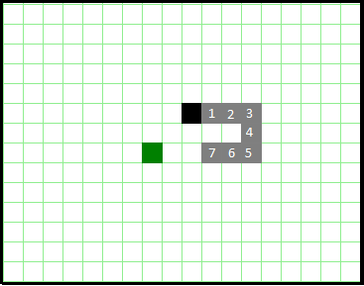

Defining State Attributes
Body Length
Body Length Affects Possible Moves
body_length = 7
Length of Body: As the body grows, the length will affect how the snake can move. Often the body will be blocking the food and the straight path is not the right one. In a perfect game, the tail length could be $gridsize^{2}$
0 ≤ $x≤{gridsize}^{2}$

Slide 7

Defining Transitions
All transitions in Snake are deterministic
$P\left(r, s^{′}\right| s, a)=1.0, ∀a ε A, ∀s ε S$
Moving $direction$ will move the snake 1 cell in $direction$
Moving into a wall or body is terminal
Obtaining food will add a tail piece to the end of the snake
Food will be randomly placed, but this is environment stochasticity, not transition

Slide 8




Defining Actions
Moving Right
Moving Left
At an state, the snake may go any direction but the direction it is coming from
In the game, the snake will continue in the same direction it is moving if there is no input. For the agent, this is simply defined as being forced to choose an action at the state.
Agent can go up, down, or continue right
Agent can go up, down, or continue left
Moving Down
Moving Up
Agent can go left, right, or continue down
Agent can go left, right, or continue up

Slide 9



Defining Rewards
Away From Goal
Collision
+10 for obtaining food
+1 for moving towards the goal
-100 for collision of any kind (termination)
-1 for moving away from the goal
-100
-1
Food
Towards Goal
+10
+1

Slide 10
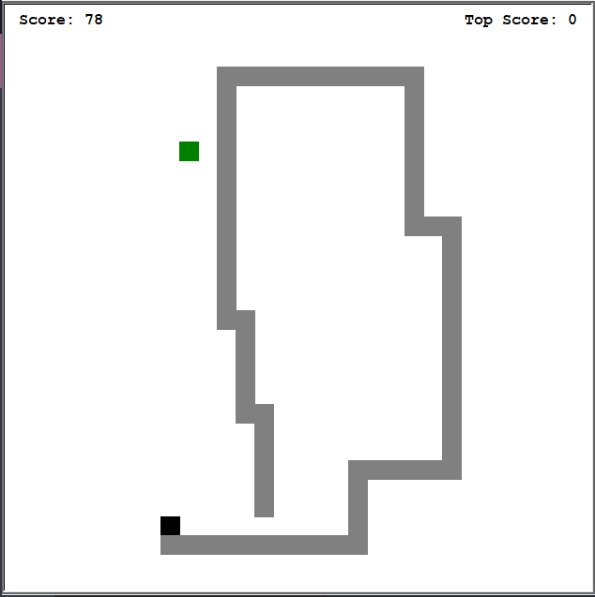
Episode and Steps
An episode is defined as going until the snake dies
Since episodes can get very large, the number of steps will be limited to 5,000
Variable number of episodes will be tried for training

Slide 11

Choosing an Algorithm
State space is $2^{16}∗grid_{size}^{2}$
For 30x30 grid, state space is around 39,321,600 states
Stochasticity of reward placement, body growing, and large state size means tabular methods will not scale
Function value approximation can handle large state space.
Deep Q-Learning (DQN) will allow for non-linear estimation and handle stochasticity of environment
Replay Buffer will be used to promote independent-identical distribution (IID)

Slide 12
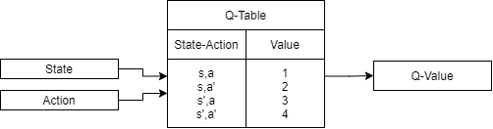

Deep Q-Learning (DQN)
Traditional Q-Learning
$Q_{t+1}\left(S_{t},A_{t}\right)= \underset{current Q value}{\underbrace{Q_{t}\left(S_{t},A_{t}\right)}}+ α\left[ \underset{Observed Reward}{\underbrace{R_{t+1}}}+ γ ∗ \underset{maximum expected reward}{\underbrace{\max_{a}{Q_{t}\left(s_{t+1}, a\right)}}} − \underset{current Q value}{\underbrace{Q_{t}\left(s_{t}, a_{t}\right)}}\right]$
Directly approximate q* independent of policy. However, limited by high state space.

Slide 13
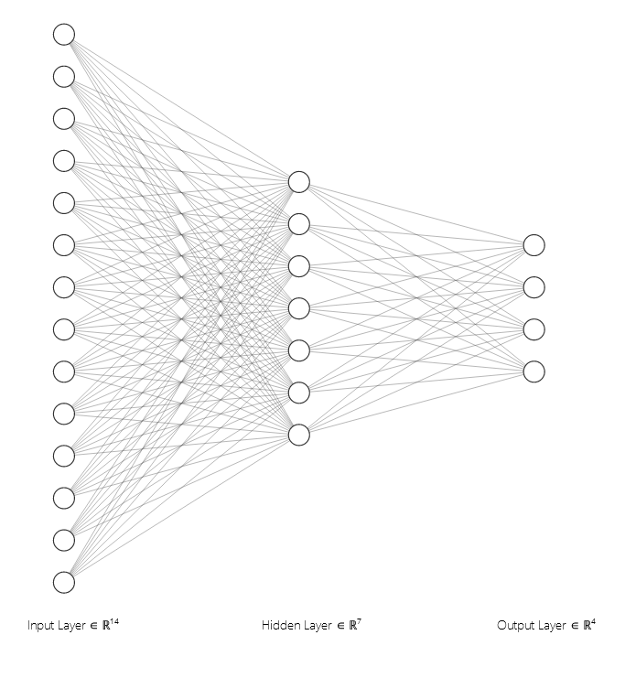



DQN ANN Diagram
Input
ReLU
SoftMax Output
wall_up
wall_down
wall_right
wall_left
$$\left[ \underset{maximum expected reward}{\underbrace{\max_{a}{Q_{t}\left(s_{t+1}, a\right)}}} \right]$$
body_up
$$Q\left(s,up\right)$$
$$Q\left(s,right\right)$$
$$Q\left(s,left\right)$$
$$Q(s,down)$$
body_down
Calculated by artificial neural network (ANN)
body_right
$$\max_{a}{Q(s,a)}$$
body_left
food_up
food_down
Q(s, a)
food_right
food_left
body_length
…

Slide 14

DQN Functions
Loss function is backpropagated into the network to calculate weights for inputs and hidden layers
$mse loss function=\frac{1}{2}{\left[R_{t}+ γarg\max_{a}\left(Q\left(s_{t+1}\right)\right) −Q\left(s_{t}, a_{t}\right)\right]}^{2}$
ReLU activation on hidden layer function to avoid vanishing gradient
$ReLU(x)= max⁡(0, x)$
SoftMax on output layer to determine which probability with which DQN believes action to take
$\log\left(1+e^{x^{T}w}\right)$
Use $ε−greedy$ with $ε$ decay to promote exploration in training

Slide 15

Summary
Goal : Obtain the most pieces of food
State attributes: Head near wall, head near body, head near food, distance x from food, distance y from food
Rewards: 75 for food, -100 for hitting an obstacle, 1 for moving towards food, -1 for moving away from food
Actions: Up, down, left, right, with restrictions
Algorithm: Deep Q-Learning (DQN) with 14 node input layer, 7 node hidden layer with ReLU activation, 4 node output layer with SoftMax activation using $ε−greedy$ with $ε$ decay for exploration and replay buffer to promote IID
Episodes: Go until death or 5,000 steps

Slide 16
References
Sutton, R. S. (1998). Introduction to reinforcement learning. Mit Press, 04-98.
Dong, H., Zihan Ding, & Shanghang Zhang. (2020). Deep reinforcement learning : fundamentals, research and applications. Springer.

