Slide 1

Learning Snake with Deep Reinforcement Learning
Tyrone Lagore
V00995698

Slide 2
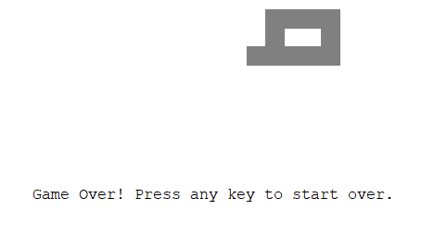
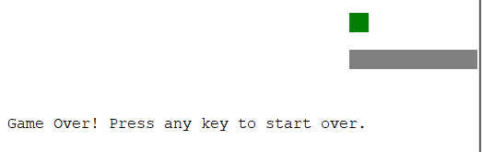

Defining the Goal
Avoid biting own tail
Episodic game where the goal is to maximize score for the round
Each time the snake obtains food, it grows in size and gains score
Hitting a wall or biting its own tail ends the game
Avoid hitting walls
Maximize score by obtaining food

Slide 3
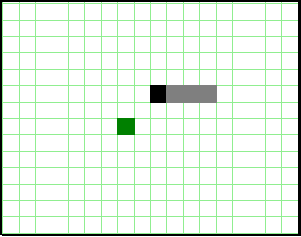
Defining the States
States can be seen as the grid cells
Direction the snake entered the cell.
Since a snake cannot go back on itself, the actions will be different at this cell
Position of head
Position of body
Position of food piece
Terminal is wall or body
But this can quickly explode the state size, with a single snake head on a 30x30 grid and 4 ways to enter a cell, there are 3600 states. Every additional tail piece will change the state space.

Slide 4
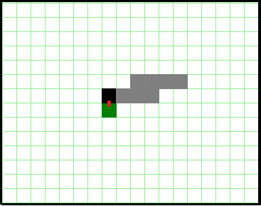
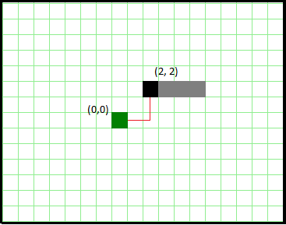

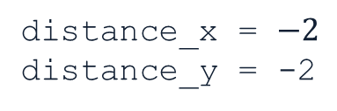
Defining State Attributes
Food
Food is immediately obtainable
food_up = 0
food_left = 0
food_down = 1
food_right = 0
Food Obtainability: Food is obtainable if it is in a cell immediately next to the snake head. Instead of maintaining this as one attribute, it can be maintained as 4, with the direction of the piece marked as 0 or 1 to avoid categorization bias
$x∈\{0, 1\}$
Distance From Food: Distance to the goal is simply $food_{y}−head_{y}$ and $food_{x}−head_{x}$
$−g_{size}≤x, y≤g_{size}, x ∈ ℤ$
$g_{size}=size of grid$
Distance
Distance to goal
distance_x = $−2$
distance_y = -2

Slide 5
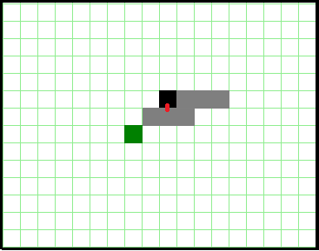
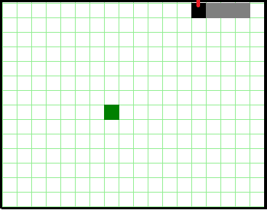

Defining State Attributes
Next to body
Head is next to body
obstacle_up = 0
obstacle_left = 0
obstacle_down = 1
obstacle_right = 0
OR
Head position relative to obstacles: The head can collide with 2 things to lose the game, the body and a wall. They can either be defined separately, or as a single obstacle.
Both methods will be used to see what produces the best results
$x∈\{0, 1\}$
A similar method as was used to describe food location will be used to avoid categorization bias
$x∈\{0, 1\}$
body_up = 0
body_left = 0
body_down = 1
body_right = 0
Next to wall
Head is next to wall
obstacle_up = 1
obstacle_left = 0
obstacle_down = 0
obstacle_right = 0
OR
wall_up = 1
wall_left = 0
wall_down = 1
wall_right = 0

Slide 6

Defining Transitions
All transitions in Snake are deterministic
$P\left(r, s^{′}\right| s, a)=1.0, ∀a ε A, ∀s ε S$
Moving $direction$ will move the snake 1 cell in $direction$
Moving into a wall or body is terminal
Obtaining food will add a tail piece to the end of the snake
Food will be randomly placed, but this is environment stochasticity, not transition

Slide 7




Defining Actions
Moving Right
Moving Left
At an state, the snake may go any direction but the direction it is coming from
In the game, the snake will continue in the same direction it is moving if there is no input. For the agent, this is simply defined as being forced to choose an action at the state.
Agent can go up, down, or continue right
Agent can go up, down, or continue left
Moving Down
Moving Up
Agent can go left, right, or continue down
Agent can go left, right, or continue up

Slide 8



Defining Rewards
Away From Goal
Collision
+75 for obtaining food
+1 for moving towards the goal
-100 for collision of any kind (termination)
-1 for moving away from the goal
-100
-1
Food
Towards Goal
+75
+1

Slide 9
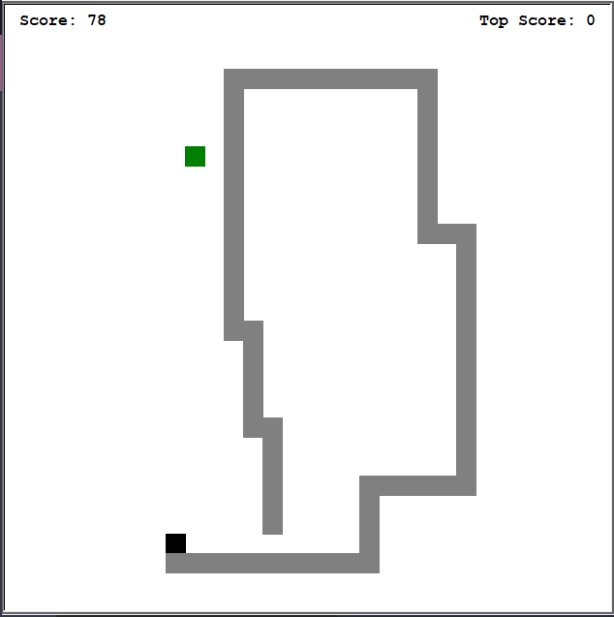
Episode and Steps
An episode is defined as going until the snake dies
Since episodes can get very large, the number of steps will be limited to 5,000
Variable number of episodes will be tried for training

Slide 10
Choosing an Algorithm
Even with the growing state space size, it could be stored in memory and tabular methods might work.
But the state space changes every time we gain a food piece. Furthermore, the food piece is placed randomly
Scaling the problem to say a 100x100 grid, or adding “opponent” snakes would require a new algorithm
Deep Q-Learning (DQN) can help with stochasticity and handle large state space
Replay Buffer will be used to promote independent-identical distribution (IID)

Slide 11
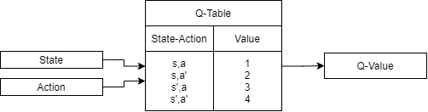

Deep Q-Learning (DQN)
Traditional Q-Learning
$Q_{t+1}\left(S_{t},A_{t}\right)= \underset{current Q value}{\underbrace{Q_{t}\left(S_{t},A_{t}\right)}}+ α\left[ \underset{Observed Reward}{\underbrace{R_{t+1}}}+ γ ∗ \underset{maximum expected reward}{\underbrace{\max_{a}{Q_{t}\left(s_{t+1}, a\right)}}} − \underset{current Q value}{\underbrace{Q_{t}\left(s_{t}, a_{t}\right)}}\right]$
Directly approximate q* independent of policy. However, limited by high state space.

Slide 12
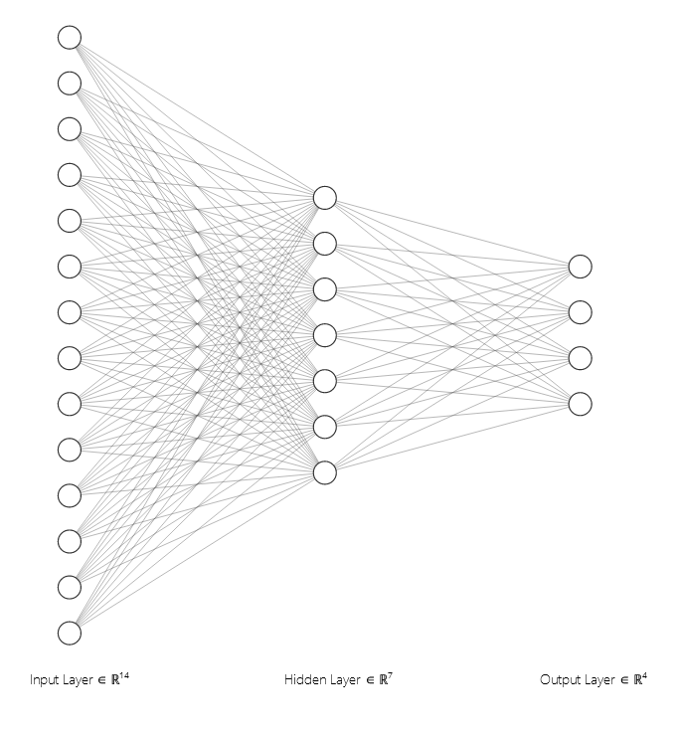



DQN ANN Diagram
Input
ReLU
SoftMax Output
wall_up
wall_down
wall_right
wall_left
$$\left[ \underset{maximum expected reward}{\underbrace{\max_{a}{Q_{t}\left(s_{t+1}, a\right)}}} \right]$$
body_up
$$Q\left(s,up\right)$$
$$Q\left(s,right\right)$$
$$Q\left(s,left\right)$$
$$Q(s,down)$$
body_down
Calculated by artificial neural network (ANN)
body_right
$$\max_{a}{Q(s,a)}$$
body_left
food_up
food_down
Q(s, a)
food_right
food_left
distance_x
distance_y

Slide 13

DQN Functions
Loss function is backpropagated into the network to calculate weights for inputs and hidden layers
$mse loss function=\frac{1}{2}{\left[R_{t}+ γarg\max_{a}\left(Q\left(s_{t+1}\right)\right) −Q\left(s_{t}, a_{t}\right)\right]}^{2}$
ReLU activation on hidden layer function to avoid vanishing gradient
$ReLU(x)= max⁡(0, x)$
SoftMax on output layer to determine which probability with which DQN believes action to take
$\log\left(1+e^{x^{T}w}\right)$
Use $ε−greedy$ with $ε$ decay to promote exploration in training

Slide 14

Summary
Goal : Obtain the most pieces of food
State attributes: Head near wall, head near body, head near food, distance x from food, distance y from food
Rewards: 75 for food, -100 for hitting an obstacle, 1 for moving towards food, -1 for moving away from food
Actions: Up, down, left, right, with restrictions
Algorithm: Deep Q-Learning (DQN) with 14 node input layer, 7 node hidden layer with ReLU activation, 4 node output layer with SoftMax activation using $ε−greedy$ with $ε$ decay for exploration and replay buffer to promote IID
Episodes: Go until death or 5,000 steps

Slide 15
References
Sutton, R. S. (1998). Introduction to reinforcement learning. Mit Press, 04-98.
Dong, H., Zihan Ding, & Shanghang Zhang. (2020). Deep reinforcement learning : fundamentals, research and applications. Springer.

