Slide 1
Deep Shadows with 2D Textures
Mach Kobayashi
Square USA

Slide 2
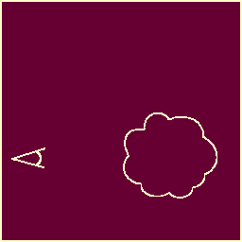
Volume Rendering
cast a ray
for each ray, sample the volume and calculate opacity
accumulate the opacities
output final opacity

Slide 3
Volume Rendering
cast a ray
for each ray, sample the volume and calculate opacity
accumulate the opacities
output final opacity

Slide 4
Volume Rendering
cast a ray
for each ray, sample the volume and calculate opacity
accumulate the opacities
output final opacity

Slide 5
Volume Rendering
cast a ray
for each ray, sample the volume and calculate opacity
accumulate the opacities
output final opacity

Slide 6
Volume Rendering
cast a ray
for each ray, sample the volume and calculate opacity
accumulate the opacities
output final opacity

Slide 7
Volume Rendering
cast a ray
for each ray, sample the volume and calculate opacity
accumulate the opacities
output final opacity

Slide 8
Volume Rendering
cast a ray
for each ray, sample the volume and calculate opacity
accumulate the opacities
output final opacity

Slide 9
Volume Rendering
cast a ray
for each ray, sample the volume and calculate opacity
accumulate the opacities
output final opacity

Slide 10
Volume Rendering
cast a ray
for each ray, sample the volume and calculate opacity
accumulate the opacities
output final opacity

Slide 11
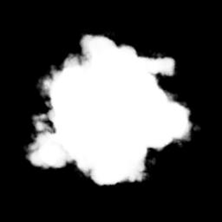
Volume Rendering

Slide 12
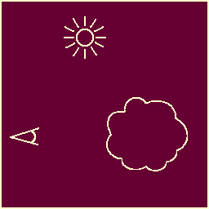
Lights
brute force method
offset method
deep shadows

Slide 13
Lights
brute force method
offset method
deep shadows

Slide 14
Lights
brute force method
offset method
deep shadows

Slide 15
Lights
brute force method
offset method
deep shadows

Slide 16
Brute Force Method
for each sample, cast a ray towards light
accumulate opacities
squares the number of samples
very slow
redundant

Slide 17
Brute Force Method
for each sample, cast a ray towards light
accumulate opacities
squares the number of samples
very slow
redundant

Slide 18
Brute Force Method
for each sample, cast a ray towards light
accumulate opacities
squares the number of samples
very slow
redundant

Slide 19
Brute Force Method
for each sample, cast a ray towards light
accumulate opacities
squares the number of samples
very slow
redundant

Slide 20
Brute Force Method
for each sample, cast a ray towards light
accumulate opacities
squares the number of samples
very slow
redundant

Slide 21
Brute Force Method
for each sample, cast a ray towards light
accumulate opacities
squares the number of samples
very slow
redundant

Slide 22
Offset Method
for each sample, cast a ray towards light
sample just once more
extrapolate
double the samples
no global information
see notes from last year

Slide 23
Offset Method
for each sample, cast a ray towards light
sample just once more
extrapolate
double the samples
no global information
see notes from last year

Slide 24
Offset Method
for each sample, cast a ray towards light
sample just once more
extrapolate
double the samples
no global information
see notes from last year

Slide 25
Offset Method
for each sample, cast a ray towards light
sample just once more
extrapolate
double the samples
no global information
see notes from last year

Slide 26
Offset Method
for each sample, cast a ray towards light
sample just once more
extrapolate
double the samples
no global information
see notes from last year

Slide 27
Offset Method
for each sample, cast a ray towards light
sample just once more
extrapolate
double the samples
no global information
see notes from last year

Slide 28
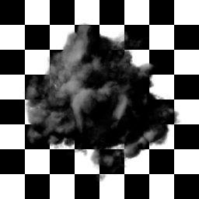
Offset Method

Slide 29
Deep Shadows
create a deep shadow map
for each sample, read the shadow map
efficient
globally accurate

Slide 30
Deep Shadows
create a deep shadow map
for each sample, read the shadow map
efficient
globally accurate

Slide 31
Deep Shadows
create a deep shadow map
for each sample, read the shadow map
efficient
globally accurate

Slide 32
Deep Shadows
create a deep shadow map
for each sample, read the shadow map
efficient
globally accurate

Slide 33
Deep Shadows
create a deep shadow map
for each sample, read the shadow map
efficient
globally accurate

Slide 34
Normal Shadows
depth map
alpha mask
2D images

Slide 35
Normal Shadows
depth map
alpha mask
2D images

Slide 36
Normal Shadows
depth map
alpha mask
2D images

Slide 37
Normal Shadows
depth map
alpha mask
2D images

Slide 38
Deep Shadow
At each sample, record the alpha
3D images

Slide 39
Deep Shadow
At each sample, record the alpha
3D images

Slide 40
Deep Shadow
At each sample, record the alpha
3D images

Slide 41
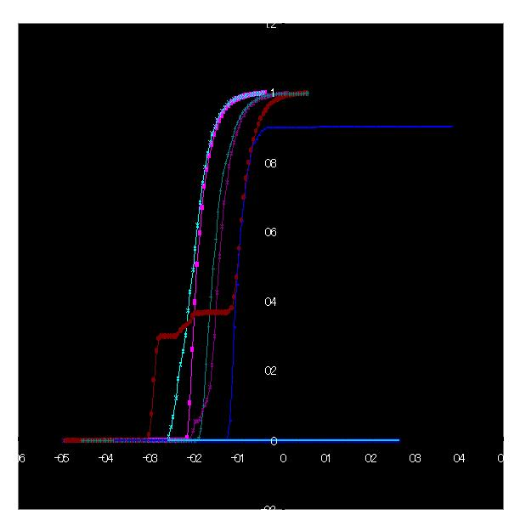
Deep Shadow
monotonic
starts at zero
smooth at ends

Slide 42
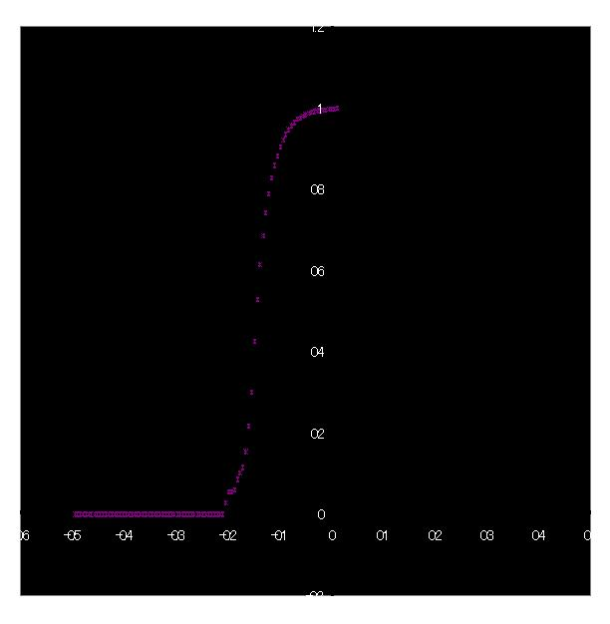
Deep Shadow Generation
maximum opacity
10% opacity depth
50% opacity depth
90% opacity depth

Slide 43
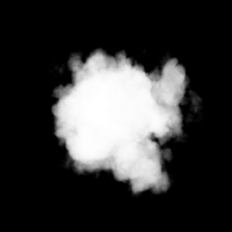
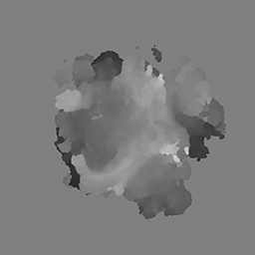
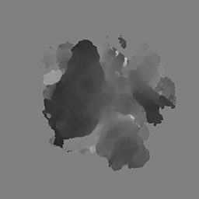
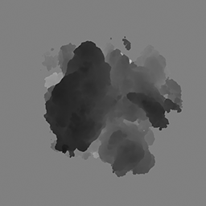
Deep Shadow Generation

Slide 44
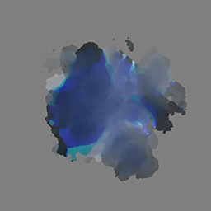
Deep Shadow Generation

Slide 45
Deep Shadow Usage
reconstruct using smoothstep
lookup sample’s opacity
output appropriate light value

Slide 46
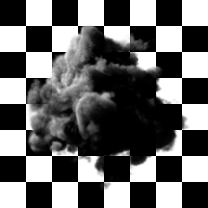
Deep Shadow Usage

Slide 47
Comparison

Slide 48
The End

