Slide 1

Stupid Renderman Tricks
On Shadow Buffers…
Christophe Hery
ILM

Slide 2
(Not so) Stupid Use of Shadow Buffers
A shadow texture is a floating point depth pass, so
use it for depth cueing in your comp script
  set the depthfilter to “min”
use it for bounding box detection
  requires both a “min” and a “max” pass
use it for quick and dirty ray tracing

Slide 3
Ray tracing with shadow buffers
textureinfo is your friend
uniform matrix shadCamSpace, shadNdcSpace
textureinfo(shadMap, “viewingmatrix”, shadCamSpace)
  uniform matrix shadInvSpace = 1/shadCamSpace
textureinfo(shadMap, “projectionmatrix”, shadNdcSpace)
  point shadNdcP = transform(shadNdcSpace, P)
  float shadNdcS = (1.0+xcomp(shadNdcP)) * 0.5
  float shadNdcT = (1.0-ycomp(shadNdcP)) * 0.5

Slide 4
Ray tracing with shadow buffers
make sure you point sample the shadow
float z = texture(shadMap, shadNdcS, shadNdcT, shadNdcS, shadNdcT, shadNdcS, shadNdcT, shadNdcS, shadNdcT, “samples”, 1)
shadow ray hit
point projP = transform(shadCamSpace, P)
projP *= z/zcomp(shadP)
projP = transform(shadInvSpace, projP)

Slide 5
Sub-surface scattering
[Jensen et all, Sig 2001]
Two components:
single scattering
diffusion scattering
Can we do those without a ray tracer?

Slide 6
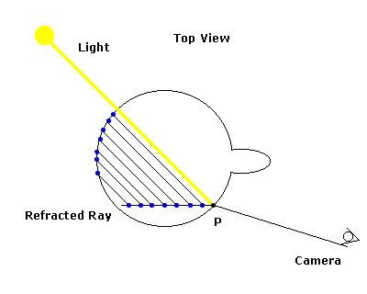
Single scattering
March along refracted outgoing ray at P

Slide 7
Single scattering
Requires the normal at the projected point
like z-buffer, precompute a normal pass, for instance through an arbitrary output variable
  Display “+myLight.N.tif” “tiff” “N”
  txmake -float -pattern single myLight.N.tif myLight.N.txt
read it with a similar texture call
  color projN = color texture(shadNMap, shadNdcS, shadNdcT, shadNdcS, shadNdcT, shadNdcS, shadNdcT, shadNdcS, shadNdcT, “samples”, 1)

Slide 8
Single scattering
  #include "hgphase.h”
  #include "poissondist.h”
  color singlescatter (
  color Cin; /* Light color*/
  vector Lin; /* Light position*/
  vector Iin; /* View direction*/
  point Pin; /* Surface position*/
  normal Nin; /* Surface normal*/
  color sigma_s; /* Scattering coeff*/
  color sigma_a; /* Absorption coeff*/
  uniform float samples; /* Number samples*/
  uniform float g; /* Scattering eccentr */
  uniform float eta; /* Index of refraction*/
  uniform float filterWidth; /* Blur width*/
  )

Slide 9
Single scattering
  {
  varying color scattsingle = 0;
  uniform string shadName = "";
  uniform string normName = "";
  lightsource("_shadName", shadName);
  lightsource("_normName", normName);
  uniform float oneovereta = 1.0/eta;
  uniform float oneovereta2 = oneovereta*oneovereta;
  uniform float samp = samples;
  if (samp > maxSamples) samp = maxSamples;
  color sigma_s2 = 304.8 * sigma_s;
  color sigma_t = sigma_s2 + 304.8 * sigma_a;

Slide 10
Single scattering
  uniform matrix ndcSpace = 1, shadowSpace = 1;
  textureinfo(shadName,"projectionmatrix",ndcSpace);
  textureinfo(shadName,"viewingmatrix",shadowSpace);
  uniform matrix invshadowSpace = 1/shadowSpace;
  extern float du, dv;
  extern vector dPdu, dPdv;
  vector uBasis = du * dPdu * filterWidth;
  vector vBasis = dv * dPdv * filterWidth;
  /* precompute the phase */
  float phase = hgphase(g,-Lin.Iin);
  /* compute outgoing fresnel transmission direction */
  vector To = normalize(refract(Iin,Nin,oneovereta));

Slide 11
Single scattering
  /* sample over ray */
  uniform float i, k;
  float realsamples[3];
  for ( k = 0.0; k < 3; k += 1.0) realsamples[k] = samp;
  for ( i = 0; i < samp; i += 1.0 )
  /* TODO MAYBE stratified sampling */
  {
  for ( k = 0.0; k < 3.0; k += 1.0 )
  {
  /* generate new random Pi,Ni along refracted ray */
  float sigma_t_k = comp(sigma_t,k);
  float sp_o = -log(random())/sigma_t_k;
  /* corresponding to density: sigma_t_k*exp(-sigma_t_k*x) */
  point Pi = Pin + To * sp_o;
  Pi += uBasis * poissonDistU[i] + vBasis * poissonDistV[i];

Slide 12
Single scattering
  /* project it into the first visible point from the view of the scattering light */
  point Pndc = transform(ndcSpace, Pi);
  point Pshad = transform(shadowSpace, Pi);
  float ndcS = (1.0+xcomp(Pndc))*0.5;
  float ndcT = (1.0-ycomp(Pndc))*0.5;
  float z = texture(shadName, ndcS,ndcT,ndcS,ndcT,
  ndcS,ndcT,ndcS,ndcT, "samples", 1);
  float zshad = zcomp(Pshad);
  if ((z>1e20) || (z==0.0)) {
  /* ignore larger results, they're errors */
  realsamples[k] -= 1.0;
  } else {
  Pshad *= z/zshad;
  Pshad = transform(invshadowSpace, Pshad);

Slide 13
Single scattering
  /* approximation: no refraction on the way in (Kti = 1.0 and Ti = -Lin) */
  normal Ni;
  color CNi = color texture(normName,ndcS,ndcT,ndcS,ndcT,
  ndcS,ndcT,ndcS,ndcT, "samples", 1);
  setxcomp(Ni,comp(CNi,0)); setycomp(Ni,comp(CNi,1));
  setzcomp(Ni,comp(CNi,2));
  Ni = ntransform(invshadowSpace, Ni);
  float TidotNi = abs(Lin.Ni);
  float sp_i = length(Pshad - Pi) * TidotNi
  / sqrt (1.0 - oneovereta2 * (1.0 - TidotNi*TidotNi));
  float sigma_tc = sigma_t_k * ( 1.0 + abs(Ni.To) / TidotNi );
  setcomp(scattsingle,k, comp(scattsingle,k)
  + exp(-sp_i*sigma_t_k)/sigma_tc);
  }
  }

Slide 14
Single scattering
  for ( k = 0.0; k < 3.0; k += 1.0)
  {
  if (realsamples[k] > 0.0)
  setcomp(scattsingle,k,comp(scattsingle,k)
  * comp(sigma_s2,k)*phase / realsamples[k]);
  }
  scattsingle *= Cin;
  return (scattsingle);
  }

Slide 15
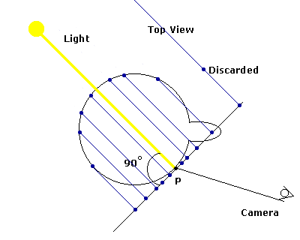
Diffusion scattering
Create dipole positions on the surface

Slide 16
Diffusion scattering
The theory holds true for flat surfaces, so
first create the samples on a plane
  point Psamp = P + base1 * diffdist1[I] + base2 * diffdist2[I]
then project them on the surface (where light entered)
  use shadow ray hit
create the dipoles and reject the samples which are to close (high-curvature)

Slide 17
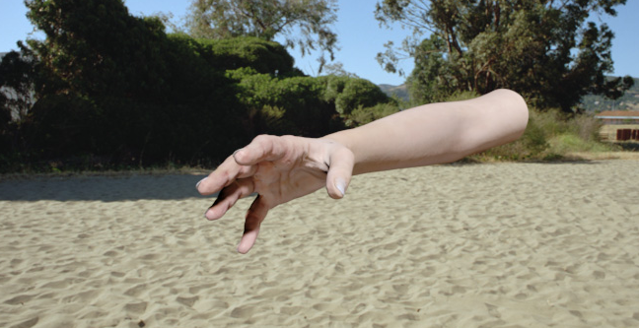
BRDF

Slide 18

BSSRDF

