Slide 1
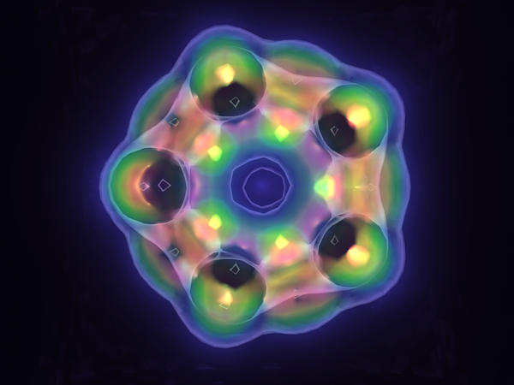
Visualization Shading
David Bock - National Center for Supercomputing Applications University of Illinois

Slide 2
Approach
Scientific visualization process
RenderMan as a “visualization renderer”
Notion of “shading data”
Basic strategy
Shader examples
Some results

Slide 3
Previous Work
Corrie, B. and Mackerras, P. “Data Shaders,” Proceedings of Visualization ‘93, pp. 275-282, October 1993.
Foster, N. and Metaxas, D., “Modeling the Motion of a Hot Turbulent Gas,” SIGGRAPH ‘97, Computer Graphics, ACM SIGGRAPH, pp. 181-188
Hanson, C., “Advanced RenderMan,” SIGGRAPH ‘98 course notes, August ‘98
Larry Gritz, Pixar - initial volume shader work

Slide 4
Motivation
Tool for scientists
Development environment for visualization algorithms
Integration of different “primitives”
Leverage rendering technology
Applicability to visual effects field
Notes:
Easy interface for scientists to analysis data using variety of visualization methods and output high-fidelity and high-quality imagery for publication
Developers can encapsulate and test new representation algorithms within a shader and not worry about overhead - similar to other useful modular systems
RenderMan correctly handles rendering different types of objects in the same scene - I.e. surfaces, volumes, points, lines, etc…
RenderMan has been developed and worked on by leaders in the computer graphics community over several years
Sources of data can be non-scientific (I.e. noise, particle software, objects)

Slide 5
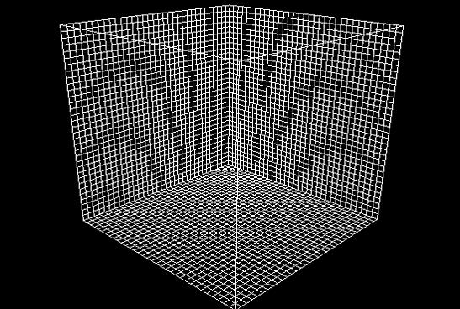
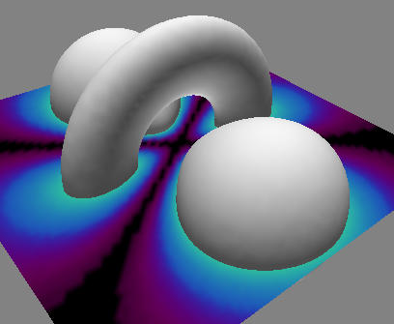
Scientific Visualization
Definition
  Transformation from data to imagery
  Algorithms map data to representations (geometry, color, …)

Slide 6
Scientific Visualization
Typical Rendering Process
Input
Mapping
Rendering
Output
Hardware
Render
Data
Visualization
Package
Geometry
Animation
Package
Imagery
Custom
Renderer

Slide 7
Visualization Shading
Input
Mapping & Rendering
Output
RenderMan
Visualization Shader
Data
Imagery
Visualization Shader
Visualization Shader
Custom Visualization
Software/Libraries
Notes:
Since many mapping methods are inherently coupled to the rendering process, we merge the 2 into 1 process. Examples include those procedures representing volume data.

Slide 8
Basic Strategy
RIB file
  Bounding box of data set
  Attach visualization shader
  Other scene elements (lights, other objects, etc…)
Visualization Shader
  Data set (filename, texture, or shared memory id)
  Region of interest specifications
  Mapping parameters (colormap, thresholds, etc…)

Slide 9
Basic Strategy
Visualization Shader Algorithm
Basic ray tracing - Applications Notes
Shoot incident ray from P into data set
For step positions along the ray
  Sample the data
  Do mapping and visualization work
  Lighting contribution
  Blend, accumulate with previous steps

Slide 10
Basic Strategy
Working with data in a shader
Option 1) Format data as a texture file
Option 2) Use C/C++ shadeop functionality
  SL shader calls shadeop passing any globals needed (I,P,E,etc…)
  Shadeop performs data management (read, filter, sample, map)
  Shadeop returns results to SL shader

Slide 11
Basic Strategy
SL and Shadeop interchange
Method 1) Ray trace and composite in C/C++ shadeop
surface VolRenderMethod1( string dataSet = ""; float stepSize = 5.0;
float dataScale = 1.0; string colorMap = ""; )
{
/* Point, incident ray, camera in shader space */
point PS = transform( "shader", P );
vector IS = normalize( vtransform( "shader", I ) );
point ES = transform( "shader", E );
/* Ray trace and composite within C++ shadeop */
color accumColor = dsTraceRay( dataSet, PS, IS, stepSize, colorMap, ES );
/* Final color and opacity */
Ci = accumColor *= dataScale;
Oi = 1.0;
}
Notes:
Initial volume shader, with data as a texture, no need for C/C++ shadeop

Slide 12
Basic Strategy
SL and Shadeop interchange
Method 2) Ray trace in SL, sample in C/C++ shadeop
surface VolRenderMethod2( string dataSet = ""; float stepSize = 10.0;
float dataScale = 1.0; string colorMap = ""; )
{
/* Point, incident ray, camera in shader space */
point PS = transform( "shader", P );
vector IS = normalize( vtransform( "shader", I ) );
point ES = transform( "shader", E );
/* Ray trace and composite within the SL shader, sample in the shadeop */
vector gradient, step = stepSize * IS;
color accumColor, sampleColor;
while( dsSample( dataSet, PS, colorMap, sampleColor, gradient, ES ) )
{
/* Add light contribution, blend, increment to next step along ray */
}
/* Assign final color and opacity... */
}
Notes:
Useful for adding lighting to the volume, the SL gets and adds the lighting contribution for each step along the ray

Slide 13
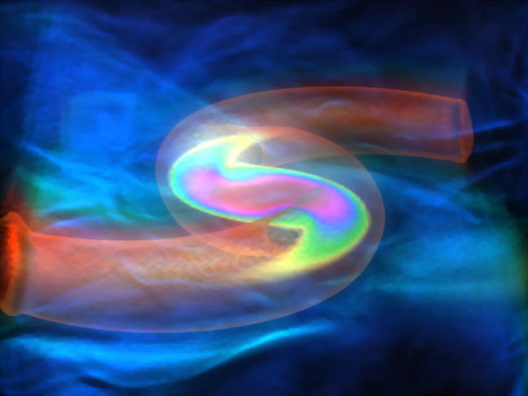
Visualization Shaders
Standard volume rendering
Notes:
Sampling, mapping to color, and blending results along a ray. This example represents the density of 2 colliding Neutron Stars as 1) a volume render, 2) an isosurface, and 3) a slice plane through the middle

Slide 14
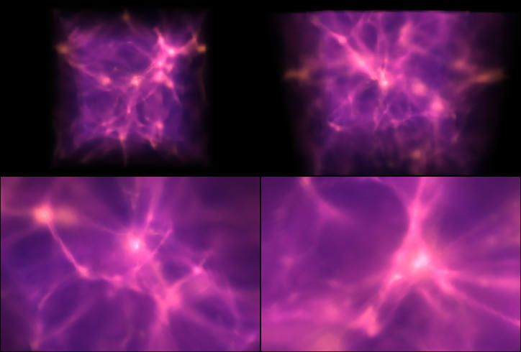
Visualization Shaders
Custom volume rendering for AMR data
Notes:
We’re extending the basic volume renderer to accurately sample and accumulate Adaptive Mesh Refinement data. AMR simulations simulate phenomena by using finer and finer nested grids within the volume bounds. Rather than increasing the entire resolution of a uniform grid, AMR allows only interested regions that are developing to be more fully investigated while leaving other regions at lower resolutions.
Here we see a still from an AMR simulation of galaxy formations

Slide 15
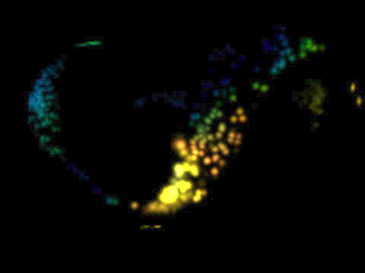
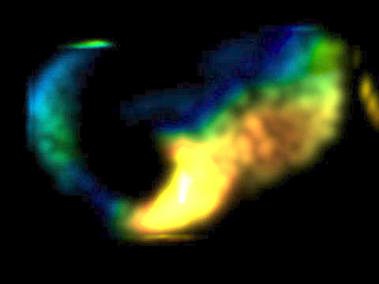
Visualization Shaders
Experiments with vector data
Notes:
This past week, I’ve been experimenting with ways to use visualization shading for vector data. For this image, I wrote a shader to input particle information from Maya (PDA file), released the particles in a data set, sampled the vector data, and colored by magnitude. This is a birds-eye view of vector data from a tornadic thunderstorm simulation.

Slide 16
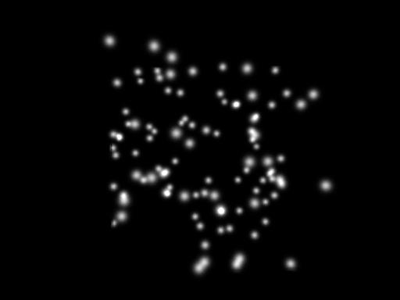
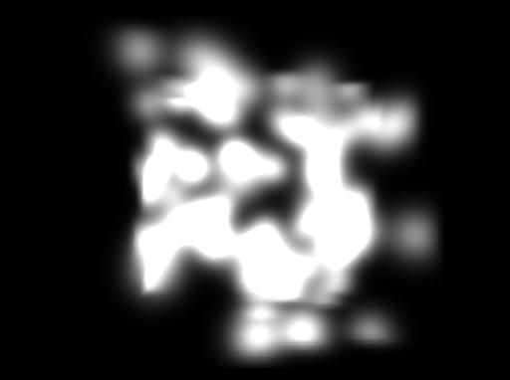
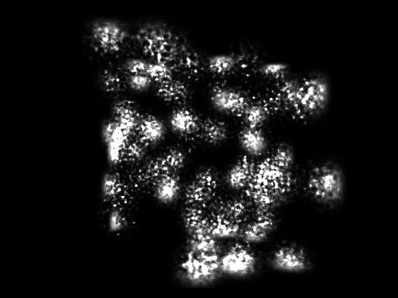
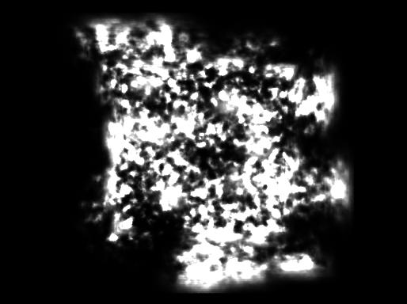
Experiments with Particle Volumes
Notes:
This past week, I’ve been experimenting with ways to use visualization shading for vector data. For this image, I wrote a shader to input particle information from Maya (PDA file), released the particles in a data set, sampled the vector data, and colored by magnitude. This is a birds-eye view of vector data from a tornadic thunderstorm simulation.

Slide 17
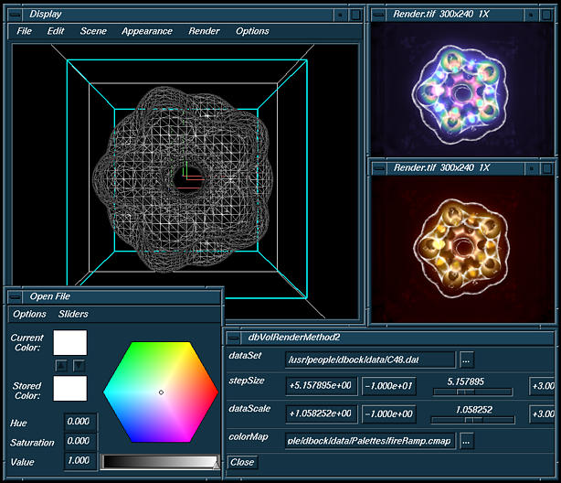
Application Interface
Notes:
Continuing experiments, here we see some early tests with the idea of volume shading a region only around input particle positions. We can vary things like the Gaussian variance and amplitude. We can also add noise to our results while we’re sampling. Here we see some results of volume shading with particles with various variance and noise parameter settings.

Slide 18
Some Results
Notes:
Continuing experiments, here we see some early tests with the idea of volume shading a region only around input particle positions. We can vary things like the Gaussian variance and amplitude. We can also add noise to our results while we’re sampling. Here we see some results of volume shading with particles with various variance and noise parameter settings.

