Slide 1

Pixar’s
RenderMan
User’s Group
SIGGRAPH 2002

Slide 2
Agenda
Welcome: Lola Gil
Overview: Dana Batali
RAT Trick #1: Ian Stephenson
Ray Davis: renderman.pixar.com
RAT Trick #2: Doug Epps
Ray Tracing: David Laur
RAT Trick #3: Christophe Hery
Global Illumination: Per Christensen
RAT Trick #4: Wayne Wooten
PRMan 11 Meat & Spuds: Julian Fong
Looking Ahead: Dana Batali

Slide 3
Shader “thermograms”
Wayne Wooten
Pixar Animation Studios

Slide 4
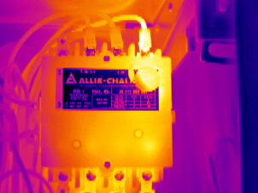
Real life thermograms
www.snellinfrared.com

Slide 5
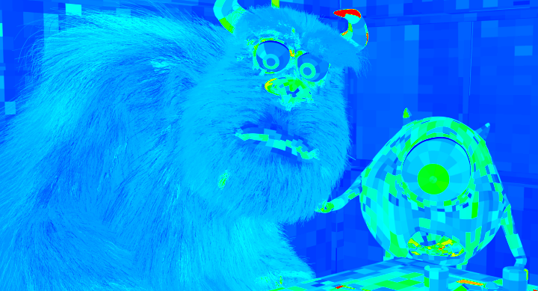
Renderman thermograms
Copyright © Pixar Animation Studios

Slide 6
How “hot” is a shader?
Correlate render time to “temperature”
  Record time before Displacement()
  Run Surface()
  Record time after Atmosphere()
  Calculate delta between times
We can do this with DSOs and AOVs in PRMan v10.1

Slide 7
Timing shaders
displacement shadetimeBEGIN ()
{
uniform float shadeRunTime;
shadeRunTime = systime(0);
}
atmosphere shadetimeEND
(output uniform float shadeRunTime = 0;)
{
shadeRunTime = systime(1);
}

Slide 8
“Magic” DSOs and AOVs
#include <stdio.h>
#include <stdlib.h>
#include <ri.h>
#include <rx.h>
#include "shadeop.h"
#include <sys/time.h>
SHADEOP_TABLE(systime) =
{
{ "float systime (float)", "", "" },
{ "" }
};
static float lasttime = 0;
SHADEOP (systime)
{
…

Slide 9
“Magic” DSOs and AOVs
…
float *result = (float *)argv[0];
float *endFlag = (float *)argv[1];
struct timeval tv;
long curtime_usecs;
float curtime;
gettimeofday(&tv, NULL);
curtime_usecs = tv.tv_sec * 1000000 + tv.tv_usec;
curtime = curtime_usecs / 1000000.0f;
if (*endFlag == 0.0) {
*result = 0;
lasttime = curtime;
} else {
*result = curtime - lasttime;
}
return 0;
}

Slide 10
“Magic” DSOs and AOVs
Remember that: output uniform float shadeRunTime?
In PRMan 10 you can now use atmosphere AOVs.
In RIB:
# Various setup RIB (camera, format, etc)
. . .
Display “mypic.tif” “tiff” “rgba”
Display “+thermogram.tif” “tiff”
“uniform float shaderRunTime”;
WorldBegin
Displacement “shadertimeBEGIN”
Atmosphere “shadertimeEND”
. . .
# The rest of the RIB file here

Slide 11
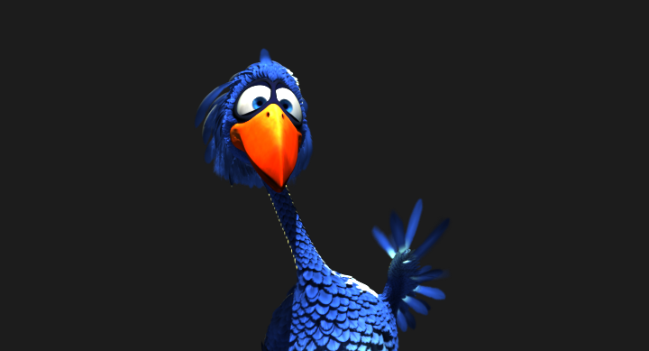
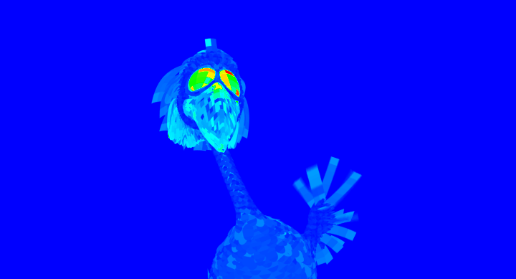
Another example
Copyright © Pixar Animation Studios

Slide 12
Caveats…
Assumes displacement in surface.
Assumes no atmosphere shaders.
Timing for whole grid, not micropolys
Assumes hi-res timer
Instrumenting displacement and atmosphere shaders can help

Slide 13
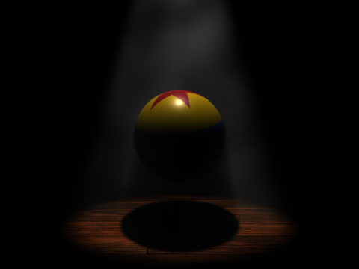
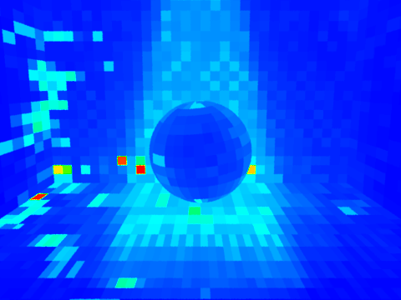
Instrumented example
Example from Chapter 12 of “Advanced Renderman” by
Anthony A. Apodaca and Larry Gritz

Slide 14
Acknowledgements
Rick Sayre - original concept/implementation
Mark VandeWettering - tiff histogram code
Pixar and Disney - example footage

