Slide 1

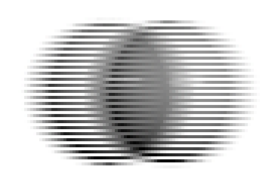

Slide 2


Slide 3
Field Rendering is Annoying
Render at 60fps?
Half vertical resolution?

Slide 4
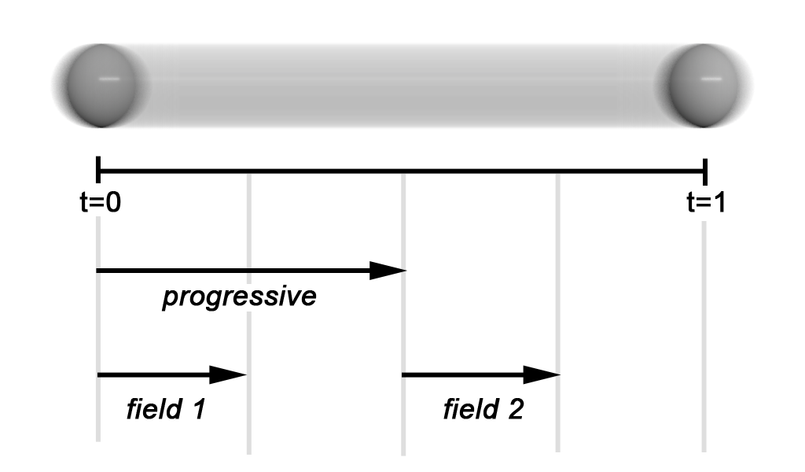

Slide 5
Two-pass Approach
1. Render scene normally
with full-frame shutter interval
store shaded, blurred micropolygons
2. Re-render with field shutter intervals

Slide 6
Advantage:
No more tessellation/shading effort than a single progressive render!

Slide 7
Drawbacks:
Shading, motion only sampled at 30Hz
Storing & reading micropolygons imposes a large fixed cost
Sidedness issues

Slide 8
Hey, Pixar!
Could do this in one pass with renderer feature:
Option "shutter" “fieldoffset" [0.5]

Slide 9
Non-Demo

