Slide 1

Anti-Aliasing
Perlin Noise
Ian Stephenson
NCCA,
Bournemouth

Slide 2
Anti-Aliasing Techniques
SuperSampling
  Easy
  Slow
Frequency Clamping
  Inaccurate
  Difficult for User

Slide 3
Integration of Noise
  “can’t be done”
  Calculus is Hard
  How does it work anyway?

Slide 4
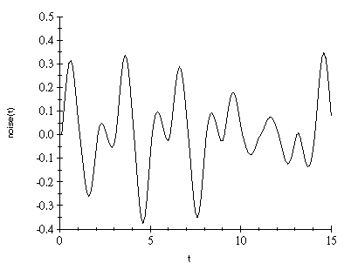
1D Noise
Gradient Noise

Slide 5
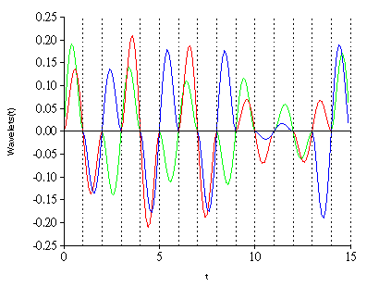
1D Noise
Gradient Noise
Wavelets

Slide 6
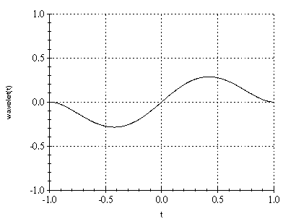
1D Noise
Gradient Noise
Wavelets
Zero outside support (±1)
Sum to zero

Slide 7
1D Noise
Gradient Noise
Wavelets
Zero outside support (±1)
Sum to zero
Easy to Integrate

Slide 8
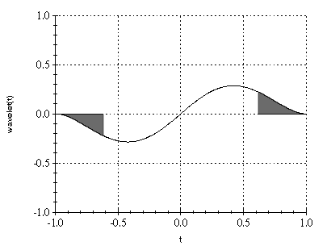
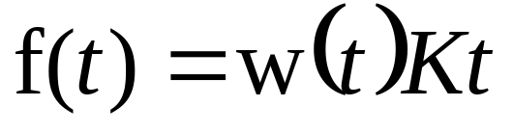
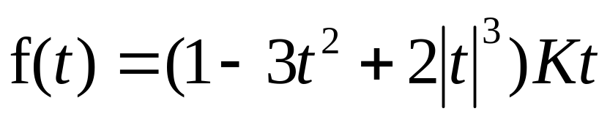
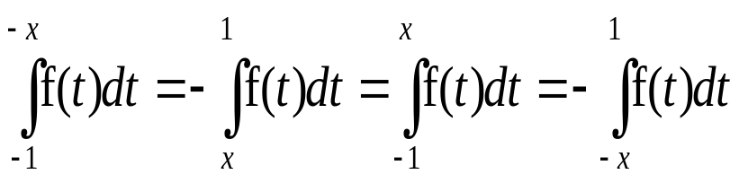
1D Noise

Slide 9
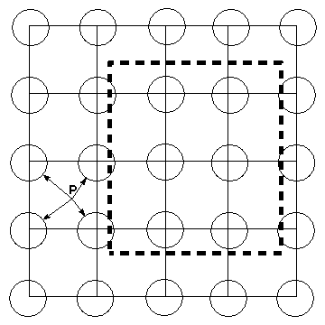
2D Noise
Wavelets arranged
in a grid
Corners, just like 1D case
Also consider the edges

Slide 10
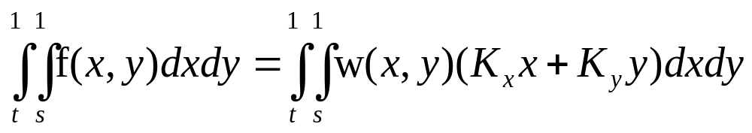
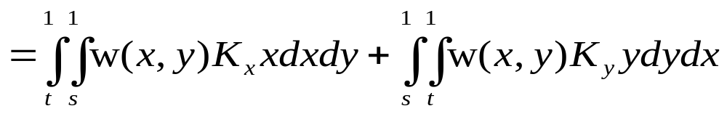
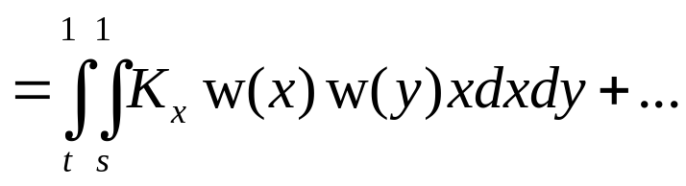
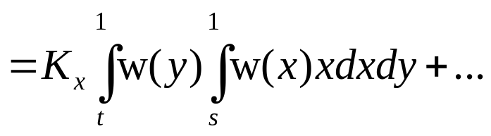
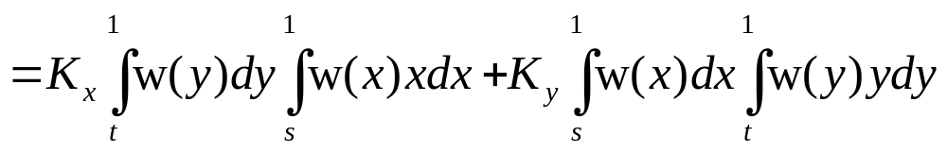
2D Noise

Slide 11
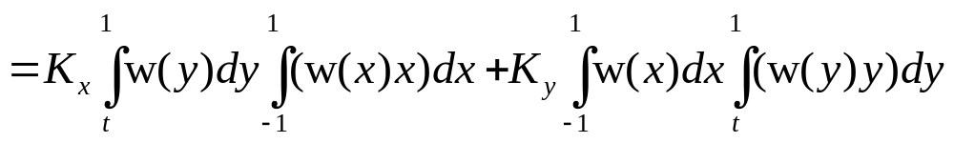
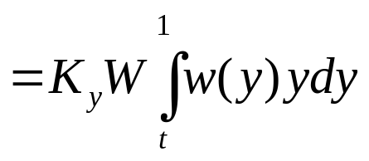
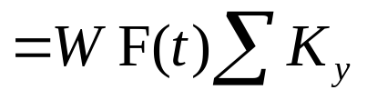
Edges
Wavelets don’t sum to zero
Edge Summation rather than integration

Slide 12
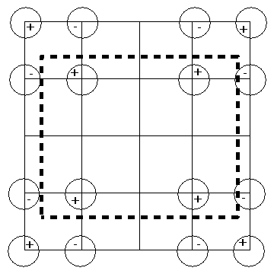
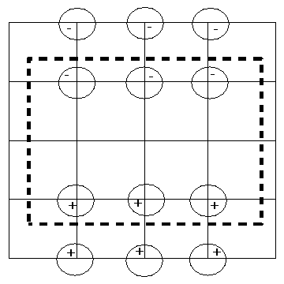
Bringing it together

Slide 13
Implementation
DSO Shadeop in PRMan
  val=Inoise(u,v,du,dv);
assert(floor(f)+1 = floor(f+1));
  int ix=floor(x);
  float fx=x-ix;

Slide 14
Examples

Slide 15
Conclusion
AA of noise by Integration is possible
Not a panacea but a tool.
Can produce better results than FC

Slide 16
Anti-Aliasing
Perlin Noise
Ian Stephenson
NCCA,
Bournemouth
www.dctsystems.freeserve.co.uk

