Slide 1
Khonsu: Scaling Cooperative Prediction Across Edge Locales
Research questions and evaluation plan

Slide 2
Conductor solved one locale
Done
• One shared cooperative-prediction service per road region, covering fusion, tracking, and trajectory prediction.
• Admission control and prediction scheduling keep it inside the 300 ms deadline up to 31 CAVs.
• Accepted at SEC 2026.
• We know how to operate one locale.

Slide 3
The next problem is metropolitan scale
• One locale has finite spatial extent.
• City coverage therefore needs many locales.
• Vehicles and tracked actors cross between them continually.
Main question
How do we extend edge-hosted cooperative prediction from one locale to a metropolitan deployment while preserving planner safety?
RQ1 (scale-out). How should cooperative prediction be partitioned across locales, and what limits the region one locale can serve?
RQ2 (state continuity). When actors move between locales, what state must follow them to preserve prediction quality?
RQ3 (safe handoff). What handoff timing and mechanism keep predictions inside the maneuver-specific safe-age envelope?
RQ4 (multi-locale operation). Can the design sustain repeated and concurrent handoffs across a realistic corridor?
Khonsu is the answer that falls out of RQ2 and RQ3. RQ4 tests it as a system.

Slide 4
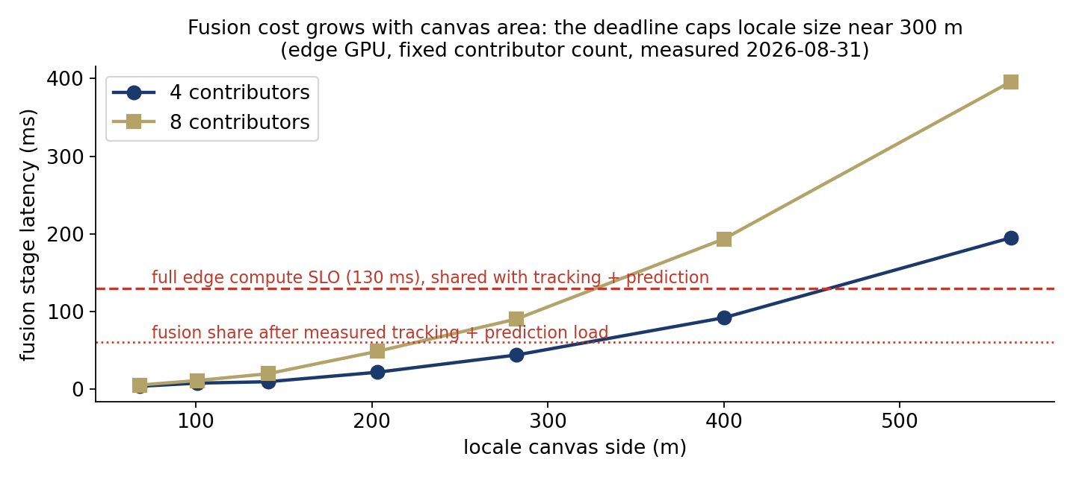
RQ1: one locale has a finite region
RQ1
Done
• BEV fusion cost grows with canvas area.
• At 8 contributors, fusion exceeds its 130 ms allocation between 282 and 400 m.
• Memory is not the limit, at 6.8 GB of 16 GB for a 563 m canvas.
• For our hardware and fusion stack, the practical locale size is about 300 m.
Evidence: canvas latency sweep on the edge GPU · Caveat: the number is architecture-specific, the existence of a cap is general

Slide 5
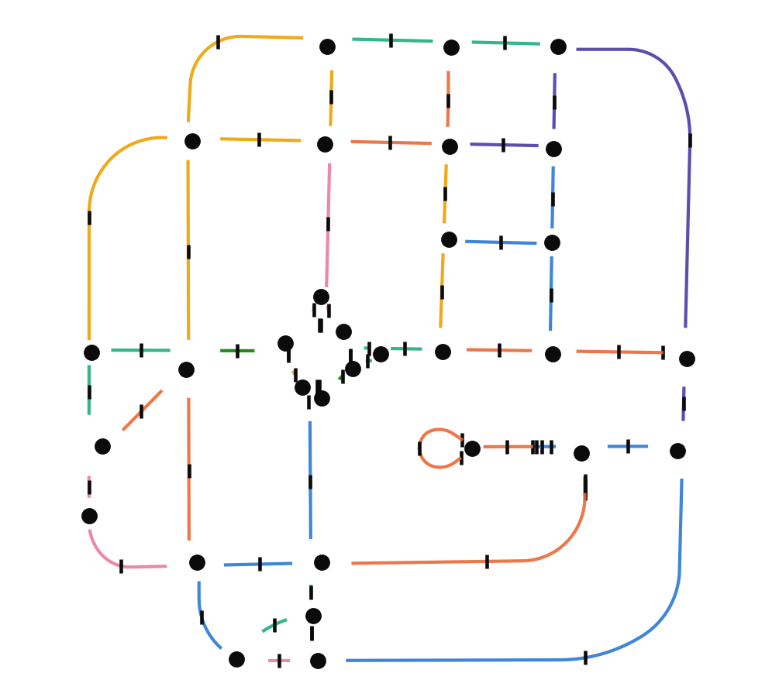
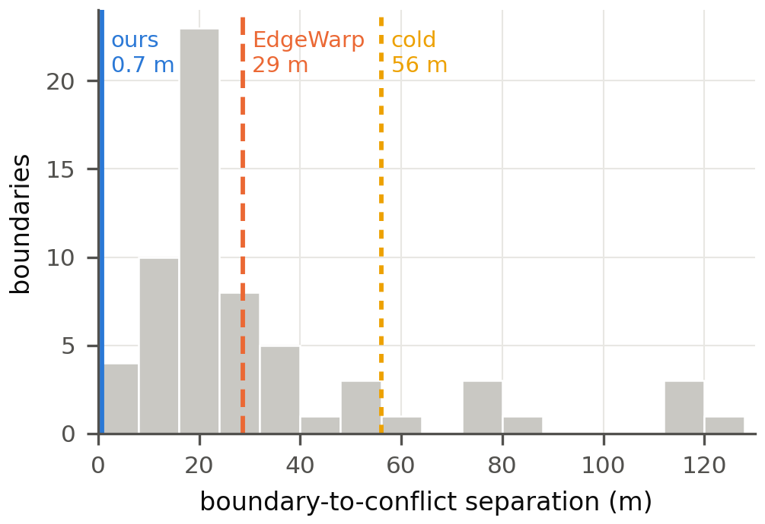
RQ1: what a multi-locale deployment looks like
RQ1
Done
• Fixed conflict points, intersections and merges, are the natural locale anchors.
• Boundaries necessarily fall on the roads connecting them.
• A vehicle crosses a boundary every 20 to 30 seconds of urban driving.
• Handoffs are the steady-state workload of the deployment.

Slide 6
Partitioning creates a new problem
• Conflicts do not respect the partition. Queue tails, stopped vehicles, overtakes, and lane changes form between intersections.
• The service is stateful. The tracker and predictor condition on observations accumulated before the crossing.
Locale A
Locale B
Locale C
RSU
RSU
RSU
a
v
observation history accumulates in A
decision in B, on the segment between anchors
same again at the next boundary
The boundary separates the observations that establish an actor's motion from the decision that consumes them.

Slide 7
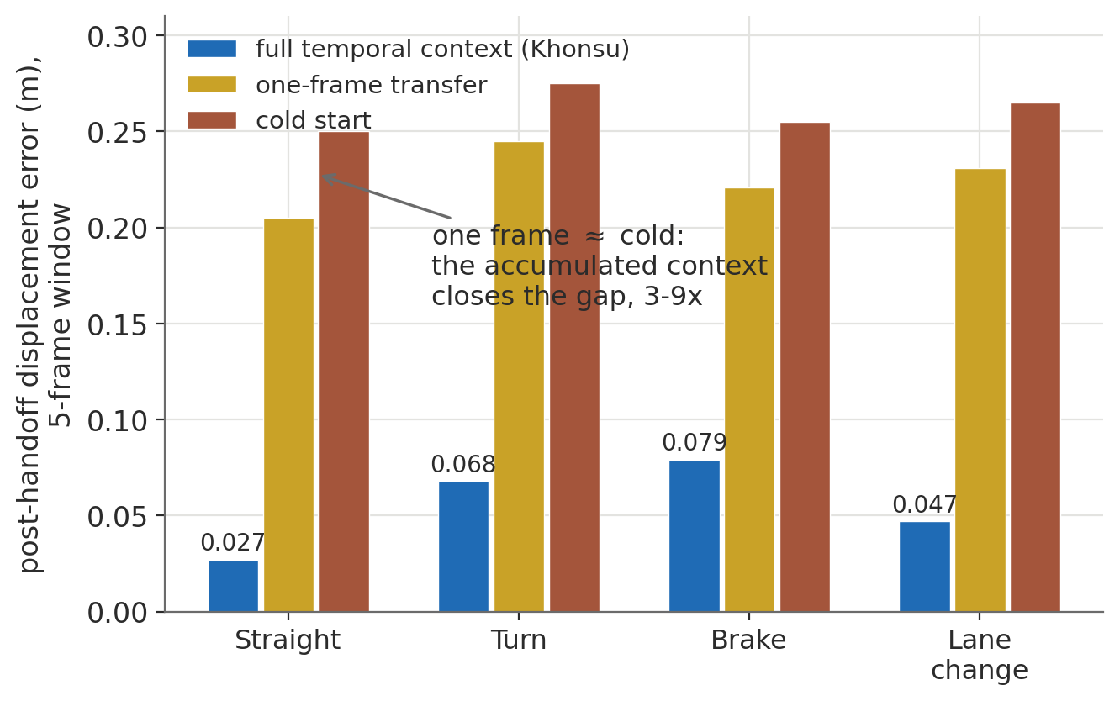
RQ2: what state must survive a crossing?
RQ2
Done
• Real motion includes acceleration, braking, and turning. Constant-velocity Kalman tracking degrades there.
• Our 3D adaptation of MambaTrack gains its accuracy from a history of K observations.
• Once the service is partitioned, that history becomes cross-locale service state.
• One frame is indistinguishable from cold start. The history reduces post-handoff error by a factor of 2.8 to 9.3.
Evidence: forced-handoff microbenchmark, four maneuvers · Claim scope: first SSM 3D tracker inside a distributed cooperative-prediction pipeline

Slide 8
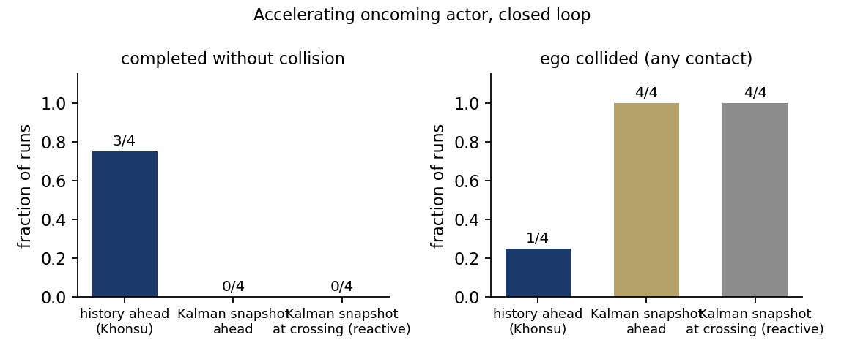
RQ2: a Kalman snapshot is insufficient under acceleration
RQ2
Done
• The oncoming actor accelerates through the conflict.
• With a Kalman snapshot, ahead of or at the crossing, the ego collides in 4 of 4 runs.
• With the observation history ahead, 3 of 4 runs complete without a collision.
• The difference comes from motion history, not transfer size.
Evidence: closed-loop acceleration experiment, 4 seeds per arm, validated scenario · Metric: collided or not per run · Missing: post-handoff minADE and minFDE

Slide 9
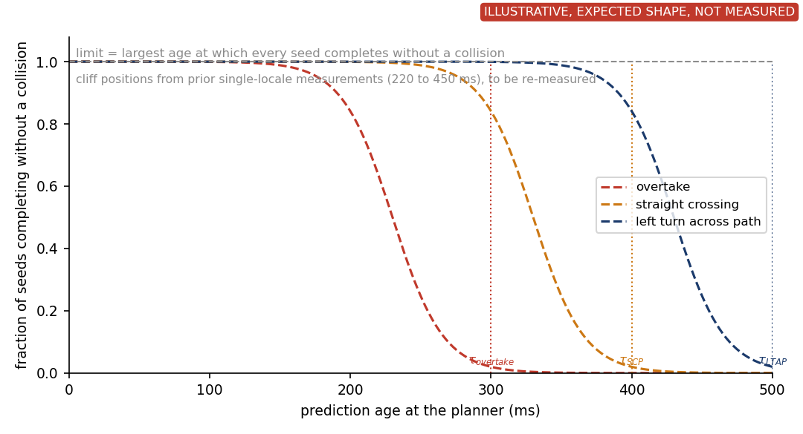
How old can a prediction be and still support the maneuver?
RQ3
Needed
Question
What freshness limit must a locale handoff preserve? The limit depends on maneuver urgency, not on one universal latency number.
Experiment
Inject a controlled forecast age at the planner around a locale crossing, with no migration in play, and measure closed-loop success per scenario (T12).
Result we need
A maneuver-specific safe-age limit per scenario that every handoff experiment uses as its pass or fail boundary. Cliff positions from earlier single-locale work (not accepted) are placeholders until re-measured.
Replaces the earlier 220 to 450 ms citation with numbers measured inside Khonsu

Slide 10
RQ3: how should a handoff work?
RQ3
• Cold start. Does no state transfer violate the envelope?
• Transfer at the boundary. Is reactive migration early enough?
• EdgeWarp timing. Does radio-predicted migration give the predictor time to warm?
• Overlap. Can both locale services simply run in an overlap region?
• Continuous replication. Can we mirror everything and avoid predictive handoff?
• Khonsu. Does forecast-driven prepare, final update, and ownership transfer preserve the envelope efficiently?
• Oracle. What is the upper bound?
All seven are alternative designs for cross-locale continuity, measured as arms of one experiment

Slide 11
Khonsu mechanism
RQ3
Done
• The predictor already forecasts each actor. A forecast that crosses the boundary names the actor, the destination, and the arrival time.
• Prepare moves the temporal track state early. The track is warm but unpublished.
• A final update at commit closes the gap while the source keeps observing.
• Every forecast carries an ownership epoch. Planners accept only the highest, so one owner is consumed.
• If the state cannot be imported safely, the track is marked cold and the planner falls back.
Lead time is computed from the age chain, transfer EMA plus destination fold-in plus margin

Slide 12
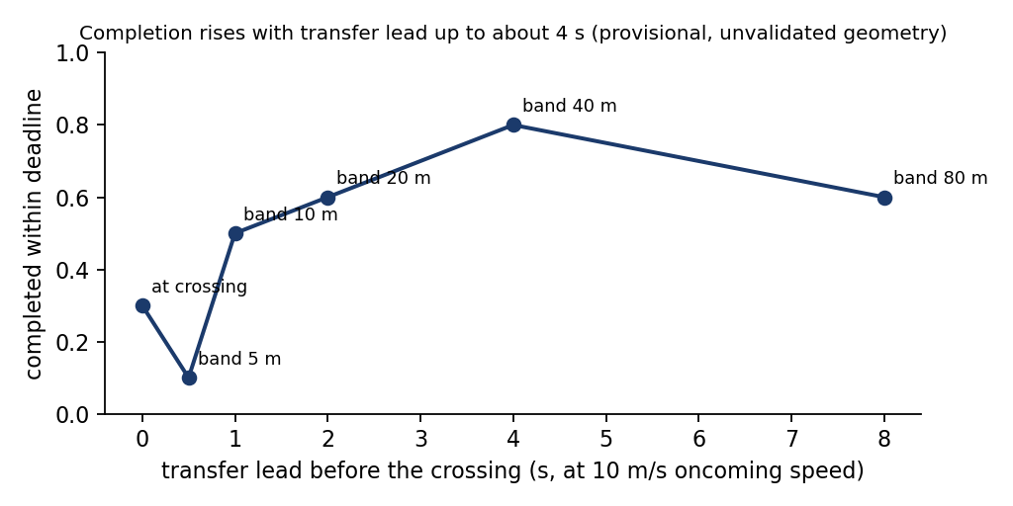
RQ3: evidence so far
RQ3
Done
• Handoff microbenchmark (Done). History beats one frame by a factor of 2.8 to 9.3.
• Acceleration closed loop (Done). Snapshot collides in 4 of 4, history completes 3 of 4 cleanly.
• Ownership protocol (Done). Eight fault scenarios, one publishable epoch at every step.
• v3 re-baseline (Done). Corrected scenario, 10 runs per arm. History at crossing 9 of 10 clean, history 1 s ahead 7 of 10, Kalman 2 of 10, cold 2 of 10, EdgeWarp timing 0 of 10.
• Burst (Done). Five-vehicle platoon on one boundary. History ahead 5 of 5 clean, EdgeWarp timing 0 of 5, cold 0 of 5.
• Lead-time sweep (Provisional). The v1 curve was on an unvalidated geometry. On the corrected geometry the source sees the actor, so at-crossing transfer suffices. The trigger table decides timing.
Missing: predictor-mode trigger and lead sweep on the corrected scenario (T15), live fault arms with the epoch check on and off

Slide 13
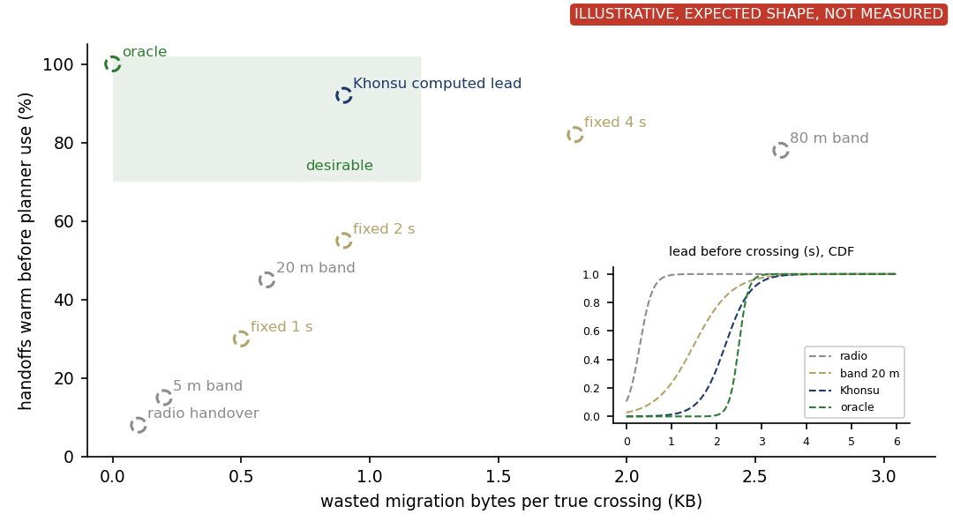
A trigger must be early without migrating everything
RQ3
Needed
Question
Why not EdgeWarp timing, a fixed band, or simply triggering 4 s early?
Experiment
Trigger study on the corrected scenario. Radio handover, bands of 5 to 80 m, fixed leads of 1 to 4 s, the computed lead, and the oracle. Record warm-before-use, wasted bytes, and the lead-time distribution (v3, T11).
Result we need
Khonsu near the oracle vertically while left of aggressive fixed leads and wide bands. The inset shows why: its lead tracks the predicted arrival.

Slide 14
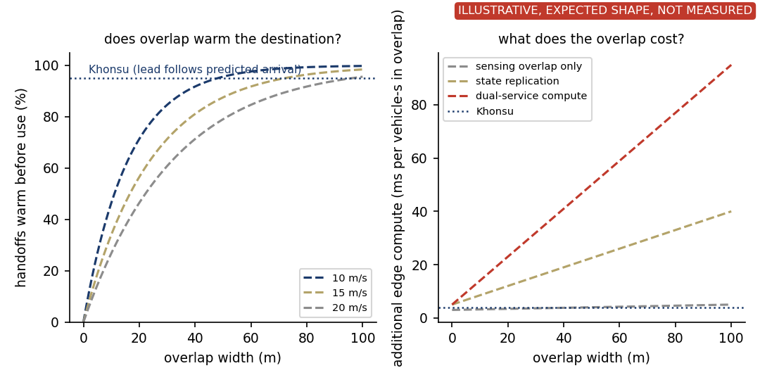
Overlap can provide lead time, but its cost grows with width
RQ3
Provisional
Question
Can overlapping locales eliminate the explicit handoff? Sensing overlap, compute overlap, and dual authority are three different things.
Experiment
Sweep overlap width 20 to 120 m for each meaning. Measure warm-before-use, bytes per crossing, dueling forecasts, age at use, collisions (T14). First sweep, replication doubled bytes and changed nothing (Provisional).
Result we need
Lead time from a fixed width shrinks with speed, so enough time at 20 m/s needs a wide overlap, and wider overlap means more duplicated work. Khonsu sizes the lead from the predicted arrival instead.

Slide 15
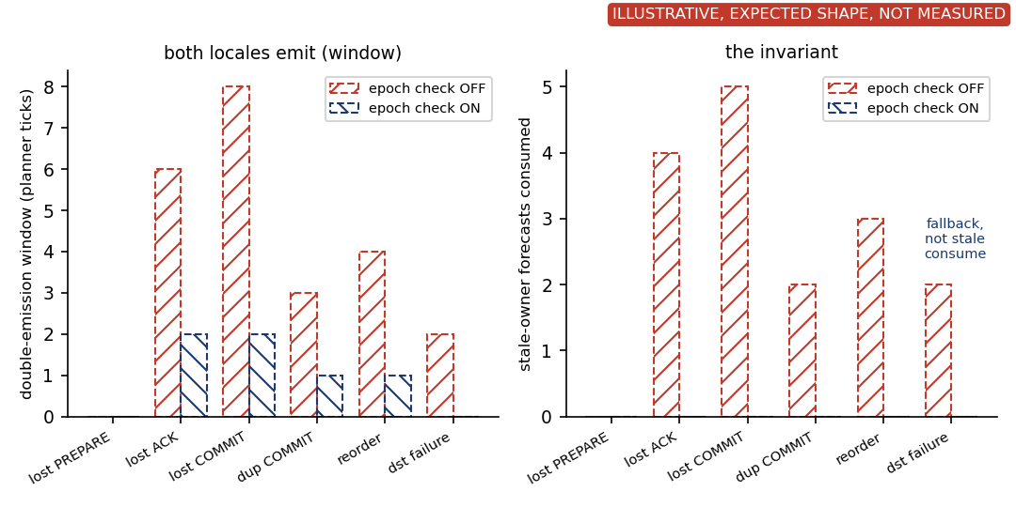
Ownership epochs block stale forecasts at the planner
RQ3
Running
Question
Both locales may emit forecasts for a moment under message loss. Does the planner ever consume a stale owner's forecast?
Experiment
Inject lost PREPARE, lost ACK, lost COMMIT, duplicate COMMIT, reordering, and destination failure on the live path, with the epoch check off and on (T7 live). The unit-level state machine already passes eight scenarios.
Result we need
Double emission may remain briefly with the check on. Stale-owner forecasts consumed must be exactly zero in every fault. Destination failure ends in fallback, not a stale consume.

Slide 16
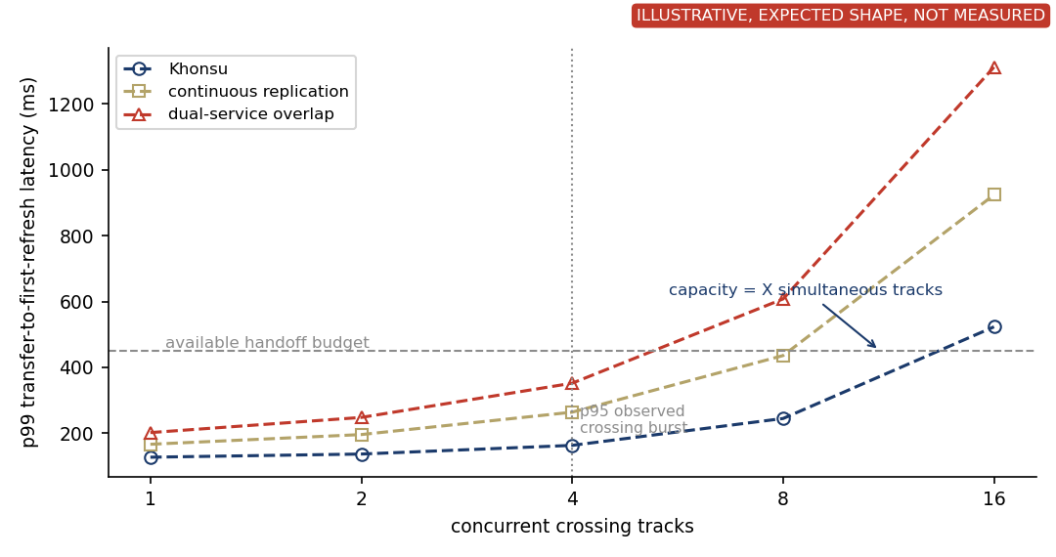
How many simultaneous handoffs can one locale sustain?
RQ4
Running
Question
At what crossing load does the handoff path stop meeting the budget?
Experiment
Landed (q5, 5 runs per cell): with 2, 4, and 8 oncoming vehicles, history 1 s ahead avoids a collision in 5, 2, and 4 runs, the handover snapshot in 0, 1, and 0, cold start in 0, 0, and 1. Needed: platoons of 1 to 16 tracks, p99 transfer-to-first-refresh latency against the handoff budget, with replication and dual-service overlap as arms (T19b).
Result we need
The concurrent-track count at which Khonsu crosses the budget, stated as a capacity. Replication and dual-service overlap should cross earlier.

Slide 17
RQ4: what happens across an actual corridor?
RQ4
Needed
• Four locales of about 300 m on the flow-scenario arterial, boundaries at the midpoints between anchors.
• One ego drives 1.2 km at 12 m/s through three handoffs.
• Oncoming stream of 4 and 8 vehicles per run, half connected, 2 to 4 crossings per minute per boundary.
• Conflicts at anchors 1 and 3, and between them a queue tail, a stopped vehicle with an overtake, and a merge. A platoon crosses boundary 2 together.
• Success per run means no ego collision, age at use under the limit at every decision, and 95% of handoffs warm before use.
Locale A
Locale B
Locale C
Locale D
RSU
RSU
RSU
RSU
x
x
x
x
x
x
crossing path
queue tail
overtake
crossing path
stopped vehicle
merge
ego route, three handoffs, actors crossing independently and several at once
A cooperative-prediction service operating across a sequence of locales · Missing: build (T13), go/no-go on a 3-locale smoke by Sep 9

Slide 18
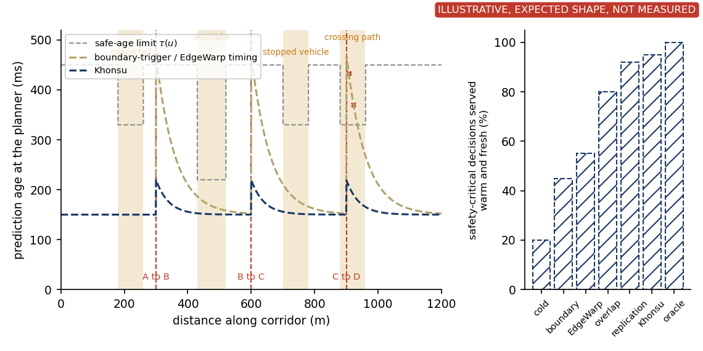
Is prediction usable across repeated locale handoffs?
RQ4
Needed
Question
Do reactive mechanisms spike above the safe-age limit at every boundary, and does Khonsu stay below it through all three?
Experiment
Trace prediction age at the planner along the 1.2 km route for the boundary-trigger baseline and Khonsu, with the per-maneuver limit stepping through the conflict windows. Summarize the whole route per arm (T13).
Result we need
Khonsu shows small bumps at each transition and stays below the limit. The aggregate is the fraction of safety-critical decisions served warm and fresh, with collisions and fallbacks per km as numbers.

Slide 19
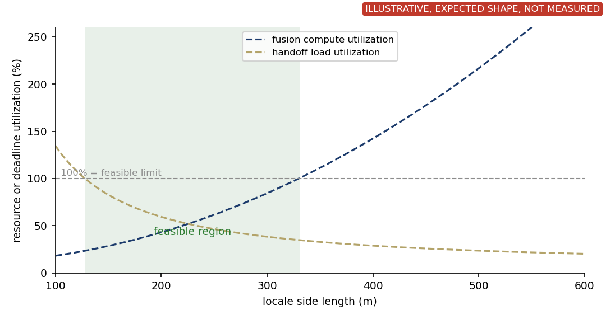
Locale size has an upper and a lower bound
RQ1
Needed
Question
Where does the metropolitan story close? What locale sizes are feasible at all?
Experiment
Sweep locale side length. Fusion compute utilization comes from the canvas measurement (in hand). Handoff load comes from crossings per boundary at the corridor traffic times the measured per-handoff cost (T22, analysis after T8 and T13).
Result we need
An upper bound from per-locale compute, a lower bound from cross-locale transition load, and the feasible interval between them. The paper follows with the size by boundary-position surface.

Slide 20
Done, running, missing
Question | Evidence in hand | Running | Missing | Status
RQ1 scale-out | canvas sweep, CARLA partition | sizing study | density-trace sizing | Done
RQ2 state continuity | microbench 2.8 to 9.3x, acceleration 4/4 vs 3/4 | post-handoff minADE and minFDE (T9) | none | Done
RQ3 safe handoff | v3 flow table (history 9/10 and 7/10 vs 0 to 2/10), 8-scenario ownership faults, age chain | lookahead redo, computed-lead fix | safe-age limits (T12), predictor-mode trigger (T15), live fault arms (T7), real transport (T8), overlap sweep (T14) | Running
RQ4 multi-locale | burst: history ahead 5/5 vs EdgeWarp 0/5 vs cold 0/5; density 2/4/8: history 5,2,4 vs snapshot 0,1,0 vs cold 0,0,1 of 5 | corridor build (T13) | crossing-load sweep (T19b), corridor route-level metrics (T13), sizing analysis (T22), association for unconnected actors (T10) | Running
Provenance. The first two sweeps ran an unvalidated scenario geometry (found Sep 3). The fix is a runner default. The canonical warm arm reproduced 4/4 under the documented settings, and v3 is the re-baseline.
Timeline. NSDI'27 abstracts Sep 10, papers Sep 17.
Done = validated evidence in hand · Provisional = measured on an unvalidated geometry · Running = in the queue · Needed = staged

Slide 21
Minimum remaining evidence for NSDI
Needed
• Safe-age limit re-measured per handoff scenario (T12).
• Trigger table on the corrected scenario: predictor-mode trigger, fixed leads, bands (T15, lookahead redo). The v3 baselines have landed.
• Overlap in its three meanings over overlap width, with the dual-authority arm (T14).
• Real two-process transport with emulated backhaul delay and loss (T8).
• The corridor scenario with route-level metrics (T13, go/no-go Sep 9).
• Association for unconnected actors measured under pose error and distractors, or scoped as a limitation (T10).
Without these, the paper argues mechanism superiority from two-locale evidence and provisional sweeps

