Slide 1
Khonsu: Scaling Cooperative Prediction Across Edge Locales
Research questions and evaluation plan

Slide 2
The argument in five steps
Done
• Conductor solved one locale: one cooperative-prediction service per road region, inside its deadline.
• Metropolitan coverage needs many locales: fusion compute bounds a locale near 300 m.
• Boundaries create a safety-relevant state discontinuity: the tracker and predictor condition on observations the destination never saw.
• Khonsu preserves that state through the handoff: prepare early, shadow until commit, final update, stable-ID merge, one owner per track.
• The corridor tests whether this works as a multi-locale service, not as one boundary.

Slide 3
Conductor solved one locale
Done
• One shared cooperative-prediction service per road region, covering fusion, tracking, and trajectory prediction.
• Admission control and prediction scheduling keep it inside the 300 ms deadline up to 31 CAVs.
• Accepted at SEC 2026.
• We know how to operate one locale.

Slide 4
The next problem is metropolitan scale
• One locale has finite spatial extent.
• City coverage therefore needs many locales.
• Vehicles and tracked actors cross between them continually.
Main question
How do we extend edge-hosted cooperative prediction from one locale to a metropolitan deployment while preserving planner safety?
RQ1 (scale-out). How should cooperative prediction be partitioned across locales, and what limits the region one locale can serve?
RQ2 (state continuity). When actors move between locales, what state must follow them to preserve prediction quality?
RQ3 (safe handoff). What handoff timing and mechanism keep predictions inside the maneuver-specific safe-age envelope?
RQ4 (multi-locale operation). Can the design sustain repeated and concurrent handoffs across a realistic corridor?
Khonsu is the answer that falls out of RQ2 and RQ3. RQ4 tests it as a system.

Slide 5
What we think the paper contributes
Done
• 1. Multi-locale cooperative prediction. Why metropolitan cooperative prediction must be geographically partitioned, and why traffic-generated conflicts prevent boundaries from being made harmless.
• 2. Temporal-state continuity. Realistic 3D tracking depends on observation history that a locale handoff loses; a current-state transfer is insufficient in the regimes that motivate learned tracking.
• 3. Khonsu. A selective, forecast-driven handoff that prepares per-actor temporal state before it is needed, sends a final update at ownership transfer, and keeps stale owners from reaching the planner.
• 4. Evaluation across alternatives and repeated handoffs. When reactive migration, radio-timed migration, overlap, and continuous replication suffice, and their safety and system cost across a multi-locale corridor.
Scaling cooperative prediction from one locale to metropolitan coverage creates a continuity problem that partitioning, overlapping, or migrating the service does not solve cleanly. Khonsu preserves the state the planner needs, when it needs it, without continuously duplicating the service.

Slide 6
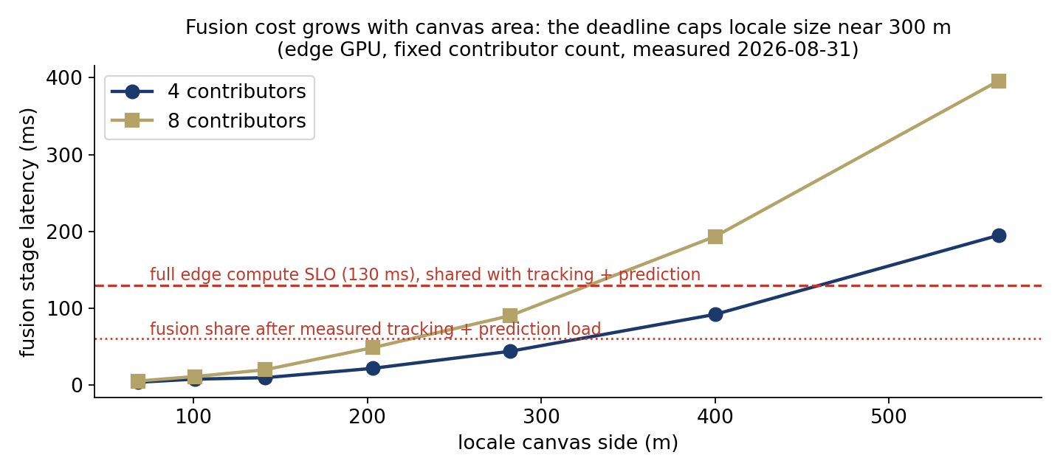
RQ1: one locale has a finite region
RQ1
Done
• BEV fusion cost grows with canvas area.
• At 8 contributors, fusion exceeds its 130 ms allocation between 282 and 400 m.
• Memory is not the limit, at 6.8 GB of 16 GB for a 563 m canvas.
• For our hardware and fusion stack, the practical locale size is about 300 m.
Evidence: canvas latency sweep on the edge GPU · Caveat: the number is architecture-specific, the existence of a cap is general

Slide 7
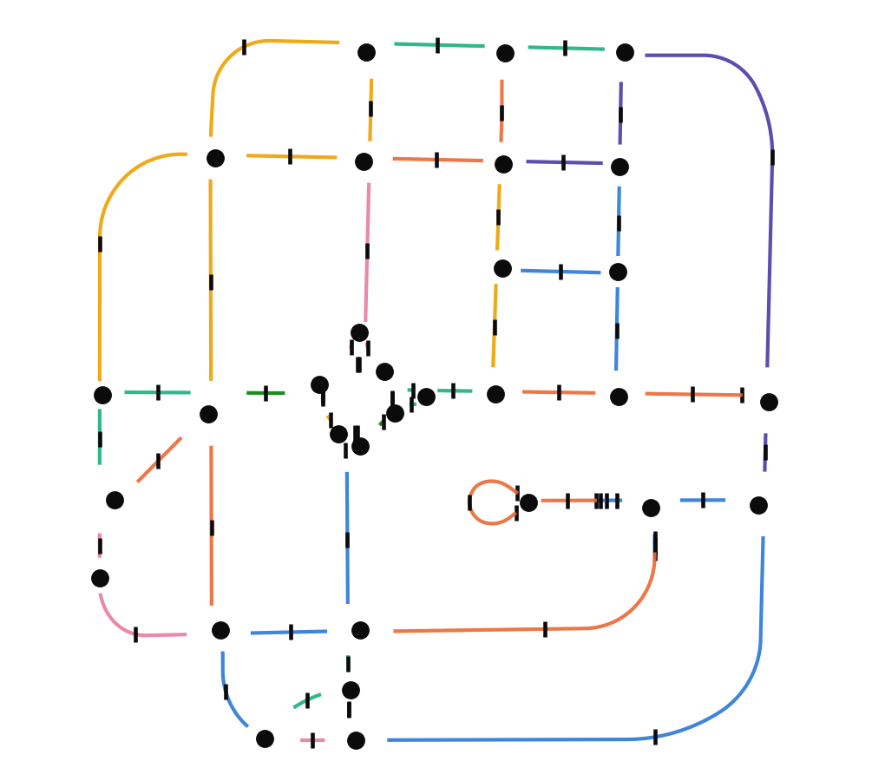
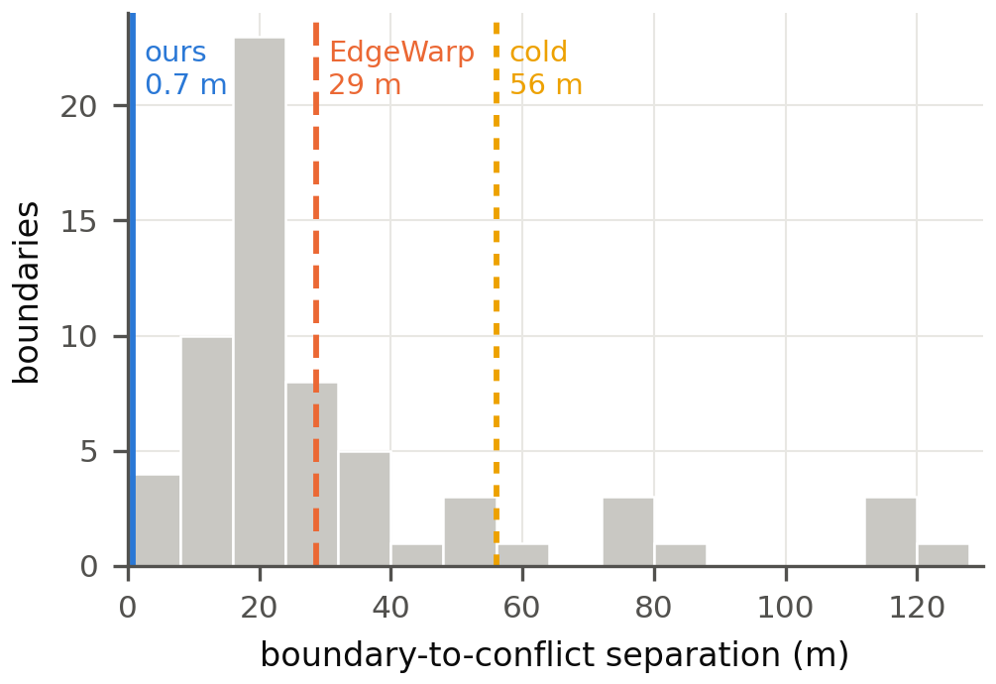
RQ1: the multi-locale architecture
RQ1
Done
• One cooperative-prediction instance per locale; an edge server may host several.
• Locales are anchored on fixed conflict points, intersections and permanent merges; boundaries fall on the roads that connect them.
• Each track has exactly one owning locale at a time; adjacent locales share a record schema and a calibrated frame transform.
• A vehicle crosses a boundary every 20 to 30 seconds of urban driving, so handoffs are the steady-state workload.

Slide 8
Partitioning creates a state discontinuity
• Traffic conflicts do not respect the partition: queue tails, stopped vehicles, overtakes, and lane changes form on the roads where boundaries fall.
• A boundary separates the observations that established an actor's motion from the planner decision that needs its forecast. The destination must recover the track before that decision, with observations it never made.
Locale A
Locale B
Locale C
RSU
RSU
RSU
a
v
observation history accumulates in A
decision in B, on the segment between anchors
same again at the next boundary
The boundary separates the observations that establish an actor's motion from the decision that consumes them.

Slide 9
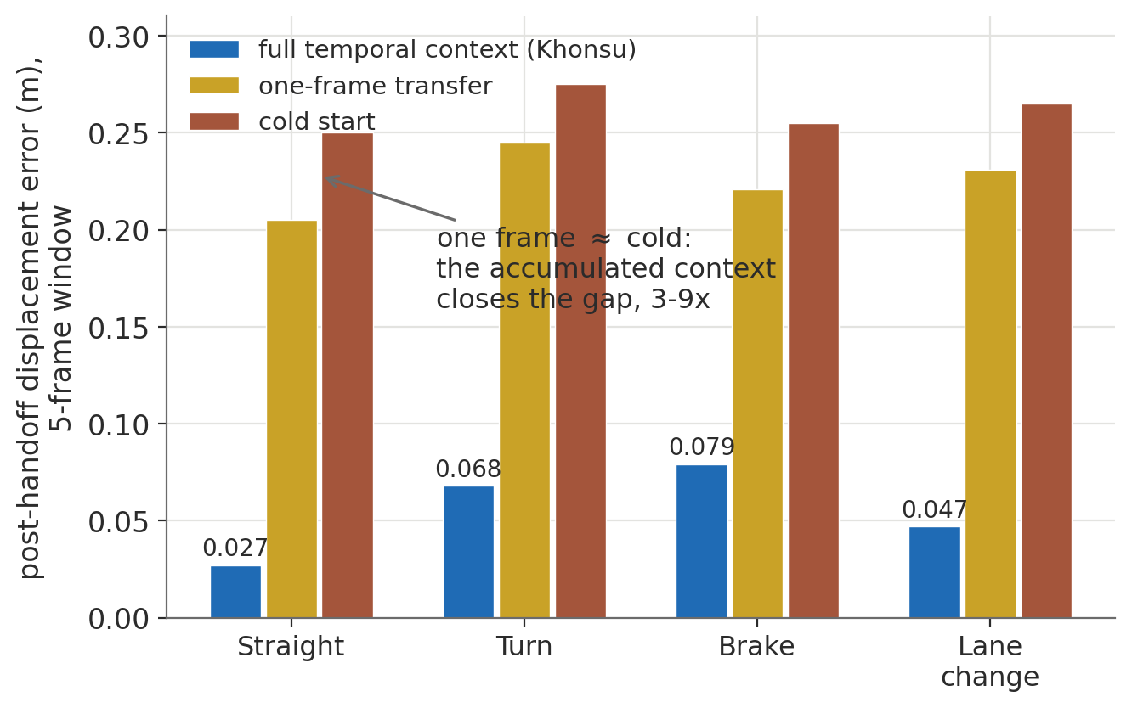
RQ2: what state must survive a crossing?
RQ2
Done
• Real motion includes acceleration, braking, and turning. Constant-velocity Kalman tracking degrades there.
• Our 3D adaptation of MambaTrack gains its accuracy from a history of K observations.
• Once the service is partitioned, that history becomes cross-locale service state.
• One frame is indistinguishable from cold start. The history reduces post-handoff error by a factor of 2.8 to 9.3.
Evidence: forced-handoff microbenchmark, four maneuvers · Claim scope: first SSM 3D tracker inside a distributed cooperative-prediction pipeline

Slide 10
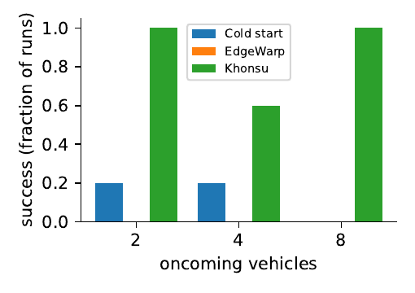
RQ2: a snapshot is insufficient for the overtake scenario
RQ2
Done
• Two-locale flow scenario, ego occluded by a stopped truck, oncoming at 12 m/s, 10 runs per arm, freeze-1g.
• Arms that carry the observation history: Khonsu 9 of 10 complete without a collision, reactive history 8 of 10.
• Arms that carry a snapshot fail regardless of timing: Kalman snapshot 1 of 10, EdgeWarp with pre-copy and final sync 1 of 10, handover snapshot 0 of 10. Cold start 2 of 10.
• Every collision is the ego striking the truck it is passing: the overtake is gated on the oncoming forecast, and a snapshot carries no motion.
• The maneuvering (accelerating) case is being rerun after a planner gate fix found this weekend; the earlier 4-seed result is withdrawn.
Metric: collided or not per run, completed without collision · Tonight: the same six arms at 20 seeds on freeze-1i, plus FDE at 5 s per arm

Slide 11
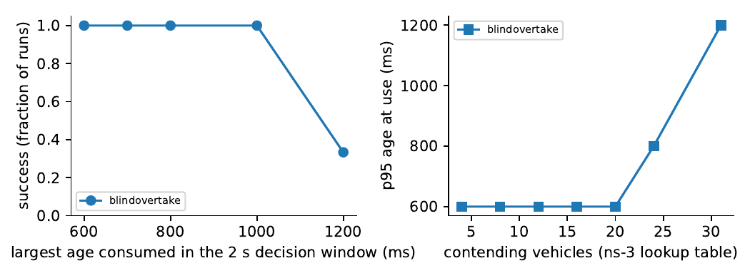
How old can a prediction be and still support the maneuver?
RQ3
Done
Question
What freshness limit must a locale handoff preserve? The limit depends on maneuver urgency, not on one universal latency number.
Experiment
Current measurement: load-induced age sweep. Radio load through the ns-3 lookup table (4 to 31 contending vehicles), no migration in play, realized forecast age logged at every planner decision. Needed: controlled age-injection sweep per scenario.
Result we need
Blind overtake: the pipeline floor is 300 ms of age; every run completes up to 1.0 s; onset at 1.2 s, 2 of 5 runs collide at 31 contending vehicles. The acceleration scenario runs tonight on the fixed planner.
MEASURED, blind overtake, freeze-1f (7 loads x 5 runs)
Replaces the earlier 220 to 450 ms citation with numbers measured inside Khonsu

Slide 12
We compare seven ways to maintain continuity
RQ3
• No continuity: cold start. The destination begins from its own first detection.
• Reactive continuity: transfer at the boundary (reactive history), and EdgeWarp, which pre-copies a snapshot on the predicted radio attachment and syncs at handover.
• Brute-force continuity: overlap, where both locale services run over the boundary region, and continuous replication, which mirrors every track to the neighbor.
• Khonsu: forecast-driven prepare, shadow until commit, final update, stable-ID merge, ownership epoch.
• Oracle: prepare at the true crossing time. The upper bound on any trigger.
Seven designs for cross-locale continuity, measured as arms of one experiment with identical scenarios, seeds, and metrics

Slide 13
Why isn't an existing mechanism enough?
RQ3
Alternative | State adequate? | Early enough? | Selective? | One current owner?
Cold restart | no | - | yes | yes
Kalman / current snapshot | no under maneuvering | yes / no | yes | yes
Transfer at boundary | yes if full state | no | yes | yes
EdgeWarp radio timing | yes if full state | sometimes | yes | yes
Geometric overlap | yes | depends on width and speed | no | yes
Continuous replication | yes | yes | no | yes
Dual publication | yes | yes | no | NO
Khonsu | yes | yes | yes | yes
Each column is one experiment: state at fixed timing (RQ2), timing at fixed state (trigger table), selectivity (overlap and replication cost), ownership (fault arms).
Replication and wide overlap are valid designs; the question is their steady-state cost against selective migration

Slide 14
Why doesn't overlap eliminate the problem?
RQ3
Proposal | What it gives you | What remains
Sensing overlap | both locales detect the actor near the boundary | B still lacks A's earlier history
Compute overlap | B can start processing early | a fixed width gives a speed-dependent lead (w / v) and duplicates computation
Dual authority | no hard cutover | two services can publish different forecasts; the planner still needs ownership or arbitration
Continuous replication | continuity for every track | cost proportional to all tracks x neighboring locales, not to crossing tracks
Measured so far: the forced-handoff microbench shows a current detection is not the history (sensing overlap). Planned: overlap width 20 to 120 m at 12 and 20 m/s in the three forms, and replication at a fixed rate, all with the same success and freshness metrics plus bytes per second and duplicated compute (T14, T19b).
Desired result: replication and wide overlap approach Khonsu on continuity at substantially higher steady-state cost; reactive mechanisms are cheaper but miss the deadline; Khonsu sits in the useful middle

Slide 15
Khonsu mechanism
RQ3
Done
• The predictor already forecasts each actor. A forecast that crosses the boundary names the actor, the destination, and the arrival time.
• Prepare moves the temporal track state early. The imported track is a shadow: tracked, not published, until the actor enters the locale.
• At commit the source sends its latest record and it replaces the prepared one, so drift accumulated during the lead is discarded.
• The destination merges its first own detection into the migrated track by stable ID; a position gate on the projected pose is the fallback.
• Every forecast carries an ownership epoch. Planners accept only the highest, so one owner is consumed.
• If the state cannot be imported safely, the track is marked cold and the planner falls back.
Lead time is computed from the age chain, transfer EMA plus destination fold-in plus margin

Slide 16
Two experiments, not one: what must move, and when
RQ3
Running
• Experiment A holds timing fixed (Khonsu trigger with final update) and varies the state: nothing, latest detection, Kalman state, 2- and 5-frame history, full temporal record. Claim: a snapshot is insufficient; the history matters.
• Experiment B holds the state fixed (full temporal record for every arm) and varies the timing: transfer at the boundary, EdgeWarp radio timing, geometric band, fixed 1 to 4 s leads, Khonsu predicted lead, trigger oracle. Report warm before first use, freshness compliance, wrong destination, wasted bytes.
• The current headline table confounds the two: EdgeWarp carries a snapshot while reactive carries the full record. Both experiments are added to tonight's campaign on the same tag.
If EdgeWarp timing fails in Experiment B it fails because its trigger event is wrong or late, not because its payload was handicapped

Slide 17
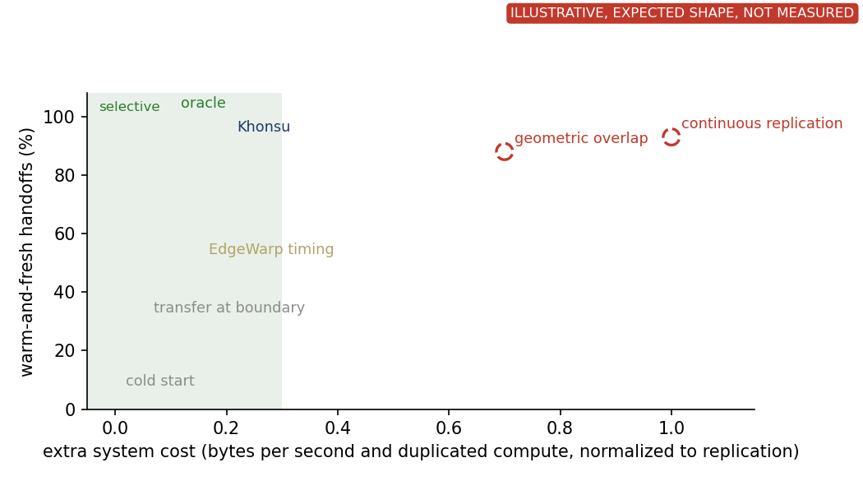
The result the evaluation should culminate in
RQ3
Needed
Question
Where does each mechanism sit on continuity against system cost?
Experiment
One figure over all arms from the same runs: x is extra cost (bytes per second and duplicated compute, normalized to replication), y is warm-and-fresh handoffs; operational success as a second panel.
Result we need
Reactive schemes cheap but not warm in time; wide overlap and replication warm but expensive; Khonsu warm at a fraction of the cost; oracle the bound. The statement: Khonsu keeps X% of handoffs warm and fresh and Y% operational success while moving Z KB per crossing.

Slide 18
RQ3: evidence so far
RQ3
Done
• Six defects between the paper's protocol and the code were found by measured collapses this week and fixed, each followed by a rerun: scenario geometry, missing final update, trigger without a lead gate, publish before commit, association ignoring identity, and a planner overtake gate that skipped head-on tracks.
• Trigger ladder on freeze-1g, 10 runs per arm: fixed leads 1, 2, 3 s at 9 of 10; computed lead 9; predictor-mode 7; oracle 8; fixed 4 s 5 of 10 (the drift-then-duplicate failure that motivated the identity merge). Measured leads 0.9, 1.9, 2.9, 4.0 s.
• Freshness limit, blind overtake, radio load through the ns-3 lookup table, 7 loads x 5 runs: the pipeline floor is 300 ms of age; all runs complete up to 1.0 s of forecast age in the 2 s decision window; onset at 1.2 s (2 of 5 collide at 31 contending vehicles).
• Density at 2, 4, 8 oncoming vehicles: Khonsu 5, 3, 5 of 5; EdgeWarp 0; cold 1, 1, 0.
• Ownership protocol: eight fault scenarios, one publishable epoch at every step; live fault arms run tonight.
Running tonight on freeze-1i: headline and trigger at 20 seeds, burst and density, acceleration freshness, FDE at 5 s per arm

Slide 19
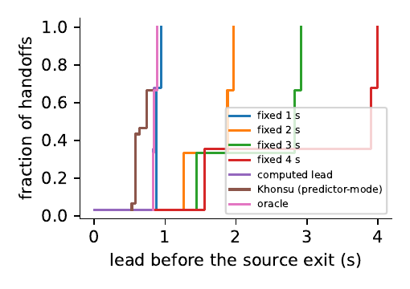
A trigger must be early without migrating everything
RQ3
Done
Question
Why not EdgeWarp timing, a fixed band, or simply triggering 4 s early?
Experiment
Trigger study on the corrected scenario. Radio handover, bands of 5 to 80 m, fixed leads of 1 to 4 s, the computed lead, and the oracle. Record warm-before-use, wasted bytes, and the lead-time distribution (v3, T11).
Result we need
Khonsu near the oracle vertically while left of aggressive fixed leads and wide bands. The inset shows why: its lead tracks the predicted arrival.
MEASURED, freeze-1g, per-handoff true lead

Slide 20
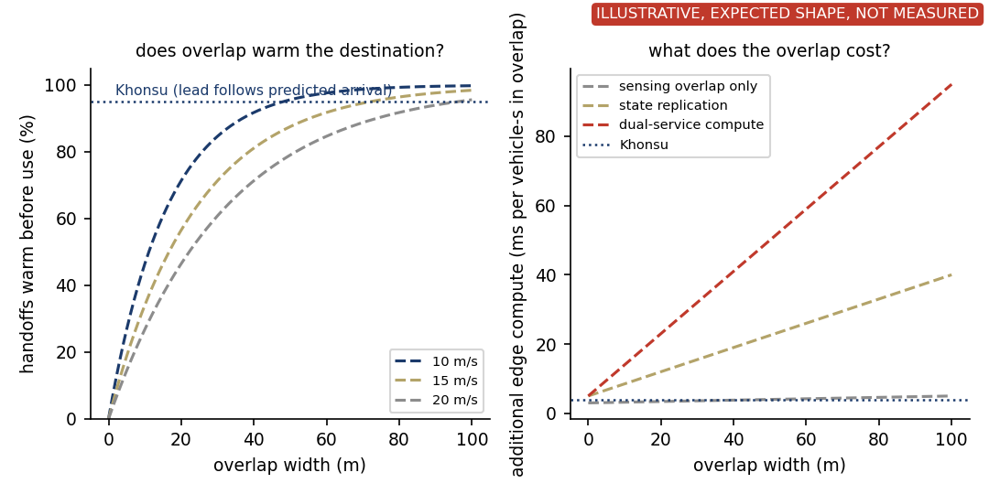
Overlap can provide lead time, but its cost grows with width
RQ3
Provisional
Question
Can overlapping locales eliminate the explicit handoff? Sensing overlap, compute overlap, and dual authority are three different things.
Experiment
Sweep overlap width 20 to 120 m for each meaning. Measure warm-before-use, bytes per crossing, dueling forecasts, age at use, collisions (T14). First sweep, replication doubled bytes and changed nothing (Provisional).
Result we need
Lead time from a fixed width shrinks with speed, so enough time at 20 m/s needs a wide overlap, and wider overlap means more duplicated work. Khonsu sizes the lead from the predicted arrival instead.

Slide 21
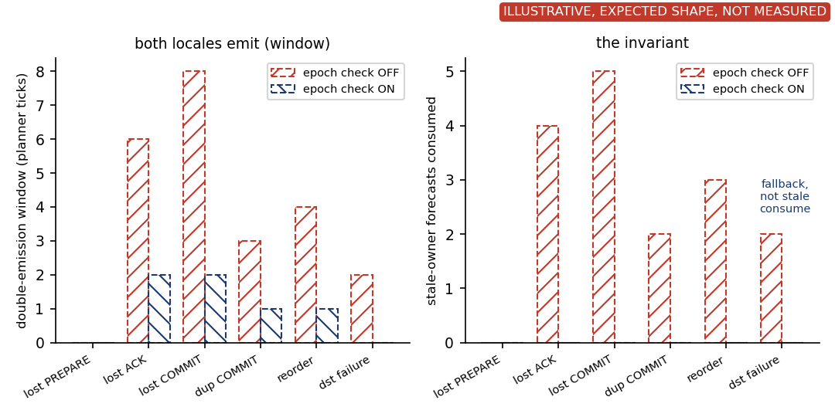
Ownership epochs block stale forecasts at the planner
RQ3
Running
Question
Both locales may emit forecasts for a moment under message loss. Does the planner ever consume a stale owner's forecast?
Experiment
Inject lost PREPARE, lost ACK, lost COMMIT, duplicate COMMIT, reordering, and destination failure on the live path, with the epoch check off and on (T7 live). The unit-level state machine already passes eight scenarios.
Result we need
Double emission may remain briefly with the check on. Stale-owner forecasts consumed must be exactly zero in every fault. Destination failure ends in fallback, not a stale consume.

Slide 22
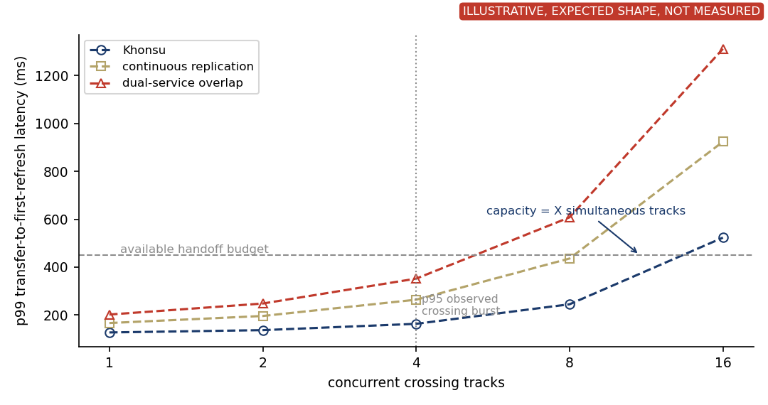
How many simultaneous handoffs can one locale sustain?
RQ4
Running
Question
At what crossing load does the handoff path stop meeting the budget?
Experiment
Landed (q5, 5 runs per cell): with 2, 4, and 8 oncoming vehicles, history 1 s ahead avoids a collision in 5, 2, and 4 runs, the handover snapshot in 0, 1, and 0, cold start in 0, 0, and 1. Needed: platoons of 1 to 16 tracks, p99 transfer-to-first-refresh latency against the handoff budget, with replication and dual-service overlap as arms (T19b).
Result we need
The concurrent-track count at which Khonsu crosses the budget, stated as a capacity. Replication and dual-service overlap should cross earlier.

Slide 23
RQ4: what happens across an actual corridor?
RQ4
Needed
• Four locales of about 300 m on the flow-scenario arterial, boundaries at the midpoints between anchors.
• One ego drives 1.2 km at 12 m/s through three handoffs.
• Oncoming stream of 4 and 8 vehicles per run, half connected, 2 to 4 crossings per minute per boundary.
• Conflicts at anchors 1 and 3, and between them a queue tail, a stopped vehicle with an overtake, and a merge. A platoon crosses boundary 2 together.
• Success per run means no ego collision, age at use under the limit at every decision, and 95% of handoffs warm before use.
Locale A
Locale B
Locale C
Locale D
RSU
RSU
RSU
RSU
x
x
x
x
x
x
crossing path
queue tail
overtake
crossing path
stopped vehicle
merge
ego route, three handoffs, actors crossing independently and several at once
A cooperative-prediction service operating across a sequence of locales · Missing: build (T13), go/no-go on a 3-locale smoke by Sep 9

Slide 24
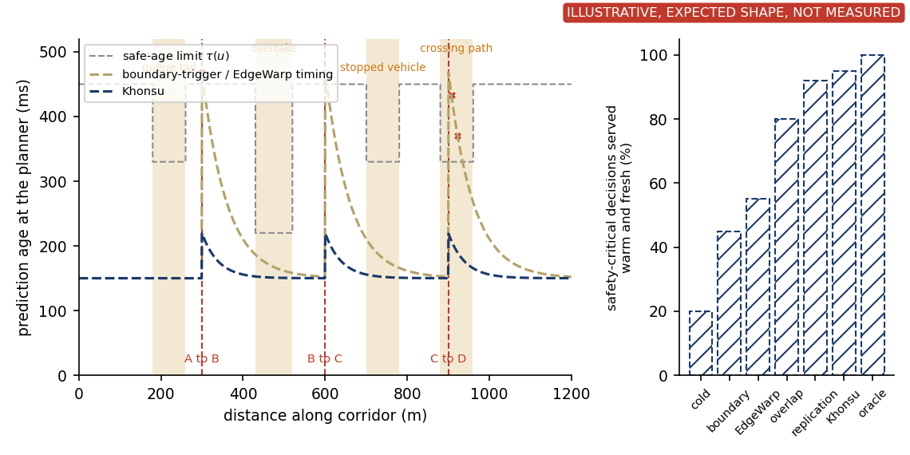
Is prediction usable across repeated locale handoffs?
RQ4
Needed
Question
Do reactive mechanisms spike above the safe-age limit at every boundary, and does Khonsu stay below it through all three?
Experiment
Trace prediction age at the planner along the 1.2 km route for the boundary-trigger baseline and Khonsu, with the per-maneuver limit stepping through the conflict windows. Summarize the whole route per arm (T13).
Result we need
Khonsu shows small bumps at each transition and stays below the limit. The aggregate is the fraction of safety-critical decisions served warm and fresh, with collisions and fallbacks per km as numbers.

Slide 25
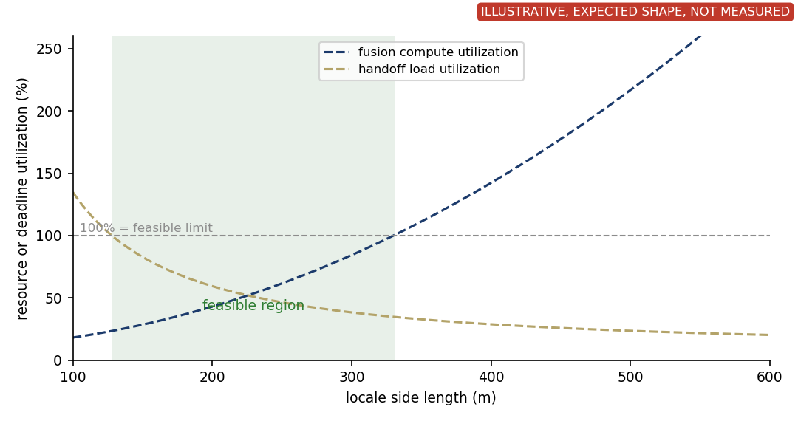
Locale size has an upper and a lower bound
RQ1
Needed
Question
Where does the metropolitan story close? What locale sizes are feasible at all?
Experiment
Sweep locale side length. Fusion compute utilization comes from the canvas measurement (in hand). Handoff load comes from crossings per boundary at the corridor traffic times the measured per-handoff cost (T22, analysis after T8 and T13).
Result we need
An upper bound from per-locale compute, a lower bound from cross-locale transition load, and the feasible interval between them. The paper follows with the size by boundary-position surface.

Slide 26
Done, running, missing
Question | Evidence in hand | Running | Missing | Status
RQ1 scale-out | canvas sweep, CARLA partition | sizing study | density-trace sizing | Done
RQ2 state continuity | flow 1g: history arms 9/10 and 8/10 vs snapshot arms 0 to 1/10; microbench centimetres vs 0.2 to 0.3 m | FDE at 5 s per arm (1i logs) | maneuvering case (planner gate fix) | Done
RQ3 safe handoff | 1g trigger ladder (leads 0.9 to 4.0 s; 4 s collapse explained and fixed), blind-overtake freshness limit 1.0 s, 8-scenario ownership faults | headline and trigger at 20 seeds (1i), live fault arms, netem | acceleration freshness, overlap sweep (T14) | Running
RQ4 multi-locale | burst: history ahead 5/5 vs EdgeWarp 0/5 vs cold 0/5; density 2/4/8: history 5,2,4 vs snapshot 0,1,0 vs cold 0,0,1 of 5 | corridor build (T13) | crossing-load sweep (T19b), corridor route-level metrics (T13), sizing analysis (T22), association for unconnected actors (T10) | Running
Provenance. The first two sweeps ran an unvalidated scenario geometry (found Sep 3). The fix is a runner default. The canonical warm arm reproduced 4/4 under the documented settings, and v3 is the re-baseline.
Timeline. NSDI'27 abstracts Sep 10, papers Sep 17.
Done = validated evidence in hand · Provisional = measured on an unvalidated geometry · Running = in the queue · Needed = staged

Slide 27
Minimum remaining evidence for NSDI
Needed
• Safe-age limit re-measured per handoff scenario (T12).
• Trigger table on the corrected scenario: predictor-mode trigger, fixed leads, bands (T15, lookahead redo). The v3 baselines have landed.
• Overlap in its three meanings over overlap width, with the dual-authority arm (T14).
• Real two-process transport with emulated backhaul delay and loss (T8).
• The corridor scenario with route-level metrics (T13, go/no-go Sep 9).
• Association for unconnected actors measured under pose error and distractors, or scoped as a limitation (T10).
The missing evidence is not whether the idea is plausible. It is whether it holds across repeated handoffs, overlap alternatives, real transport, and unconnected-actor association.

