Slide 1
You Deserve Unicode TLA⁺
And Other Nice Things Too
by: Andrew Helwer

Slide 2
Outline
Feature announcement! Unicode support in the Java tools!
What it’s like to contribute to the core tools; FOSS is hard!
The Future! What this work unlocks for us

Slide 3
SANY now parses pretty Unicode math symbols!
Use an editor plugin to auto-convert to Unicode as you type
  https://github.com/tlaplus-community/tlaplus-nvim-plugin
  Hope to add this feature to VS Code extension soon
  Ron Pressler had this working for the Toolbox back in 2016
Convert existing ASCII specs to Unicode with TLAUC
  https://github.com/tlaplus-community/tlauc
PlusCal translator support pending in a pull request
  https://github.com/tlaplus/tlaplus/pull/911

Slide 4
How does it look?
Highlighting at rest: https://github.com/ahelwer/Examples/blob/pcal-unicode/specifications/SpecifyingSystems/AdvancedExamples/DifferentialEquations.tla
Conversion as you type: https://asciinema.org/a/620647

Slide 5
Work still to be done
TLAPM parser support – onboard to unified parser corpus
Emit Unicode in PlusCal in addition to parsing it
tla2tex support
As-you-type conversion extensions for additional editors
  VS Code, TLA Toolbox, Emacs
  Would love some help with this!

Slide 6
The experience of contributing to the TLA+ tools
FOSS offers social problems to equal technical problems
The dynamic is very different from working on in-house corporate software projects
Much of the Java code is untouched since being written 25 years ago!

Slide 7
My perception of how to contribute to the tools
The name of the game: be surgical
If your pull request can be split up, split it up
Build consensus on need for change before working on it
Write lots of tests, before writing your changes if possible!

Slide 8
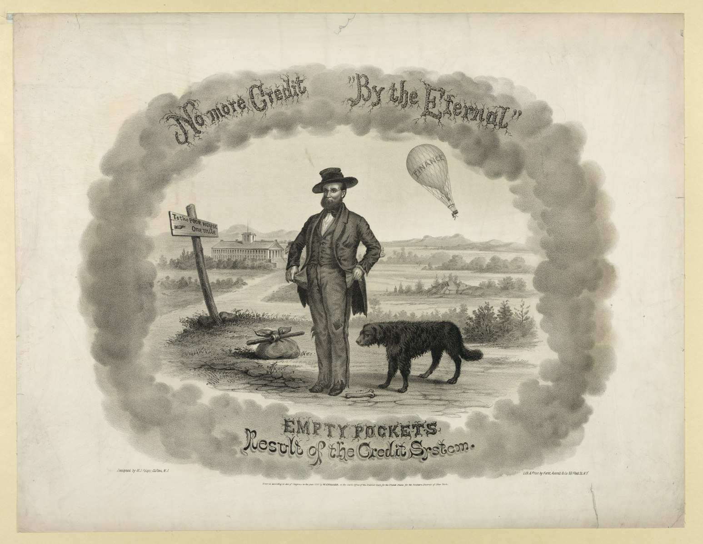
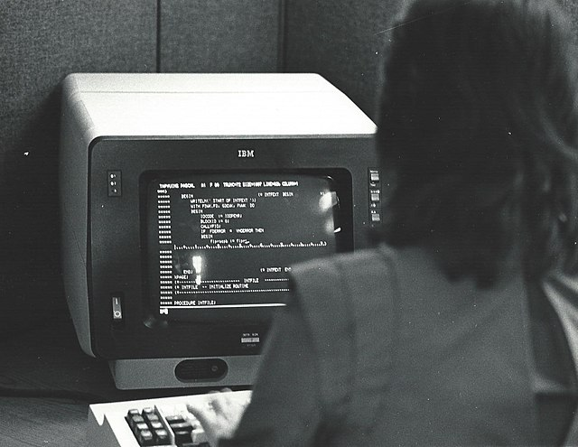

Funding this work: email consulting@disjunctive.llc
Andrew works on TLA+ features living on savings
Andrew runs out of money
Andrew works on contract for a while

Slide 9
Evolving the language: we own the future!
We have regained control of the TLA+ parser!
We can add additional language features if we want!
My suggestion: combine set map & set filter
  {f(x) : x ∈ S : p(x)}
I would like sets to be as pleasant to use as functions
What would you like to see?

Slide 10
Contact: Andrew Helwer
Website: https://ahelwer.ca
Mastodon: @ahelwer@discuss.systems
LinkedIn: ahelwer
Email: consulting@disjunctive.llc

