Slide 1
Semantic Highlighting in TLA+
How to create modern user-assistive language tooling using tree-sitter
Web demo: https://tlaplus-community.github.io/tree-sitter-tlaplus/
Repo: https://github.com/tlaplus-community/tree-sitter-tlaplus
Andrew Helwer
https://ahelwer.ca
consulting@disjunctive.llc

Slide 2
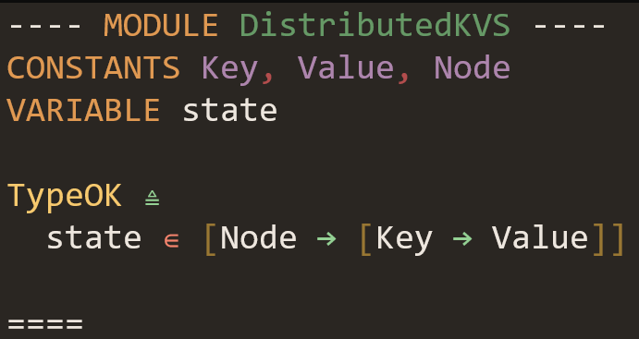
What can you do with real-time access to the TLA+ parse tree?
(source_file (module (header_line) (identifier) (header_line)
(constant_declaration (identifier) (identifier) (identifier))
(variable_declaration (identifier) (identifier))
(operator_definition (identifier) (def_eq)
(bound_infix_op (identifier_ref) (in)
(set_of_functions
(identifier_ref) (maps_to)
(set_of_functions
(identifier_ref) (maps_to) (identifier_ref)
)
)
)
)
(double_line)))

Slide 3
Tree-Sitter Grammar Capabilities
Error recovery
Fast incremental parsing
Tree queries
Standalone library
Bindings for many languages
Standardized API – and there are tree-sitter grammars for many languages!

Slide 4
Tree-Sitter Grammars vs. Language Servers
Language servers:
Standardized LSP capability-based API (get reference, go to definition, etc.)
Written in any language, framework, runtime, etc.
LSP clients built into many platforms (VS Code, Neovim, Eclipse, Emacs)
Tree-Sitter grammars:
Standardized API for parse/edit/update, tree query, and tree traversal
Generated C code from DSL, plus C/C++ external scanner
Supported by fewer platforms so far (Neovim, GitHub)
People have built very interesting apps that consume tree-sitter grammars!

Slide 5
Some Ideas
Semantic highlighting
  “Syntax highlighting is a waste of an information channel” – Hillel Wayne
Code folding
Symbol/reference finding
Code analysis/linting/transformation tools
Accessibility: coding via alternative input methods
  https://github.com/pokey/cursorless-vscode

Slide 6
Highlighting
Conventional syntax highlighting uses regular expressions
Tree-sitter enables exposing semantic information via highlighting
  the ∈ in x ∈ Nat can be highlighted differently from the one in ∀ x ∈ Nat : …
Identifiers can be highlighted based on what sort of thing they refer to
Conjunction/disjunction lists can be given “rainbow” highlighting
Can highlight expressions of the form other ≜ CHOOSE v : v ∉ S
All powered by tree queries!

Slide 7



How Highlighting Works
[1,10]-[1, 13] @constant
[1,15]-[1-20] @constant
[1,22]-[1,26] @constant
[2,9]-[2,14] @variable
[4,0]-[4,6] @operator
...

Slide 8
Tree Queries
(source_file (module (header_line) (identifier) (header_line)
(constant_declaration (identifier) (identifier) (identifier))
(variable_declaration (identifier) (identifier))
(operator_definition name: (identifier) (def_eq)
(bound_infix_op (identifier_ref) (in)
(set_of_functions
(identifier_ref) (maps_to)
(set_of_functions
(identifier_ref) (maps_to) (identifier_ref)
)
)
)
)
(double_line)))
(operator_definition name: (identifier) @operator)

Slide 9
Tree Queries
Basic node match: (node_name) @capture_name
Match node with child: (operator_definition definition: (conj_list)) @capture
Negation, quantification, wildcards, predicates, etc.
https://tree-sitter.github.io/tree-sitter/using-parsers#pattern-matching-with-queries
It’s really easy to define highlighting based on captures!

Slide 10
Consuming the Grammar
Official bindings available for Python, TypeScript/JavaScript, Rust, and C/C++
Many other unofficial bindings to be found
Grammar available as NPM module, Rust crate, and as download from GitHub
https://github.com/tlaplus-community/tlaplus-tool-dev-examples

Slide 11
How can I actually use the grammar today?
Install Neovim
Install/enable nvim-treesitter plugin
:TSInstall tlaplus
Open any .tla file in nvim

Slide 12
Unicode TLA+
Benefits:
Get to see all the beautiful math symbols as you’re writing the spec!
Drawbacks:
Requires care in choice of font
SANY/TLC don’t support it (Ron Pressler has worked on this)
Tricky to convert between ASCII & Unicode TLA+ specs
https://github.com/tlaplus-community/tlaplus-standard/tree/main/unicode
https://github.com/tlaplus-community/tlaplus-nvim-plugin

Slide 13
Fun nooks & crannies to the TLA+ language
The block comment start token (* is a valid character sequence in the language
  Passing multiplication operator as a parameter to another operator, as in f(*)
You can define values in binary, octal, or hex with \b0101, \o5678, \hF85A
You can define RECURSIVE operators inside LET/IN constructs
You can use LET/IN constructs anywhere you can have an expression
You can “destructure” tuples, as in f[⟨a,b,c⟩ ∈ Nat×Nat×Nat] ≜ a
Complicated ambiguity with the (+) infix operator; what does f (+) g mean?
Ability to refer to sub-expressions of larger expressions
You can write <= as =<

Slide 14
The experience of writing a TLA+ parser
Conjunction/disjunction lists are difficult to parse!
Proofs are also difficult to parse!
CASE constructs are difficult to parse!
I started out thinking TLA+ was a small language, but actually it is complicated!

Slide 15
How can you contribute?
Add your specs to https://github.com/tlaplus/examples
Build development tools using the grammar, file bugs/feature requests/etc.

Slide 16
Possible Future Work – consulting@disjunctive.llc
PlusCal tree-sitter grammar
1-2 months
Tree-Sitter can handle multiple languages in a single file
TLA+ language server using the grammar
4-6 months
Bring standardized language extension functionality to many platforms
Full alternative TLA+ parser & interpreter
1 year
Having multiple language implementations is very healthy!

