Slide 1
It’s never been easier to write TLA⁺ tooling!
Andrew Helwer
@ahelwer@discuss.systems
ahelwer.ca
Notes:
We will talk about recent work funded by the TLA⁺ Foundation to make it easier to both contribute to the core TLA⁺ tools and develop your own TLA⁺ tools.
Thesis: everything we want to do is downstream of making it easy to develop TLA⁺ language tooling

Slide 2
Outline
What TLA⁺ language tooling exists?
Overcoming the legacy code challenge
What’s next for TLA⁺ language tooling?
Notes:
See tools you can use or adapt for your own project

Slide 3
Existing Tools: TLA⁺ Parsers
SANY – Syntactic AnalYzer
TLAPM parser
Tree-sitter grammar
Others:
  https://pypi.org/project/tla/ by Ioannis Filippidis
  DCal by Finn Hackett
  A few more floating around
Notes:
Parsers are the base of any TLA⁺ project
SANY:
Recursive descent parser written in Java
Generated by JavaCC
Only full-featured parser in existence
Handles all syntax
Level-checker
Runs many semantic checks
TLAPM
Ocaml parser using parser combinators
Doesn’t handle all syntax (RECURSIVE)
Minimal semantic checking
Tree-sitter grammar
I presented this at the 2021 conference
LR(1), JS generates C code + handwritten C
Syntax only, no semantic analysis
Bindings for many languages
Others:
Gabriela presented Elixir translator in 2021
One written in Haskell, mine in Rust

Slide 4
Existing Tools: TLA⁺ Interpreters
TLC’s (Temporal Logic Checker) interpreter
Spectacle (aka tla-web)
Notes:
TLC
Java, uses SANY for parsing
Tools also include a REPL now
Spectacle (aka tla-web)
Presented at 2024 TLA⁺ conf
Written in JavaScript, runs in browser
Uses tree-sitter grammar for parsing
Choose your path through state space

Slide 5
Existing Tools: TLA⁺ Model-Checkers
TLC
Apalache
Spectacle
Notes:
TLC
Java, uses SANY for parsing
Finite model checker
Can handle liveness and refinement
Apalache
Scala, uses SANY for parsing
Symbolic model checker using Z3
Can do some liveness checking
Spectacle
JavaScript, uses tree-sitter for parsing
Finite model checker for safety properties

Slide 6
Existing Tools: Other
TLAPM – check formal proofs
Snowcat – type checker
Tlaplus-formatter & tlafmt – formatters
LSP (Language Server Protocol)
TLAUC – TLA⁺ Unicode Converter
TLA⁺ VS Code Extension
Notes:
TLAPM translates to backend provers
Isabelle, Z3, Zenon
Snowcat
Underutilized!
Integrated with Apalache, written in Scala
Uses type annotations in comments
Tlaplus-formatter by Federico Ponzi
Java, uses SANY for parsing
Tlafmt by Dom Dwyer
Written in rust, uses tree-sitter grammar
LSP by Karolis Petrauskas
OCaml, uses TLAPM parser
Primarily targeted at proof writing
TLAUC by myself
Written in rust, uses tree-sitter grammar
VS Code extension
Written in TypeScript, uses regexes to parse

Slide 7
Existing Tools
The ecosystem is fairly healthy!
There is clear community interest
People don’t just want to use TLA⁺, they want to make it better!

Slide 8
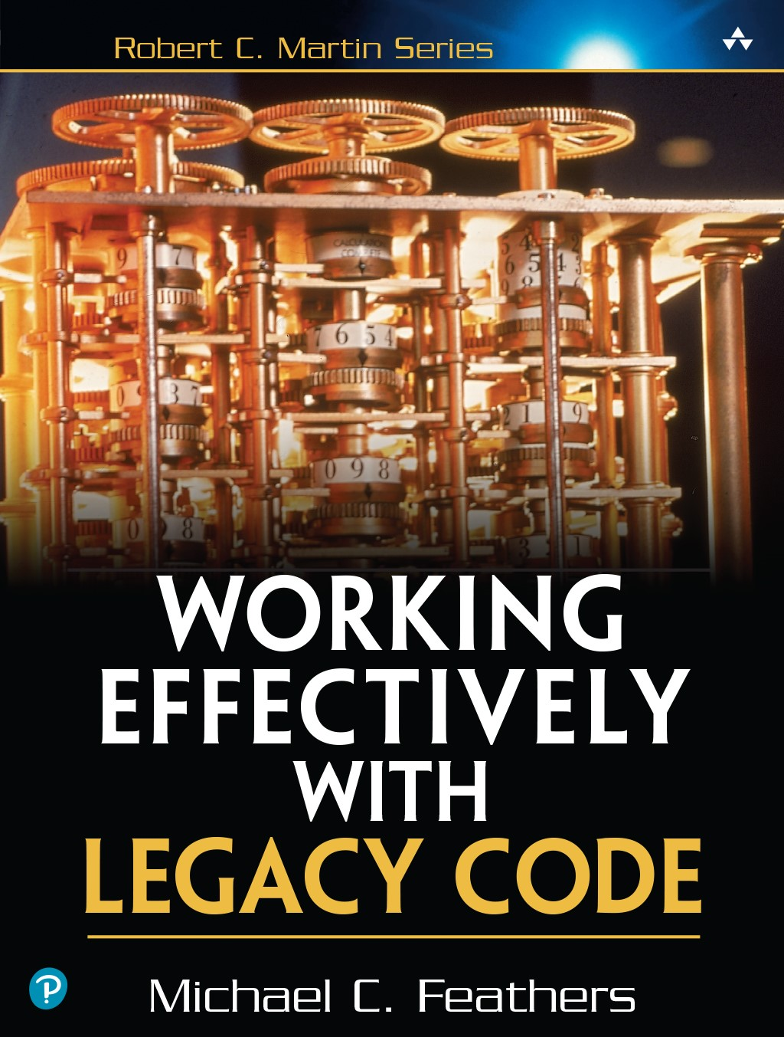
Overcoming the legacy code challenge
Legacy code is code without tests
Legacy code is code not in living knowledge
We must overcome the legacy code challenge if TLA⁺ is to thrive
Notes:
Two ways to get living knowledge: actually be the one who wrote the code in the first place, or be able to safely work with & analyze it
Rebuilding living knowledge requires tests or at least testability!
There are reasons to be optimistic about our ability to overcome the legacy code challenge!
Specifically we need this to get more core contributors – everything is downstream of that goal

Slide 9
Overcoming the Challenge: What
SANY & TLC
TLAPM
Apalache?
Notes:
SANY & TLC (focus of this talk)
Written in Java over 25 years ago
Modified for TLA⁺ 2 around 10 years ago
No original authors still with the project
Liveness checker difficult to understand
Global static state makes it hard to test
TLAPM is a much more difficult problem
Came out of Inria-MSR collab 10 years ago
Funding lapsed, needs academic skills
Ocaml, translation to Isabelle, SMT, Zenon
Need strong theoretical knowledge of TLA (Leslie’s new book A Science of Concurrent Programs is good for this)

Slide 10
Overcoming the Challenge: The Dream
A world where we are bold and unafraid to make large changes to the core TLA⁺ tools

Slide 11
Overcoming the Challenge: How
Language tooling is a blessed field
Tests! Tests! Tests! Tests!
Onboarding new core contributors
Stipends from TLA⁺ Foundation
Notes:
Blessed
Specifications complete & unambiguous
Tests
tlaplus/examples repo E2E tests
Syntax corpus
Extended & applied to TLAPM
Semantic & level-checking corpus
Semantic error corpus
Refactoring: should be easy to write tests for code where you are working
Onboarding
Add CONTRIBUTING/DEVELOPING docs
Curate good first issues (blog posts)
Tutorials – not just documentation
Stipends
Fundamental contradiction of FOSS
Projects require full-time commitment
People need to eat

Slide 12
Building your own TLA⁺ tools
Toy implementations are the best way to learn
https://docs.tlapl.us/creating:start
Notes:
Tutorial series on writing a model checker for a simple subset of the TLA⁺ language
You gotta know how to write a parser!
https://codecrafters.io/
Build your own Redis, SQLite
Follows the book Crafting Interpreters by Robert Nystrom

Slide 13
Overcoming the Challenge
It is fundamentally surmountable
Many languages have greater complexity!
Even the exotic stuff is “just” algorithms

Slide 14
What’s next?
Generative testing for TLA⁺ language tools?
Syntax simplifications?
Improve SANY API & consumption experience?
Notes:
Generative testing
Random state spaces to test liveness
Random semantically-valid specs
Wherever we use parallelism in tools, instrument to test thread interleavings
Syntax simplifications
Personally I like the syntax, am not a language designer
Hillel Wayne has lots of opinions about this
Set filter/set map disambiguation
People get confused by conj & disj
Stylistic: all-caps keywords are outdated
Alt: stay course, let other languages do this
SANY API
No need to write files to temp directory
Developer documentation & tutorials
GraalVM native image for embeddability

Slide 15
A bold initiative
Increase TLC model checker throughput to 1 billion states per minute by using a bytecode interpreter
Notes:
Currently TLC uses a treewalk interpreter
Could output a C program like SPIN does?
However, Jevons’ paradox: increasing the efficiency of a process leads to more of a consumed resource being used in absolute terms, because the process is more economical to run
Here the “resource” is states explored: people will do things like “find the largest model that runs in ten minutes”

