Slide 1
TLA+ Quinceañera
FLoC TLA+ Workshop
David Langworthy
Microsoft Engineer

Slide 2
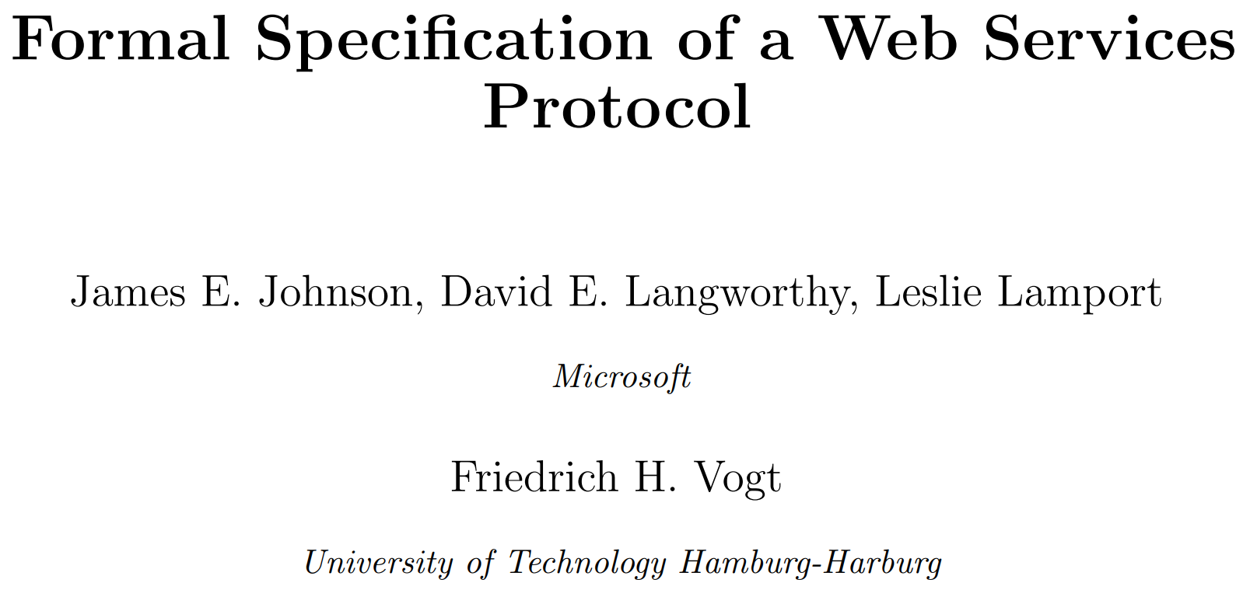
2003: WS-Transaction
Notes:
I began working with Leslie in 2003 on the WS-Transaction specification. The purpose of the specification is to provide an interoperation protocol for transaction managers from different vendors, largely IBM and Microsoft.
. . .

Slide 3
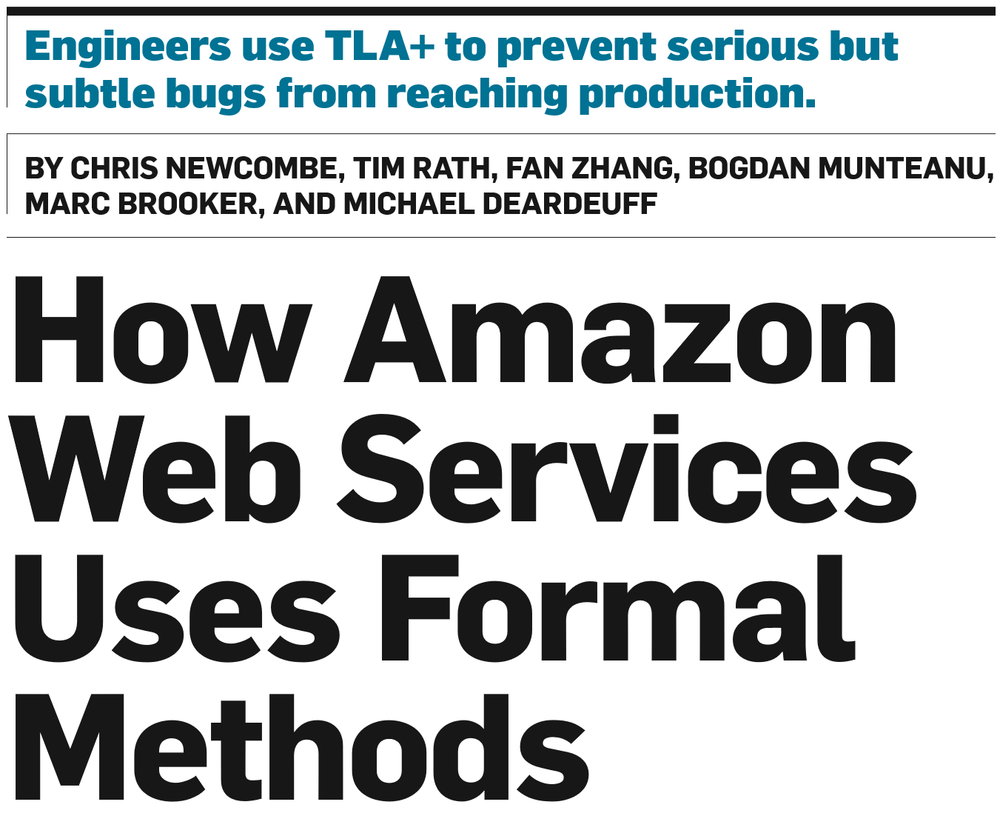
April 2015: How AWS Uses Formal Methods

Slide 4
December 2015: Christmas TLA+
December 26th: Email from Satya to Me & 20 or so VPs
Not Common
TLA+ is Great
We should do this
Go!

Slide 5
April 2016: TLA+ School
2 Days Lecture & Planned Exercises
1 Day Spec’ing
Goal: Leave with the start of a spec for a real system
80 seats
Significant waitlist
50 finished
13 Specs Started
Now run 3 times

Slide 6
April 2018
TLA+ Workshop
Application of TLA+ in production engineering systems
Mostly Azure
3 Execs
6 Engineers
Real specs of real systems finding real bugs
Notes:
On April 7th several VPs and a half dozen engineers came to MSR to present their experience using TLA+ for their production systems. All had positive things to say. They had written TLA+ specifications and could point to concrete benefits. This did not happen by accident, but there several doses of good luck along the way. Over the next 30 minutes, I will explain how this came to be and some possible futures.

Slide 7
Quinceañera
Latin American tradition
Woman’s 15th birthday
Introduction to society as an adult
Party
Fancy dress

Slide 8
Systems
Service Fabric
Azure Batch
Azure Storage
Azure Networking
Azure IoT Hub

Slide 9
Product: Service Fabric
People
Gopal Kakivaya
Tom Rodeheffer
System: Federation Subsystem

Slide 10
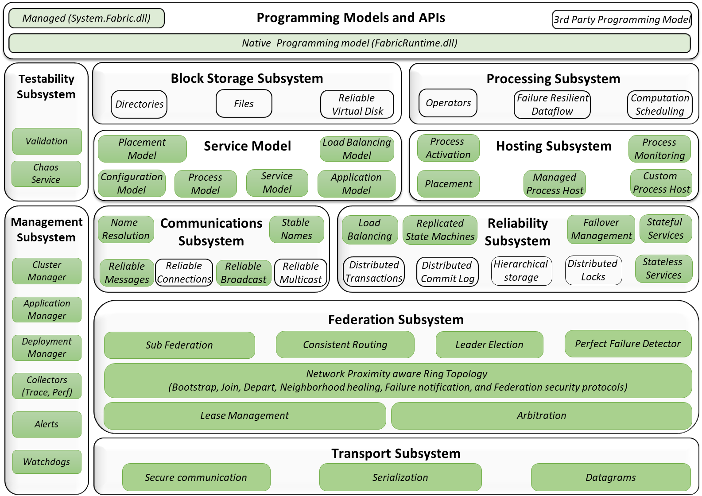

Slide 11
Product: Service Fabric
People
Gopal Kakivaya
Tom Rodeheffer
System: Federation Subsystem
Invariant violations found by TLC : None noted
Insights:
Clear definition of system
Verification with TLC

Slide 12
Product: Azure Batch
People: Nar Ganapathy
System: Pool Server
PoolServer manages the creation/resize/delete of pools
Has to enforce and maintain batch account quota
Need to track persistent data across many operations

Slide 13
PoolServer
A role in Azure Batch Service with multiple instances
Responsible for Pool Entity in the REST API
Underneath a pool is a collection of VMSS deployments (e.g., 1000 VMs could be 200 deployments of 50 VMs each)
A pool can be really large (can hold 10K-100K VMs)
PoolServer manages the creation/resize/delete of pools
Has to enforce and maintain batch account quota
Maintain subscription quotas
Has to build a deployment breakdown of the pool across many subscriptions
Create deployments by talking with RDFE/CRP
Pool creation is a long process and failovers can happen any time

Slide 14
What did I get out of my experience
A compact, precise model of core pool server functionality
Real code is several 10s of thousands of lines
Eliminate environmental complications that are not germane to core algorithms
E.g., skipped modeling VMSS mechanisms, updating table storage
Relatively easy to explain to someone new
Precisely understood the safety and liveness properties
Developing the invariants where very valuable and these carried over into the code
The TLA+ rigor makes my ability to write asserts more effective
I later decided to adopt an MSR state machine runtime called Psharp which has many of the properties of TLA+ but at a much lower level
TLA+ model helped me write the safety and liveness properties in Psharp

Slide 15
Product: Azure Batch
People: Nar Ganapathy
System: Pool Server
PoolServer manages the creation/resize/delete of pools
Has to enforce and maintain batch account quota
Need to track persistent data across many operations
Invariant violations found by TLC : None Noted
Insights
A compact, precise model of core pool server functionality
Precisely understood the safety and liveness properties
Developing the invariants was very valuable

Slide 16
Product: Azure Storage
People: Cheng Huang
System: Paxos Ring Management

Slide 17
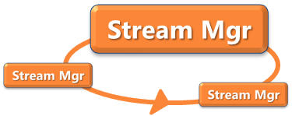
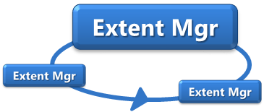

Azure Storage vNext Architecture
scale out metadata management
keep same consistency and atomicity
Partition
Master
scale-out metadata:
create stream
create extent
Partition Layer
Partition
Server
Partition
Server
Partition
Server
Partition
Server
1
2
1
vNext
Master
Stream Mgr
Stream Mgr
Stream Mgr
Stream Mgr
2
Extent Mgr
Extent Mgr
Extent Mgr
same data path –
chain replication
Stream
Layer
M
M
Paxos
M
Extent Nodes (EN)

Slide 18
Managing Many Paxos Rings
Each shard of StreamManager and ExtentManager is a Paxos ring
XvMaster manages all Paxos rings
not on critical path
monitors all nodes and updates the Paxos rings dynamically
Dynamic Paxos ring management – two cases
Case I: node replacement based on health, clock, etc.
when a node is offline for long, replacing it with a new node
when node’s clock is skewed, replacing it with a new node
Case II: ring resizing in multiple availability zones (AZ)
AZ3 failure reduces ring from 9 to 6
AZ3 recovery increases ring from 6 to 9
AZ1
n2
AZ2
n4
AZ3
n9
n3
n6
n7
n1
n5
n8

Slide 19
Safety Violation Discovered by TLC
Straightforward node replacement is unsafe
To change Ring from {n1, n2, n3} to {n1, n3, n4}
XvMaster sends a configuration change command to the ring
XvMaster blocks until the configuration change command is confirmed by the ring
XvMaster then sends command and instructs n4 to load RSL engine with the new configuration
TLC error trace
vNext
Master
metadata updates
configuration change: replace n2 w/ n4
initial ring: {n1, n2, n3}
n1
XvMaster sends configuration command to n1 (leader)
n1 acks when configuration change succeeded
XvMaster instructs n4 to load RSL with {n1, n3, n4}
network partition => n1 & n2 separated from n3 & n4
n3 reboots and XvMaster sends configuration {n1, n3, n4}
n3 & n4 elect a new leader => committed data lost
n2
n3
n4

Slide 20
Product: Azure Storage
People: Cheng Huang
System: Paxos Ring Management
Invariant violations found by TLC:
Quorum split on server swap
Insights
Trust the log not the manager

Slide 21
Product: Azure Networking
People
Albert Greenburg
Luis Irun-Briz
Andrew Helwer
System
RingMaster
Global replication
Checkpoint coordination
Cloud DNS
Record propagation
Distributed Load Shedding
MacSec encryption key rollover orchestration

Slide 22
Problem Statement
Goal: Balance checkpoints
Guarantee a healthy checkpoint frequency,
Allowing for frequent checkpointing
To reduce restart time after failure
Guarantee a minimum rqps across the cluster,
Limiting the simultaneous checkpointing
… which freezes updates on that replica for the duration of the checkpoint
Avoid common pitfalls:
No global time
No locks “acquire…release”

Slide 23
Problem Statement
w1
w2
w2
P0
w1
w1
w2
S1
w1
w1
S4
w2
w2
w2
w2
w1
w1
w1
w1
w2
w2
S2
S3
w2
w2
w1
w1

Slide 24
Problem Statement
w1
w2
w2
P0
w1
S1
S4
w2
w2
w1
w1
100% rqps!
80% rqps!
S3
S2
S3
w2
w2
w2
w2
w1
w1
w1
w1

Slide 25
Problem Statement
w1
w2
w2
P0
w1
S1
S4
w2
w2
w1
w1
60% rqps!
S3
S2
S3
S2
w2
w2
w2
w1
w2
w1
w1
w1

Slide 26
Invariants and Failure Model
Safety Invariants:
the primary never takes a checkpoint
multiple secondary replicas never take a checkpoint concurrently
Temporal Invariants:
all secondary replicas eventually take a checkpoint
a checkpoint always eventually completes or is aborted
Failure Model:
Replicas crash, then later recover
Network links fail between any two replicas in the cluster, then recover
The rate of passage of time differing between replicas

Slide 27
Discarded Implementations
Simple time slice approach
each replica is allocated a slice of time in an uncoordinated round-robin fashion.
Checkpoint time is not known. → Requires coordination to vary time slice size
Local time passage rate can vary between replicas → drift out of coordination
Inefficient: if a replica is down (or for primary) that time-slot is wasted
Pseudo-time slice based on decree numbers instead of real time
The rate of new decrees can vary widely → inconsistent slices to checkpoint.
Still inefficient if replica is down
Replicas can see decrees at different times → incorrect!

Slide 28
Selected Implementation
Primary Lacks Knowledge of Lease:
A brand new cluster with no checkpoint lease issued in its history
The following execution trace:
Checkpoint lease given to secondary A
Secondary A finishes checkpoint before timeout
Secondary B dies
Secondary B recovers
Secondary B is rehydrated from checkpoint created by secondary A
Leader dies
Secondary B becomes leader
Is it safe for the primary to issue a new lease immediately?
Yes, as long a replica can only become primary after executing all previous decrees.

Slide 29
Selected Implementation
New Primary discards lease to itself:
If a replica promotes to primary and sees a checkpoint lease extended to itself.
Is it safe for the primary to issue a new lease immediately?

Slide 30
Selected Implementation
New Primary discards lease to itself:
If a replica promotes to primary and sees a checkpoint lease extended to itself.
Is it safe for the primary to issue a new lease immediately?
No,
n1 becomes leader
n1 send “n2 gets lease”(m1) → n1 gets it
n2 gets “n2 gets lease”
n1 dies
n2 becomes leader (and ignores the current lease)
n2 send “n3 gets lease” (m2) → n2 gets it
n3 gets “n3 gets lease”
n2 dies
n2 recovers and starts from scratch
n2 gets “n2 gets lease” (m1)
--> n2 can take checkpoint
n3 gets “n2 gets lease” (m1)
n3 gets “n3 gets lease” (m2)
--> n3 can take checkpoint
!!

Slide 31
Product: Azure Networking
People
Albert Greenburg
Luis Irun-Briz
Andrew Helwer
System
RingMaster
Global replication
Checkpoint coordination
Cloud DNS
Record propagation
Distributed Load Shedding
MacSec encryption key rollover orchestration
Invariant violations found by TLC:
Checkpoint coordination: A sequence of 12 events would cause two replicas to take a checkpoint at the same time
RingMaster Global Replication: accidentally apply a transaction twice.
Insights

Slide 32
Product: Azure IoT
People: Kapil Agarwal
System: TBA
Invariant violations found by TLC
4
Insights
TBA

Slide 33
Product: Cosmos DB
People
Dharma Shukla
Karthik Raman
System: Strict Convergence on Multi Master System

Slide 34
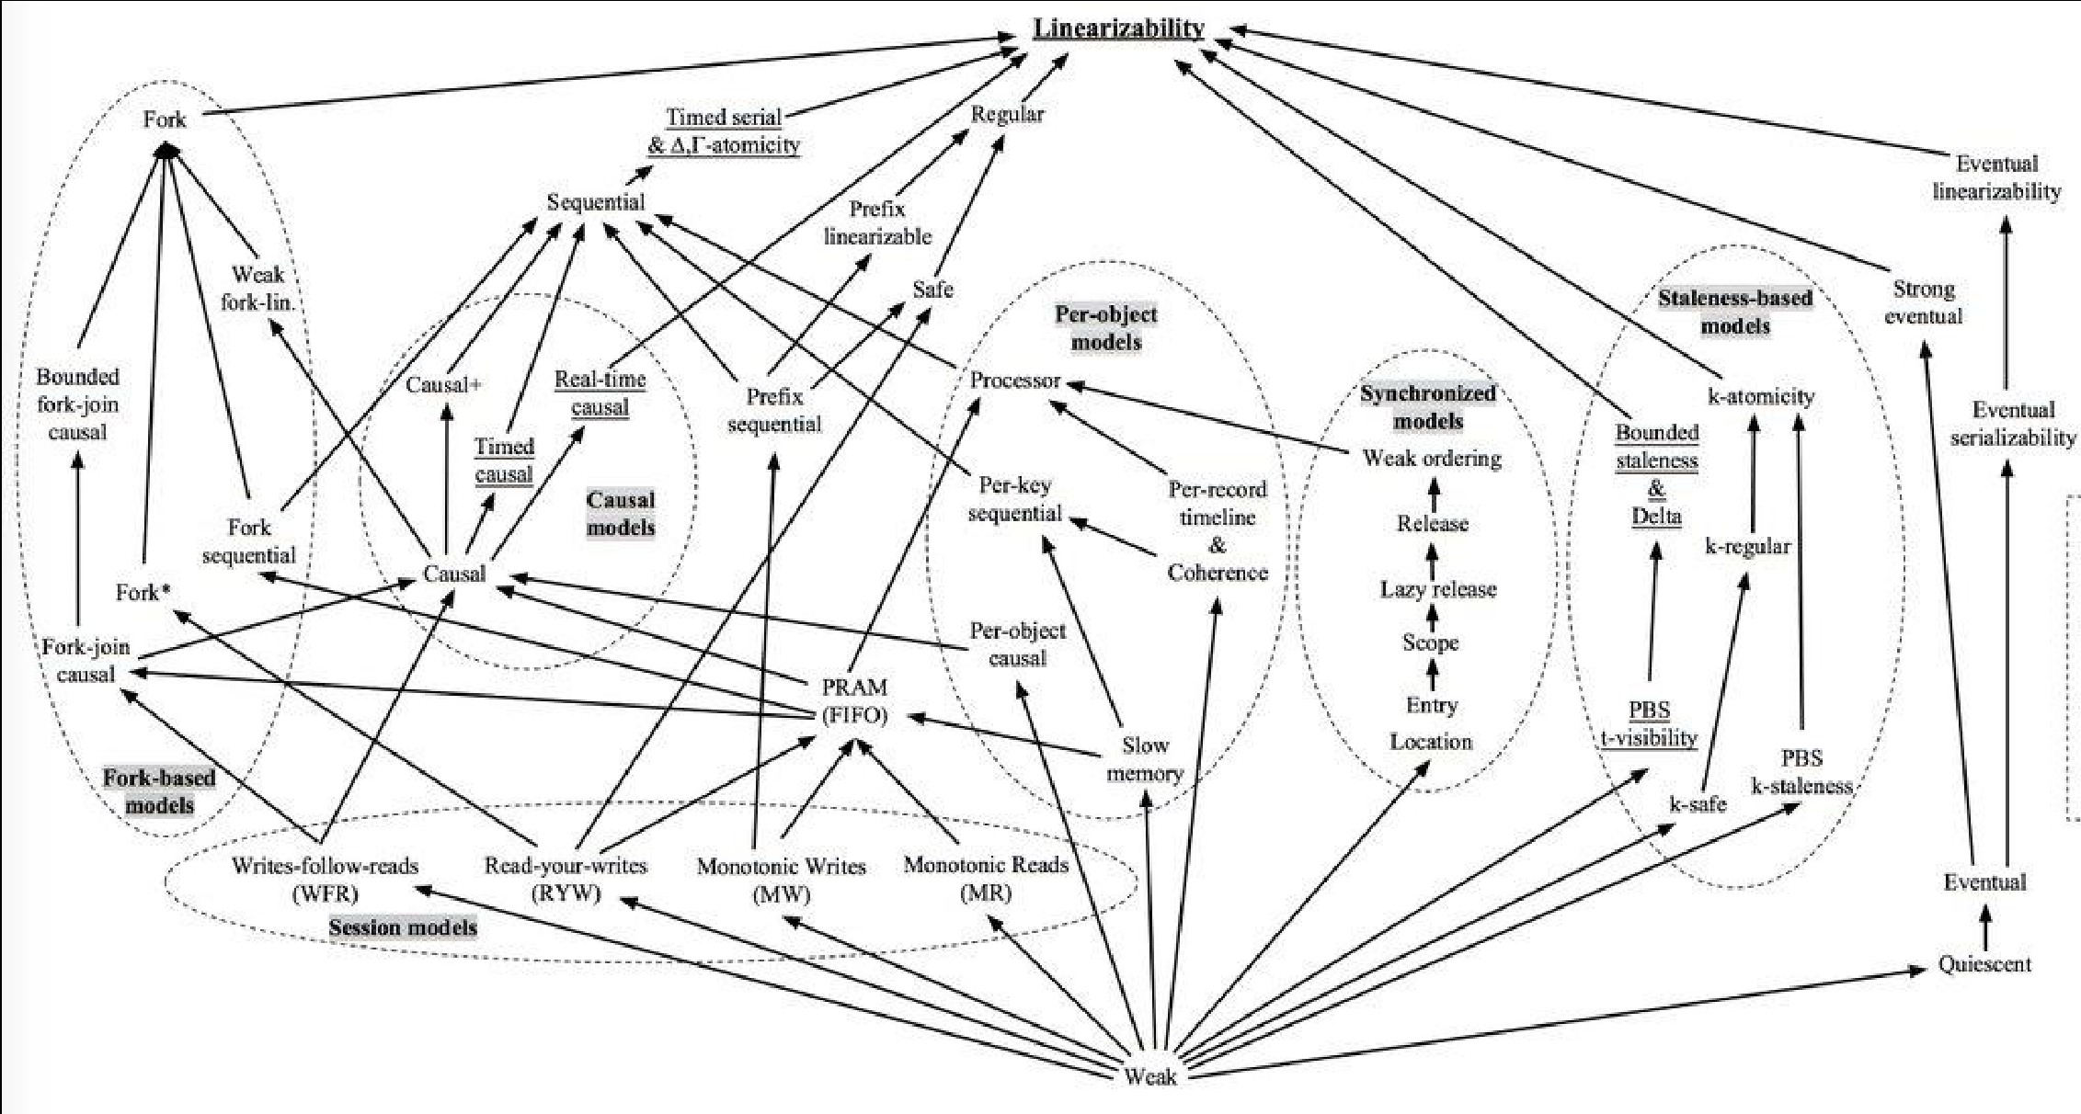

Slide 35
5 Consistency Levels
Strong
Bounded Staleness
Eventual Consistency
Session
Consistent Prefix

Slide 36
Cosmos DB Model 0.1
Database
(Replicated)
Conflict Detection
Conflict Resolution
Vector Clock
R1
R2
R3
a
b
c
State Replication
Conflict Detection
Conflict Resolution
State Replication
Database
(Replicated)
GLSN
LSN
ID
CONTENT
State Replication
Database
(Replicated)
State Replication
GLSN
ID
CONTENT

Slide 37
Cosmos DB Model 0.2
Database
(Replicated)
Conflict Detection
Conflict Resolution
Vector Clock
R1
R2
R3
a
b
c
State Replication
Conflict Detection
Conflict Resolution
State Replication
Database
(Replicated)
GLSN
LSN
ID
CONTENT
PREVIOUS
State Replication
Database
(Replicated)
State Replication
GLSN
ID
CONTENT
PREVIOUS

Slide 38
Cosmos DB Model
Database
(Replicated)
Conflict Detection
Apply or Drop
Vector Clock
R1
R2
R3
a
b
c
State Replication
Conflict Detection
Conflict Resolution
Anti-Entropy
Database
(Replicated)
Tentative Operation Log
GLSN
LSN
ID
CONTENT
State Replication
Database
(Replicated)
Anti-Entropy
GLSN
ID
CONTENT

Slide 39
Product: Cosmos DB
People
Dharma Shukla
Karthik Raman
System: Strict Convergence on Multi Master System
Invariant violations found by TLC
0.1
Replicas diverge due to lack of previous image for performing correct undo.
Due to ID conflicts, multi-record correctness issue could happen.
0.2
State replication was not enough.
Missing intermediate version results in divergence.
Multi-record conflicts could result in complex list of previous image map.
Insights

Slide 40
Observations
Syntax is not the problem
Starting in isolation is a difficult
TLC: Anti Runtime
Benefits the Author

Slide 41
The End

